Slide 1
Stress Modeling Results for CCT5 Relevant to Epoxy Properties
Lucas Brouwer
10/20/2020
MDP Modeling Working Group

Slide 2
Outline
Last meeting we heard from Steve/Tengming about epoxy and interface strength
From the CCT modeling side, what are:
interface normal/shear stress distributions
potential trouble locations
Subscale and diagnostics options for probing impact on training

Slide 3
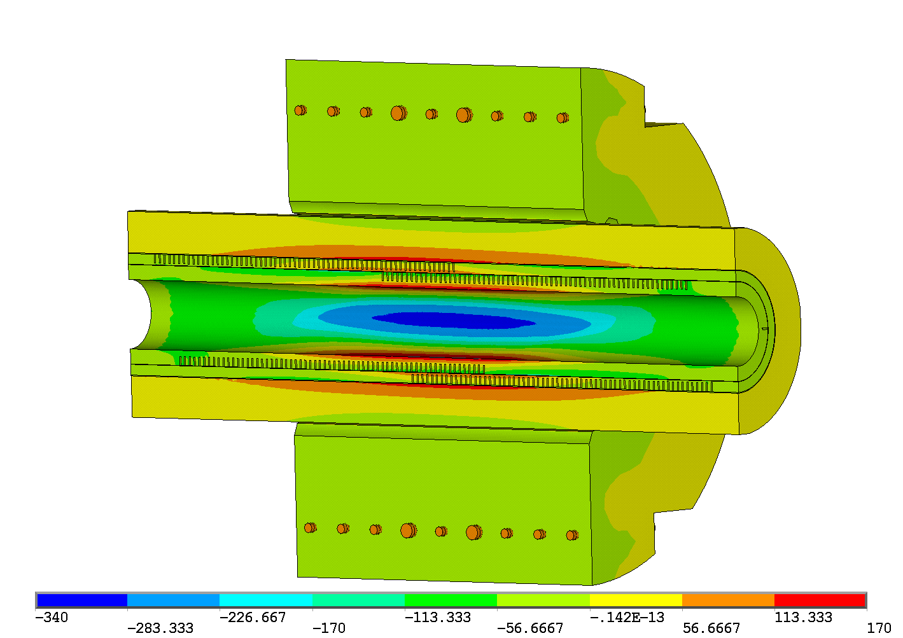
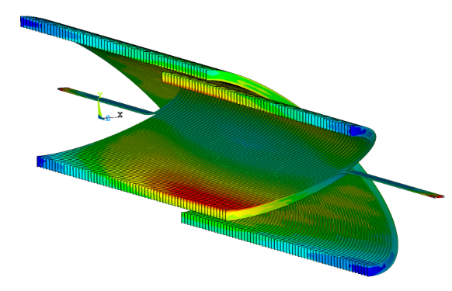
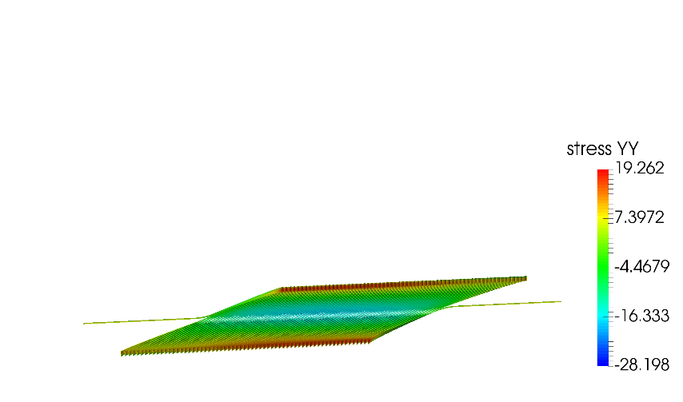
Results in a local, cable frame are shown for CCT5
Mechanical model for CCT5 with load steps of
cooldown to 4.5 K
powering to 16 kA (~90% of short-sample)
conductor bonded in channel, layers sliding with friction
stress in Cartesian frame
mesh information
convert stress to local frame and output to paraview

Slide 4
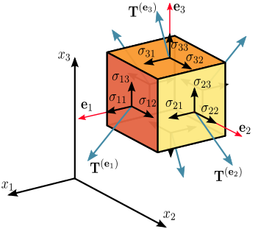
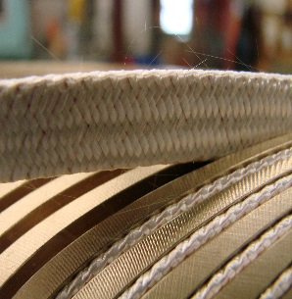
Local Conductor Frame Normal and Shear Stress
Local cable frame
y
x: tangent (along cable)
y: radial (along broad face)
z: bi-normal (along thin edge)
x
Thin Face (y-const)
Syz
Syx
Broad Face (z-const)
Szy
4
Szx

Slide 5
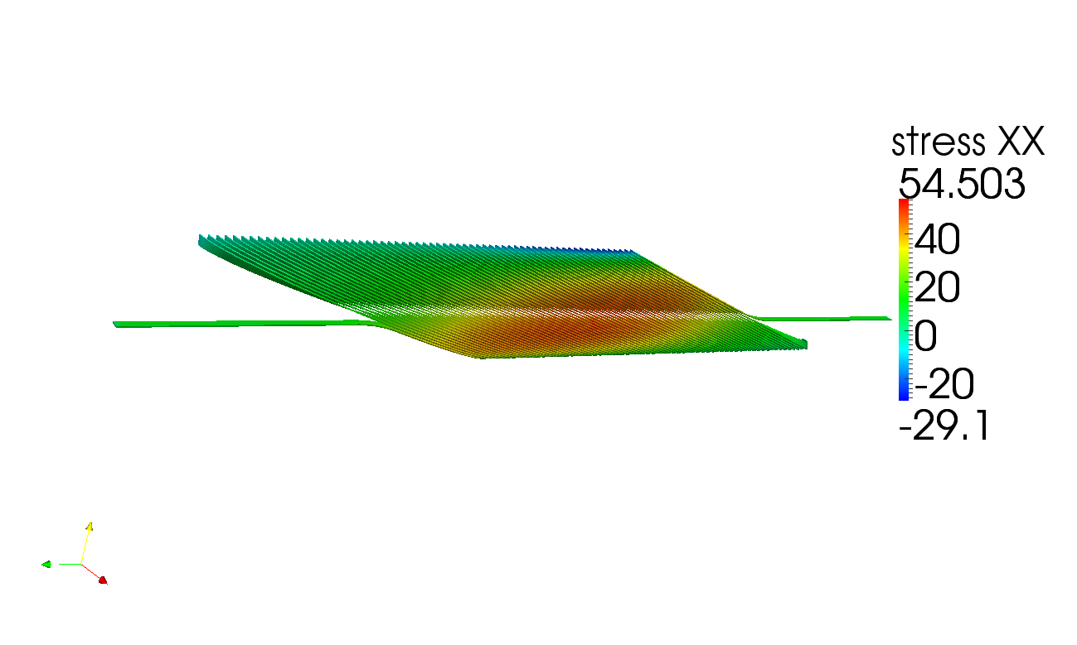
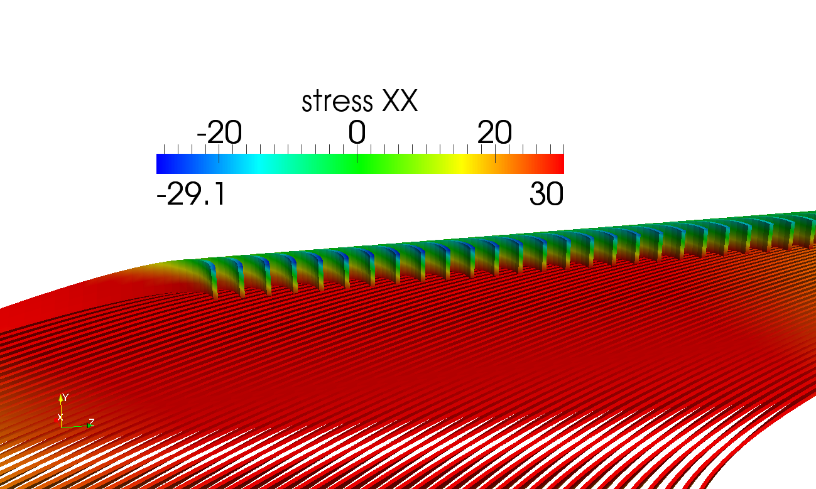
Normal: tangent stress (along cable)
Local cable frame
y
x
At pole there is a gradient from positive to negative across the cable (+/- 30 MPa due to bending)
Scale capped at +/-30 MPa

Slide 6
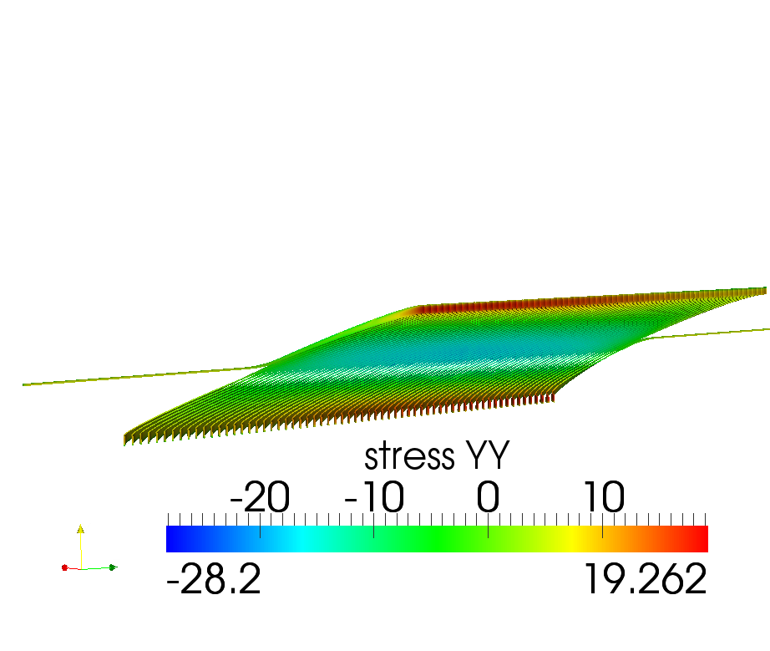
Normal: radial stress
Local cable frame
y
x
Scale capped at +30 MPa

Slide 7
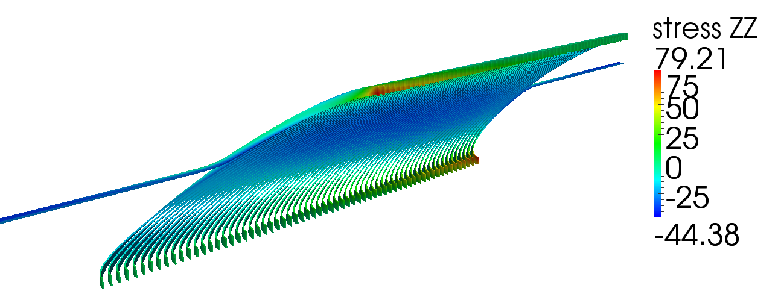
Normal stress towards the wall (bi-normal)
Local cable frame
y
ZZ represents pulling or pushing in the direction of the channel wall (first several turns want to separate)
x
In reality, the turns will likely separate long before 80 MPa

Slide 8
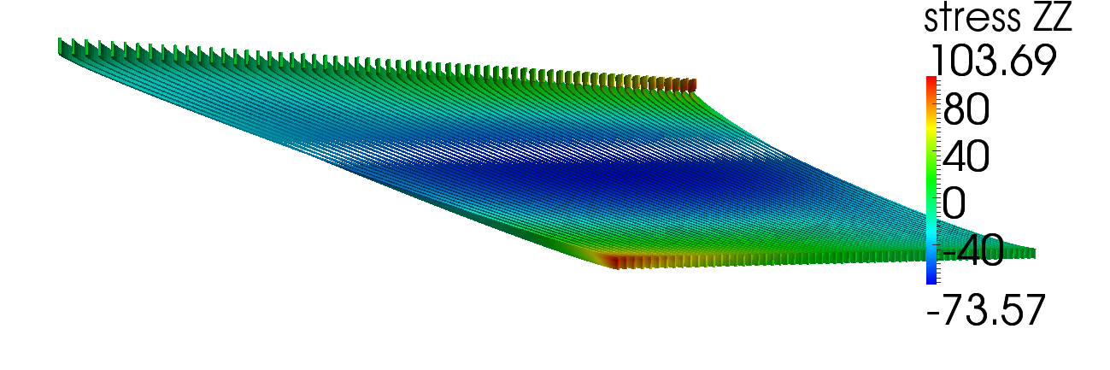
Layer 2 is similar, but higher
Local cable frame
y
x
But, most training quenches in CCT5 were in the inner layer
In reality, the turns will likely separate long before 100 MPa

Slide 9
Shear Stress in Local Frame (16 kA)
Broad Face (z-const)
Thin Face (y-const)
Szy
Syz
Szx
Syx
9
distributed at +/- 45 deg and concentrated on inner edge
peak is localized, 3D effect near pole
“holds” back cable on the broad face from moving radially
“holds” back cable on the broad face from moving along channel (tangent)
“holds” back cable on the thin face from moving along channel (tangent)
“holds” back cable on the thin face from moving along bi-normal

Slide 10
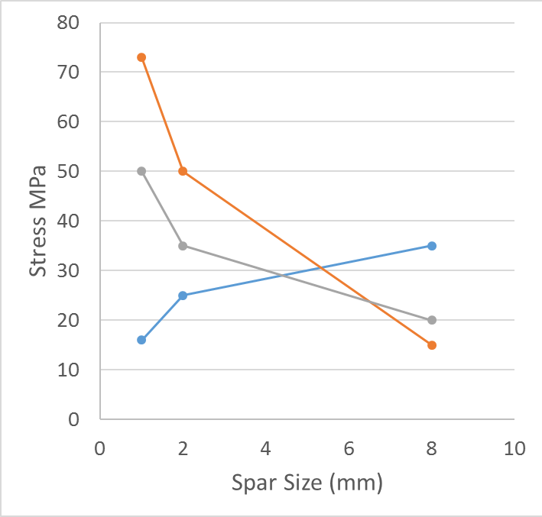
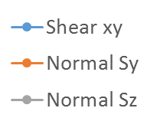
First set of Subscale Magnets will Probe Different Stress States by Adjusting the Spar Thickness of Layer 1
Sxy (radial-azimuthal)
Thin spars
Low shear
High normal
Thick spars
High shear
Low normal
8 mm spar
-35 MPa
35 MPa
2 mm spar
-35 MPa
35 MPa
Thin spar test
1 mm spar
Thick spar test
-35 MPa
35 MPa

Slide 11
Summary / Thoughts
CCT stress distribution is complicated and has several strong 3D effects
potential locations of trouble
normal separation of turns from starting in the pole region
shear at channel/conductor interface concentrated at +/- 45 deg
diagnostics which can resolve quench locations as a function of angle (azimuthal) can help correlate potential trouble spots with training quenches
thick/thin spar subscale tests will probe trade-off between shear/normal stress

