Slide 1
Welcome
To the virtual EIC MRPI meeting!

Slide 2
UC Berkeley report

Slide 3
Personnel
Rey Cruz Torres
Wenqing Fan joins Nov.2, 2020
Fernando Torales Acosta
Dhruv Dixit joined NSSC, but still collaborates
Youqi Song until August 2020 (now grad student at Yale)
Undergrad Drew Palmer
Barbara Jacak
Close collaboration with Ernst Sichtermann, Yue Shi Lai at LBNL

Slide 4
UCB Goals for MRPI
Simulate jet production and reconstruction
Aim to specify
tracking requirements
Jet reconstruction also implies requirements on calorimetry performance and design
Use physics-driven performance specs and connect with detector technology R&D
Perform full simulations of silicon tracker
Contribute to Yellow Report
Collaborate with LBNL on tracker design

Slide 5
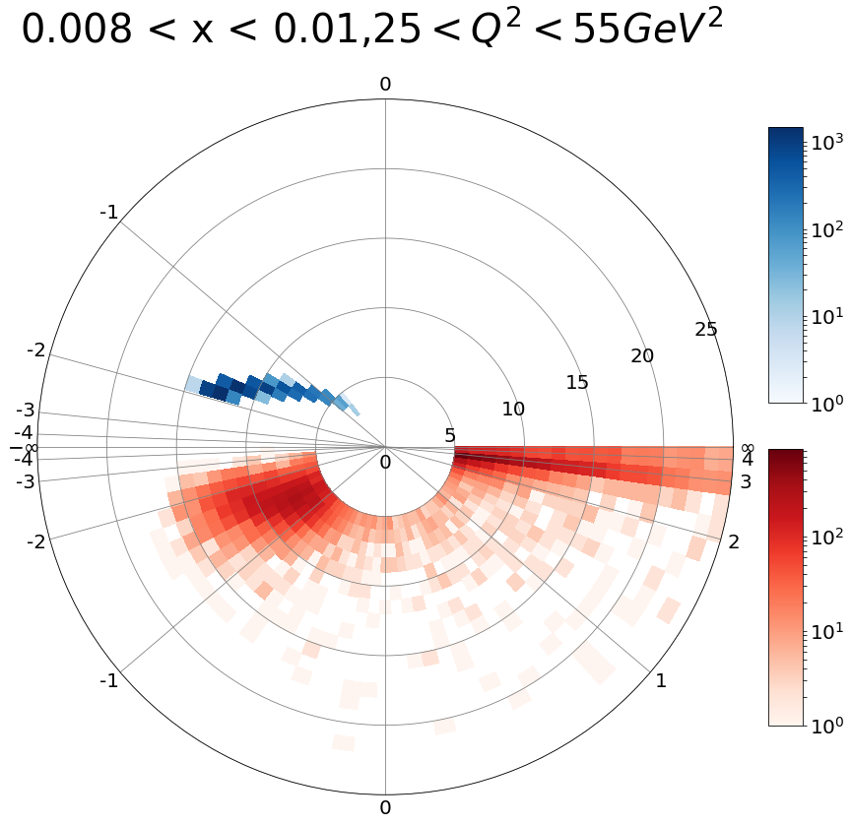
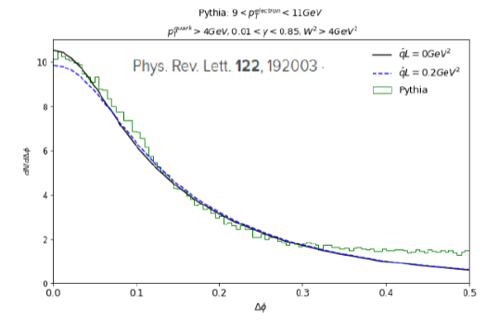
Approach
Focus on jet probes of cold, dense matter
Kinematics, Identify struck quark in DIS
Characterize jets from the struck quark
Interesting Measurements:
Jet yields & spectra in e+p & e+A
Energy balance, opening angle to get q-hat
Jet fragmentation functions & modification
Jet substructure & modifications in cold QCD matter
Simulate detector response
Ensure performance for physics goals
Contribute to detector design

Slide 6
Results
Implement Fun4All on HPC at NERSC (Dhruv Dixit)
All-silicon tracker simulations (Rey Cruz Torres + Youqi Song + Winston De Graw)
Single track resolution & efficiency if hits are lost
Performance with Pythia events
Account for expected EIC beam characteristics
Optimize tracker parameters
Contribute to Yellow Report!
Jet reconstruction performance (Fernando Torales Acosta)

Slide 7
Next steps
How well can we measure substructure variables?
What detector hardware R&D is needed?
What to copy & what to develop for silicon pixels?
How might we utilize timing information?
Address these in collaboration with LBNL.
Figure out how best to use the technical infrastructure of the 3 labs for tracker development (detector hardware development & computing)

Slide 8
For EOI
Submit EOI jointly with LBNL, focus on silicon tracker
Commit to the following personnel levels:
NB: UCB group size = 1 faculty + 1 PD + 4 GS + 3 UG
Let’s discuss UC EOI later this afternoon
level | FTE Now: R&D phase | FTE Phase 2: Begin detector construction | FTE Phase 3: Construction underway
faculty | 0.15 | 0.15 | 0.25
PD | 0 | 0.5 | 0.5
GS | 0.8 | 0.8 | 1.5
UGS | 0.2 | 0.4 | 0.4
total | 1.15 | 1.85 | 2.65

Slide 9
Backup

Slide 10
Advertising our consortium & output
Time to seek speaking opportunities as a consortium?
Become visible as a consortium
Reports on pooled results more impactful
Help to get us “on the EIC map”
Let’s plan at the end of today
Venues of interest
Conferences: POETIC, DIS, Moriond, APS GHP, Lepton-Photon, PANIC, etc.
Users group: EICUG, others: RHIC, Jlab Users’ Groups, where else?
Workshops...

