Slide 1
Costheta cross section – v2/6
V. Marinozzi
11/03/2020

Slide 2
Assumptions
Goal: compare different cross sections
6 layers
50 mm aperture
HTS is Bi-2212 rutherford cable, with filamentery strands
LTS is Nb₃Sn
No grading
Conductor parameters from existing cable
No harmonics optimization

Slide 3
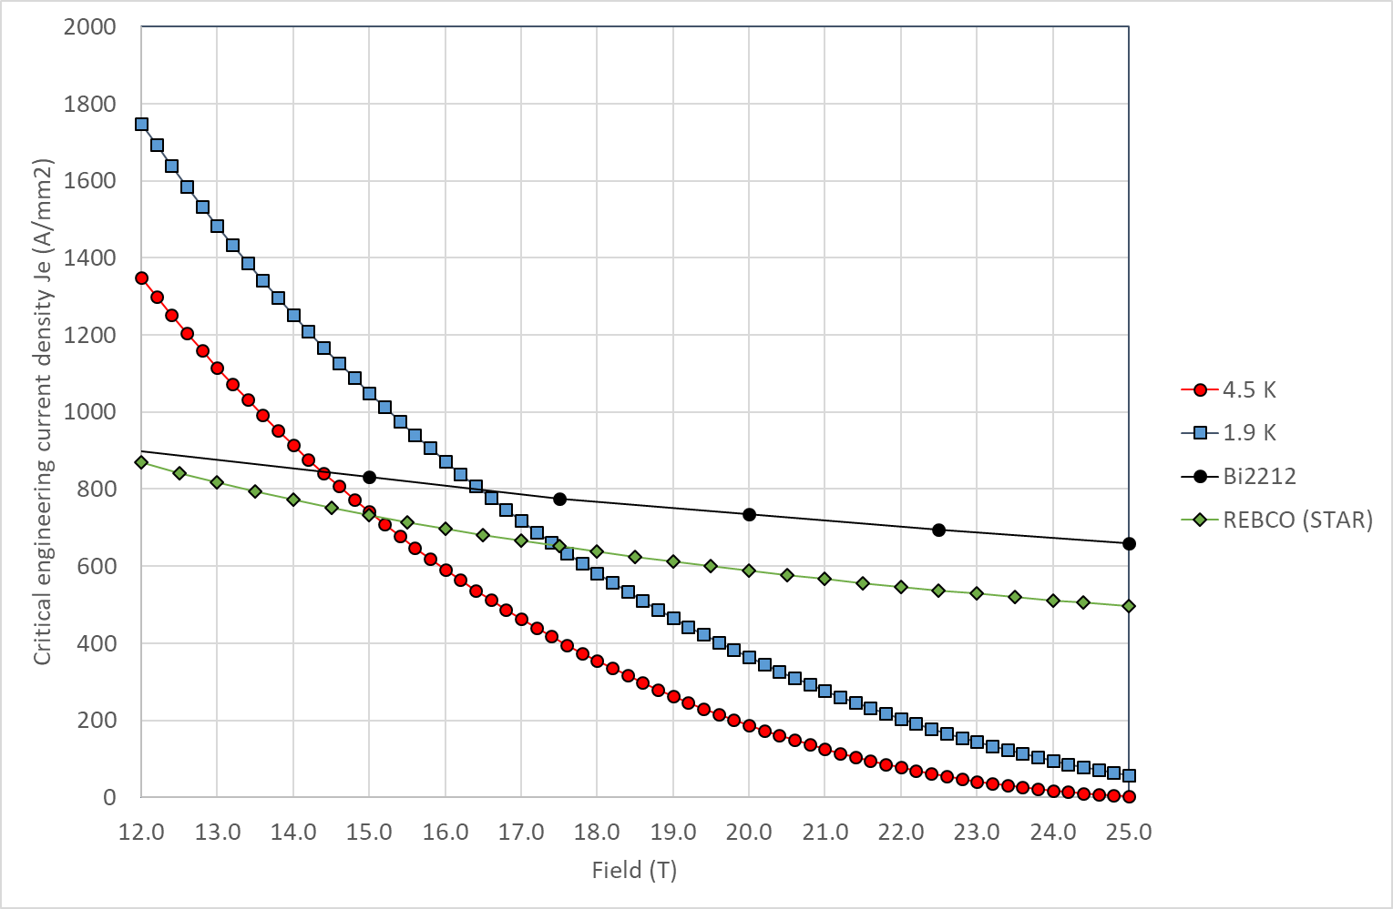
Critical current
Still using linear approximation in the peak field zone
Jc in SC obtained by scaling Jc engineering from Paolo slides
J_{c} for Nb₃Sn: 1928 A/mm² @16 T, 1.9 K
J_{c} for Bi2212: 2944 A/mm² @20 T, 1.9 K

Slide 4
Conductor for comparison with Paolo model
Quantity | Bi-2212 | Nb₃Sn
Strand diameter | 0.8 mm | 0.8 mm
Number of strands | 30 | 30
Cu(stabilizer)/SC | 3 | 1
Bare width | 13.76 mm | 13.3 mm
Bare height (inner) | 1.44 mm (0.9 packing) | 1.44 mm (0.9 packing)
Bare height (outer) | 1.56 mm (0.5 keystone) | 1.55 mm (0.5 keystone)
Insulation thickness | 0.15 mm | 0.15 mm
From RC coil (17 strands)
From DCC017

Slide 5
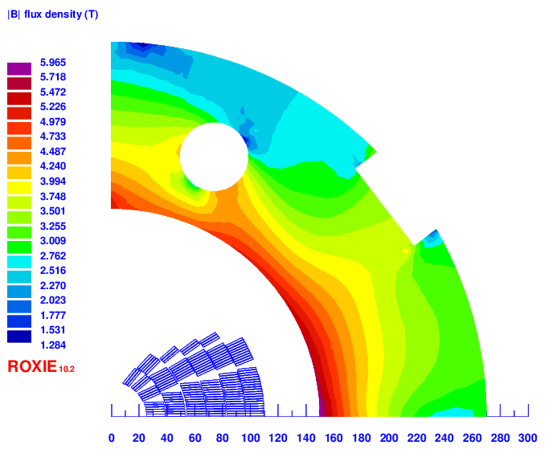
Iron yoke

Slide 6
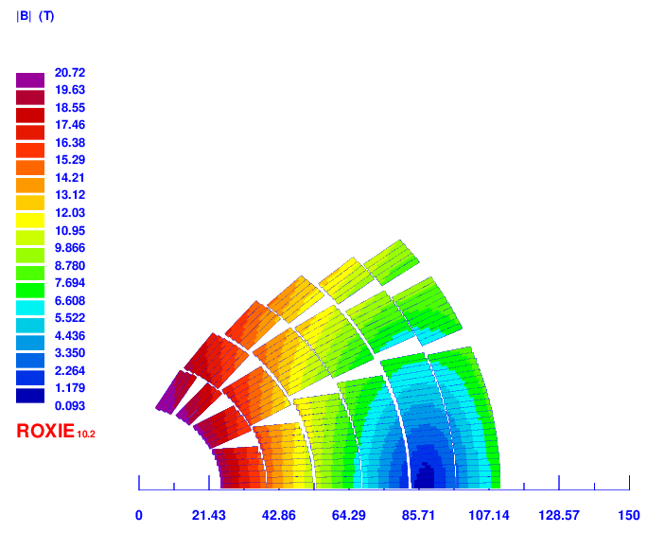
20T-v5
Total conductor area (bare):
Bi2212: 2271 mm² (2540 for Paolo)
Nb₃Sn: 1514 mm² (2470 for Paolo)
Total conductor area (insulated):
Bi2212: 2691 mm²
Nb₃Sn: 1798 mm²
Layer 1: 18 turns
Layer 2: 26 turns
Layer 3: 31 turns
Layer 4: 35 turns
Layer 5: 37 turns
Layer 6: 39 turns
Total: 186 turns
Operating current | 9820 A
Operating bore field | 20 T
Peak field (Bi-2212) | 20.72 T
Margin on the load line (Bi-2212) | 93 %
Peak field (Nb₃Sn) | 12.42 T
Margin on the load line (Nb₃Sn) | 67 %
85 mm

Slide 7
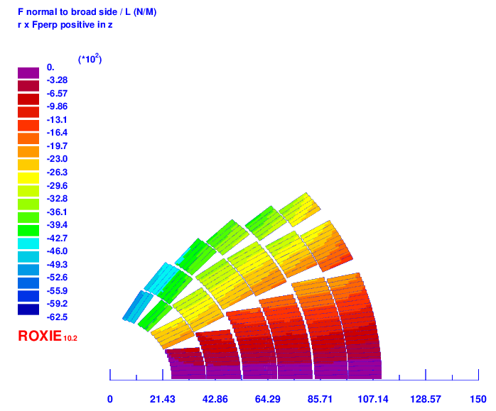
Perpendicular forces (20T-V5)
Layer | Perpendicular pressure [MPa]
1 | 99
2 | 141
3 | 149
4 | 155
5 | 149
6 | 134

Slide 8
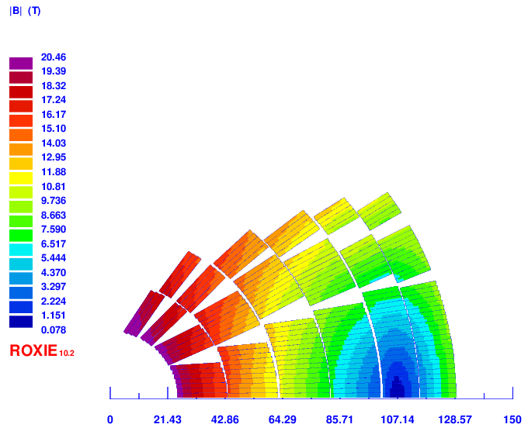
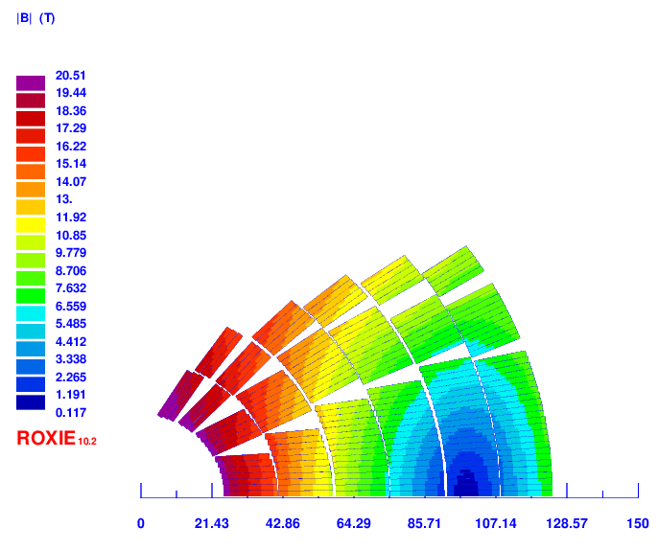
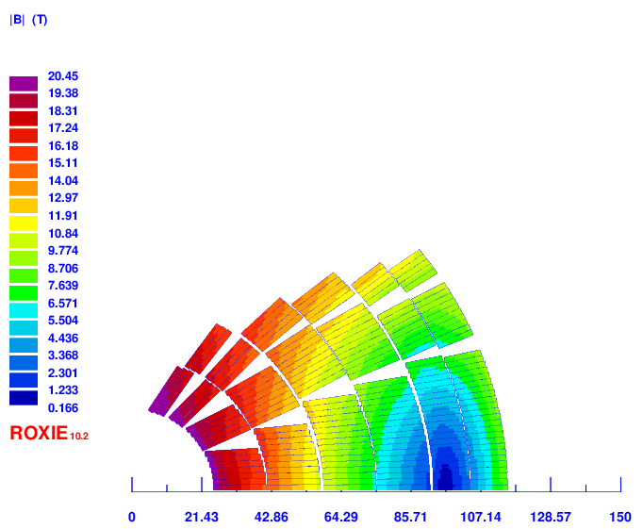
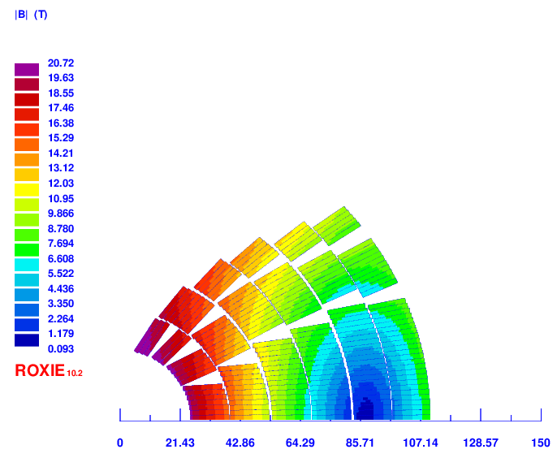
Comparison from different designs
All magnets have same number of blocks/turns
Conductor dimensions obtained by scaling real conductor as done for v5
Magnet | Str # (HTS) | Str # (LTS) | HTS area [mm²] | LTS area [mm²] | Coil Width [mm] | Curr [A] | Peak field on HTS [T] | Peak field on LTS [T] | Margin on HTS [%] | Margin on LTS [%] | J_{Cu} on LTS [A/mm²] | Peak stress on HTS [Mpa] | Peak stress on LTS [Mpa]
20 T – v2 | 40 | 30 | 3069 | 1514 | 104 | 11020 | 20.47 | 12.48 | 82.9 | 77.4 | 1461 | 132 | 170
20 T – v3 | 35 | 35 | 2667 | 1777 | 99 | 10420 | 20.51 | 12.19 | 87.17 | 72.6 | 1184 | 141 | 134
20 T – v4 | 35 | 25 | 2667 | 1253 | 90 | 10290 | 20.45 | 12.76 | 86.37 | 81 | 1637 | 140 | 188
20 T – v5 | 30 | 30 | 2271 | 1514 | 85 | 9820 | 20.72 | 12.42 | 93.06 | 75.2 | 1302 | 155 | 149
v2
v3
v4
v5

Slide 9
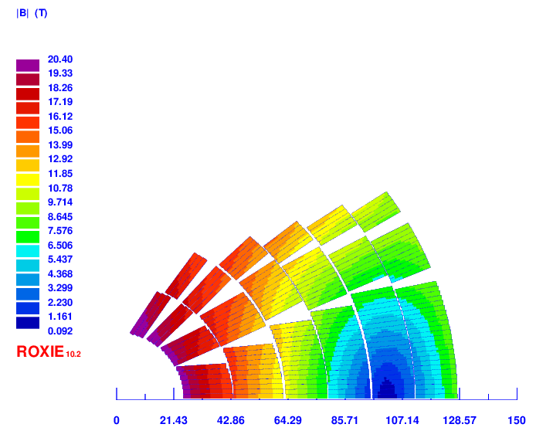
20T-v6
2 Layers HTS, 4 layers LTS
Layer 1: 18 turns
Layer 2: 26 turns
Layer 3: 31 turns
Layer 4: 35 turns
Layer 5: 37 turns
Layer 6: 39 turns
Total: 186 turns
Strands # HTS | 40
Strands # LTS | 35
Operating current | 10810 A
Operating bore field | 20 T
Peak field (Bi-2212) | 20.4 T
Margin on the load line (Bi-2212) | 81.8 %
Peak field (Nb₃Sn) | 15.88 T
Margin on the load line (Nb₃Sn) | 90.6 %

Slide 10
To do
Implement J_{c} fits for HTS and LTS to improve margin calculation
Improve 20T – v2
Reduce HTS (2 strands less), increase Cu quantity in LTS
Credible wedges, layer distance, coil distance, midplane distance, pole radius
Field quality, inductance and energy
Radial forces
Work on 20T – v6 to reduce margin
Increase LTS strand diameter?
Introduce grading?
Introduce 60 strands conductor and 4 layers?
Any suggestion?

