Slide 1
Update on CCT4 acoustic data analysis
M. Marchevsky
D. Arbelaez and S. Prestemon
LBNL

Slide 2
Outline
Introduction on the canted-cosine-theta CCT4 dipole: test results, training plot and acoustic instrumentation
Acoustic signal analysis
Event count
Released energy and scaling
Accumulated displacement
Wavelet frequency analysis for event type identification
Conclusions

Slide 3
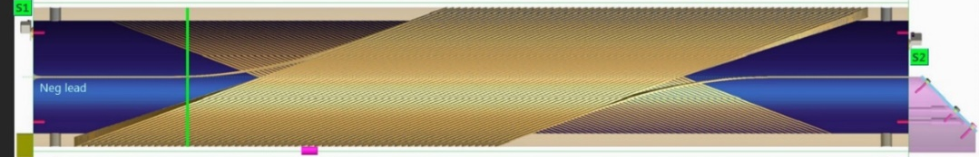
CCT4 Canted-Cosine-Theta Nb₃Sn dipole: training summary
I
B
Tested in 2017
104 training quenches in total
11 quenches in the OL, the rest is IL
Highest quench current: 16731 A
Bore dipole field: 9.14 T
Field at the conductor: 10.32 T
“Short sample” limit: 19.3 kA (4.5 K)
Slope change
Good quench memory after thermal cycle: reached 16590 A in 9 quenches
Training plot of the CCT4 magnet

Slide 4
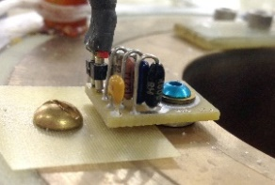
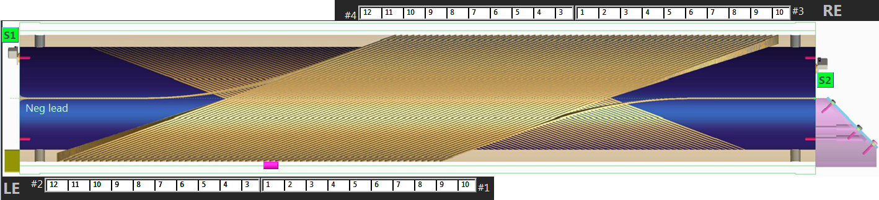
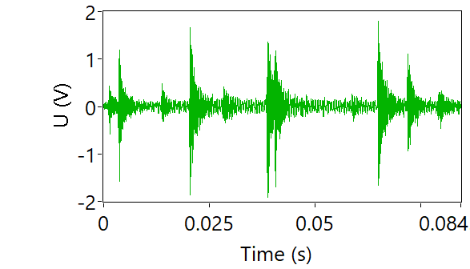
Acoustic instrumentation
Shell sensors
(8x)
S_{bot}
S_{top}
120⁰ apart
OL
IL
120⁰
Shell
Cryogenic acoustic sensors
Broadband: ~350 kHz bandwidth
120⁰ apart
Epoxy cracking, de-lamination, or slip-stick motion of the conductor or a structural part are the common sources of Acoustic Emission
We collected acoustic signals in both triggered mode (for all 8 sensors, triggered by the magnet quench detection system) and in continuous streaming mode for 2 acoustic sensors, magnet current and voltage.
The continuous rate was either 1 MHz or 500 kHz; we then re-sampled all 1 MHz data to 500 kHz for a consistency of analysis.

Slide 5
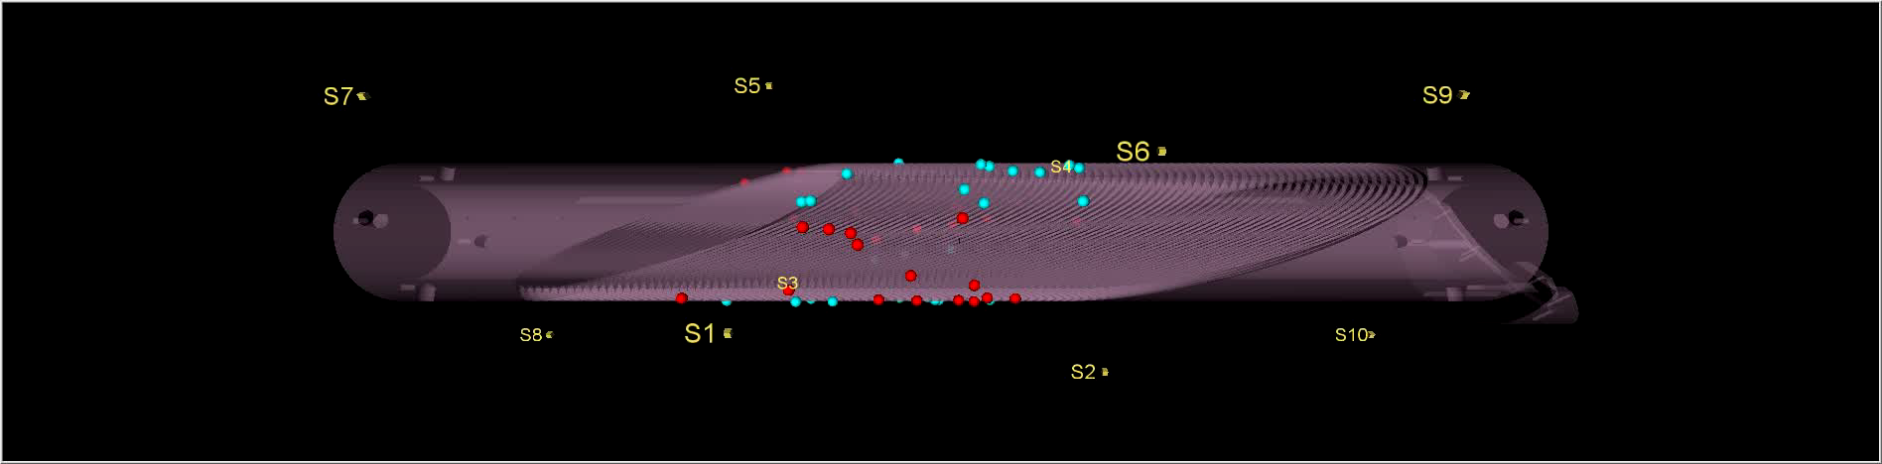
Quench locations
Quench locations we determined using AE triangulation, they appear to be distributed uniformly around the coil
What is the physics of energy releases responsible for premature quenching?
What defines the length of the training process
What defines the shape and slopes of the training plot?

Slide 6
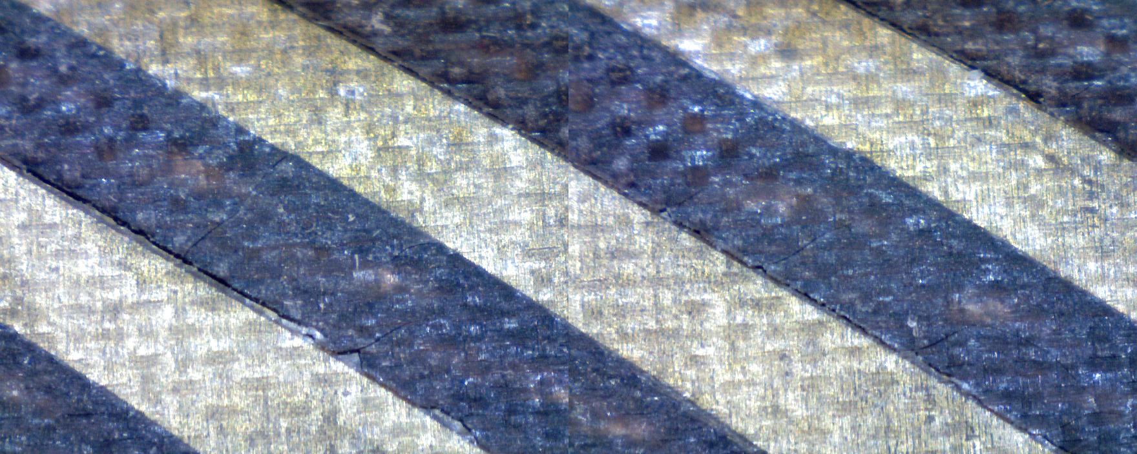
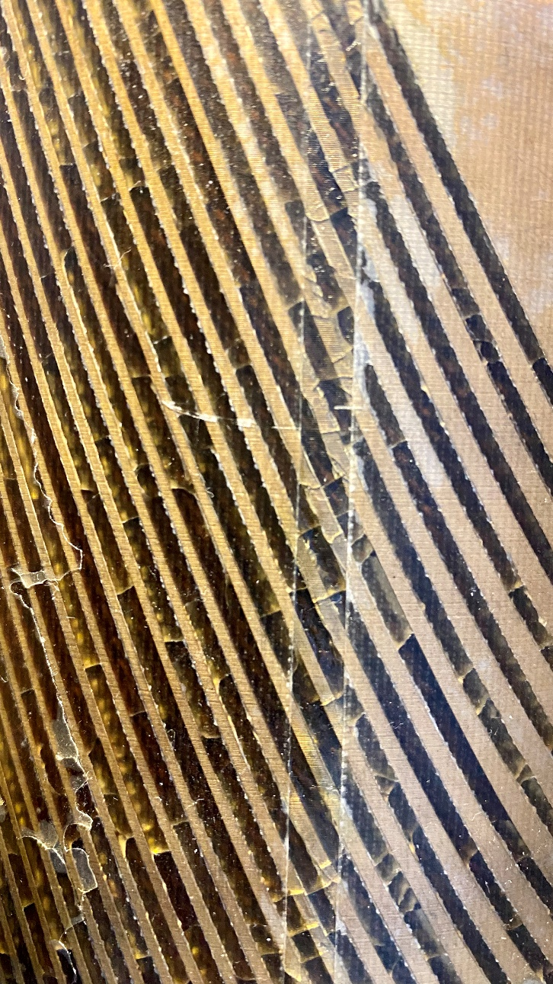
Visible coil defects after testing
49⁰
De-bonding/ separation
Transverse cracking

Slide 7

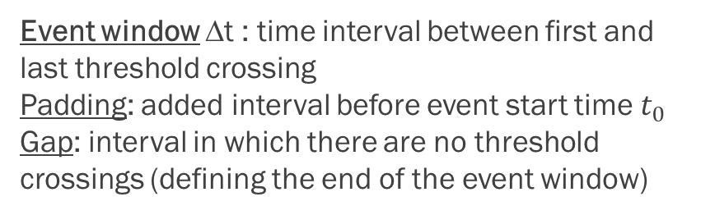
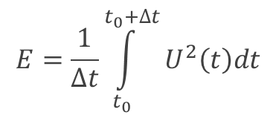
Acoustic signal parameters
Event window Δt : time interval between first and last threshold crossing
Padding: added interval before event start time $t_{0}$
Gap: interval in which there are no threshold crossings (defining the end of the event window)
Acoustic voltage: U(t) ~ instant displacement
$$E=\frac{1}{∆t}\int_{t_{0}}^{t_{0}+∆t}{U^{2}\left(t\right)dt}$$
Event energy:
# of zero crossings = how many times the oscillatory waveform crossed time axis within the event window
Frequency: (# of zero crossings) / Δt
Acoustic event thresholding from a continuous stream
Bias:
${U_{bias}= U}_{+}+U_{−}$
∼ net displacement

Slide 8
Acoustic event count
We sampled and thresholded continuous acoustic signal streams sequentially within 1s - long intervals. AE events were counted in each interval, and net count was plotted vs. magnet current.
Quench 1
Quench 2
Quench 3
Quench 90
AE events occur only when current is being ramped. For a fixed ramping rate the AE rate is non-linear with the current. When current ramping rate is changed, the acoustic event rate changes as well.
However, the AE net count plots for different quenches collapse towards a universal asymptotic power-law dependence at high current values.

Slide 9
Power-law scaling of AE energy
Power–law scaling is a hallmark of critical dynamics seen in many physical systems including superconductors, magnetics, geoscience, etc.
This result suggests that the critical dynamics emerges in the magnet at I_{0,} and is sustained throughout the current ramp until the quench. Also, a step divergence from the power-law develops a few seconds prior the quench for some ramps.
Divergence
No scaling
Power law
AE energy per event exhibits no scaling with current up to ~ 9500 A and distinct power-law scaling $E\sim E_{o}{\left(\frac{I}{I_{0}}\right)}^{n}$above that current. Fit for Q59 yields E₀ = 0.00066 [V²], I₀= 9951 [A] and n = 3.12
The first quench was at 9677 A (~I₀ ) !
As strain in the magnet is $σ\sim I^{2}$, we then get E($σ$) $\sim σ^{γ}$ , where $γ=\frac{n}{2}=$ 1.56

Slide 10
Displacement (bias) accumulation
When plotting bias vs current squared, a proxy for the stress-strain dependence can be obtained that uniquely characterizes magnet interfaces affected by the training process.
The linear dependence is eventually recovered for high quench numbers suggesting “clearing up” of mechanical barriers and evolution towards more elastic behavior in the end of the training process

Slide 11
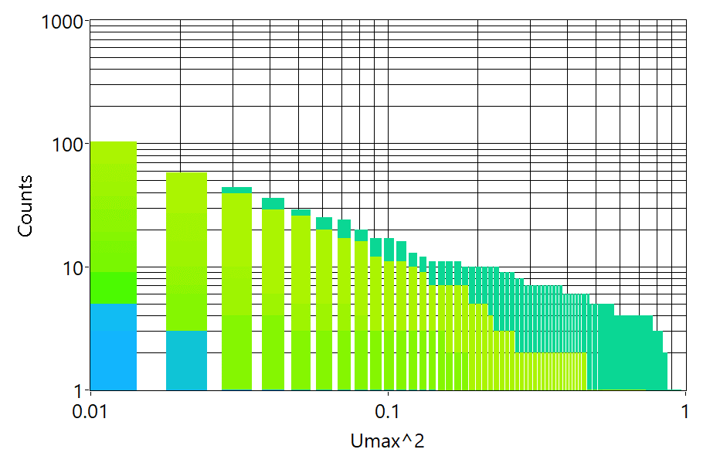
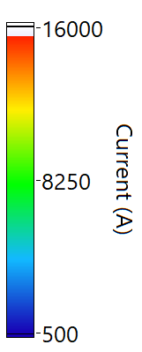
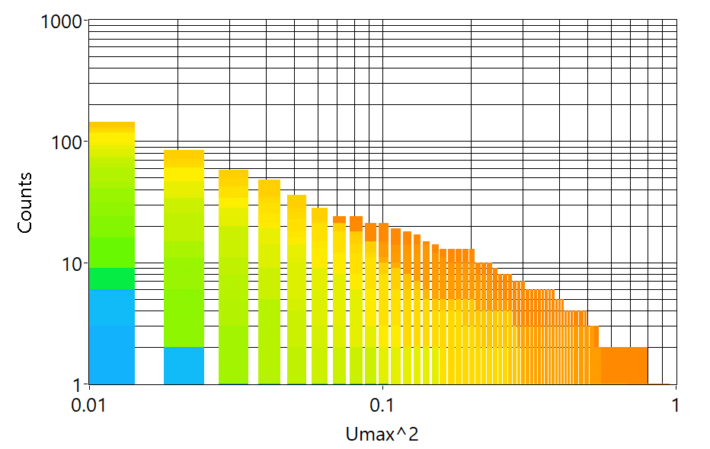
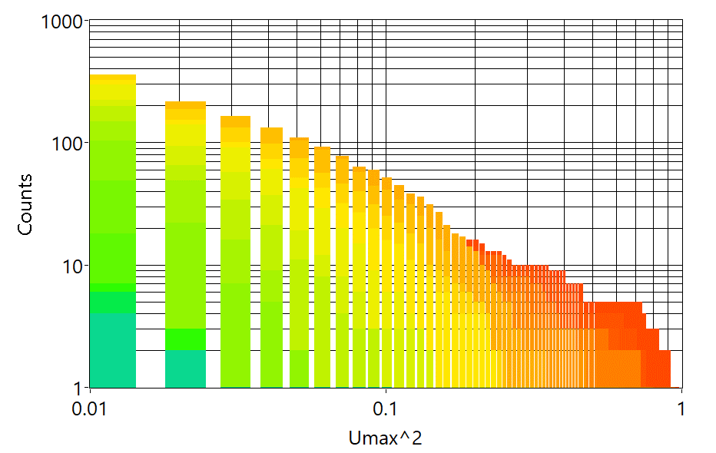
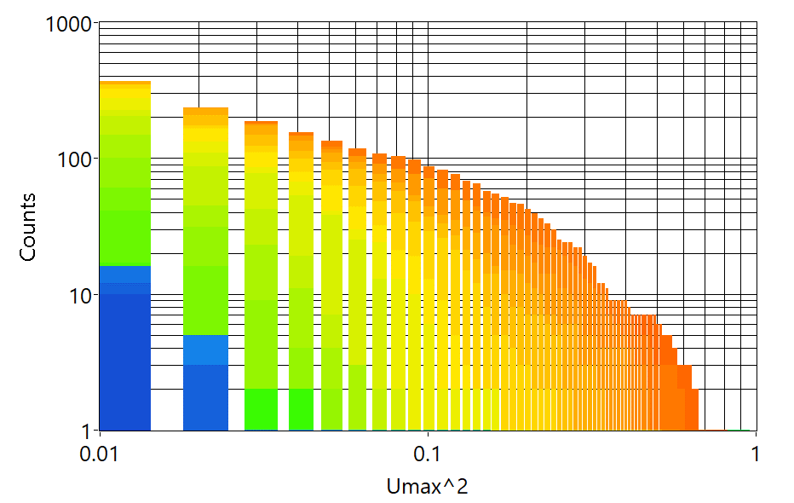
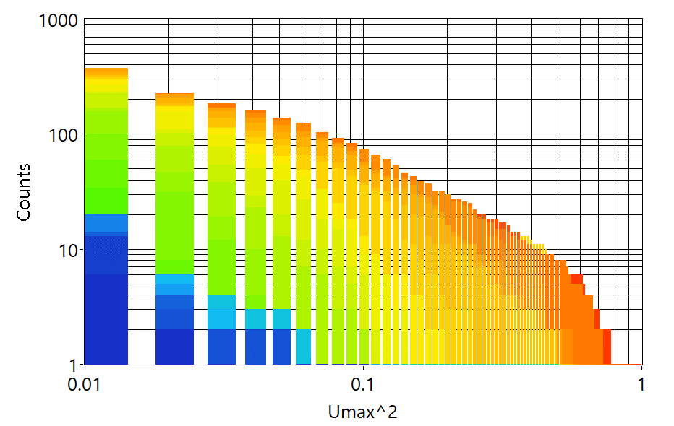
Event energy statistics
Histograms of peak energy (V²) vs event counts adhere to a universal power law scaling with the exponent ~1 (similar to Gutenberg-Richter law observed for earthquakes and may other self-organized critical systems).
However, the low current ramps reveal an excess of high energy events while latest training ramps to high current exhibit an excess of mid-level events.
Q6
Q39
Q59
Q76
Q103

Slide 12
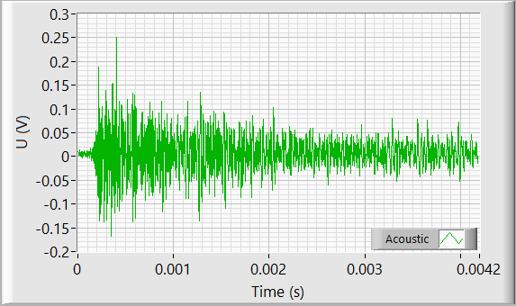
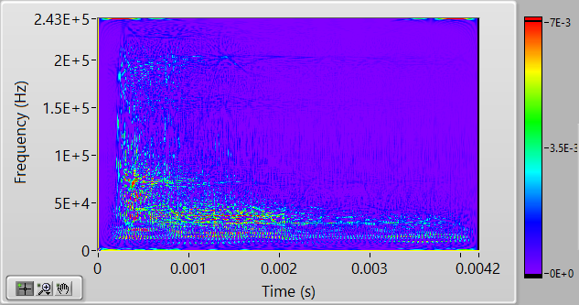
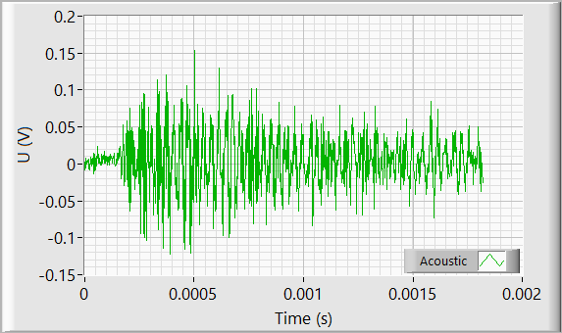
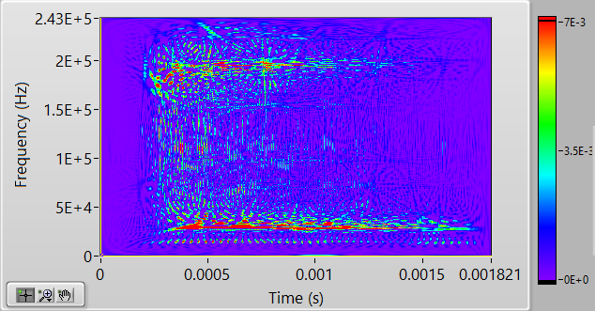
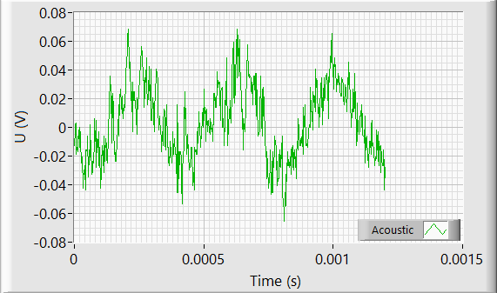
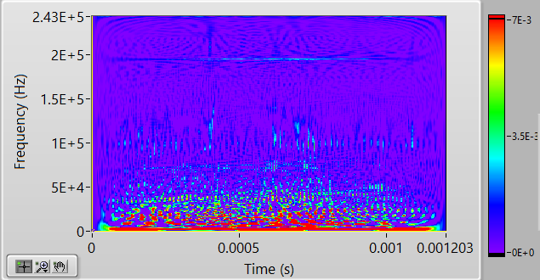
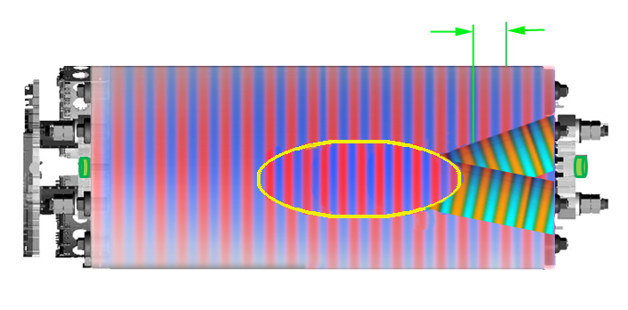
Typical acoustic signatures of mechanical transients
Bulk (P-) wave
v
Predominantly a high-frequency bulk wave
Surface (S-) wave
Bulk (P-) wave
Acoustic waves both in the in bulk (high frequency) and along separating surfaces (lower frequency)
v
Surface (S-) wave
Bulk resonances
Low-frequency structural resonances

Slide 13
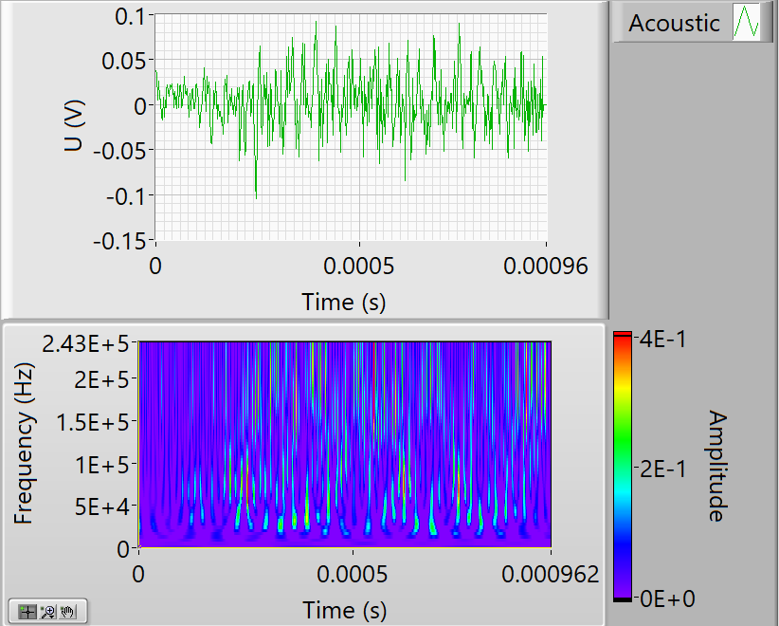

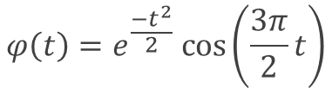
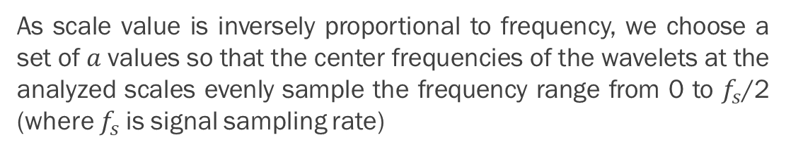
Wavelet analysis
To analyze transient waveforms such as AEs, wavelet transforms are most convenient as they allow to accurately estimate frequency content of the signals.
We used the Morlet Wavelet
$$φ\left(t\right)=e^{\frac{−t^{2}}{2}} cos⁡\left(\frac{3π}{2}t\right)$$
with the central frequency of ¾ Hz
For the scale $a$ the corresponding frequency value is then
$$f_{a}= \frac{3}{4at}$$
As scale value is inversely proportional to frequency, we choose a set of $a$values so that the center frequencies of the wavelets at the analyzed scales evenly sample the frequency range from 0 to $f_{s}$/2 (where $f_{s}$is signal sampling rate)
Example of AE transient signal and its scalogram (64 frequency scales)
A4
A3
A2
For our analysis we sub-divide the scalogram over four equally-sized frequency bands and compare integrated relative amplitude in those bands.
A1

Slide 14
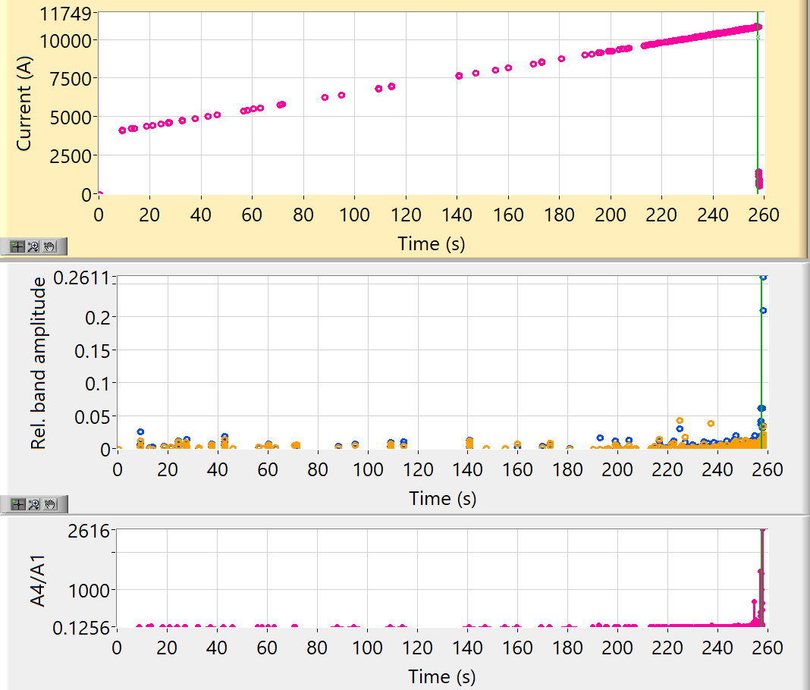
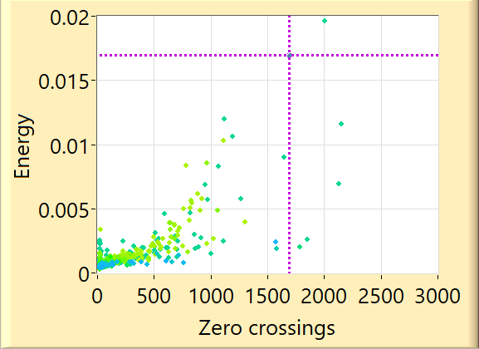
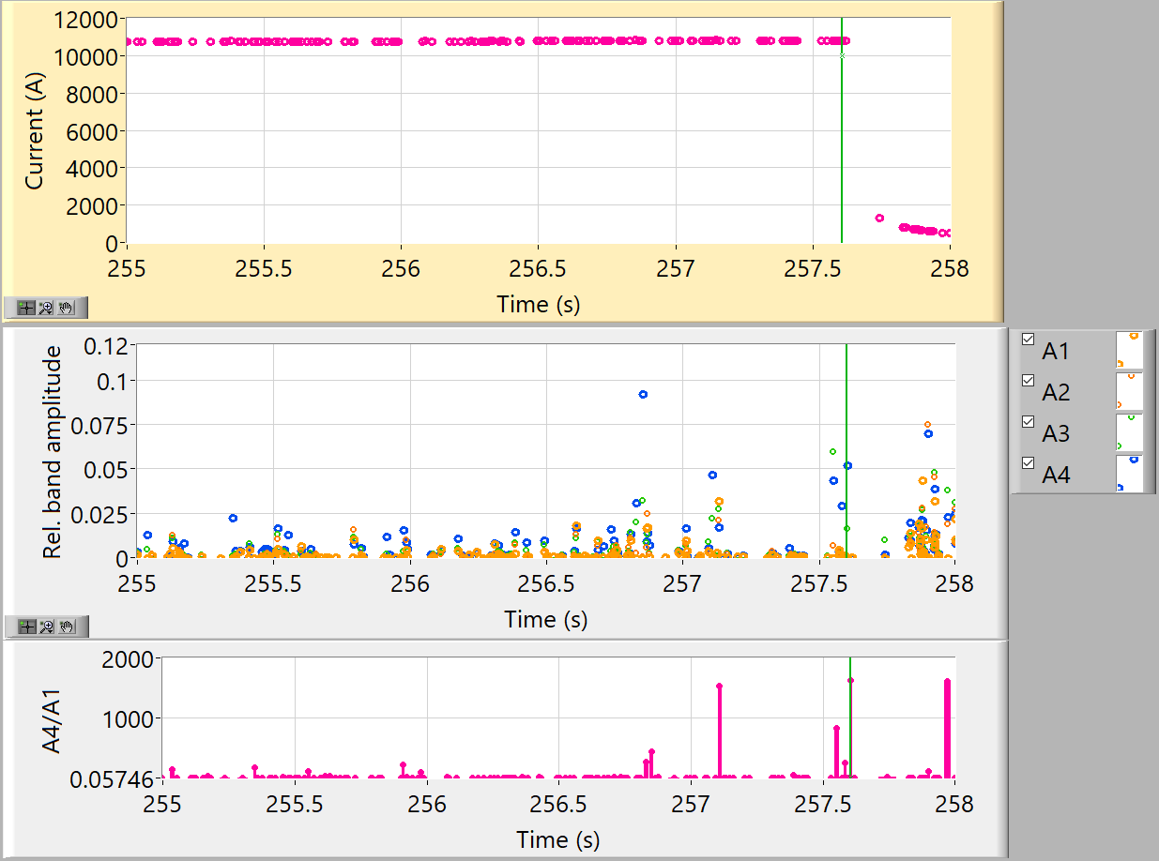
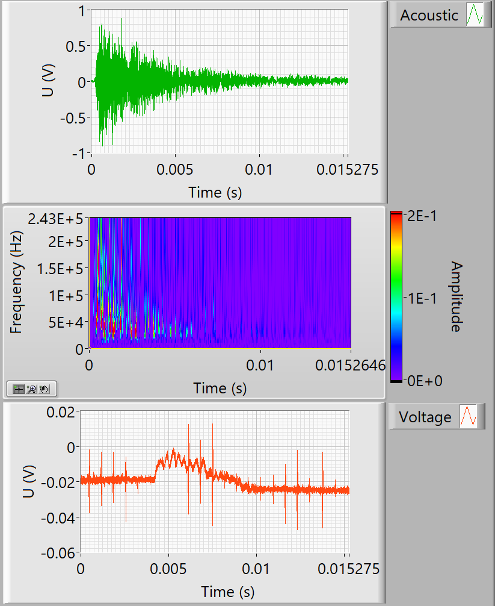
Beginning of training (Q6)
Few large high-frequency events
Voltage response in the coil

Slide 15
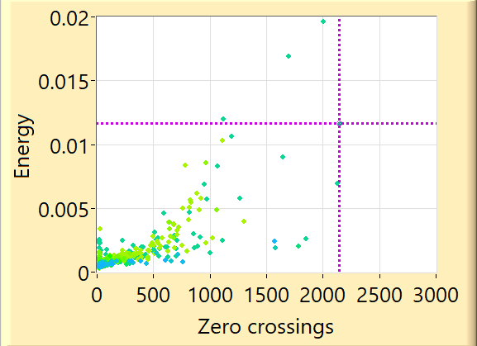
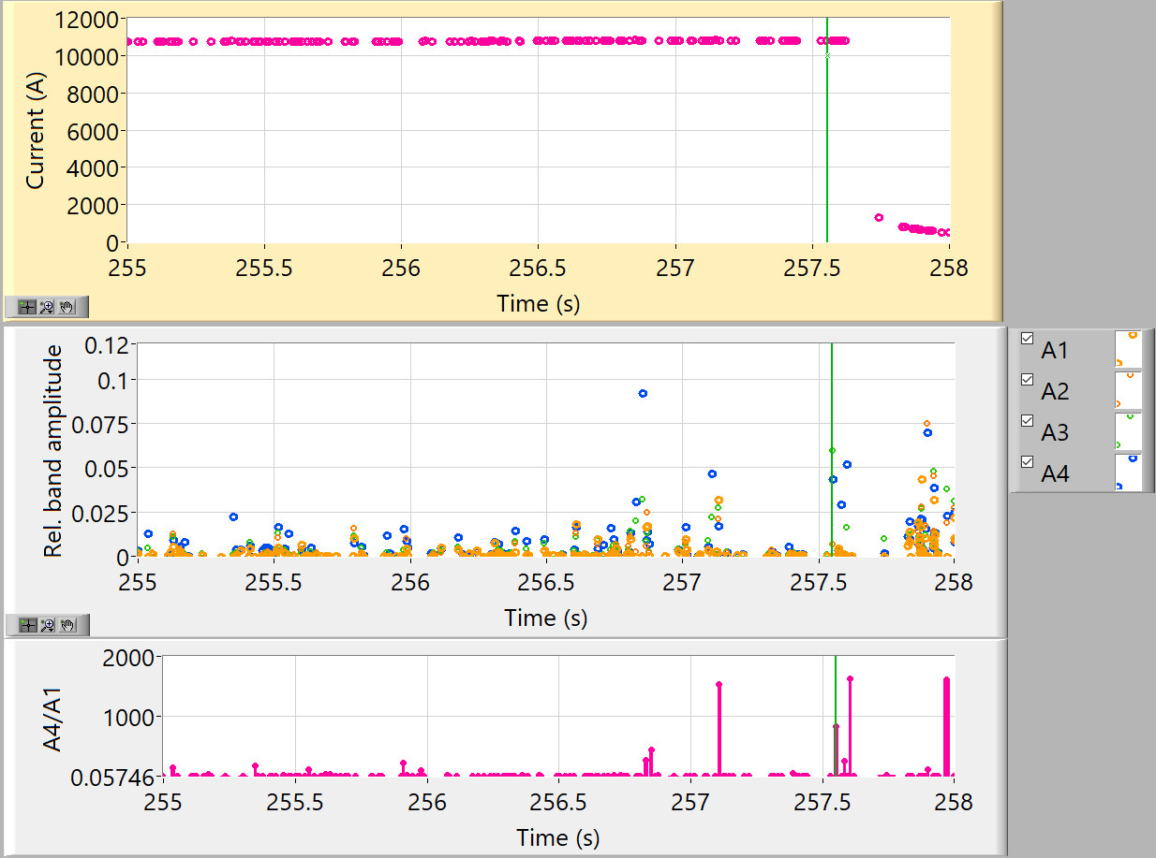
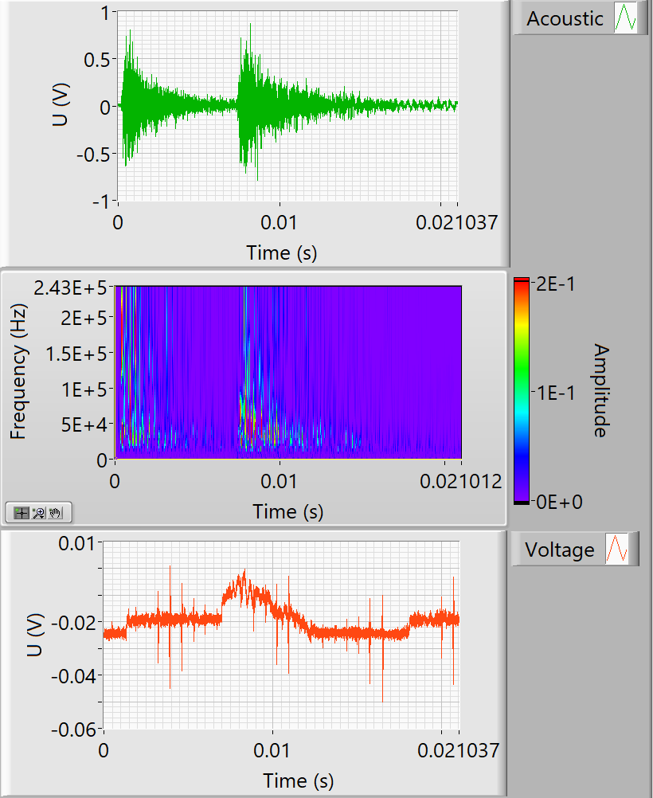
Beginning of training (Q6)
Few large high-frequency events
Voltage response in the coil

Slide 16
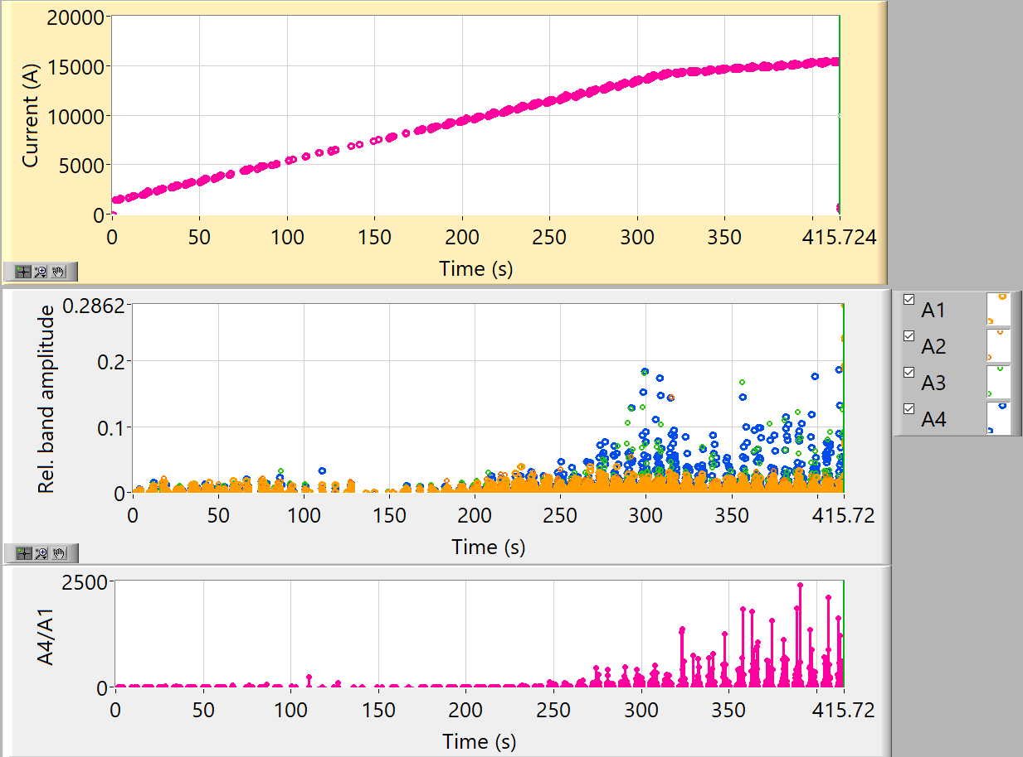
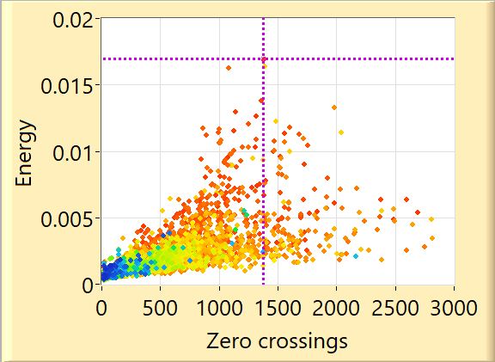
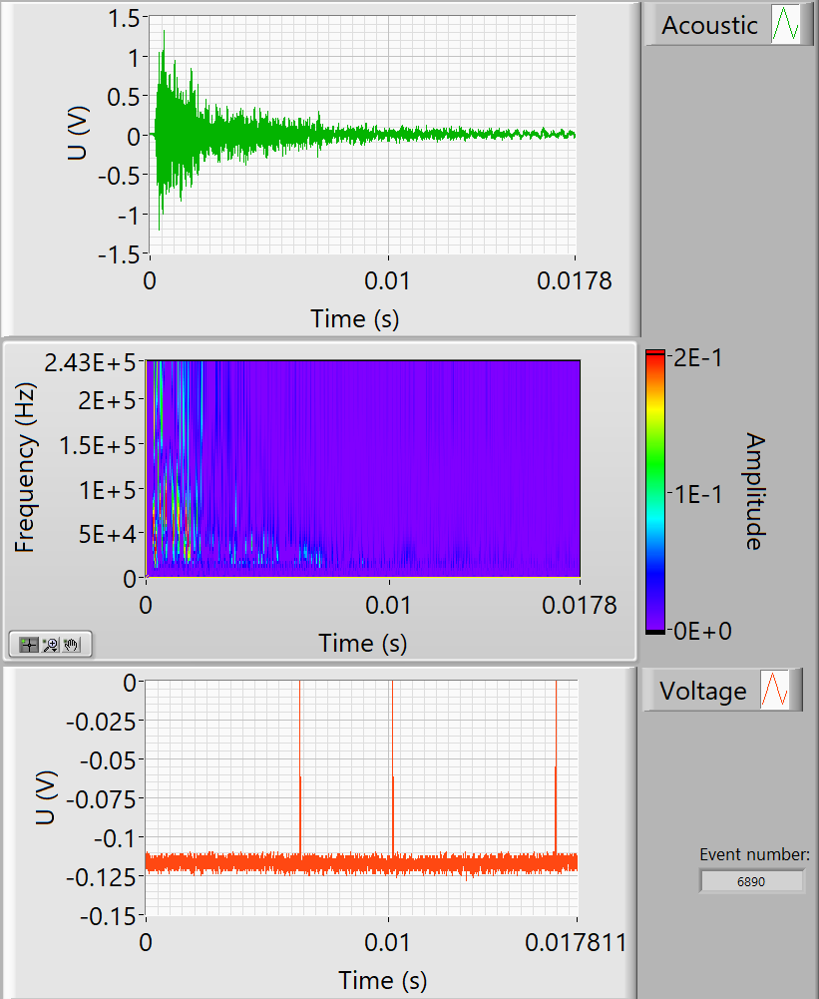
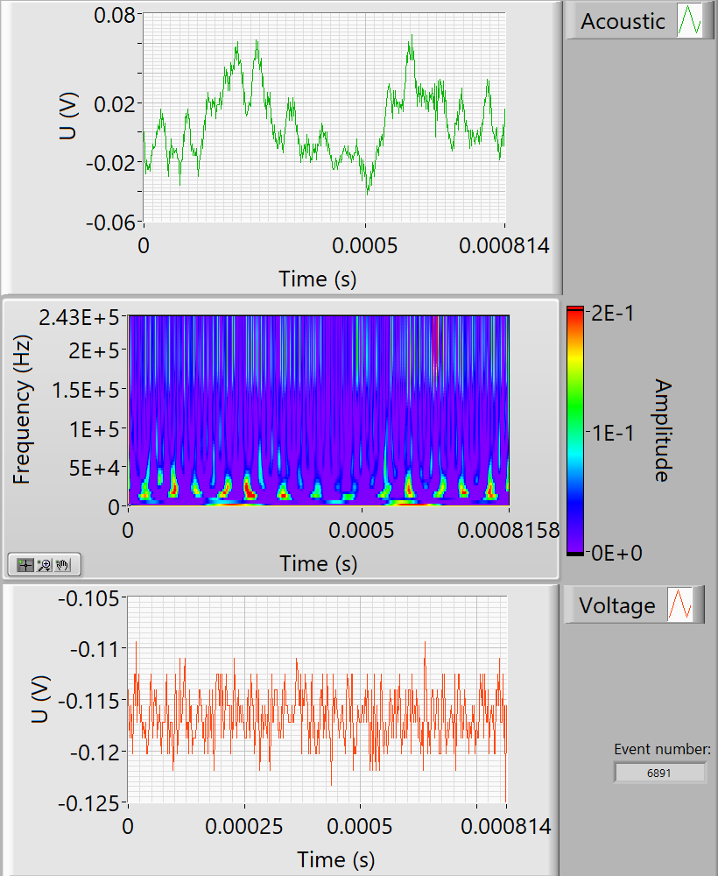
End of training (Q103)
Numerous multiplet events
Many large high-frequency events, followed by excitation of structural resonances (de-bonding?)
No voltage response in the coil

Slide 17
Conclusions
We observed two distinct AE regimes during ramping to quench. In the beginning of training AE energy is independent on the magnet current. With continuing training, a universal power-law scaling of AE energy emerges which is a hallmark of critical dynamics. Also, a clear divergence from the power-law is seen in this second regime within seconds of the upcoming quench.
Accumulated displacement (AE waveform bias) plotted versus Lorentz force converges towards a linear dependence (= recovered elastic behavior) as training progresses.
We applied wavelet-based analysis to AE signals, and observed emergence of multiplet transients at high currents that can be attributed to a successive crack propagation. We also identified high-frequency (>200 kHz) bursts immediately followed by excitation of low-frequency structural resonances that may be indicative of interfacial debonding.
Analysis of CCT4 AE data will continue…

Slide 18
Localization of hot spots in solids using acoustic waves
Technology Commercialization Fund project
Supported by the Office of Technology Transitions, US Department of Energy
M. Marchevsky, R. Teyber
LBNL
In collaboration with
C. Sanabria, M. Segal
Commonwealth Fusion Systems

Slide 19
Scope of the project
Future generation and distribution markets based on the use of high-temperature superconductor (HTS) materials. Traditional quench detection methods for LTS relying on fast normal propagation zones (e.g. measuring a voltage increase of the system) do not work for HTS devices. The technology we are proposing was laboratory-tested on HTS tape conductors and small coils for detecting hot spot development down to liquid helium temperature.
Now we want to focus on the localization aspect of the technology it to be able not only detect hot spots but also provide their location information.
c
delay
U_{Ref}(t)
Milestones
U*_{x}(t)
Demonstration of hot spot detection and localization in a commercial transformer device
Demonstration of hot spot detection in a conductor sample provided by CFS
Testing of HTS cable sample under operational conditions at BNL test facility in collaboration with CFS
Δt
cross-correlation
autocorrelation

Slide 20
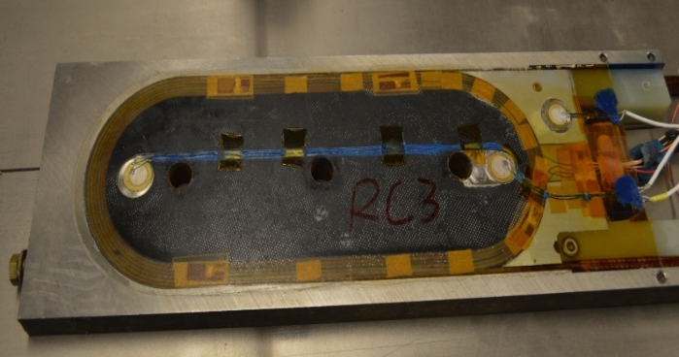
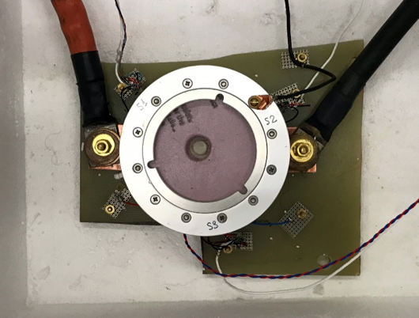
Equivalence to voltage-based detection has been demonstrated
Bi-2212 coil RC3
Pulser
Receiver
Coil design and test by T Shen / K. Zhang
ΔT~1.6 K
Experiment at 4.2 K. Current ramp stopped at 6100 A (stable) and then increased by 30 A (quenching)
Δt_{rel} ~ 3.5 ns
ΔU_{max} ~ 7.6 mV (68 μV/cm)
M.M., E. Hershkovitz (LBNL)
*STTR with ACT

Slide 21
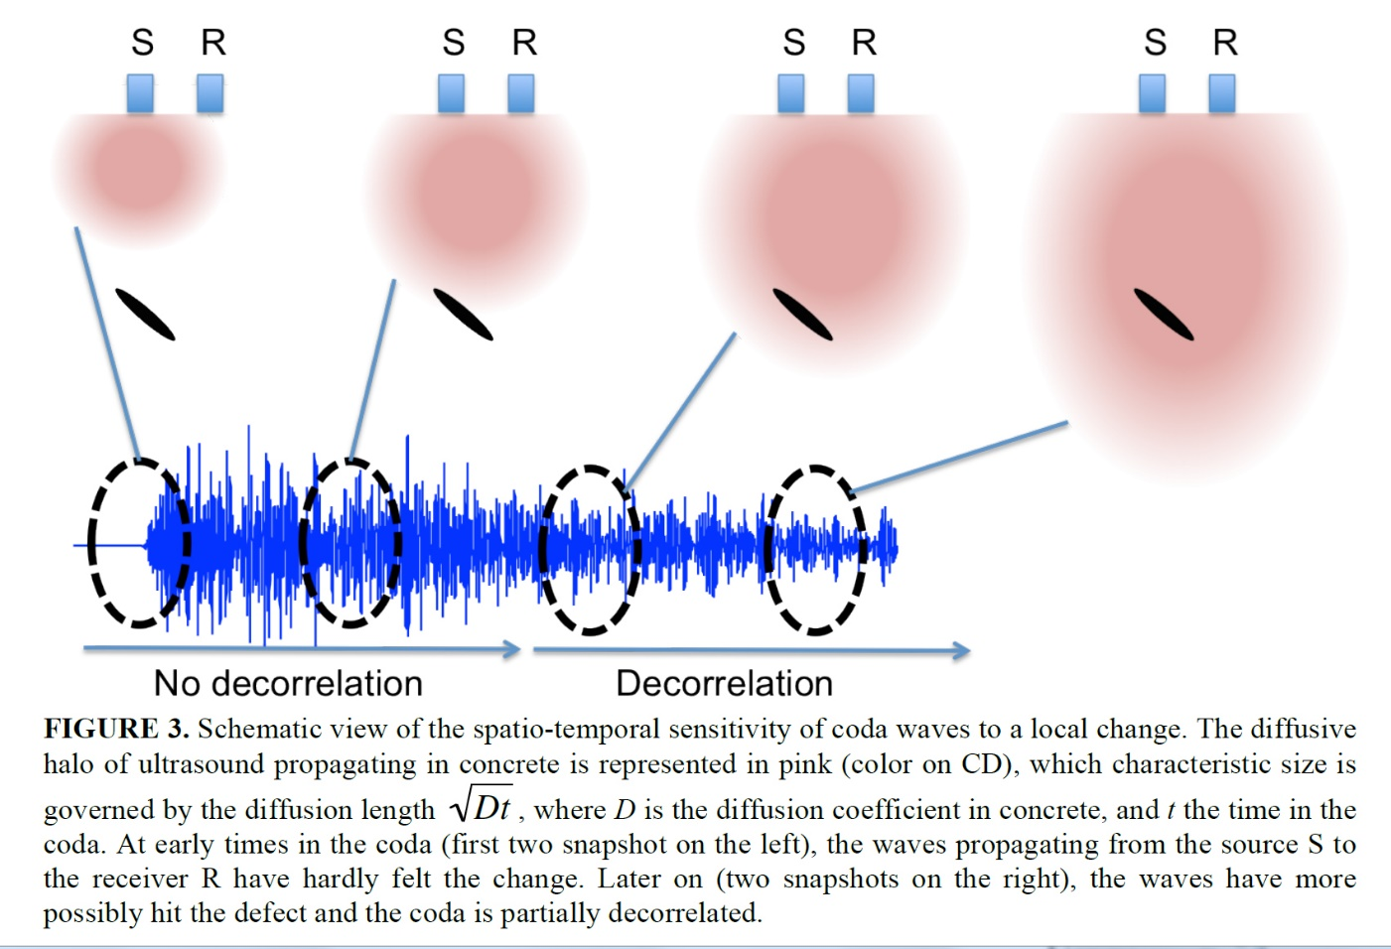
Coda wave “diffusion” provides means for localization of a weak change
Diffusion properties of the coda wave can be explored to evaluate distance to the point of weak change or heat source
Thomas Planès and Eric Larose, “LOCADIFF: Locating a weak change with diffuse ultrasound”, AIP Conference Proceedings, v. 1511, p.405 (2013)

Slide 22
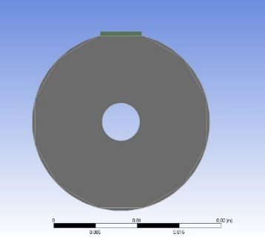
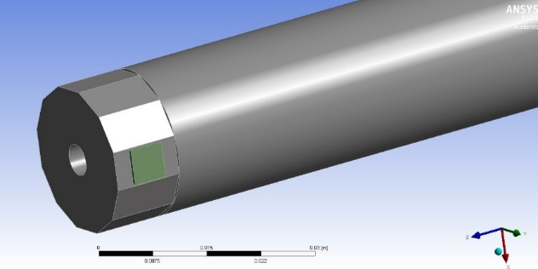
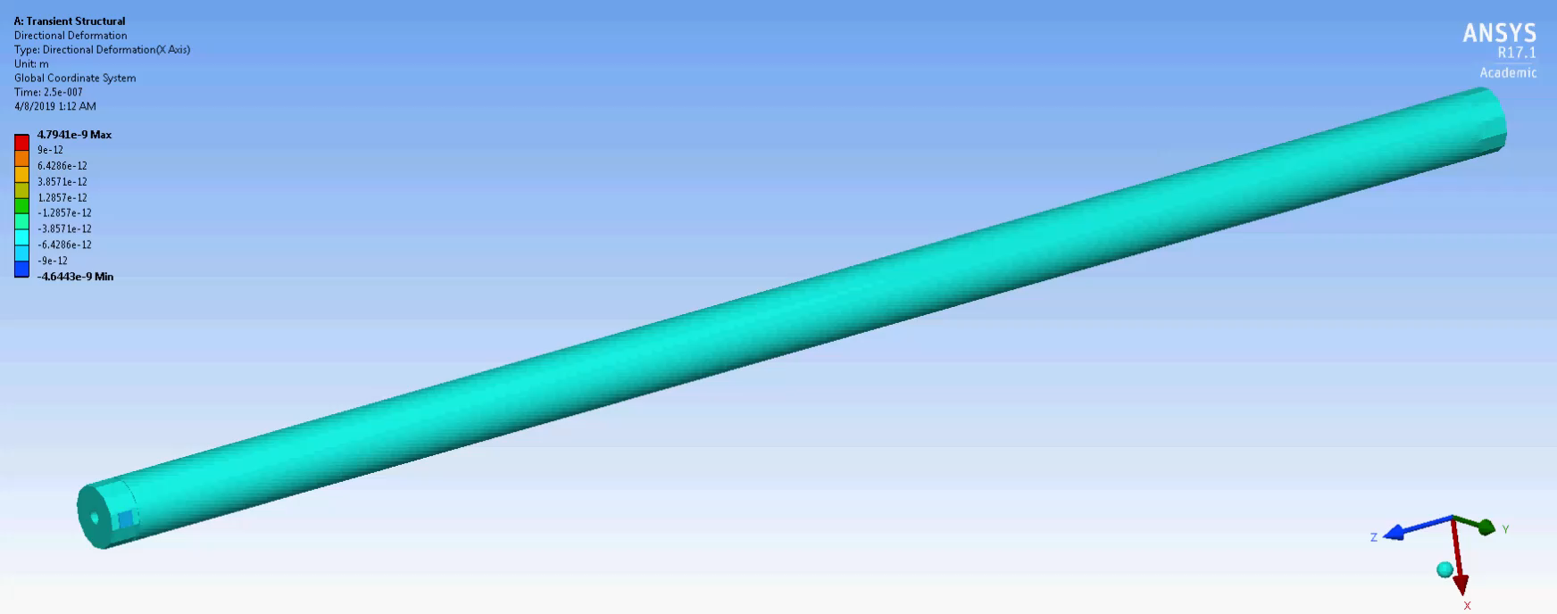
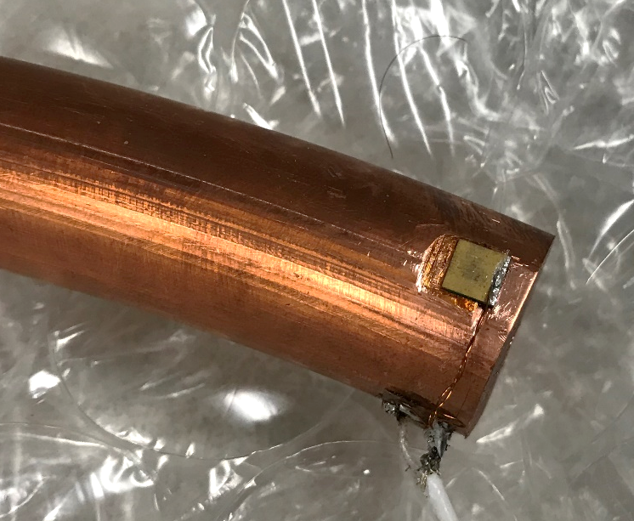
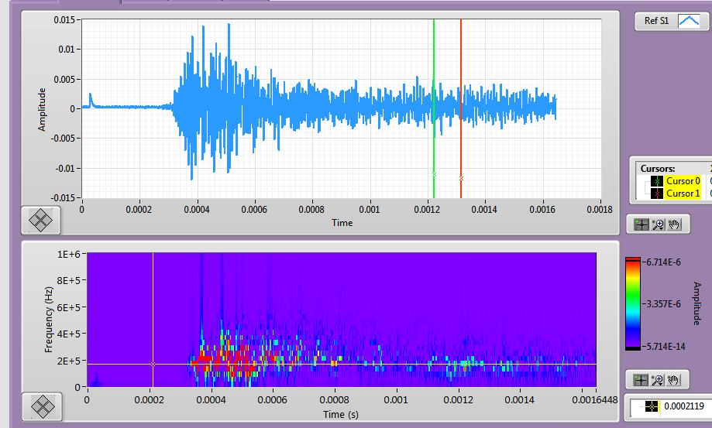
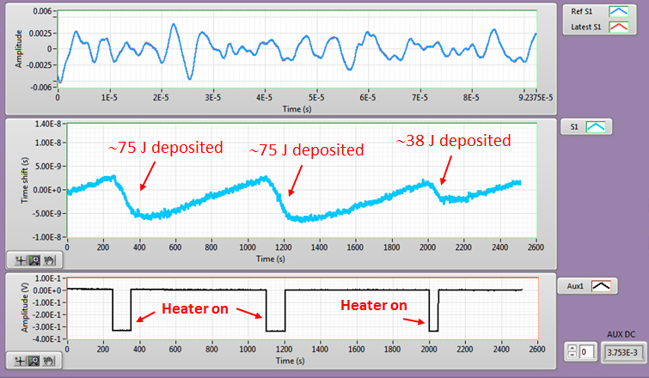
Simulations and tests on a mock-up fusion cable
ANSYS simulation of acoustic wave propagation and scattering in the fusion cable geometry
Tabletop test on a mock-up “cable”: a 50 cm-long copper rod:
Copper rod with a central flow channel and flattened end
Well-formed shear wave propagates along the cable
Shear piezo-plate
Shear piezo-plate
In collaboration with
Pulses of 2.3 μs duration were applied 5 Hz repetition rate. Pulse amplitude is ∼40 V p-p.
Heater was placed at the middle of the cable (∼25 cm from the ends; its power is 0.753 W. Heater was on for 100 s, 100 s and 50 s respectively

Slide 23
Simulations to optimize transducer placement
In order to couple the acoustic transducer to the fusion cable in a best possible way, we investigated vibrational modes of a fusion cable geometry using ANSYS modal analysis. Several vibrational modes that are well coupled to the surface of the cable cooling channel (cable ID) and also close to the resonance frequency of the piezo-transducer were found, including a prominent one at 410 kHz (shown in the left image).
We have therefore decided to mount the acoustic transducers to the ID of the cable cooling channel for best efficiency and stronger mechanical coupling to the cable. The ID is also a “free surface” that would not be mechanically coupled to anything else when the cable is wound in a coil.

Slide 24
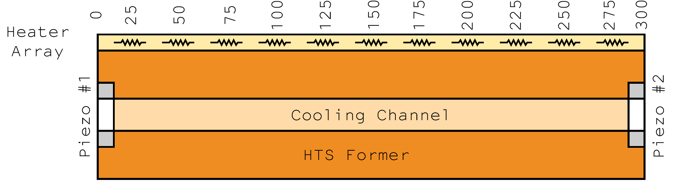
Heater array design
To deliver localized heat to the cable sample for testing and calibration purposed, we have developed and built a flexible array of spot heaters capable of inducing small temperature variations with a good spatial accuracy and minimal intrusion
2-layer Flex PCB
Allows mounting to a cylindrical surface
Minimizes change in vibrational modes due to mass, damping of heater assembly
Linear array of 11 small, surface mount resistors
Any individual or pairs of resistors can be powered
Can attach multiple linear heater arrays to samples of interest
R. Teyber

Slide 25
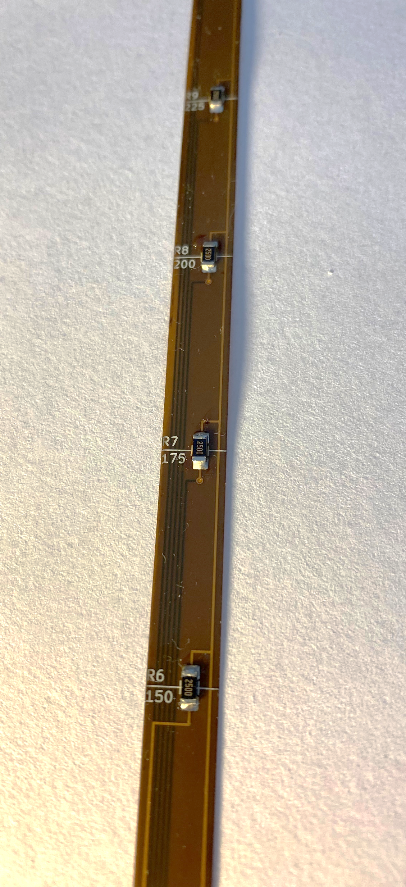
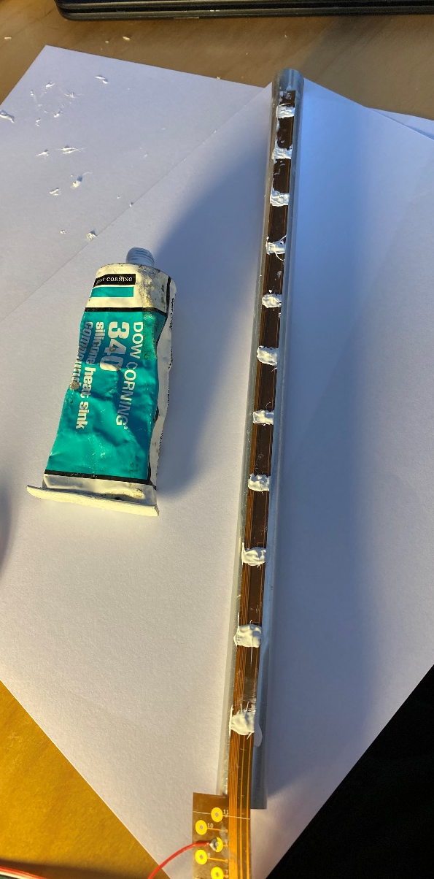
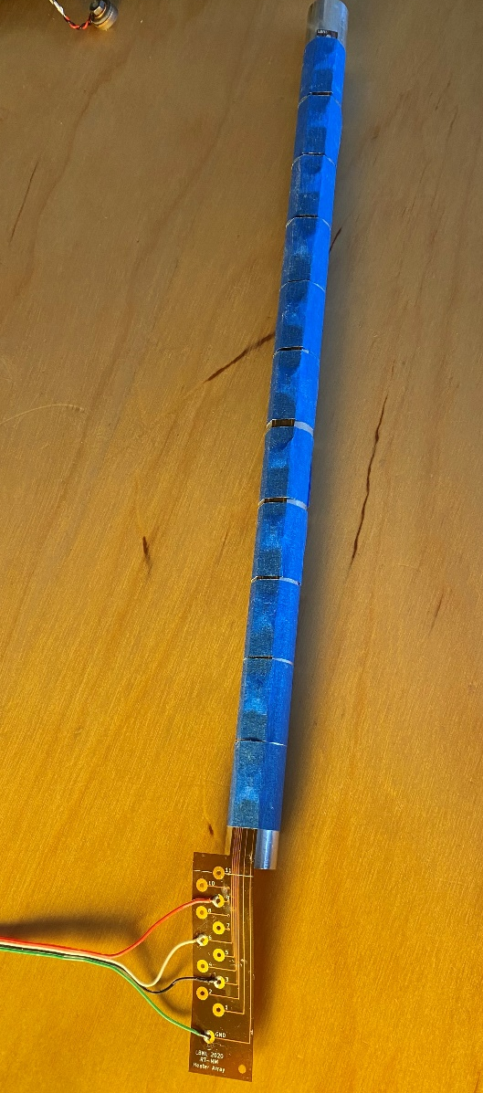
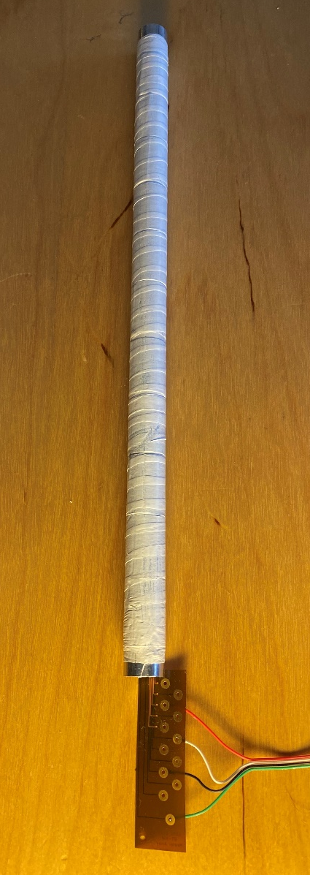
Heater installation on the “mock-up” sample

Slide 26






Experimental setup
Heater array
Function
generator
DC power supply
Pulser piezo
USB relay card
Acoustic sensor coupling box and Picoscope-based ADC
Amplified acoustic sensor
Analysis and localization software

Slide 27
Signal processing for hot spot localization
The original hot spot detection algorithm is based on measuring time shift variation for a small portion of coda waveform that is empirically selected to achieve maximal signal-to-noise ratio for the detection
Because coda is a result of multiple acoustic scattering inside the sample, it encodes different locations within the samples not uniformly, but in some “biased” way when different locations contribute differently to each particular segment of the coda. The exact relation between the location of the “disturbance” and its “encoding” in complex and not known. Still, such relation may be exploited for hot spot localization.
We do it by conducting a calibration procedure to create a “database” of coda variations specific to hot spots generated at different sample locations. Once created, such “database” can be then used to localize unknown disturbances by matching the measured variation to the database.
To realize this in practice, we programmed and tested a new algorithm that sub-divides the coda into 100 sequential intervals of equal duration and calculates time shift for each of those interval independently.

Slide 28

New software was developed to monitor time shift simultaneously over multiple coda segments
We expanded our original quench detection software to include calculation of time shift along the pre-selected number of intervals along the coda, plot is as a waterfall plot as function of number of pulses (=time), and also calculate average variation of the time shift for those pre-defined segments as it accumulates over time.
Coda
“Instant“ (per pulse) time shift measured along the coda
“Waterfall plot” of time shift vs time
Number of segments to calculate time shift
Average time shift per segment

Slide 29


Examples for different heaters producing time shift at different positions along the coda waveform
Heater 1 fired
Heater 11 fired
Coda
Instant time shift along the coda
Time
Average time shift along the coda
Segments of the coda along the time axis that are exhibiting largest time shift in response to a heater firing are marked with arrows. The “bar code” pattern in Time Shift vs Time waterfall plot are clearly different for different heaters, showing a potential for using this property for hot spot localization.

Slide 30

Automated sampling and localization software
Time shift vs time monitored for an arbitrary chosen coda segment (shown on the left)
Spot heater voltage vs. time
Kendall’s Tau coefficient for the current waveform comparing it to the waveforms in the database corresponding to different heaters
Accumulated average time shift per coda segment (100 pts)
A program randomly fires the heaters using USB relay card, collects time shift variation data, update the database and localize the heater based on the data that is already in the database.
Localized vs actual heater location. Heaters are fired randomly

Slide 31

Actual vs localized heater locations
Heaters were fired at random 120 times and localization was performed. The result is plotted above.
Percentage of cases plotted vs absolute error
In 48% of cases heater firing location was determined exactly, in another 36% of cases heater firing location was determined with a +/- 1 accuracy, corresponding to an inter-heater distance of 26 mm. This clearly demonstrates feasibility of our localization approach. As number of event in the “database” increases with each consecutive heater firing, the accuracy of localization increases as well. Further improvement can be made using more advanced classifier methods based on machine learning algorithms, and we plan to adapt it for future (real cable sample) experiments.

Slide 32

Sketch of the cryogenic testing setup
The sample will be sealed inside a “cassette” that will be installed in the bore of BNL’s 10 T common coil magnet for testing at 4.2 K / 10 T background field.
Cernox thermometers
From the pulse generator
Cable sample
∼30 mm
To the acoustic DAQ
Piezoelectric element
(ring)
G-10 spacers
∼300 mm
Flexible strip with spot heaters
This sketch represents basics of the planned test setup and instrumentation, and preparations to the test are ongoing at BNL (funded by the INFUSE project that CFS and BNL are part of).
We are working on preparing for a cryogenic test at Brookhaven National Lab in Dec 2020.

