Slide 1
Update on Costheta cross section
V. Marinozzi
11/17/2020

Slide 2
Assumptions
Goal: compare different cross sections
6 layers
50 mm aperture
HTS is Bi-2212 rutherford cable, with filamentery strands
LTS is Nb₃Sn
Conductor parameters from existing cable
No harmonics optimization

Slide 3
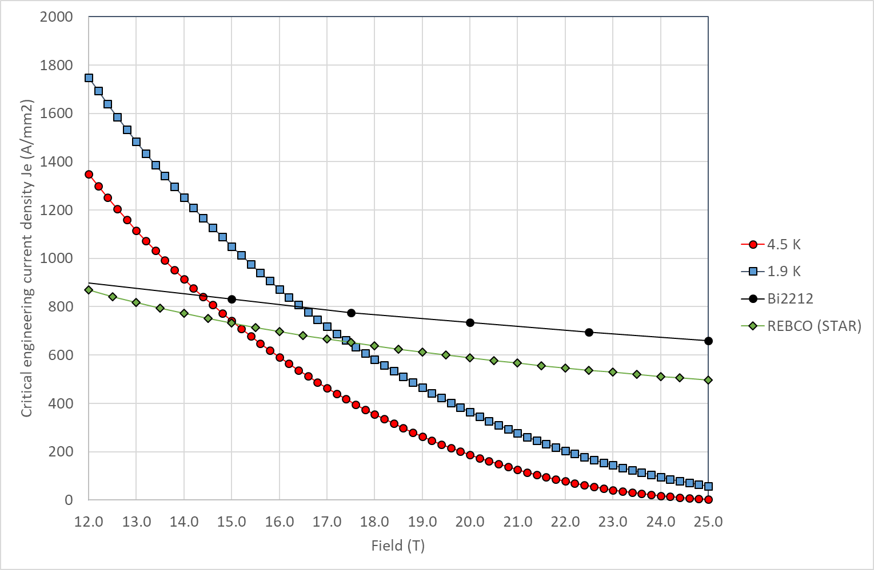
Critical current
Still using linear approximation in the peak field zone
Jc in SC obtained by scaling Jc engineering from Paolo slides
J_{c} for Nb₃Sn: 1928 A/mm² @16 T, 1.9 K
J_{c} for Bi2212: 2944 A/mm² @20 T, 1.9 K

Slide 4
Conductor for comparison with Paolo model
Quantity | Bi-2212 | Nb₃Sn
Strand diameter | 0.8 mm | 0.8 mm
Number of strands | 30 | 30
Cu(stabilizer)/SC | 3 | 1
Bare width | 13.76 mm | 13.3 mm
Bare height (inner) | 1.44 mm (0.9 packing) | 1.44 mm (0.9 packing)
Bare height (outer) | 1.56 mm (0.5 keystone) | 1.55 mm (0.5 keystone)
Insulation thickness | 0.15 mm | 0.15 mm
From RC coil (17 strands)
From DCC017

Slide 5
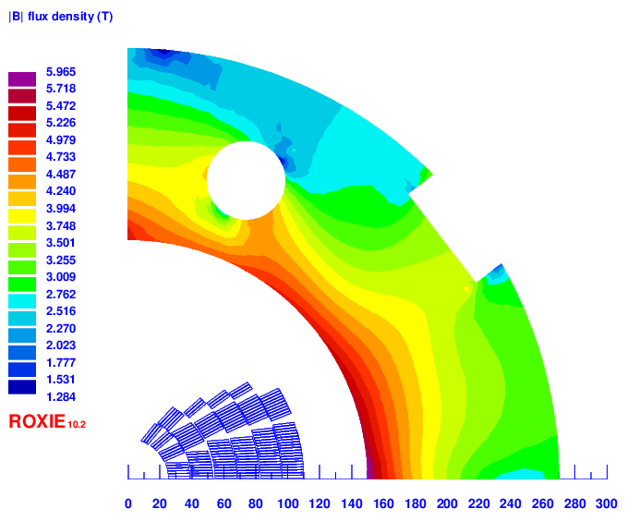
Iron yoke

Slide 6
Magnet | Layers of HTS/LTS | Str # (HTS) | Str # (LTS) | HTS Str diameter [mm] | LTS Str diameter [mm] | Stabilizer/Superconductor (HTS/LTS) | HTS Bare cable width [mm] | LTS Bare cable width [mm] | HTS area [mm²] | LTS area [mm²] | Coil Width [mm] | Curr [A] | Peak field on HTS [T] | Peak field on LTS [T] | Margin on HTS [%] | Margin on LTS [%] | J_{Cu} on LTS [A/mm²] | Peak stress on HTS [Mpa] | Peak stress on LTS [Mpa] | Horizontal stress on midplane [Mpa]
20 T – v2 | 4 / 2 | 40 | 30 | 0.8 | 0.8 | 3/1 | 18.35 | 13.30 | 3069 | 1514 | 104 | 11020 | 20.47 | 12.48 | 82.9 | 77.4 | 1461 | 132 | 170
20 T – v3 | 4 / 2 | 35 | 35 | 0.8 | 0.8 | 3/1 | 16.06 | 15.52 | 2667 | 1777 | 99 | 10420 | 20.51 | 12.19 | 87.2 | 72.6 | 1184 | 141 | 134
20 T – v4 | 4 / 2 | 35 | 25 | 0.8 | 0.8 | 3/1 | 16.06 | 11.08 | 2667 | 1253 | 90 | 10290 | 20.45 | 12.76 | 86.4 | 81 | 1637 | 140 | 188
20 T – v5 | 4 / 2 | 30 | 30 | 0.8 | 0.8 | 3/1 | 13.75 | 13.30 | 2271 | 1514 | 85 | 9820 | 20.72 | 12.42 | 93.1 | 75.2 | 1302 | 155 | 149
20 T - v6 | 2 / 4 | 40 | 35 | 0.8 | 0.8 | 3/1 | 18.35 | 15.52 | 1143 | 3392 | 102 | 10810 | 20.4 | 15.88 | 81.8 | 90.6 | 1228 | 118 | 144
20 T – v7 | unfinished, not worth
20 T – v8 | 4 / 2 | 40/35 | 25 | 0.8 | 0.8 | 3/1 | 18.35/16.06 | 11.08 | 2753 | 1253 | 95 | 10750 | 20.38/ 15.86 | 13.16 | 81.5/ 81.9 | 83.8 | 1710 | 151 | 205
20 T – v9 | 4 / 2 | 40/35 | 30 | 0.8 | 0.8 | 3/1 | 18.35/16.06 | 13.30 | 2753 | 1514 | 100 | 10820 | 20.42/ 15.86 | 12.82 | 81.9/ 82.3 | 78 | 1435 | 151 | 170
20 T – v9b | 4 / 2 | 40/35 | 30 | 0.8 | 0.8 | 3/1.5 | 18.35/16.06 | 13.3 | 2753 | 1514 | 100 | 10820 | 20.42/ 15.86 | 12.82 | 81.9/ 82.3 | 83.3 | 1195 | 151 | 170
20 T – v10 | 2 / 4 | 40 | 35/30 | 0.8 | 0.8 | 3/1 | 18.35 | 15.52/13.75 | 1143 | 3112 | 98 | 10750 | 20.39 | 15.90/ 12.91 | 81.5 | 90.5/ 79.06 | 1222/ 1425 | 117 | 169
20 T – v11 | 2 / 4 | 40 | 35/30 | 0.8 | 1.1/0.8 | 3/1 | 18.35 | 15.52/13.75 | 1143 | 3112 | 110 | 11650 | 20.7 | 15.77/ 11.43 | 86.2 | 83.3/ 73.6 | 700.5/ 1545 | 119 | 165

Slide 7
Effect of 3mm between layers (v9)
20 T
18.9T
To get again 20 T
Current [A]: 10820 → 11500
Margin HTS [%]: 81.9/82.3 → 85.2/85.4
Margin LTS [%]: 83.3 → 82.5
Force HTS [MPa]: 151 → 158
Force LTS [MPa]: 170 → 178

Slide 8
Open Question
What is minimum bending radius of Bi2212?
~4.9 mm

Slide 9
Cross sections

Slide 10
v2

Slide 11
v3

Slide 12
V4

Slide 13
v5

Slide 14
v6

Slide 15
v8

Slide 16
v9

Slide 17
v10

Slide 18
v11

