Slide 1
Update on Costheta cross section
V. Marinozzi
11/30/2020

Slide 2
Assumptions
Goal: compare different cross sections
6 layers
50 mm aperture
HTS is Bi-2212 rutherford cable, with filamentery strands
LTS is Nb₃Sn
Conductor parameters from existing cable
No harmonics optimization

Slide 3
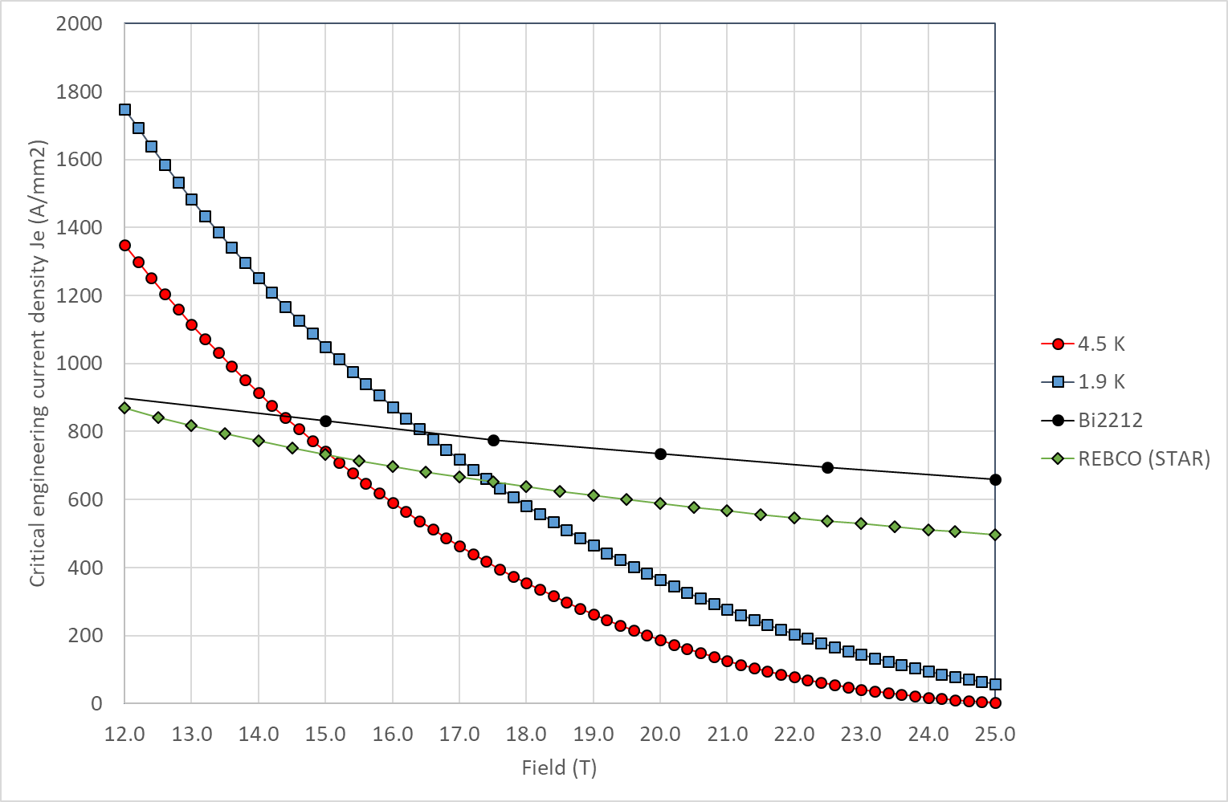
Critical current
Still using linear approximation in the peak field zone
Jc in SC obtained by scaling Jc engineering from Paolo slides
J_{c} for Nb₃Sn: 1928 A/mm² @16 T, 1.9 K
J_{c} for Bi2212: 2944 A/mm² @20 T, 1.9 K

Slide 4
Conductor for comparison with Paolo model
Quantity | Bi-2212 | Nb₃Sn
Strand diameter | 0.8 mm | 0.8 mm
Number of strands | 30 | 30
Cu(stabilizer)/SC | 3 | 1
Bare width | 13.76 mm | 13.3 mm
Bare height (inner) | 1.44 mm (0.9 packing) | 1.44 mm (0.9 packing)
Bare height (outer) | 1.56 mm (0.5 keystone) | 1.55 mm (0.5 keystone)
Insulation thickness | 0.15 mm | 0.15 mm
From RC coil (17 strands)
From DCC017

Slide 5
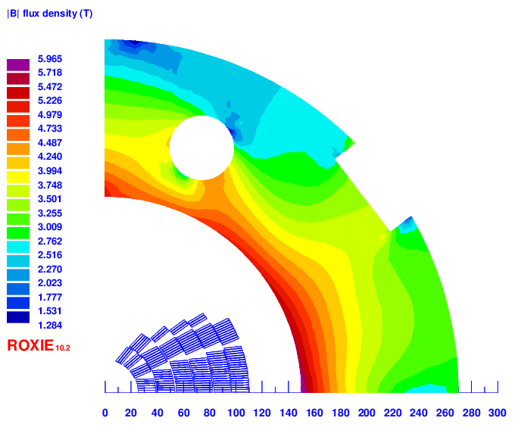
Iron yoke

Slide 6
Baseline classic costheta (size optimized): v9b
4 layer HTS, 2 layer LTS
Strands: 0.8 mm, 40 – 35 – 30
Cable width: 18.35 – 16.06 – 13.3 mm
Stabilizer/Superconductor: 3 – 3 – 1.5
Coil width: 100 mm
Current: 10820
Peak field: 20.42 – 15.86 – 12.82 T
Margin: 81.9 – 82.3 – 83.3 %
J_{cu} on LTS: 1195 A/mm²

Slide 7
Baseline classic costheta (HTS optimized): v11
2 layer HTS, 4 layer LTS
Strands: 0.8 – 1.1 – 0.8 mm, 40-35-30
Cable width: 18.35 – 21.3 – 13.3 mm
Stabilizer/Superconductor: 3 – 1 – 1
Coil width: 110 mm
Current: 11650
Peak field: 20.7 – 15.77 – 11.43 T
Margin: 86.2 – 83.3 – 73.6 %
J_{cu} on LTS: 700 – 1545 A/mm²

Slide 8
SMCT-like with 3 mm rings (v9 evo): v9c
4 layer HTS, 2 layer LTS
Strands: 0.8 mm, 40 – 35 – 30
Cable width: 18.35 – 16.06 – 13.3 mm
Stabilizer/Superconductor: 3 – 3 – 1.5
Coil width: 112 mm
Current: 11500
Peak field: 20.51 – 15.52 – 12.34 T
Margin: 85.2 – 85.4 – 82.5 %
J_{cu} on LTS: 1271 A/mm²

Slide 9
SMCT-like with 5 mm rings (v9 evo): v9d
4 layer HTS, 2 layer LTS
Strands: 0.8 mm, 40 – 35 – 30
Cable width: 18.35 – 16.06 – 13.3 mm
Stabilizer/Superconductor: 3 – 3 – 1.5
Coil width: 122 mm
Current: 13000
Peak field: 20.59 – 15.65 – 12.73 T
Margin: 92.4 – 93.7 – 87.5 %
J_{cu} on LTS: 1436 A/mm²

Slide 10
SMCT-like with 5 mm rings: v12
4 layer HTS, 2 layer LTS
Strands: 0.8 mm, 46 – 40 – 30
Cable width: 21.1 – 18.35– 13.3 mm
Stabilizer/Superconductor: 3 – 3 – 1.5
Coil width: 132 mm
Current: 13790
Peak field: 20.54 – 15.39 – 12.78 T
Margin: 87.6 – 88.3 – 83.8 %
J_{cu} on LTS: 1828 A/mm²

Slide 12
Cross sections

Slide 13
v2

Slide 14
v3

Slide 15
V4

Slide 16
v5

Slide 17
v6

Slide 18
v8

Slide 19
v9

Slide 20
v10

Slide 21
v11

