Slide 1
MDP Technical Meeting #15
20 T hybrid magnet and comparative analysis
P. Ferracin, G. Ambrosio, E. Barzi, L. Cooley, R. Gupta, V. Kashikhin, V. Marinozzi, I. Novitski, B. Yahia, A. Zlobin
US Magnet Development Program

Slide 2
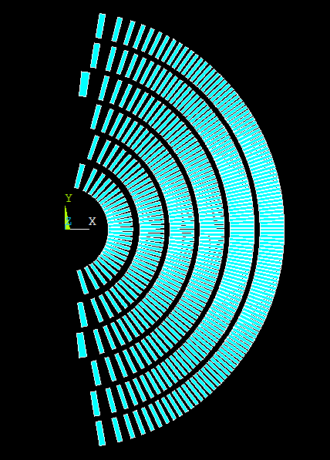
CT preliminary design (D. Arbelaez)
6 layers, same cable
HQ cable
With Iron
5 mm thick spars

Slide 3
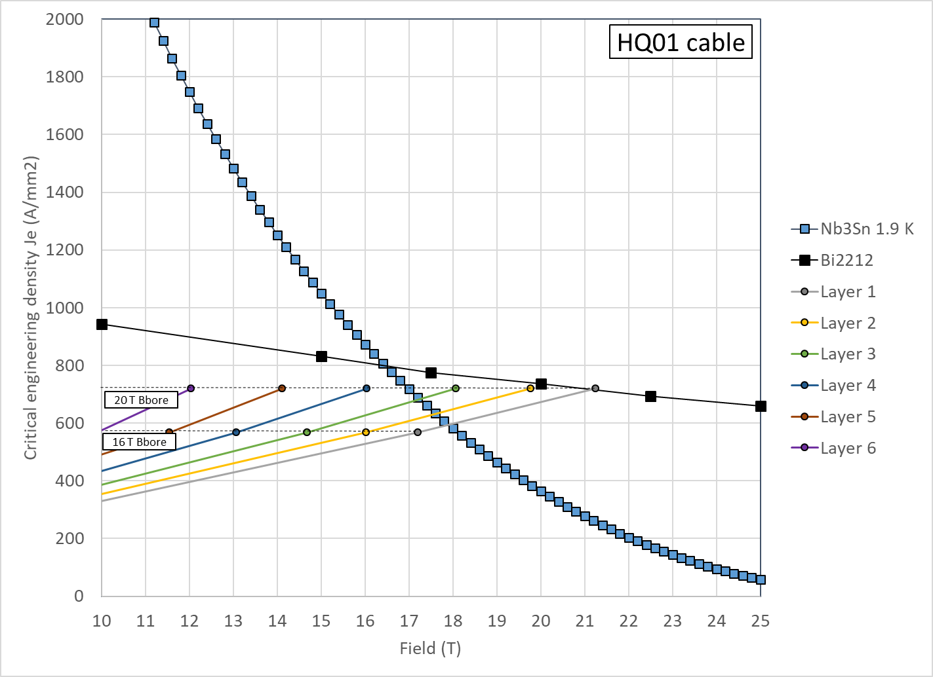
CT preliminary design (D. Arbelaez)

Slide 4
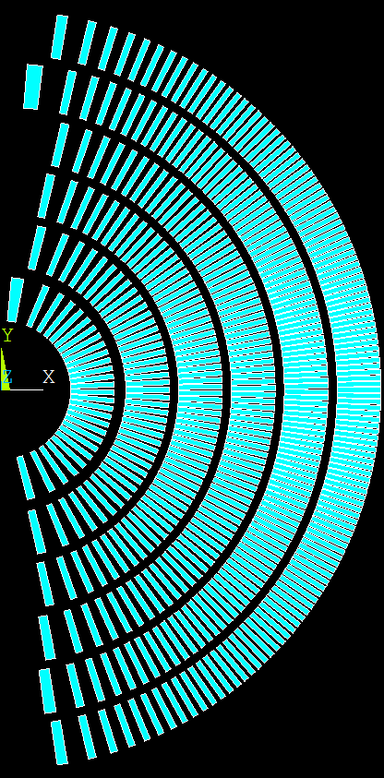
CT preliminary design (D. Arbelaez)
6 layers, same cable
MQXF cable
With Iron
5 mm thick spars

Slide 5
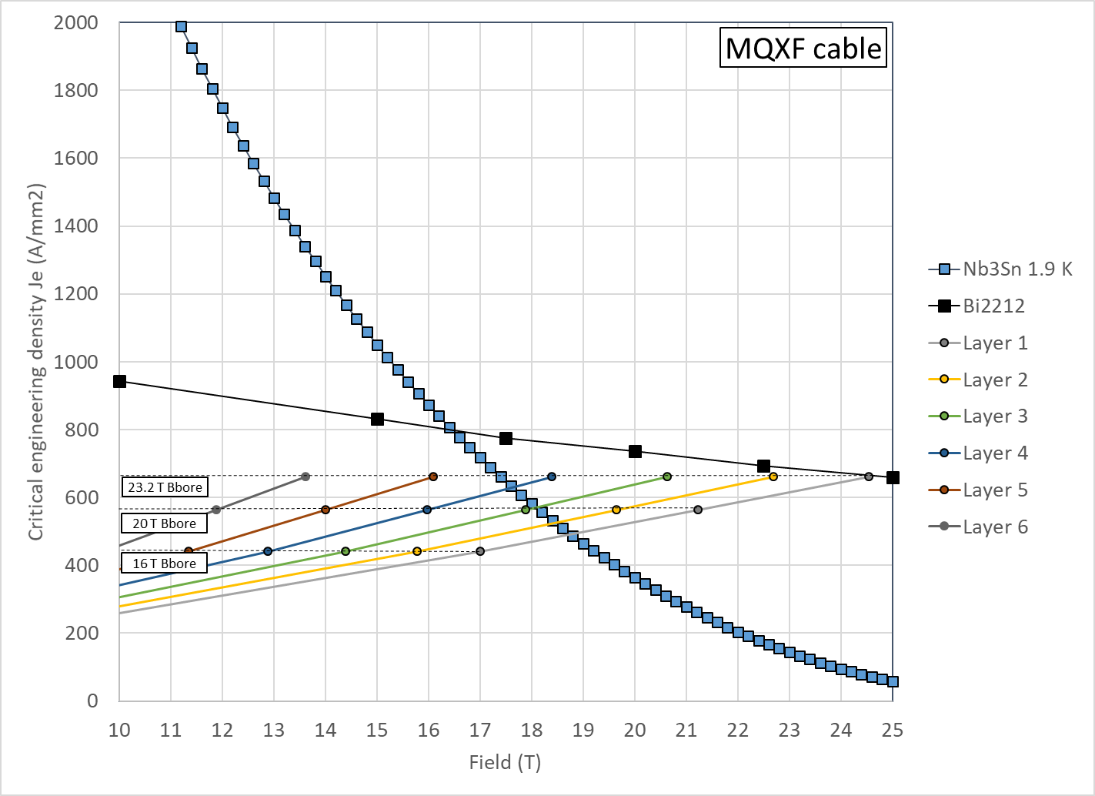
CT preliminary design (D. Arbelaez)

Slide 6
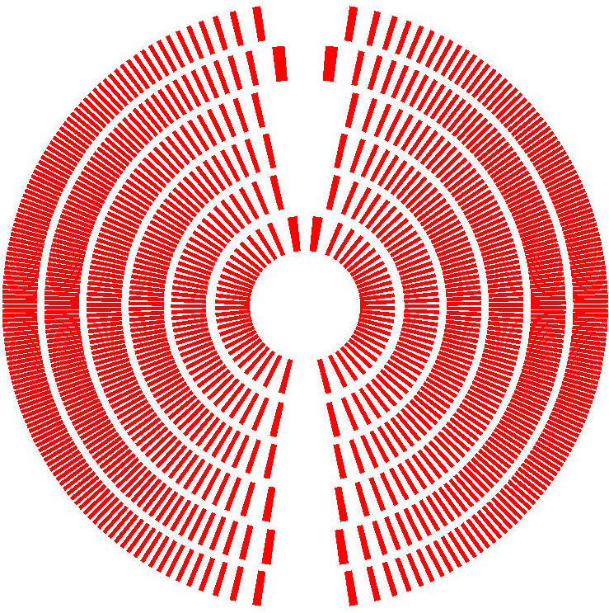
CT preliminary design (D. Arbelaez)
Coil OR: 165 mm

