Slide 1
DOE Nuclear Physics & Nuclear Data
Workshop on Applied Nuclear Data Activities
January 25, 2021

Slide 2
Progress Since WANDA 2020
Completion of SC Awards from the last Joint Inter-Agency FOA
Latest Nuclear Data Advisory Committee Review
Quarterly Meeting of Nuclear Data Inter-Agency Working Group
Release of next Joint Nuclear Data FOA
Nuclear Data Briefing for Office of Science Management
DEPARTMENT OF ENERGY OFFICE OF SCIENCE NUCLEAR PHYSICS
NUCLEAR DATA INTERAGENCY WORKING GROUP (NDIAWG) RESEARCH PROGRAM
FUNDING OPPORTUNITY ANNOUNCEMENT (FOA) NUMBER: DE-FOA-0002440
    FOA TYPE: INITIAL CFDA NUMBER: 81.049
FOA Issue Date: December 7, 2020
Submission Deadline for Letters of Intent: January 7, 2021 at 5 PM Eastern Time (A
Letter of Intent is required)
Letter of Intent Response Date January 21, 2021 at 5 PM Eastern Time
Submission Deadline for Applications: March 8, 2021 at 5 PM Eastern Time

Slide 3
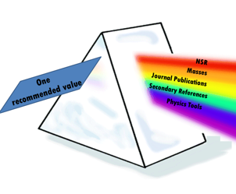
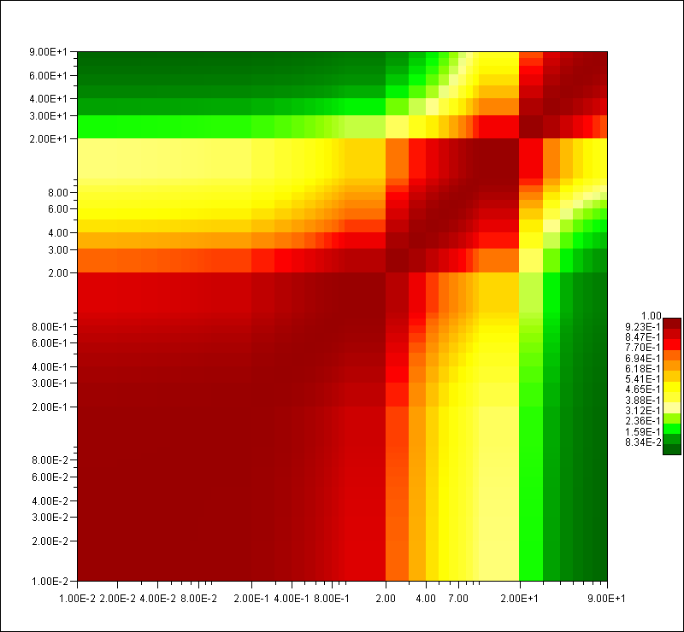
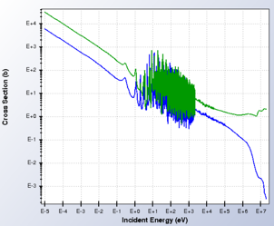
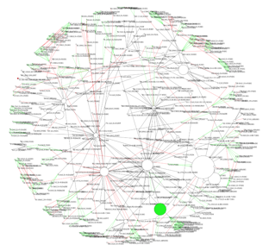
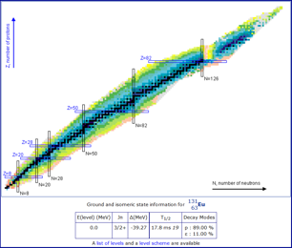
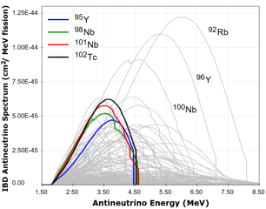
U.S. Nuclear Data Program
DoE Office of Science Briefing
January 5th, 2021
Lee Bernstein, UC-Berkeley/LBNL
David Brown, NNDC - BNL
Elizabeth McCutchan, NNDC - BNL
Alejandro Sonzogni, NNDC - BNL

Slide 4
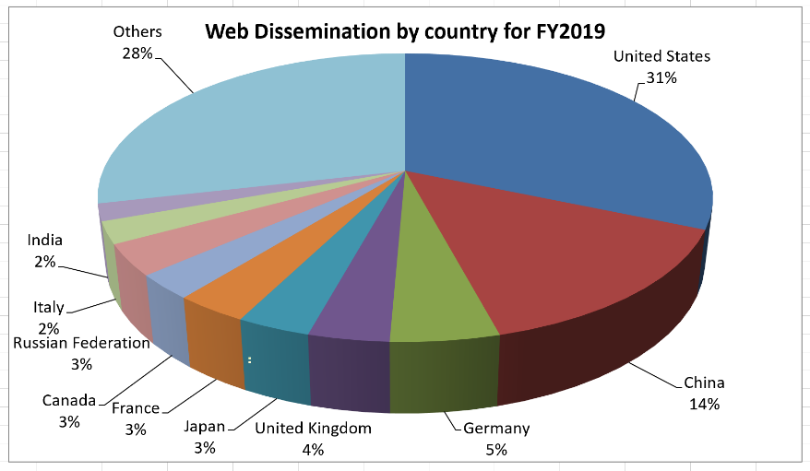
NNDC & USNDP Continue to be a Global Resource
Open data web downloads
Zero vulnerabilities in yearly DoE cybersecurity audits.
The number of retrievals has reached a plateau.
User’s profile remains stable.
Dual architecture for high service reliability, three web servers, two database servers and one GitLab server. Servers are replaced every 5 years.

Slide 5
A Note Added in Proof
Nuclear Data Sheets 5 years download statistics from Elsevier.
About 8,000 downloads / per year in US alone
Many more statistics available at https://journalinsights.elsevier.com/journals/0090-3752
USNDP

Slide 6
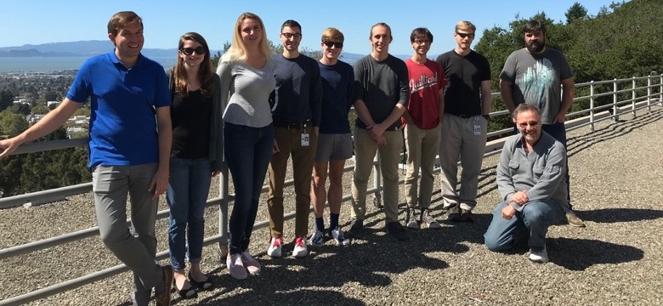
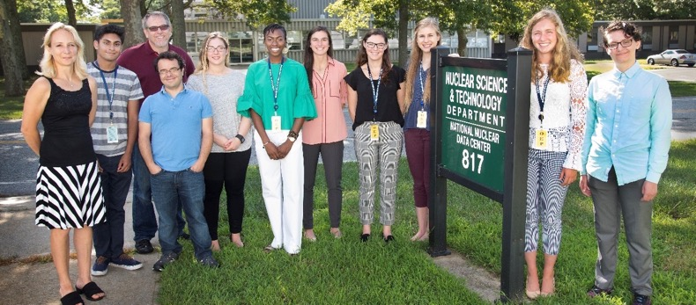
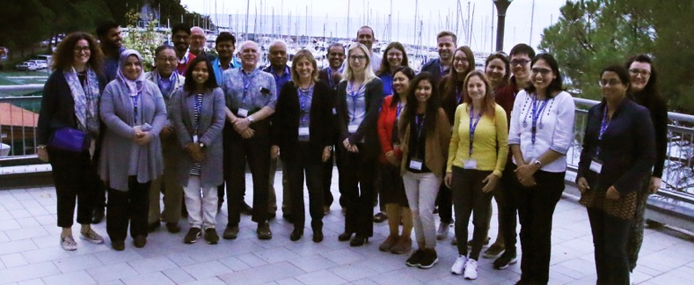
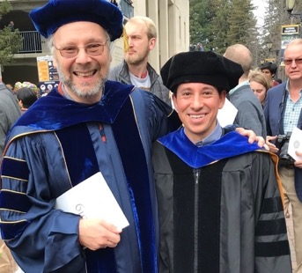
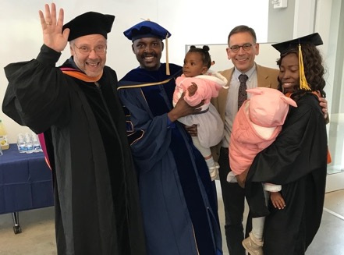
USNPD’s educational programs are producing a workforce that understands the importance of nuclear physics and nuclear data to basic and applied science
The Other Precious Resource Being Curated
NNDC Summer internship programs
(55 students over last 5 years)
First graduate program in Nuclear Data
Joint ICTP-IAEA Workshop (2018)
Nuclear Data Group Graduates 2019
M. Ayllon (NASA)
N. Nnamani (NTID)
https://nucleardata.Berkeley.edu
Notes:
Mauricio Ayllon’s Ph.D. involved developing a neutron interrogation system for soil carbon sequestration studies.
Nnaemeka Nnamani’s Ph.D. involved integral scattering on Polyethylene.
19 student first author papers in the last 5 years (Berkeley). NNDC numbers to follow…

Slide 7
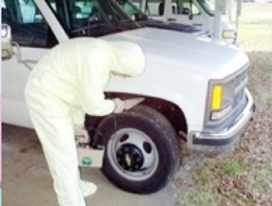
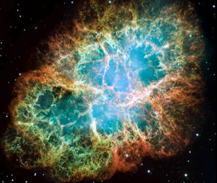
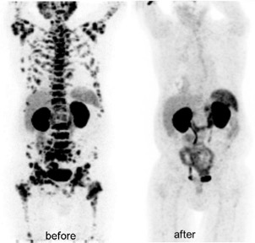
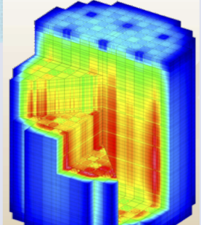
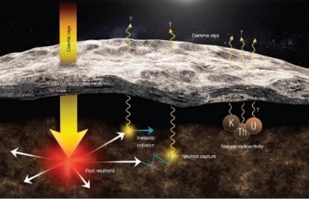

Many types of nuclear data are “crosscutting” to numerous applications
New & Traditional Frontiers Requiring Accurate Nuclear Data
Nonproliferation
Astrophysics
Materials Damage
Nuclear Data
Medicine
Energy
Elemental ID in Space Exploration
Gamma-rays
Cosmic rays
Fast neutrons
Natural
Radioactivity
Notes:
Replace figures as appropriate

Slide 8
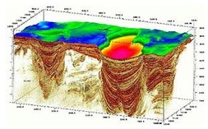
Public Datasets are becoming more prevalent
A Future Vision on the Use of Nuclear Data
Hubble Open Data
CERN Open Data
Raw data
Calibrated Data
Example code
Tutorials
Full data lifecycle
Raw data
Collaboration platform
Dissemination
> 2PB data
Preprocessed data
Basic Science
Education
No mechanism to uniformly preserve or share data in LE NP YET !!

Slide 9



NNDC initial ideas for open data
A Future Vision on the Use of Nuclear Data
Create repository of low-energy ND at NNDC
Guided by FAIR principles
Integrate NNDC in Data Management Plans
Start with new facilities (i.e. FRIB)
Work backwards to legacy data
We don’t have to reinvent the wheel
Servers
Data Management Software
Discussions with FRIB Management
Leverage RHIC/HP Data Computing Facility
Leverage DOE experience
(DOE Data Days)
Expansion of DOE DMP

Slide 10
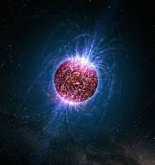

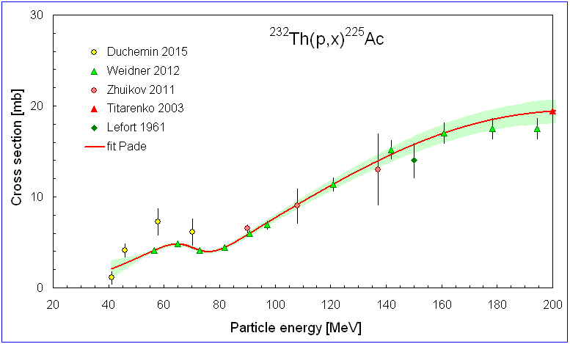
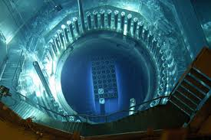
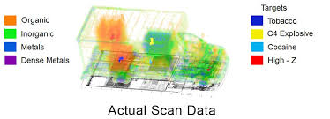
Summary and Future
To personalized medicine
From stars and moons
To energy and security
Nuclear data forms an essential component of an amazingly diverse sets of applications – in addition to addressing fundamental nuclear physics questions

