Slide 1
WANDA 2020
Neutron Induced Gamma
Production and Gamma Decay Session
Lee Bernstein
Department of Nuclear Engineering
University of California – Berkeley
Nuclear Science Division
Lawrence Berkeley National Laboratory
Andrew S. Voyles
13 June 2018 – Program Review for NSSC2 – TA1

Slide 2
This topic has been a perennial favorite of these meetings…
NDNCA (2015)
NDEM (2016)
1. Dosimetry Standards
2. Fission
3. Decay Data and γ-Branching Ratios
4. Neutron Transport Covariance Reduction
5. Expanded Integral Validation
6. Antineutrinos from Reactors
Improving the Pipeline infrastructure
Improved Covariance Data
Inelastic Scattering on actinides
Capture gamma spectra
Improved Fission yields
Target Prod. to Support ND Experiments
WANDA (2019)
NDREW (2019)
Nuclear Data for Isotope Production
Safeguards
Materials Damage
Nuclear Data for Nuclear Energy
(n,x) reactions
Atomic Data, NRF Data
Uncertainty, Sensitivity, and Covariance
Neutron Capture and Associated Spectra
Fission I, Independent and Cumulative Yields
Gamma-Induced Reactions
Inelastic Neutron Scattering & Assoc. Spectra
Fission II, Prompt Gammas and Neutrons
(α,n) Reactions
Targets, Facilities and Detector Systems
Fission III, Decay Data
Development of Benchmark Exercises
Data Processing & Transport Code Needs
Actinide Cross Sections
WANDA (2020)
Covariance/Uncertainty/Sensitivity/Validation
Nuclear Data for Isotope Prod. and Targetry needs
Machine Learning/Artificial Intelligence
Detector Models, Atomic Data & Stopping Powers
Scattering, Transport and Shielding
Neutron induced gammas and gamma decay

Slide 3
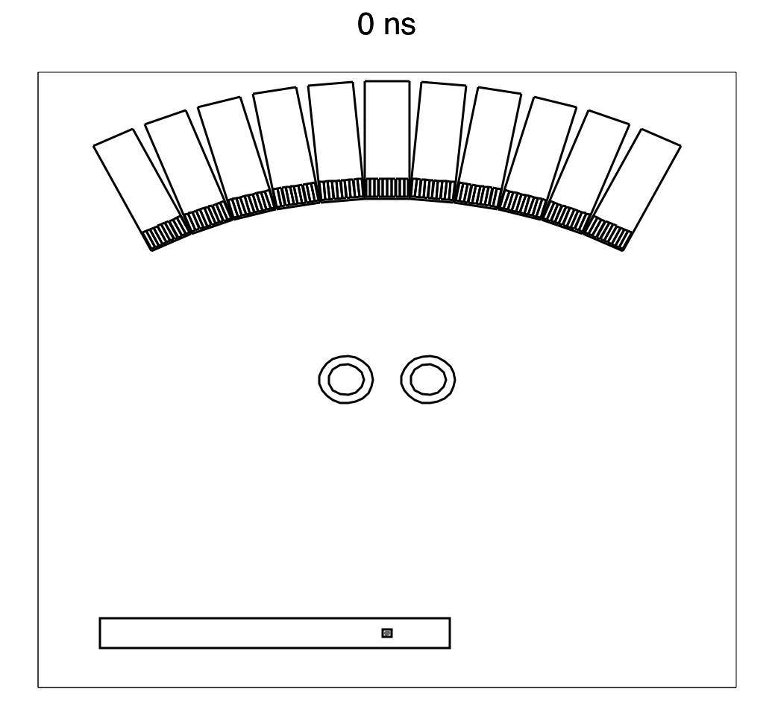
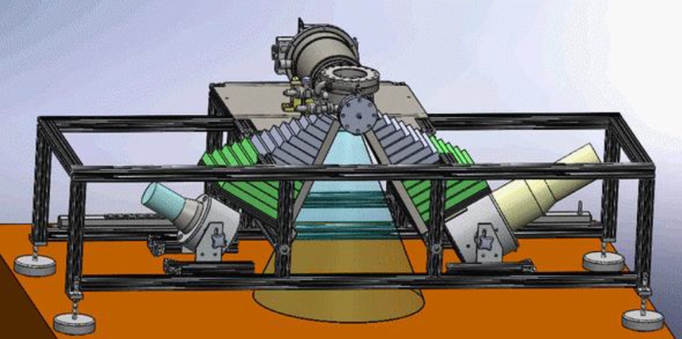
We saw that prompt (n,xγ) data was valuable for hydrocarbon production, carbon sequestration, space exploration and nonproliferation
McConchie
Ayllon
(n,xγ)
data
Ressler
Active Interrogation
Space Exploration &
Planetary Defense
Sensors + Electronics
Formation to be measured
Casing + Cement
Mauborgne
Ayllon
Oil Well Logging
Carbon Sequestration

Slide 4
The status of measured nuclear (n,xγ) data across the chart of nuclides from NSR since 1950
Reaction | Quantity | # of ref.
(n,γ) | all | 6278
(n,γ) | thermal | 4270
(n,γ) | thermal+γ-spec | 1294
(n,γ) | epithermal | 37
(n,γ) | epithermal+γ-spec | 26
(n,γ) | keV+γ-spec | 522
(n,γ) | MeV+γ-spec | 369
Reaction | Quantity | # of ref.
(n,np) | All | 163
(n,np) | 14 MeV | 12
(n,np) | γ-spec | 13
(n,nα) | γ-spec | 13
Reaction | Quantity | # of ref.
(n,2n) | all | 956
(n,2n) | γ-spec | 224
(n,2n) | 14 MeV | 90
(n,2n) | 14 MeV+γ-spec | 21
Reaction | Quantity | # of ref.
(n,n') | all | 2157
(n,n') | γ-spec | 781
(n,n') | 14 MeV | 92
(n,n') | 14 MeV+γ-spec | 14
Reaction | Quantity | # of ref.
(n,f) | all | 3113
(n,f) | γ-spec | 376
(n,f) | 14 MeV+γ-spec | 14
The data collected reflects the interest and capabilities available over the last 71 years

Slide 5
The status of measured nuclear (n,xγ) data across the chart of nuclides from NSR
Reaction | Quantity | # of ref.
(n,γ) | all | 6278
(n,γ) | thermal | 4270
(n,γ) | thermal+γ-spec | 1294
(n,γ) | epithermal | 37
(n,γ) | epithermal+γ-spec | 26
(n,γ) | keV+γ-spec | 522
(n,γ) | MeV+γ-spec | 369
Reaction | Quantity | # of ref.
(n,np) | All | 163
(n,np) | 14 MeV | 12
(n,np) | γ-spec | 13
(n,nα) | γ-spec | 13
Reaction | Quantity | # of ref.
(n,2n) | all | 956
(n,2n) | γ-spec | 224
(n,2n) | 14 MeV | 90
(n,2n) | 14 MeV+γ-spec | 21
Reaction | Quantity | # of ref.
(n,n') | all | 2157
(n,n') | γ-spec | 781
(n,n') | 14 MeV | 92
(n,n') | 14 MeV+γ-spec | 14
Reaction | Quantity | # of ref.
(n,f) | all | 3113
(n,f) | γ-spec | 376
(n,f) | 14 MeV+γ-spec | 14
…BUT much of that was NOT focused on γ-ray production

Slide 6
The status of measured nuclear (n,xγ) data across the chart of nuclides from NSR
Reaction | Quantity | # of ref.
(n,γ) | all | 6278
(n,γ) | thermal | 4270
(n,γ) | thermal+γ-spec | 1294
(n,γ) | epithermal | 37
(n,γ) | epithermal+γ-spec | 26
(n,γ) | keV+γ-spec | 522
(n,γ) | MeV+γ-spec | 369
Reaction | Quantity | # of ref.
(n,np) | All | 163
(n,np) | 14 MeV | 12
(n,np) | γ-spec | 13
(n,nα) | γ-spec | 13
Reaction | Quantity | # of ref.
(n,2n) | all | 956
(n,2n) | γ-spec | 224
(n,2n) | 14 MeV | 90
(n,2n) | 14 MeV+γ-spec | 21
Reaction | Quantity | # of ref.
(n,n') | all | 2157
(n,n') | γ-spec | 781
(n,n') | 14 MeV | 92
(n,n') | 14 MeV+γ-spec | 14
Reaction | Quantity | # of ref.
(n,f) | all | 3113
(n,f) | γ-spec | 376
(n,f) | 14 MeV+γ-spec | 14
At least this looks pretty good, right?

Slide 7
The status of measured nuclear (n,xγ) data across the chart of nuclides from NSR
Reaction | Quantity | # of ref.
(n,γ) | all | 6278
(n,γ) | thermal | 4270
(n,γ) | thermal+γ-spec | 1294
(n,γ) | epithermal | 37
(n,γ) | epithermal+γ-spec | 26
(n,γ) | keV+γ-spec | 522
(n,γ) | MeV+γ-spec | 369
Reaction | Quantity | # of ref.
(n,np) | All | 163
(n,np) | 14 MeV | 12
(n,np) | γ-spec | 13
(n,nα) | γ-spec | 13
Reaction | Quantity | # of ref.
(n,2n) | all | 956
(n,2n) | γ-spec | 224
(n,2n) | 14 MeV | 90
(n,2n) | 14 MeV+γ-spec | 21
Reaction | Quantity | # of ref.
(n,n') | all | 2157
(n,n') | γ-spec | 781
(n,n') | 14 MeV | 92
(n,n') | 14 MeV+γ-spec | 14
Reaction | Quantity | # of ref.
(n,f) | all | 3113
(n,f) | γ-spec | 376
(n,f) | 14 MeV+γ-spec | 14
(n,f) | γ-spec-²³⁵U-HPGe | 5
(n,f) | γ-spec-²³⁸U-HPGe | 2
(n,f) | γ-spec-²³⁹Pu-HPGe | 1
Nope ☹ {

Slide 8
The status of measured nuclear (n,xγ) data across the chart of nuclides from NSR
Reaction | Quantity | # of ref.
(n,γ) | all | 6278
(n,γ) | thermal | 4270
(n,γ) | thermal+γ-spec | 1294
(n,γ) | epithermal | 37
(n,γ) | epithermal+γ-spec | 26
(n,γ) | keV+γ-spec | 522
(n,γ) | MeV+γ-spec | 369
Reaction | Quantity | # of ref.
(n,np) | All | 163
(n,np) | 14 MeV | 12
(n,np) | γ-spec | 13
(n,nα) | γ-spec | 13
Reaction | Quantity | # of ref.
(n,2n) | all | 956
(n,2n) | γ-spec | 224
(n,2n) | 14 MeV | 90
(n,2n) | 14 MeV+γ-spec | 21
Reaction | Quantity | # of ref.
(n,n') | all | 2157
(n,n') | γ-spec | 781
(n,n') | 14 MeV | 92
(n,n') | 14 MeV+γ-spec | 14
Reaction | Quantity | # of ref.
(n,f) | all | 3113
(n,f) | γ-spec | 376
(n,f) | 14 MeV+γ-spec | 14
(n,f) | γ-spec-²³⁵U-HPGe | 5
(n,f) | γ-spec-²³⁸U-HPGe | 2
(n,f) | γ-spec-²³⁹Pu-HPGe | 1
What do we need?
More Data! (G. Nobre)

Slide 9
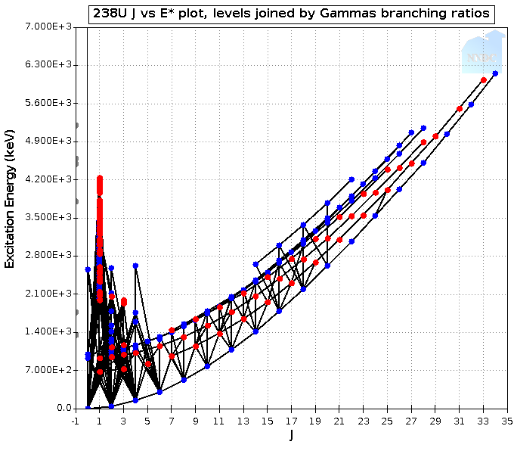
The existing data has lots of problems (McCutchan, Nobre, Lewis)
There are numerous inconsistencies between ENSDF and ENDF
ENSDF doesn’t have cross sections
ENDF has discrete and continuum γ’s
but is focused on transport, not spectra
There are no (n_{fast}, xγ_{spectral}) benchmarks
The Baghdad Atlas might help, but work is needed in determining the spectrum
ENDF
Here there be
“Easter Eggs”
ENSDF
⁶⁵Cu – ENSDF vs. ENDF
ENDF continuous
A consistent modeling treatment and database format (GNDS) is needed to address data throughout this region

Slide 10
A Path Forward – Formation of the Gamma Rays Induced by Neutrons (GRIN) task force ☺
Modeled on CRP/WPEC SG structure
Charge - Address outstanding needs throughout the pipeline:
Sensitivity Study for Active Interrogation (ORNL).
Compilation - Address missing/discrepant data between ENSDF and ENDF
New Experimental data – Clearly needed for (n,xγ) for E_{n} ≤ 14 MeV. Consistency between scattered neutron- and γ-ray data a must.
Evaluation – Put (n,xγ) into the evaluation process, conserving energy and angular momentum. Don’t just “paste” γ-ray spectra into ENDF (Is there a processing issue here?)
Validation – New high energy benchmarks (extend Baghdad Atlas range)
Essential for 14 MeV Active Interrogation on earth and in space

