Slide 1
The Centrality of Validation
“Validation as a Three-Body Problem”
Dr. Jerry N. McKamy
DOE Nuclear Criticality Safety Program Manager, Retired
Spectra Tech Senior Criticality Safety Consultant

Slide 2
Outline
Validation as a Three Body Problem
History/Background of Validation: Transforming from “prototype” to tests of underlying nuclear data.
Rise of and importance of S/U; Transitioning from qualitative to quantitative area of applicability
CeDT Process Developed and Applied To Ensure Which of the Underlying Problems are Targeted with Sufficient Precision and Accuracy to be effective
Wrap Up/Summary

Slide 3
Validation as a three body problem
The calculated observables coming out of a Monte-Carlo code depend upon:
The physics and calculations of the code being accurate with no errors;
Having all needed differential nuclear data measured with known precision; and,
The evaluated nuclear data files used by the code accurately representing the differential nuclear data.
Every application of Monte-Carlo to a nuclear observable MUST have a validation system that verifies all the necessary conditions above are met and can produce a result of the desired precision and accuracy.
Evaluated nuclear data files contain compensating errors and these are reaction channel and energy dependent. Slight changes in the neutron energies can remove the undetected compensating error.
Flying blind can produce unacceptably large and unquantified errors in calculated observables.

Slide 4
A Brief History of Validation
ANSI/ANS-8.1 requires that criticality safety limits be based on direct comparison to experiment data or on computational methods validated by experiment data.
1943-1969 Era: Direct comparison to prototype integral experiment dominates (e.g. underground nuclear weapons testing, Pajarito Site at LANL, etc.).
1969-1985 Era: Prototype integral experiments and Monte-Carlo co-equal. Every nuclear weapons site had a critical mass lab (Hanford, LLNL, LANL, ORNL, and Rocky Flats).
1985-Present Era: Monte-Carlo dominates with validation focused on precision and accuracy of underpinning basic and evaluated nuclear data (last underground nuclear test was in 1992; last critical mass lab standing was Pajarito Site by 1994).
1990’s brings the end of nuclear structure investigations as active university research areas. Basic differential nuclear physics data frozen in time as is nuclear theory. Everything has NOT been measured and what has been measured was NOT driven to the accuracy and precision required to produce a given end uncertainty in a modern code-calculated observable.

Slide 5
The Reformation of Validation
1985 – Anderson and McKamy at Rocky Flats make the following observations:
Criticality experiments for validation must focus on testing the energy dependent neutron cross-sections in the application.
All extant validation experiments can be characterized as either purely thermal, purely fast, or a coupled fast-slow system. No tests of the intermediate energies exist.
Experimental uncertainties of existing integral data are at least 2% in k_{eff} and must be reduced to produce meaningful tests of underlying nuclear data.
Propose true intermediate energy integral experiments (NESVEX)
1992 Rocky Flats Organizes the “Area(s) of Applicability Workshop” under the leadership of Dr. Paul Felsher and Dr. Sean Monahan
1992 DOE Defense Programs (Chung) establishes the ICSBEP.

Slide 6
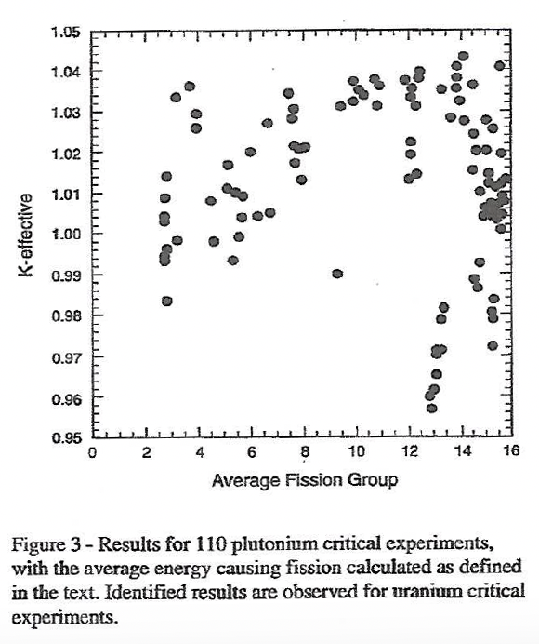
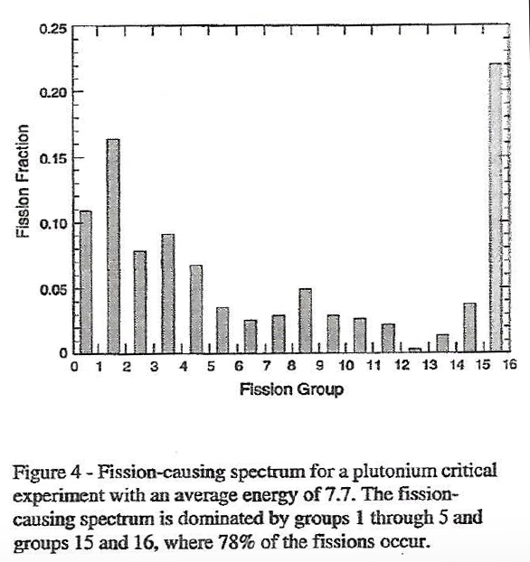
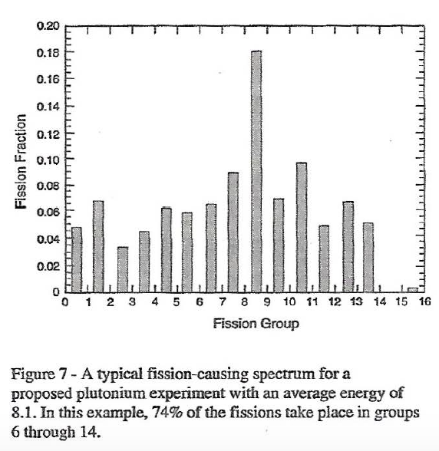
The case for intermediate energy experiments
“Validation Experiments In Nuclear Criticality Safety,” R.E. Anderson & J.N. McKamy, Proceedings of the Topical Meeting on Physics and Methods in Criticality Safety, 1993

Slide 7
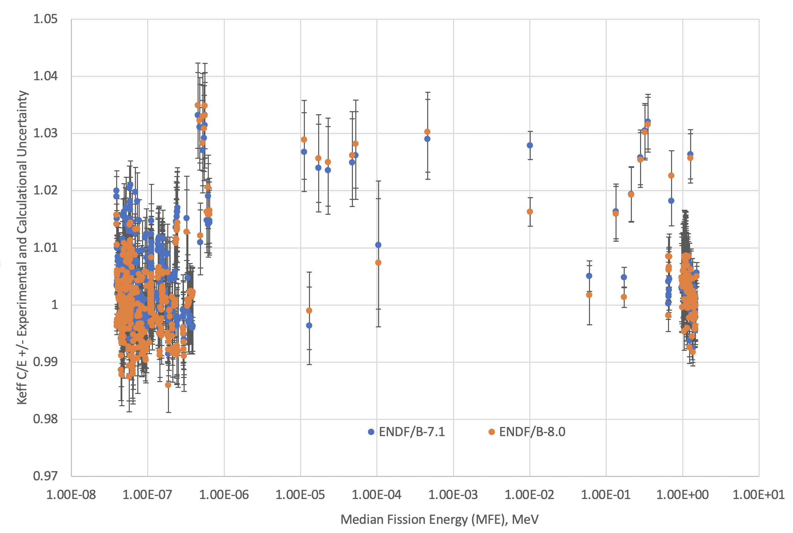
International Criticality Safety Benchmark Evaluation Project- 748 Plutonium Benchmarks
Benchmarks calculated with COG10 in 2019 by LLNL, C/E plotted versus Median Fission Energy (MFE)

Slide 8
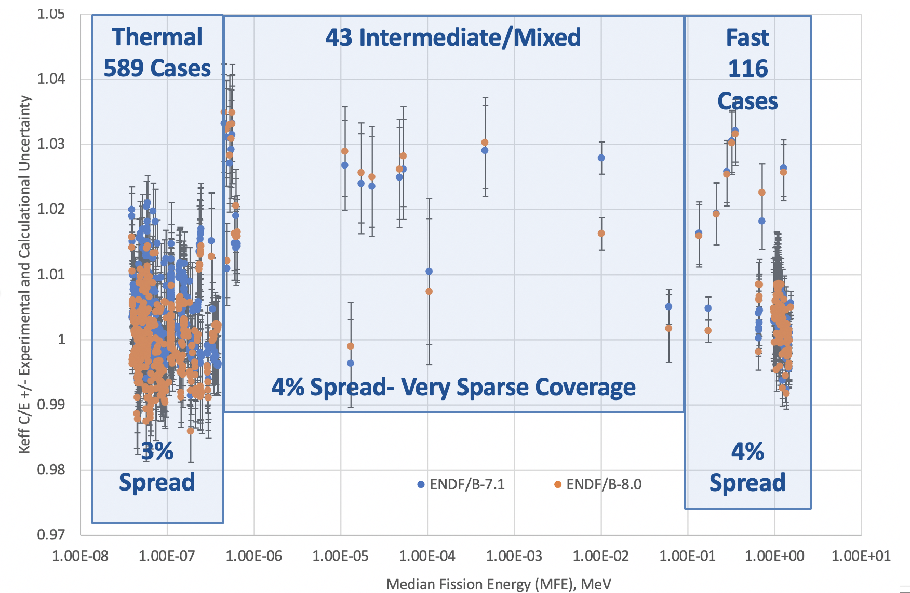
International Criticality Safety Benchmark Evaluation Project- 748 Plutonium Benchmarks
Benchmarks calculated with COG10 in 2019 by LLNL, C/E plotted versus Median Fission Energy (MFE)

Slide 9
From Qualitative to Quantitative
1993 – DNFSB Recommendation 93-2 preserves Pajarito Site and prevents DOE from eliminating integral critical experiment capability. Thank you Dr. Herb Kouts!!
1997 – DNFSB Recommendation 97-2 broadens 93-2 to include the overall infrastructure and pipeline supporting criticality safety including one specific recommendation to develop a capability to develop and share data that are not plant/site/process specific.
DOE developed the AROBCAD (AReas Of Bounding Curves And Data) initiative at ORNL under the leadership of Calvin Hopper. This gave birth to quantitative sensitivity and uncertainty analysis by reaction channel and neutron energy for characterizing applications and corresponding benchmark experiments. This evolved into what we know as TSUNAMI for SCALE and later on, WHISPER for MCNP.
2004 - DOE NCSP developed and instituted a process to design critical experiments focused on the quantitative match between S/U analysis of the application and the benchmark experiment and including quantitative estimates of experimental uncertainty to test specific reaction channels in specific energy regimes. This is called the ”Critical/Sub-Critical Design Team” (C_{e}dT) approach.

Slide 10
The Integrated nuclear criticality safety program
The DOE Nuclear Criticality Safety Program is designed precisely to maintain and improve the surety of the calculational tools used by nuclear data practitioners with an emphasis on nuclear criticality safety applications. Every element of the Validation Three Body Problem is addressed.

Slide 11
Wrap Up
The NCSP nuclear data and methods infrastructure has been utilized to solve real world application problems such as U233 down-blending at ORNL.
Any program that relies on Monte-Carlo calculated observables based on evaluated nuclear data sets MUST ensure the surety of their Validation Three Body Problem to:
Understand the specific nuclear physics of their application,
Validate the applicability of the code/method and underlying evaluated nuclear data sets for their specific application (inter-code comparison, vary cross-section sets used, use S/U methods to select applicable existing benchmarks, etc.),
If the bias and uncertainty in the bias of the available validation result is unacceptably large, use C_{e}dT methodology to design tailored physics benchmarks to reduce the bias and uncertainty in the bias targeted at specific nuclear reactions driving the final result, and
Use all this insight to drive either new differential measurements or new evaluations of the nuclear data (feedback and improvement).
You don’t know what you don’t know! Theory must always be tested by experiment.

