Slide 1


National Nuclear Security Administration
WANDA 2021: Nuclear Data for Defense Nuclear Nonproliferation Applications
David Matters, NNSA/NA-221
DNN R&D, Office of Proliferation Detection
January 27, 2021

Slide 2
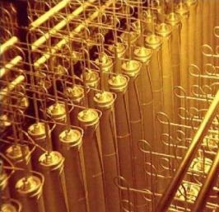
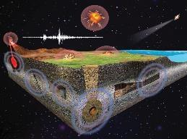
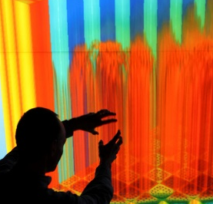
Defense Nuclear Nonproliferation (DNN) Research and Development (R&D)
Advance U.S. nuclear security capabilities, in close coordination with mission Partners, using DOE National Laboratories, Universities, & Industry
Detect Foreign
Weapons
Activities
Increase
Nuclear
Security
Detect Nuclear
Explosions
Steward
Nonproliferation
Capabilities
Develop timely early proliferation detection capabilities
  Capabilities to detect, locate & characterize foreign nuclear weapons development activities
  Capabilities to detect presence, movement & diversion of SNM, including for interdiction, emergency response, safeguards
  Develop, produce, & deliver capabilities for detecting & monitoring ground-, atmospheric-, & space-based nuclear detonations
Develop high-confidence verification and monitoring capabilities
Capabilities to detect, locate & characterize foreign nuclear weapons development activities
Capabilities to detect presence, movement & diversion of SNM, including for interdiction, emergency response, safeguards
Capabilities for detecting & monitoring ground-, atmospheric-, & space-based nuclear detonations
Enabling infrastructure, science, and technology, and an expert workforce to meet future nonproliferation challenges

Slide 3
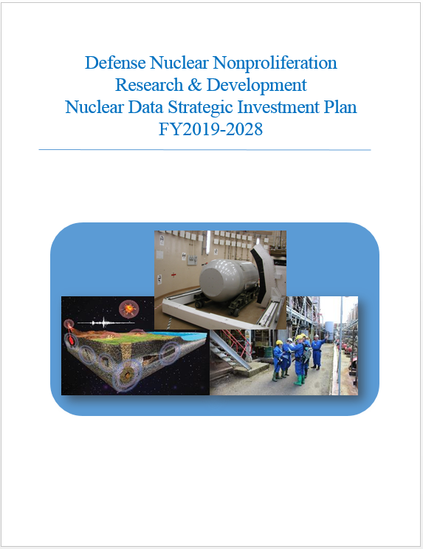
DNN R&D Support to Improve Nuclear Data
Between FY09-FY21, experimental and theoretical investments to improve nuclear data capabilities total ~$75M
Investments made by:
  NA-221 - Emergency Response, Safeguards, Arms Control Monitoring & Verification, and Near-field Detection
  NA-222 – Forensics
NDREW (2018) provided input for DNN R&D collectively organize nuclear data efforts
Participation in the Office of Nuclear Physics Interagency FOA in FY18 through FY22 (including current FOA)

Slide 4
Current Nuclear Data Projects in DNN R&D
2017-2022, ANL: Improving Antineutrino Spectra Predictions for Nonproliferation Applications
  Nuclear data for fission products (FP) needed to reliably predict reactor antineutrino spectra
  FP beams provided by the CARIBU facility, measurements w/Gammasphere
2018-2022, LLNL: Fission Products decay measurements of selected isotopes for nonproliferation applications
  Improving the Nuclear Data on Fission Product Decays at ANL’s CARIBU
2019-2023, LANL: Evaluation of Energy Dependent Fission Product Yields
  FPY data for 235U, 238U, and 239Pu isotopes using monoenergetic and pulsed neutron beams with energies from 0.5 MeV to 15.0 MeV
Schematic of beta particle detector array
Target chamber for installation in the Gammasphere detector array
Sample harvested at CARIBU
β-γ coincidence measurement

Slide 5
Focus of Projects for FY22 Interagency FOA
Scoping studies on neutron-induced emission, (α,n) reaction data, secondary γ-ray emission, non-actinide reaction networks, etc. have informed NA-22’s FOA input
Reconcile discrete gamma-ray energies, multipolarities, and branching ratios and primary/secondary gamma-ray spectral data between the ENDF/B-VIII.0 and ENSDF libraries.
Extend the Generalized Nuclear Database Structure format to include level density information and allow discrete levels in the continuum energy range. This extension enables primary-gamma triggered cascades (i.e., from neutron capture), including complete states up to the neutron separation energy and transitions from other unresolved states.
Review identified existing gamma production cross-section data for validity, assess any unvalidated existing cross-section data for acceptability to correct existing cross-section data, or fill in missing cross-section data.
Perform new gamma production cross-section measurements for incident neutron energies spanning from thermal to 14 MeV for identified, specific instances of incorrect or missing cross-sections.
Benchmarks
Notes:
Secondary gamma emission from active neutron interrogation provides a physical mechanism for unambiguously assessing the isotopic composition of an object (i.e., material identification). These measurements typically involve a neutron source which interrogates an object and an array of gamma-ray detectors which measure induced gamma-ray energies.
For some applications this technique can provide bulk material assay where X-ray resonance fluorescence is infeasible, such as for explosives and chemical warfare agent detection. In the 4
oilfield industry this technique provides a means of characterizing the oil well environment during hydrocarbon exploration. Areas of direct interest to DNN R&D include emergency response and arms control and treaty verification.
Development of improved nonproliferation capabilities exploiting secondary gamma emission requires improvement in modeling tools and addressing identified nuclear data gaps in order to facilitate signature exploration, optimization of system design

Slide 6
Benchmark Data Needs
NA-22 has needs for improved benchmark data on a variety of elements that comprise structural and shielding materials, controlled or dangerous substances, and detector materials
Active neutron interrogation techniques are employed in a variety of nonproliferation applications
Modeling of secondary γ-ray emission from active neutron interrogation would benefit greatly from quality assurance checks with benchmark datasets
Improved γ-production cross sections are needed on priority elements
Benchmark data are primarily required from radiative capture (n,γ) and inelastic scattering (n,n’γ), depending on which cross sections dominate γ-ray production
 | First Priority | Follow-up | Remaining
 | H | He | F | Gd
 | C | Li | Mg | Bi
 | N | Be | P | Np
 | O | B | S | Am
 | Na | Cl | Ar
 | Al | Cr | K
 | Si | Mn | Ca
 | Fe | Ni | Ti
 | Cu | Ge | As
 | Pb | Br | Kr
 | W | Cd | Mo
 | U | I | Sn
 | Pu | Cs | Sb
 |  | La | Xe

