Slide 1
Containerization and microservices for nuclear data
Georg Schnabel
Nuclear Data Section
Division of Physical and Chemical Sciences NAPC
Department for Nuclear Sciences and Applications
IAEA, Vienna
Workshop for Applied Nuclear Data Activities
29 January 2021

Slide 2
Nuclear data pipeline
Compilation
Evaluation
Processing,
Verification
Validation
Applications

Slide 3
Collaborative effort of experts
Compilation
Evaluation
Processing,
Verification
Validation
Applications

Slide 4
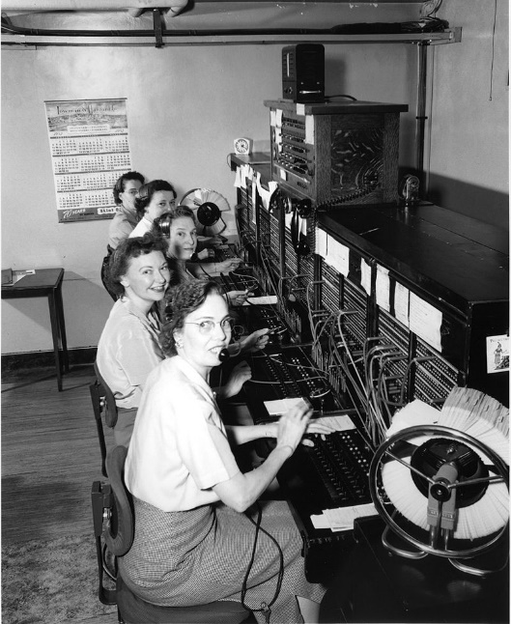
Technical overhead
Cluster
Compilation
Seattle Municipal Archives
Evaluation
Processing,
Verification
Validation
Applications

Slide 5
Empower great minds
Cluster
Seattle Municipal Archives
Compilation
Evaluation
Processing,
Verification
Validation
Applications

Slide 6
Automation
Cluster
Compilation
Examples:
BNL Advance
OECD NEA V&V system
Evaluation
Processing,
Verification
Validation
Applications

Slide 7
Microservices
Data from EXFOR DB
Q&A Service
Evaluation
Verification
service
Model predictions

Slide 8
Microservices
Data from EXFOR DB
Q&A Service
Evaluation
service
Verification
service
Model predictions

Slide 9
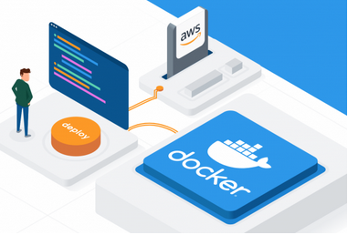
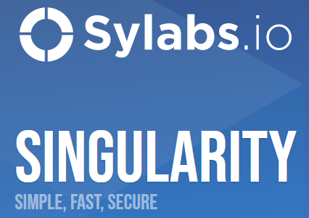
Containerization
“A container is a standard unit of software that packages up code and all its dependencies so the application runs quickly and reliably from one computing environment to another. A Docker container image is a lightweight, standalone, executable package of software that includes everything needed to run an application: code, runtime, system tools, system libraries and settings.” (quoted from www.docker.com)
https://www.docker.com

Slide 10
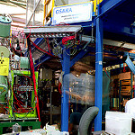
Evaluation with advanced statistical processing
Experiments
Model
Levenberg-Marquardt
algorithm
rule-based covariances
GNLLS
Gaussian processes
for energy-dependent
parameters
uncertainty correction (MLO)
925 TALYS parameters considered
144 TALYS parameters adjusted
4322 experimental data points
In this work: parallel computing on ~80 CPU cores sufficient; statistical inference could benefit from use of GPU in the future (but not the bottleneck at present)
[2009.00521] Conception and software implementation of a nuclear data evaluation pipeline (arxiv.org)

Slide 11
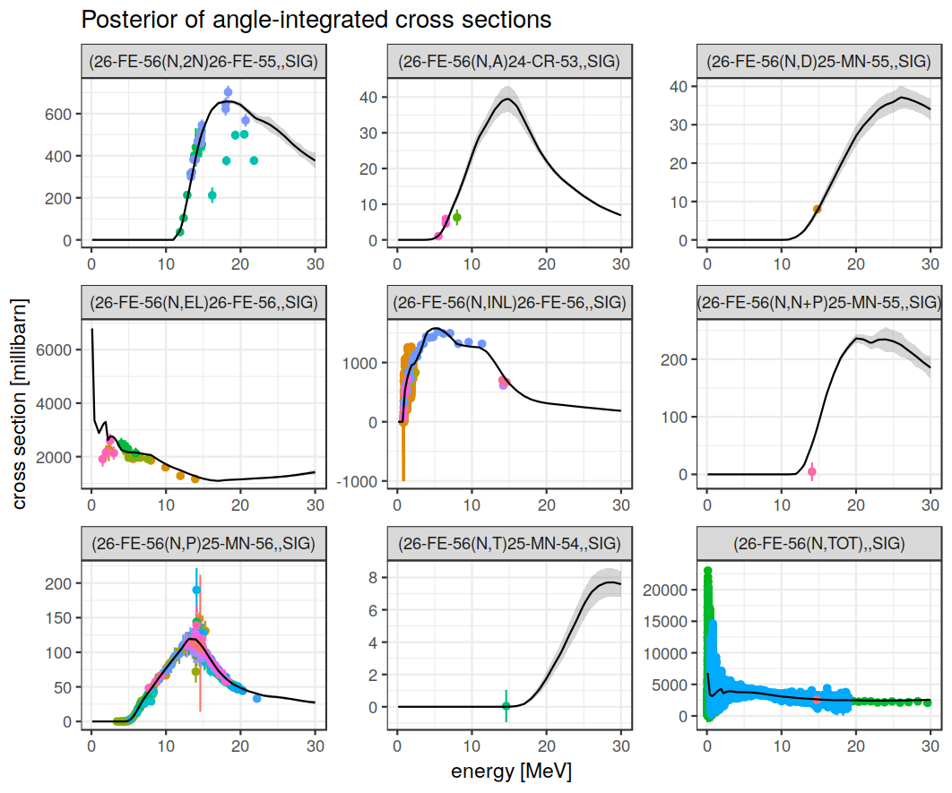
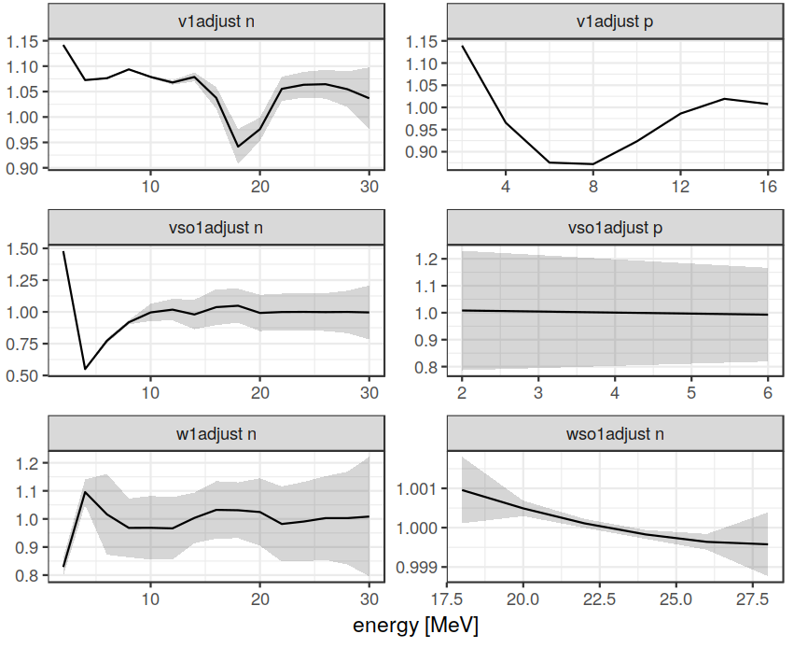
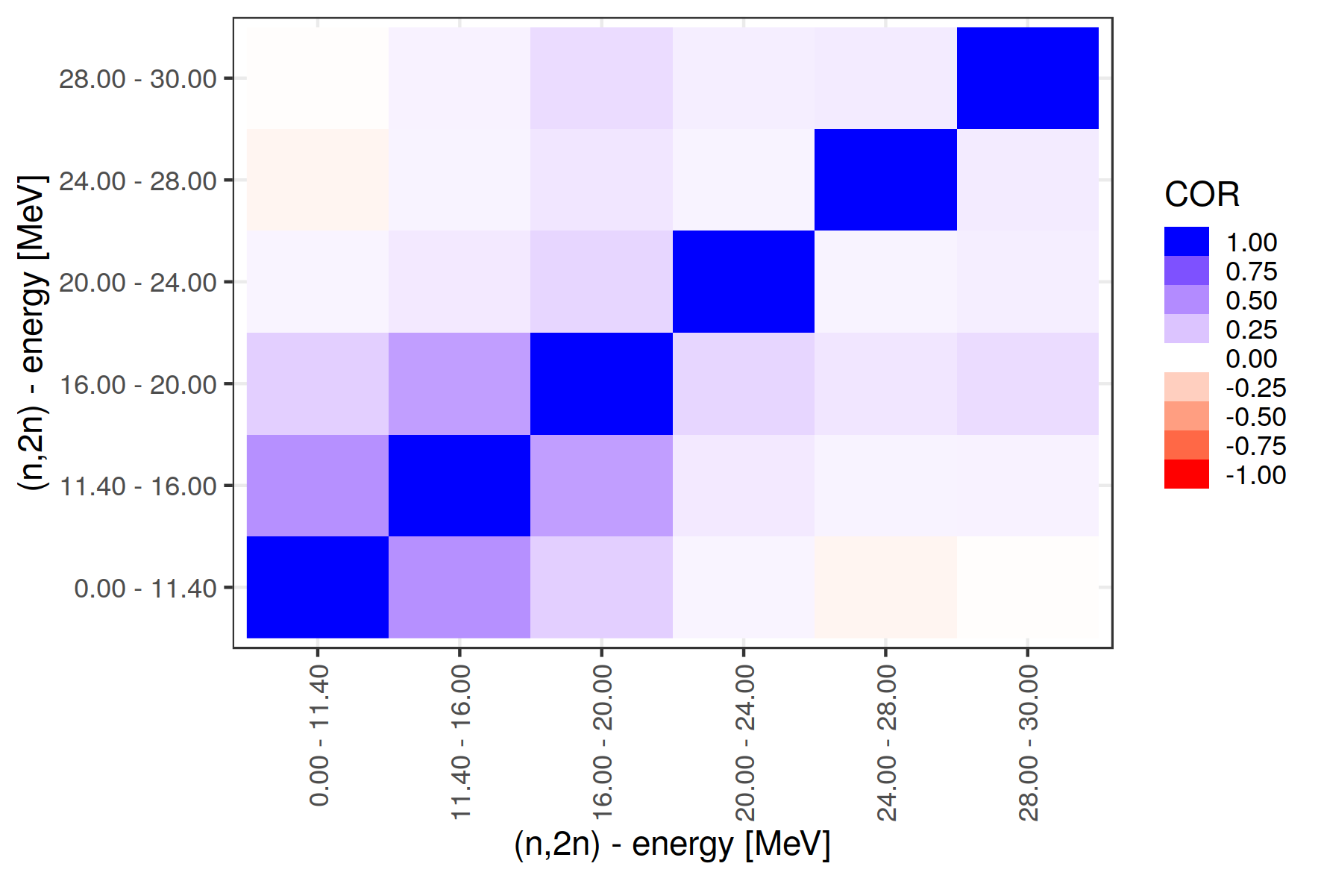
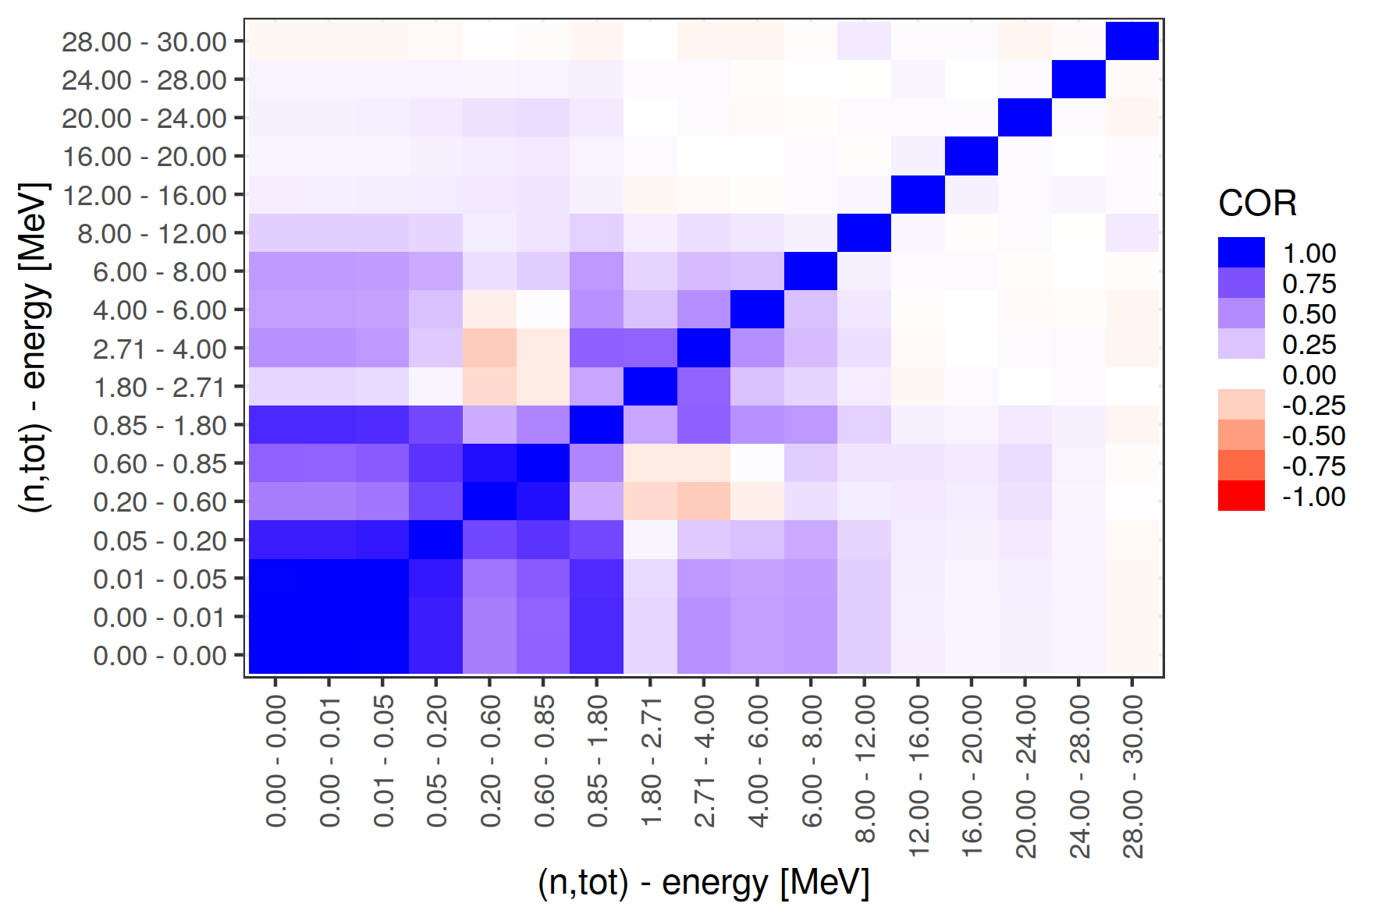
Results

Slide 12
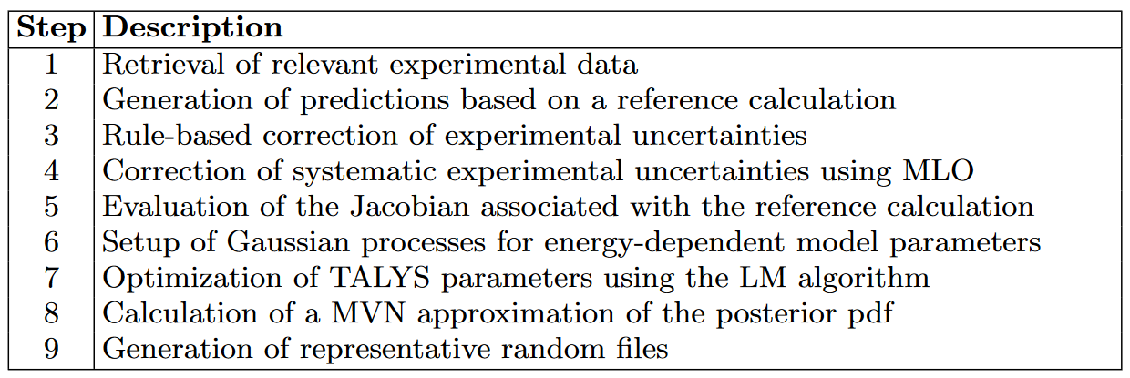
Evaluation as pipeline

Slide 13
Evaluation as pipeline
Database interaction
Model calculation on
computer cluster

Slide 14
Implemented Containers
EXFOR DB Container
Pipeline Container
Computation container
Database software
Data retrieval
Model and processing codes
Model fitting
Writing output
Current limitations:
- Pipeline container specialized to Fe56,
- Communication with computation container coupled to R programming language

Slide 15
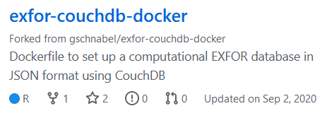
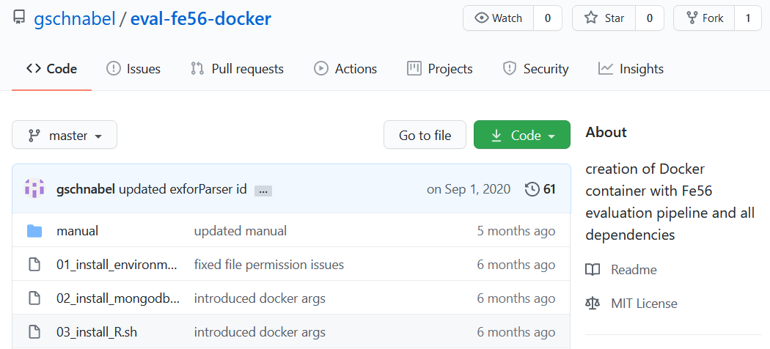
Advantages
Composability
Transparency
Extensibility
Reusability
Transferability
Reproducibility
Collaboration
docker run -it -p 9090:8787 \
-v outdata:/home/username/eval-fe56/outdata \
-v talysResults:/home/username/talysResults \
-v /dev/shm:/dev/shm \
-e extUID=<UID> -e extGID=<GID>
-e maxNumCPU=32 \
--name eval-fe56-cont eval-fe56-img test_eval

Slide 16
Nuclear data pipeline
Cluster
Compilation
Examples:
BNL Advance
OECD NEA V&V system
Evaluation
Processing,
Verification
Validation
Applications

Slide 17
Conclusion
Nuclear data pipeline requires diverse expertise and depends on a variety of codes
Microservices for nuclear data enable human experts to write evaluation scripts concisely codifying what data should be used and what should be done with it
Microservices as containers allow their easy shipping and reuse
Prototypes of a nuclear database container and evaluation container available online

Slide 18
Outlook & Challenges
Interaction with containers should be language agnostic, e.g., use widely employed data structures and protocols
Microservices & data should be discoverable and usable, i.e., the conception that something is stored somewhere on a specific architecture becomes more and more irrelevant
(Simple) Programmatic access to databases, model codes, statistical microservices and compute power will be an accelerator for AI/ML as enabling technology

Slide 19
Thank you for your attention!
Thanks to my collaborators:
Henrik Sjöstrand, Joachim Hansson, Dimitri Rochman, Arjan Koning, Roberto Capote

Slide 20
Links & References
Pipeline paper: https://arxiv.org/abs/2009.00521
Pipeline code: https://github.com/gschnabel/eval-fe56
EXFOR CouchDB database: https://github.com/IAEA-NDS/exfor-couchdb-docker

