Slide 1
Neutron Energy Effects on Asteroid Deflection
Workshop for Applied Nuclear Data Activities
(WANDA 2021)
Lansing S. Horan, IV
MS Nuclear Engineering Class 20M
Air Force Institute of Technology
29 January 2021

Slide 2
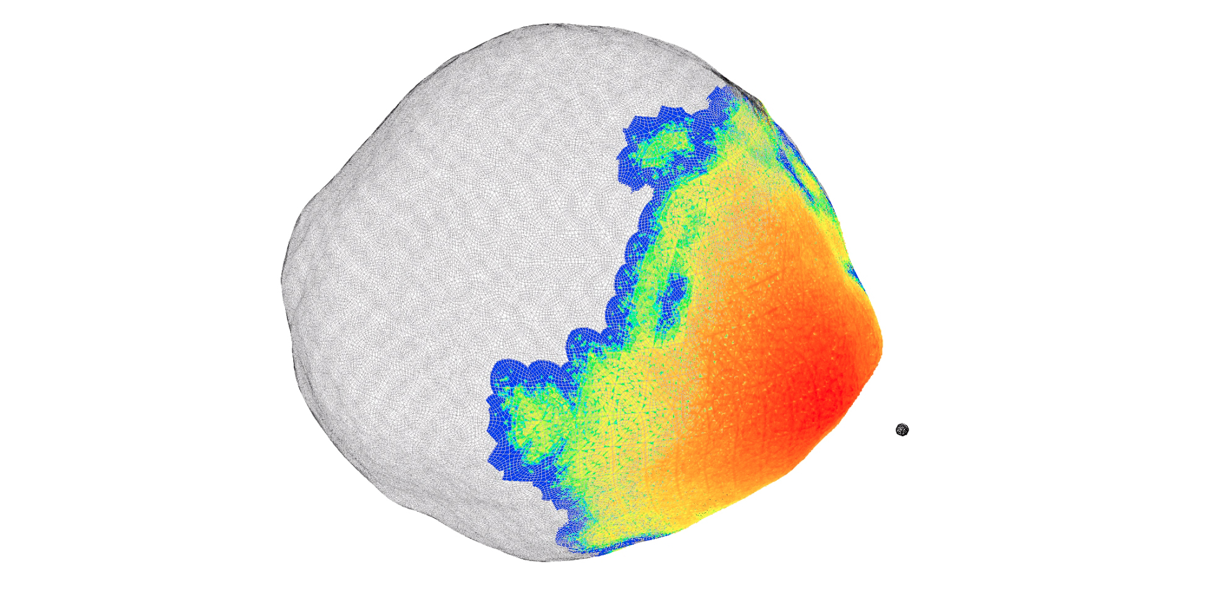
Overview
Background & Motivation
Role of Nuclear Data
Energy Deposition & Deflective Response
Summary & Conclusions
https://www.llnl.gov/news/nuclear-impulse-could-deflect-massive-asteroid

Slide 3
1. Background & Motivation

Slide 4
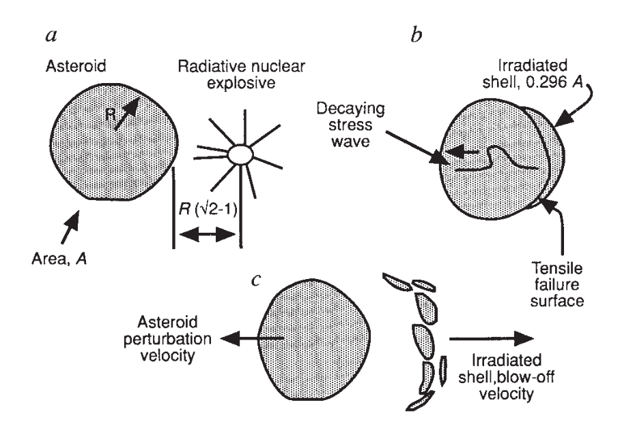
How does asteroid deflection via a stand-off nuclear detonation work?
Thomas Ahrens & Alan Harris. Deflection and fragmentation of near-Earth asteroids. Nature, 1992.
Newton’s Law of Conservation of Momentum.
Notes:
Detonate a nuclear device some distance away from an asteroid target.
A fraction of the asteroid’s surface area is irradiated, and radiation energy (neutrons, gammas, x-rays) is deposited.
Due to a nearly-instantaneous increase in internal energy and temperatures, a pressure wave is formed in the asteroid. As the pressure wave propagates, and as the melted/vaporized material has had enough time to finally respond and move, it blows-off the surface and carries momentum with it. In space, you’re surrounded by a vacuum. This is the perfect environment for Newton’s Law of Conservation of Momentum. The remaining, majority asteroid body is given an impulse of momentum that is equal and opposite of the blow-off momentum. By giving the asteroid some momentum, you change its velocity. THAT is asteroid deflection – changing the velocity of the asteroid slightly will change the timing of its orbit and hopefully mean that it misses the Earth entirely.

Slide 5
Nuclear deflection is an established concept. But, open-question: which neutron energy is best?
Problem: Does the neutron energy affect asteroid deflection?
Hypothesis: Affirmative.
Why? Neutrons of different energies can interact very differently when they traverse the same material, which can change:
energy deposition profiles
energy coupling efficiencies
Why does this matter? This type of research could help determine which type of device outputs are most effective for deflecting asteroids, and whether altering the neutron energy spectrum would ever be worthwhile.

Slide 6
Specifications of the sources and the target considered in this work.
Sources:
Neutron energies – 14.1 MeV (fusion) & 1 MeV (fission)
Neutron yield – 50 kt
Stand-off distance ~ 62 m from asteroid
Target:
300 m diameter asteroid, perfectly spherical
SiO₂ @ 2.65 g/cc, with 30% porosity (1.855 g/cc bulk density)
Phase I, Neutron Energy Deposition.
Sources were simulated in MCNP6.2,
a Monte Carlo radiation transport code.
Phase II, Asteroid Deflective Response.
Target was simulated in ALE3D,
a hydrodynamic material response code.

Slide 7
2. Role of Nuclear Data

Slide 8
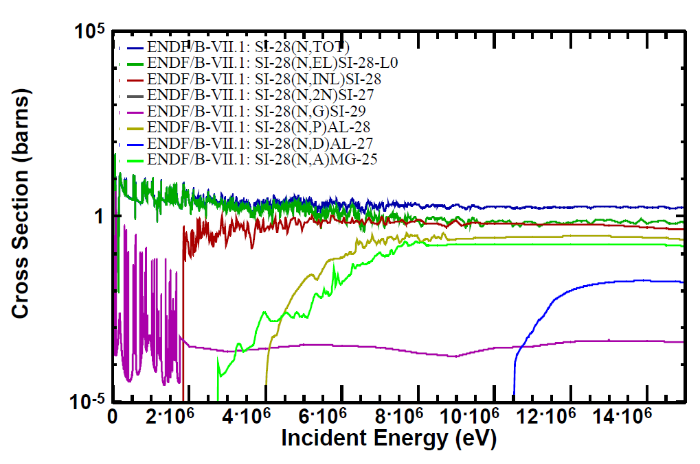
Nuclear data is the very foundation of this work.
For a given problem geometry and material composition, nuclear cross sections are how bulk neutron interactions are mapped to energy deposition profiles.
changing the neutron energy changes:
cross section magnitude
mean-free-path
spatial extent/distribution
energy deposition profiles
changing the neutron energy changes:
open/closed reaction channels
endothermic/exothermic reactions
energy coupling efficiencies
Nuclear data ultimately determines the end results of asteroid deflection.

Slide 9
3. Energy Deposition & Deflective Response

Slide 10
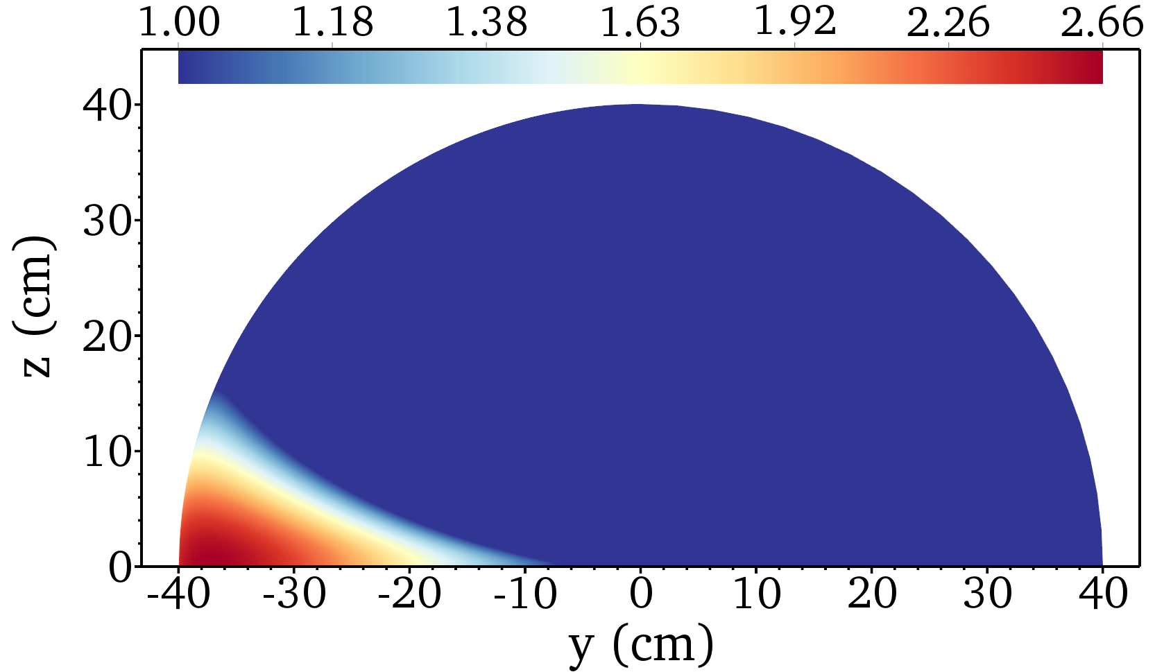
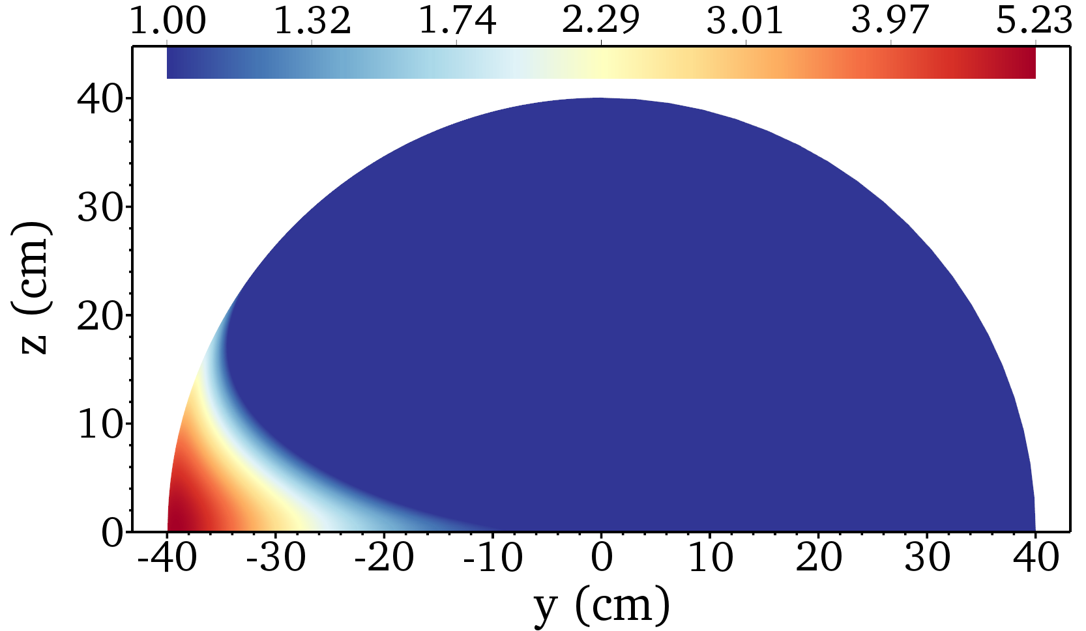
Input: nuclear cross section data Output: energy deposition
MCNP
14.1 MeV neutrons
max melt depth ~33 cm
max melt angle ~22.5°
peak intensity ~2.66X melt threshold
coupling efficiency ~69%
1 MeV neutrons
max melt depth ~31 cm
max melt angle ~35°
peak intensity ~5.23X melt threshold
coupling efficiency ~109%

Slide 11
ALE3D
Input: energy deposition Output: deflection velocity change
For a 50 kt neutron yield, the deflection velocity change, 𝛿V, is 61% higher for 1 MeV neutrons vs 14.1 MeV neutrons.
In some respects, for certain deflection scenarios, devices with greater 1 MeV neutron outputs can be more effective at deflecting asteroids than 14.1 MeV neutrons.

Slide 12
4. Summary & Conclusions

Slide 13
All of my results depend on the underlying nuclear data that I accessed, and how I accessed it.
I used ENDF/B-VII.1 cross section libraries via MCNP6.2.
Preliminary work with Mercury (discontinued due to lack of time): energy deposition trends were in agreement, but some unresolved quantitative differences vs. MCNP.
ENDF/B-VII is not the newest U.S. library (ENDF/B-VIII.0), nor did I get to consider/compare to JENDL, KAERI, etc. libraries.
MCNP’s energy deposition (radiation) w/high-fidelity nuclear data was only loosely coupled to ALE3D’s deflective response (hydrodynamics) – time-dependence of neutron energy deposition warrants further investigation.
Accuracy/precision of cross sections is paramount to correct energy deposition: any changes to cross section data could have significant effects on the end results.

Slide 14
Acknowledgements.
LLNL Planetary Defense Group Collaborators
Dr. Megan Bruck Syal
Dr. Joseph Wasem
AFIT Faculty
Dr. Darren Holland, thesis research advisor
Maj James Bevins, Ph.D.
Dr. John McClory
NNSA, under grant NA000103
SMART Scholarship, with AFTAC as sponsoring facility

Slide 15
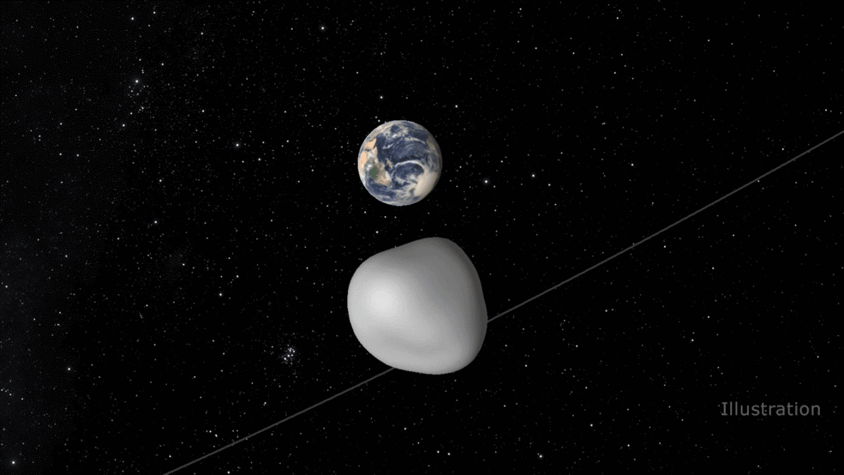
Questions?
NASA/JPL-Caltech: https://www.nasa.gov/feature/jpl/asteroid-flyby-will-benefit-nasa-detection-and-tracking-network

Slide 16
Summary & Conclusions.
Problem: Does the neutron energy affect asteroid deflection?
Hypothesis: Affirmative. Confirmed.
Why? Because changing the neutron energy means changing the:
energy deposition profiles
energy coupling efficiencies
Why does this matter? This type of research could help determine which type of device outputs are most effective for deflecting asteroids, and whether altering the neutron energy spectrum would ever be worthwhile.

Slide 17
Backup Slides

Slide 18
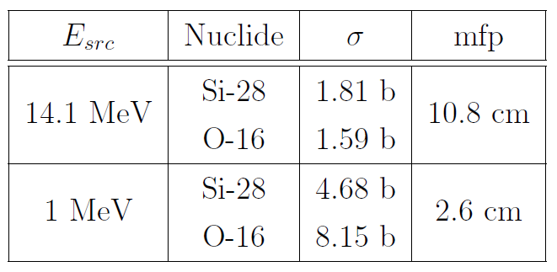
Two ways how changing the neutron interactions amounts to changing the energy deposition.
First: changing the neutron energy = changing total cross-section magnitude = changing the mean-free-path = changing the spatial extent/distribution of energy.
On average, 14.1 MeV neutrons are more penetrative than 1 MeV neutrons.

Slide 19
Two ways how changing the neutron interactions amounts to changing the energy deposition. (Cont.)
Second: changing the neutron energy = opening or closing reaction channels = changing the energy coupling.
Mass destroyed,
Energy created
Energy destroyed,
Mass created
Exothermic (+Q) reaction channels are a bonus for energy coupling, while endothermic (-Q) reactions draw a coupling penalty.

Slide 20
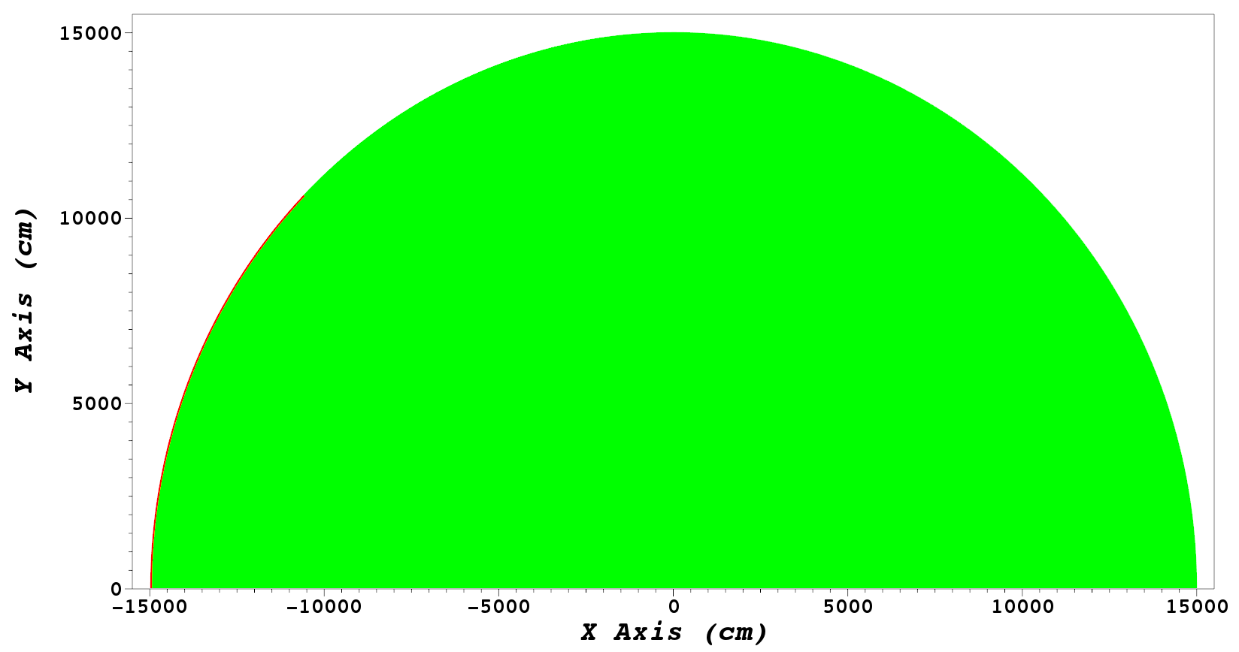
The region where some material is melted is very thin (in depth) and very long (in angle).
melt-depths ~ 19 cm up to 200 cm
arc-length ~ 11,781 cm
massive disparity

Slide 21
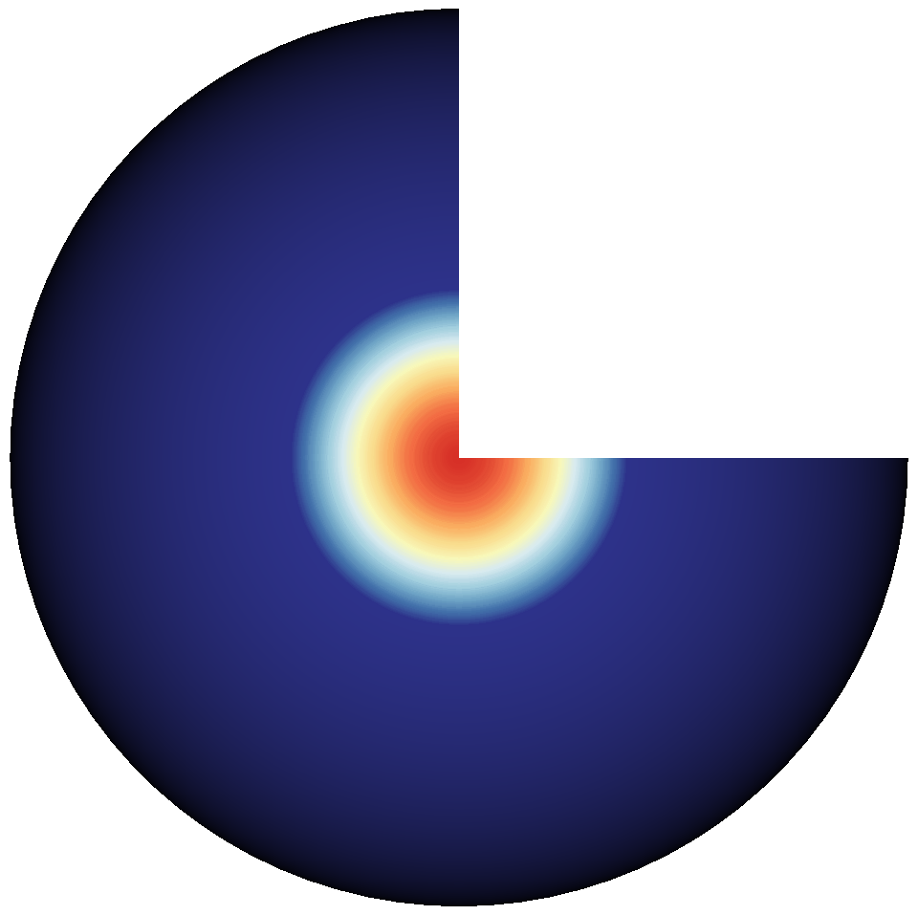
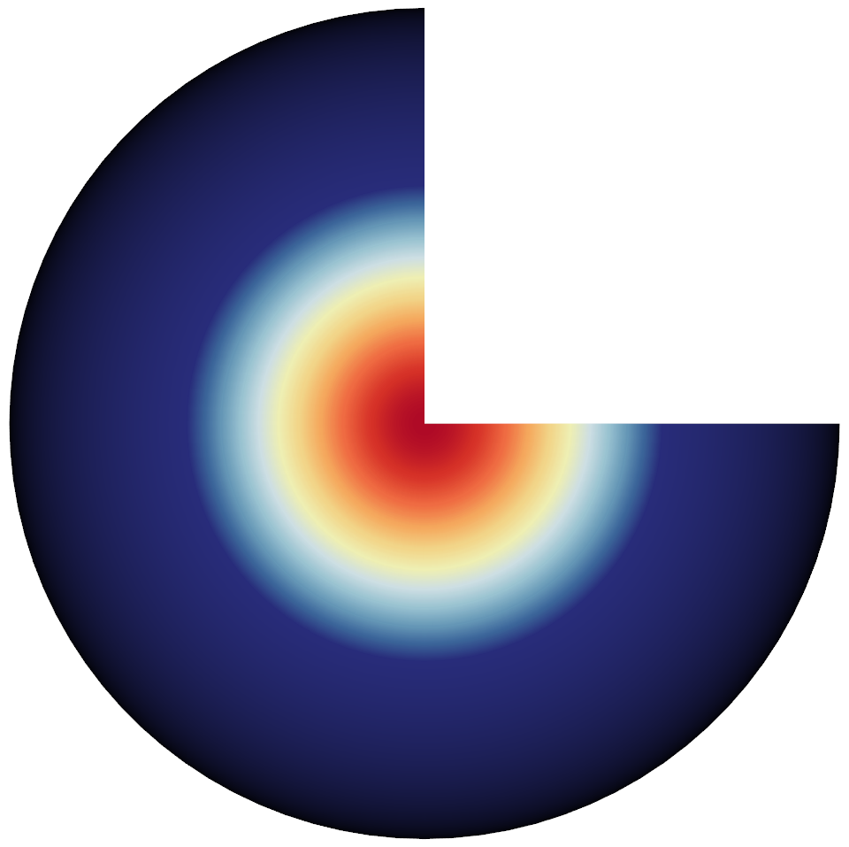
Energy deposition heatmap resulting from 50 kt’s worth of 14.1 MeV neutrons (left) and 1 MeV neutrons (right).

Slide 22
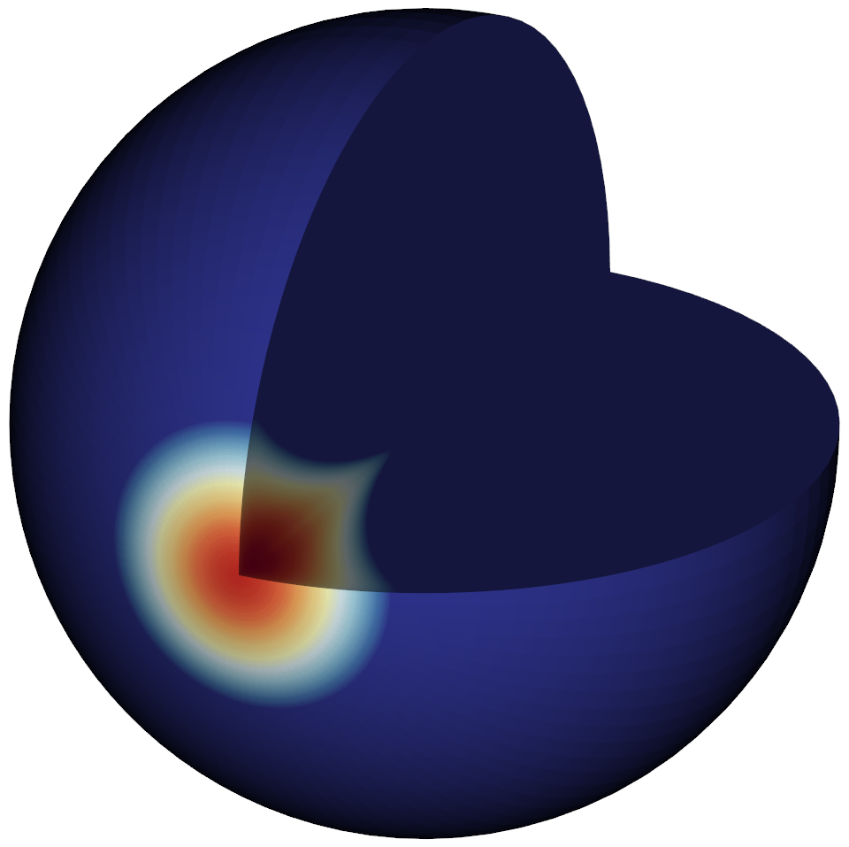
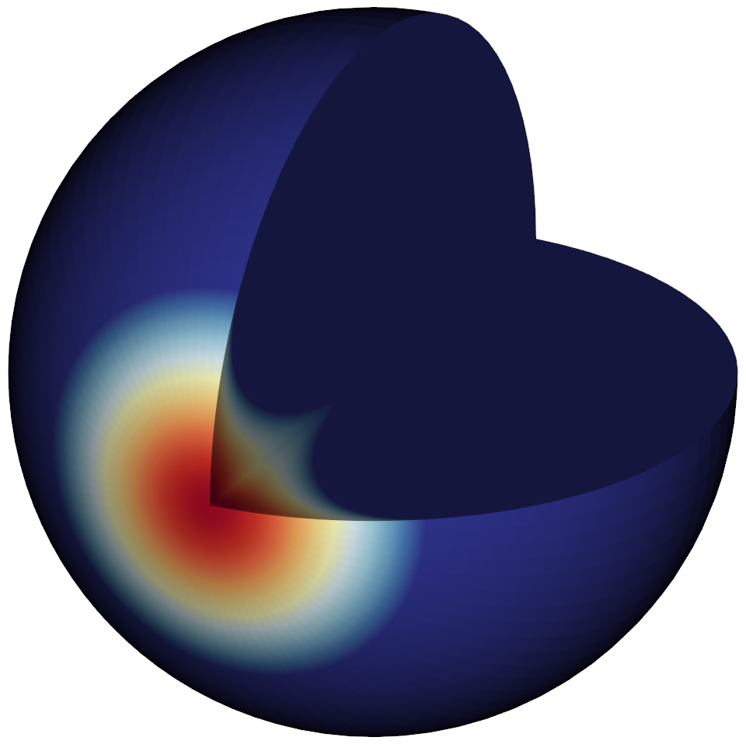
Energy deposition heatmap resulting from 50 kt’s worth of 14.1 MeV neutrons (left) and 1 MeV neutrons (right).

Slide 23
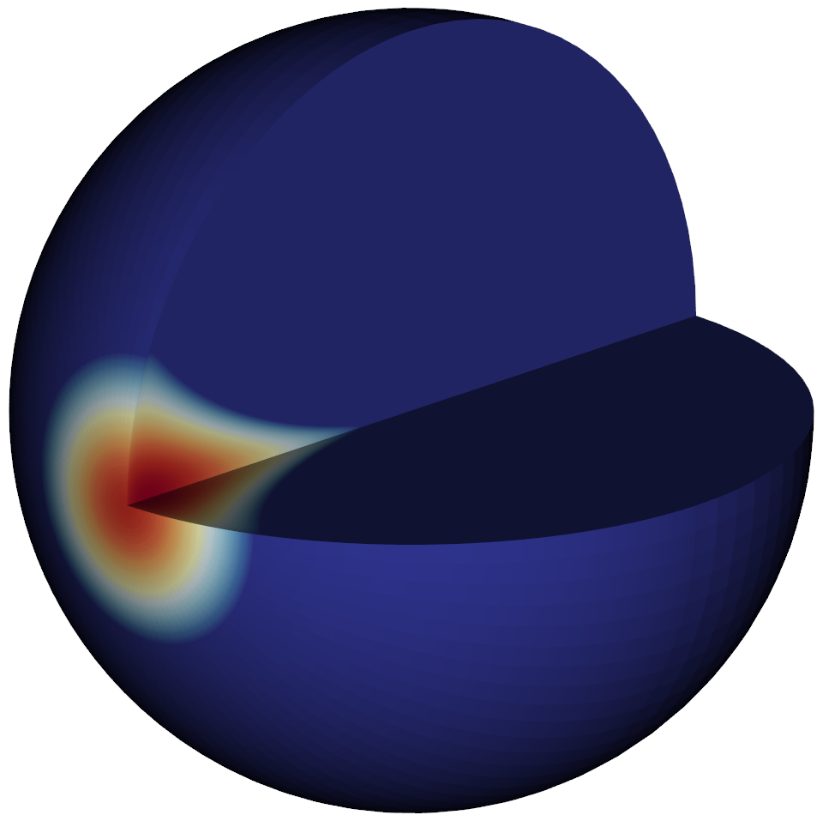
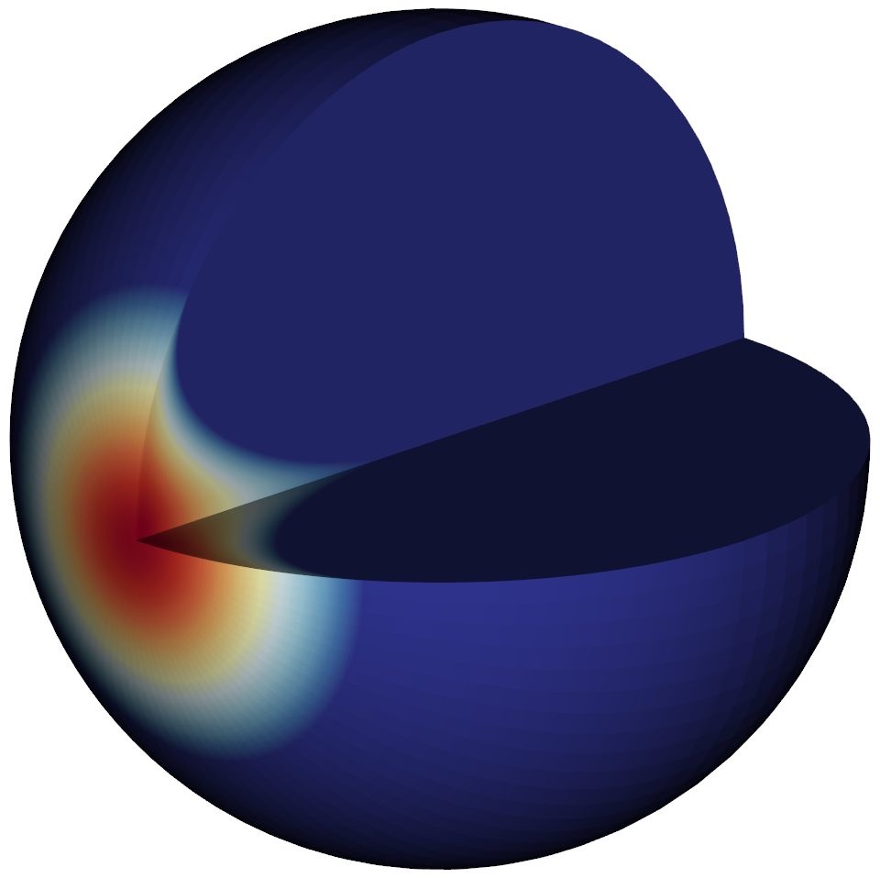
Energy deposition heatmap resulting from 50 kt’s worth of 14.1 MeV neutrons (left) and 1 MeV neutrons (right).

Slide 24
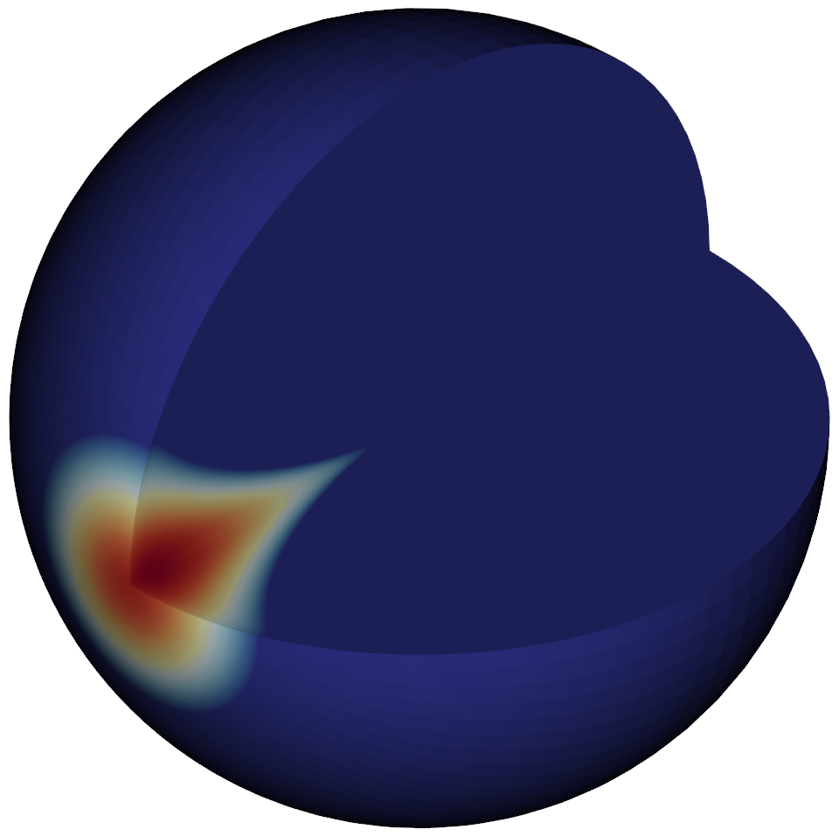
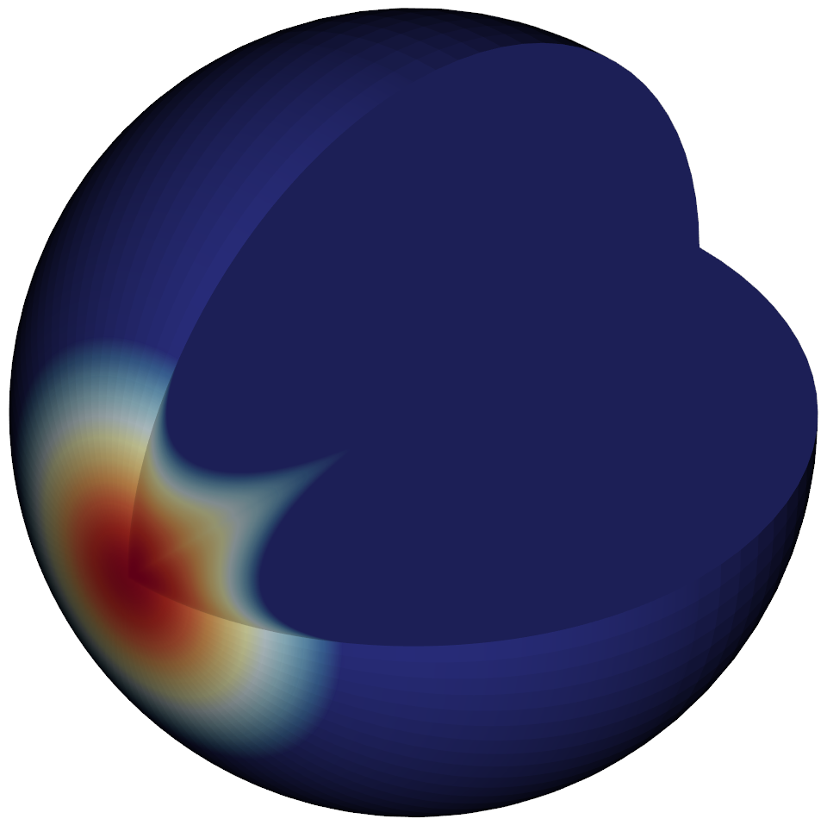
Energy deposition heatmap resulting from 50 kt’s worth of 14.1 MeV neutrons (left) and 1 MeV neutrons (right).

Slide 25
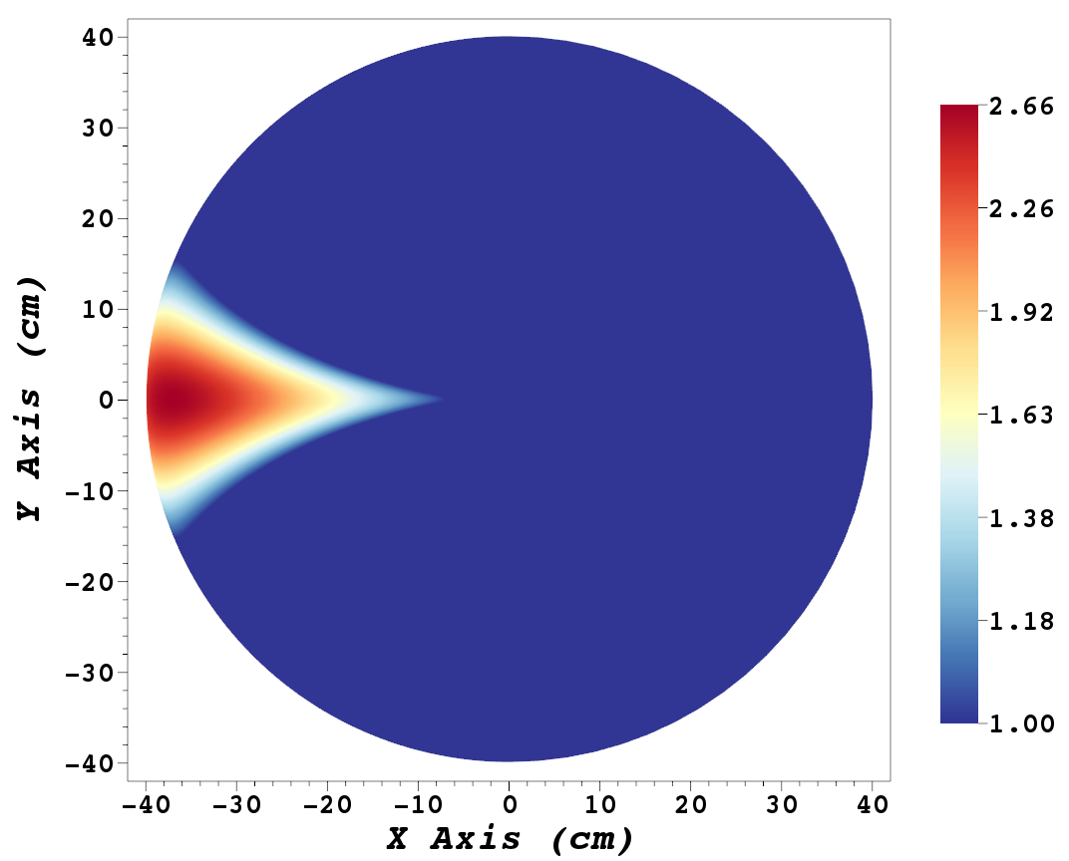
Energy deposition heatmap resulting from 50 kt’s worth of 14.1 MeV neutrons.

Slide 26
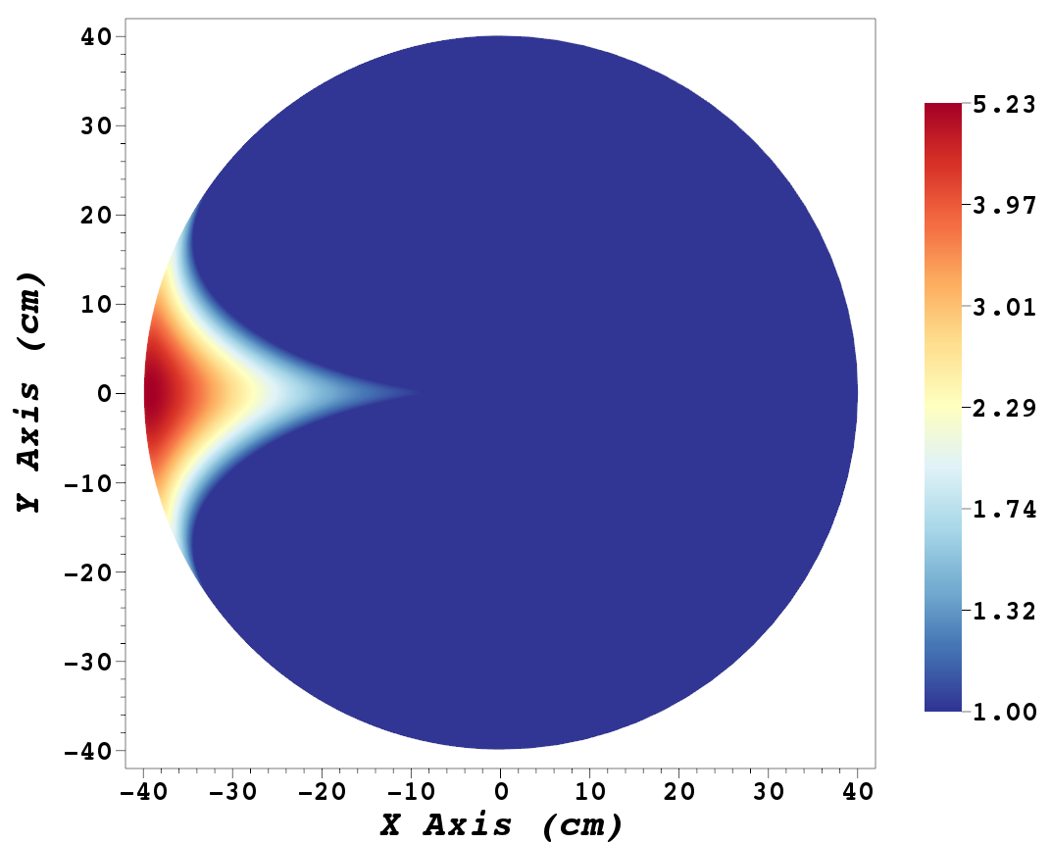
Energy deposition heatmap resulting from 50 kt’s worth of 1 MeV neutrons.

Slide 27
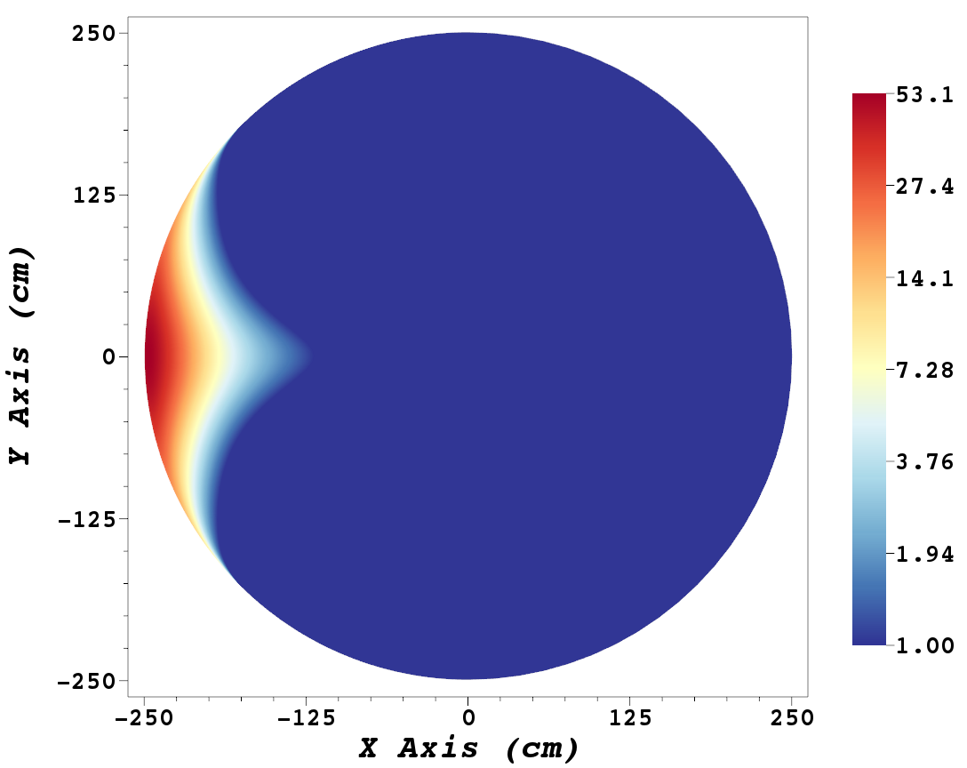
Energy deposition heatmap resulting from 1 Mt’s worth of 14.1 MeV neutrons.

Slide 28
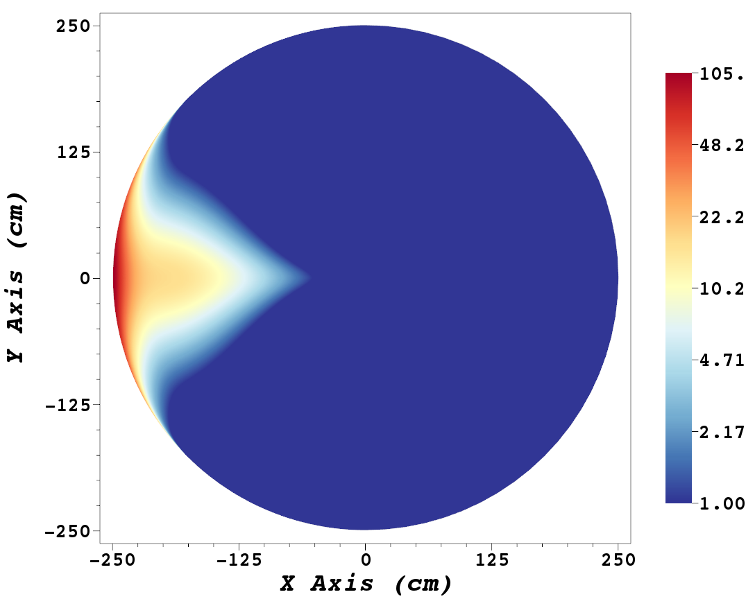
Energy deposition heatmap resulting from 1 Mt’s worth of 1 MeV neutrons.

Slide 29
A nuclear device is the most efficient technology for asteroid deflection.
Nuclear standoff explosions are “10-100 times more effective than non-nuclear alternatives”
NASA study
Nuclear energy densities (energy/mass) are millions of times greater than chemical bonds
mass payload considerations are vital for space travel, delivery
Nuclear deflection could mitigate an asteroid threat within a few years for objects a few hundred meters in size
other mitigation technologies require decades or more of warning time
If NASA announced tomorrow an asteroid was going to hit in 5 years, a nuclear device would likely be the most effective choice of combat.

Slide 30
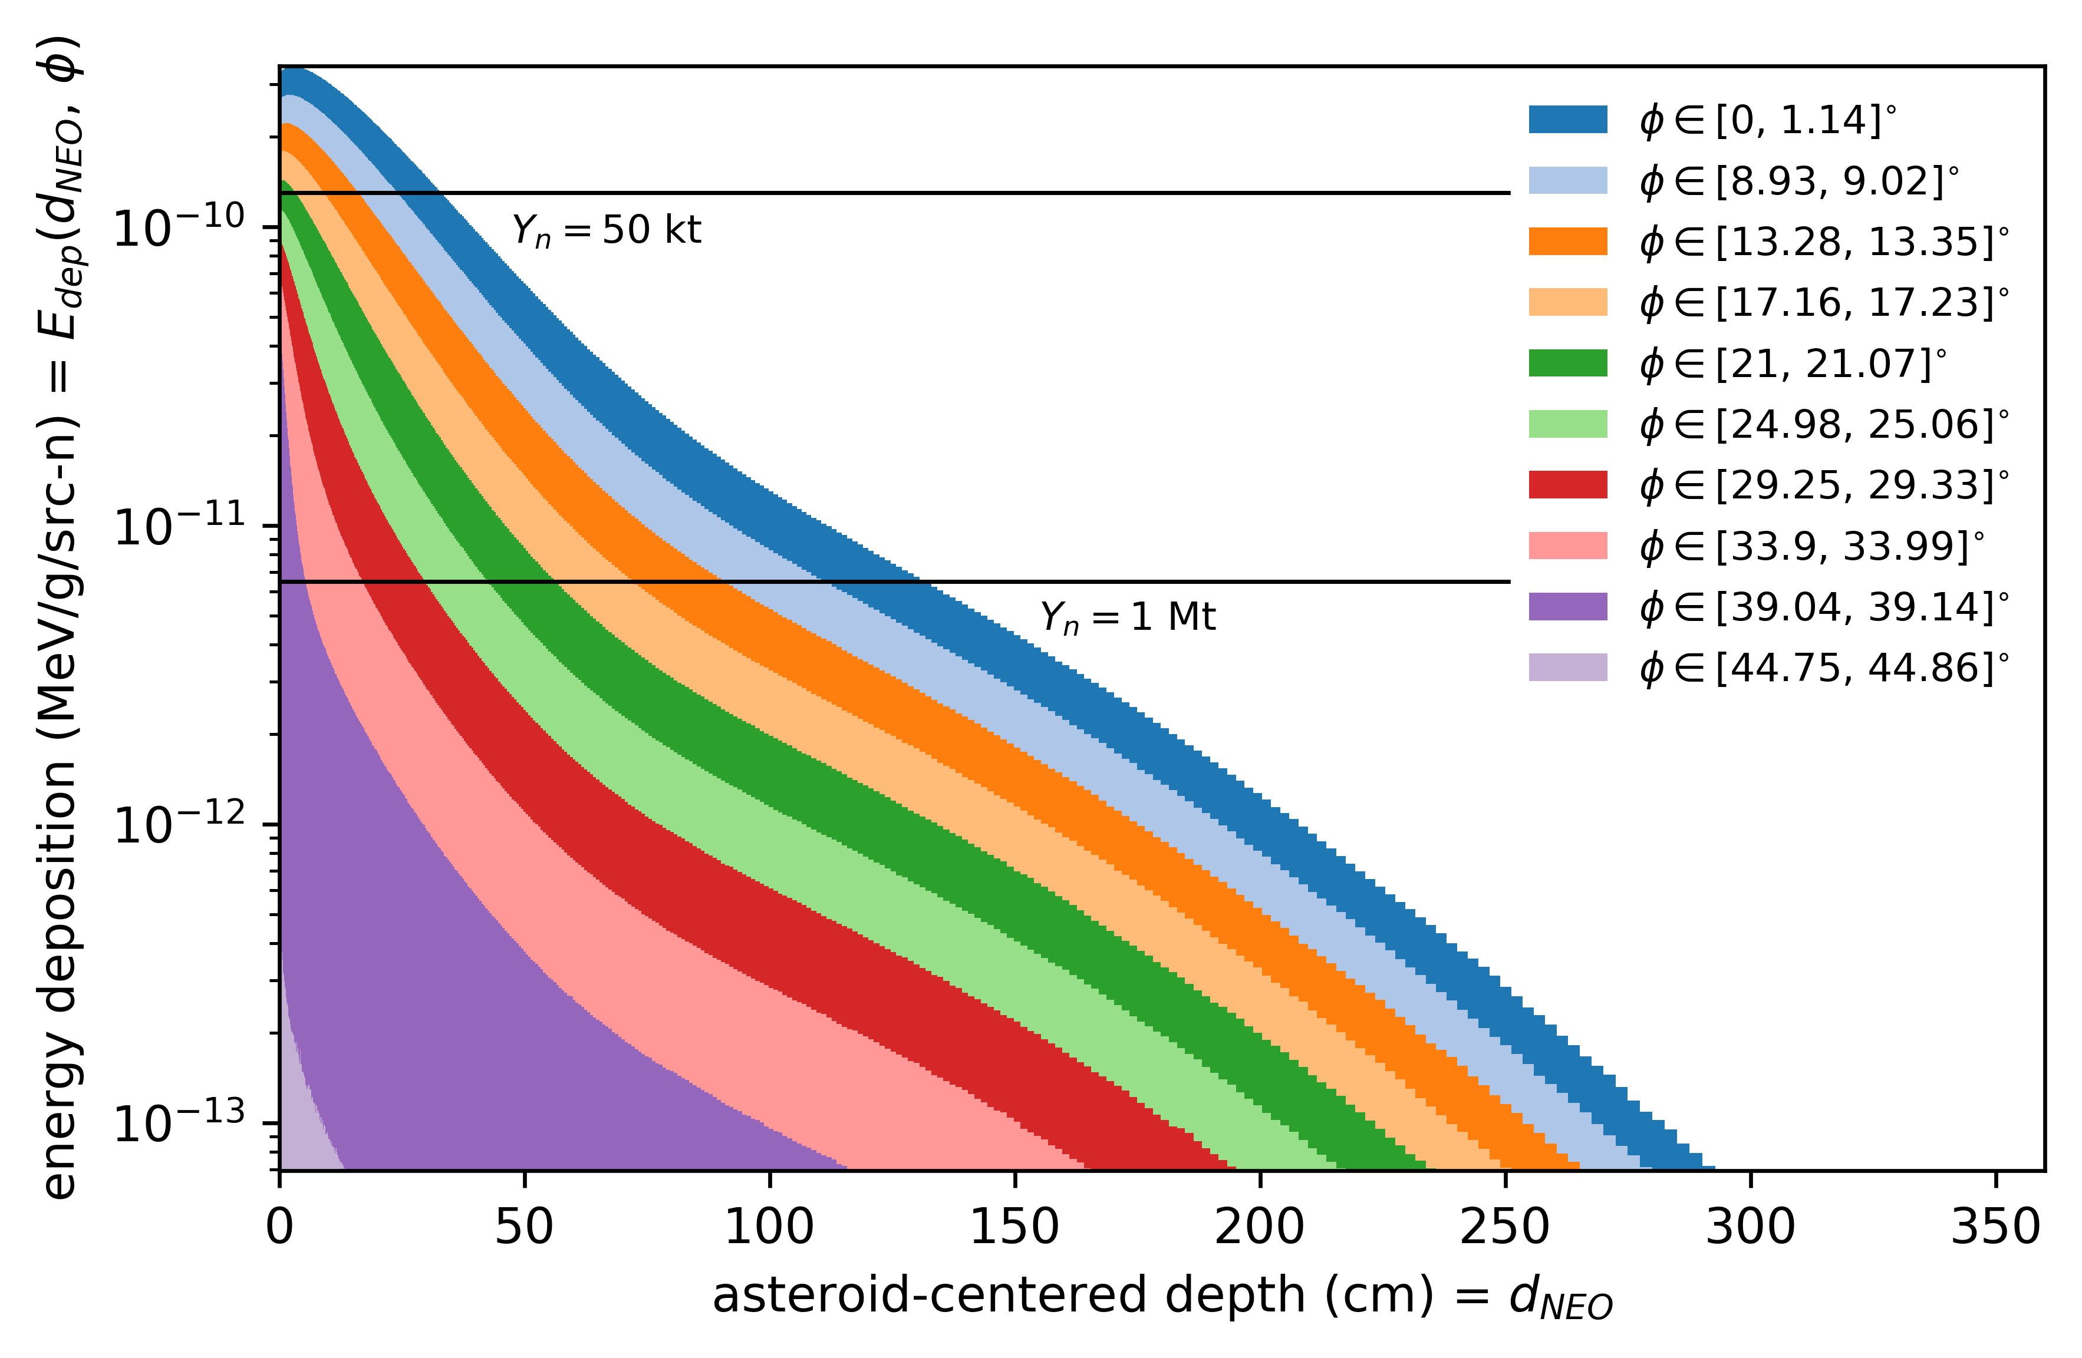
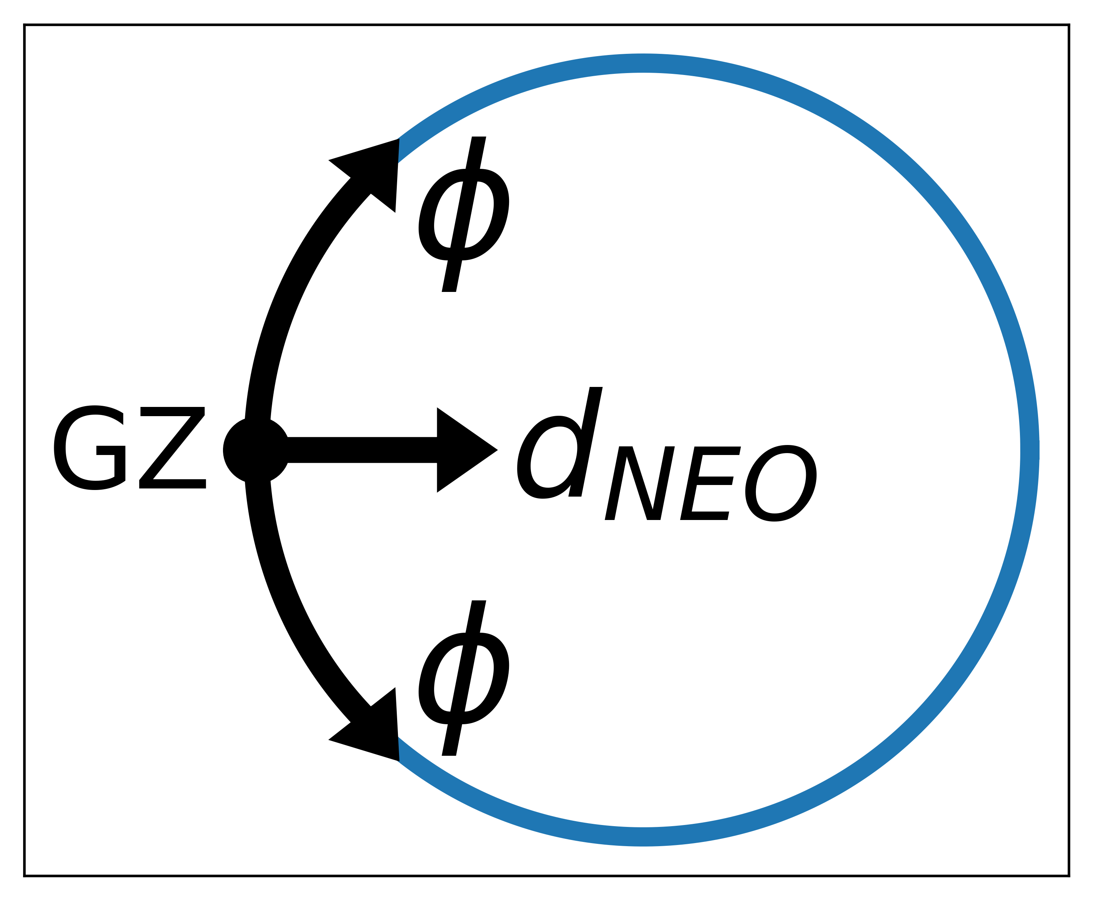
14.1 MeV neutron energy deposition profiles.

Slide 31
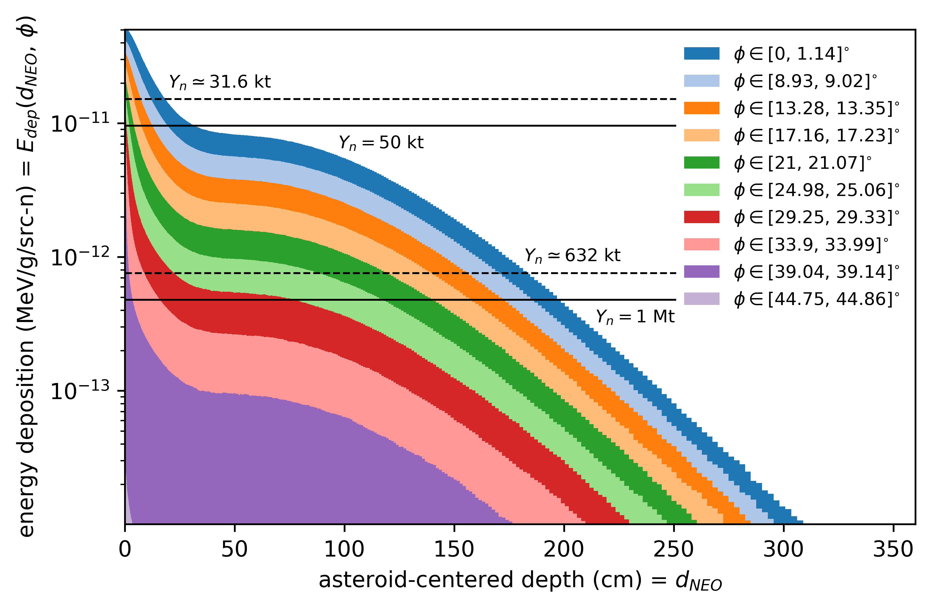
1 MeV neutron energy deposition profiles.
The 1 MeV profiles have different spatial features than the 14.1 MeV profiles.

Slide 32
Notable historical asteroid impacts, recent and long-ago.
In 1908, in Tunguska, Siberia:
60 m asteroid
airburst, 10-20 Mt
2,000 km² of forest and 80 million trees destroyed
In 2013, in Chelyabinsk, Russia:
19 m asteroid
airburst, 400-600 kt
injured 1,500 people, damaged 7,000 buildings
65 million years ago, Yucatan region of Mexico:
10 km asteroid
direct impact with ground (Chicxulub crater)
K-T dinosaur extinction, 70% of all species eliminated
Asteroids “small” and large can cause devastation.

Slide 33
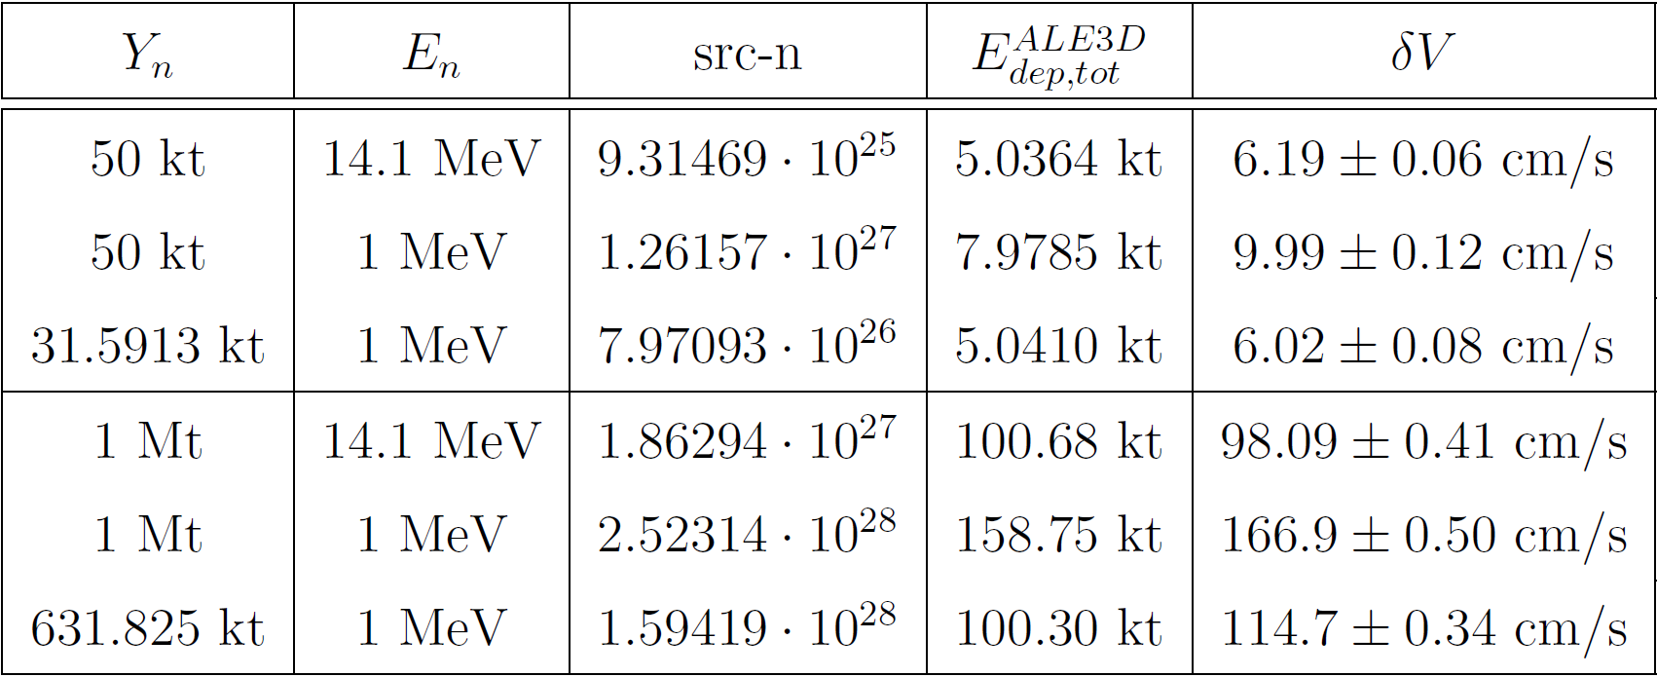
Summary table of all yield & neutron configurations.

Slide 34
Equal 50 kt detonation yields.
1 MeV 𝛿V is 61% greater than 14.1 MeV 𝛿V.
1 MeV E_{dep} is 58% higher.

Slide 35
Equal 1 Mt detonation yields.
1 MeV 𝛿V is 70% greater than 14.1 MeV 𝛿V.
1 MeV E_{dep} is 58% higher.

Slide 36
Equal ~5 kt energy depositions.
14.1 MeV 𝛿V is 3±2% greater than 1 MeV 𝛿V.

Slide 37
Equal ~100 kt energy depositions.
1 MeV 𝛿V is 17% greater than 14.1 MeV 𝛿V.

Slide 38
Does the neutron energy affect asteroid deflection? Yes.
Why? Because different neutron energies result in different energy deposition profiles & different energy coupling efficiencies.
The significance of these differences is sensitive to the yield.
The energy coupling appears more important than the energy deposition profile, especially at low yields and shallow melt-depths.
1 MeV neutrons are equal-or-better than 14.1 MeV neutrons in terms of coupling and profiles, but they require many more source neutrons to compensate for the MeV/src-n reduction.

Slide 39
Asteroid impacts are rare, but potentially devasting.
1+ kilometer asteroid impacts:
once every 500,000 years
~25% of the world’s global population would perish
individual’s annual chance of death: 5×10⁻⁵ %
comparable to risk of dying from an airplane crash
100 meter asteroid impacts:
once every 300 years
damage more confined to region of impact (cities, states)
individual’s annual chance of death: 3.3×10⁻⁶ %
The magnitude of the damage that could result from these fairly-rare, one-off impact events makes the planetary defense mission a prudent pursuit.

Slide 40
How does changing the neutron interactions change the energy deposition? (cont.)
Energy deposition = transferring the energy from radiation (neutrons) to the asteroid particle population (nuclei)
Consider 14.1 MeV n’s being absorbed by ²⁸Si:
(n,γ) = ²⁹Si nuclei keeps all 14.1 MeV, and an extra 8.474 MeV is shared between ²⁹Si and a γ. E_{dep} = 14.1 + 8.474*
(n,α) = ²⁹Si nuclei initially has all 14.1 MeV, but it quickly loses 2.749 MeV because it chose to emit an α. E_{dep} = 14.1 – 2.749
Exothermic (+Q) reaction channels are a bonus for energy coupling, while endothermic (-Q) reactions draw a coupling penalty.
Notes:
Potentially as extra slide for example

Slide 41
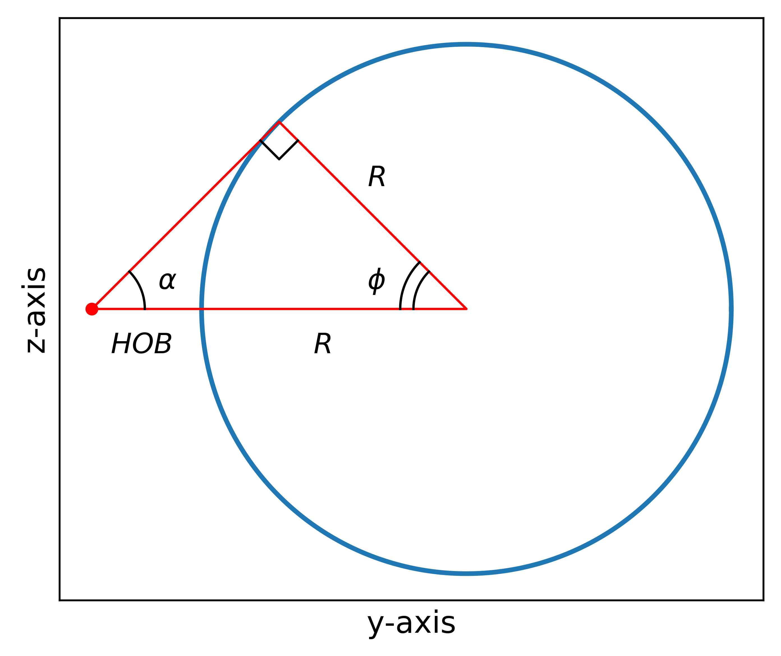
Stand-off distance (HOB) selection.
Hammerling & Remo: HOB ~ 0.414 × R
geometrical optimal HOB; α = ϕ = 45°
maximizes the sum of (fraction of asteroid surface area irradiated) + (fraction of nuclear energy incident on the asteroid)

Slide 42
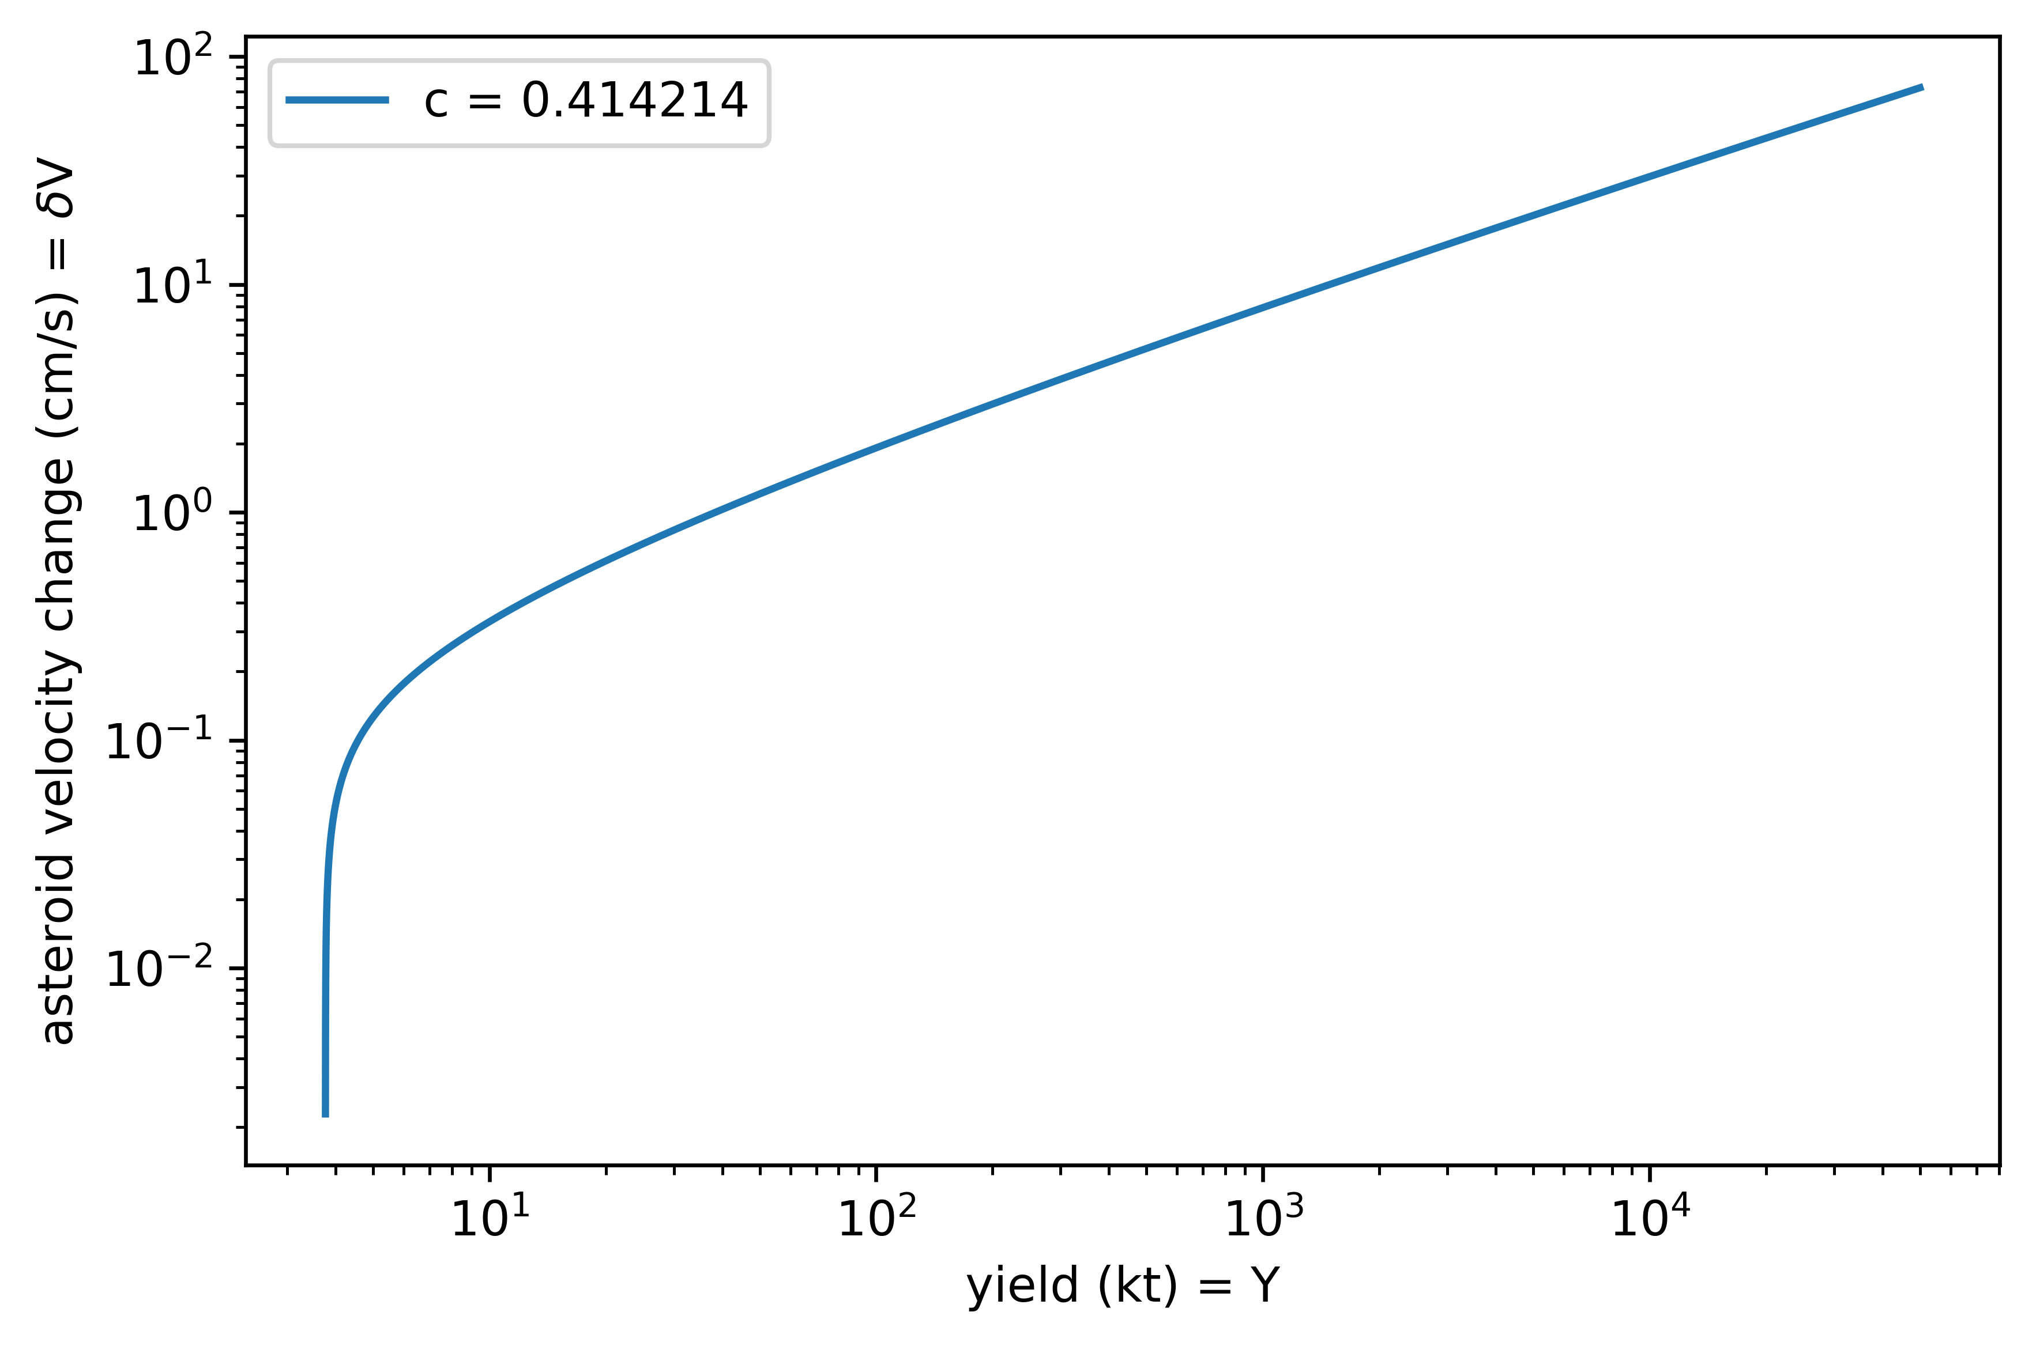
Joe Wasem’s 𝛿V vs. Y analytical equation.
Away from the threshold (need to melt), 𝛿V ~ Y^{2/3}, roughly.

Slide 43
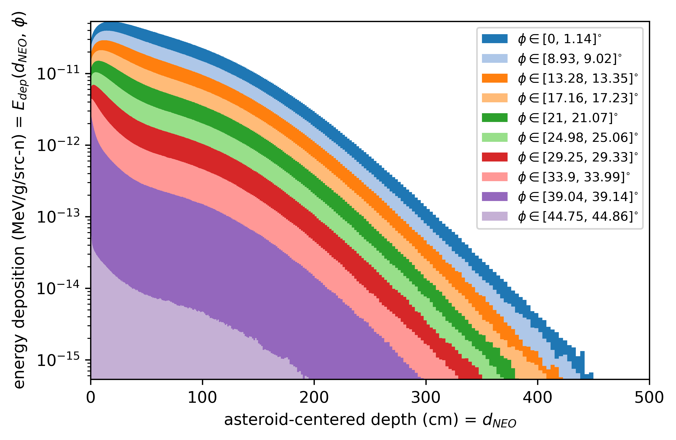
~2.45 MeV neutron energy deposition profiles.
Actually, these profiles are from an average/midpoint energy of 2.346 MeV.

Slide 44
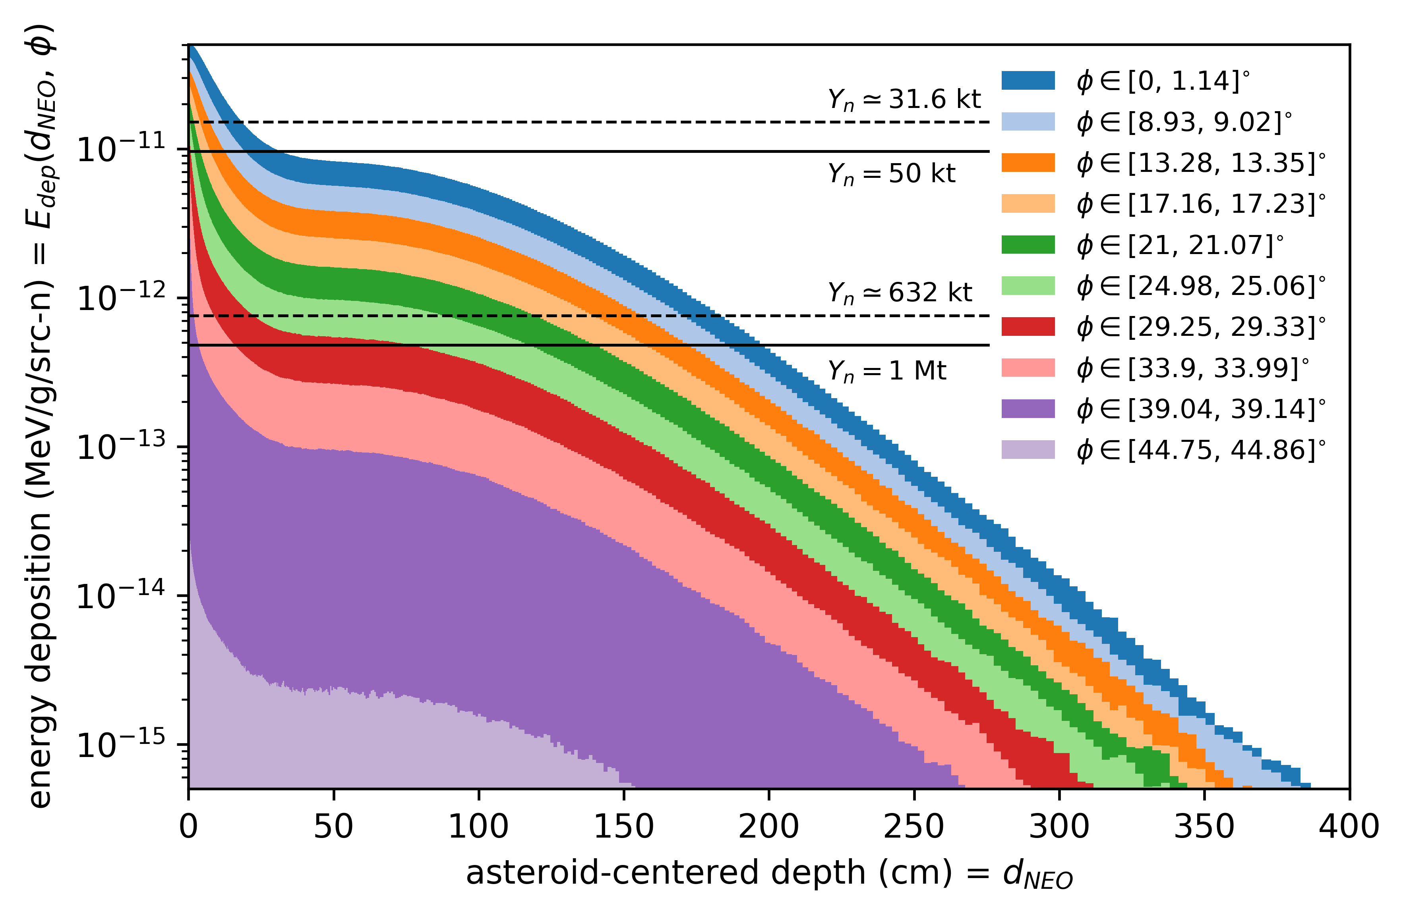
1 MeV neutron energy deposition profiles.
The “pause” region exists at ~40-80 cm depths; to melt, need higher yields.

Slide 45
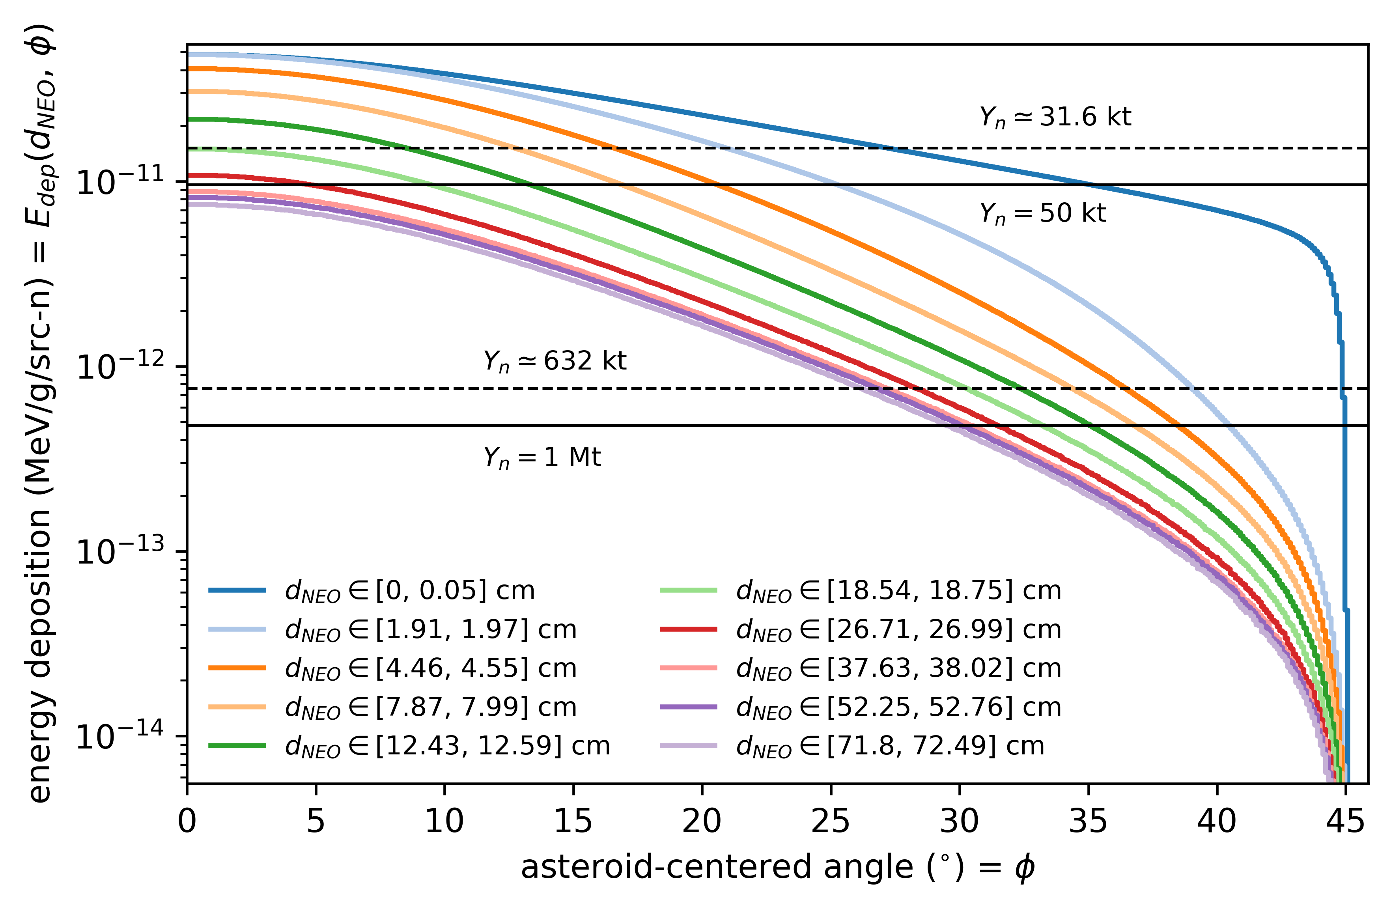
1 MeV neutron energy deposition profiles.
Clumping together of the 3 pink-purple colors is the “pause” region.

Slide 46
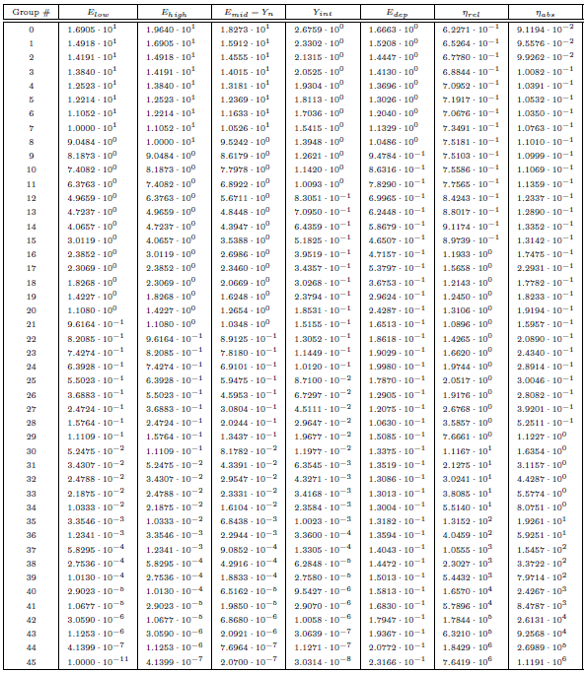
DPLUS 46-group neutron sources.

Slide 47
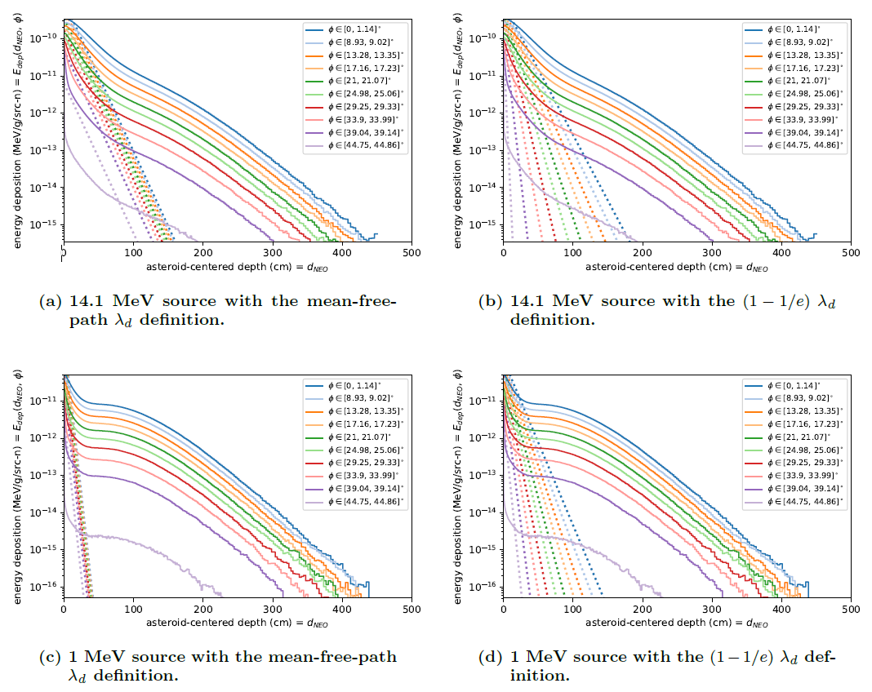
Comparison to analytical approximation.

