Slide 1
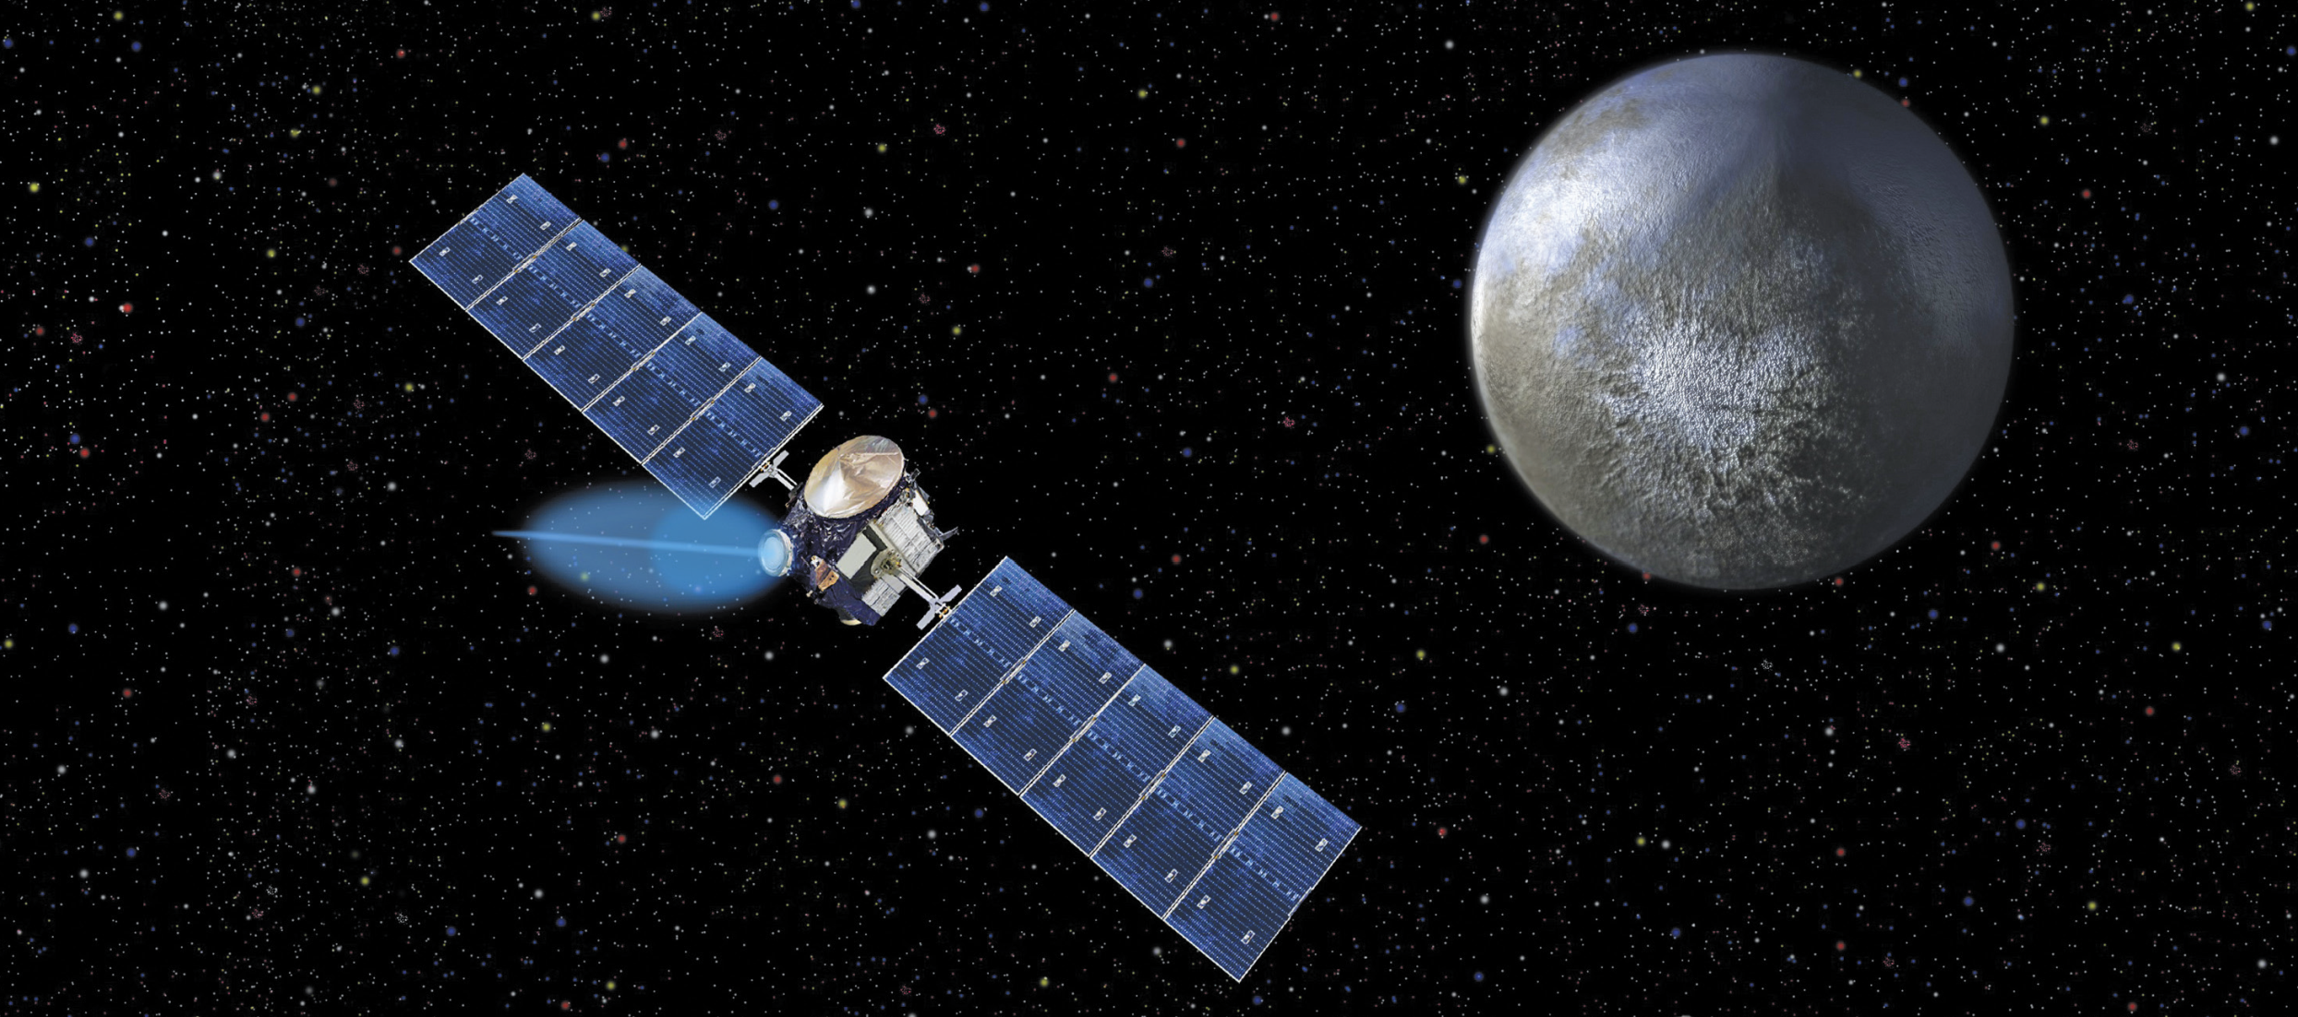
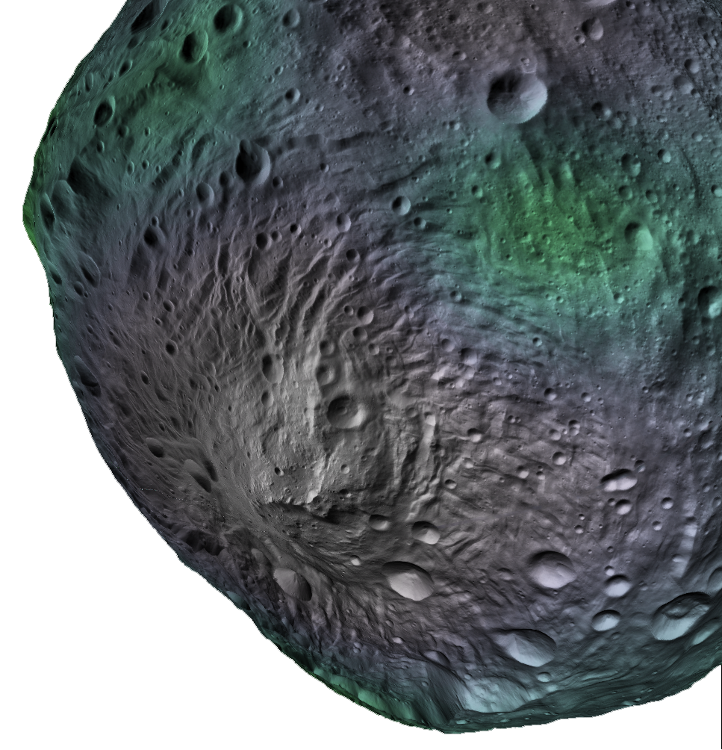
Planetary Nuclear Spectroscopy
Application Description and Data Needs
Tom Prettyman
Planetary Science Institute
Acknowledgements
NASA Discovery Program, Dawn and Psyche Missions
NASA Discovery Data Analysis Program
NASA SSERVI TREX Project
Workshop for Applied Nuclear Data Activities (WANDA 2021)
Session 4: Introduction to Nuclear Data for Space Applications
29-Jan-2021

Slide 2
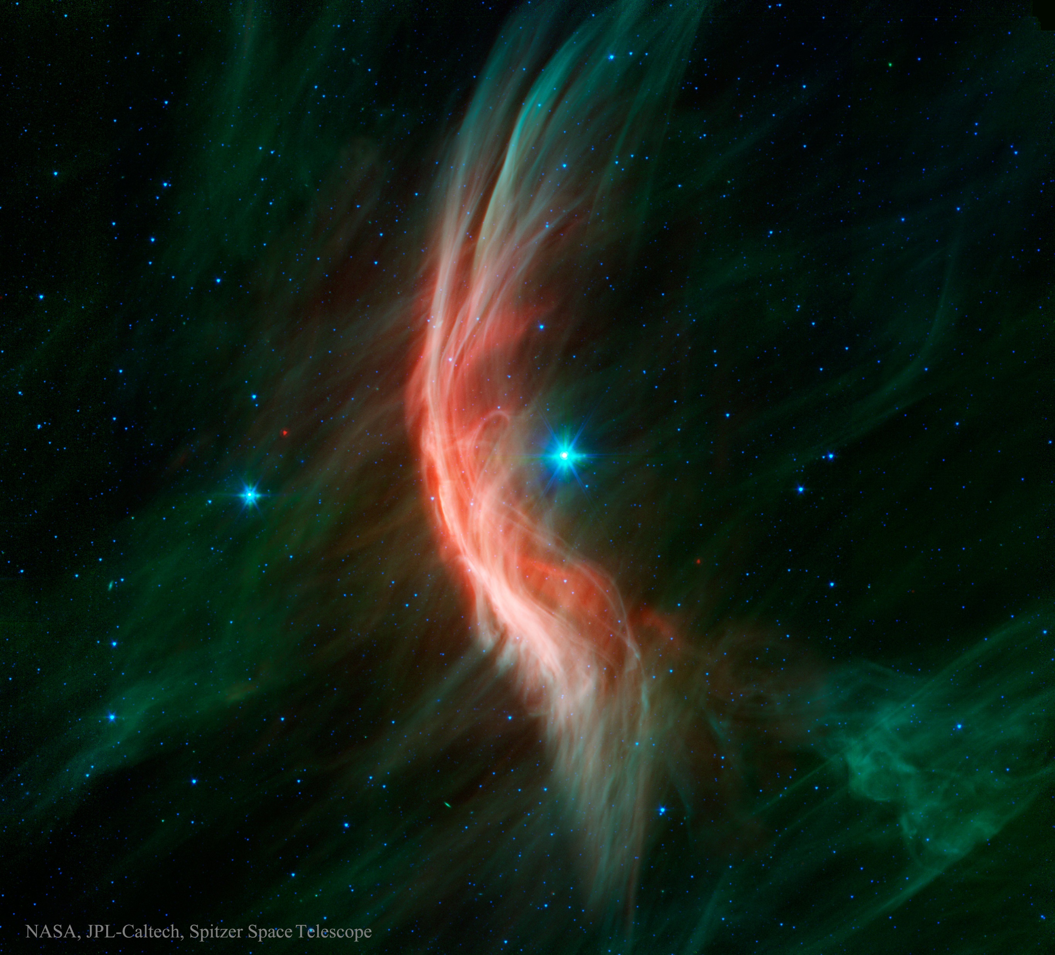

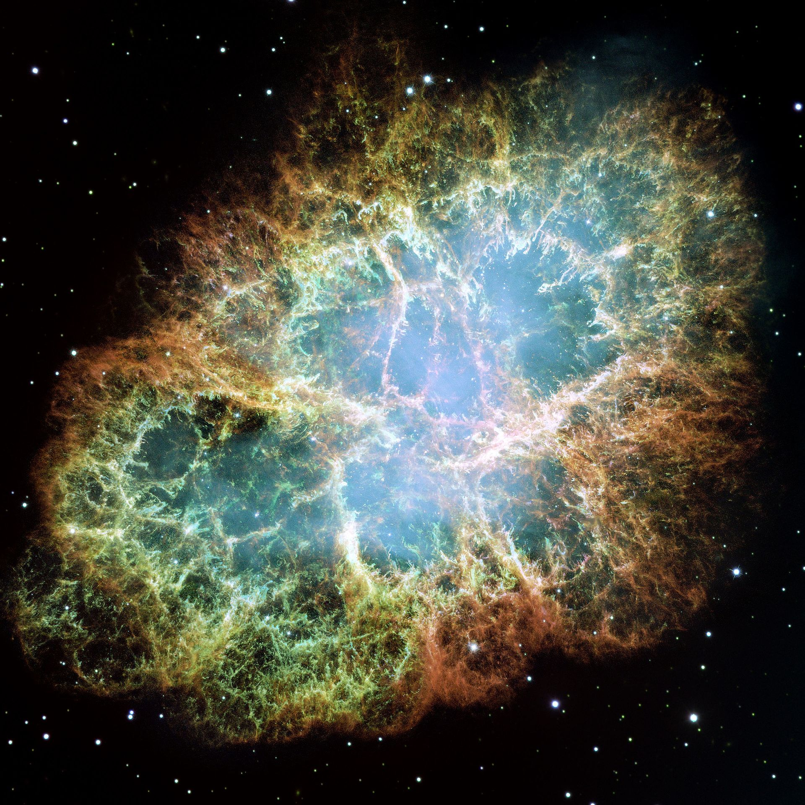

Source: Passive interrogation
Natural particle accelerators and radioelements
Modulation:
Diffusion
Convection
Adiabatic deceleration
Propagation
https://apod.nasa.gov/apod/ap150705.html
Galactic cosmic ray production
Via halo magnetic fields
LIS Cosmic ray flux
$$F^{∞}\left(E_{K}\right)$$
Through the galactic disk
Energy loss by ionization
Spallation (secondary nuclei)
Escape
Radioactive decay
e.g., Crab nebula
NASA/ESA/Hubble
Fermi acceleration of ions (H to U) at shock fronts – shell type supernovae
Relativistic jets of particles from active galactic nuclei
From Axford (1965)
Force-field approximation to convection diffusion model:
After Simpson (1983)

Slide 3
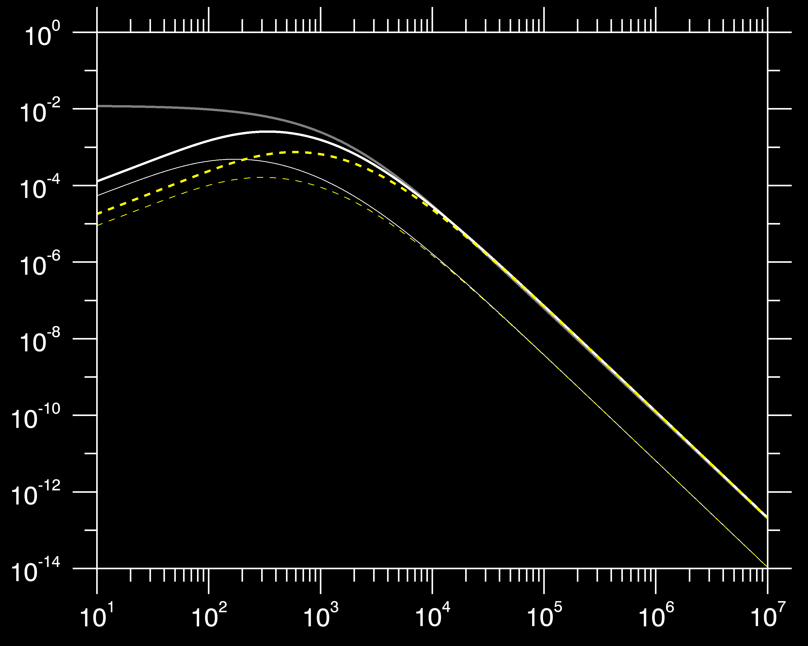

Source: Passive interrogation
Natural particle accelerators and radioelements
Badhwar-O’Neill model (O'Neill, 2010)
$$F^{∞}\left(E_{K}\right)$$
H (87%)
He (12%)
Ions/cm²/s/(MeV/nucleon)
Solar minimum
Solar maximum
Kinetic energy (MeV/nucleon)
Introductory materials from Prettyman et al. (2019a), DOI: 10.1017/9781316888872
LIS/CR flux from Moskalenko & Porter (2007)

Slide 4
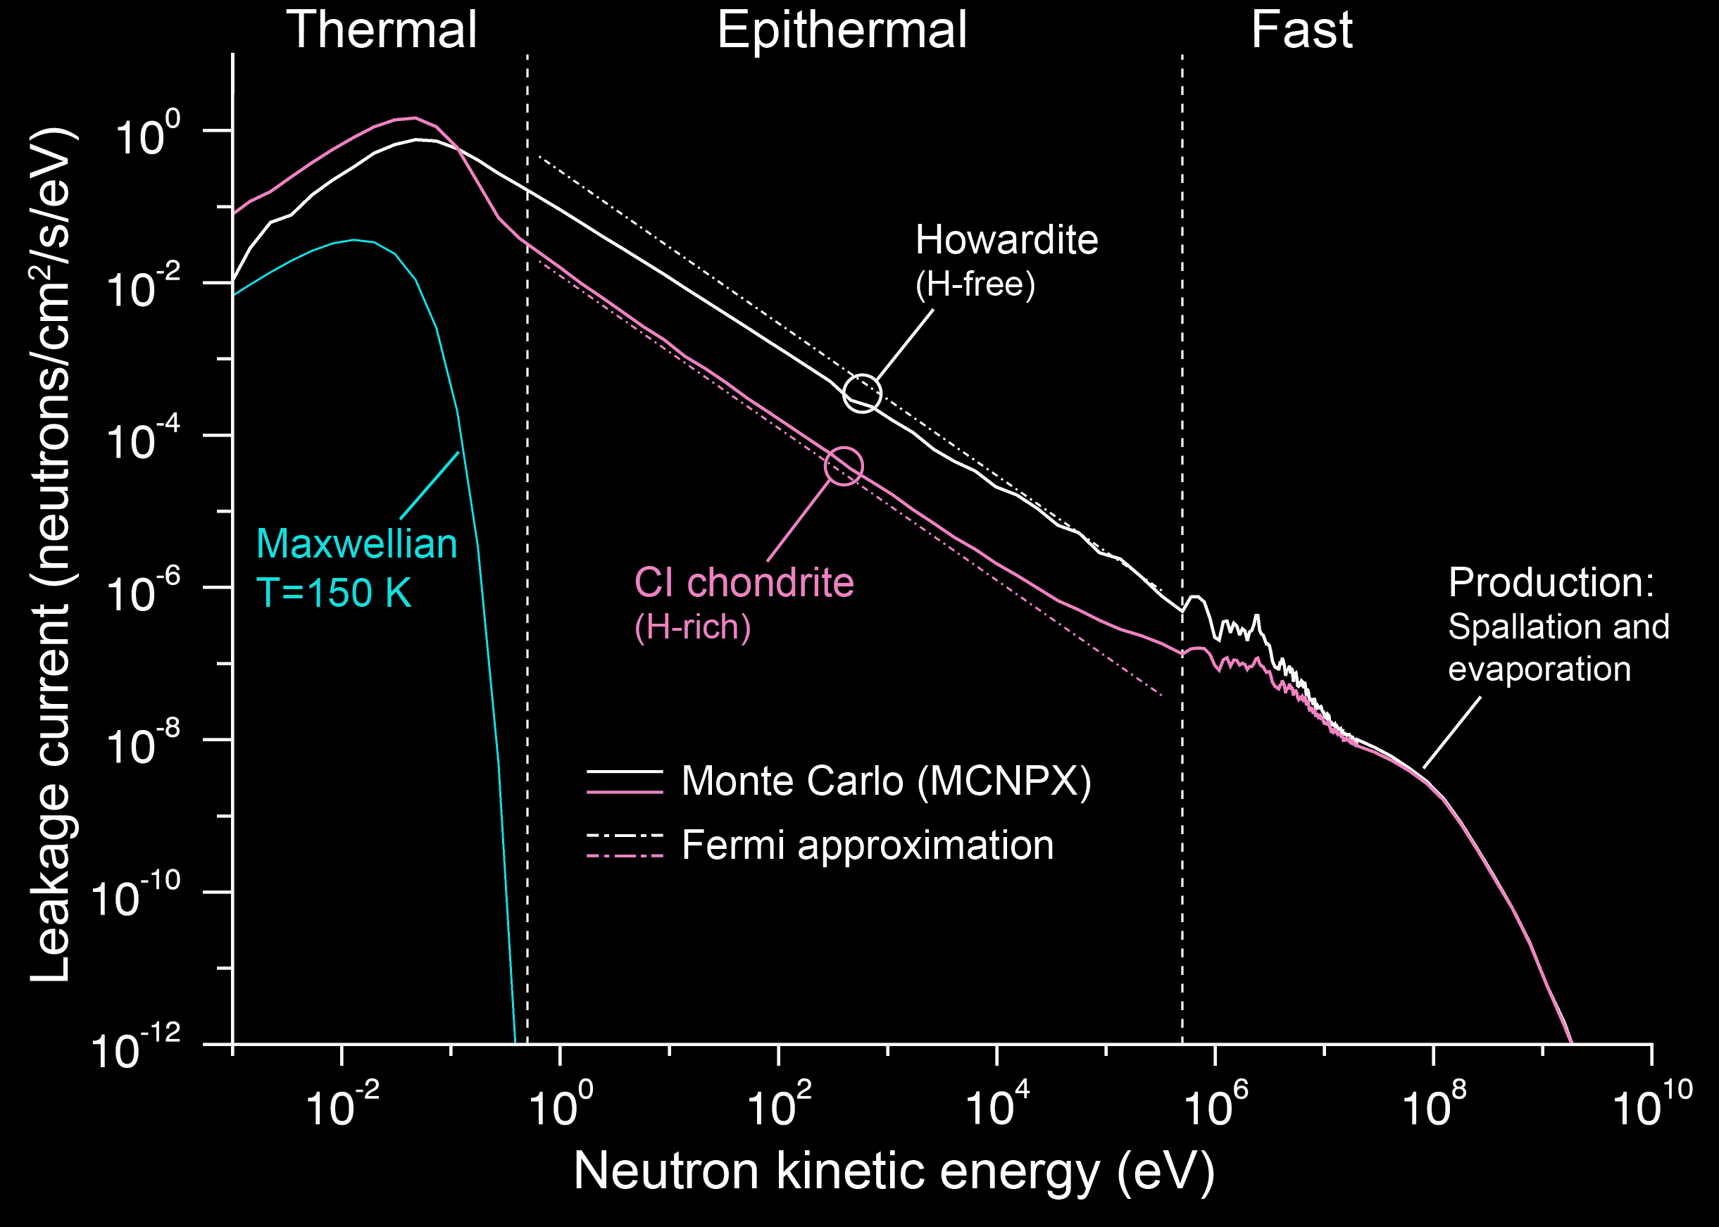
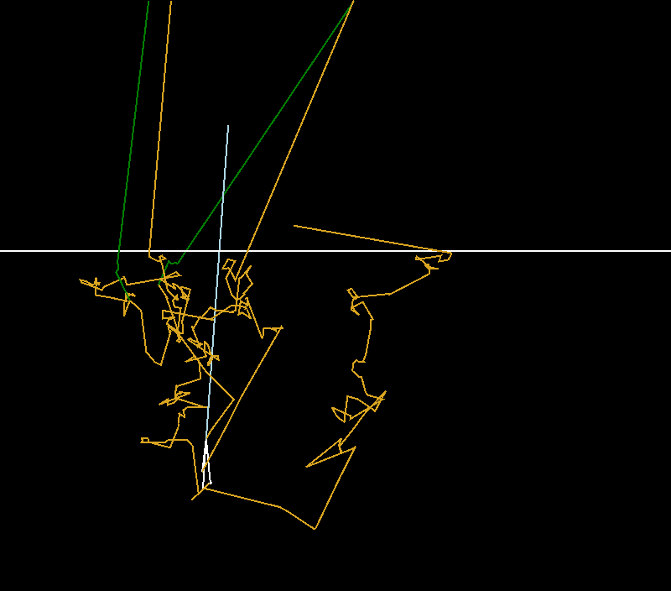
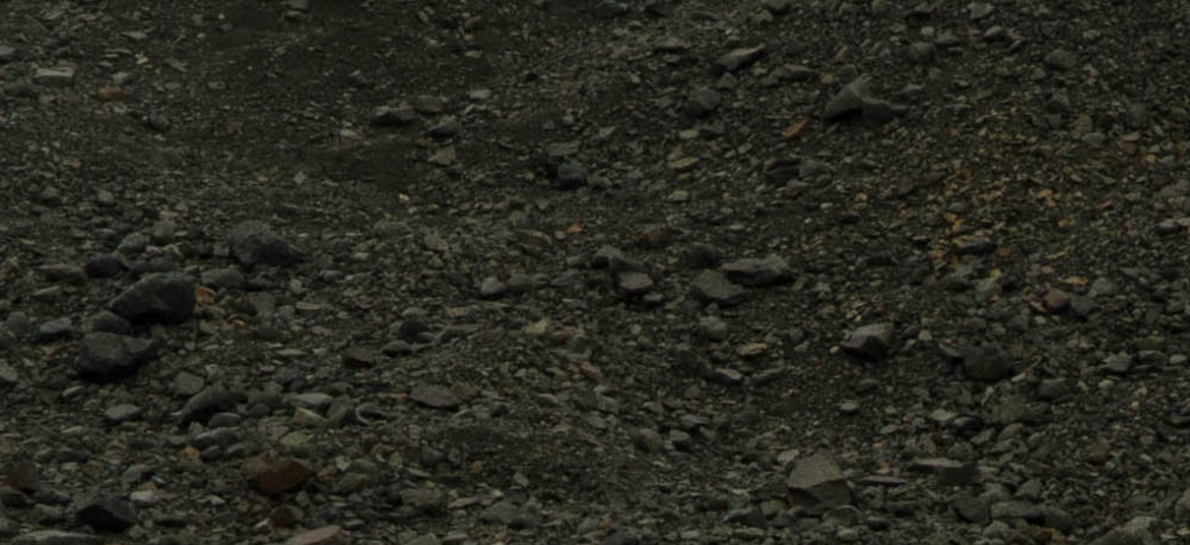

Information content
Beam stop for the cosmic accelerator (solid surfaces exposed to space)
Galactic cosmic ray
n
γ
γ
n
Space
n
$φ\left(E\right)=\frac{S}{{ξΣ}_{S} E}$
1 m
Regolith
π
Only the tracks of particles that escaped are shown
Introductory materials from Prettyman et al. (2019a), DOI: 10.1017/9781316888872
LIS/CR flux from Moskalenko & Porter (2007)

Slide 5
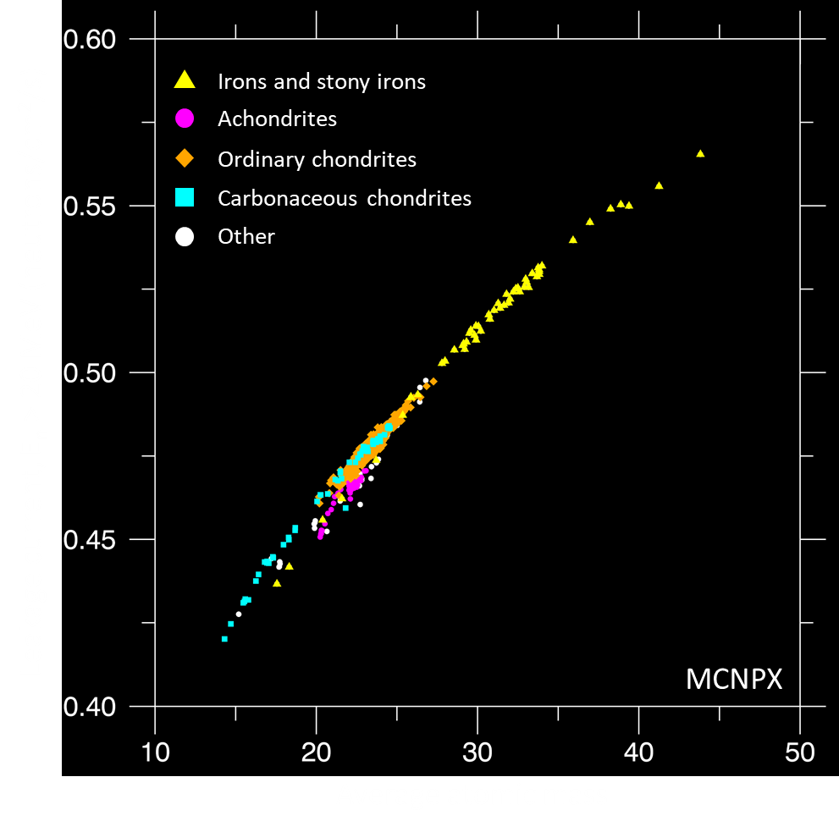
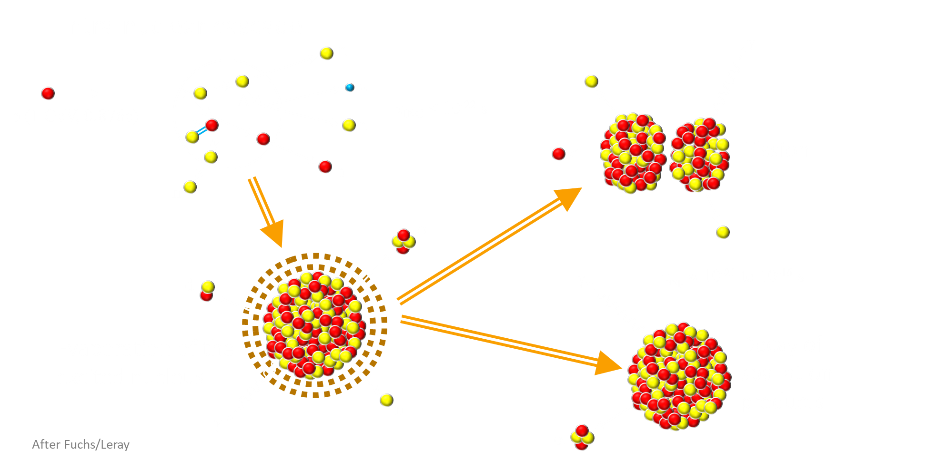
Information content
Secondary particle production by neutrons
Spallation cross sections scale with atomic mass (A) for light nuclei…
e.g. Gasnault et al., 2001
Spallation is a complex process – Model parameters used in simulations are determined experimentally.
Uncertainties in neutron production in thick-target “GCR” experiments reported by Ratliff et al. 2018.
Quantitative analyses generally require “ground truth”

Slide 6
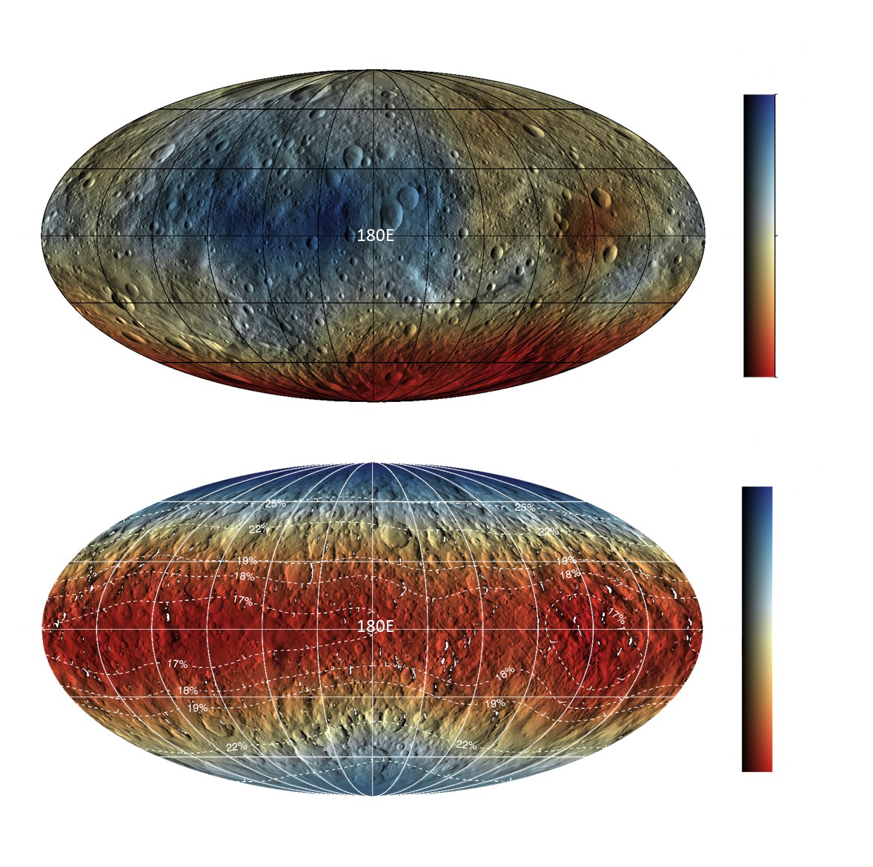
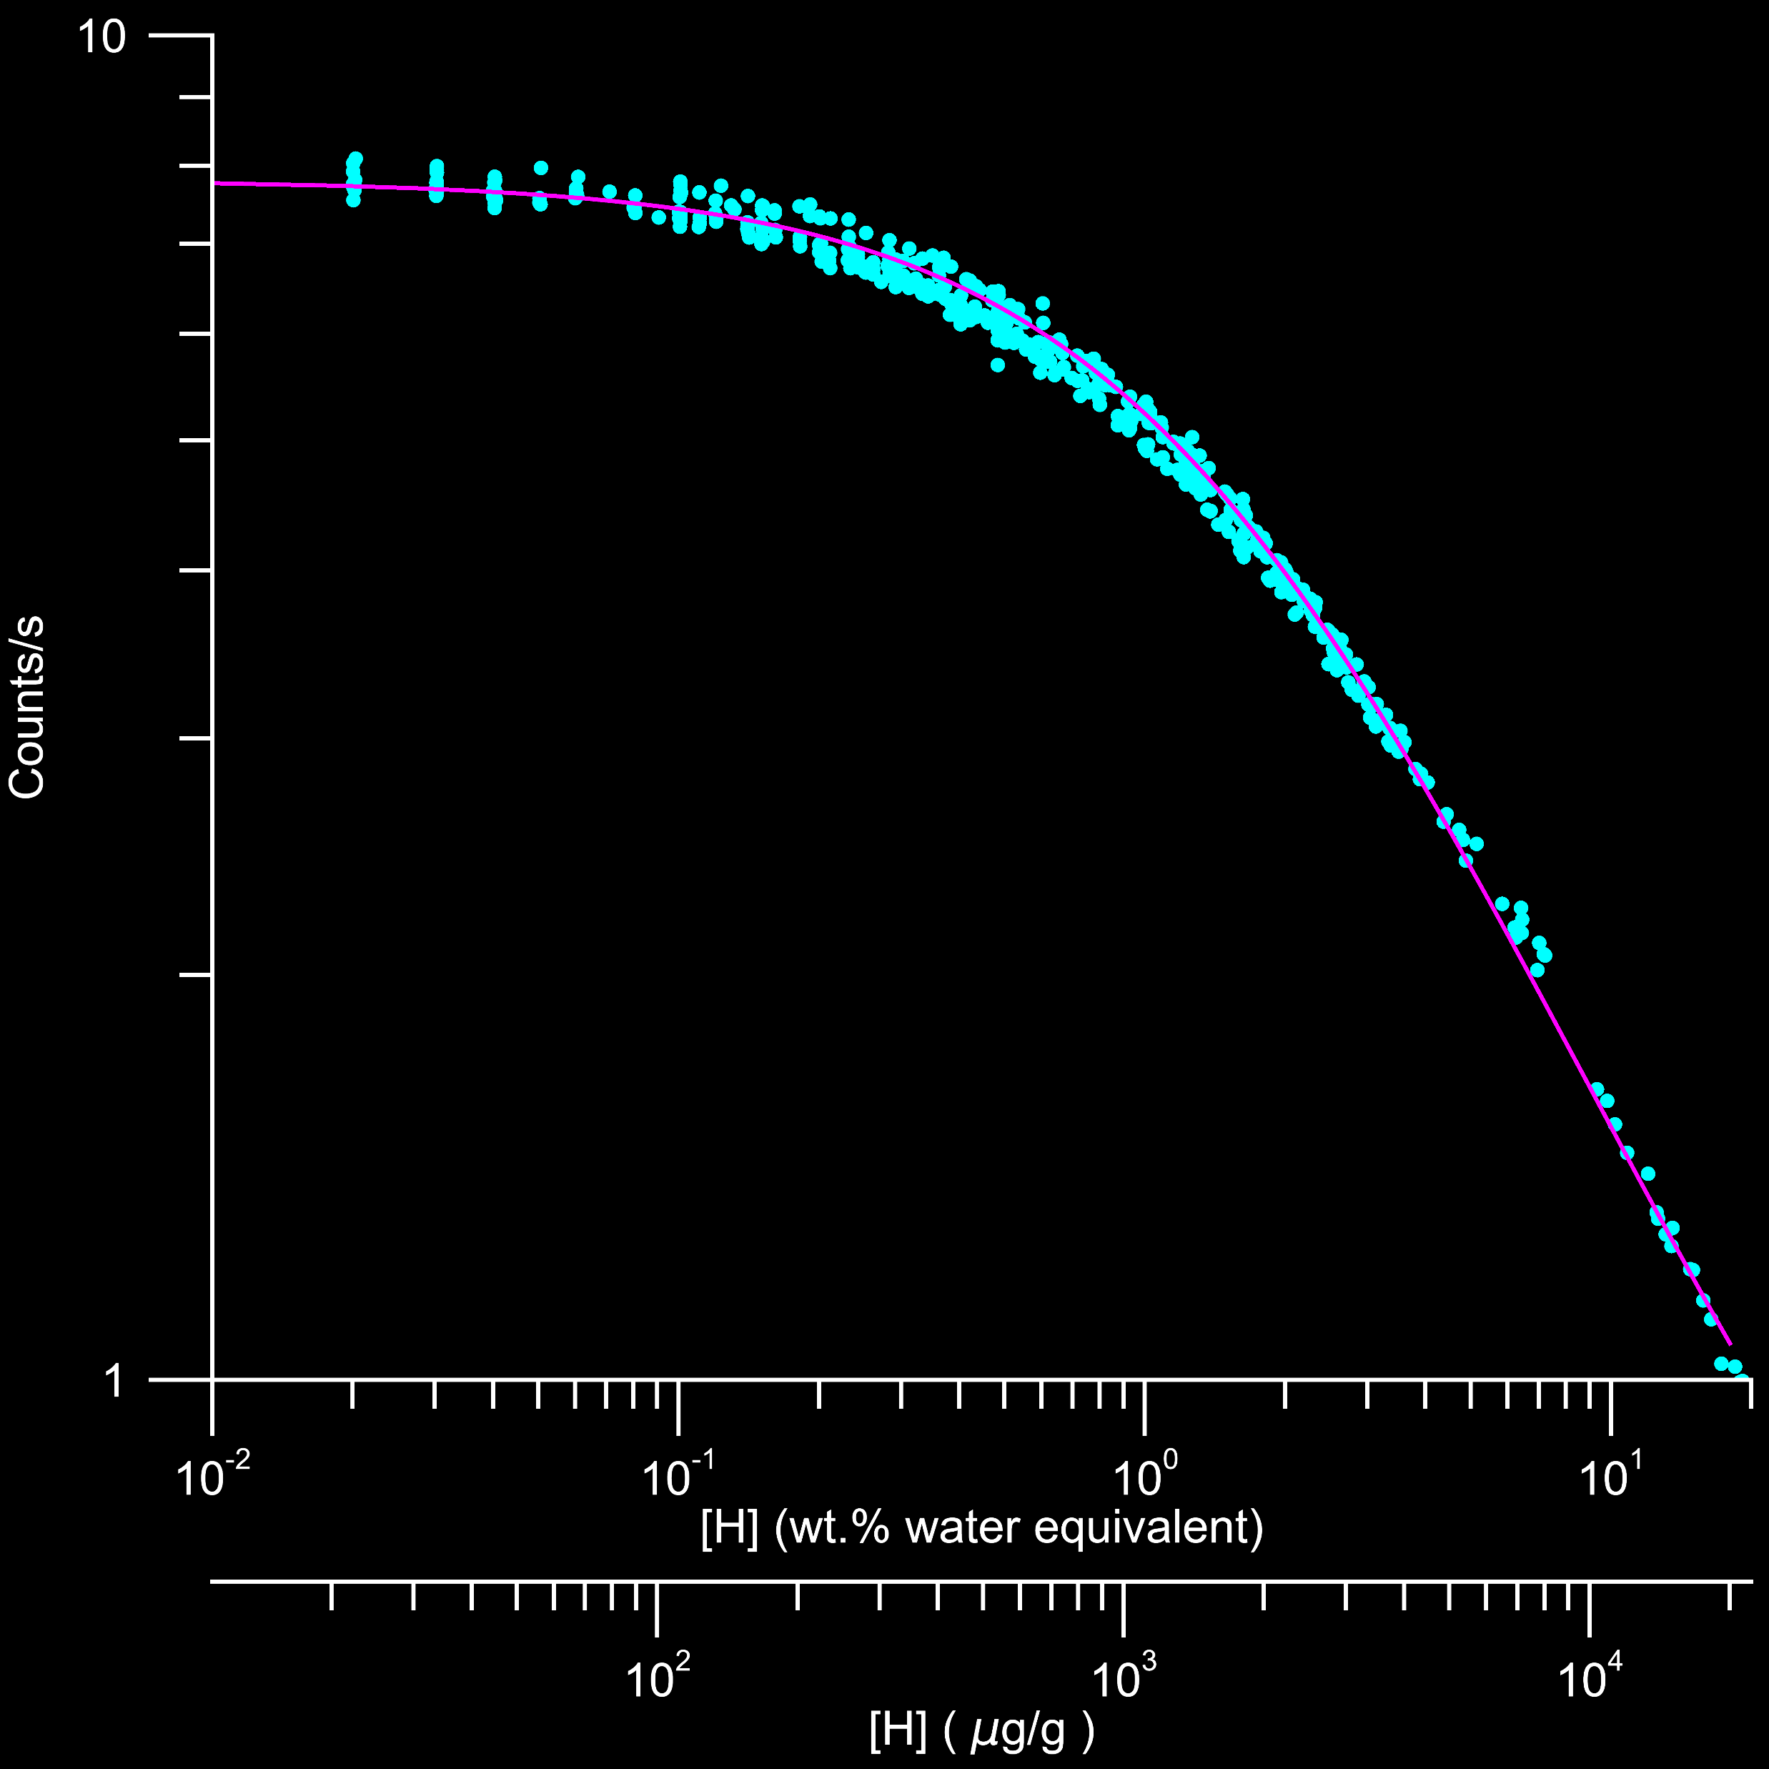
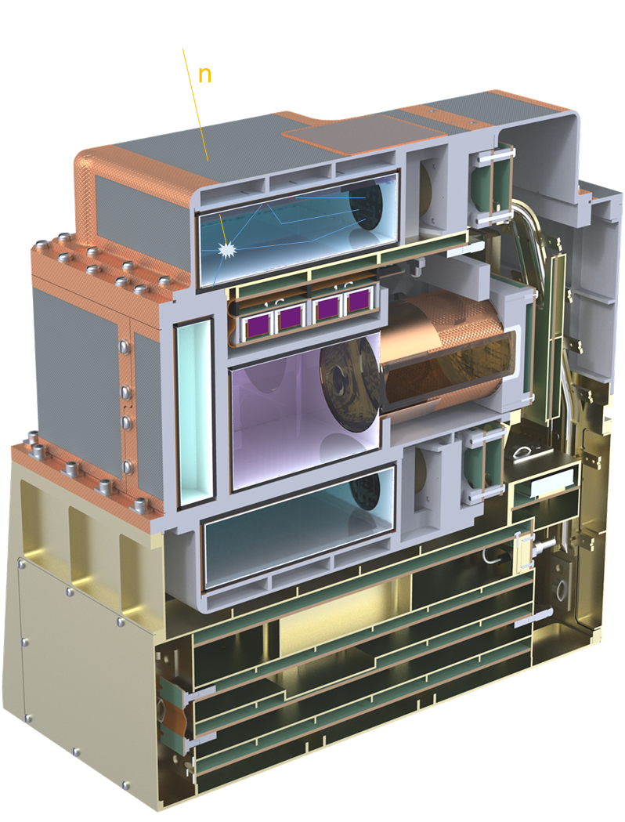
Information content
Moderated (epithermal) neutrons
All H-bearing meteorites
C₀
General trend
C
Dawn/GRaND
[H]=k(C₀/C-1)
k and C₀ are weakly dependent on composition
MCNPX
Prettyman et al. (2011, 2012, 2017, 2019b)

Slide 7
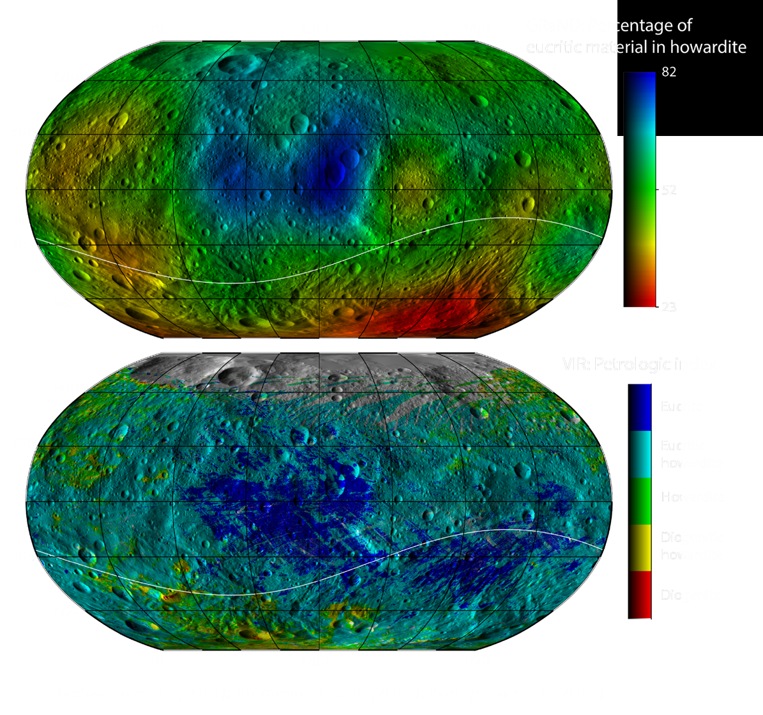
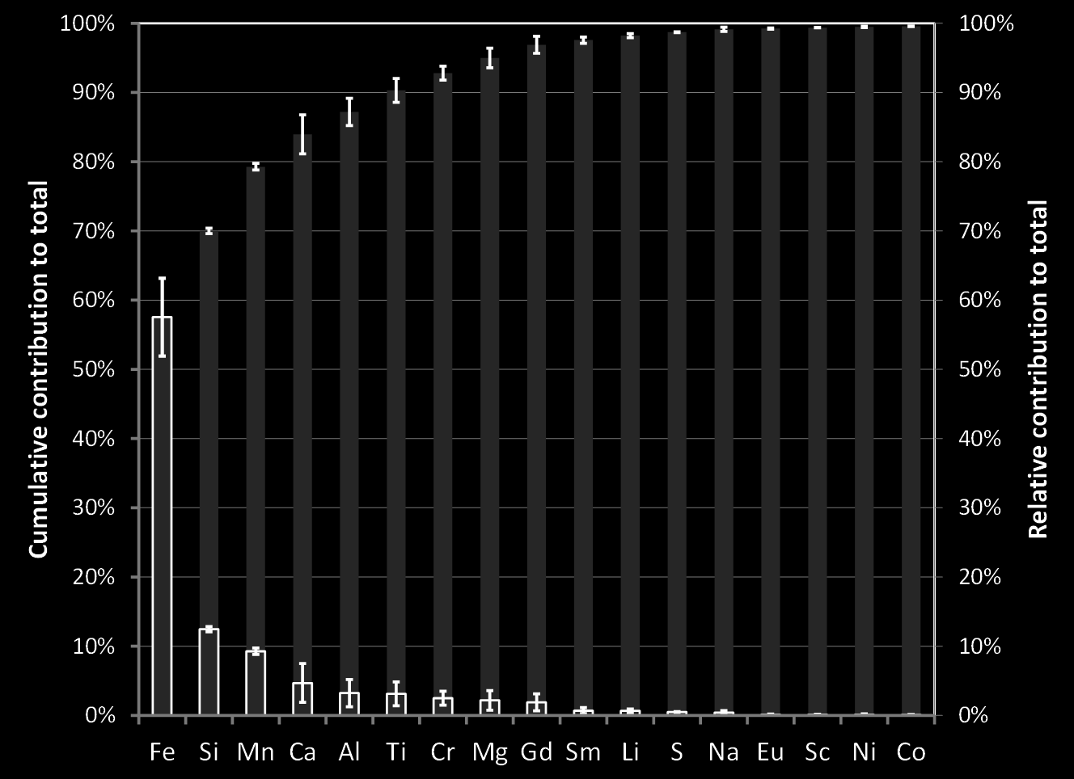
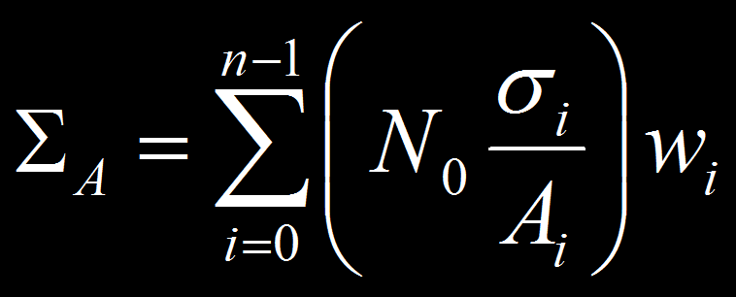
Information content
Low energy neutrons are sensitive to absorption
Asteroid 4 Vesta – Dawn mission
Neutron absorption map (top) compared to VIS-NIR petrology (rock type, bottom)
Elemental contributions to absorption
for selected howardite meteorites

Slide 8
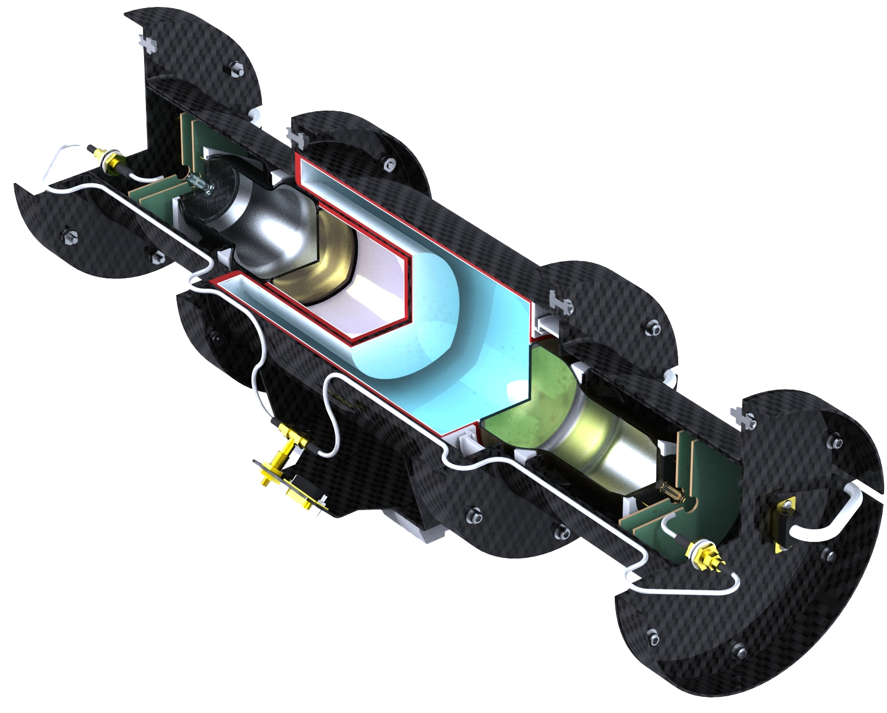
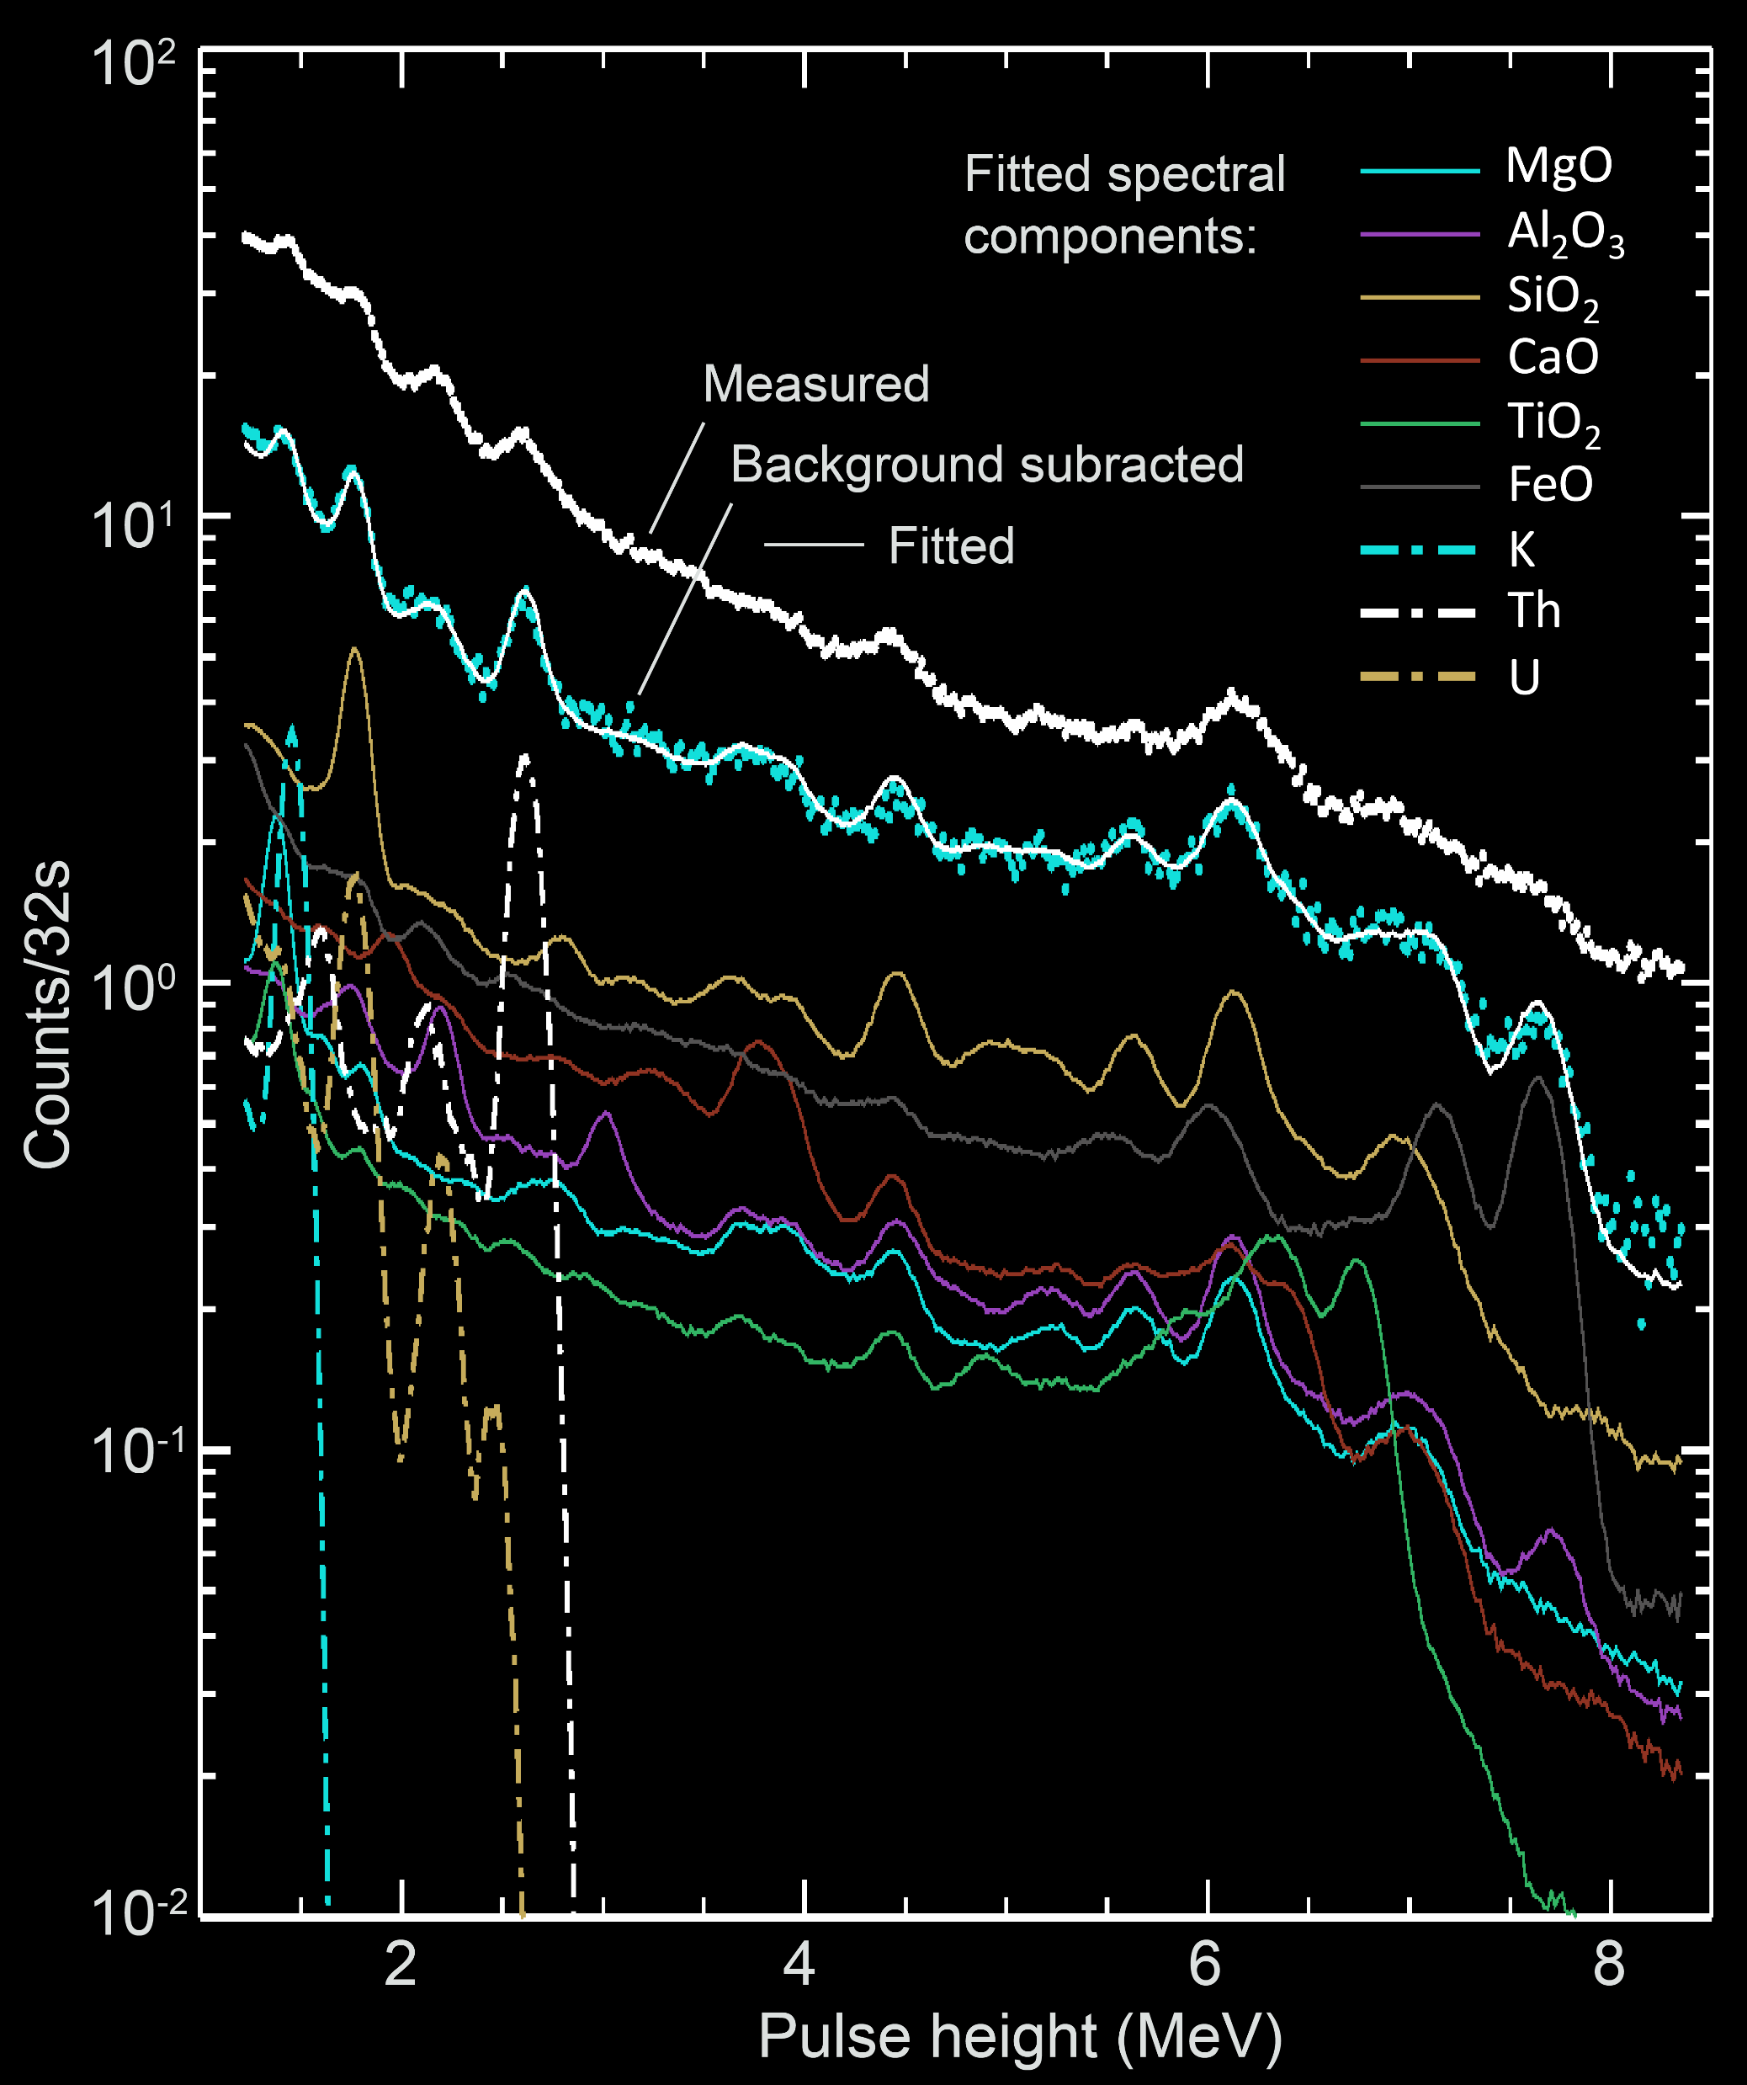
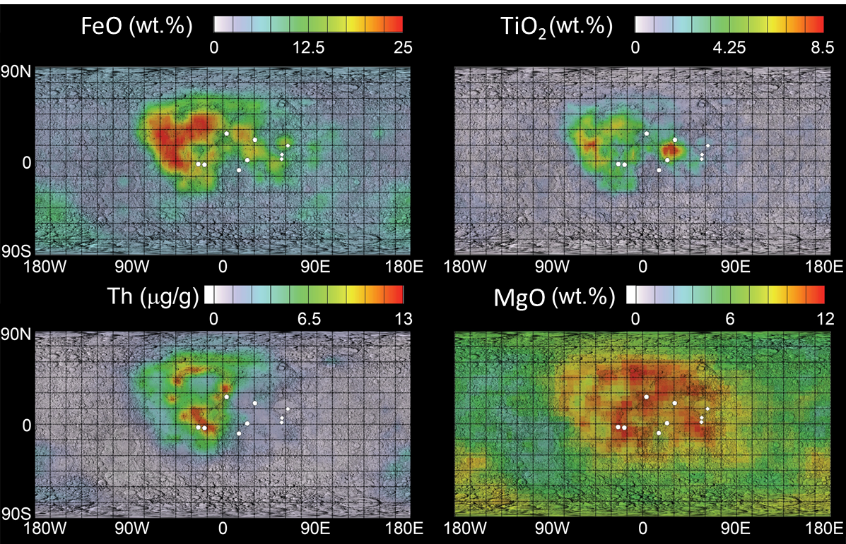
Information content
Specific elements via gamma-ray spectroscopy (with help from neutrons)
LP-GRS
Spectral unmixing – Lunar Prospector
Lunar elemental maps
ENDF/B-VI - Mg library spectrum required correction
1368.6 keV gamma-ray primarily from ²⁴Mg(n,n′γ) represented as a broad peak
FHT-FLM
calibration
Apollo sites are
sub-resolution
Peak analyses - Lawrence et al. (2000, 2002); Spectral unmixing - Prettyman et al. (2006)
LP-GRS artwork: S. Storms, LANL document LA-UR 10-05410

Slide 9
Information content
Specific elements via gamma-ray spectroscopy (with help from neutrons)
LP-GRS
Spectral unmixing – Lunar Prospector
Lunar elemental maps
Peak analyses - Lawrence et al. (2000, 2002); Spectral unmixing - Prettyman et al. (2006)
LP-GRS artwork: S. Storms, LANL document LA-UR 10-05410
LP-GRS artwork: S. Storms, LANL document LA-UR 10-05410

Slide 10
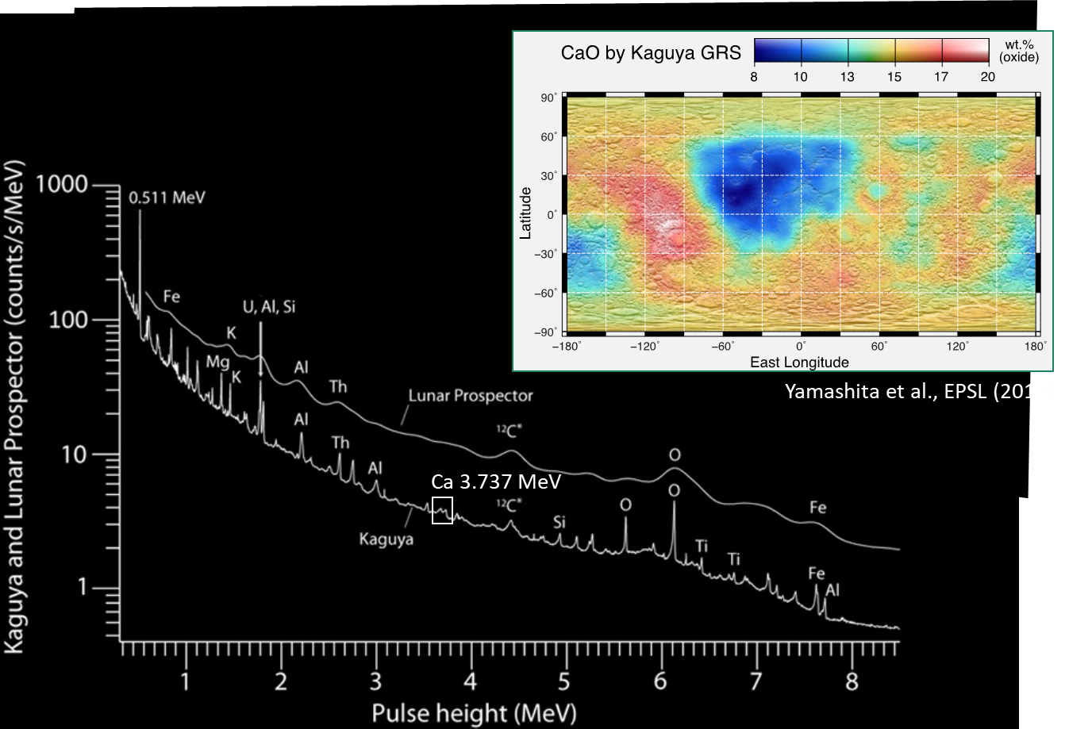
Instruments/Missions
Many instruments flown, starting with Apollo
Features:
Scintillators, semiconductors and gas proportional counters
Compact, rugged, low-power configurations required
Many, but not all, GRS instruments include cosmic ray veto
Both boom and body mounted configurations demonstrated
HPGe improves analyses of lunar calcium
Characterization of instrument response may require modeling of correlated reaction signatures for elements found in sensors, structure, and spacecraft.

Slide 11
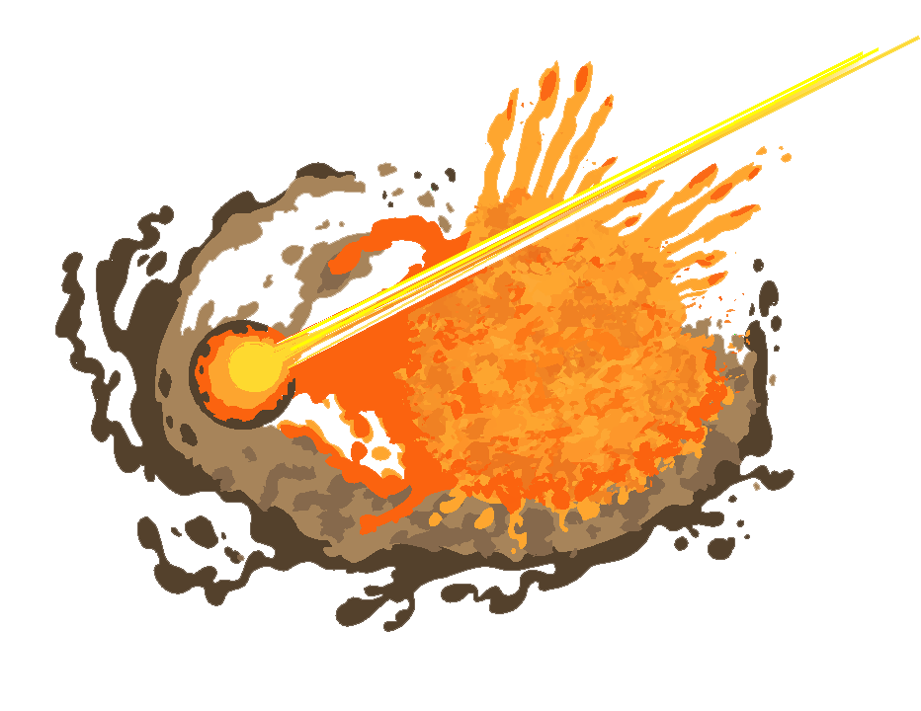
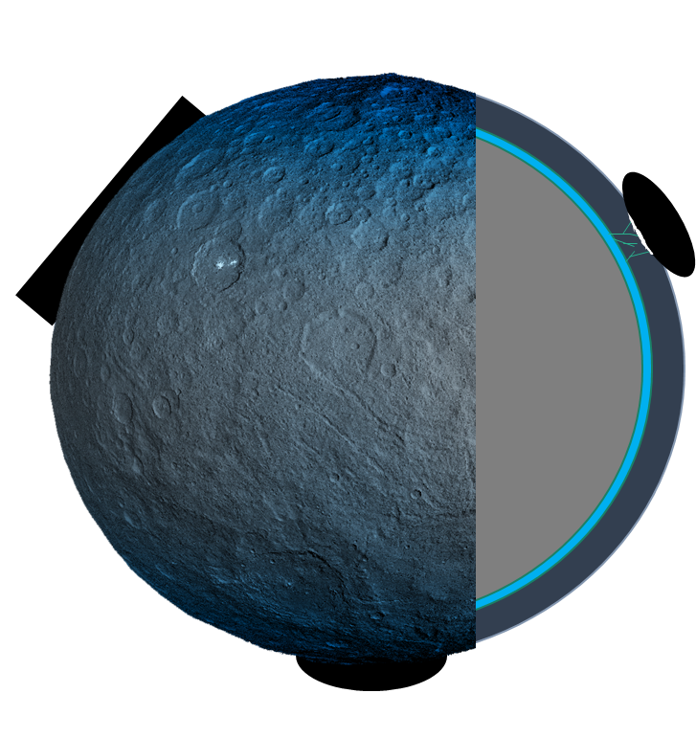
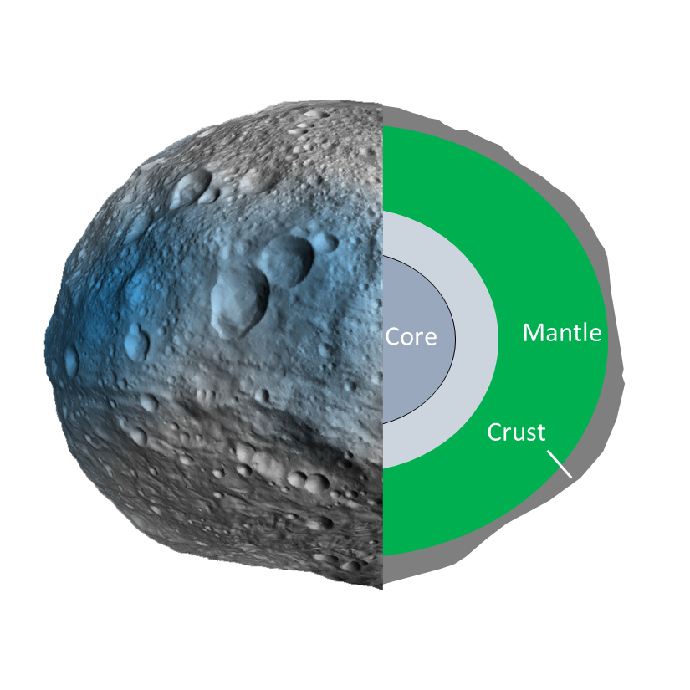
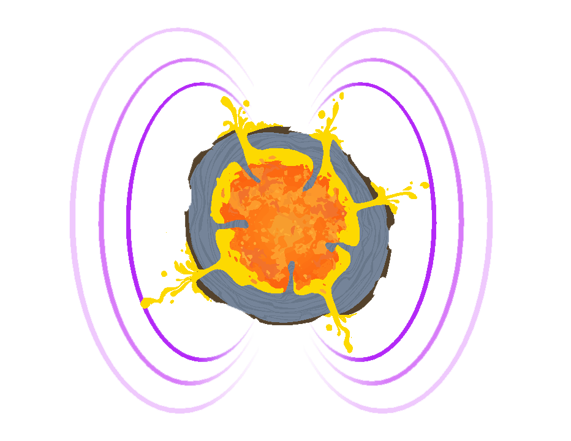
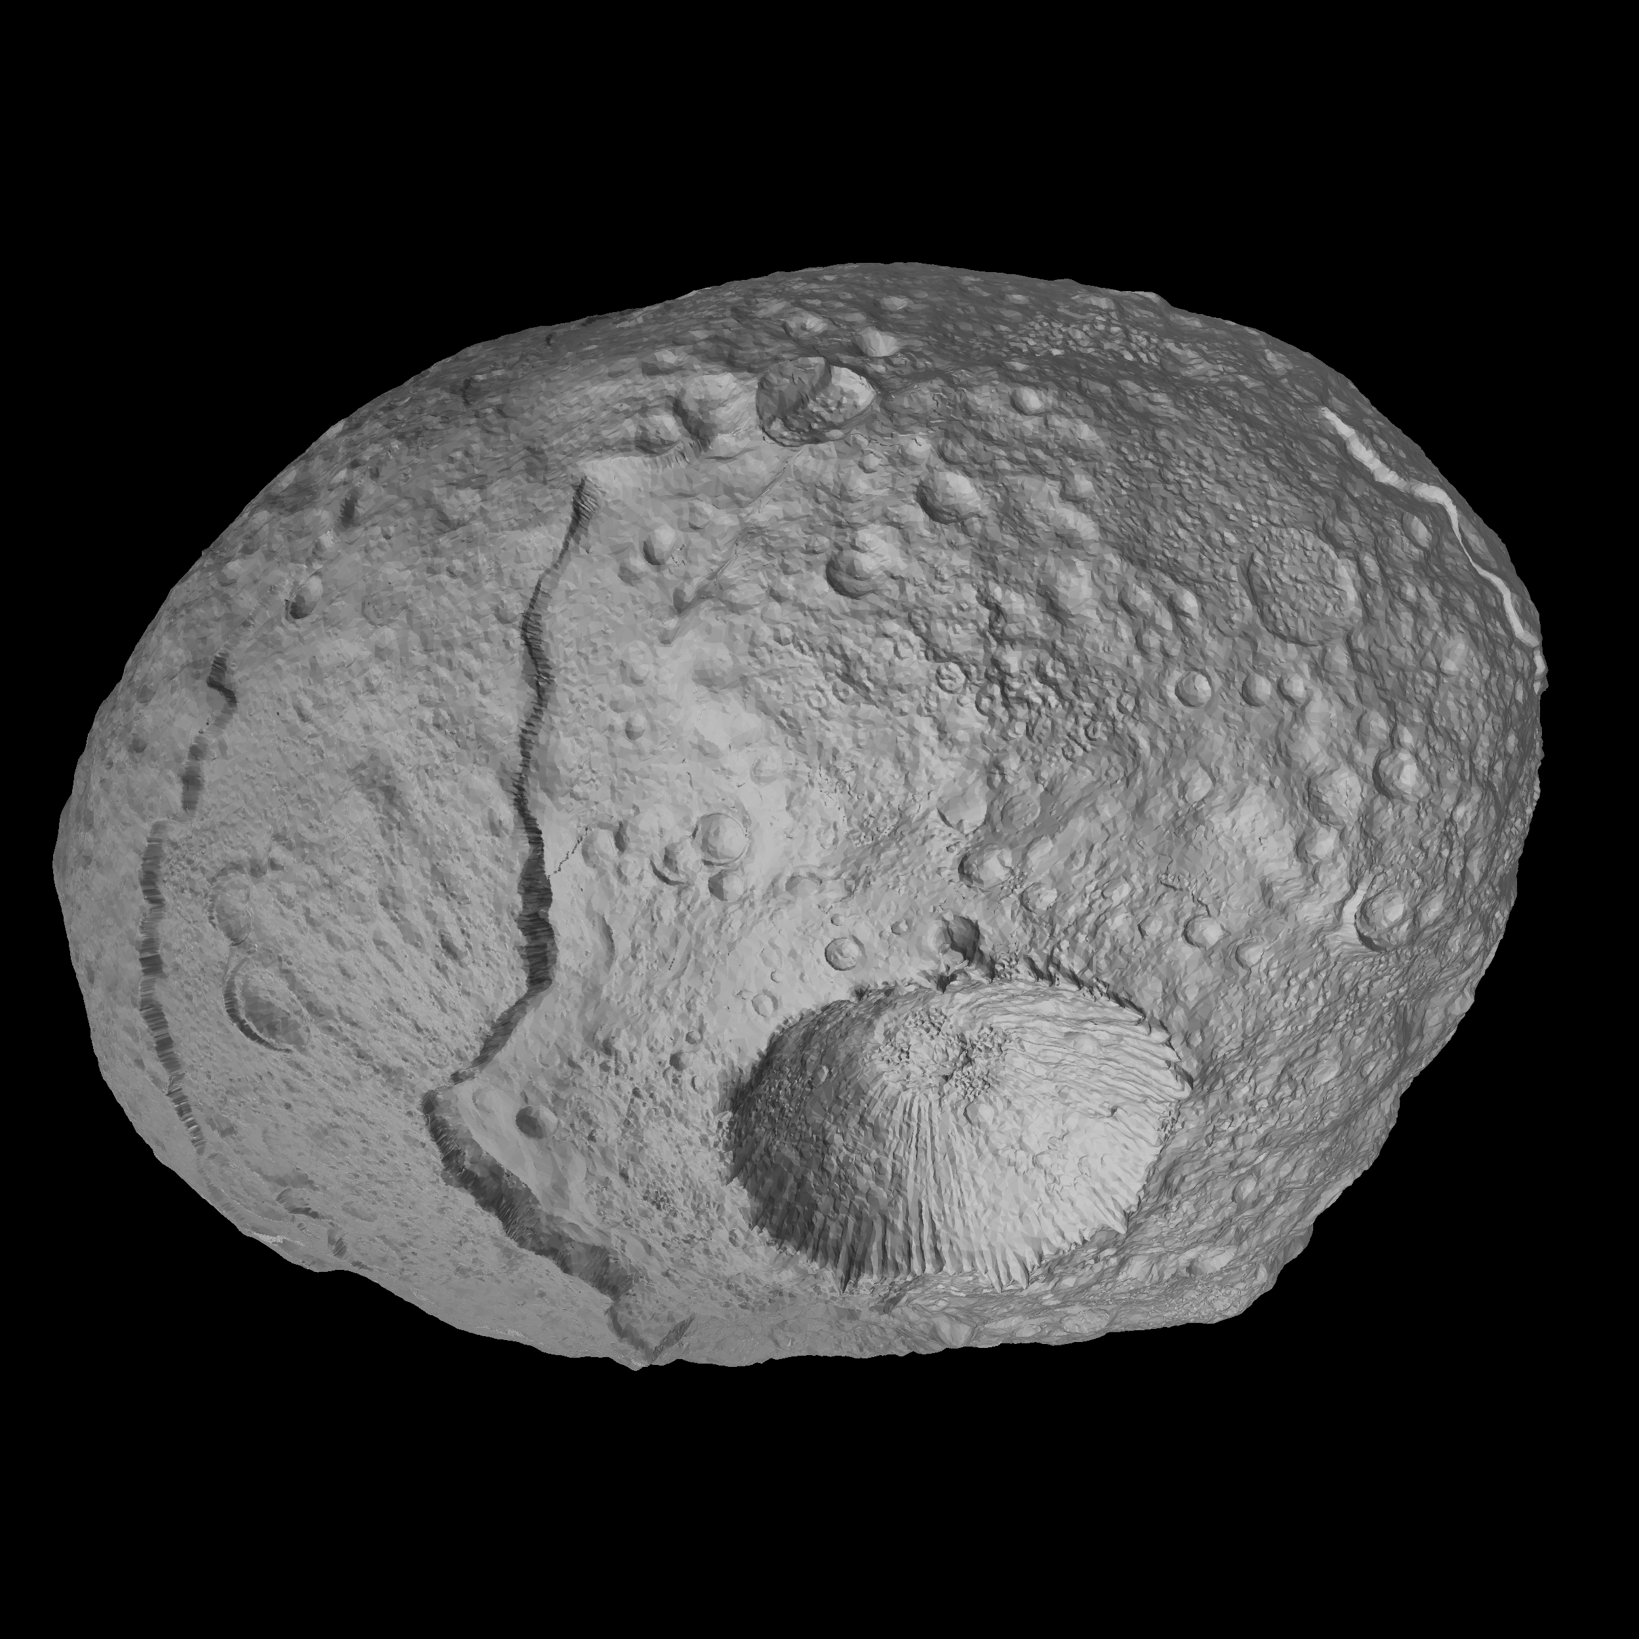
Regolith materials
Igneous versus aqueous geochemistry
Hit & run collision with igneous planetesimal
Volatile-rich
crust
Ceres
4 Vesta
Exogenic H
Subcrustal
brine layer
Receding ice table
(H-layering)
Rocky
mantle
Igneous differentiation
Aqueous alteration/differentiation
Anhydrous silicate minerals (basalts + plutonic rocks)
Li, O, Na, Mg, Al, Si, S, Ca, Ti, Mn, Fe, Co, Ni, Sc, REE (Sm, Eu, Gd)
16 Psyche?
Salts (carbonates + halides)
H, C, N, O, Na, Mg, Si, Cl, K, Ca
Aqueously altered rock (phyllosilicates and opaques)
H, C, N, O, Na, Mg, Al, Si, P, S, K, Ca, Mn, Fe, Ni
Water ice and organic matter
H, C, N, O
Variations in isotopic abundances generally ignored but might be important in some situations.
Fe-Ni metal with light alloying elements
H, C, O, Si, P, S, K, Fe, Ni
Psyche artwork courtesy ASU-led NASA Psyche mission

Slide 12
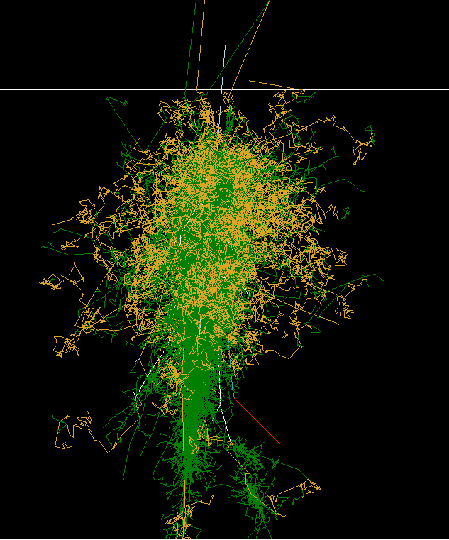
Summary of nuclear data issues
GCR
p
Planetary nuclear spectroscopy is model based:
  Models relate surface geology (chemistry, physical layering) to observations
  Requires accurate nuclear data libraries and models of high-energy interactions (up to many GeV/nucleon)
  Predictive capability is desired, ~20% accuracy achievable for many relevant signatures/materials per lunar observations
  “Ground truth” is required to achieve higher accuracy, i.e.,
    Use of known geochemical trends or regional compositions for the target body (FHT-FLM → Moon)
    Comparison of data acquired for different targets and observing conditions (Mars → Vesta)
    Selection of model parameters vs. calibration
Experimental validation of models
  Apollo Lunar Neutron Probe Experiment (e.g., McKinney et al, 2006)
  Accelerator and high-altitude balloon experiments with representative thick targets
  Model-experiment discrepancies for neutron production by light ions in thick, low-Z targets (e.g., Ratliff et al., 2018)
  Connections to space radiation shielding community
General comments
  Discrete gamma-ray lines by isotope needed for all elements of interest (see previous chart)
  Analog Monte Carlo modeling of correlated signatures may be of interest for interpretation of in situ measurements and calculations of instrument response
Space
γ
n
Regolith
5 m

