Slide 1
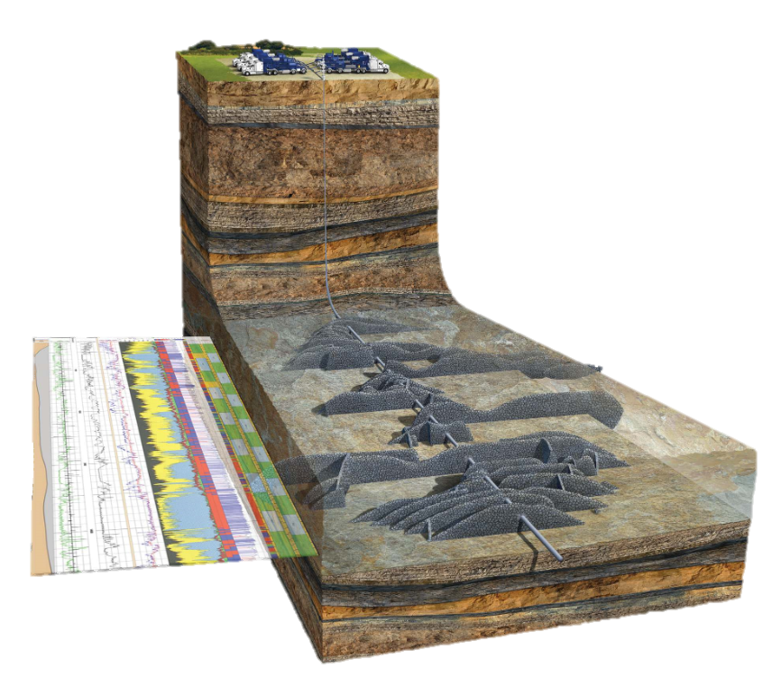
Inelastic Spectroscopy for Subsurface Exploration
Marie-Laure Mauborgne, R. J. Radtke, Fabien Haranger
Schlumberger
MMauborgne@slb.com

Slide 2
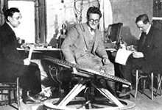
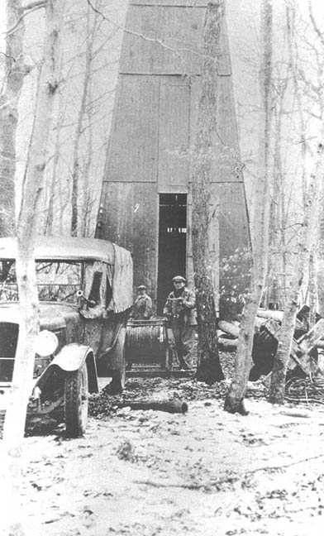
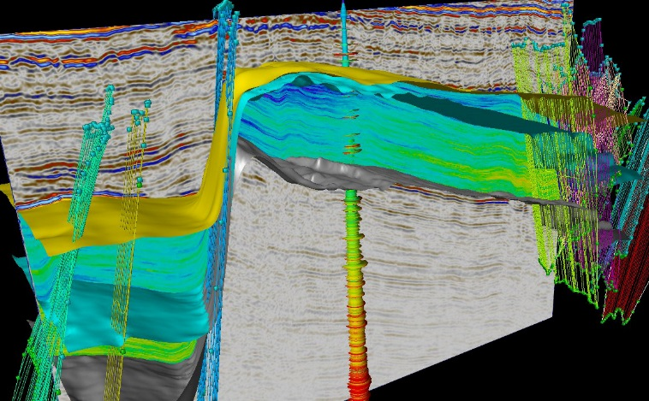
What is Schlumberger?
Founded by a physicist and an engineer to conduct geophysical measurements of rock formations First measurement in 1927
Now
82,000 employees >170 nationalities working in >120 countries
>90 research and engineering centers worldwide
Notes:
New numbers found on slb.com web page

Slide 3
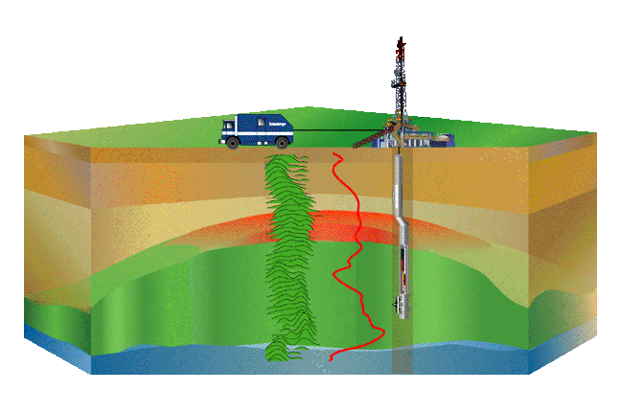
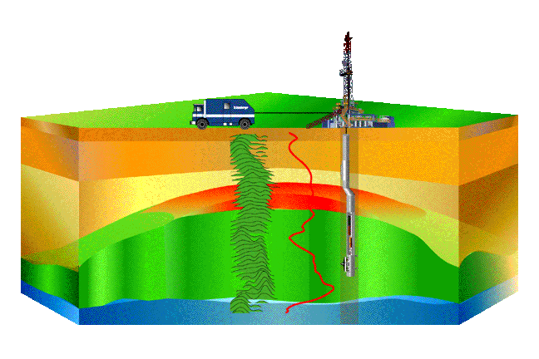
What Do We Do?
We develop tools to answer basic questions of oil exploration.
Where are the hydrocarbons?
What kind—oil or gas?
How much can be extracted?
Use nuclear physics to measure
natural radioactivity
rock density
hydrogen index, porosity
rock matrix and pore fluid composition
hole diameter
Etc.
➔ Full characterization of the reservoir

Slide 4
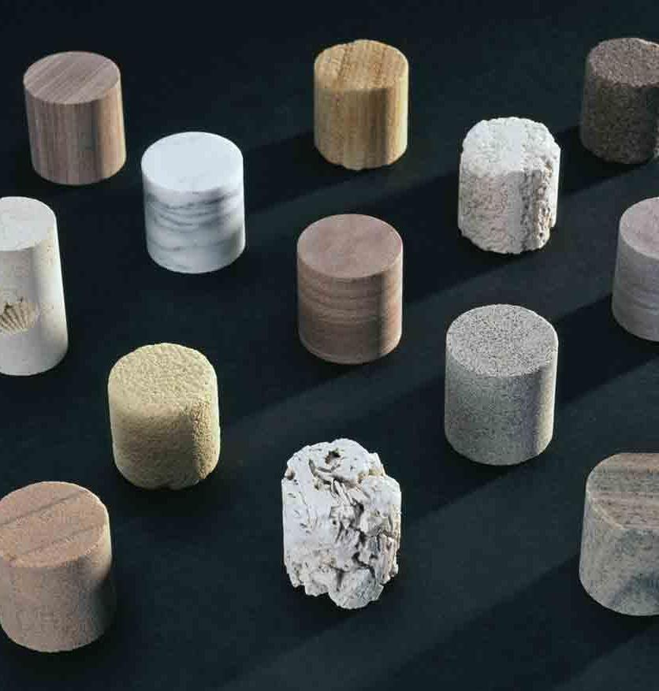
What Are Rocks Made of?
Rock = Matrix + Pores
Typical matrix materials
In the reservoir — sandstone (SiO₂), limestone (CaCO₃), dolomite (CaMg(CO₃)₂)
Everywhere else — “shale” (e.g., aluminosilicates)
Typical pore fluids
Salt water (NaCl brine)
Hydrocarbon (oil or gas, C_{n}H_{m})
Notes:
Very high overview of geology

Slide 5
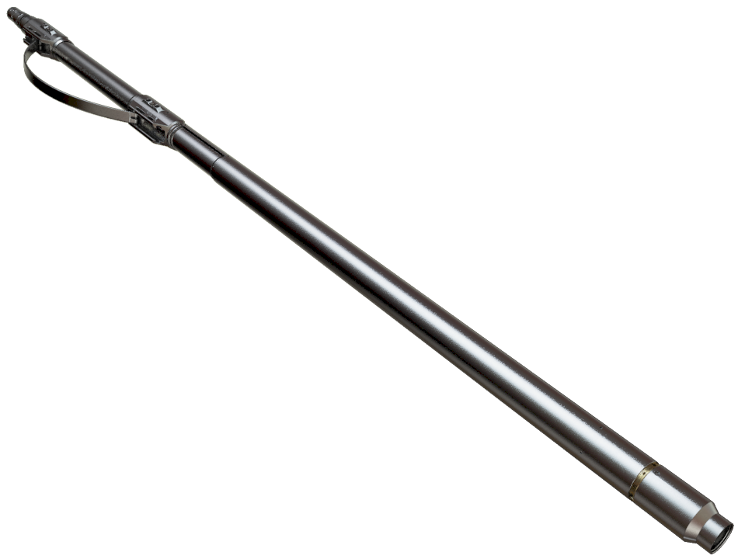
Tool Example: Dedicated to Spectroscopy
Diameter: 4½ in (11.5 cm)
Length: 9 ft (3 m)
Mass: 300 lbm (130 kg)
175°C, 20,000 psi rating (1,350 atm)
Uses LaBr₃:Ce spectroscopy detector
Pulsed Neutron Generator, 3.6 × 10⁸ neutron/s nominal output
First (in the industry) in-situ measurement of total organic carbon (TOC)
Tool used in this study
Notes:
Count rate > 10Mcps

Slide 6
Challenges
Not a laboratory environment:
Temperature (150-200°C)
Shock (hundreds of g)
Pressure (2,000 bar)
Presence of corrosive fluids
High precision/accuracy measurements are required
Rock density accuracy <1%
Short acquisition time (from less than 1 s to about 1 min)
Logging While Drilling specificities:
Space: less than 1% of the volume occupied by detectors
Power: 90W for a nuclear tool with neutron generator and detectors
Limited bandwidth for communication ~12 bits/s (mud pulse)
Memory: ~2 GB for 300 h acquisition

Slide 7
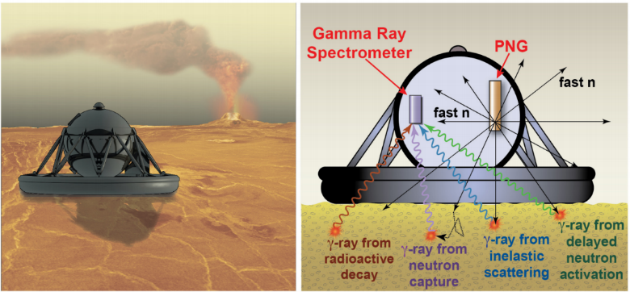
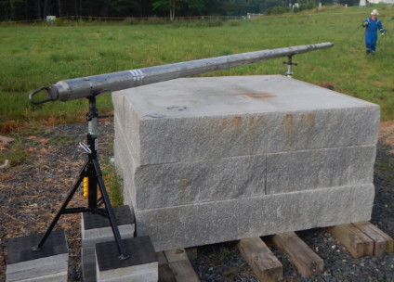
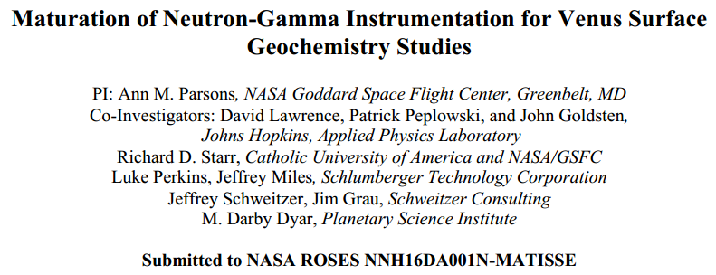
Recent Schlumberger-NASA Engagements—BECA
Proposal: Spectroscopy on Venus Lander to analyze its crust and look for water
Venus surface: P = 92 atm; T = 462ºC
Operational lifetime: 2–4 h max.
First test done at NASA Goddard Space Flight Center with an actual tool
Very good results with only minor modifications of the tool
Notes:
Bulk Elemental Composition Analyzer
IEEE 2016

Slide 8
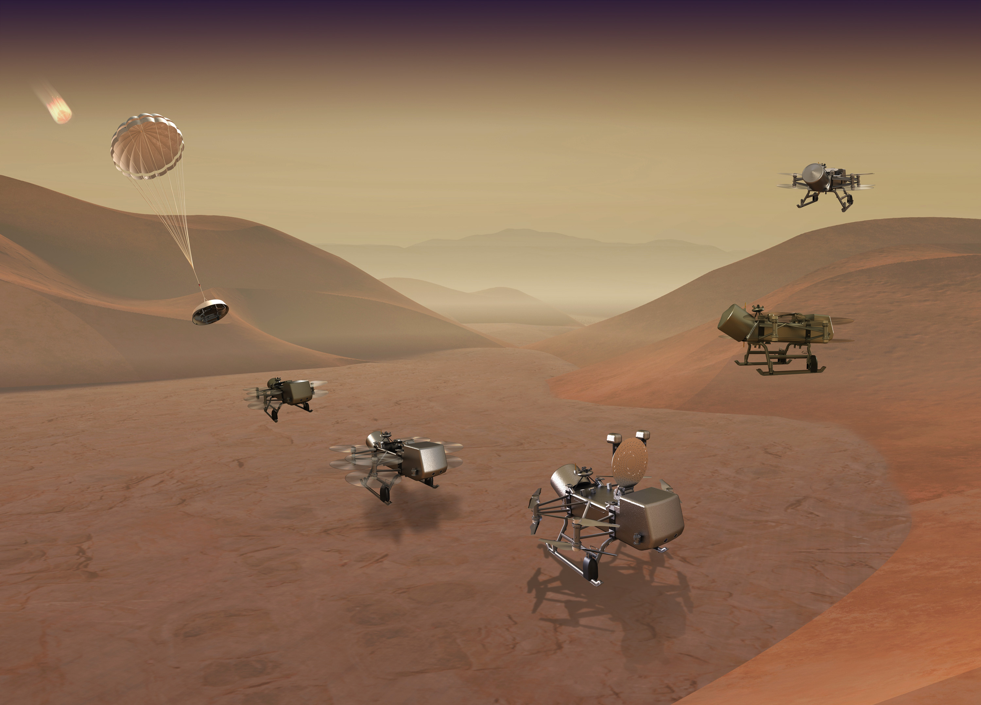
Recent Schlumberger Space Engagements—Dragonfly
In collaboration with Johns Hopkins Applied Physics Laboratory
Explore Titan (Saturn's largest moon) with an instrumented, radioisotope-powered dual-quadcopter
Provide pulsed neutron generator and expertise on gamma ray spectroscopy (capture and inelastic) to analyze the composition of the shallow subsurface

Slide 9
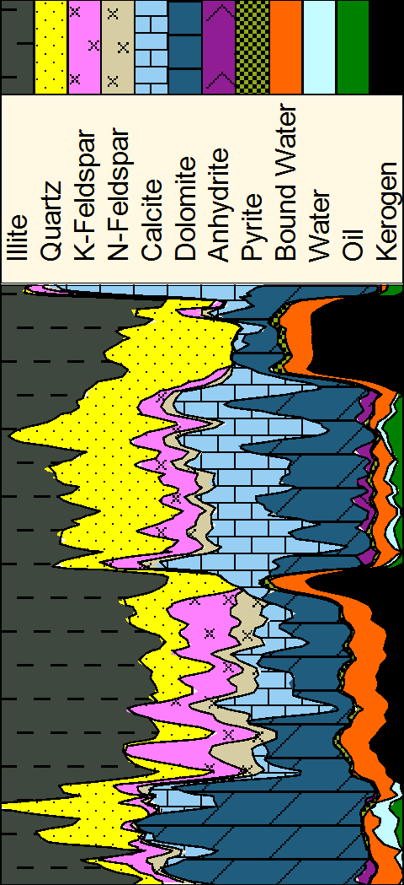
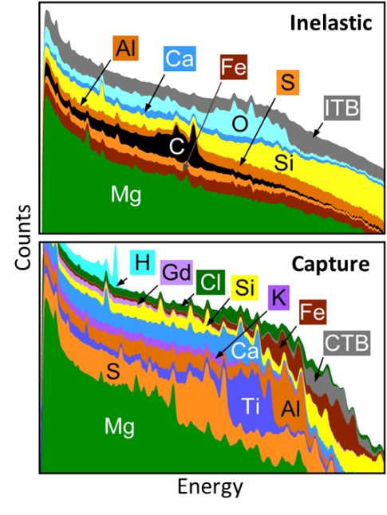
Spectroscopy Measurement
Neutron-induced gamma ray spectroscopy with a neutron generator (dT)
Temperature up to 175°C
Reconstruct lithology from elemental concentrations based on mineralogy models
Capture and inelastic gamma rays provide complementary information
Depth

Slide 10
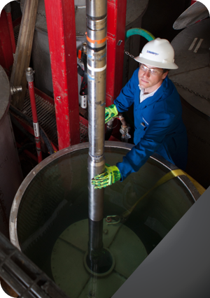
Why Do We Need Cross Sections?
Nuclear modeling is fundamental to well logging tool development
Explore design choices quickly.
Balance mechanics, electronics, and physics without costly experimentation.
Complement and extend characterization measurements.
Accurate modeling relies on accurate cross sections.
For spectroscopy, better cross sections could
improve elemental response (standard) derivation and interpretation algorithms
allow elemental standards directly from modeling.

Slide 11
Why Are Inelastic Gamma Rays Special?
Inelastic gamma rays provide:
unique information on carbon and oxygen
easier magnesium detection
complementary information on calcium, silicon, aluminum, sulfur, and iron
smaller sensitivity to chlorine.
A major drawback is the high background signal produced by the tool.
Being able to predict the amount of background is crucial to our application as well as separate elements found in the tool and the environment.

Slide 12
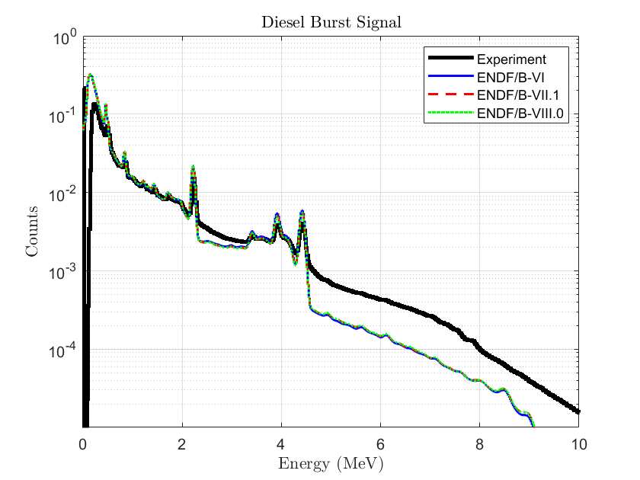
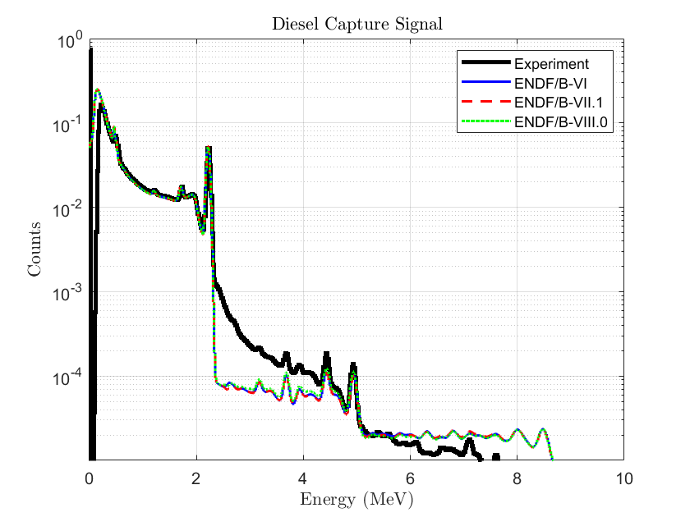
Tool Background
Tool submerged in diesel
Measurement while the PNG is on only
Mixed capture and inelastic signal
Very distinguishable peaks for carbon and hydrogen
Issue to reproduce the real magnitude of the background from the tool
3x error

Slide 13
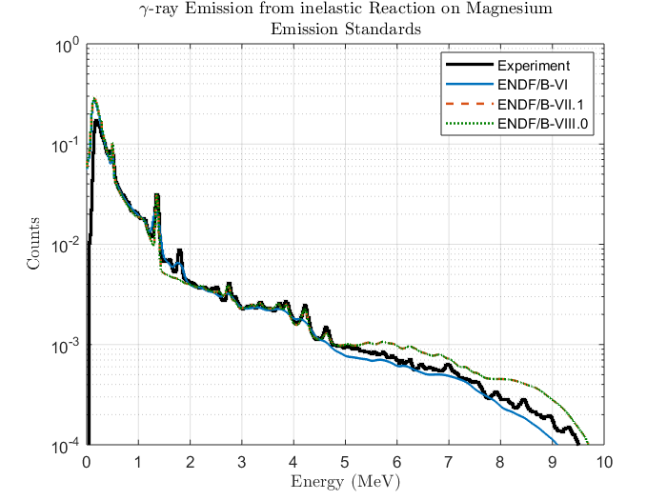
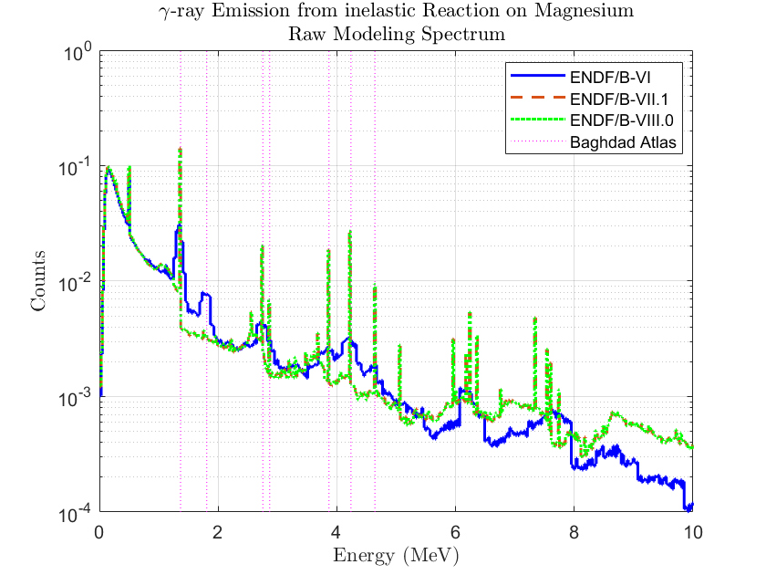
Magnesium Inelastic
ENDF/B-VI: Elemental cross sections
ENDF/B-VII: Isotopic cross sections
Finer binning of gamma ray energies but limited impact due to our detector resolution
Missing line at ~1.8 MeV

Slide 14
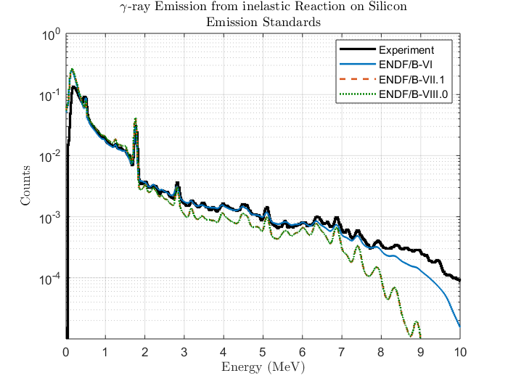
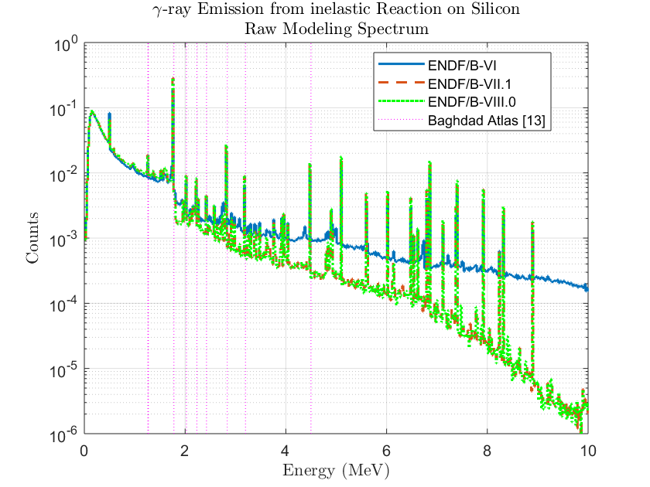
Silicon Inelastic
Use of natural compound in ENDF/B-VI, Si-28 afterward
Totally different response between ENDF/B-VI and newer releases
ENDF/B-VI in better agreement with our experimental results above 2 MeV

Slide 15
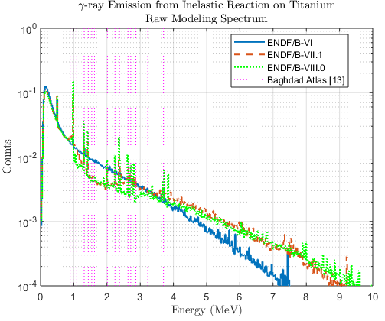
Titanium Inelastic
Unfortunately, no experimental comparison
Better agreement between the latest ENDF version and the Baghdad Atlas

Slide 16
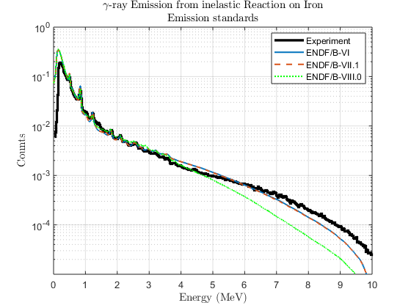
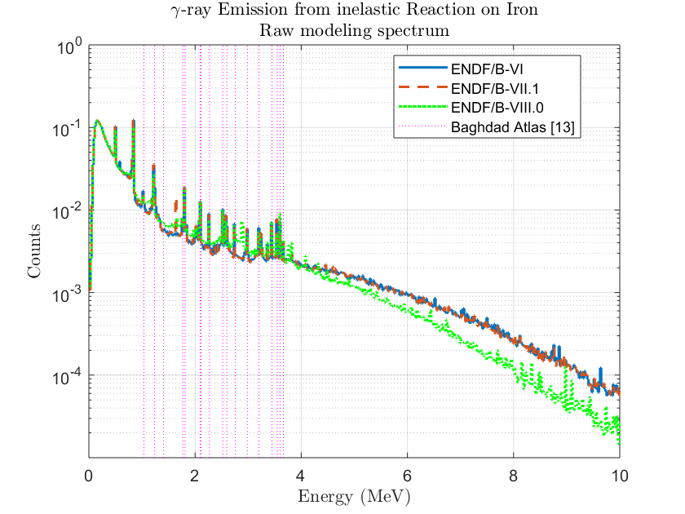
Iron Inelastic
Very limited number of features on our experimental data
Mostly in agreement with Baghdad Atlas

Slide 17
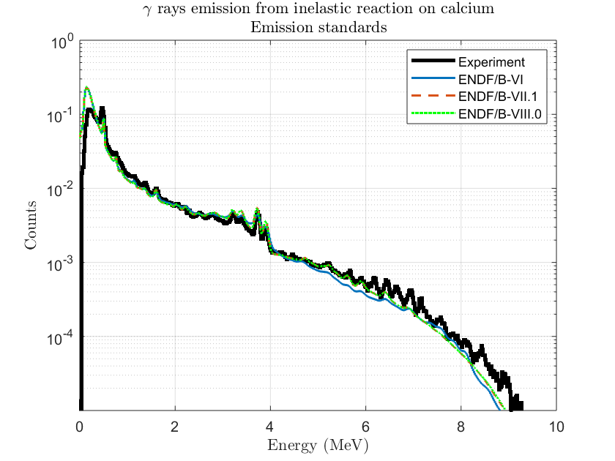
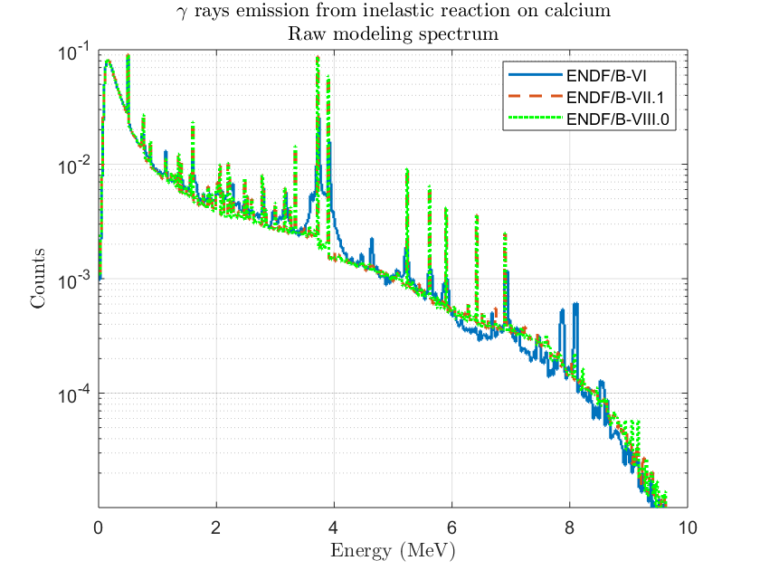
Calcium Inelastic
Calcium stays globally the same with some improvement in the sharpness of the peaks
Two peaks around 8 MeV disappeared
No experimental data at this energy

Slide 18
Conclusion
Oilfield and space applications share an interest in lithology measurements obtained from neutron-induced gamma-ray spectroscopy
Modeling is perfectly suited to help design such tools and understand their measurements
Accurate cross sections are the foundation of this work. Major issues with inelastic cross sections are
experimental measurements of inelastic gamma ray peaks above 4 MeV
absolute cross sections for tool background.

Slide 19
Related publications
Impact of the ENDF/B-VIII.0 Library on Modeling Nuclear Tools for Oil Exploration, Mauborgne et al. Nuclear Data 2019 EPJ Web of Conf. Volume 239, 2020 – 20007
Exploring for oil with nuclear physics, Mauborgne et al. Nuclear Data 2016 EPJ Web Conf. Volume 146, 2017 – 09009
Designing tools for oil exploration using nuclear modeling, Mauborgne et al. Nuclear Data 2016 EPJ Web Conf. Volume 146, 2017 – 09036

Slide 20
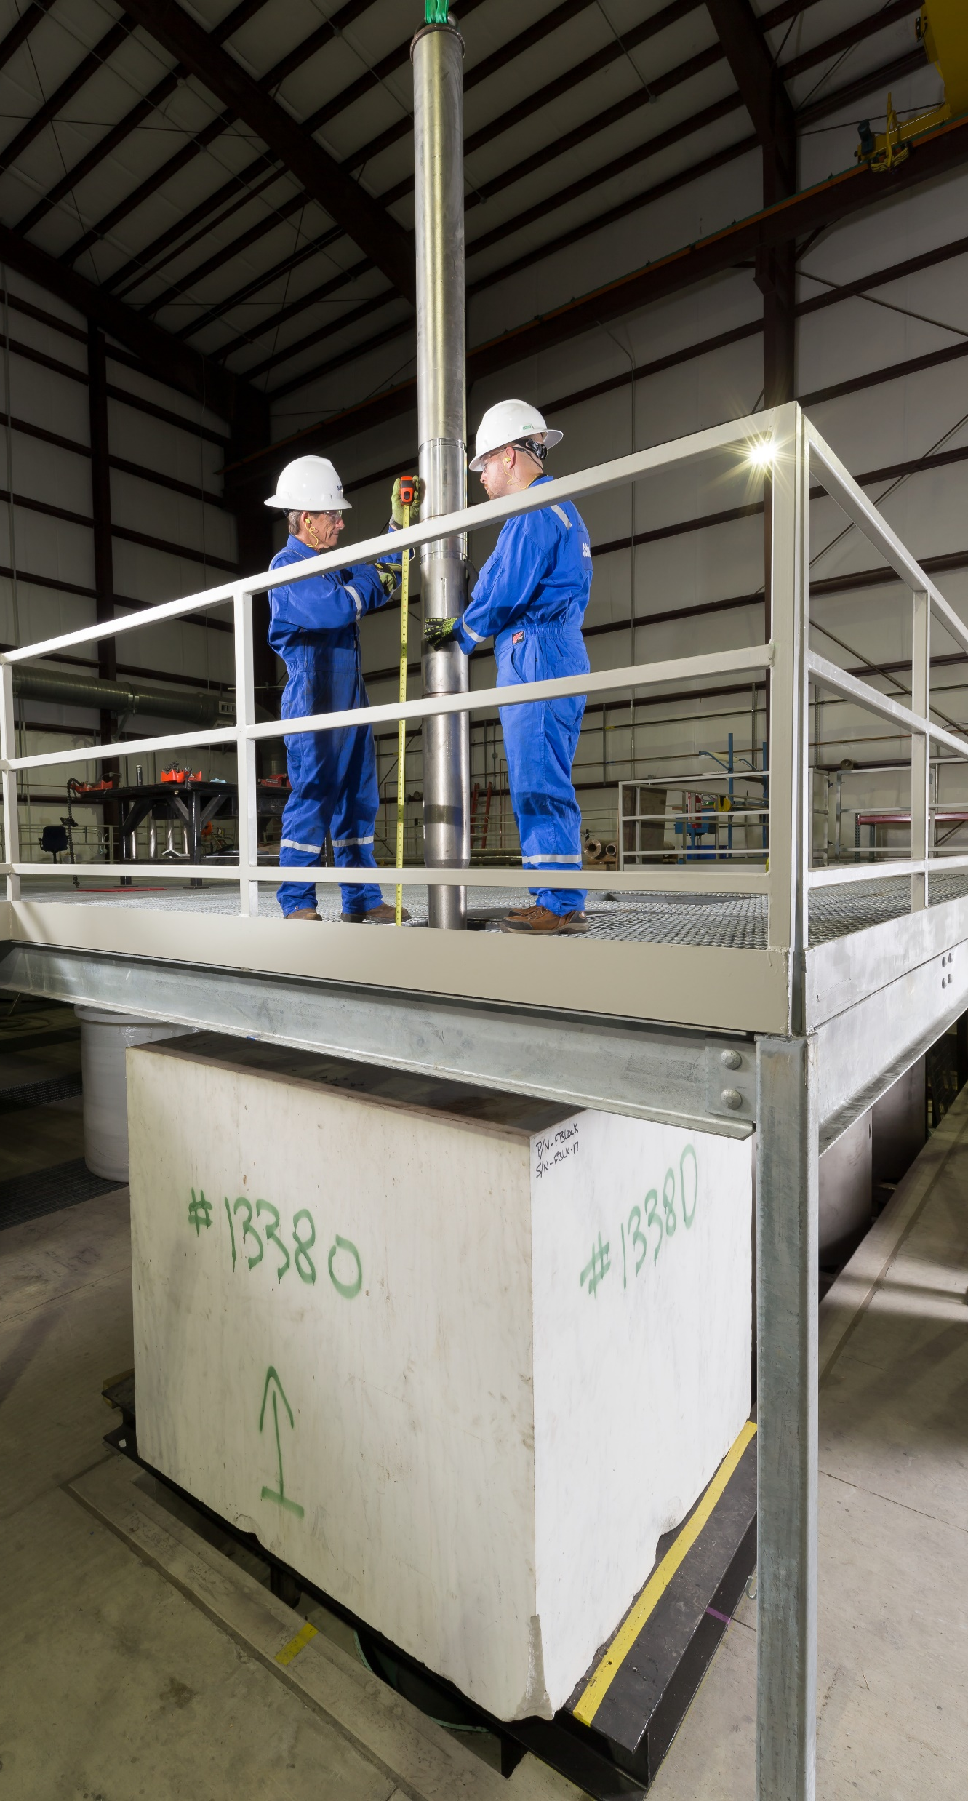
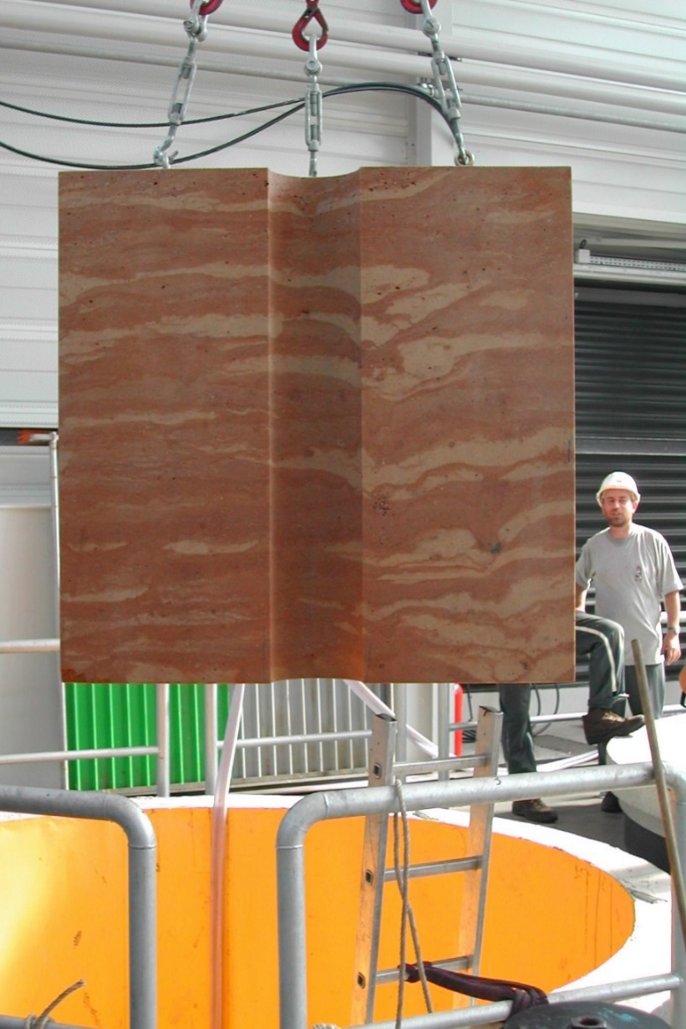
From Measurements to Elemental Standards
Focus on
Si, Ca, Mg, Al, Fe, K, S, Na to identify rock matrix
H, C, O, Cl to identify pore fluid
Extract the spectral signatures of the different elements
Acquiring high-precision spectra in variety of environments
Combining measured spectra to isolate specific contributions
Guiding this process through modeling
High-quality elemental standards enable accurate spectral analysis, from which all tool answers are derived: elemental weight fractions, mineralogy, and total organic carbon

