Slide 1
NDIAWG - Nonproliferation Scoping Studies (α,n) Nuclear Data Scoping Study
Catherine Romano
David Brown (BNL) Stephen Croft (ORNL) Andrea Favalli (LANL) Les Nakae (LLNL) Marco Pigni (ORNL) Steve Skutnik (ORNL) Michael S. Smith (ORNL) Will Wieselquist (ORNL) Michael Zerkle (NNL)
WANDA2021
January 25 – February 3, 2021

Slide 2
Project Goal is to provide an ACTIONABLE plan to resolve nuclear data issues that impact applications
Determine the state of the libraries and modeling capabilities
JENDL, TENDL, ENDF
SOURCES4C, GEANT, MCNP
Determine application needs
UF₆ enrichment
Spent fuel safeguards
Passive NDA measurements – neutron/gamma
Neutron source characterization – PuBe, AmBe, etc…
Natural neutron background calculations
Targeted alpha therapy – ²²⁵Ac and ²²⁷Th
Isotope Production – high energy alpha beams not part of study
Create a set of recommended tasks to resolve priority nuclear data and simulation needs.
ORNL Report to be published shortly

Slide 3
State of the (α,n) Data and Codes
ENDF library is mostly theoretical (TENDL) or based on JENDL (Japanese library)
GNDS format is required to accommodate enhanced data
Many cross sections for priority isotopes have large uncertainties and are based on old data
Neutron energy spectra have large uncertainties
Require more information from experiments to improve evaluation of spectrum
Neutron angular distributions not well known
Impact differential nuclear data measurements using beams
Gamma emission energies
Provide information on excitation states populated for improved neutron emission spectra calculations
May be useful for NDA measurements
Stopping powers not well understood
Application specific measurements are required
Evaluation methods require code modifications
Experiments that capture the population of excited states using gamma measurement data needed to allow theoretical models to correctly predict the neutron spectrum
SOURCES4C is unsupported and outdated

Slide 4
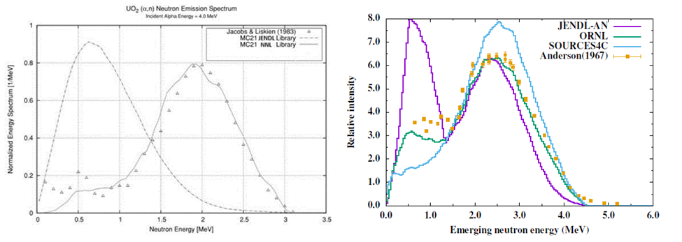
Neutron Spectrum is not well known even if the cross section has relatively low uncertainty
Calculations of neutron spectrum using MC21 with the JENDL O(α,n) library and the Naval Nuclear Laboratory (α,n) library compared to experimental data (left) and theoretical calculations of the neutron spectrum from O(α,n) reaction compared to the JENDLE library, SOURCES4C, and experimental data (right) [Pigni, 2016].

Slide 5
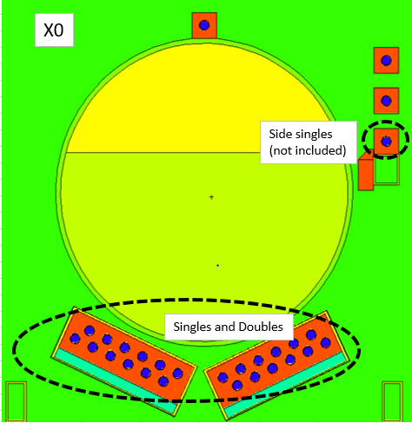
Uncertainty study of UF₆ cylinders at LANL
Goal: to determine the nuclear data contribution to the uncertainty budget for UF6 cylinder measurements
Passive Neutron Enrichment Meter (PNEM)
Two briefcase size polyethylene pods with twelve ³He tubes at 10 atm.
Varied enrichments and fraction of UF₆ bound to walls
(α,n) source terms built on the Jacobs & Liskien data (‘83 and ‘85), modeled with SOURCES4C
Included a revaluation of the stopping power.
Conclusion: The total neutron yield has biggest impact
These detectors are relatively insensitive to neutron energy
Neutrons per s per g ²³⁴U (1σ range) | Source
460 | (Reilly et al. 1971)
576 ± 7.3% (533-618) | (Sampson 1974)
474 ± 4.4% (453-494) | (Miller et al. 2014)
503 ± ~4% (483-523) | (Kulisek et al. 2017; uncertainty estimated by Croft et al. 2020)
507 ± 1.1% (501-513) | (Croft et al. 2020)
610 | SOURCES-4C (Wilson et al. 2002)
604 | Modified SOURCES-4C (Wilson et al. 2002; private comm. Croft & Gauld 2020)
D.P. Broughton, S. Croft, C. Romano, A. Favalli, Sensitivity of the simulations of passive neutron emission from UF₆ cylinder to the uncertainties in both ¹⁹F(α,n) energy spectrum and thick target yield of ²³⁴U in UF₆ (To be submitted to NIM A)

Slide 6
Priority Recommendations
Prioritized by cross-cutting impact and program specific need for improved fluorine data
SOURCES4C code modernization
Evaluation of fluorine, oxygen and carbon (α,n) data
Fluorine thick target integral and activation experiments
ENDF database modernization and processing code updates

Slide 7
Modernization of the SOURCES4C Code
PRIORITY TASKS
Open-source distribution with software management – requires ownership/maintenance
Nuclear data read from ENDF/B
Pointwise in energy (α,n) cross sections.
Prompt neutron emission spectra.
Prompt gamma emission spectra.
Enable user input to supply specialized nuclear data file, stopping powers
The code will output include reaction rates, neutron and gamma energies
A Fortran/C++/Python API allows interface with other codes - MCNP or SCALE/ORIGEN
FOLLOW ON TASKS
Verification and Validation
Application specific test suites

Slide 8
Evaluation of Current Data
Fluorine Evaluation
An evaluation of Fluorine in year one will provide useful evaluated data to the users until improved benchmark data can be provided.
Improved data requested by IAEA, recent measurement data (Peters 2016) never evaluated
Updated evaluation based on new data once experiments are complete.
Oxygen Evaluation
New, higher resolution data sets will be available from Notre Dame with information on excitation states that will reduce uncertainties at lower energies in the previous evaluations.
Carbon Evaluation
Carbon is the isotope used to calibrate detector systems for all other (α,n) measurements. There are large discrepancies in the data that are currently being examined by multiple groups. An evaluation of the data is needed once the discrepancies are resolved.
Code Development
Reduced R-matrix formalism and penetrability factors to describe the break-up reaction channel and account for both gamma and neutron emission.
Postdoc or early career mentoring recommended

Slide 9
Experiments on Fluorine to Reduce Uncertainties
PRIORITY TASKS
Fluorine Flat-response 4p Moderated Neutron Counter Measurements
Measure total yield of neutrons from ¹⁹F(α,n)²²Na per incident alpha particle, integrated over all angles and all alpha energies.
Measure a series of fluorinated compounds to define the role that the stopping power plays in the total yield is important.
Fluorine Activation Measurements
Measure ²²Na decay produced by the ¹⁹F(a,n)²²Na reaction in a thick fluorinated target after bombardment by alpha particles.
Fluorine Neutron Spectrum Measurements
Measure the energy spectrum and angular dependence of neutrons emitted from the thick stopping fluorinated sample simultaneously with the activation measurement
Use time-of-flight combined with deuterated liquid scintillator detector spectrum unfolding.
SECONDARY TASK
Thin Fluorine Target Energy-Differential Excitation Function Measurements
10 keV energy steps including neutron and gamma spectrum benchmarked to integral measurements.

Slide 10
ENDF (α,n) Nuclear Data Sub-Library in GNDS Format
PRIMARY GOAL: Expanded ENDF (a,n) library
Extend the GNDS tools and format to allow for charged particle reactions
Develop APIs, processing and evaluation codes Fudge, GIDI and AMPX managed by the NEA GNDS Expert Group (EG-GNDS)
Extend FUDGE processing code and the open source GIDI API.
Used by LLNL codes and, in the future, GEANT4
Extend the SAMMY evaluation tool and AMPX processing code.
Used by SCALE/ORIGEN

Slide 11
Top Priority isotopes for Nonproliferation
Isotope | Current State of Data | Reaction Threshold | Applications | Recommendation
¹³C | Recent data (4-6.5 MeV) to be published, No evaluation | 450 -800 keV | NDA/ER, safeguards, advanced reactors, background simulations, alpha therapy | Low energy measurement needed < 1MeV - 4 MeV. Recent Notre Dame measurement from 4-6.5 MeV. Discrepancies in past data are being examined and new evaluation once data issues resolved.
¹⁷O | NNL and ORNL evaluation available for next ENDF release - still discrepancies in neutron spectrum | 800 keV-1.2 MeV | safeguards, reactors, NDA/ER, Background simulations, alpha therapy | Recent Notre Dame measurement from 0.8 - 7 MeV will provide data to resolve discrepancies in neutron spectrum. Updated evaluation needed
¹⁸O | NNL and ORNL evaluation available for next ENDF release - still discrepancies in neutron spectrum | 850 keV-1.4 MeV | safeguards, reactors, NDA/ER, Background simulations, alpha therapy | Recent Notre Dame measurement from 2-8 MeV will provide data to resolve discrepancies in neutron spectrum. Updated evaluation needed
¹⁹F | No evaluation on recent data, benchmark needed | 2.3 MeV | safeguards UF6, FLiBe reactors, fuel cycle & waste management applications (fluoride volatility process) | Previous cross section measurements provided improvement. Still need total neutron, neutron spectrum, gamma emission with lower uncertainty per IAEA. A combination of improved total cross section, angular distributions, neutron energy spectra, activation, and thick target integral measurements are needed to reduce uncertainties.

Slide 12
Secondary Priority – Safeguards and Reactors
⁷Li | Adjusted evaluation based on JENDL data available for next ENDF release, large discrepancies in data require new experiments | 3-4 MeV | FLIBe reactors, NDA/ER, spent fuel safeguards, Actinide-Li neutron sources | New experiments with ability to resolve excitation states and reaction channels and new evaluations are needed in order to accurately model neutron sources.
⁹Be | NNL evaluation available for next ENDF release | 200 KeV | FLIBe reactors, NDA/ER, spent fuel safeguards, Actinide-Be neutron sources | Neutron spectrum been validated by NNL by adjusting JENDL for additional breakup reaction channels. Would benefit from new measurements that provide information on reaction channels
¹¹B | No evaluation | 600 keV | Reactors, safeguards | Only measured up to 2.5 MeV
¹⁰B | Recent Experiments up to 4.5 MeV, requires evaluation | 1 MeV | Reactors, safeguards | Recent experiments from 1.5-4.5 MeV conducted at Notre Dame. Data above 4.5 MeV and an evaluation are needed
²⁷Al | Discrepancies in data from 1970s No evaluation | 3 MeV | NDA/ER, advanced reactor fuel and spent fuel safeguards | New experiments and evaluations with resolved excitation states and neutron spectrum are needed for advanced reactor fuels and emergency response.

Slide 13
Lower priority
²³Na | Need new experiments and evaluation | 3.5 MeV | molten salt reactors | New experiments with ability to resolve excitation states and evaluations are needed for advanced reactor fuels
²⁵Mg | Need new experiments and evaluation | 3 MeV | MgCl molten salt, fuel cladding, astrophysics | Recent Notre Dame measurement from 1.5-3.5 MeV. Experiments up to 6.5 MeV needed for advanced reactors. Evaluation needed
²⁶Mg | Need new experiments and evaluation | 3 MeV | MgCl molten salt, fuel cladding, astrophysics | Planned Notre Dame measurement from 1.5-3.5 MeV. Experiments up to 6.5 MeV needed for advanced reactors. Evaluation needed
²⁹Si | Need new experiments and evaluation | 2 MeV | Advanced reactor fuels | New experiments with ability to resolve excitation states and evaluations are needed for advanced reactor fuels
³⁰Si | Need new experiments and evaluation | 4 MeV | Advanced reactor fuels | New experiments with ability to resolve excitation states and evaluations are needed for advanced reactor fuels
³⁷Cl | Need new experiments and evaluation | 1 MeV | Chloride-based (Na, LiCl, MgCl) molten salt fuel, pyroprocessing | New experiments with ability to resolve excitation states and evaluations are needed for advanced reactor fuels
⁴¹K | Need new experiments and evaluation | 3.5 MeV | Pyroprocessing, molten salt fuel (FLiNaK) | New experiments with ability to resolve excitation states and evaluations are needed for advanced reactor fuels

Slide 14
Thank You!
This work sponsored by the U.S. Department of Energy (DOE), Office of Defense Nuclear Nonproliferation’s Nonproliferation Research and Development (NA-22).
Funded through the NDIAWG FOA

