Slide 1
Assessment of Nuclear Data Needs for Active Neutron Interrogation
Cathy Romano¹ (PI)
Bonnie Canion³
Jerome Verbeke³
Matthew Blackston²
Seth McConchie^{4,*}
WANDA 2021
2021 February 3
¹Previously ORNL, now IB3 Global Solutions
²Previously ORNL, now Two Six Labs
³LLNL ⁴ORNL *mcconchiesm@ornl.gov

Slide 2
Scoping Study Overview
Objective: Assess the nuclear data gaps and modeling deficiencies for secondary gamma emissions from neutron interactions (excluding fission)
Proposed to DOE National Laboratory Announcement Number LAB 19-2114 in the NNSA research area for FY19
PI: Cathy Romano {also PI for the (alpha,n) scoping study}
Performers: Matthew Blackston, Bonnie Canion, Seth McConchie, Jerome Verbeke
Output: Science plan describing why non-fission secondary gamma emissions are important, why modeling them is useful, what was learned about nuclear data gaps and modeling deficiencies, and recommendations for addressing them
Special thanks to nuclear data experts and users from many organizations in the DOE complex and industry for their input to the assessment

Slide 3
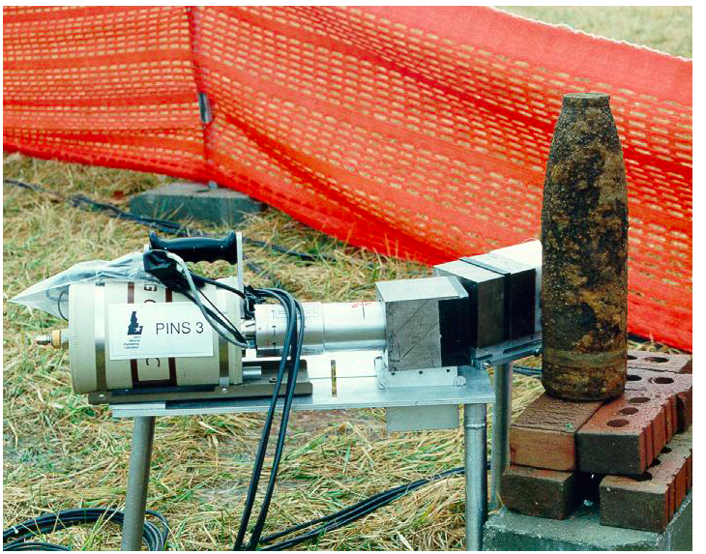
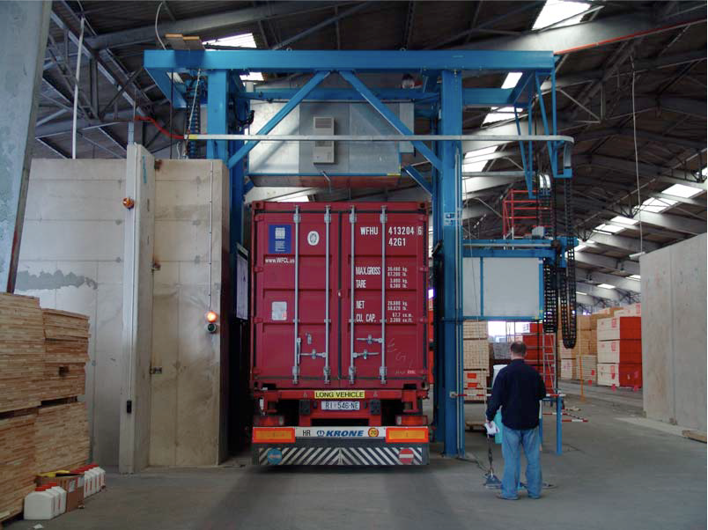
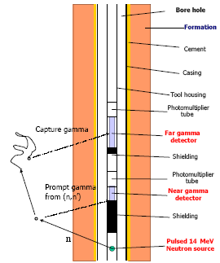
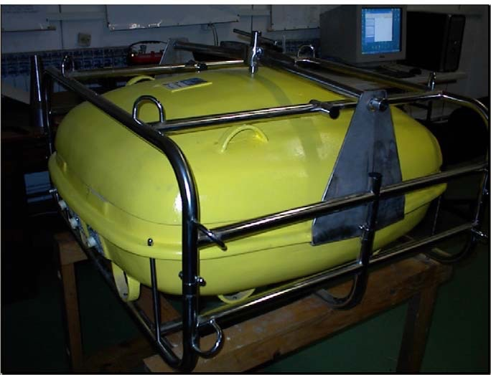
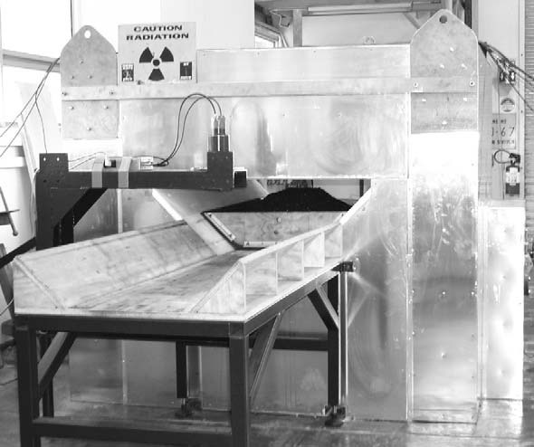
Motivation: Material Identification with Neutron-induced Gamma Spectrometry
Oil well tool from schematic
INL PINS
Purdue SOS
EURITRACK
WKU PELAN
A.C.T.d.o.o. Surveyor
CSIRO NITA
Developers of these technologies are User Group #1 in this study
These users need the number of absorption or scattering reactions and the number and energies of emitted gammas to be correct on average over many source neutrons

Slide 4
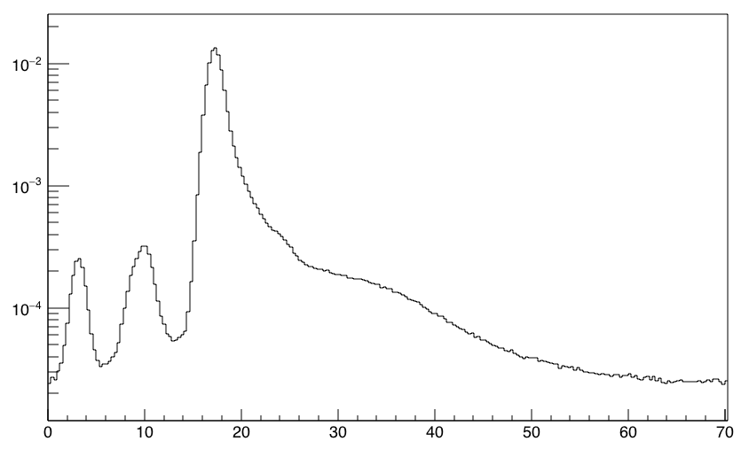
More Motivation: Geometry and Material Characterization with Associated Particle Imaging
Detector
API D-T neutron generator
Item gammas (n,n’𝛾) and (n,f)
Transmission and small angle elastic scattering neutrons
Unknown Container
d⁺
Fission neutrons
Low-Z elastic scatter neutrons
More gammas
n
α
Counts per alpha
Material characterization by reconstructing scattering events and induced fission events
Developers of these technologies are User Group #2 in this study
These users need the emission energy, time, number, and angle information for neutrons and gammas to be accurate on an event-by-event basis
D-T NG (n,n’𝛾)
Time of flight (ns)

Slide 5
Justification for Modeling Secondary Gamma Emissions
Scope physics limitations – What gamma signatures are observable for a given measurement time?
Optimize system design parameters – How should the core system components be arranged given application constraints?
Develop analysis algorithms – What is the best algorithm for translating a detector signal to a useful quantity?

Slide 6
Nuclear Data and Modeling Status
Significant number of users use MCNP or Geant for their modeling needs, and MCNP and Geant use reaction data sourced from ENDF libraries
User Group #1: MCNP6 and Geant4 are sufficient for their modeling needs if the cross-section data and gamma emission data are available and accurate
User Group #2: MCNP6 and Geant4 are not sufficient for their modeling needs
MCNP6 does not correlate neutrons and gammas without the Cascading Gamma-ray Multiplicity code, but CGM is roughly 1000 times slower when the CGM option is turned on
Geant4 correlates neutrons and gammas, but
Cross-section and gamma multiplicity data must exist for reactions leaving the residual nucleus in an excited state
Geant4 modeling of excitations to the continuum of states is unreliable, which is important for users of sufficiently energetic neutron sources like D-T neutron generators
ENDF/B-VIII.0 does not have gamma multiplicity data for several isotopes of interest and cannot have data beyond the 40th excited state

Slide 7
Recommendations for Addressing Gaps and Deficiencies
Update the gamma emission data in ENDF/B-VIII to be consistent with ENSDF to address missing discrete state data
Extend the Generalized Nuclear Databased Structure (GNDS) to include the level density information and allow states to be embedded in the continuum to address the ENDF-6 limitation of 40 excited states
Develop a computationally practical event generator that can handle excitations to the continuum of states to address the inability to model correlations for sufficiently energetic neutron sources
Assess/correct existing or fill in missing cross-section and gamma emission data
Engage users to assess any improvement in the ability to model secondary gamma emissions

Slide 8
Elements of Interest
Category | Materials | Elements
Structural | Aluminum, Steel, 3D printing materials (ABS, PLA, TPE, TPU, ASA) | H, C, N, O, Al, Si, Ti, Cr, Mn, Fe, Ni, Mo, Sn
Controlled Substances | Explosives, Drugs, Chemical Agents, Special Nuclear Materials | H, C, N, O, F, P, S, Cl, As, U, Np, Pu
Intervening, Shielding, Surrounding | Polyethylene, Water, Thermal-neutron absorbers, Lead, Tungsten, Concrete | H, Li, Be, B, C, O, Na, Mg, Si, K, Ca, Fe, Cd, Sb, W, Pb, Bi
Detector | Organic scintillator, Inorganic scintillator, Semiconductor, Detector housing, PMTs | H, He, C, O, Na, Al, Si, Cl, Ar, Ni, Ge, Br, Kr, I, Xe, Cs, La, Gd, Bi
Source | Housing, source reaction elements | Li, Be, Al, Cr, Fe, Ni, Cu, Pu, Am
Experimental Priority | Elements
First | H, C, N, O, Na, Al, Si, Fe, Cu, Pb, W, U, Pu
Follow-up | He, Li, Be, B, Cl, Cr, Mn, Ni, Ge, Br, Cd, I, Cs, La
Remaining | F, Mg, P, S, Ar, K, Ca, Ti, As, Kr, Mo, Sn, Sb, Xe, Gd, Bi, Np, Np, Am

