Slide 1
Update on the Fabrication and Test Preparation of the CCT BIN5c1
And preliminary analysis of the hybrid magnet BiCCT1-CCT6
Laura Garcia Fajardo
General MDP meeting. November 9th, 2020

Slide 2
Update on the Fabrication and Test Preparation of the Bi-2212 CCT dipole BIN5c1

Slide 3
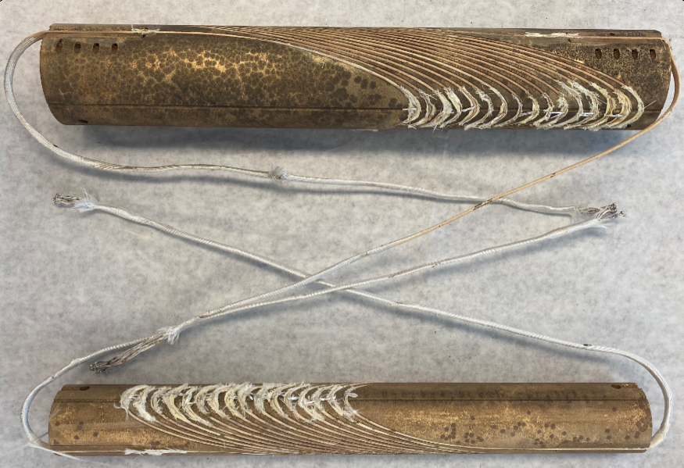
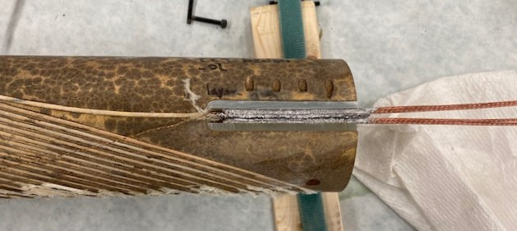
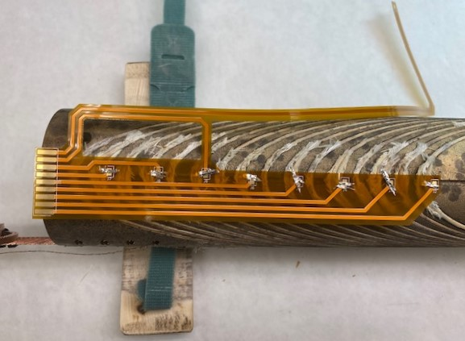
Test plans for January-February and progress in the preparation for test #1
What tests are we preparing for in the short term?
All four splices are installed
There were some challenges during the process:
Some of the SS set screws that kept the Al-bronze holders in position in the splice region got stuck in the mandrel after heat treatment
The installation of the splices required removal of the TiO₂ coating with a small metal brush and plenty of ethanol (time consuming and laborious process)
1. Test at 77 K of each coil (inner and outer layer) separated
2. Test at 77 K of the assembled BIN5c magnet
3. Test at 4.2 K of the assembled BIN5c magnet
Inner and outer layers after overpressure processing heat treatment
Splice installation (two pre-tinned Nb-Ti cables at each side of the Bi-2212 cable)
Installation of voltage tap traces on the outer layer
OL
Voltage tap wire installed in the splice
IL

Slide 4
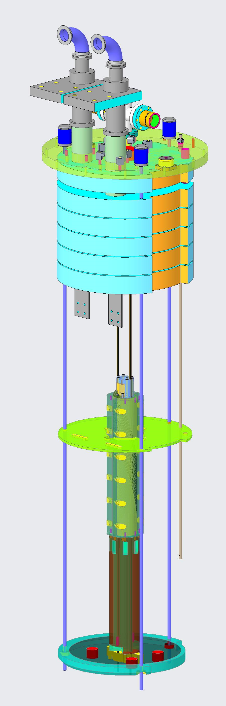
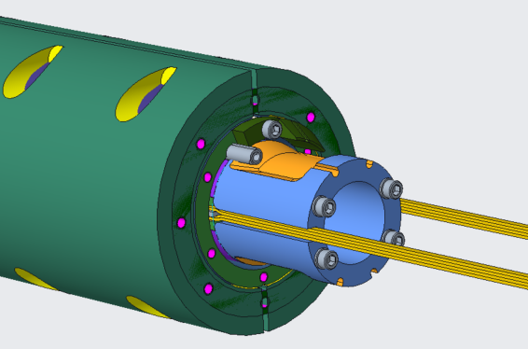
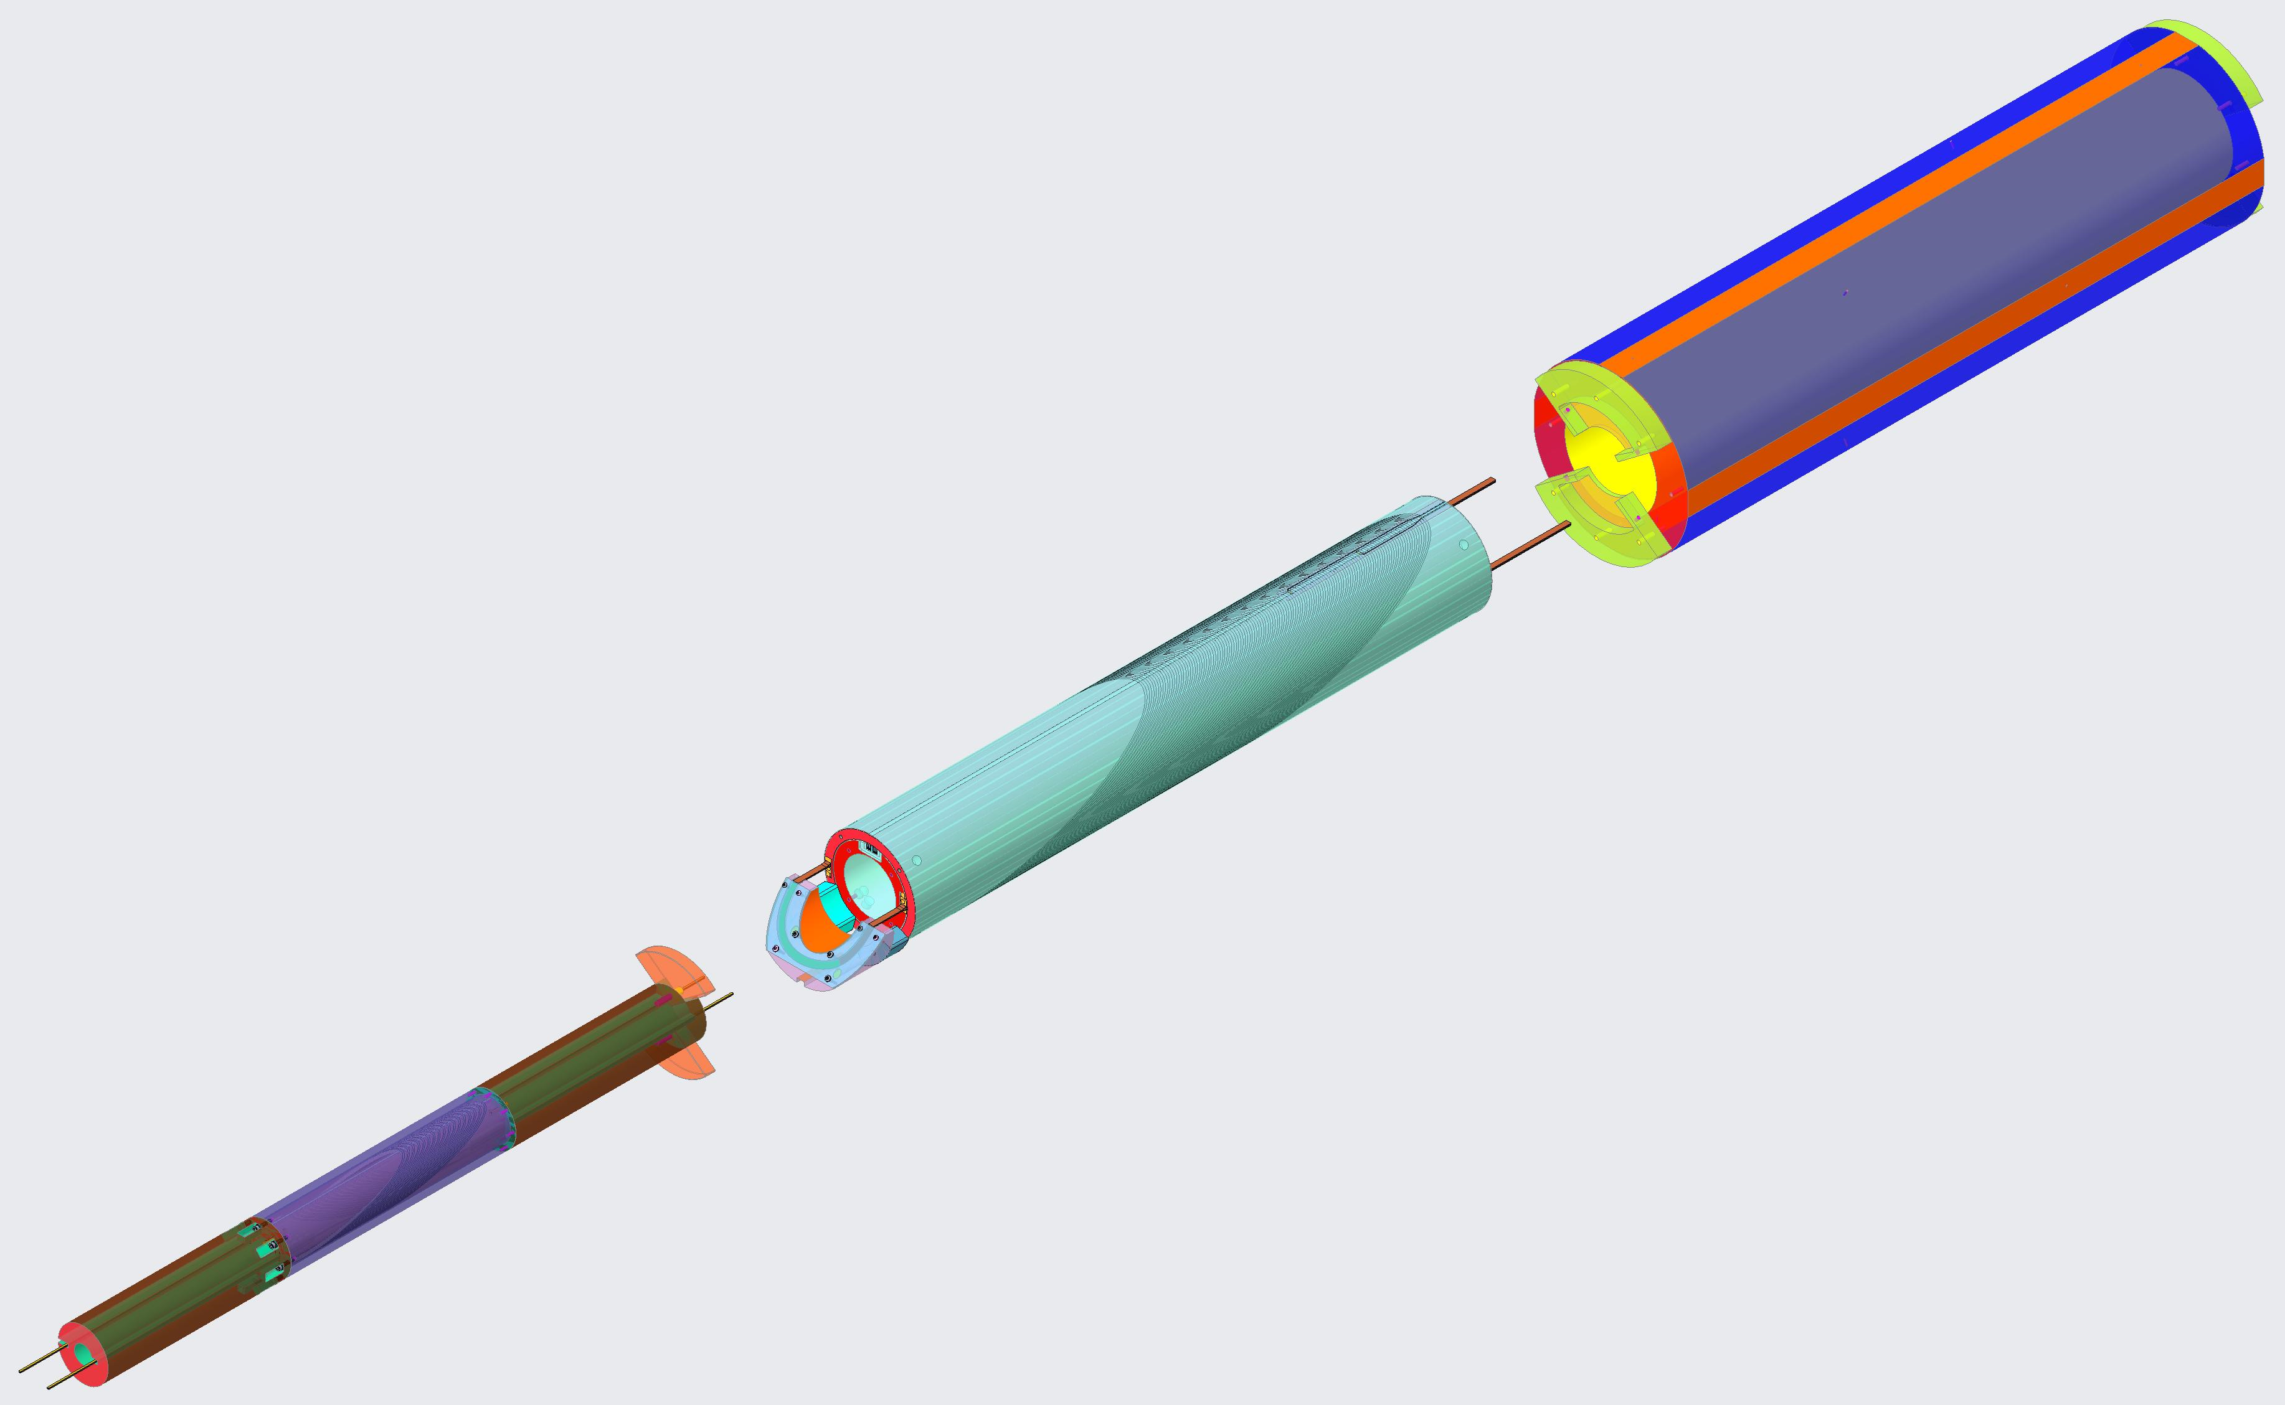
Additional preparation for tests #2 and #3
15” cryostat for the standalone test at 4.2 K
Since the ultimate goal is to test BIN5c inside CCT5, an additional extension tube will be installed at the lead end, and the voltage tap wires will be guided through the extension tube towards the header of the cryostat (that’s why we need the voltage tap wire holders)
Split aluminum shell
(already fabricated)
Outer layer
Voltage tap holders
Assembly of BIN5c inside CCT5 (Reminder)
Voltage tap wire holders
CCT5
Split aluminum shell
Inner layer
BIN5c
Extension tube to hold the layer jump
CCT5 aluminum shell
Layer jump

Slide 5
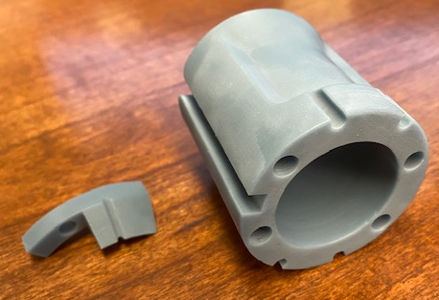
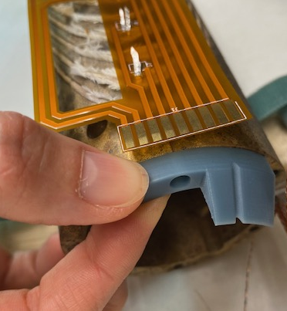
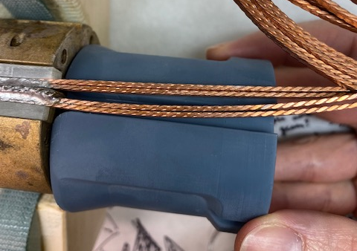
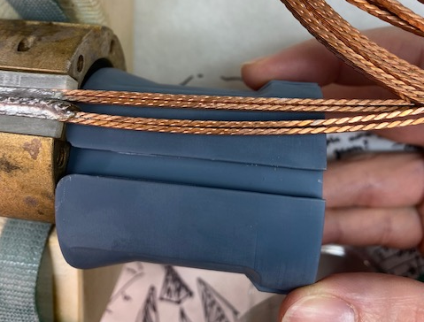
Fabrication of the voltage tap wire holders
3D printed wire holders
Wire holder for the outer layer
Modification of the wire holder for the inner layer will be needed to accommodate the transition of the Nb-Ti cables from the splice
Transition of the Nb-Ti cables from the splice

Slide 6
Summary of activities
Installation of Nb-Ti splices (done)
Installation of voltage tap traces (ongoing)
Fabrication of the impregnation tooling (done)
Impregnation process (foreseen for December/January)
Fabrication of the extension tube at the layer jump end (pending)
Fabrication of the layer jump holder (ongoing)
Fabrication of the split aluminum shell (done)
Fabrication of the voltage tap wire holders (done, one needs modification)
Needed for test #1
Needed for tests #2 and #3

Slide 7
Preliminary analysis of the hybrid magnet BiCCT1-CCT6

Slide 8
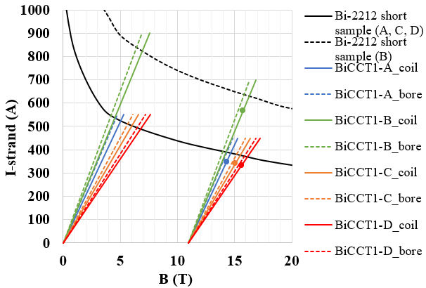
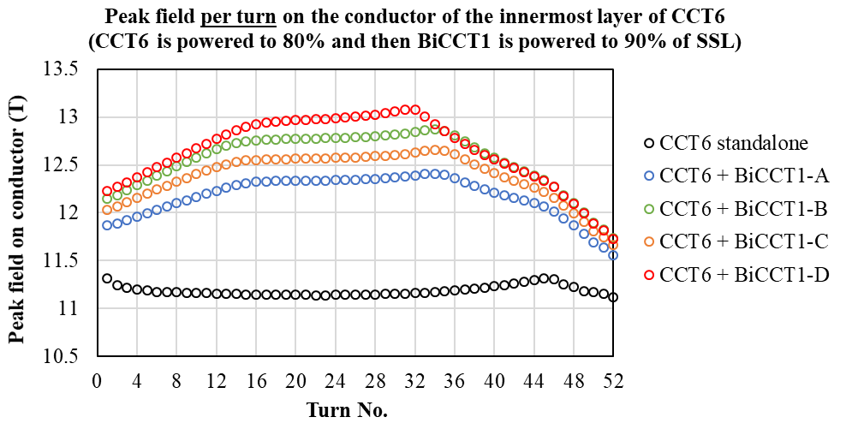
Design options for BiCCT1
Scaling study: Design parameters of Bi-2212 CCT, two layer dipole, 0.8 m long
BiCCT1-A to D are designed to fit inside CCT6: a four-layer, 120 mm bore Nb₃Sn CCT dipole that is under design
Parameter | BiCCT1-A | BiCCT1-B | BiCCT1-C | BiCCT1-D
Bore diameter (mm) | 50 | 40 | 40 | 40
Outer diameter (mm) | 99.8 | 101.7 | 101.7 | 110.4
Cable size (mm²) | 7.8 x 1.44 | 10.077 x 1.86 | 10.077 x 1.44 | 12.25 x 1.44
No. strands | 17 | 19 | 23 | 28
Strand diameter (mm) | 0.8 | 1 | 0.8 | 0.8
No. of turns | 48 | 38 | 46 | 42
Electromagnetic challenges of these designs:
Increasing the field in the insert increases the peak field in the outsert
The working point of the outsert should be kept under a safe limit to avoid quenches when powering the insert
Therefore, we might not be able to reach a high background field with the outsert
Loadlines
This plot represents the half of CCT6
BiCCT-A is the best candidate so far since we have the 17-strand cable fabricated for at least one magnet
Bore field produced by CCT6 at 80% SSL
BiCCT1 at 90% SSL

Slide 9
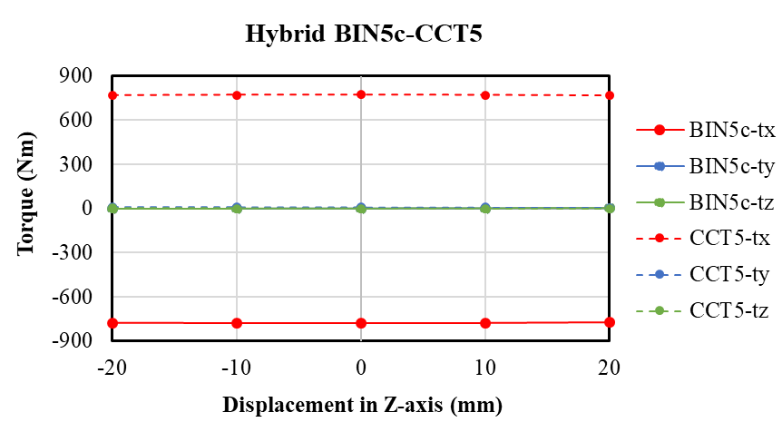
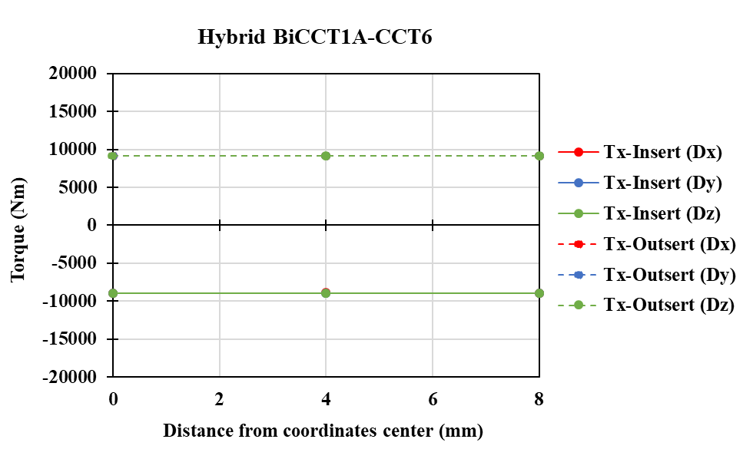
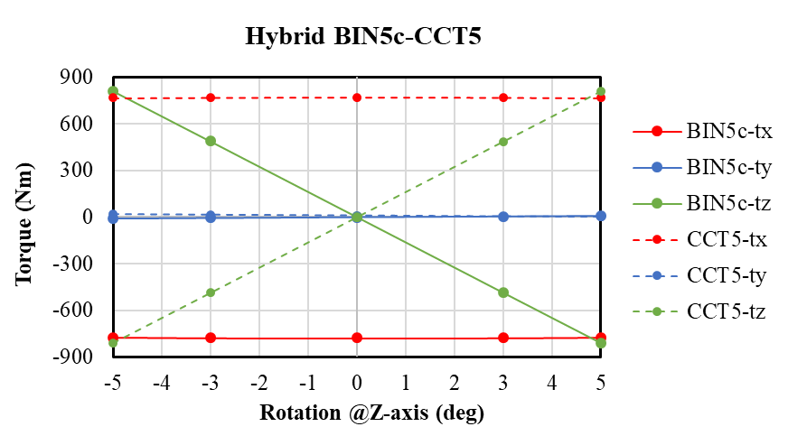
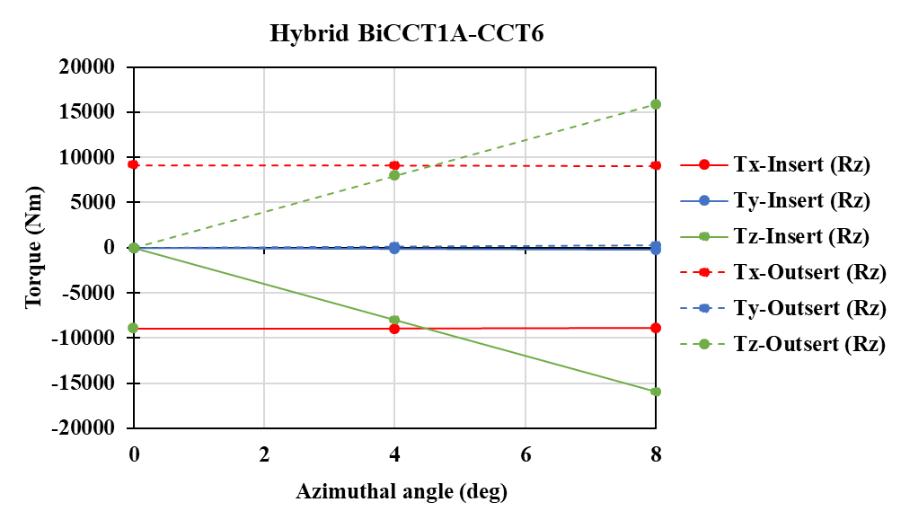
Comparison of the torque in the two planned hybrid magnet tests
In both cases, the only misalignment that influences the torque is the rotation about the z-axis
In both cases, there is always a torque about the x-axis between the magnets (even in the perfectly aligned position)
In the hybrid BiCCT1A-CCT6, Tx is more than 10 times larger than in the hybrid BIN5c-CCT5

Slide 10
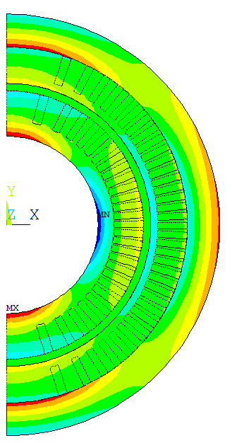
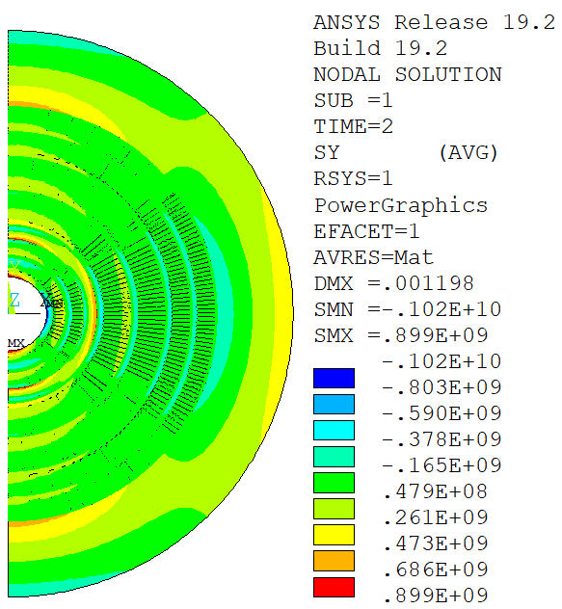
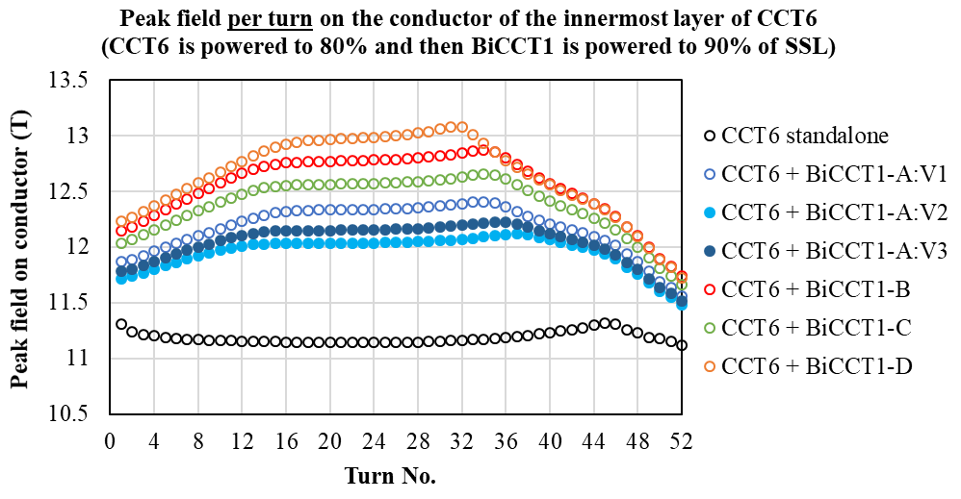
Different options for BiCCT1-A (17 strands, 0.8 mm diameter strand)
Azimuthal stress (MPa) assuming 90 deg. Shims between all layers
Parameter | BiCCT1-A:V1 | BiCCT1-A:V2 | BiCCT1-A:V3
Bore diameter (mm) | 50 | 40 | 40
Outer diameter (mm) | 99.8 | 89.8 | 94.8
Spar thickness L1 (mm) | 4.5 | 4.5 | 6
Spar thickness L2 (mm) | 2 | 2 | 3
No. of turns | 48 | 51 | 49
BiCCT1-A:V1 (insert)
BiCCT1-A:V1 inside CCT6

Slide 11
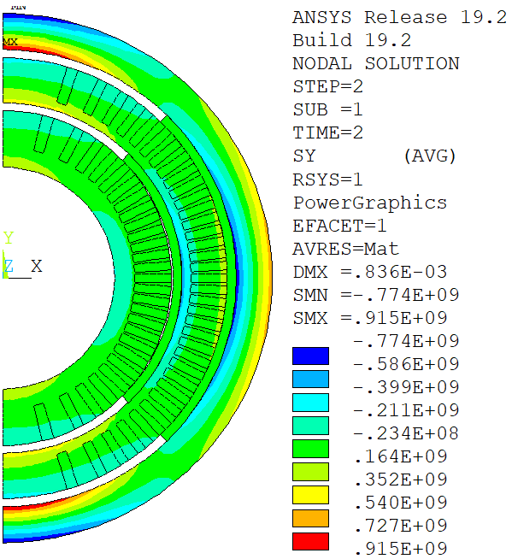
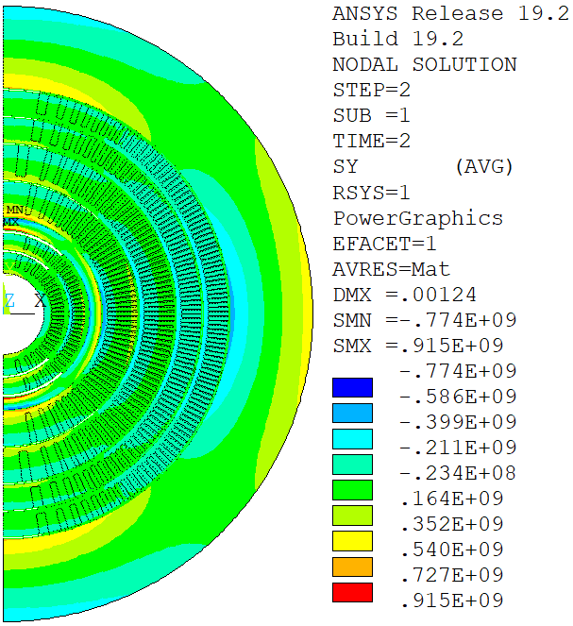
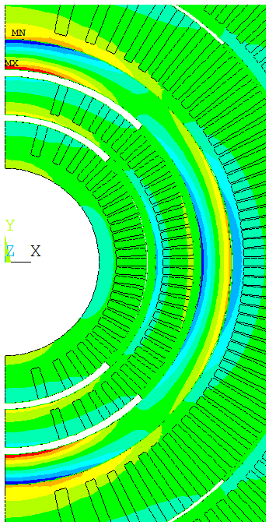
BiCCT1-A:V1 ➔ Azimuthal stress, no shim

Slide 12
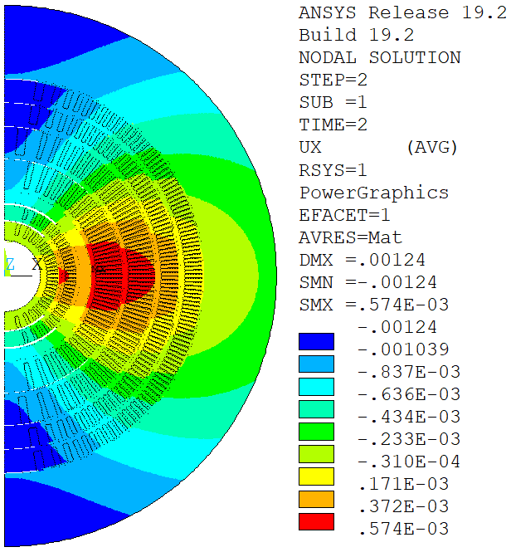
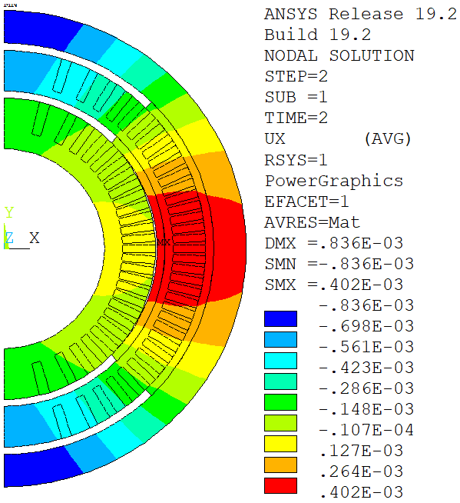
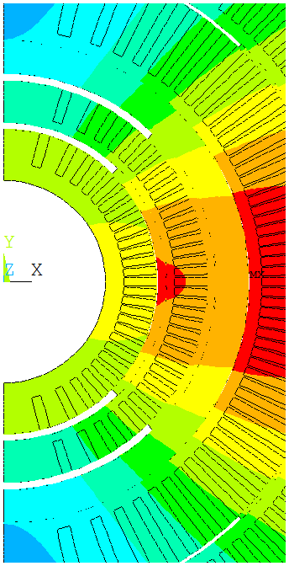
BiCCT1-A:V1 ➔ Radial displacement, no shim

Slide 13
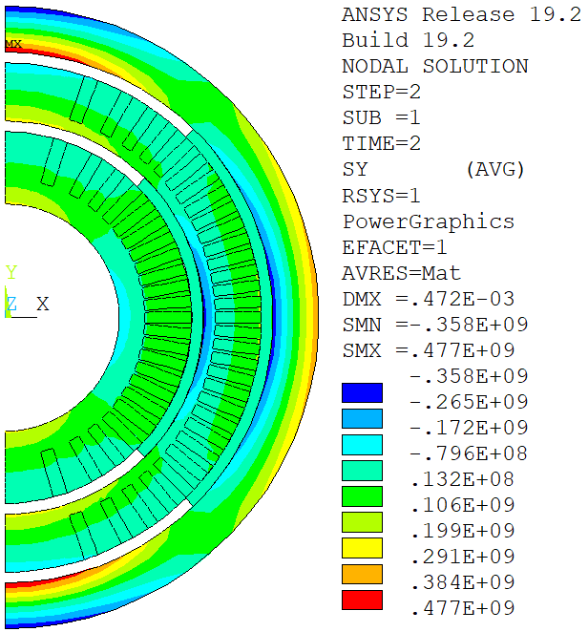
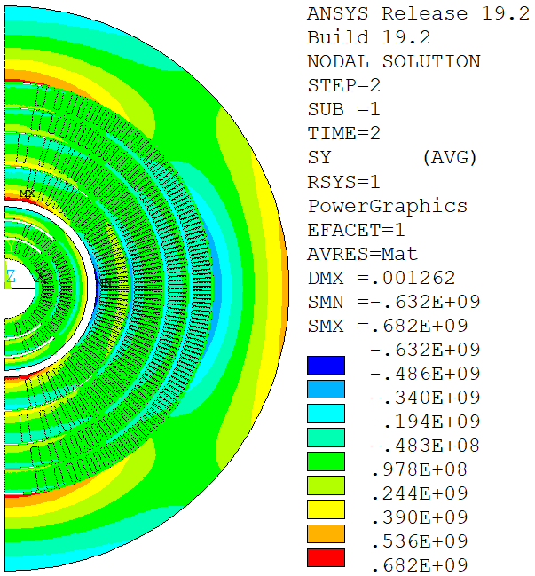
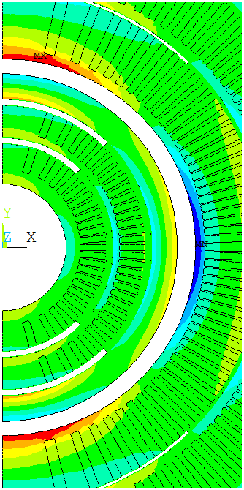
BiCCT1-A:V2 ➔ Azimuthal stress, no shim

Slide 14
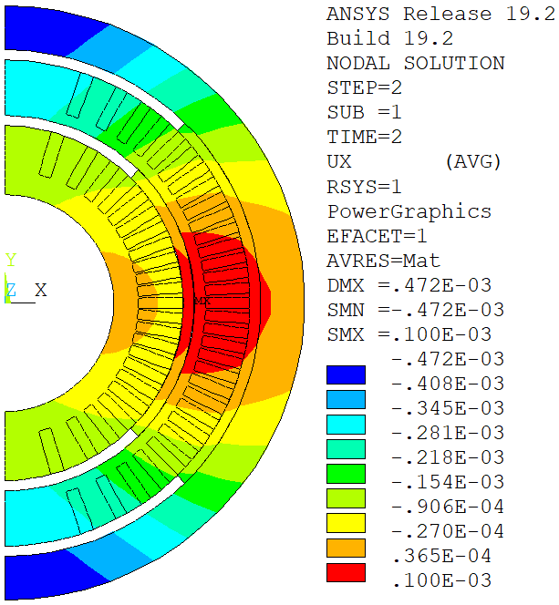
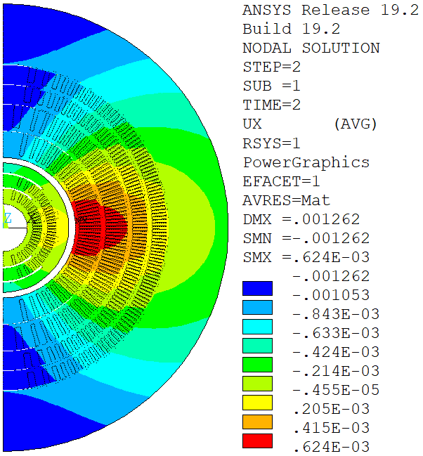
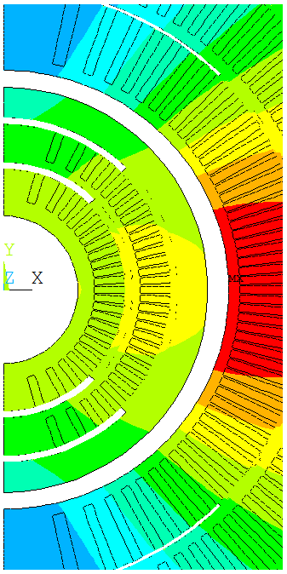
BiCCT1-A:V2 ➔ Radial displacement, no shim

Slide 15
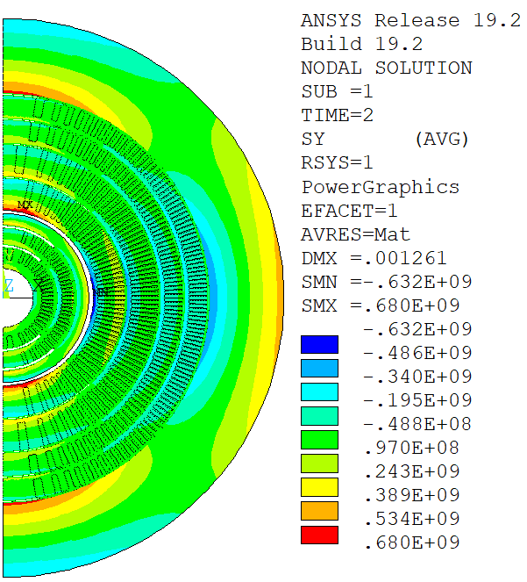
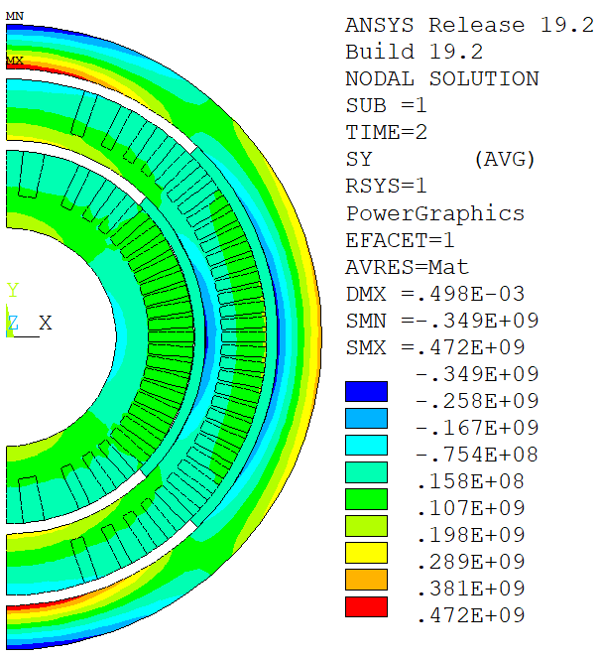
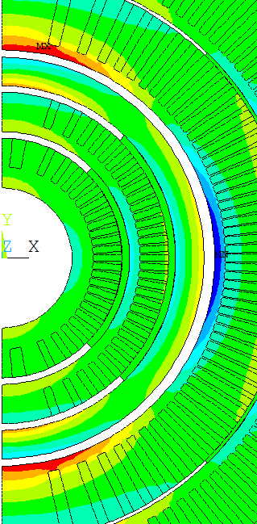
BiCCT1-A:V3 ➔ Azimuthal stress, no shim

Slide 16
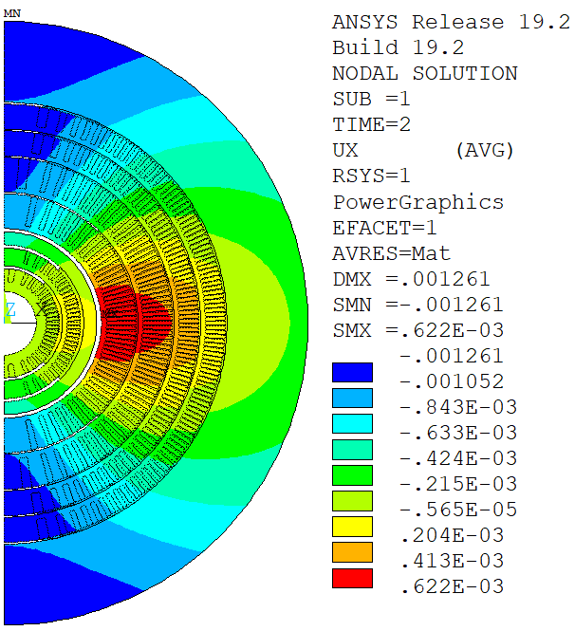
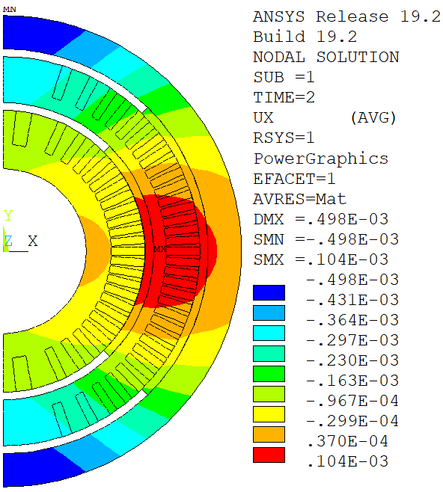
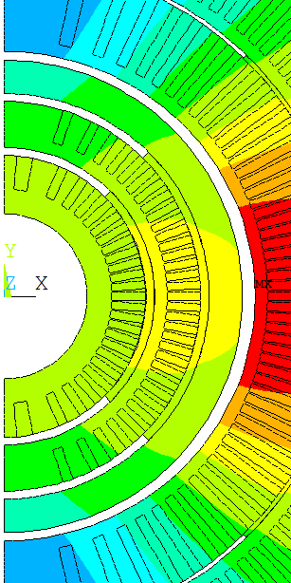
BiCCT1-A:V3 ➔ Radial displacement, no shim

Slide 17
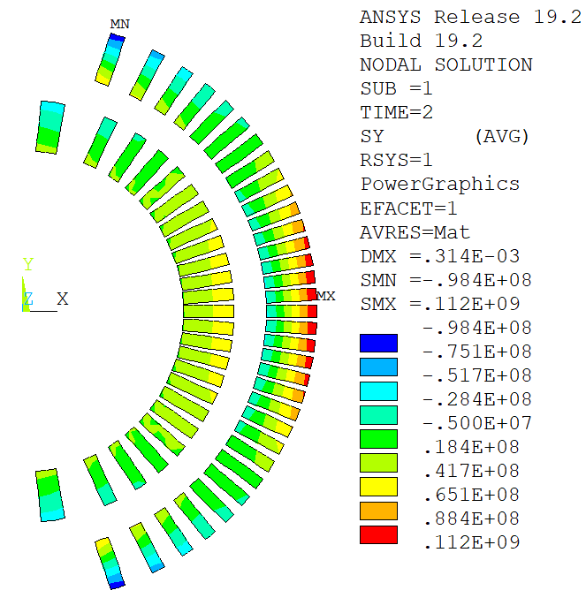
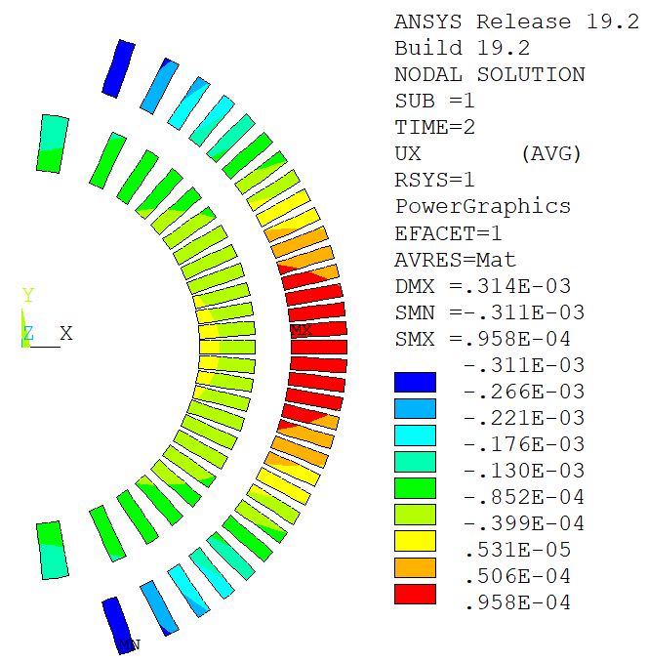
BiCCT1-A:V3 ➔ No shim
Azimuthal stress
Radial displacement

Slide 18
Summary of key points for the hybrid magnet BiCCT1-CCT6
A high field insert like BiCCT1, with the conductors close to the outsert, will increase the peak field of the outsert and the outsert will not be able to produce the desired bore field
If the outsert is intended to be a test magnet for different inserts, the best approach is to decoupled the magnets mechanically
For decoupling the magnets, the insert’s structure should withstand the Lorentz force by itself ➔ more space needed for structural material
Decreasing the insert’s bore from 50 to 40 mm provides more flexibility in the design of a decoupled magnet
The fabrication of a hybrid magnet requires close collaboration among the teams involved

Slide 19
Extra slides

Slide 20
Study of version 4
Version 4:
Parameter | BiCCT1-A:V1 | BiCCT1-A:V2 | BiCCT1-A:V3 | BiCCT1-A:V4
Bore diameter (mm) | 50 | 40 | 40 | 40
Outer diameter (mm) | 99.8 | 89.8 | 94.8 | 94.8
Spar thickness L1 (mm) | 4.5 | 4.5 | 6 | 4.5
Spar thickness L2 (mm) | 2 | 2 | 3 | 4.5
No. of turns | 48 | 51 | 49 | 49

Slide 21
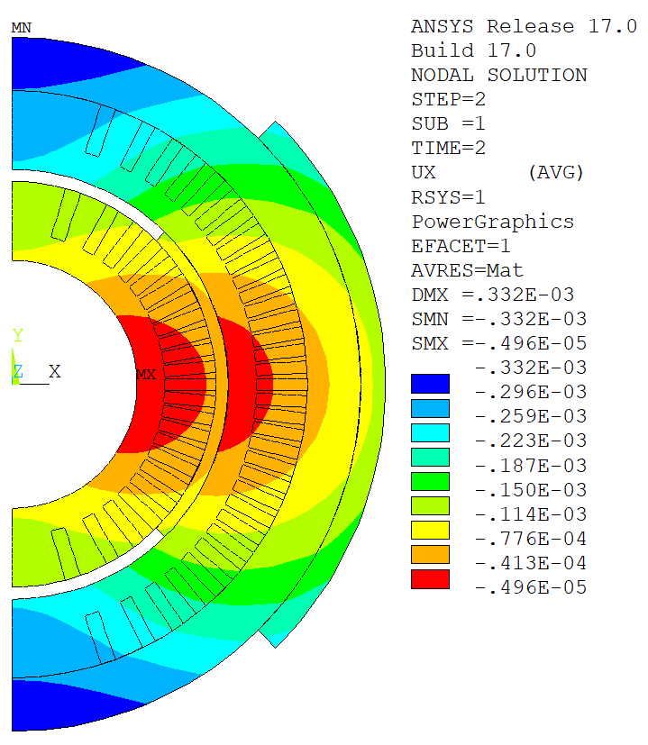
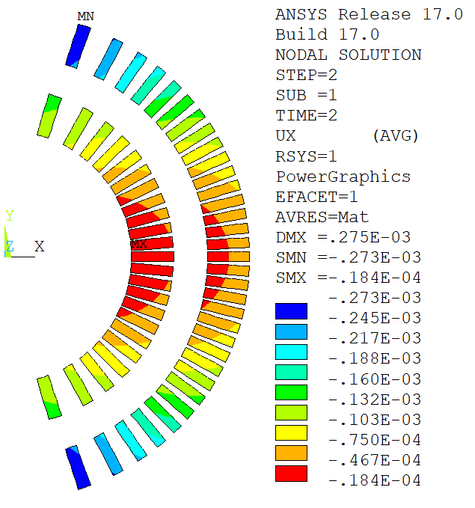
BiCCT1-A:V4 ➔ Radial displacement, 45 deg. shim

Slide 22
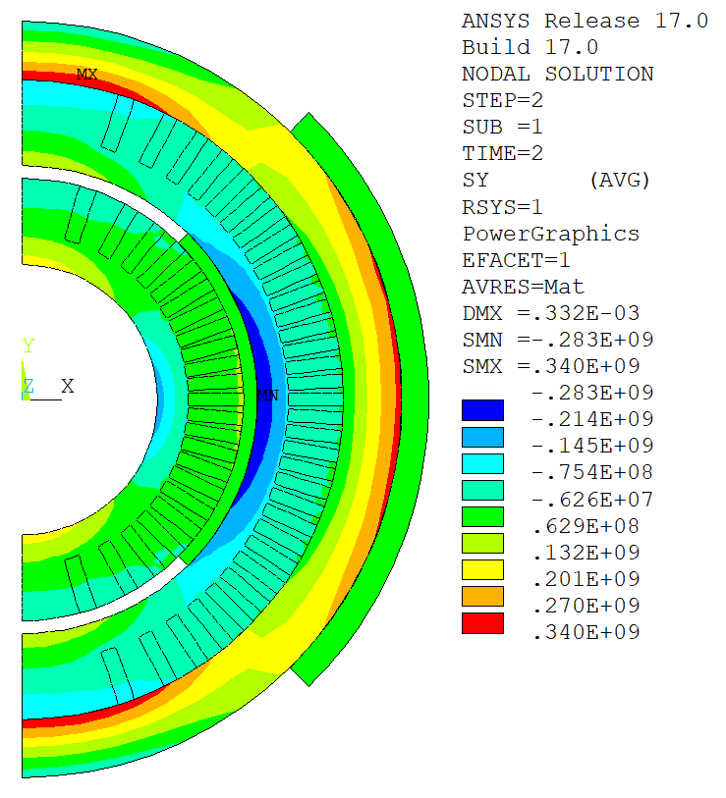
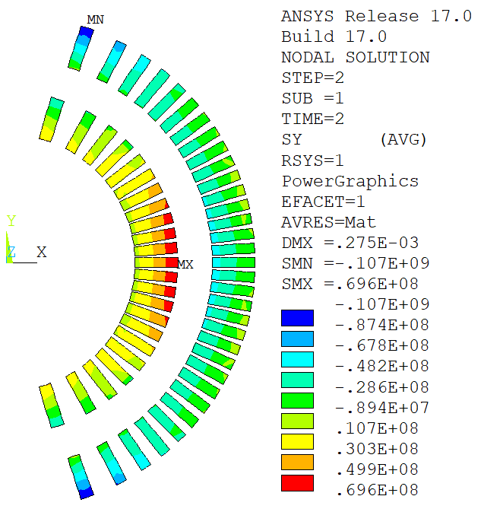
BiCCT1-A:V4 ➔ Azimuthal stress, 45 deg. shim

