Slide 1
Bi-2212 Rutherford Cable Solenoid: “Baby-Ruth” Update
Daniel S. Davis, Ulf P. Trociewitz, George Miller, Youngjae Kim, Ernesto S. Bosque, Jozef Kvitkovic

Slide 2
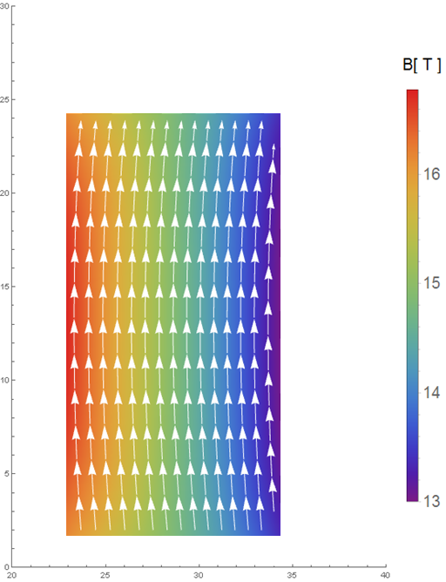
Reinforced Baby-Ruth Coils: +2 T in 14 T LTS
Coil Specs:
6.45m conductor
45 mm ID, 6 layers x 6 turns
2.781 kA (0.75*Ic) at 16.64 T load-line,
Self Field (1.97 T central field, 2.64 T peak on conductor)
Mechanics:
At 3.7 kA, 14 T
400 MPa source stress
0.38 % strain
--> we should still have some stress margin left
B_{tot} in coil, I_{op}=0.75% IC

Slide 3
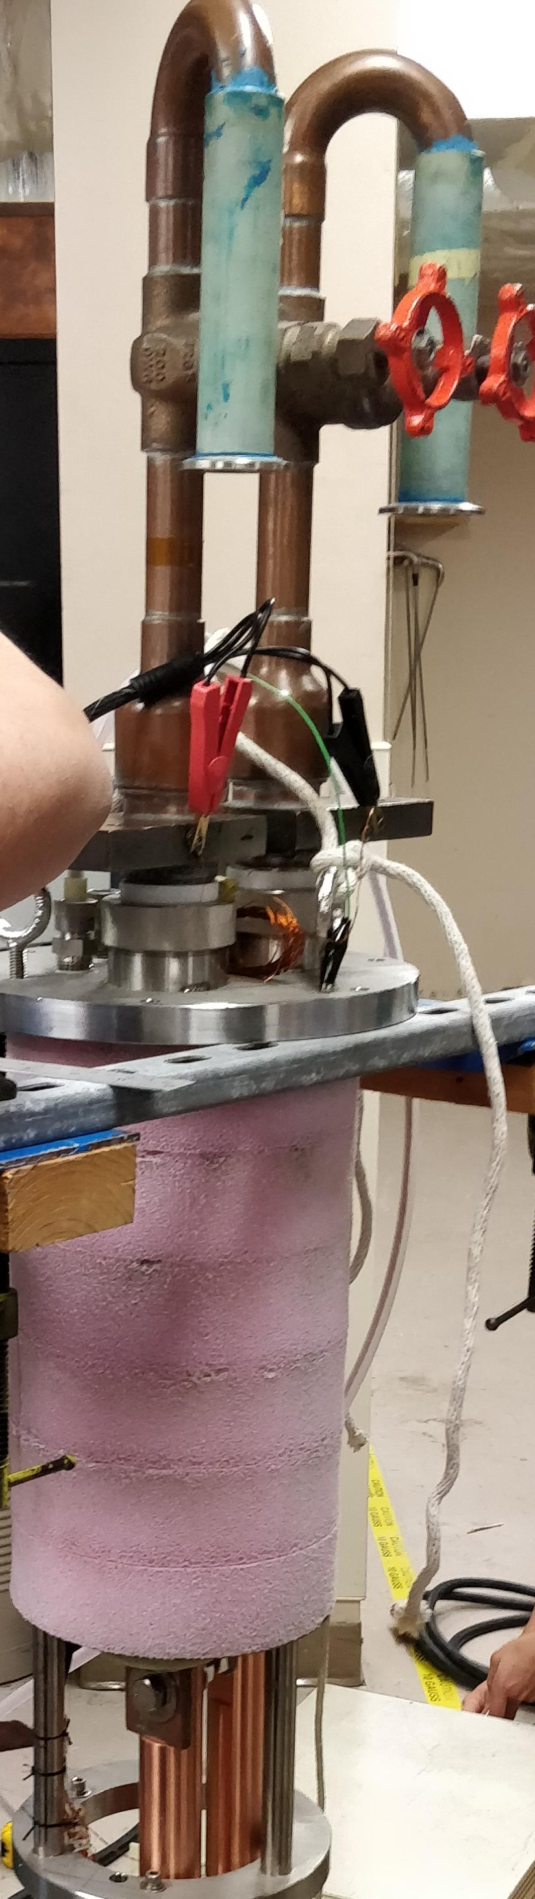
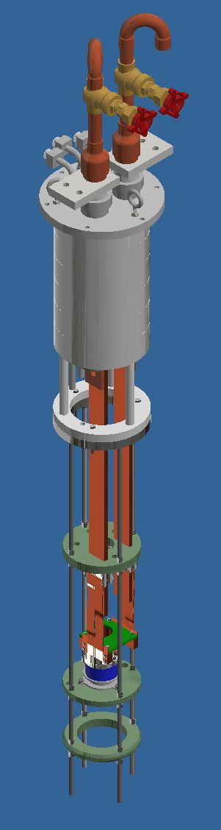
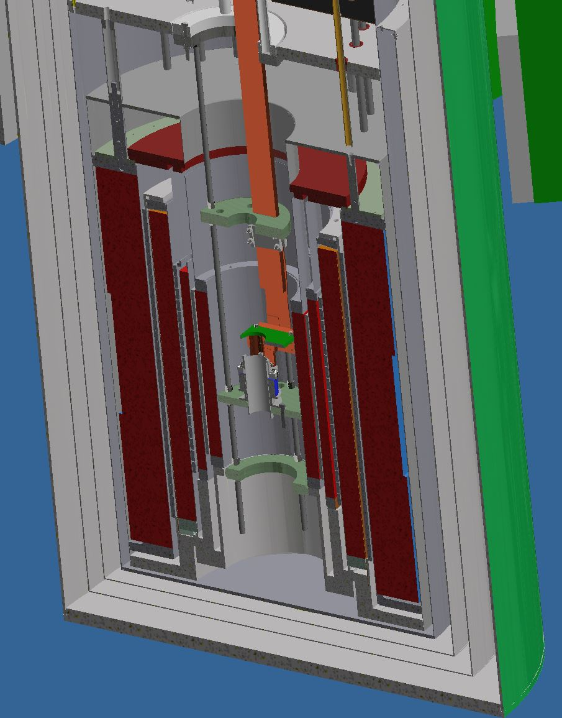
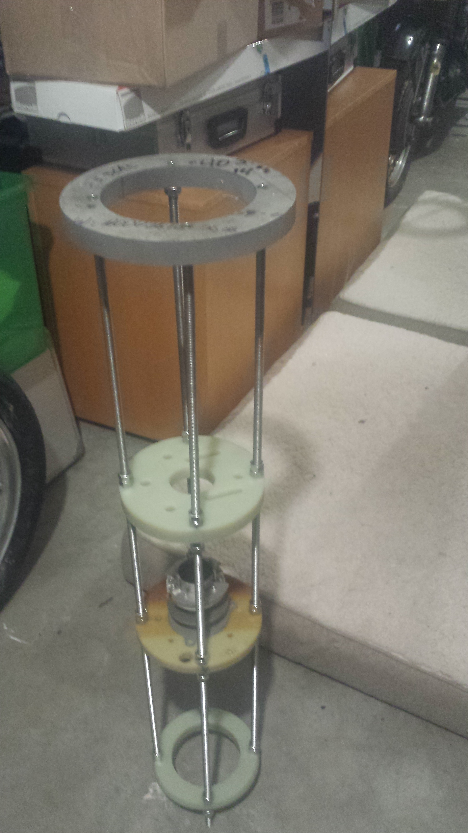
First test coil “Baby-Ruth” Fabrication Well Underway
5 kA leads
7.5 kA VCL installed on probe head
5 kA AMI LTS received
Probe supports assembled
Coil terminals
Ag terminals fabricated
Cu terminal and soldering fixture received
14 T LTS
+2 T HTS

Slide 4
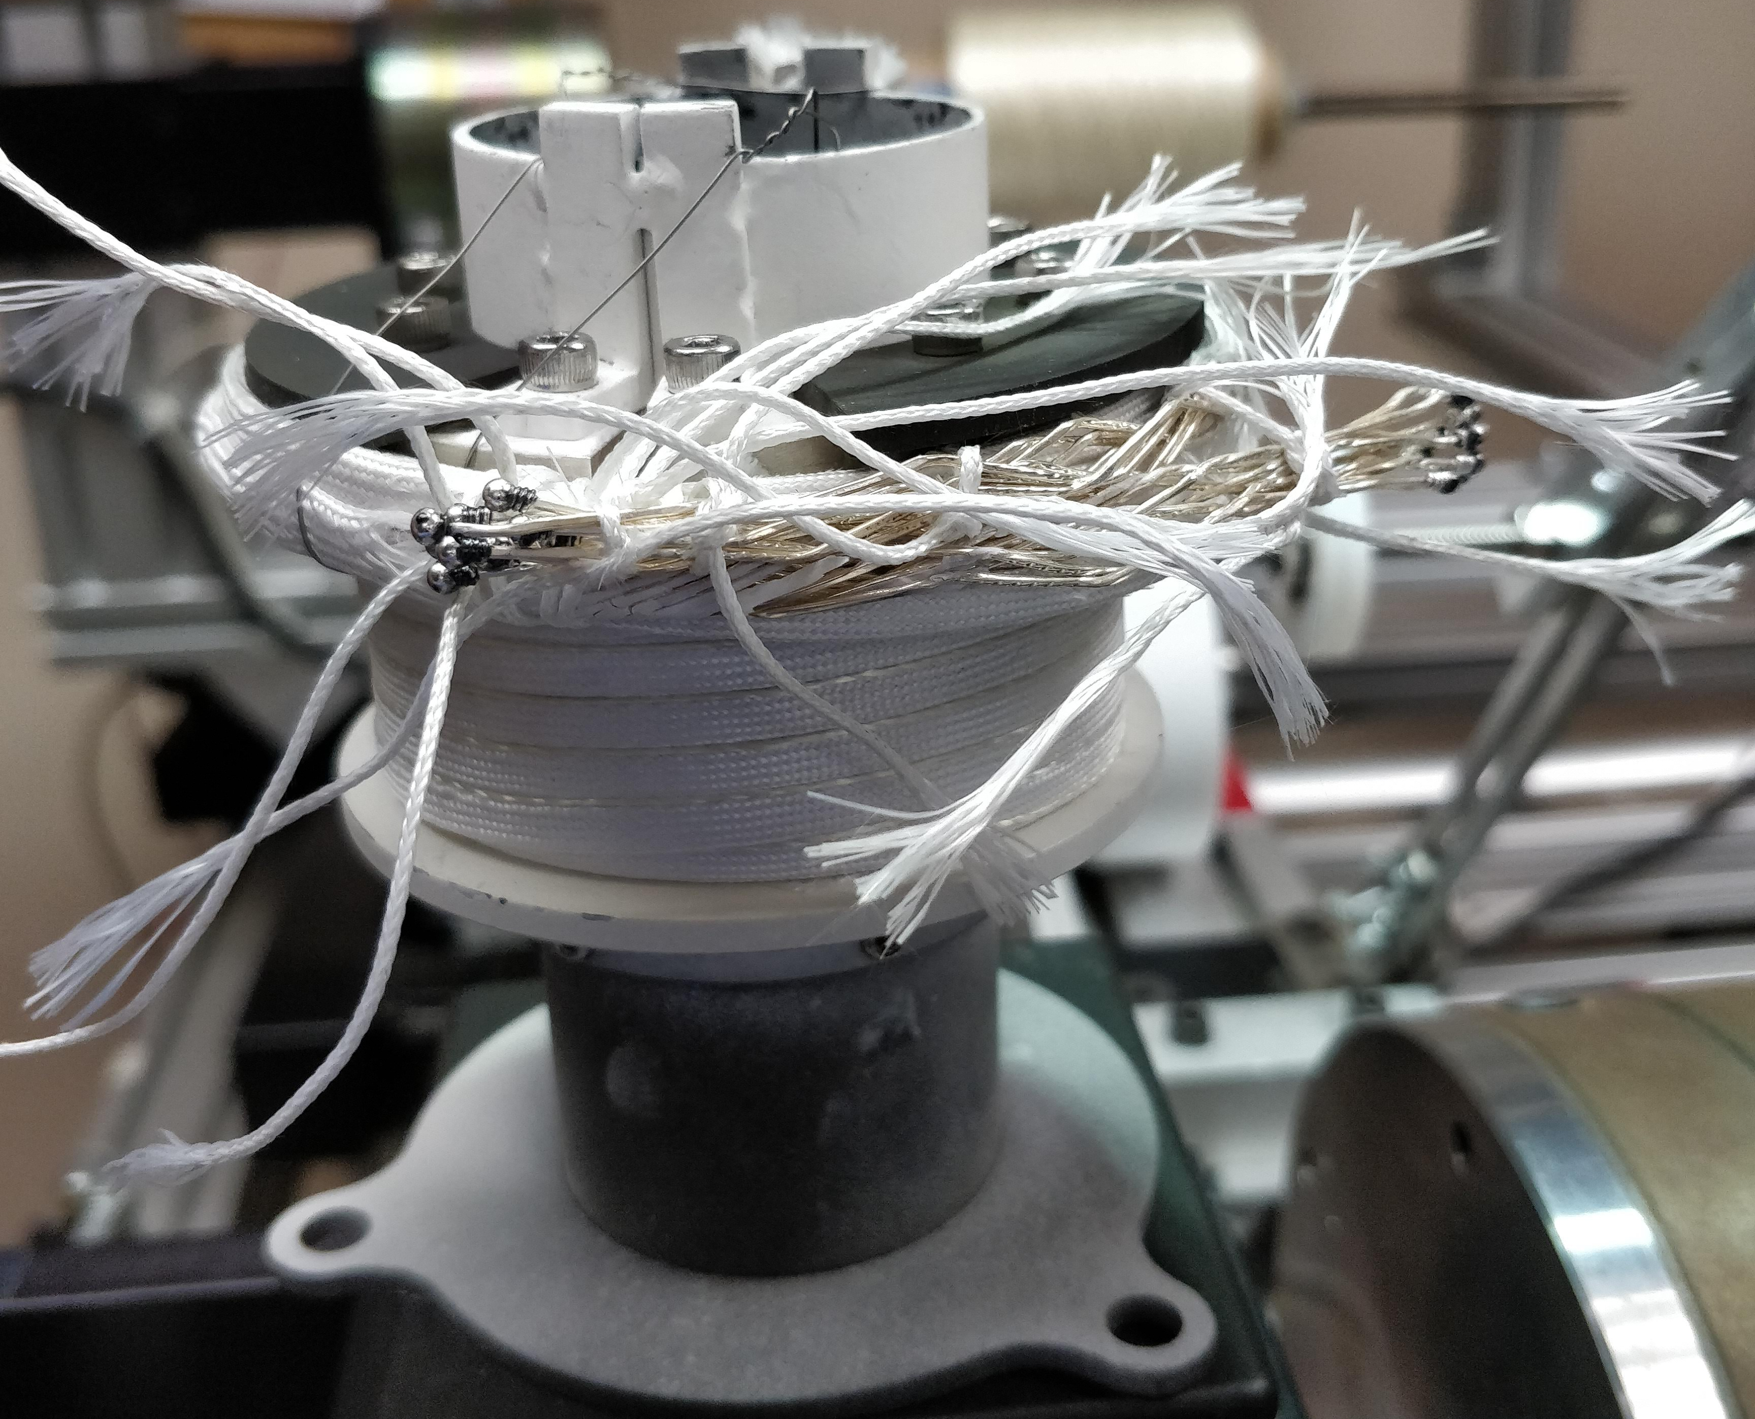
Baby-Ruth Wound Ready for OPHT
Baby-Ruth As-Wound Test-Coil
9-strand cable handles very well during coil winding
Coil has passed through the organics burn-out heat treatment
Awaiting repairs of the Deltech furnace for 50-bar OPHT
Test must wait for helium plant start-up in new year
Individually sealed wire ends

Slide 5
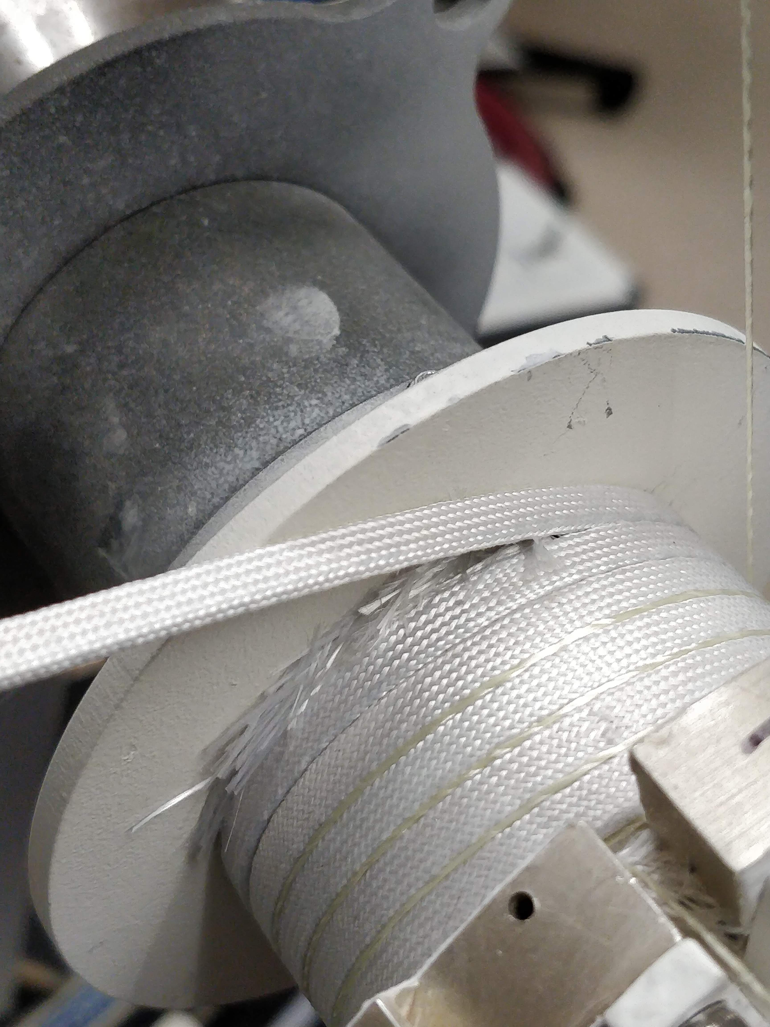
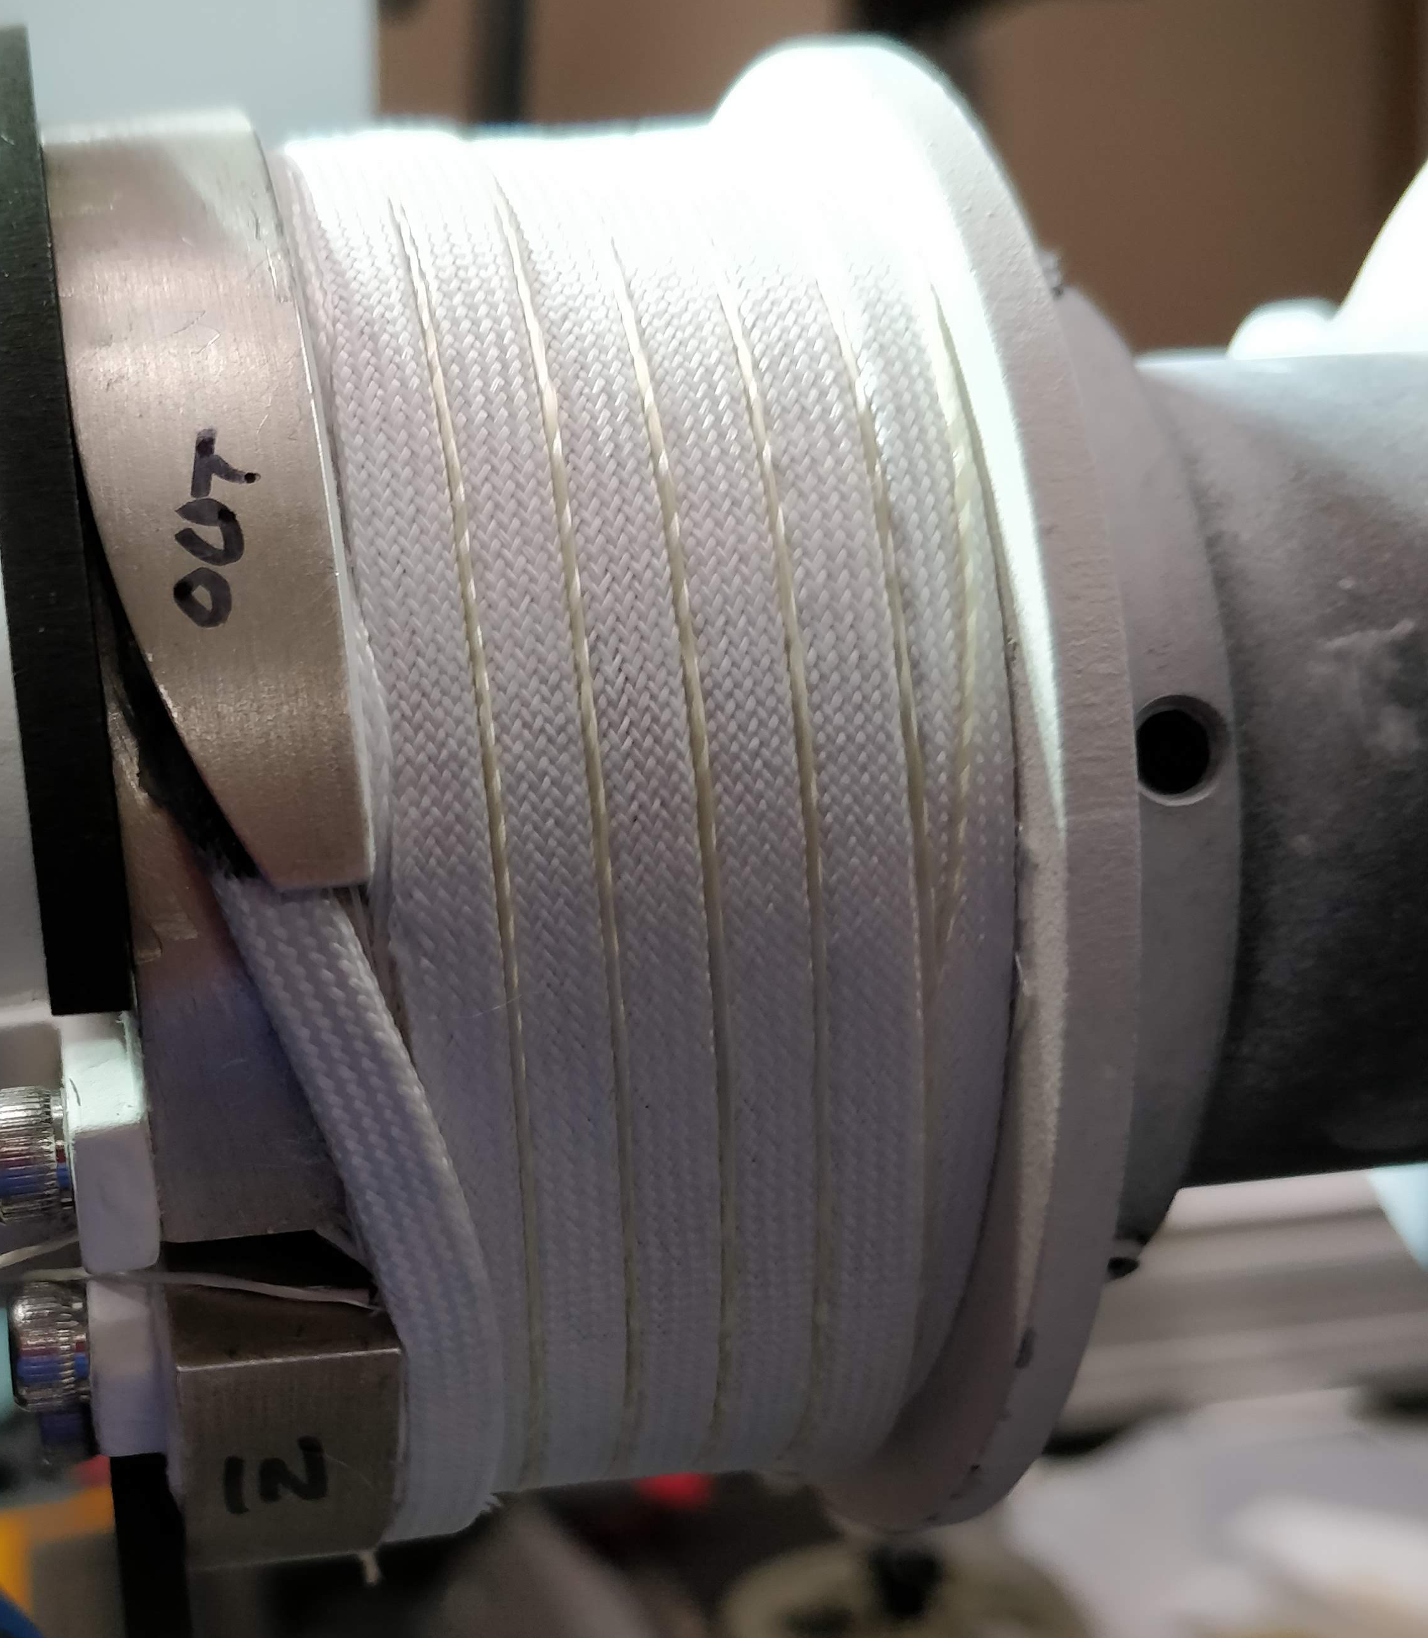
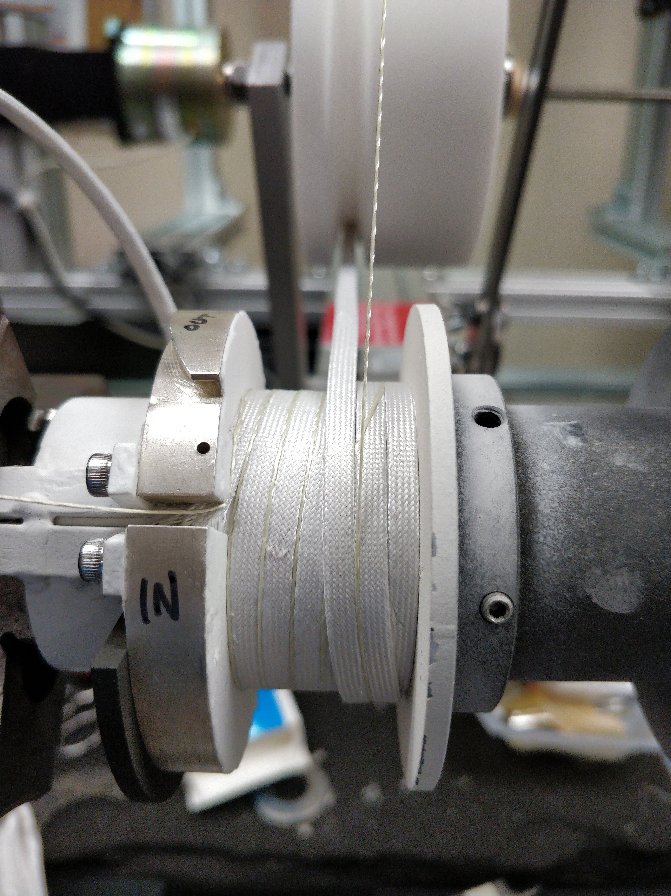
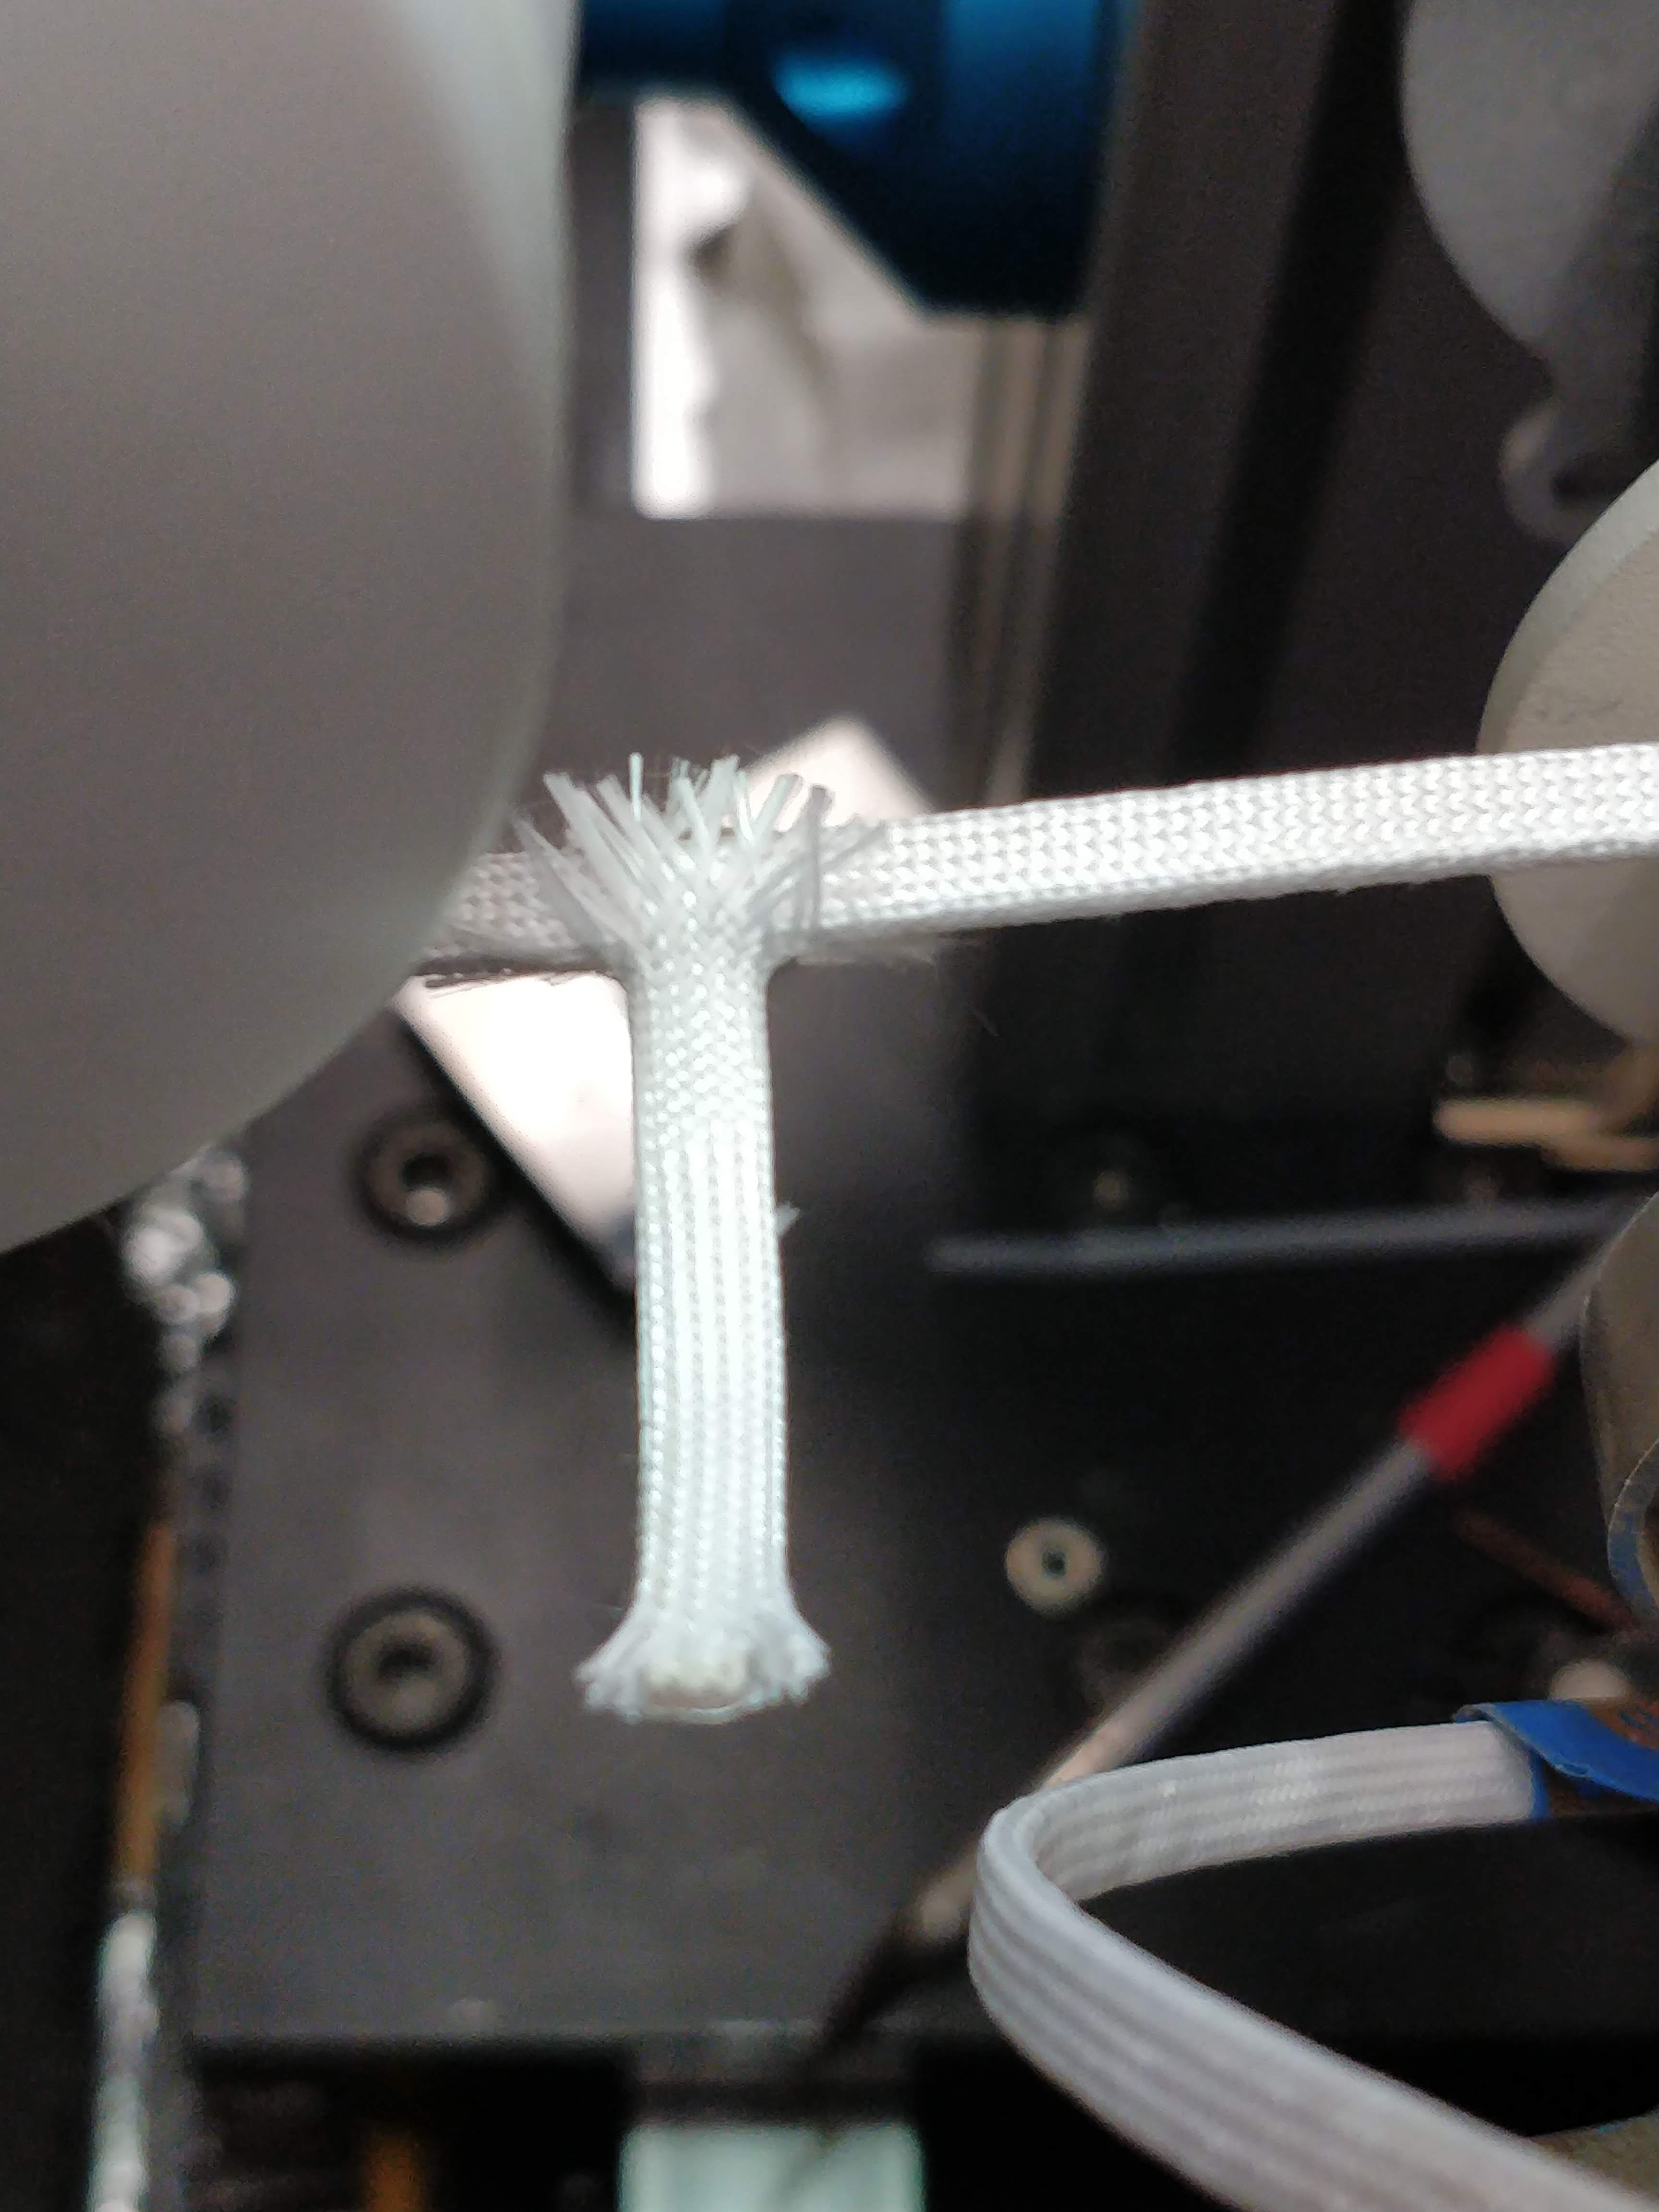
Jogged Solenoid Winding With 9-strand Cable
Smooth hard-way bends into terminal
Jogged (un-pitched) windings
Underfilled layer transitions
Ag Voltage Flags

Slide 6
Map for Rutherford Cable Solenoids from MDP Meeting
2020 Q1/2 | 2020 Q3/4 | 2021 Q1/2 | 2021 Q3/4 | 2022 Q1/2 | 2022 Q3/4
Coil-1 Engineering Design
Coil-1 Fabrication
Coil-1 Test
Coil-1 Review
Fabrication slipped due to unforeseen resource limitations and COVID delays
Coil-2 Engineering Design
Coil-2 Cable Determination
Coil-2 Cable Fabrication
Coil-2 Fabrication
Testing in 14 T B.G.
Coil-2 Test
Coil-2 Review
Coil scale-up options contingent upon successful tests
2-3 T added (17 T total), 8 meter (existing cable) = “Baby-Ruth”
5-6 T added (20 T total), 40 meter needed +back-up
Possible Full-Scale: 100’s of meters for full volume (11-18 T added 25-30 T total). Major funding and large furnace required.
Coil-3 Cable Determination
Coil-3
6

Slide 7
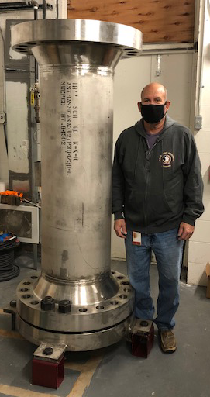
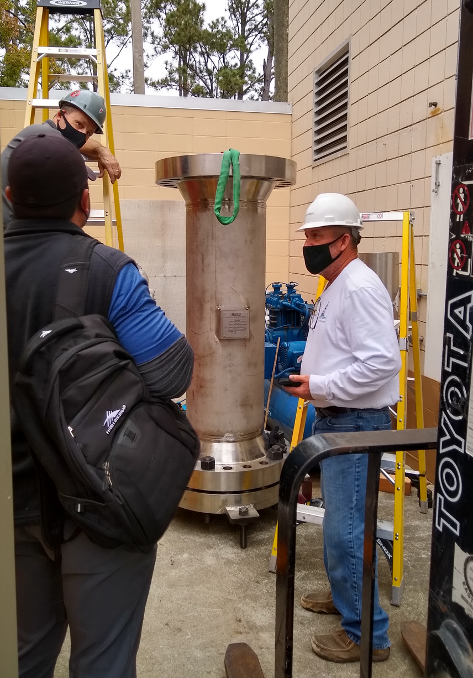
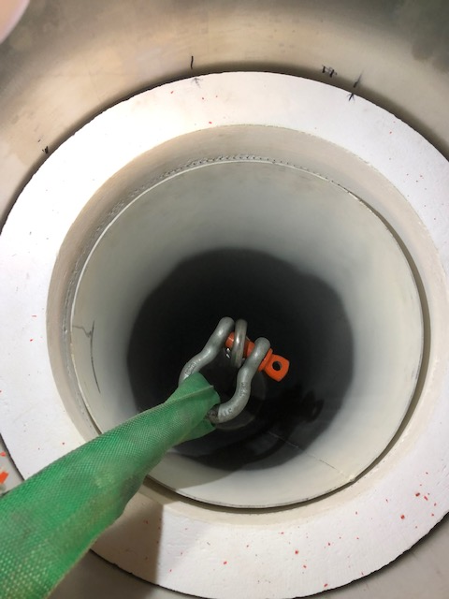
Renegade Furnace
Deltech
Had a zone failure that still needs to be addresses
Renegade activities currently have higher priority
Renegade
New heater insert is a significant better fit than the previous one
Heater insert vacuum formed in one piece instead of stacked rings
Actual bore now 279 mm
Insert and pressure vessel have now been assembled and feedthroughs are being installed
Crane service to come in this next Thursday to install assembled pressure vessel into hydraulic stand and install inside room
Thermocouples, el supply lines from control panel, and some of the gas management system to be installed by end of next week early Jan
Pressure and power tests (in that order) expected by Jan

Slide 8
2212 Coating
Rutherford cable coating
Experimented with two coating methods, airbrushing and hand painting
Airbrushing: fairly homogeneous coating possible but generates lot of waste due to overspray as well as spider-webbing, which could not be reduced significantly by changing amount and ratios of the solvents (ethanol, xylene)
Hand painting: produces significantly less waste but coating of varying thickness, second coat can remove first one
Both methods currently lack heated drying to allow application of polymer top coat
A mechanized coating facility appears desirable for both, accelerator coil and solenoid, effort
A cable coating facility is likely to look substantially different from the existing strand coating facility since a mechanized brushing or rolling application of the slurry may require a horizontal layout
With an increase in the lengths of to be coated cables it appears to be worthwhile to start thinking about setting up such a facility

Slide 9
Conductor Insulation Options
Spray
Wasteful of coating
Spider-webbing can lead to agglomeration on surface
Limited solvent choices(ethanol, xylene)
Hand coat
Labor intensive for even such a small test coil
Single coat limitation, varied thickness
Mechanized roller/brush system
How uniform would the application be
Keeping applicator clean of buildup
Moving applicator or cable?
Dip-coat
Would need to re-tool entire existing system
Moving seal for rectangular cross section
Continually saturated paint roller or sponges
How to keep from gumming up?
Alternative horizontal angled bath entry/exit
Uniformity of edge coating?
Die coat
Industrial operation, requires high speed -> furnace heat upgrades

