Slide 1
Design concepts for a 20T hybrid Block-coil Dipole
E. Rochepault – CEA Paris-Saclay
With inputs from P. Ferracin - LBNL
10/12/2020

Slide 2
Input parameters
From:
“MDP General Meeting
20 T hybrid magnet and comparative analysis”,
P. Ferracin et al., 9/2/2020

Slide 4
Current Densities assumptions

Slide 6
Parametric Analysis 1
Based on :
“The Use of Grading in High Field Block-coil Dipoles”,
E. Rochepault et al., submitted to IEEE TAS

Slide 7
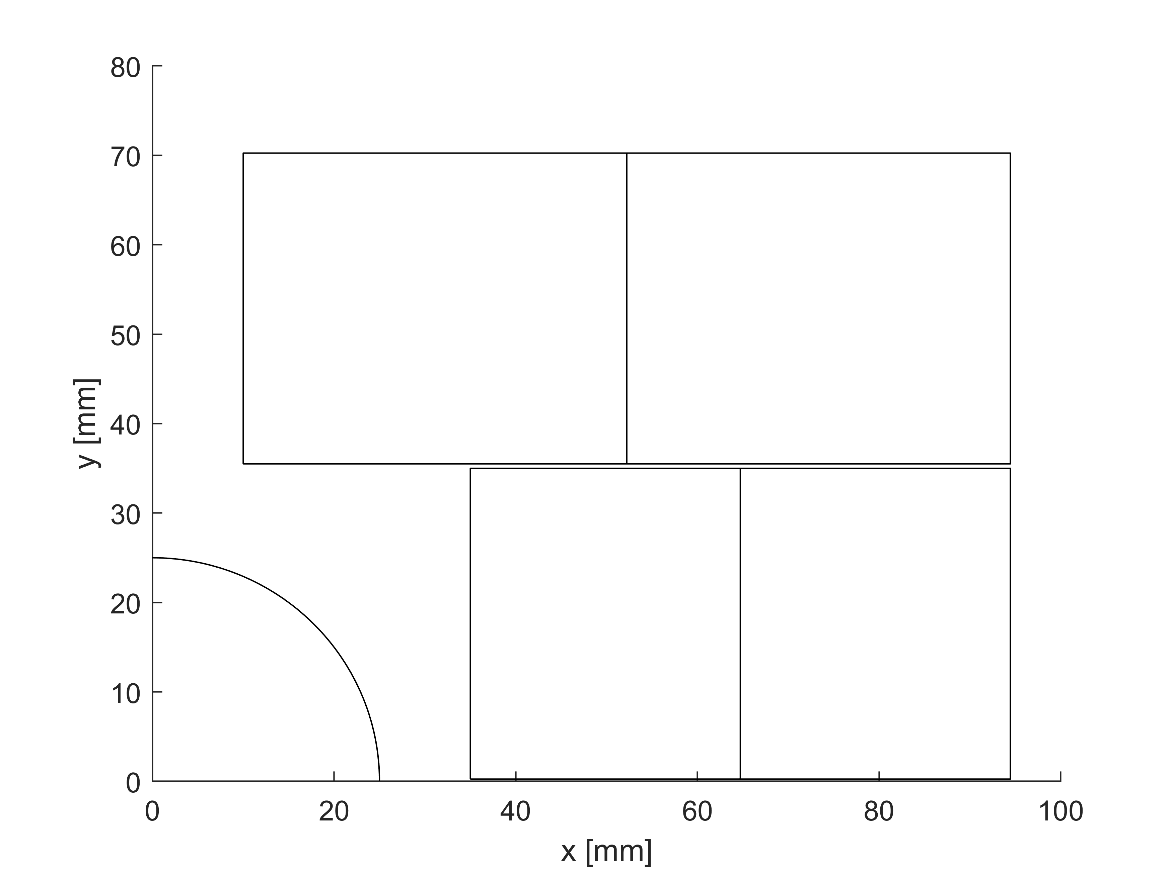
Geometric considerations
aperture = 25 mm radius
Tube th. = 10 mm
midshim = 0.5 mm /2 (in the mid plane)
interlayer = 0.5 mm (min. distance between layers)
Block height = aperture+tube_th-midshim = 35.8 mm
x min. = 10 mm (tbc)
4 blocks
V1 = [aperture+tube_th:x max.]
V2 = [x min.:x max.]
V3 = x max (aligned blocks)
x min.
v2
x max.
HF, 3
LF, 4
Block height
HF, 1
LF, 2
v1

Slide 8
Cable considerations
th. comp. = 90 %
W. comp. = 105 %
0.15 mm insulation
Single layer pancake, almost one option: (bare insulated)
Double layer pancake, several options:
Note: a large cable can carry more overall current density
D [mm] | Nstr | Th [mm] | W [mm] | Cu:nCu | Jo/Je | Jo/Jsc
1.2 | 56 | 2.46 | 35.6 | 1.1 | 0.724 | 0.345
1.2 | 27 | 2.46 | 17.3 | 1.1 | 0.717 | 0.342
1.0 | 32 | 2.10 | 17.1 | 1.1 | 0.700 | 0.333
0.85 | 38 | 1.83 | 17.3 | 1.1 | 0.683 | 0.325
0.7 | 46 | 1.56 | 17.2 | 1.1 | 0.660 | 0.314

Slide 9
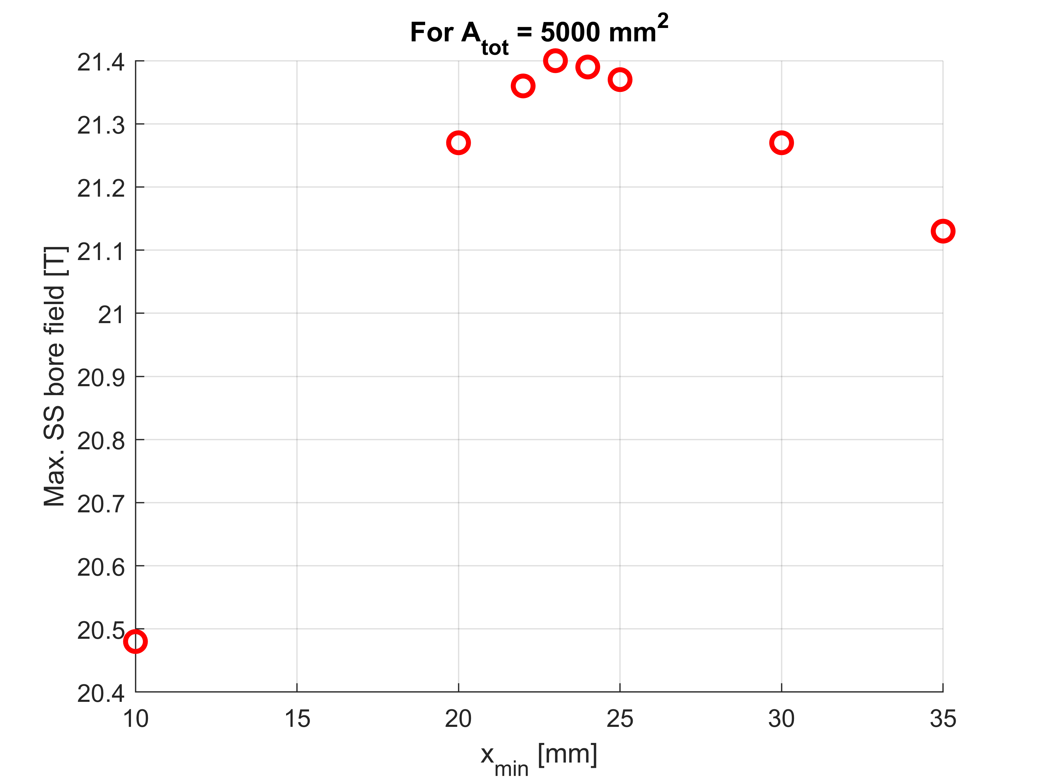
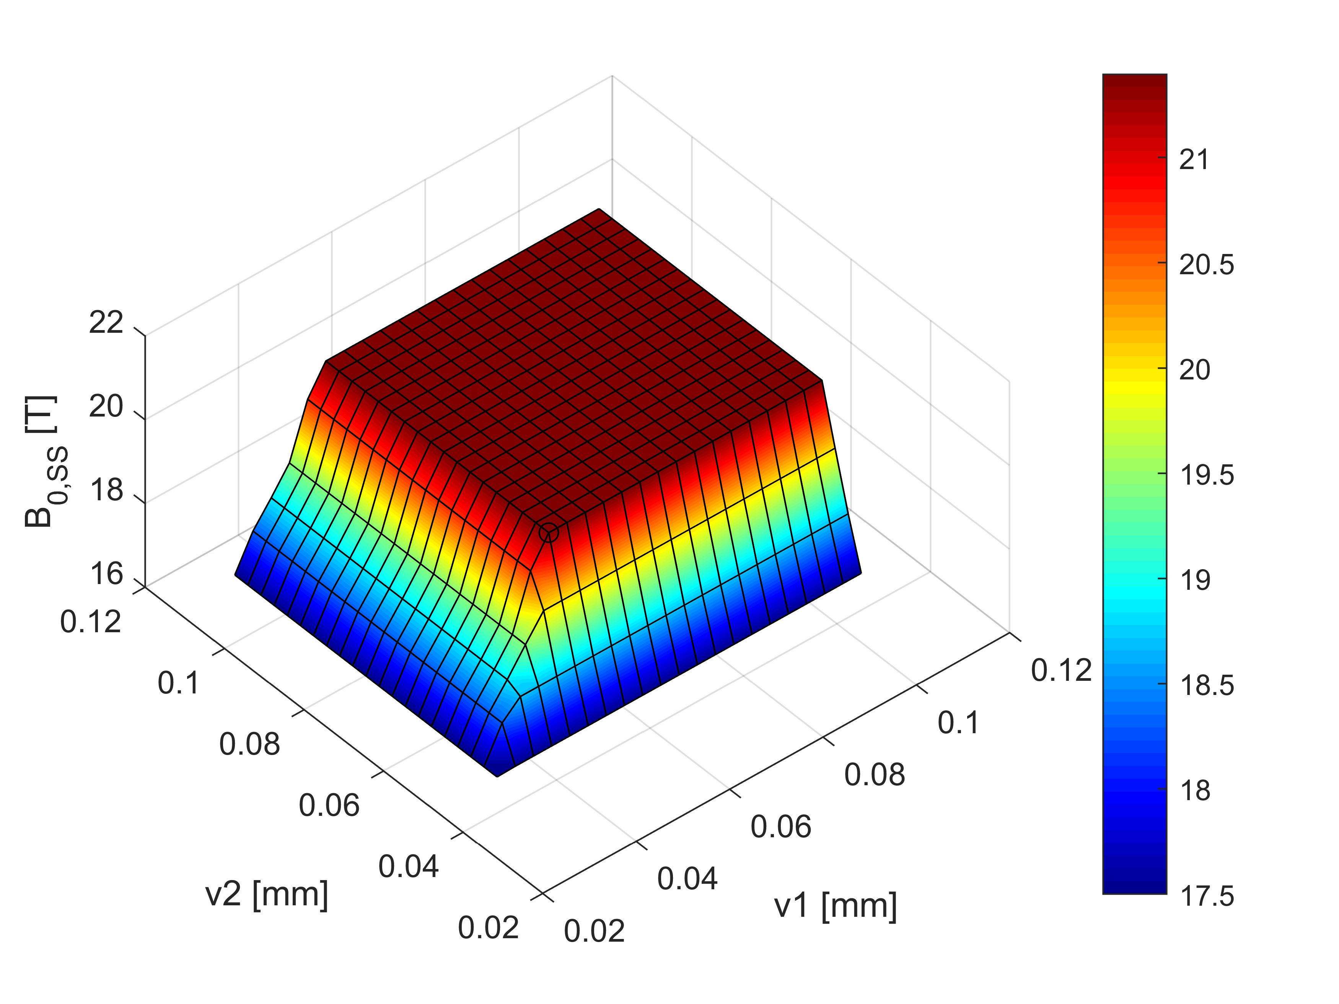
Parametric analysis 1: best inner radius?
Starting with a given A_tot and x_min
Varying v1 and v2
Selecting the configuration giving the max. B_bore @ SS. If several solutions, selecting the min v1 and min v2
Reproducing the loop 1. to 3., changing x_min
Selecting the x_min giving the max. B_bore @ SS.
Optimum for A_tot = 5000:
x_min = 23 mm
B_bore @ SS = 21.4 T

Slide 10
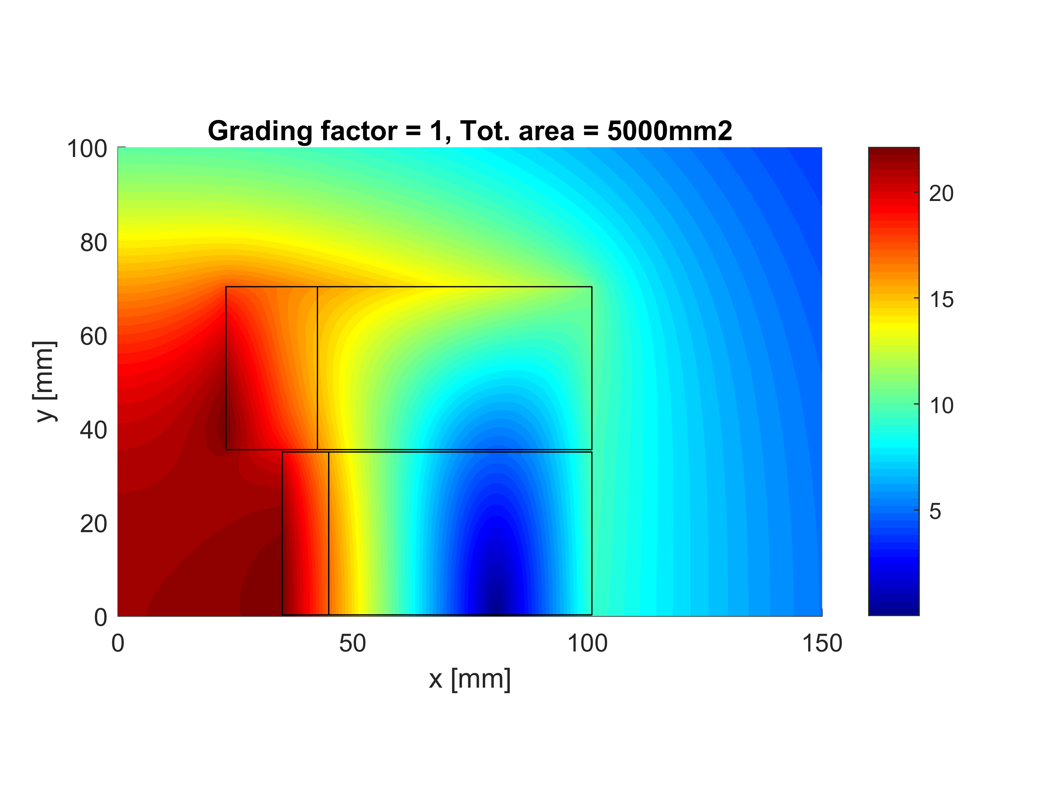
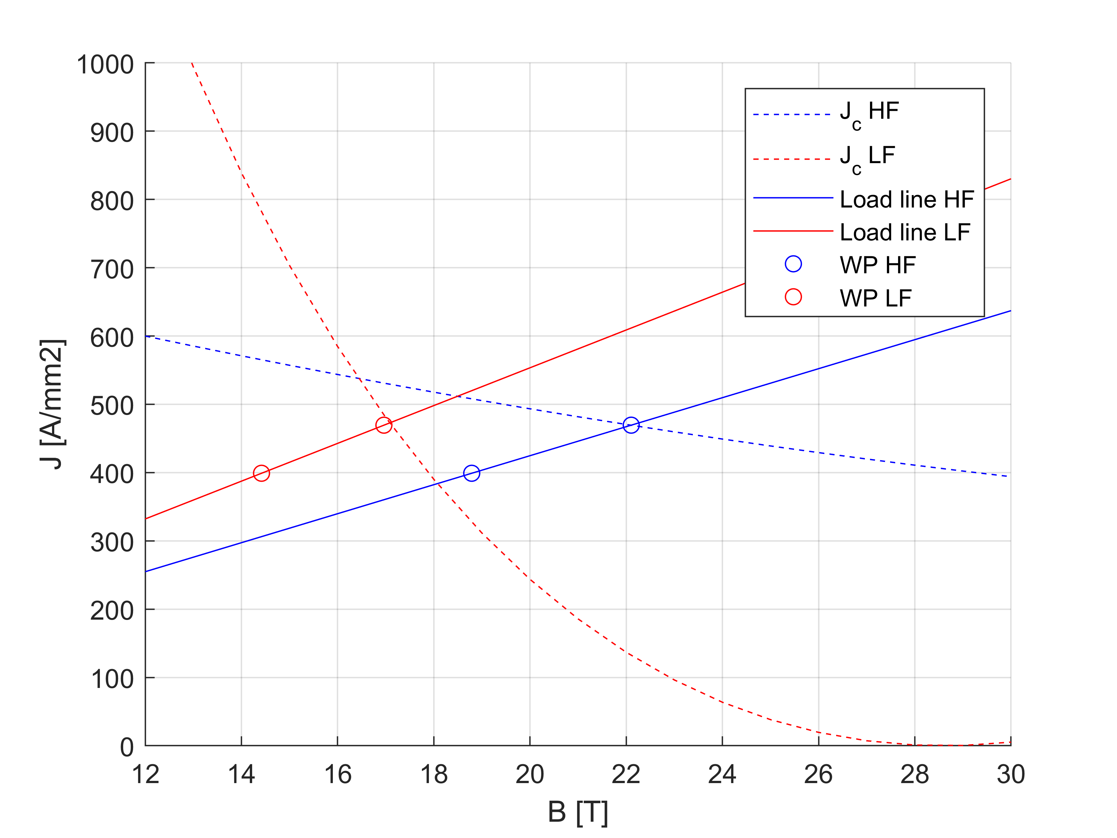
Parametric analysis 1: best inner radius?
A_HF = 1020.85 mm2
A_LF = 3979.15 mm2
A_tot = 5000 mm2
Grad_fact = 1
B0ssmax = 21.4 T
A_ratio = 3.898
Bp0_HF = 22.1 T
Bp0_LF = 16.96 T
J_HF = 469.4 A/mm2
J_LF = 469.4 A/mm2
Marg_HF = 0 %
Marg_LF = 0.7 %
Sx_max = 319 MPa
Sy_max = 141 Mpa
B0 @85%SS = 18.2 T

Slide 11
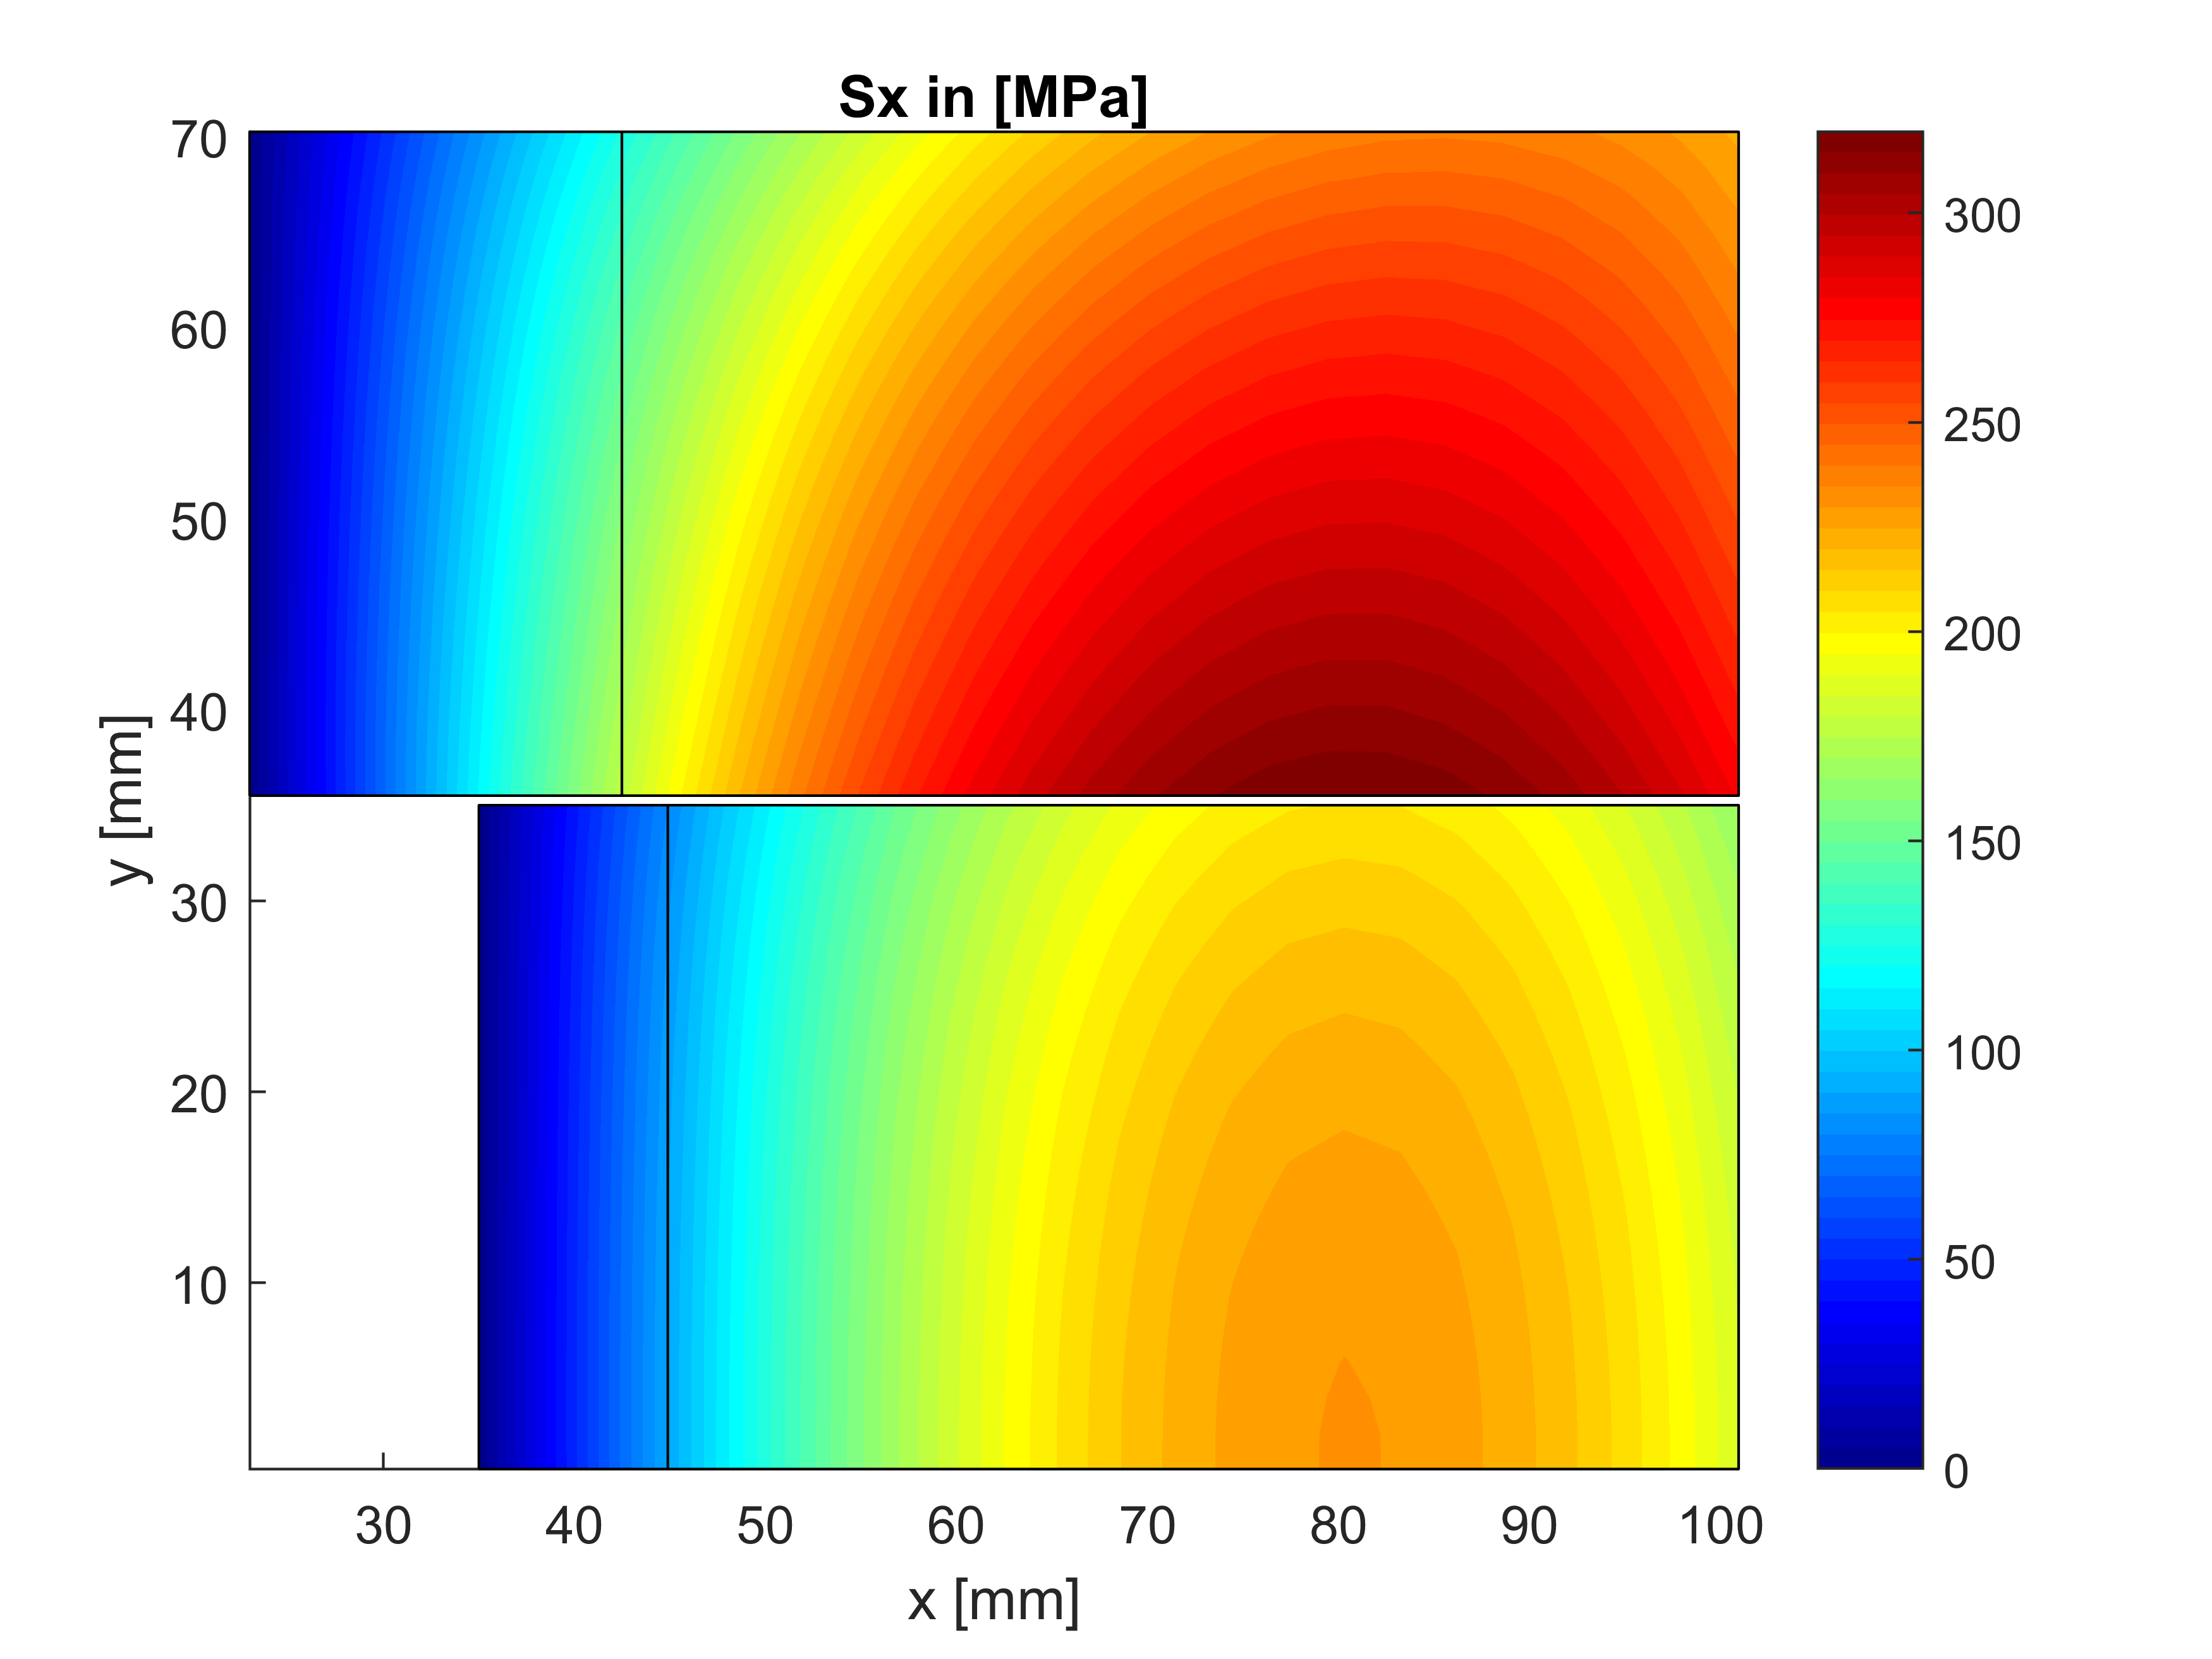
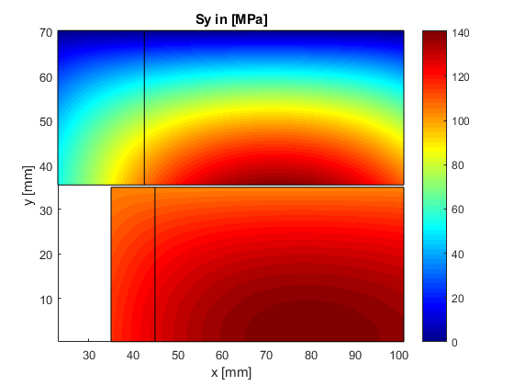
Parametric analysis 1: best inner radius?
Sx_max = 319 MPa @SS 231 Mpa @85%SS (in Nb3Sn)
Sy_max = 141 MPa @SS 102 Mpa @85%SS (in Nb3Sn)
Sx_max = 177 MPa @SS in Bi2212
Sy_max = 126 MPa @SS in Bi2212
Average Sy transferred from top to bottom pancakes
Sx decoupled between pancakes

Slide 12
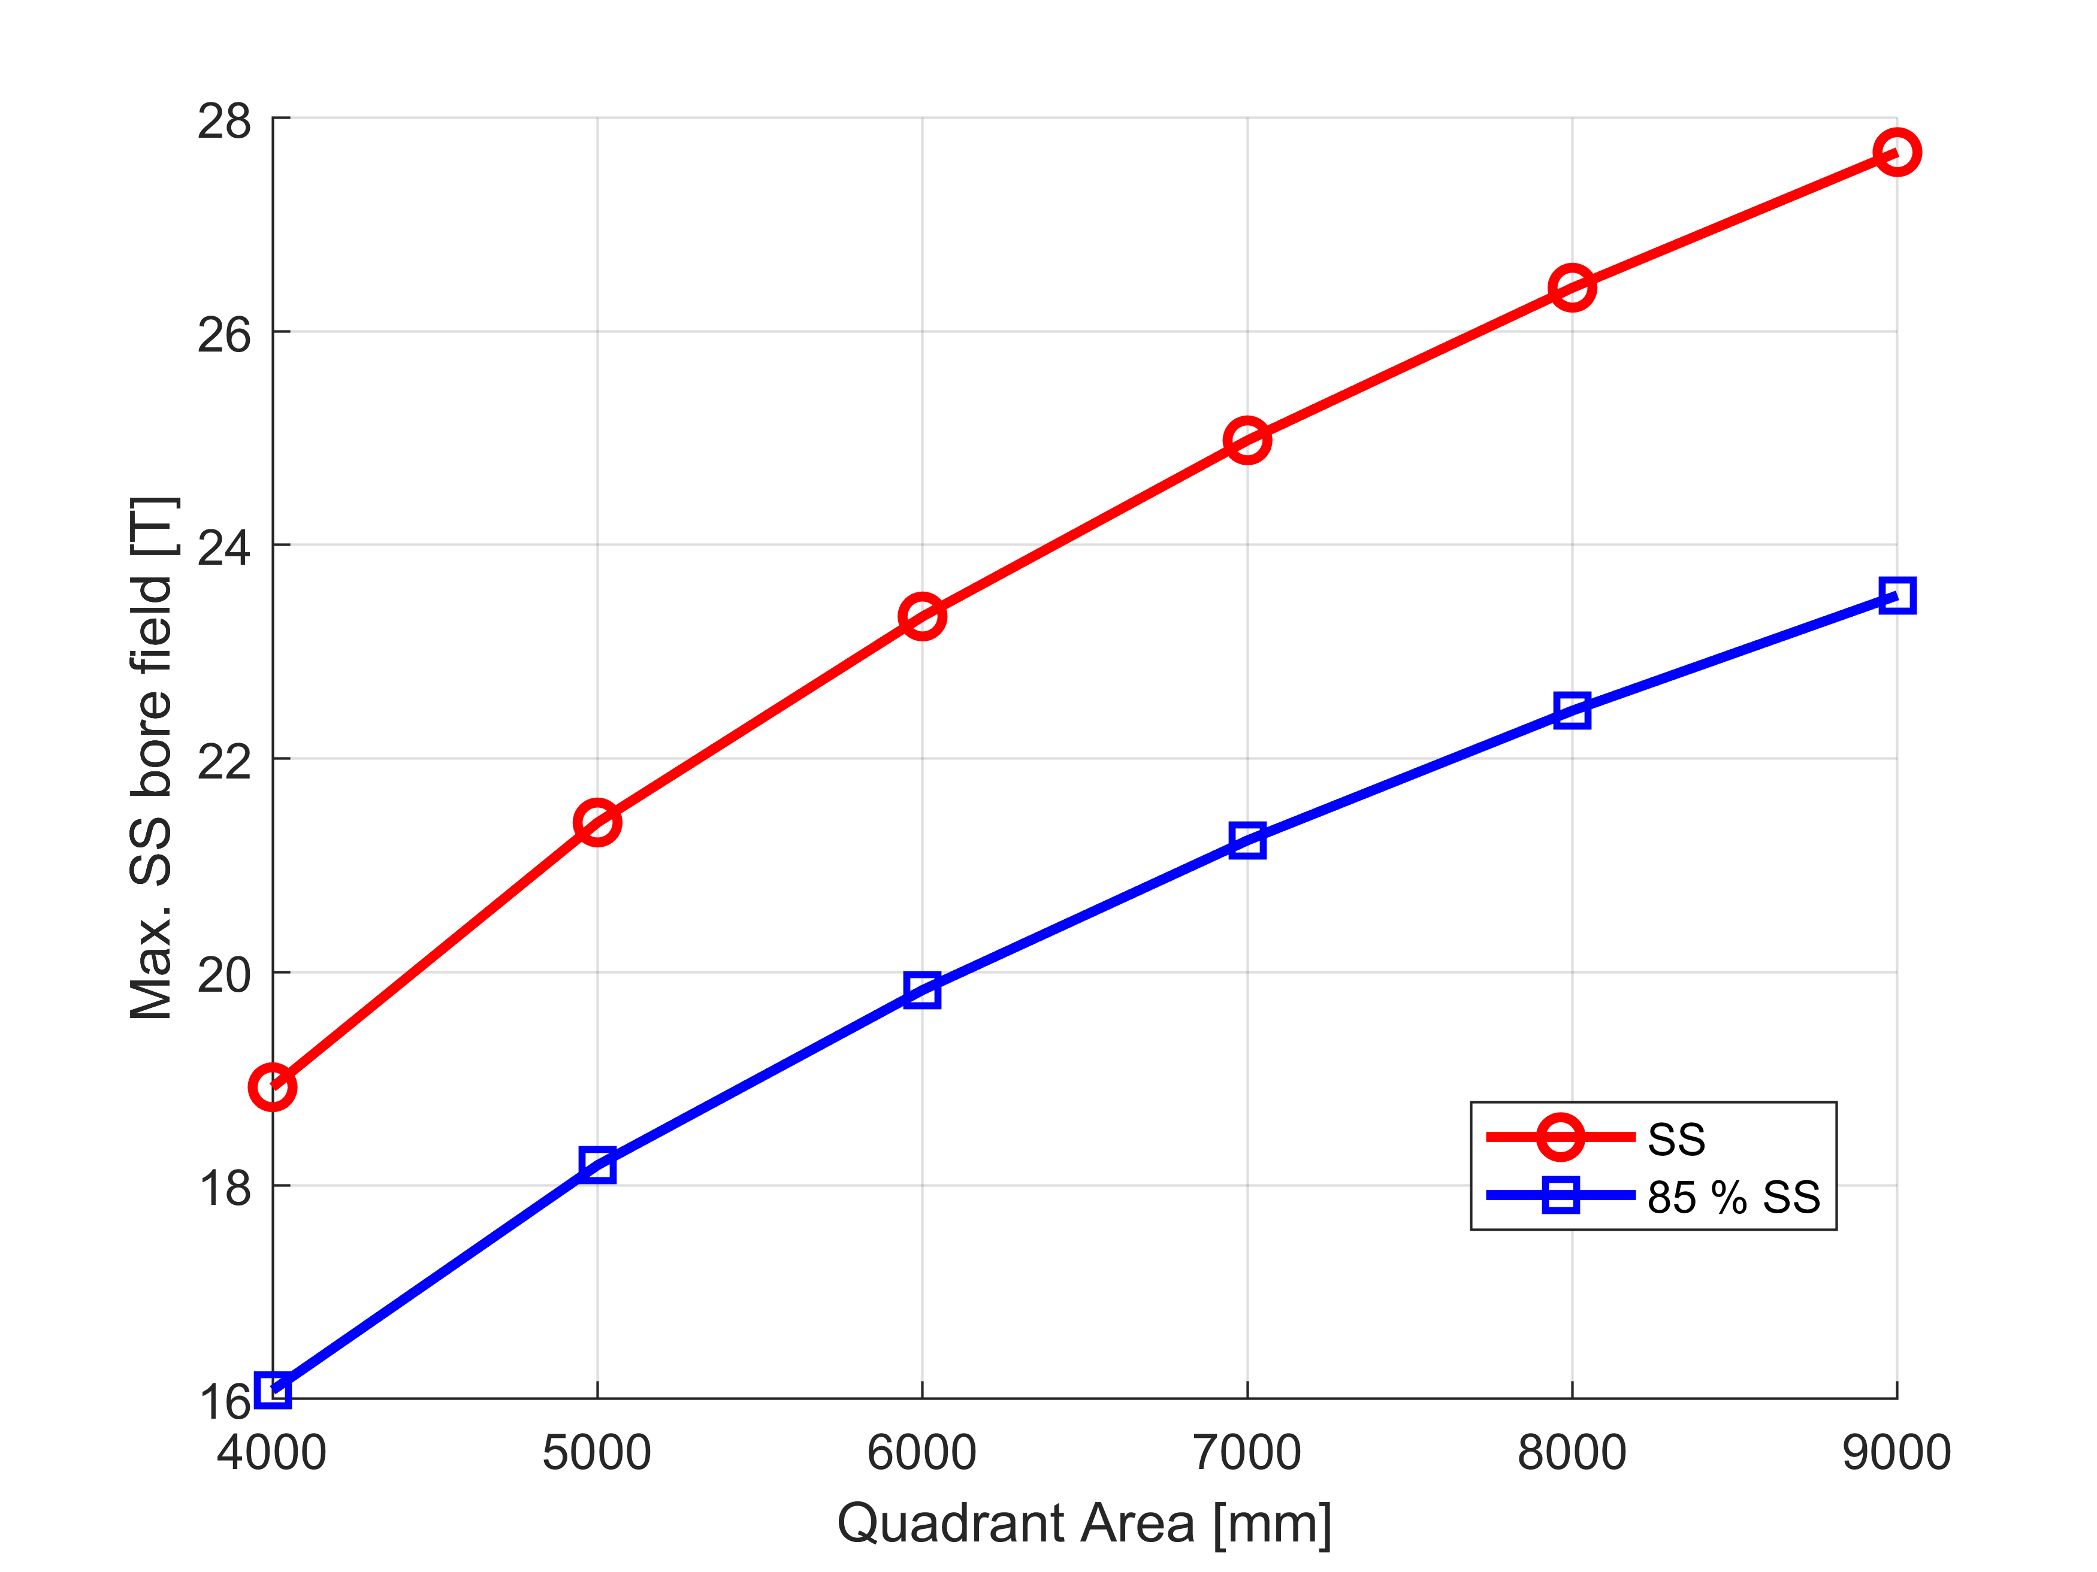
Parametric analysis 2: how much conductor?
Starting with a given A_tot and x_min = 23 mm
Varying v1 and v2
Selecting the configuration giving the max. B_bore @ SS. If several solutions, selecting the min v1 and min v2
Reproducing the loop 1. to 3., changing A_tot
Selecting the A_tot giving 20T @85%SS.
Optimum for x_min = 23 mm
A_tot = 6000 mm2
B_bore @ SS = 23.3 T
B_bore @85%SS = 19.8 T

Slide 13
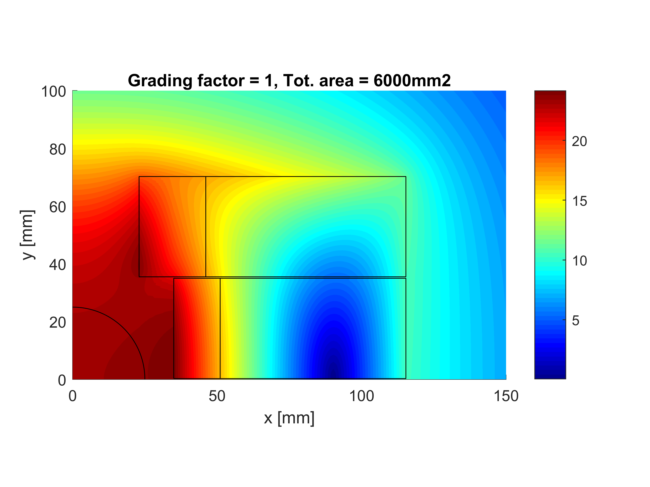
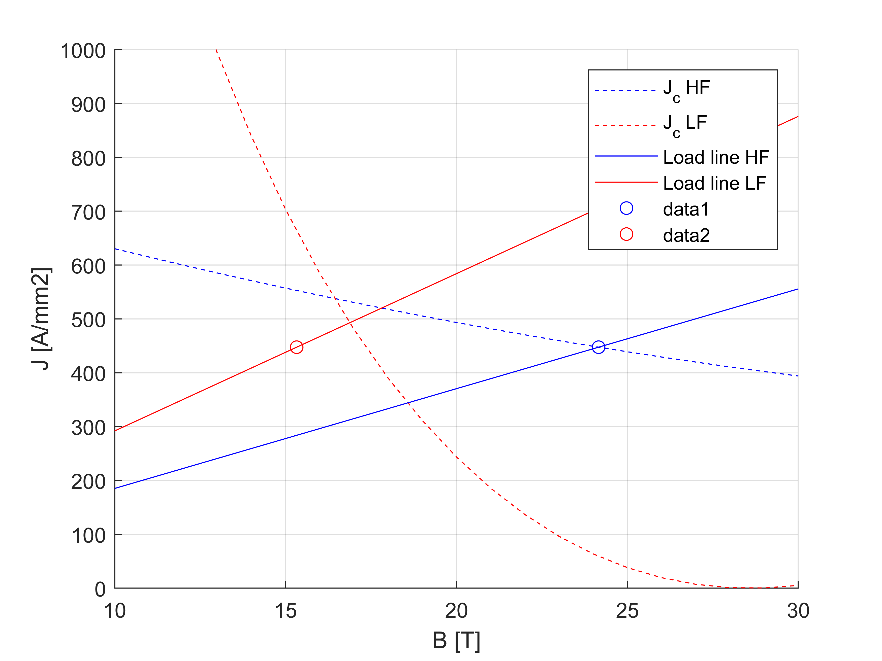
Parametric analysis 2: how much conductor?
A_HF = 1360.425 mm2
A_LF = 4639.575 mm2
A_tot = 6000 mm2
Grad_fact = 1
B0ssmax = 23.33 T
A_ratio = 3.41
Bp0_HF = 24.16 T
Bp0_LF = 15.32 T
J_HF = 447.5 A/mm2
J_LF = 447.5 A/mm2
Marg_HF = 0 %
Marg_LF = 0.93 %
Sx_max = 380 MPa
Sy_max = 151 Mpa
B0 @85%SS = 19.8 T

Slide 14
Comparison with Cos-theta (not graded)
Block-coil Cos-theta Pros/Cons Block-coil
A_HF 1360 mm2 2540 mm2 Lower use of Bi2212 → lower cost
A_LF 4640 mm2 2470 mm2 Higher use of Nb3Sn
A_tot 6000 mm2 5010 mm2 Higher area in this case
Short sample:
B0ss 23.33 T 23.5 T
Bp_HF 24.16 T 24.4 T Similar Bi2212 load-line
Bp_LF 15.32 T 17.3 T Low Nb3Sn load-line
Jov 447.5 A/mm2 450 A/mm2 Similar current density
Sx_max 380 MPa 260 MPa Higher transverse stress
Sy_max 151 Mpa 285 MPa Lower tangential stress
@85%SS:
B0 19.8 T 20.0 T
Bp_HF 20.54 T 20.8 T
Bp_LF 13.02 T 14.7 T
Jov 380.38 A/mm2 382 A/mm2
Sx_max 275 Mpa 188 MPa
Sy_max 109 Mpa 206 MPa

Slide 15
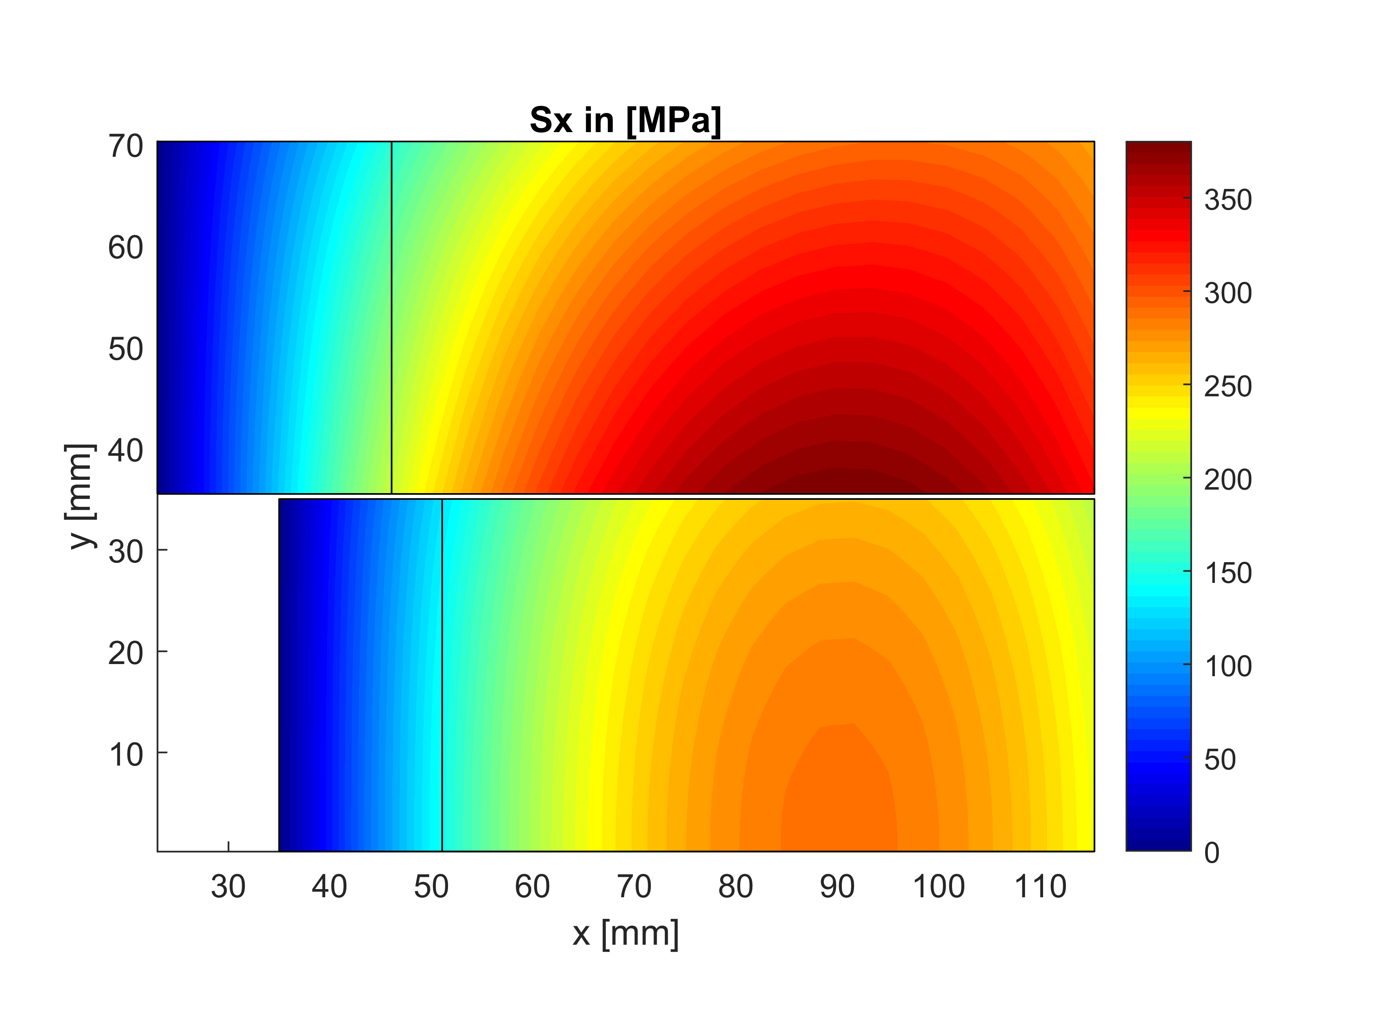
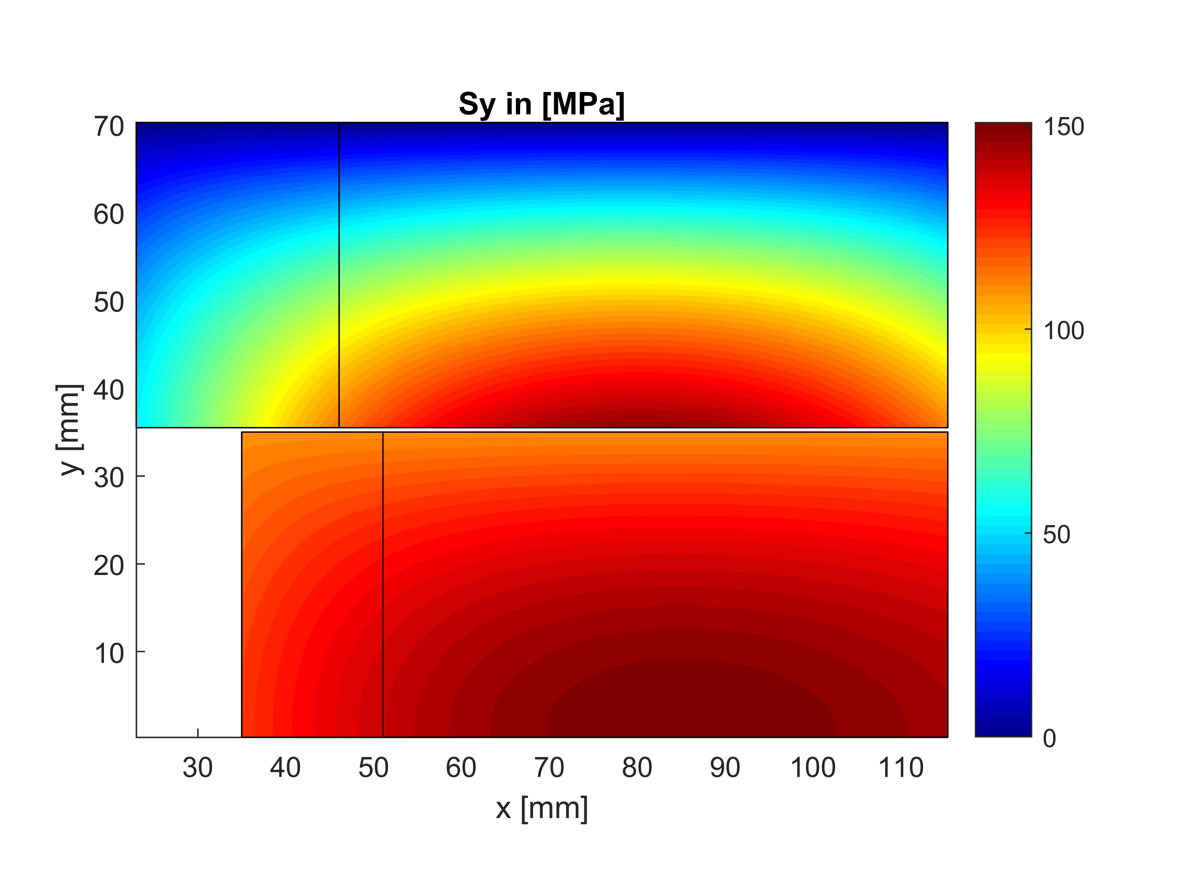
Parametric analysis 2
Sx_max = 380 MPa @SS 275 Mpa @85%SS (in Nb3Sn)
Sy_max = 151 MPa @SS 109 Mpa @85%SS (in Nb3Sn)
Sx_max = MPa @SS in Bi2212
Sy_max = MPa @SS in Bi2212
Average Sy transferred from top to bottom pancakes
Sx decoupled between pancakes

Slide 16
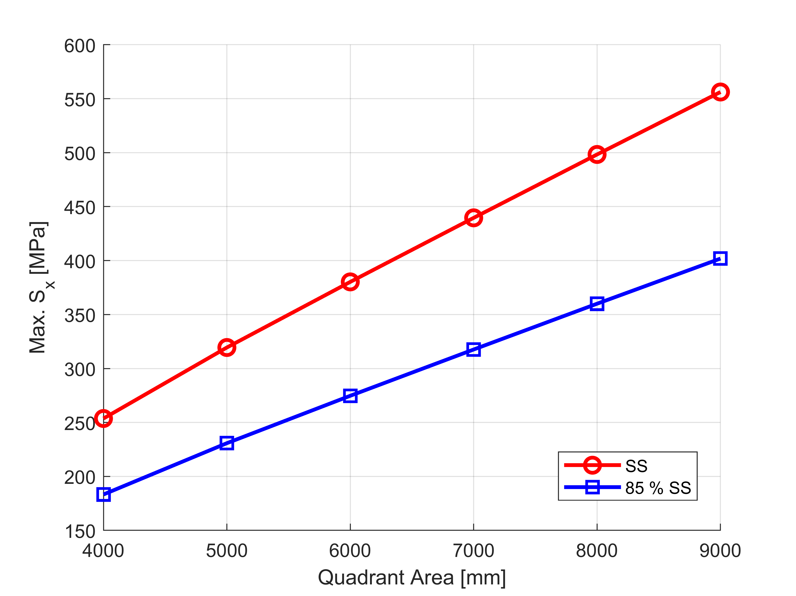
Parametric analysis 2
With 200 MPa limit @85%SS:
A_tot = 4500 mm2
B_bore = 17 T

Slide 17
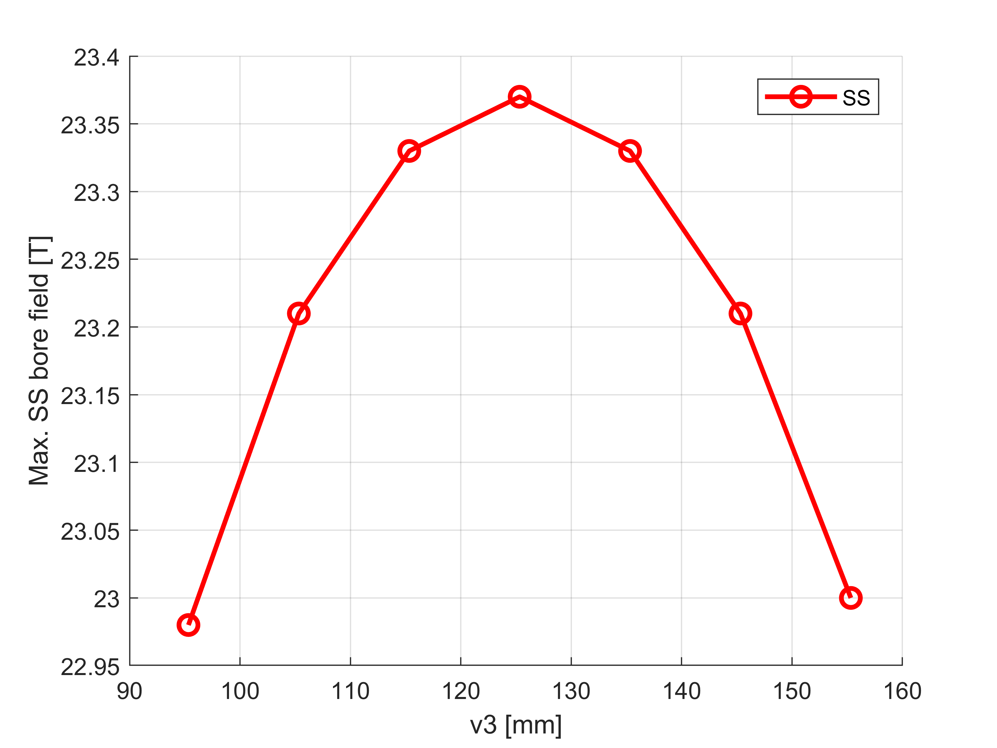
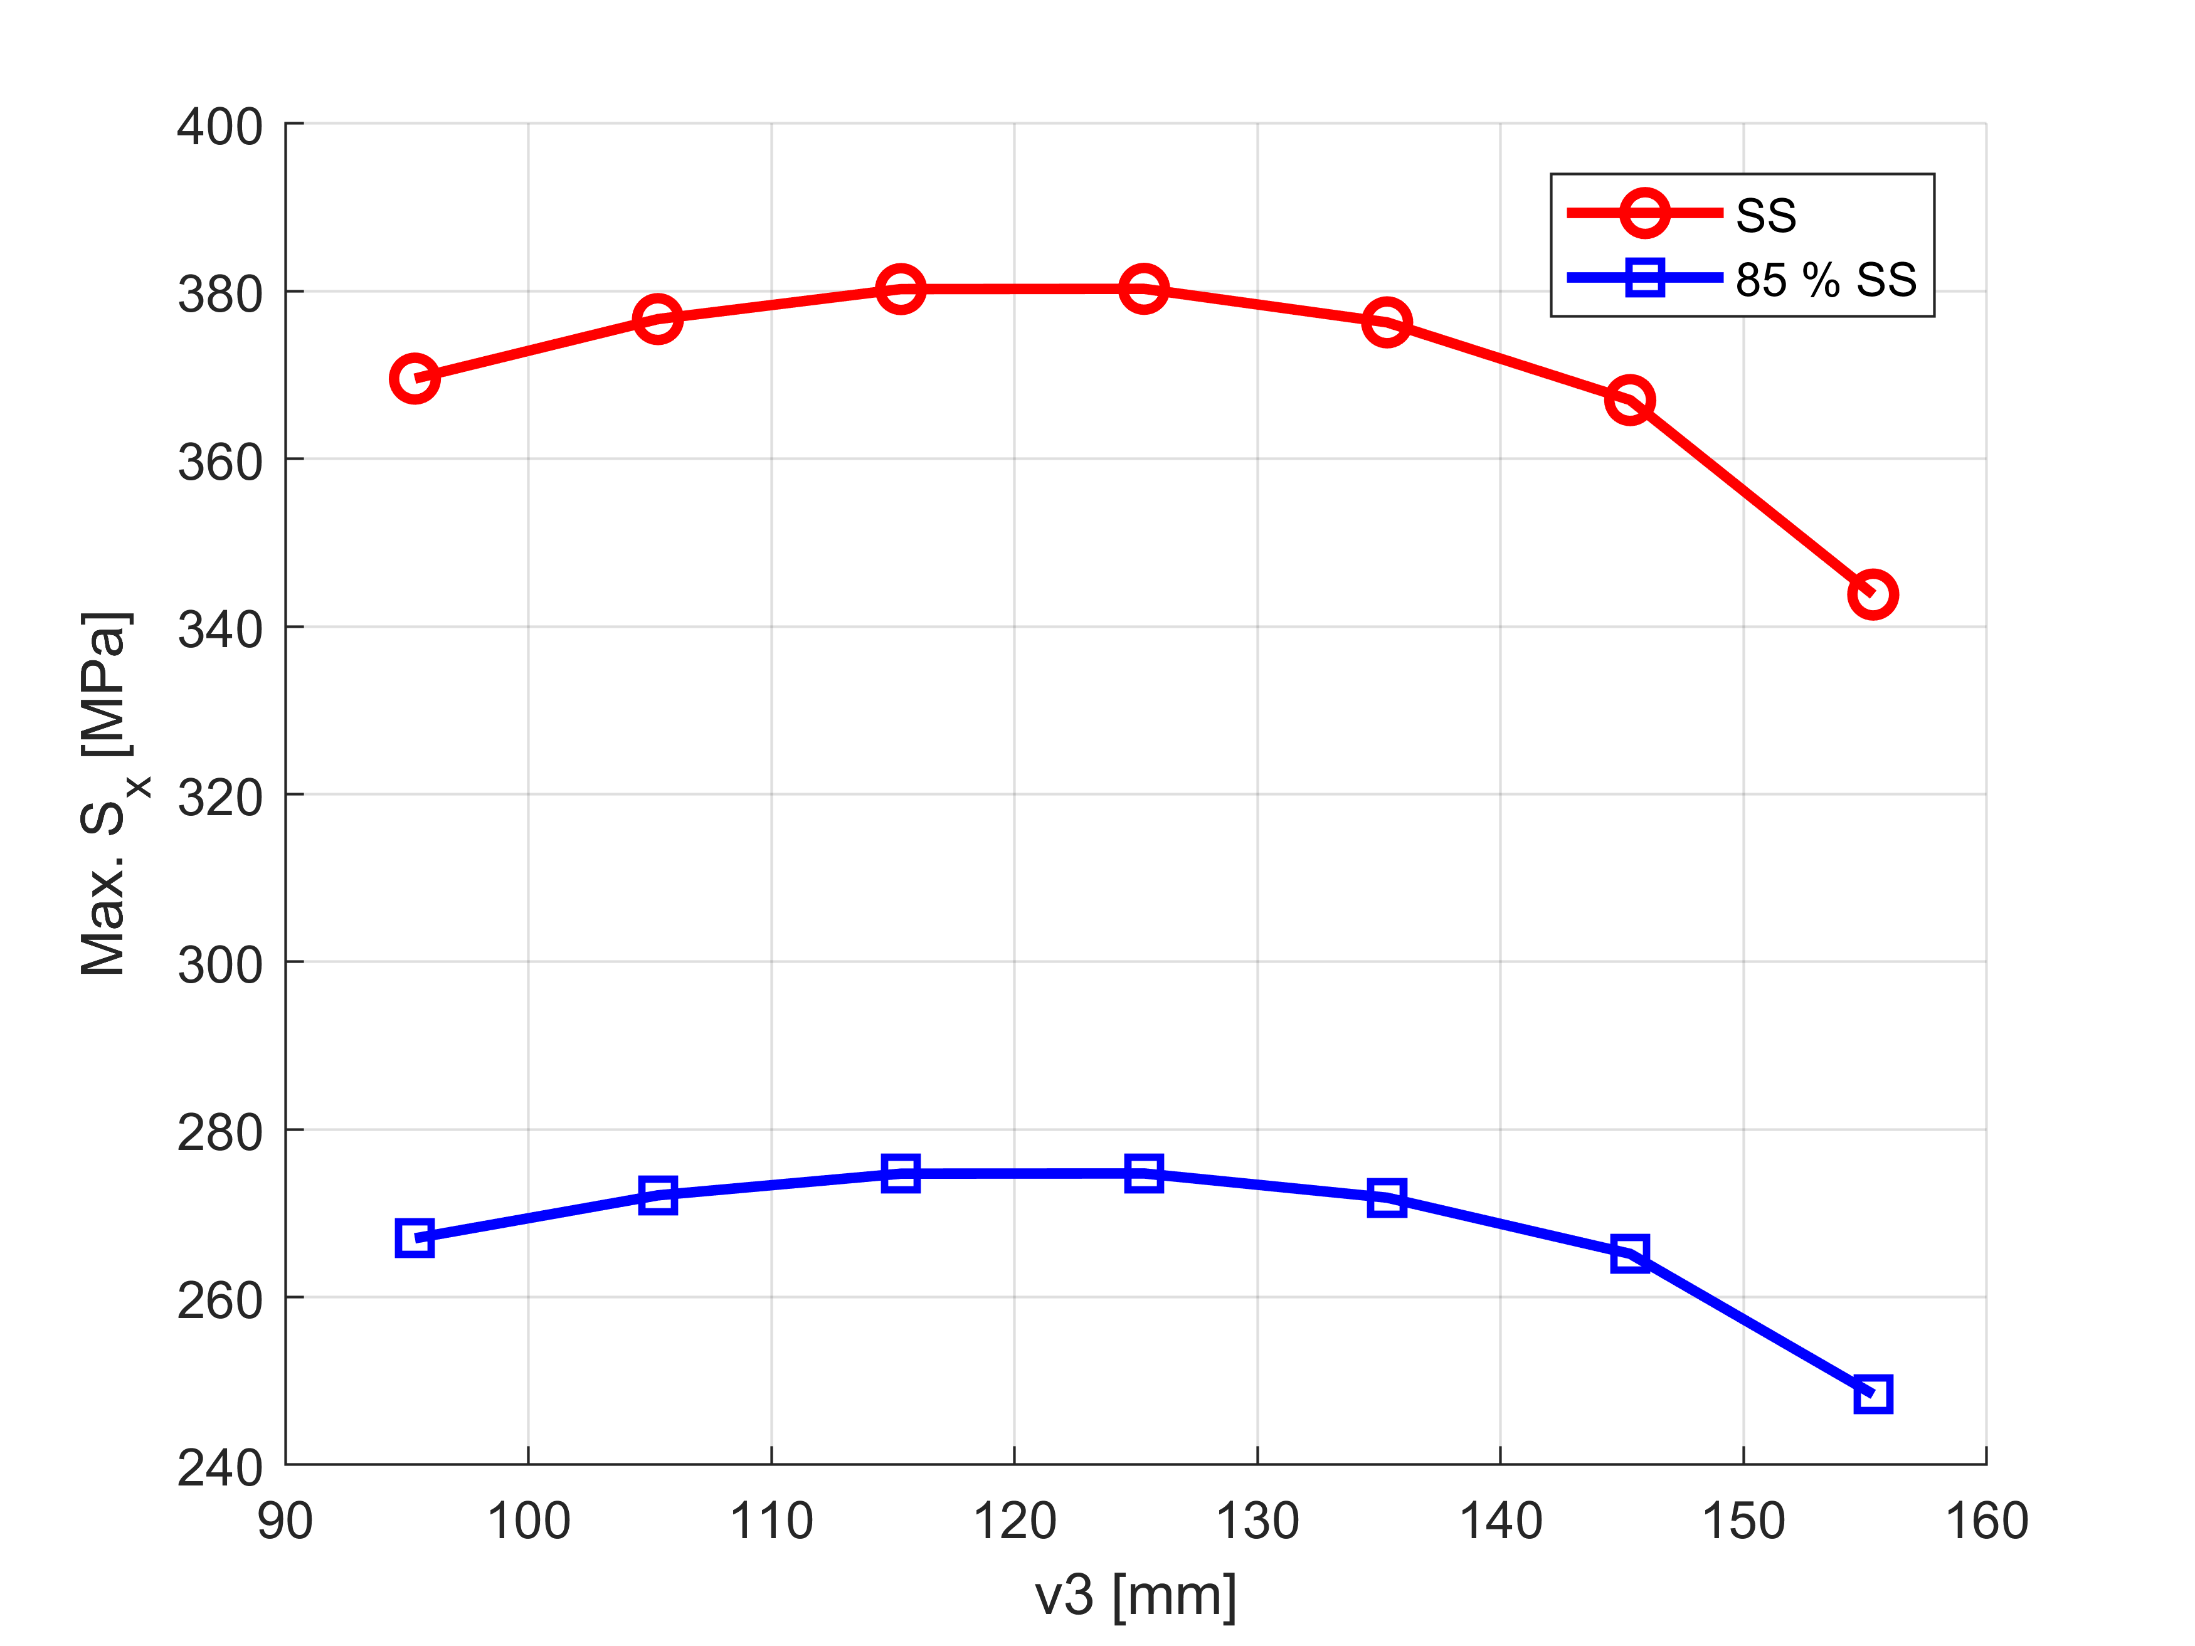
Parametric analysis 3: non-aligned blocks?
Starting with a given v3, A_tot = 6000 mm2 and x_min = 23 mm
Varying v1 and v2
Selecting the configuration giving the max. B_bore @ SS. If several solutions, selecting the min v1 and min v2
Reproducing the loop 1. to 3., changing v3
Selecting the v3 giving the max. B0.
Optimum: v3 = 125 mm
But: minor impact on B_bore
Minor impact on max. stress

Slide 18
Parametric analysis 3: non-aligned blocks?
Aligned
A_HF = 1360.425 mm2
A_LF = 4639.575 mm2
A_tot = 6000 mm2
B0ssmax = 23.33 T
Sx_max = 380 MPa
Sy_max = 151 Mpa
B0 @85%SS = 19.8 T
Non-aligned
A_HF = 1360.425 mm2
A_LF = 4639.575 mm2
A_tot = 6000 mm2
B0ssmax = 23.33 T
Sx_max = 380 MPa
Sy_max = 151 Mpa
B0 @85%SS = 19.8 T

Slide 19
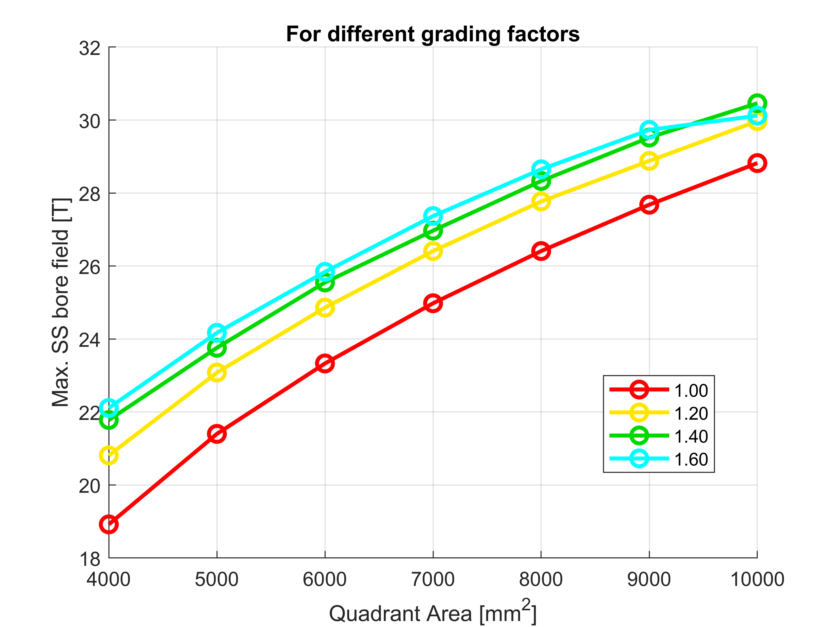
Parametric analysis 4: what grading?
Starting with a given A_tot, grading, with fixed v3 and x_min
Varying v1 and v2
Selecting the configuration giving the max. B_bore @ SS. If several solutions, selecting the min v1 and min v2
Reproducing the loop 1. to 3., changing A_tot and grading
Selecting the A_tot and grading giving the max. B0.
Keeping the same:
B_bore = 23.5T @SS
B_bore = 20T @85%SS
Max. feasible grading = 1.6
4500 mm2 required
(25% reduction)

Slide 20
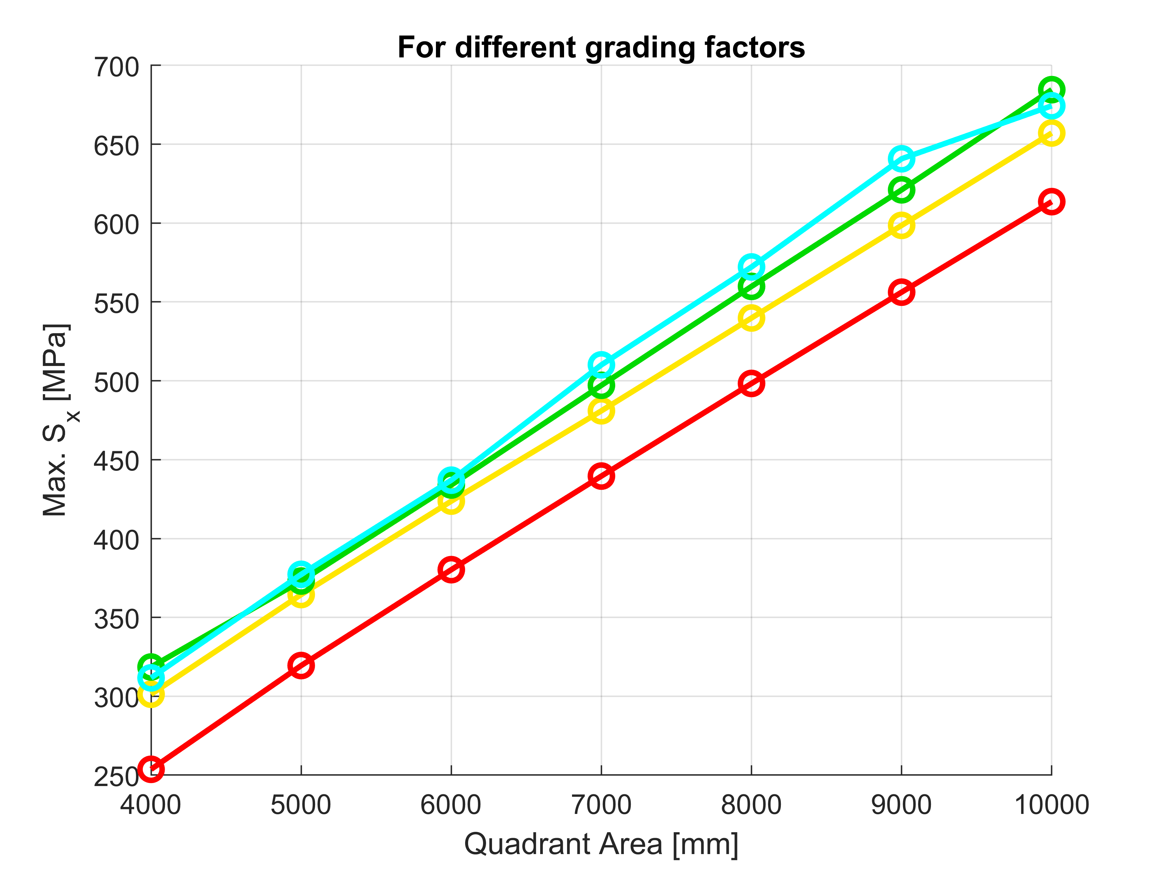
Parametric analysis 4: what grading?
Counter intuitive observation:
For a given field, the peak stress decreases with the grading

Slide 21
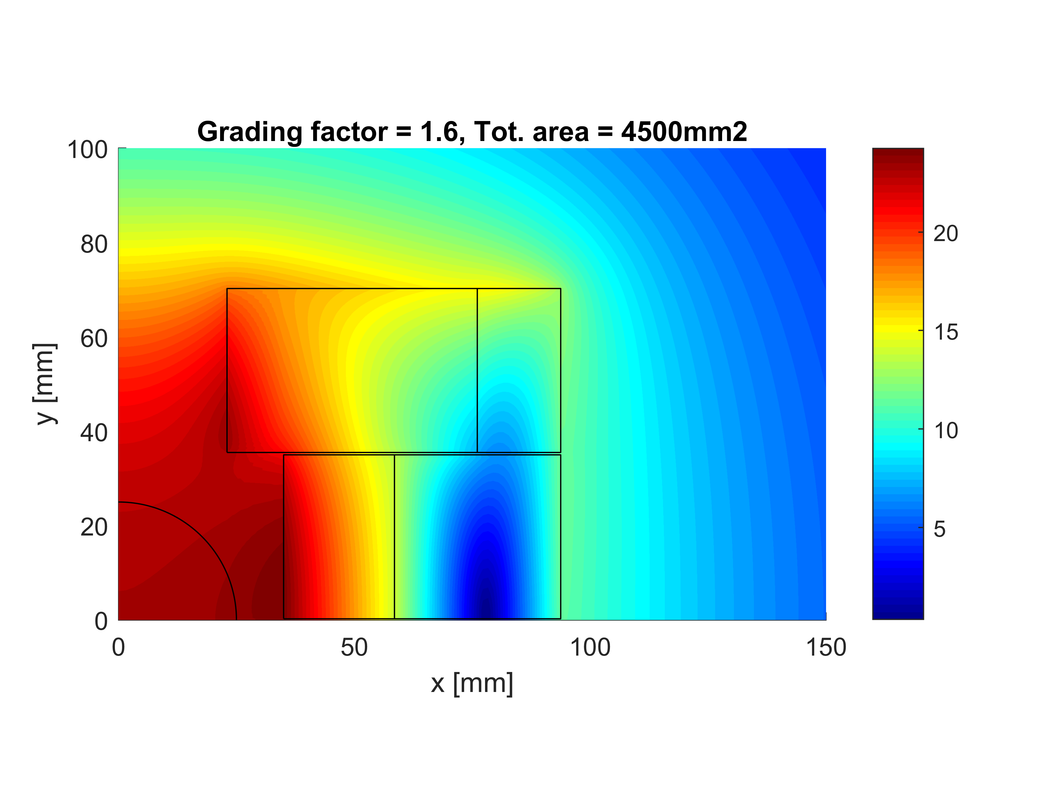
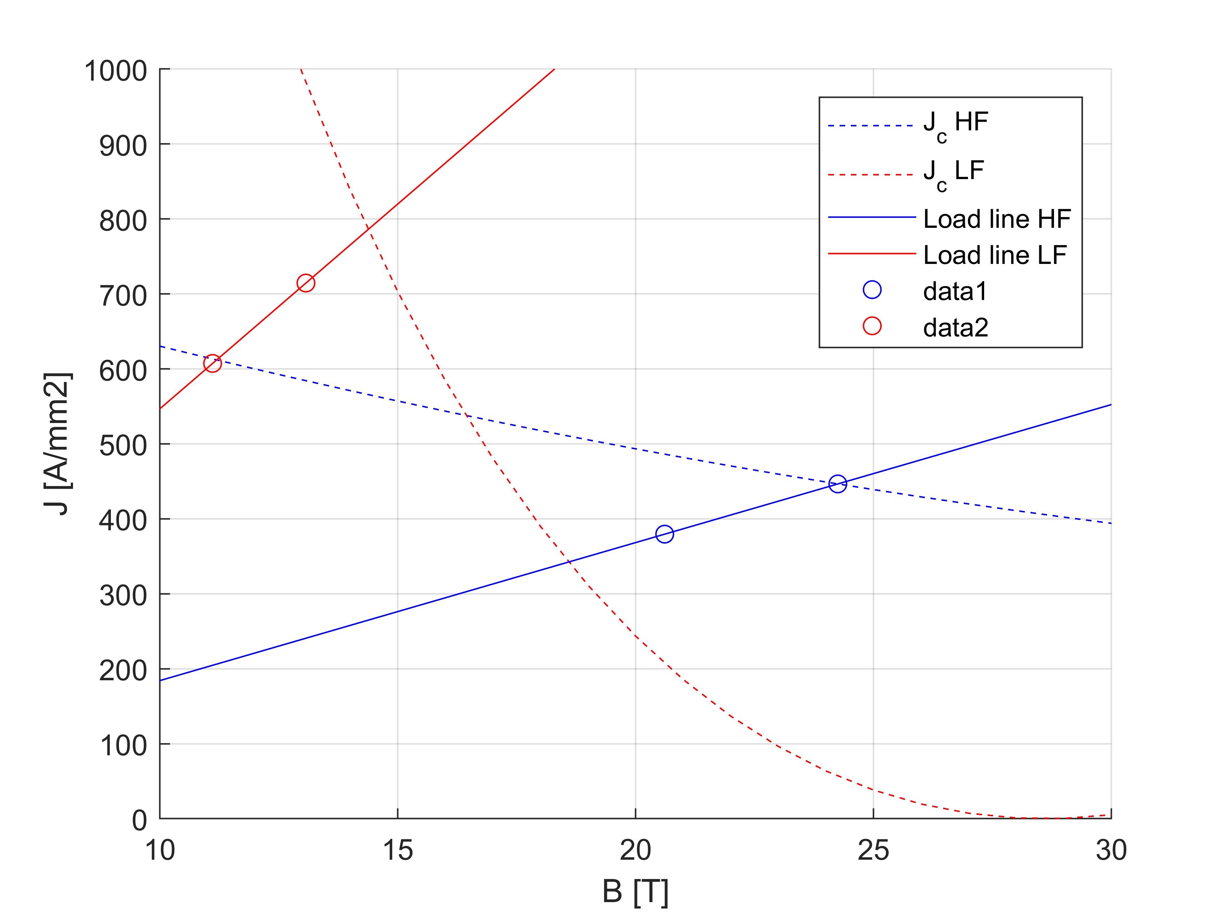
Parametric analysis 4: what grading?
A_HF = 2660.475 mm2
A_LF = 1839.525 mm2
A_tot = 4500 mm2
Grad_fact = 1.6
B0ssmax = 23.16 T
A_ratio = 0.6914
Bp0_HF = 24.25 T
Bp0_LF = 13.07 T
J_HF = 446.6 A/mm2
J_LF = 714.5 A/mm2
Marg_HF = 0 %
Marg_LF = 1.6 %
Sx_max = 346 MPa
Sy_max = 260 Mpa
B0 @85%SS = 19.7 T
Smaller total area
Lower stress
But: Higher use of Bi2212 (HF)

Slide 22
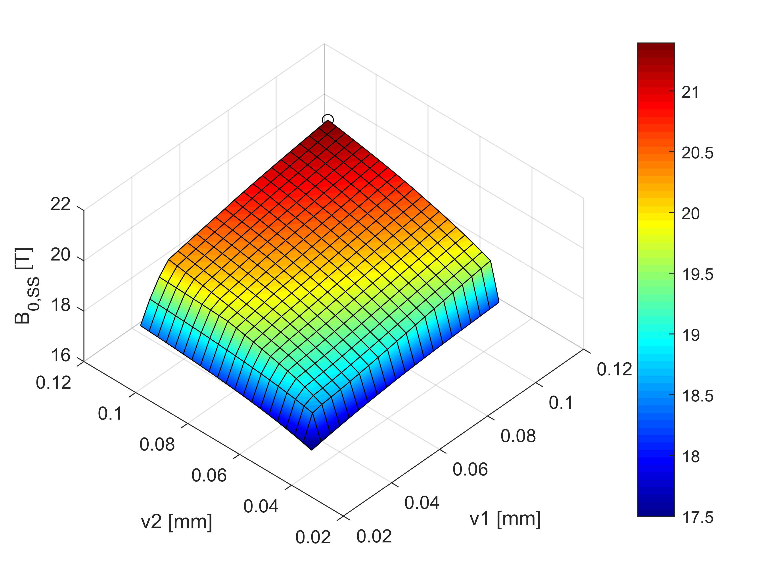
Parametric analysis 4: what if grading is<1?
The use of Bi2212 is decreased when the grading ratio = 1
With grading = 0.8 (J_{LF}/J_{HF}):
J_{LF} is lower so there is no gain in terms of field
Max B_bore is for v1=v2=x_{max} → no use of Nb3Sn
grading = 1
grading = 0.8

Slide 23
Comparison with Cos-theta (graded)
Block-coil Cos-theta Pros/Cons Block-coil
A_HF 2660 mm2 2540 mm2
A_LF 1840 mm2 2470 mm2
A_tot 4500 mm2 5010 mm2 Similar use of areas
Short sample:
B0ss 23.16 T 23.5 T
Bp_HF 24.25 T 24.4 T Similar Bi2212 load-line
Bp_LF 13.07 T 17.3 T Low Nb3Sn load-line
Jov 446.6/714.5 450 A/mm2 High J in LF
Sx_max 346 MPa 260 MPa Higher transverse stress
Sy_max 260 MPa 285 MPa Similar tangential stress
@85%SS:
B0 19.7 T 20.0 T
Bp_HF 20.61 T 20.8 T
Bp_LF 11.11 T 14.7 T
Jov 379.6/607.3 382 A/mm2
Sx_max 250 Mpa 188 MPa
Sy_max 188 Mpa 206 MPa

Slide 24
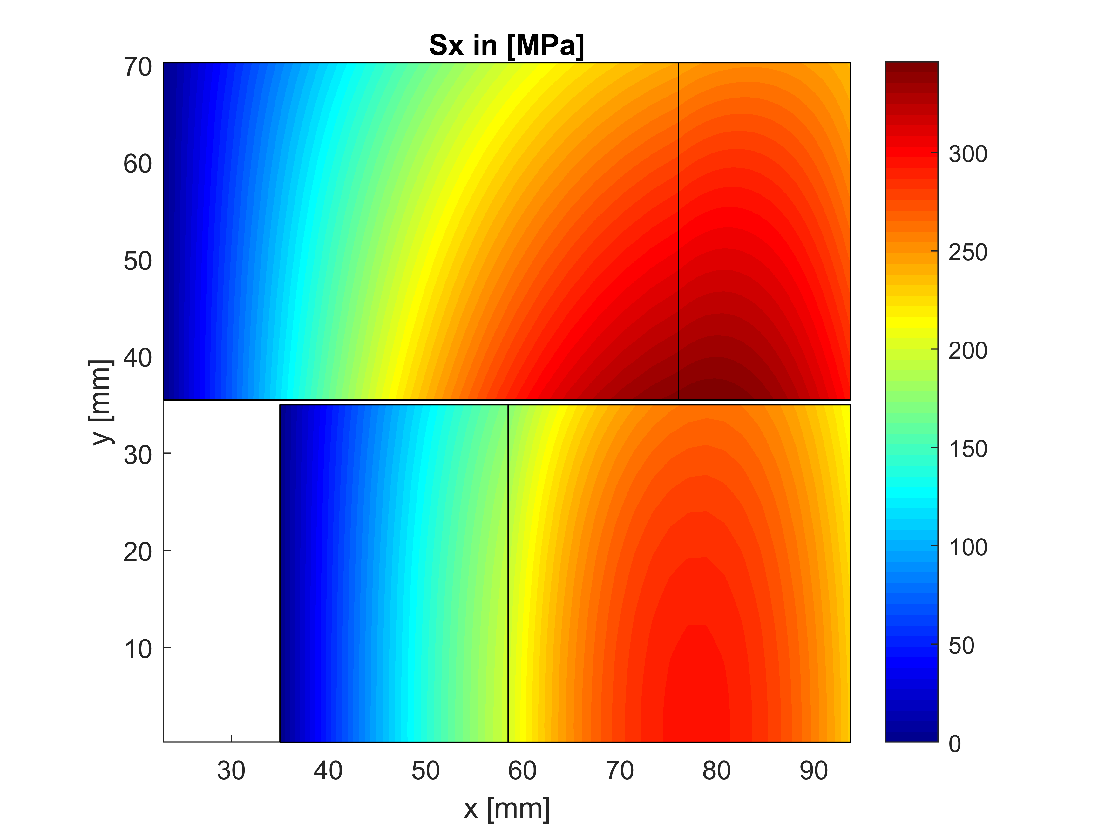
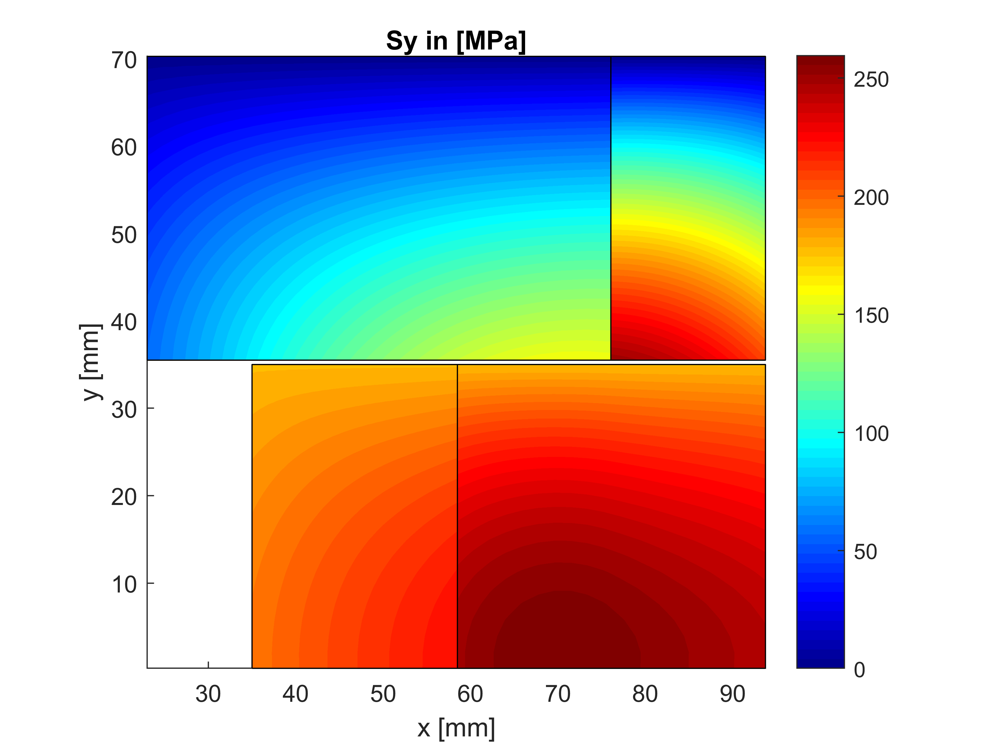
Parametric analysis 4
Sx_max = 346 MPa @SS 250 Mpa @85%SS (in Nb3Sn)
Sy_max = 260 MPa @SS 188 Mpa @85%SS (in Nb3Sn)
Sx_max = 343 MPa @SS in Bi2212
Sy_max = 223 MPa @SS in Bi2212

Slide 25
Conclusion
Parametric analysis 1: what inner radius choose for the max. bore field?
R ~ aperture radius seems the optimum
Parametric analysis 2: how much conductor the block-coil requires for the max. bore field ?
6000 mm2 for the quadrant (5000 mm2 for the cos-theta)
But 275 MPa peak stress
3. Parametric analysis 3: better with non-aligned blocks?
Marginal impact on field and stress (when additional degrees of freedom due to HF/LF boundaries)
4. Parametric analysis 4: what is the optimum grading?
Only 4500 mm2 required with a grading of 1.6
Still 250 MPa peak stress

