Slide 1
Thermal modeling, interfaces, test results
LBNL Composites Workshop
February 29-March 3, 2016

Slide 2
Thermal modeling of our typical detector structures, like ATLAS pixel local supports, is interesting
0.6W/cm^2 @-7C
thermal-mechanical deflection
steady-state heat transfer
non-trivial thermal interfaces
thin-wall and thick-wall
convection
2 phase flow
oh yes, and composite materials
fiber-reinforced
particle-reinforced
foam/filler hybrid
Thermal Grease 1.4W/mK
CC 40 X 200W/mK (0.5mm)
Flat tube —increase area
-20C
Sector ‘05
CFRP 1 X 200W/mK (0.075mm)
0.6W/cm^2 @-15C
Thermal Grease 1.4W/mK
Carbon Foam (20-40W/mK)
-30C
Current Concept
Buried tube (higher pressure)

Slide 3
High in-plane thermal conductivity can be achieved for CFRP
Typically use pitch-based fibers with high thermal conductivity (K)
K₁ of fiber itself can be extraordinary
K13D2U fiber is 800 W/m*K, which is 2x copper
this in the fiber direction (1-direction)
K₁ of a unidirectional ply is ~½ that
rule of mixtures: K_{1,ply} = K_{f1} * V_{f} + K_{m} * V_{m}
K₁ of a typical stackup is ~½ that again
tensor rotation of each ply K₁
weighted average by ply thicknesses
So for the high-performance pitch fibers, we end up with aluminum-like thermal conductivity in-plane, ~200 W/m*K

Slide 4
Thru-thickness thermal conductivity is generally 2-3 orders of magnitude lower
This is the out of plane direction (K₃)
K₃ ~ 1 W/m*K
K₁ / K₃ ~ 10² to 10³
In special cases we can do a bit better than K₁₁ = 200 W/m*K, but it often doesn’t matter:
In many practical applications the limiting factor is getting the heat into or through the thickness of the laminate
For a ply, K₂ = K₃ ~ (V_{f} / K_{f2} + V_{m} / K_{m})⁻¹
Typical K_{f2} ~ 2-10 W/m*K
Typical K_{m} ~ 0.2 W/m*K

Slide 5
The interfaces are important resistors in our typical geometries
They certainly cannot be ignored.
Generally need to modeled as discrete solids, with finite thickness.
~0.5W/m²
Silicon Module
1.25 W/mK (100μ) SE4445
Thermal Interface Material
CFRP Face Sheet
~1.0 W/mK (~200μ)
CVD Foam (30-40W/mK)
1.1 W/mK (100μ)
Interface Equivalent
Cooling Tube BC

Slide 6
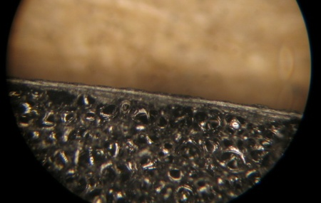
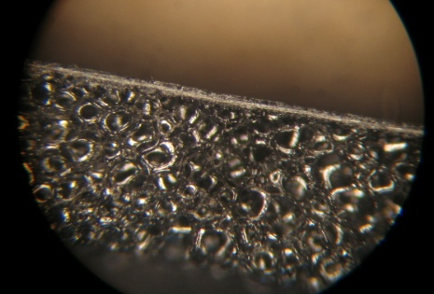
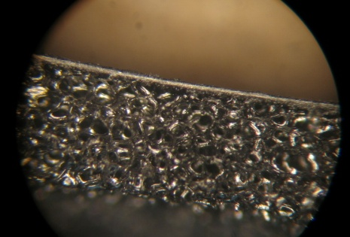
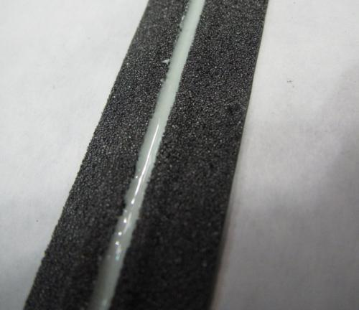
Our interfaces at foam-facesheet or foam-tube depend deeply on fabrication details
(A) 50um resin film, 25um peel
(B) No resin film, 25um peel
(C) No resin film, 75um peel
Co-cured sample
Epoxy + BN

Slide 7
We need to use solids for thermal models in FEA
For structural FEAs, we often use shell bodies (2D) to represent composite laminates
This works because the thru-thickness loads (shear and out-of-plane modulus) are negligible
For thermal FEAs, the thru-thickness conductivity is essential
So we have to model 3D bodies of finite thickness
This adds overhead to model setup
more contact surfaces to define
may need a discrete body for every ply
and each ply body needs a discrete coord system to define its orientation
some FE pre-processors (such as ACP) can make this work much faster (for complex geometries, read “possible”) to do

Slide 8
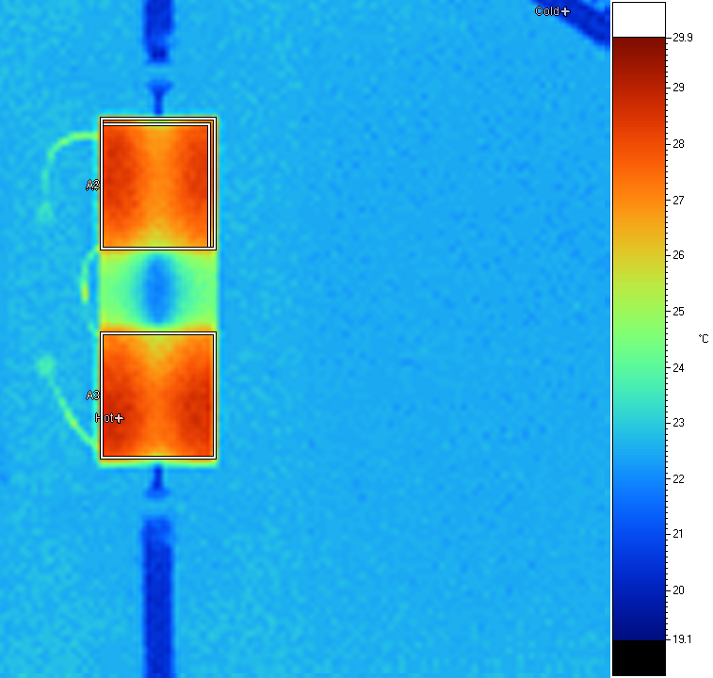
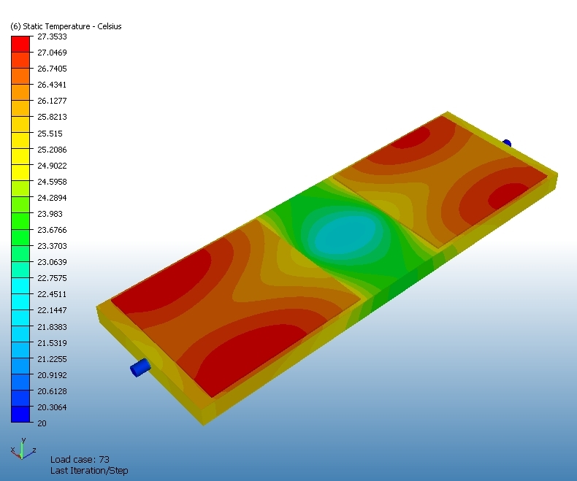
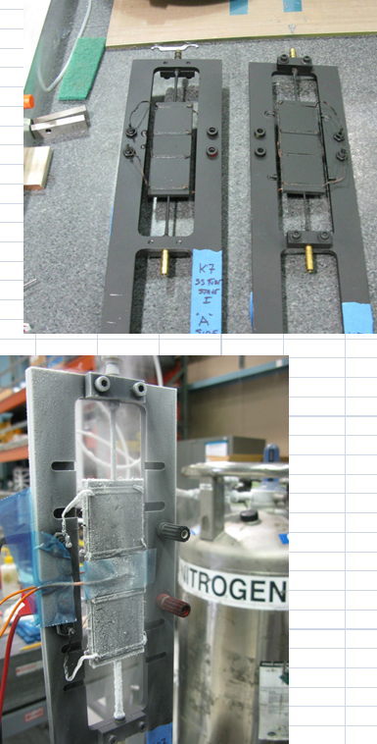
We’ve more or less standardized on a typical method for assessing thermal performance of staves for detectors
Stave has all fab processes and materials
2+ Si/Pt dummy module heaters
IR camera images heaters on and off
ΔT = T_{on} – T_{off} , typical spec ΔT < 8-10°C
This type of test includes the interfaces.

Slide 9
Thermal-mechanical behavior is pretty straightforward to do in FEA
Solve the thermal problem
Pass temperature data as input to structural
Solve the structural problem
It is not straightforward to test.

Slide 10
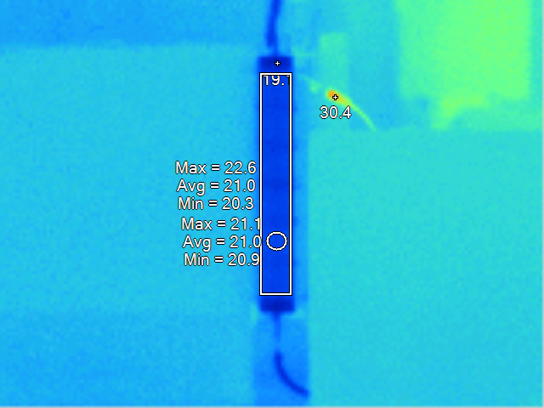
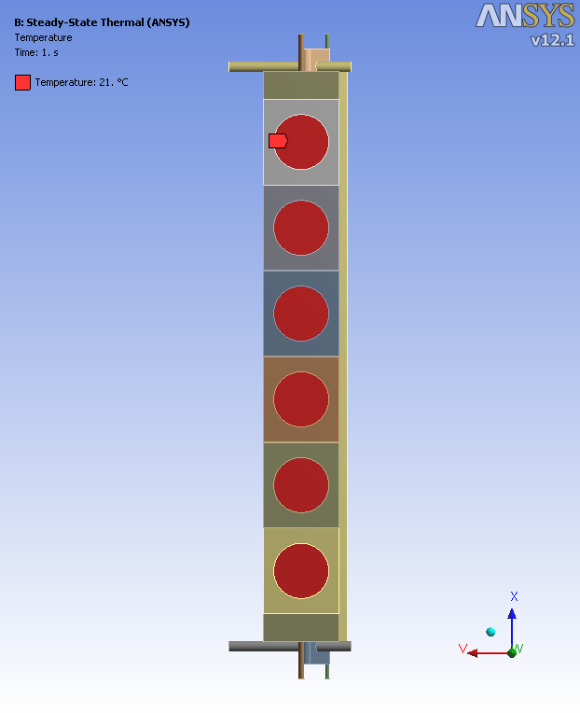
We’ve used combined IR (thermal) + TVH (interferometry) to do this on I-beam
IR temp data
→ B.C. for FEA
Solve two thermal-stress analyses at the two setpoints and then compare to TVH data
TV holography data
→ Differential deflection between 2 setpoints (2 different power inputs to silicon)

Slide 11
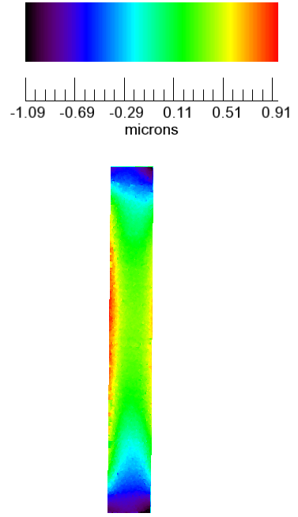
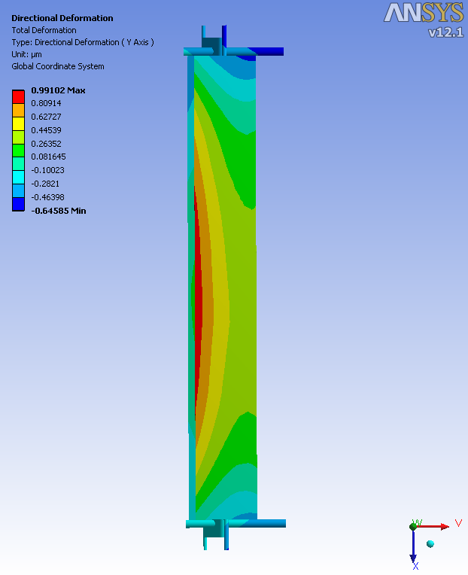
It is highly effective at validating FEA, but takes some work to do
TVH
meas.
FEA

Slide 12
We typically fill our epoxies with particles to enhance K_{m}
Typical unfilled epoxy (Hysol 9396), K = 0.2 W/m*K
Baseline filler for most of our applications is micron-sized BN, which gets you to K ~ 1.1 W/m*K at 20-30% mass fraction
easy to use, safe, gives nice viscosity
Another typical filled material is SE4445, with K = 1.25 W/m*K
frequently used to mount Si modules
proprietary filler, Dow material

Slide 13
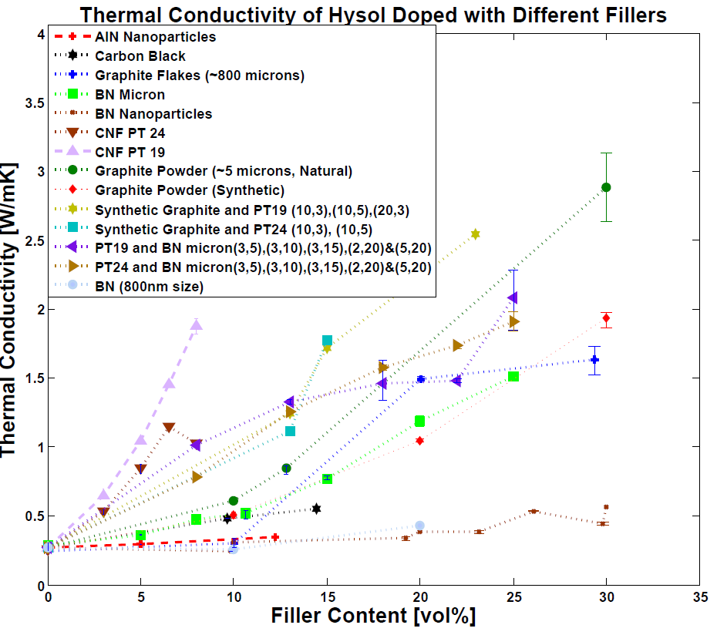
There’s been a lot of activity recently on finding new fillers for resins, to enhance K
We should be able to reliably get above ~1.5 W/m*K in practice with Hysol.
3 W/m*K is about the conceivable limit.
(and “nano” was not magical)

Slide 14
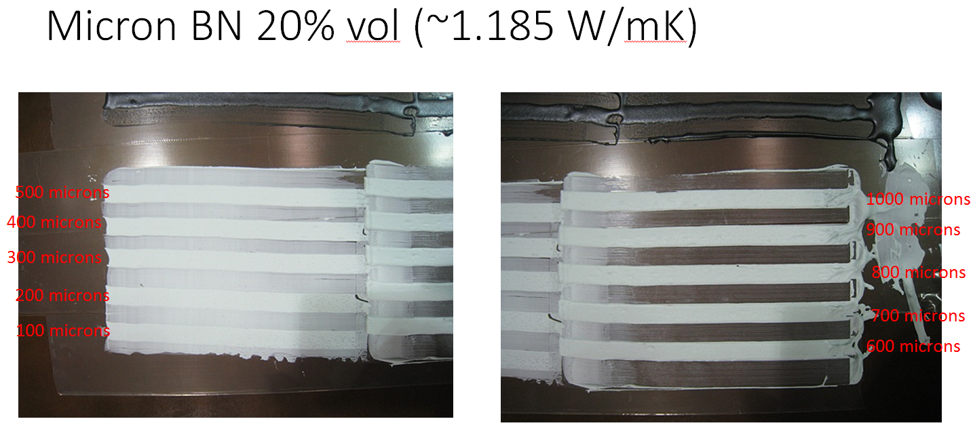
Thermal conductivity is important, but filled adhesives still need to be used as adhesives
Here is a nicely-spreadable typical BN-filled epoxy.

Slide 15
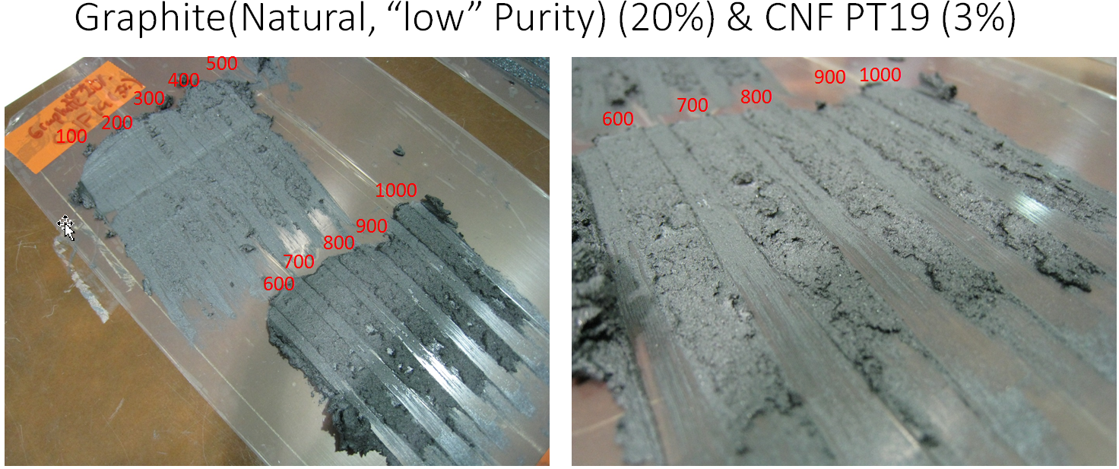
Here is an example of an unusable mixture.

Slide 16
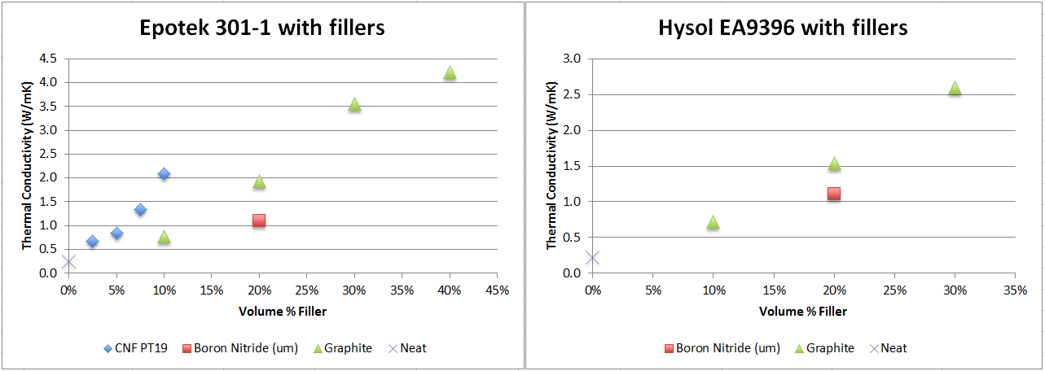
A lower viscosity resin allows more filler, and perhaps better exfoliation / distribution
Sample
‘too conductive’
To measure
This also highlights the importance of mixing quality.
A mixing machine with 2 spin axes (centrifugal + local) is an essential piece of equipment.

Slide 17
Thermal modeling is about intimate investigation of the materials and interfaces
Interfaces must be modeled discretely
K is often fabrication process-dependent
Testing properties and validating FEAs is generally not-so-simple:
accuracy and cross-calibration of temperature sensors
thermal interfaces to temperature sensors
thermal interfaces to heat sources
natural convection or other losses
cost of producing many samples
variability of samples
combining thermal and mechanical
plumbing is required
It takes a lot of iteration.
A good IR camera is really helpful.

Slide 18
