Slide 1
Composite Joining Techniques:
Bolted Joints
LBNL Composites Workshop
February 29-March 3, 2016

Slide 2
Joint grip material is anisotropic for a typical fiber-reinforced flange
  In-plane, the design might be quasi-isotropic, but that’s only in-plane
  Through the thickness (out-of-plane of the fibers) the plastic matrix dominates
  Typical moduli may be
    in-plane tensile: 100 GPa
    in-plane shear: 45 GPa
    out-of-plane tensile: 6 GPa
    out-of-plane shear: 3 Gpa
  17:1 ratio of in-plane vs out-of-plane is really important to acknowledge for bolted joint behavior

Slide 3
So composite bolted joints break some of our engineering expectations
  They tend to be…
    stiff in bending (like metal)
    soft in thru-thickness compression (like plastic)
  The joint material often limits the bolt preload!
    totally different from usual case, where it’s the tensile strength of the bolt that drives torque specs
    joint separation is a real concern
  High joint constant
    joint does not carry much
    of the load
  Usually the bolt is “along-for-the-ride”, but with composite flanges it’s the exact opposite – generally the joint is the compliant member
    joint constant = (amount of external load taken by bolt) /
    (total external load that joint carries)
    = K_{bolt} / (K_{joint} + K_{bolt})
    = a.k.a “force ratio”

Slide 4
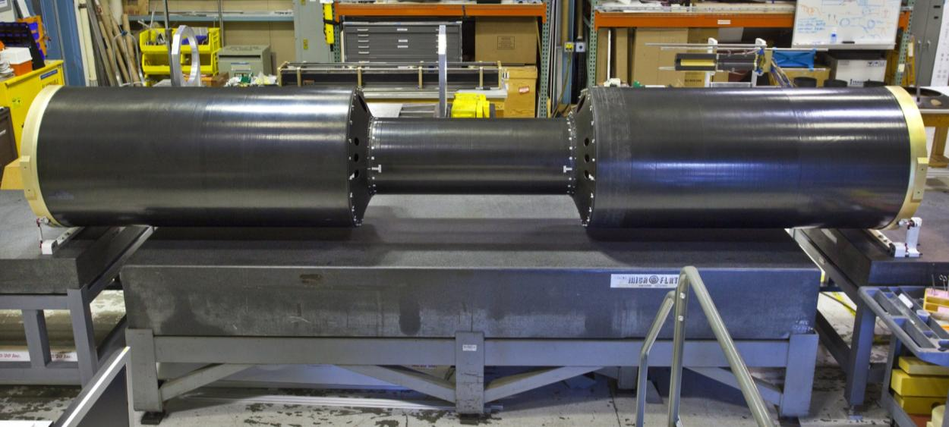
STAR IDS is example of some challenges we face in our bolted joints for detector global supports
  flanges near IR → CFRP for low Z, low mass
  surrounding detectors can force small diameter flanges
  long narrow supports
200 kg carried
thru these
flanges
4.63 m

Slide 5
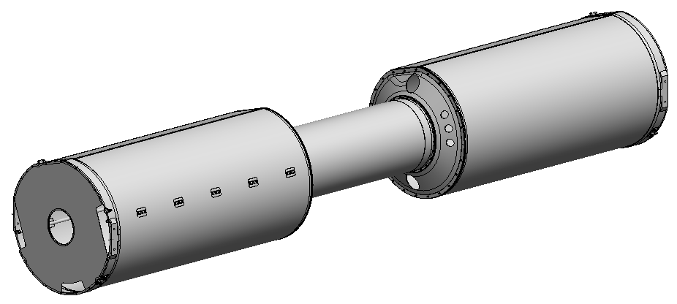
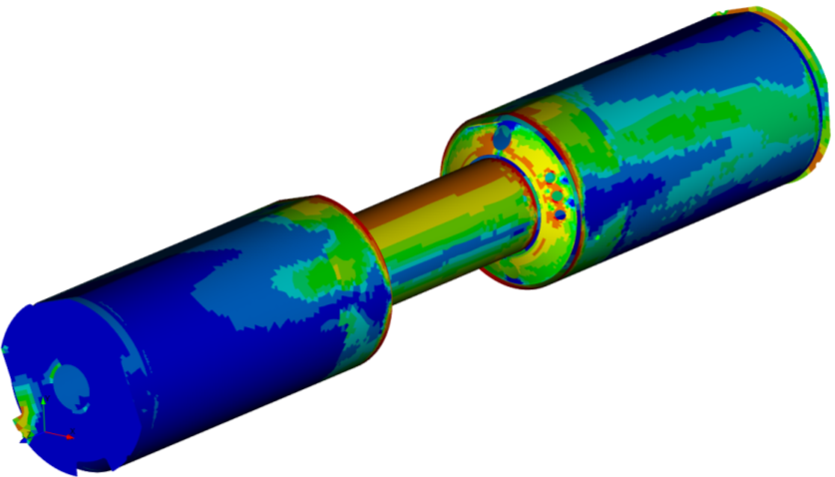
The joint flanges really matter in global deflection of the structure
Key CFRP bolted joints
Strain plot indicates how joint/flange locations are crucial to global deflection

Slide 6
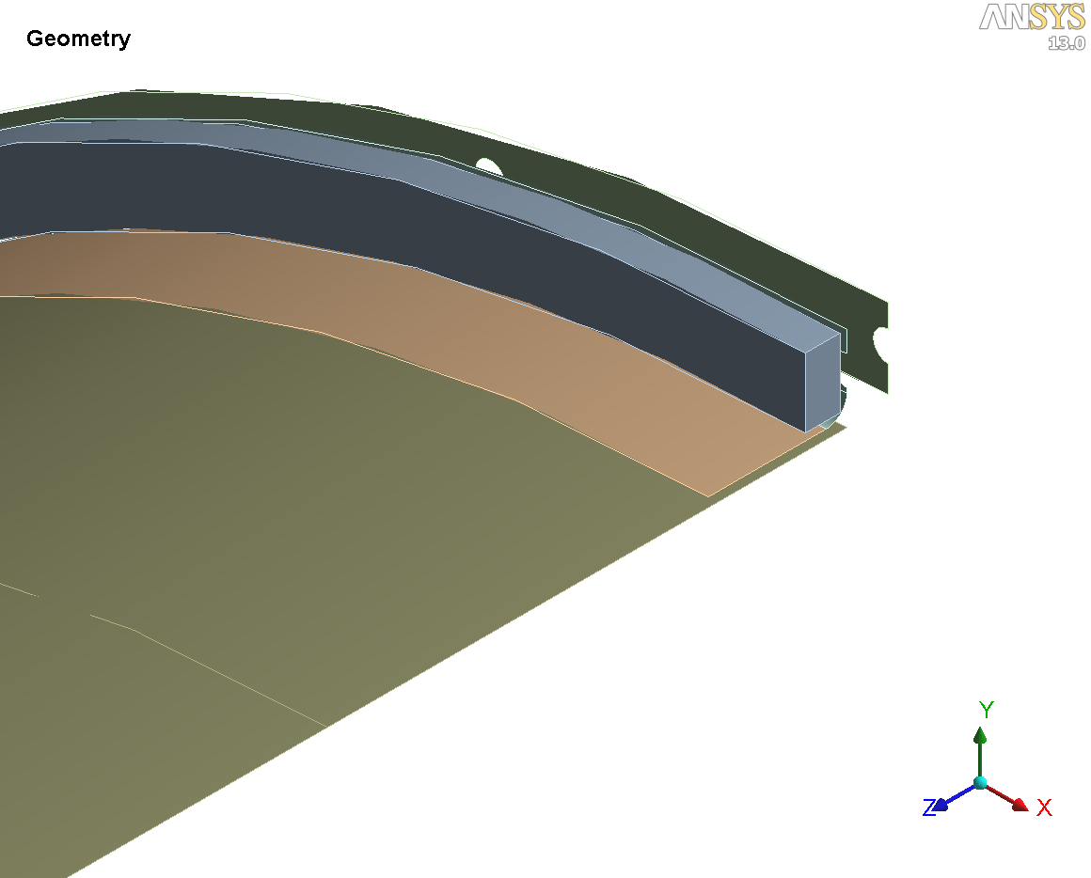
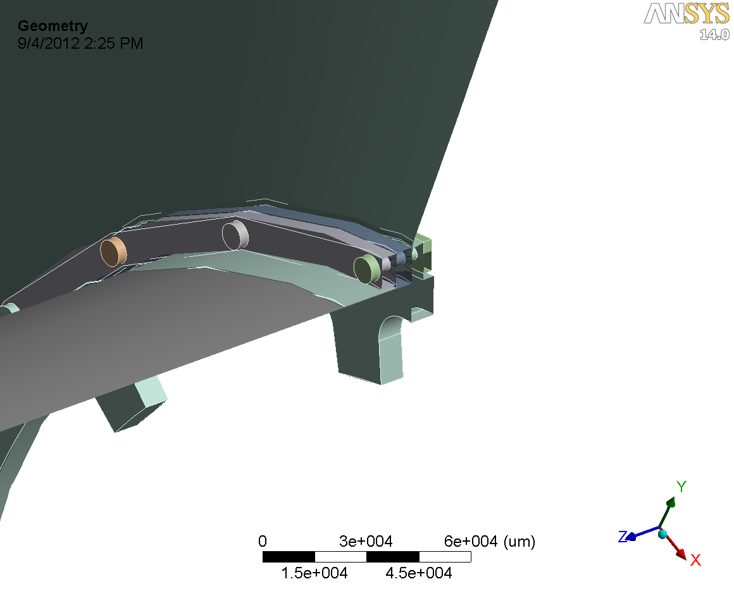
There is a temptation to initially model flanges as full face-face contacts (left). Big overconstraint. Falsely stiffens the model.
CONE
(not shown)
CONE
OSC
OSC
Original model joint geometry,
face-face contacts at joints,
some thick sections modeled as shells
Revised model joint geometry,
bolts and thick sections all solid modeled, parameterized stiffness of contact faces
(more discussion to come)
Note:
Simply replacing face-face contacts with point contacts at hole locations would increase compliance 9% (separate study). Still insufficient to capture compliance accurately.
Nearly equivalently, can model as 6 DOF springs

Slide 7
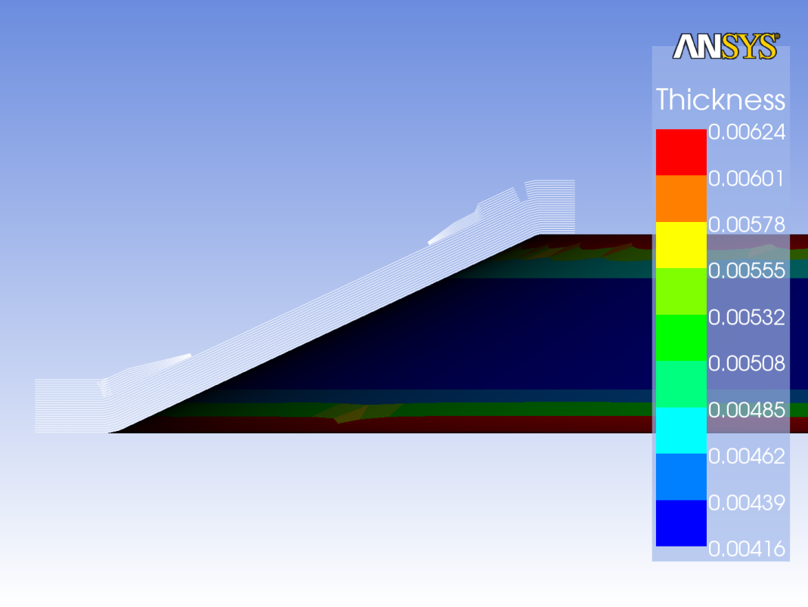
Flanges often require 3D elements rather than shell (2D), to capture thru-thickness and torsion loads appropriately
  As approach edges, thick section deforms in modes where typical thin wall, in-plane assumptions do not apply
  Middle section, though 4mm thick, ok to model as shell
  At edges, where discrete joint loads effective, the shell assumption breaks down
FLEXURE + TORSION + THRU-THICKNESS NORMAL LOADS
FLEXURE + TORSION + THRU-THICKNESS NORMAL LOADS
FLEXURE

Slide 8
If softness of joint causes partial separation, then have to do a non-linear contact study
  To right is a local submodel with high mesh refinement and nonlinear contact definitions.
  “Nonlinear” means: evaluate over a series of substeps to capture the changing contact stiffness as the grip rotates and compresses.
  Computationally very expensive, and adverse on convergence.
  Apply load of correct magnitude to the submodel, then approximate it in the global model with linear springs.
  In this case, the effect of changing from a standard, high normal stiffness bonded contact to this nonlinear model was 39% increase in compliance, very significant.

Slide 9
Non-flatness of joint interfaces is common and also affects stiffness
  Bolt preload has to close the gap of any non-flat interfaces
    but we’re often constrained to low bolt preload
    so we notice this problem in cases where, with metal, we’d never know it
  In the prototype STAR IDS a partial, tapered joint gap of only 0.2 mm max width at the edge, added about 7-10% to the global structure compliance!
  In final version we machined the joint faces flat

Slide 10
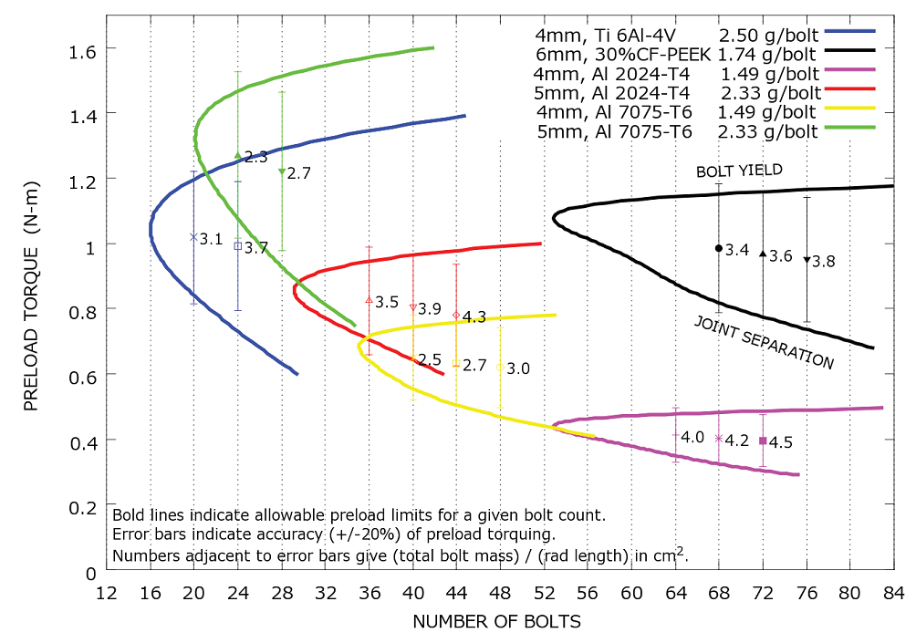
Ti 6Al-4V is probably the baseline bolt material for any joint in a detector with significant load to carry – the material reductions of weaker bolts are false savings, to first order.

