Slide 1
Composite Joining Techniques:
Adhesive Bonding
LBNL Composites Workshop
February 29-March 3, 2016

Slide 2
Adhesive Bonding
Stresses in Bonded Joints
Joint Design
Adhesives
Surface Preparation
2

Slide 3
Adhesive Joints
This is the test standard:
Don’t
BAD
Not Great but better…
Designing an adhesive joint is NOT about choosing the right glue…
It is about designing the proper geometry.

Slide 4
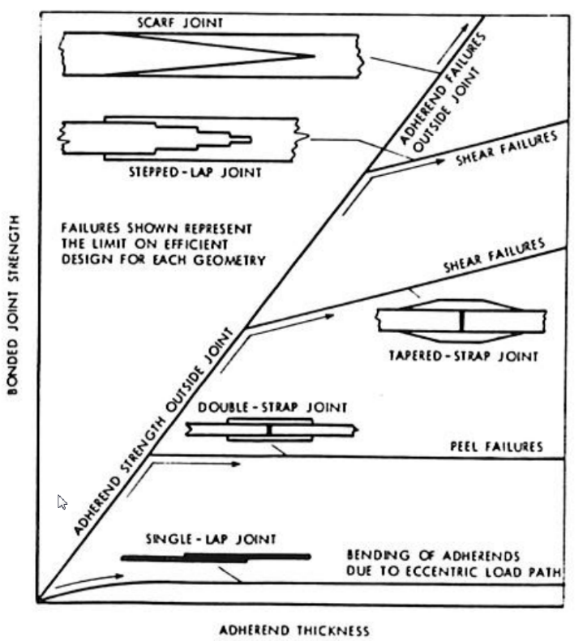
Adhesive Joints
Read the papers by Hart-Smith—all texts on adhesive joints refer to them
Excellent source on joint design and improvement methods
Designing an adhesive joint is not just choosing the right glue and overlap

Slide 5
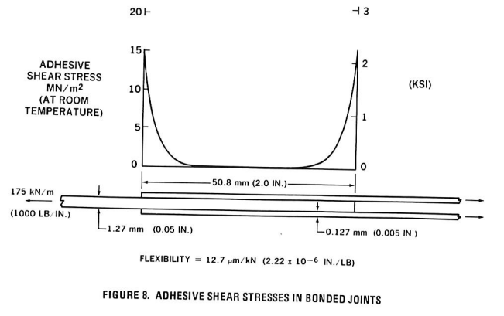
Shear Lag Theory
P
Low Strain
High Strain
0
P
P
0
Low Strain
High Strain
P
Plastic Limit
Elastic
Button

Slide 6
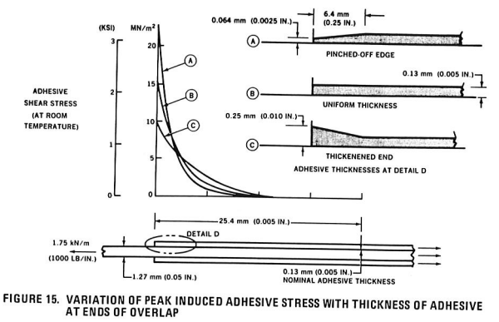
Edge Effects on Adhesive Stress
Stresses are highest at the edges of the joint
Edge treatment is important, in particular for peel, but increased adhesive volume at the edge also reduces peak elastic stress
Thin adhesive joints are not necessarily the strongest—typically 4-8mil (0.1-0.2mm) is ideal
Peak stresses can exceed the plastic limit of the adhesive with no degradation in overall strength if joint is sufficiently long…
Figures from: “Further Developments in the Design and Analysis of Adhesive-Bonded Structural Joints” L.J. Hart-Smith 1980

Slide 7
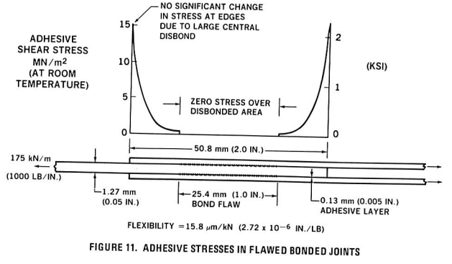
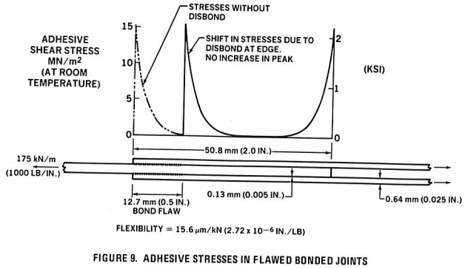
Adhesive Joints are Fault Tolerant to Disbonds
Figures from: “Further Developments in the Design and Analysis of Adhesive-Bonded Structural Joints” L.J. Hart-Smith 1980

Slide 8
Joint Design
Peel
Standard Test Sample tends to fail in Peel
P
P
Peel
Low Strain, Low Stiffness
Design the Adherends to take the load
Design the joint to be stronger than the adherends
Tapered adherends match stiffness better, reducing stress in the adhesive
Spew Fillet increases volume at ends allowing for more strain in peel direction
Spew Fillet
Back Taper

Slide 9
Adhesive Selection
While not more important than joint geometry, there is substantial variation among adhesives
Strengths vary from 2000 to 5000 psi
Bond line tolerance varies from 100 microns to millimeters
Fillers can substantially alter adhesive viscosity and toughness, and can permit uses such as vertical applications

Slide 10
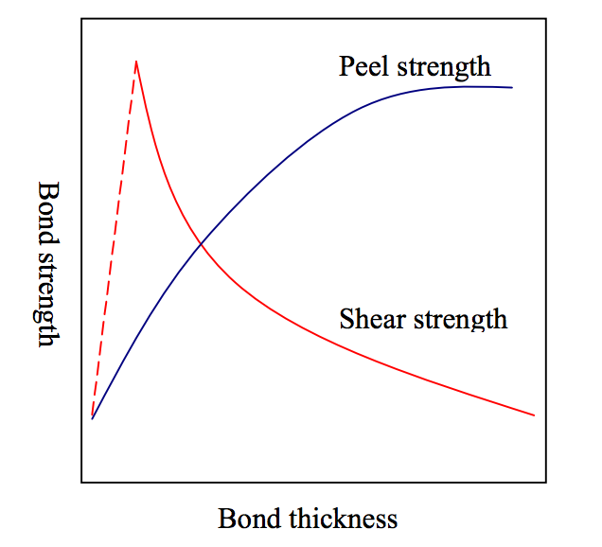
Effect of Bond Line Thickness
https://afendirojan.files.wordpress.com/2010/04/phddissertation9.pdf

Slide 11
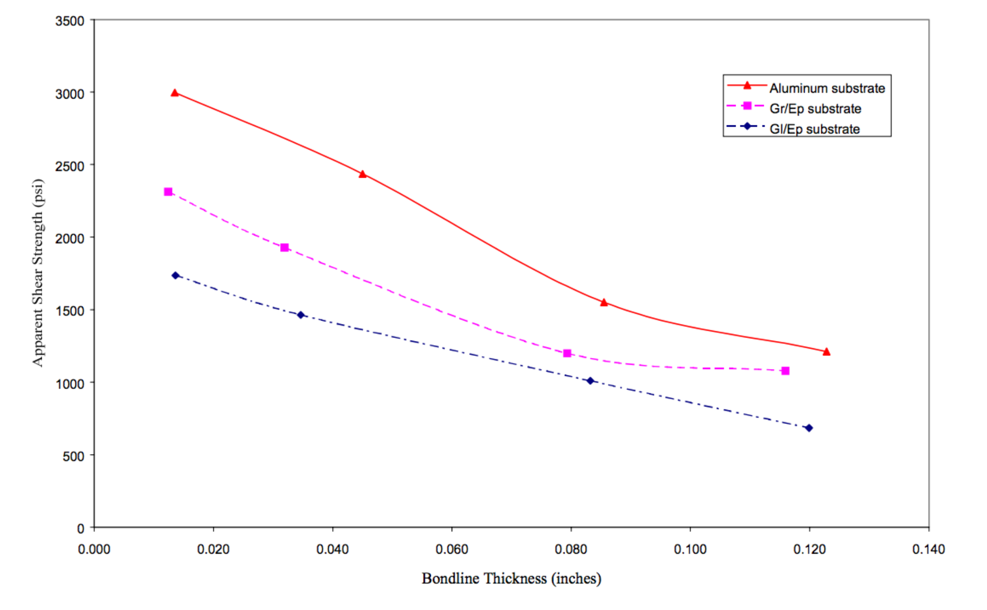
Very Thick Bondlines
ASTM D 3165, HYSOL EA9394

Slide 12
Achieving Bond Line Control
Fillers in the adhesive such as glass beads
Gap control materials
    Shims
    Monofilament
    Wire
  Building gap into the joint design
    Ridges or steps in bond region
    But must be aware of high stress regions

Slide 13
Surface Treatment
Abrasion
    Increase surface bonding area
    Remove surface contaminants
    Increase surface energy (expose more energetic chemical structure)
    Must reclean after abrasion
  Cleaning or etch treatment
    Remove surface contaminants
    Form highly adherent, stable surface
    Bond within short time after treatment to maximise advantage

Slide 14
Hysol Surface Treatment Guide
http://www.loctite.ph/php/content_data/LT4536_TT_Aerospace_Surface_Preparation_Guide.pdf

Slide 15
Final Words on Adhesive Bonding
First and foremost, joint geometry should be intelligently designed
Bond line thickness must be well controlled
Surfaces must be properly treated and bond performed within the specified time
Choose the right adhesive (this is the least important element)
A good joint will outperform the adherends – this should be the goal

