Slide 1
Physical Science Area’s Workplace Life Committee
6/15/2021

Slide 2
Outline
Intro:
What is workplace life and the PSWLC?
PSWLC website
Relationship to IDEA committees
PSWLC Initiatives past and present:
Policy changes
Mentorship program
Lab reopening and the future of work
Small projects support
Other ongoing efforts

Slide 3
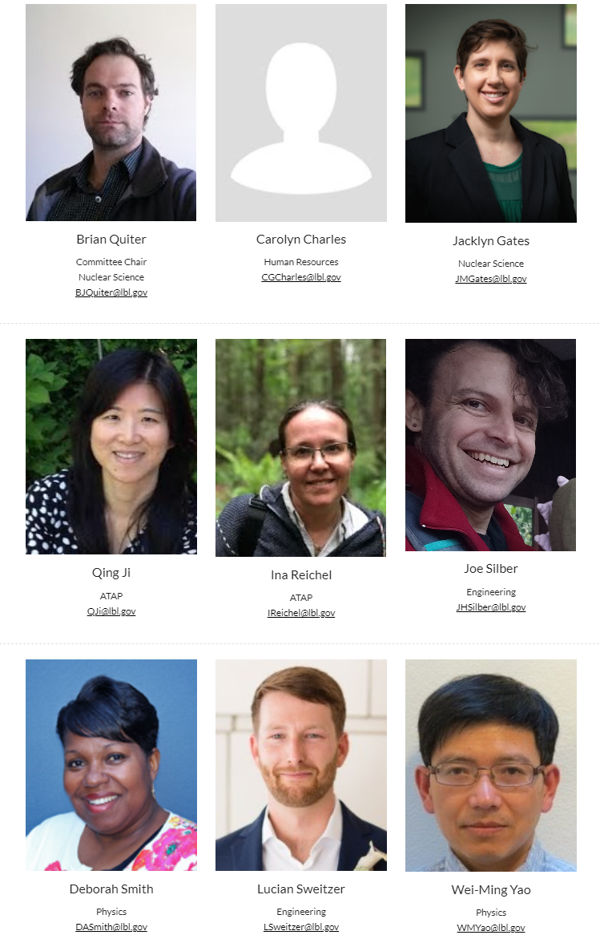
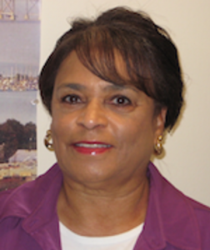
The Physical Sciences
Workplace Life Committee
Two members from each PS division + HR representative. NSD members:
Brian Quiter (chair)
Jacklyn Gates - new in FY21
We explore issues affecting workplace quality of life for the four Physical Sciences Divisions
We report to Physical Sciences ALD, Natalie Rowe and occasional brief at the PS Division Directors’ meetings.
We’ve been around for awhile:
Mike Johnson was the chair in 2012.

Slide 4
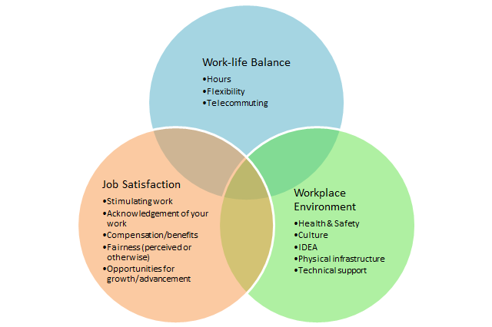
What is Workplace Life?
PSWLC focuses on issues that impact workplace life across the physical sciences
We also coordinate with division IDEA committees
Lots of things…

Slide 5
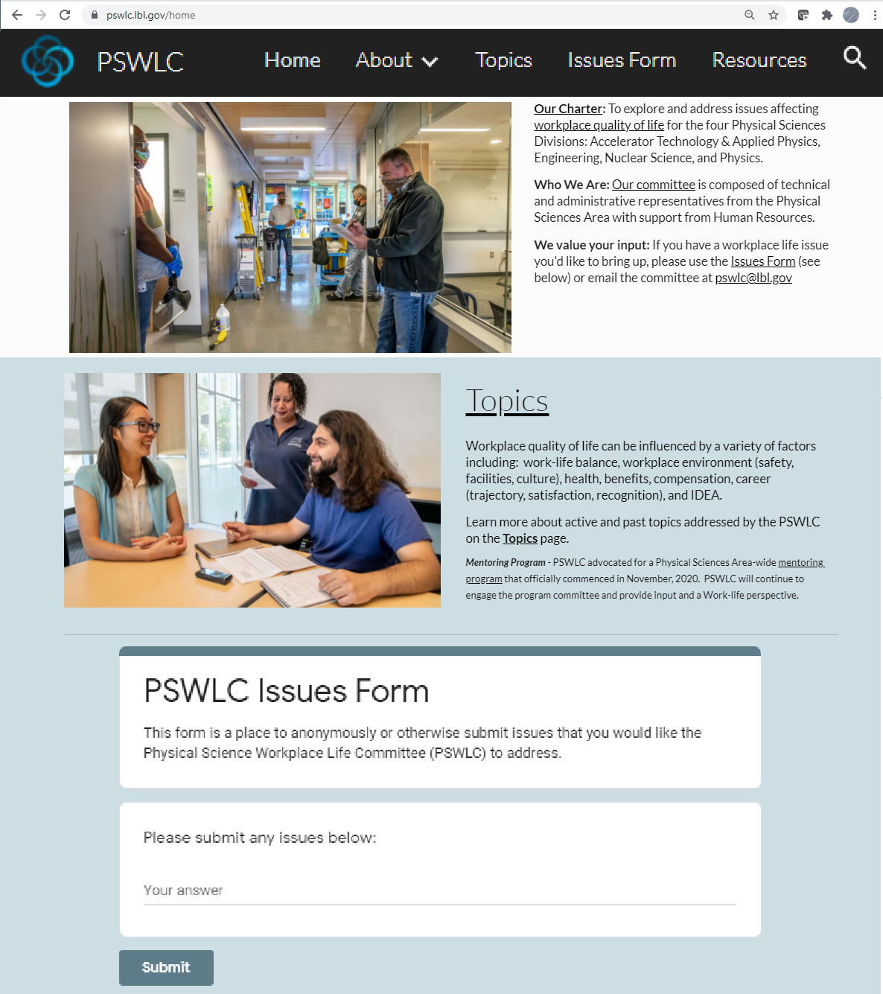
How we work
Get a new topic
Web form, committee member, ALD/DD request, other division personnel requests (direct email, personal communication)
Investigate/explore/discuss
Recommend solutions as appropriate and report to ALD, as appropriate

Slide 6
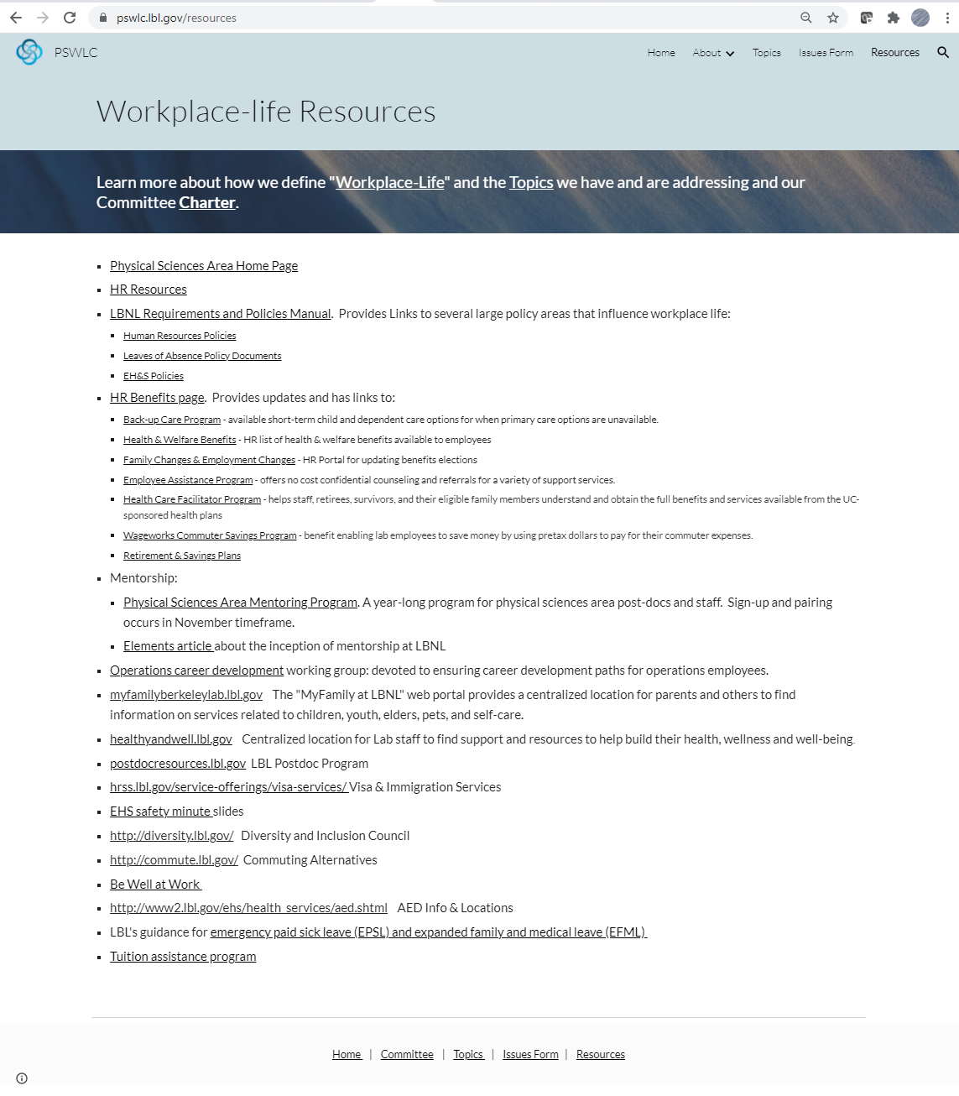
The Website
Updated in 2021
Collection of information on previous ‘issues’
Growing list of LBNL Workplace Life resources

Slide 7
Past Issues
PSWLC was founded to address inclusiveness and diversity issues in Physical Sciences
Now there are IDEA committees
We still feel strongly that many issues related to workplace life/work-life balance
Work-life Balance
Telecommuting, unpaid leave policy
Work Environment
AED’s in every building (2015). And signage to indicate their locations (2016)
Pestering shuttle services to reset their GPS trackers for NextBus
Working with IT to document state of and subsequently take ownership of conference rooms
Job Satisfaction
SPOT awards, highlighting availability of benefits,

Slide 8
Current Activities
Covid and its impacts:
Work/life balance
Health, safety, and families!
Engaging in “Future of Work” initiative
Availability of engineering support for small projects
Surveyed PIs of Small Projects within Physical Sciences Area
88” has had many challenges
Engineering standing up Small Projects Support Group
Led by Jeff Takakuwa.
Other ongoing topics
Covid impacts,
Promotion processes,
Onboarding,
Changing business models
Block → soft funding
Leave policies
Unpaid leave
Mental health days

Slide 9
Conclusion & Outlook
We serve the Physical Sciences ALD
Natalie reinvigorated ALD support in FY20
We work based on requests from PS Area staff
Please provide input/questions/concerns if you have them!
PSWLC is here to help make LBNL and the Physical Sciences a great place to work

