Slide 1
Overview of the US Magnet Development Program
Working the Updated MDP Roadmaps
Soren Prestemon
US Magnet Development Program
Lawrence Berkeley National Laboratory

Slide 2
Outline
Welcome!
A synopsis of the evolution of the US Magnet Development Program
A reminder of our Magnet Development Program vision and goals
Our context in the broader HEP community
Goals for the collaboration meeting and charge to the TAC
Some guidance for this meeting

Slide 3
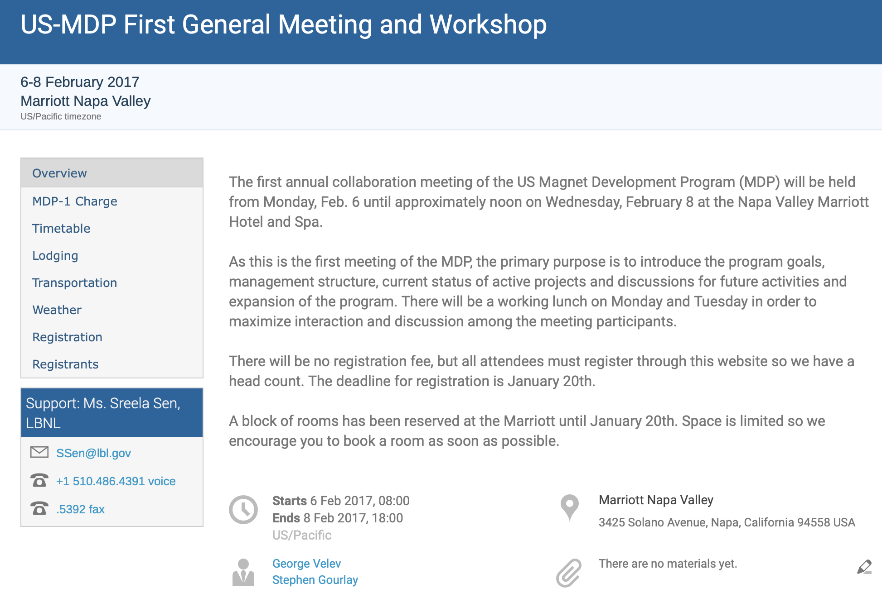
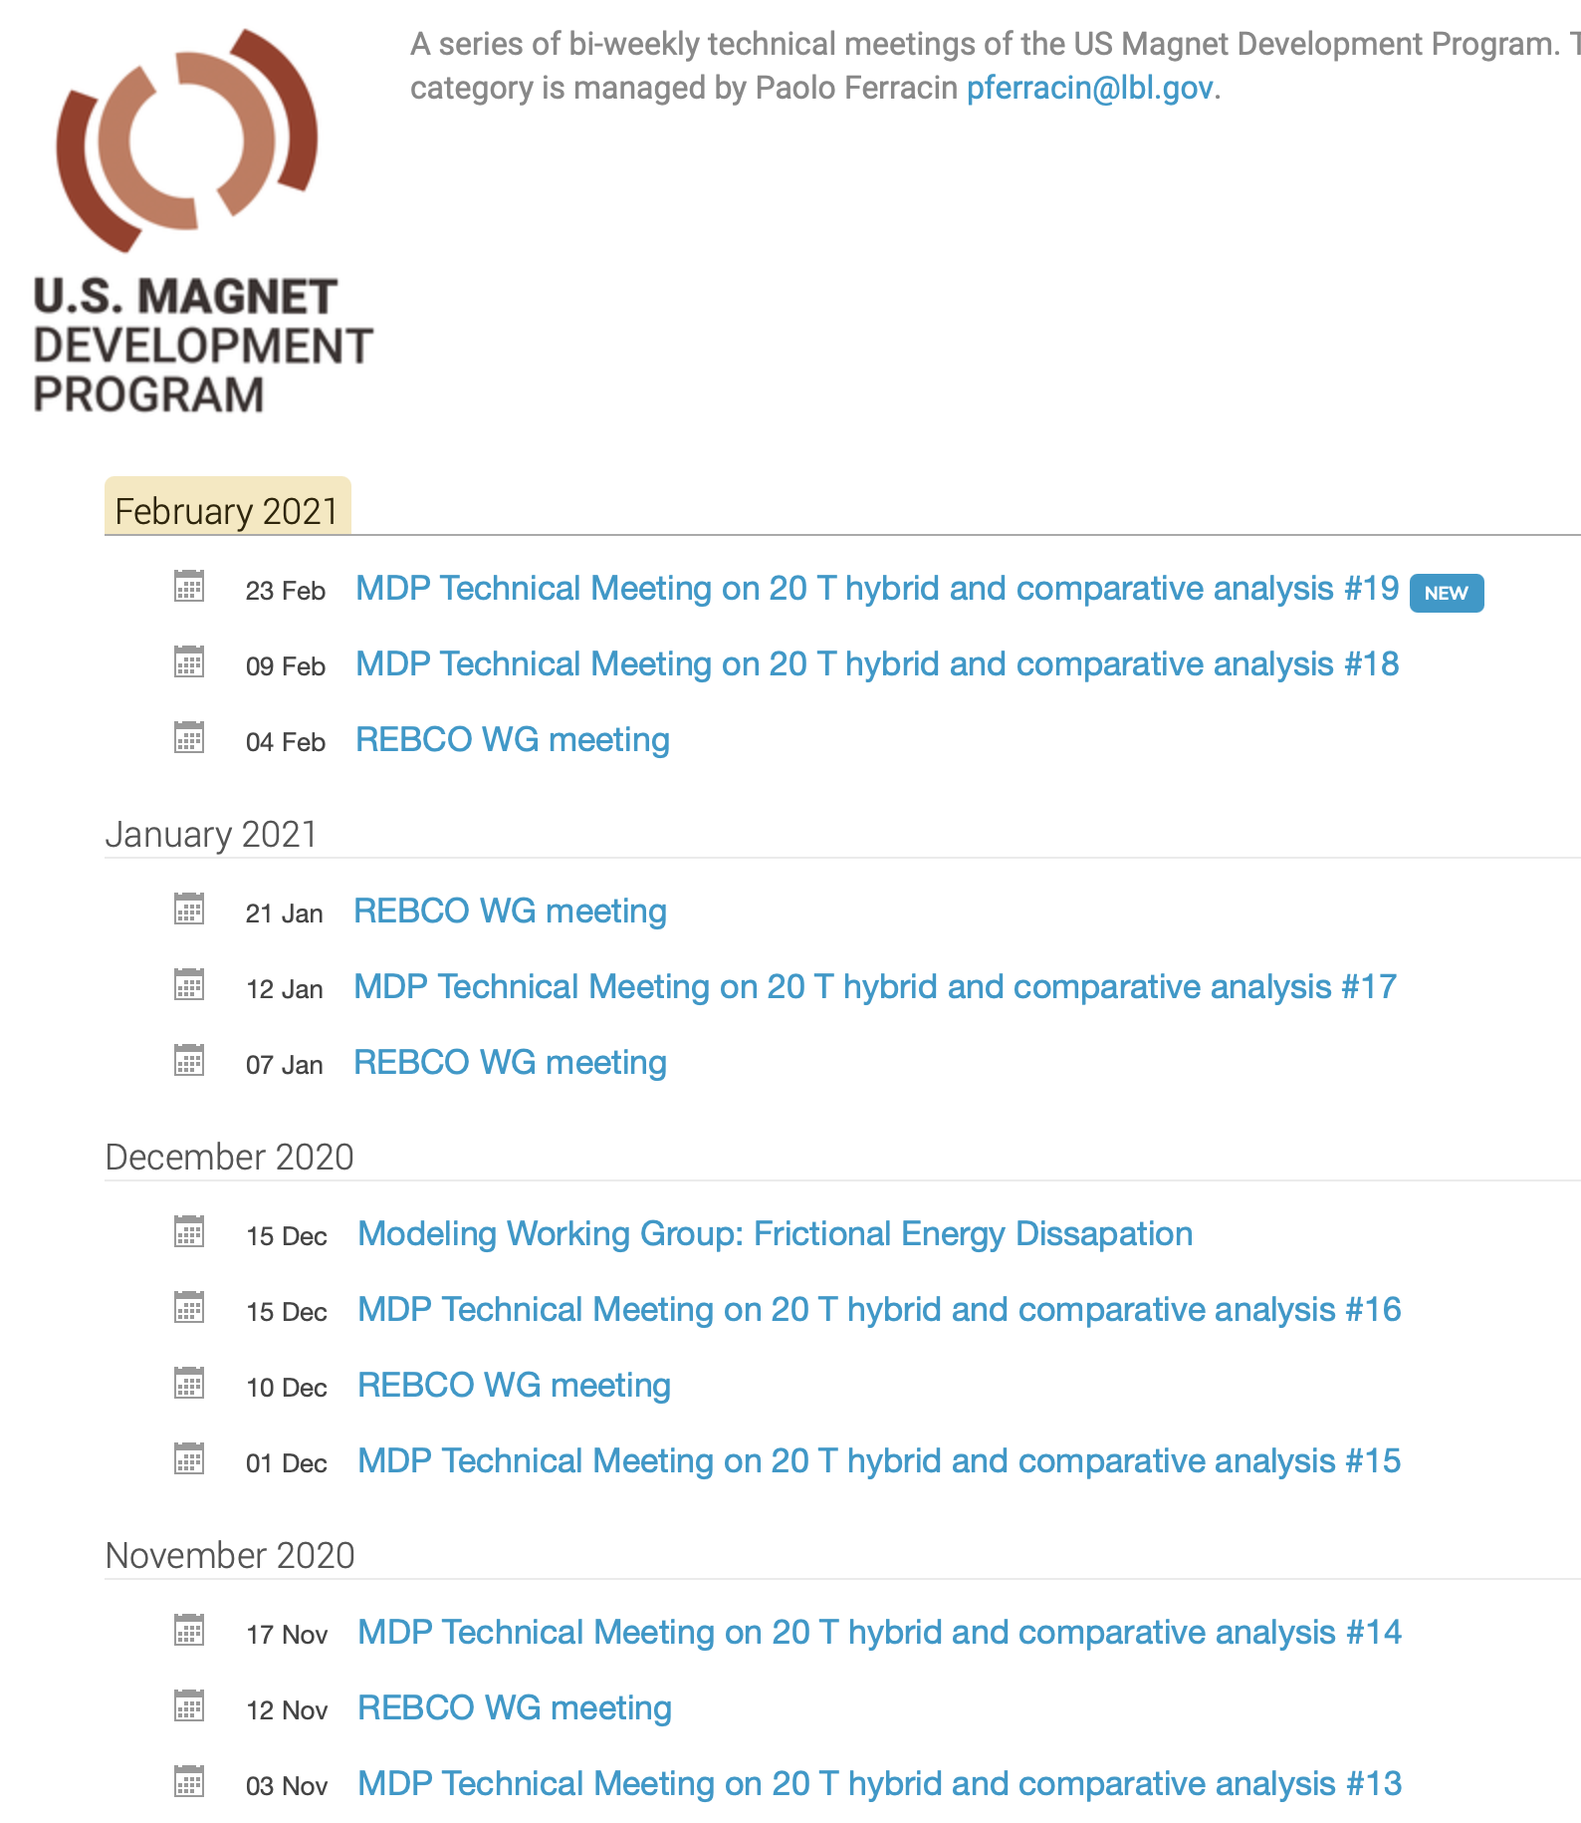
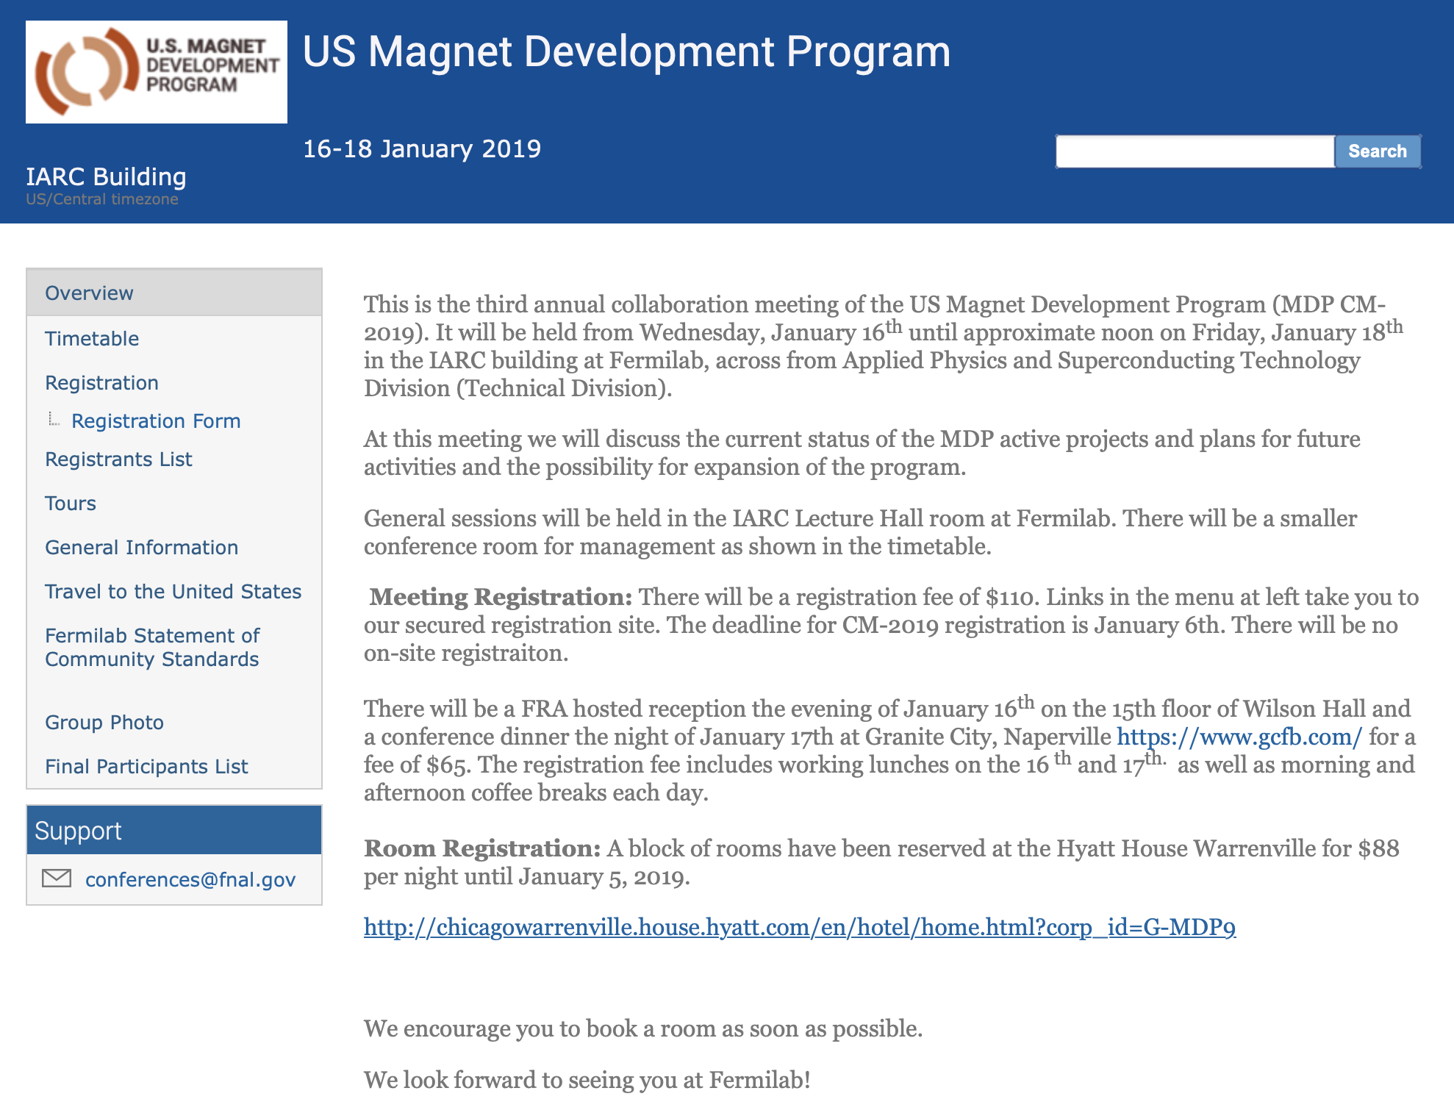
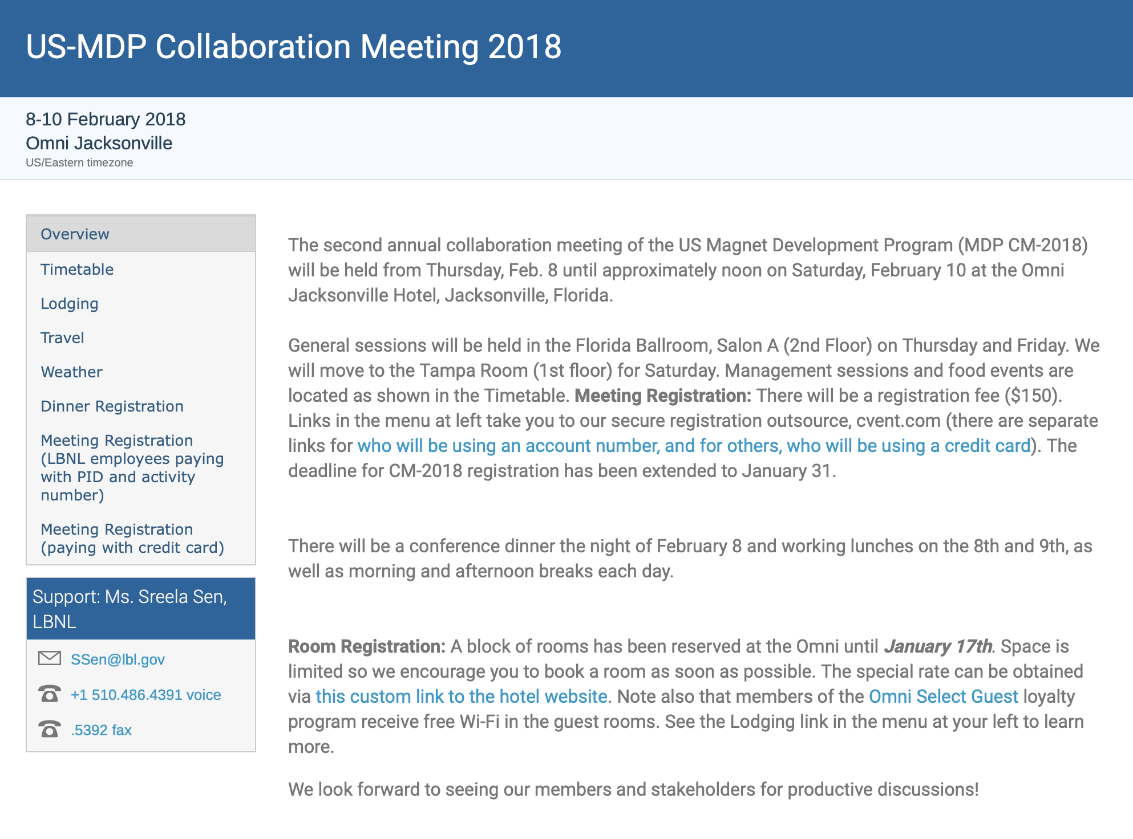
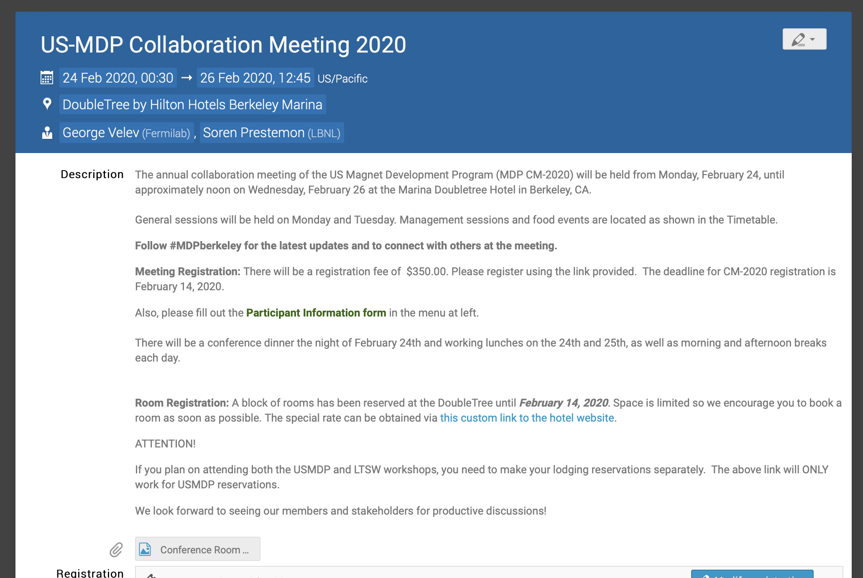
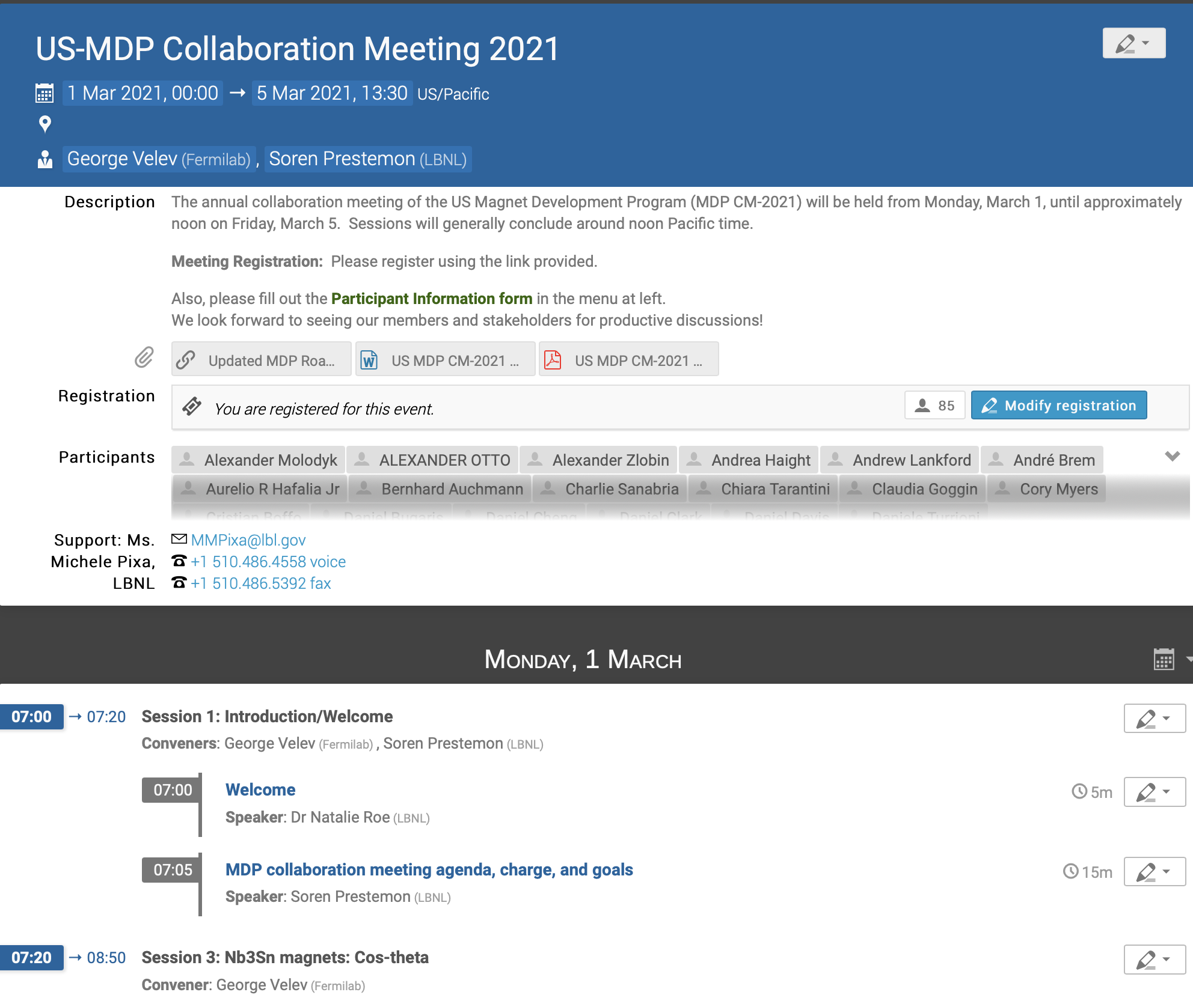
Welcome to the 5th Annual US MDP Collaboration Meeting!
Napa => Jacksonville => FNAL => Berkeley
=>… and now virtual!
Last year the collaboration meeting focused on “Planning the Work”
This year we focus on “Working the Plan”
We have ”empowered” Areas to organize themselves with topical, technical meetings
  Then provide updates in bi-weekly General Meetings
We have our updated Roadmap to guide our work, and milestones that serve as metrics of our progress
  help identify resource limitations and program prioritization

Slide 4
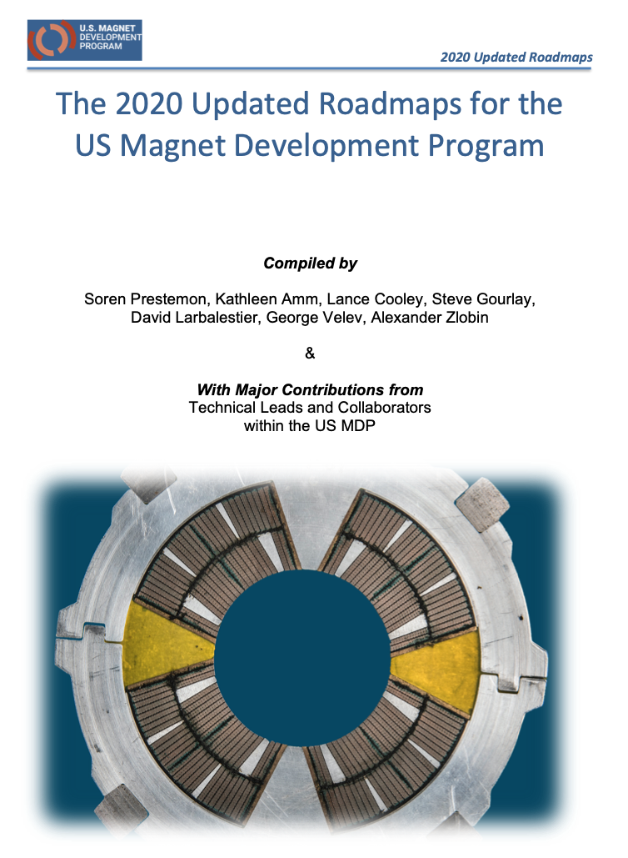
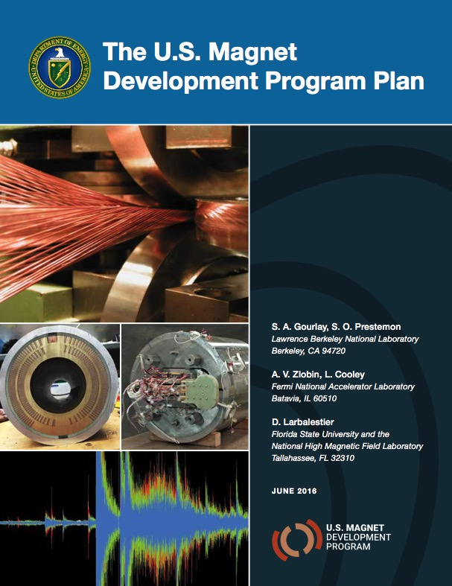
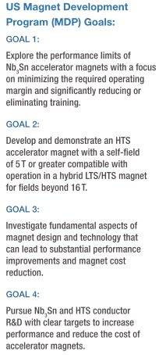
Evolution of the US Magnet Development Program
The formation was initiated by DOE-OHEP as a response to the last Snowmass and P5 process
The Updated Roadmap for MDP is publicly available
  https://arxiv.org/abs/2011.09539

Slide 5
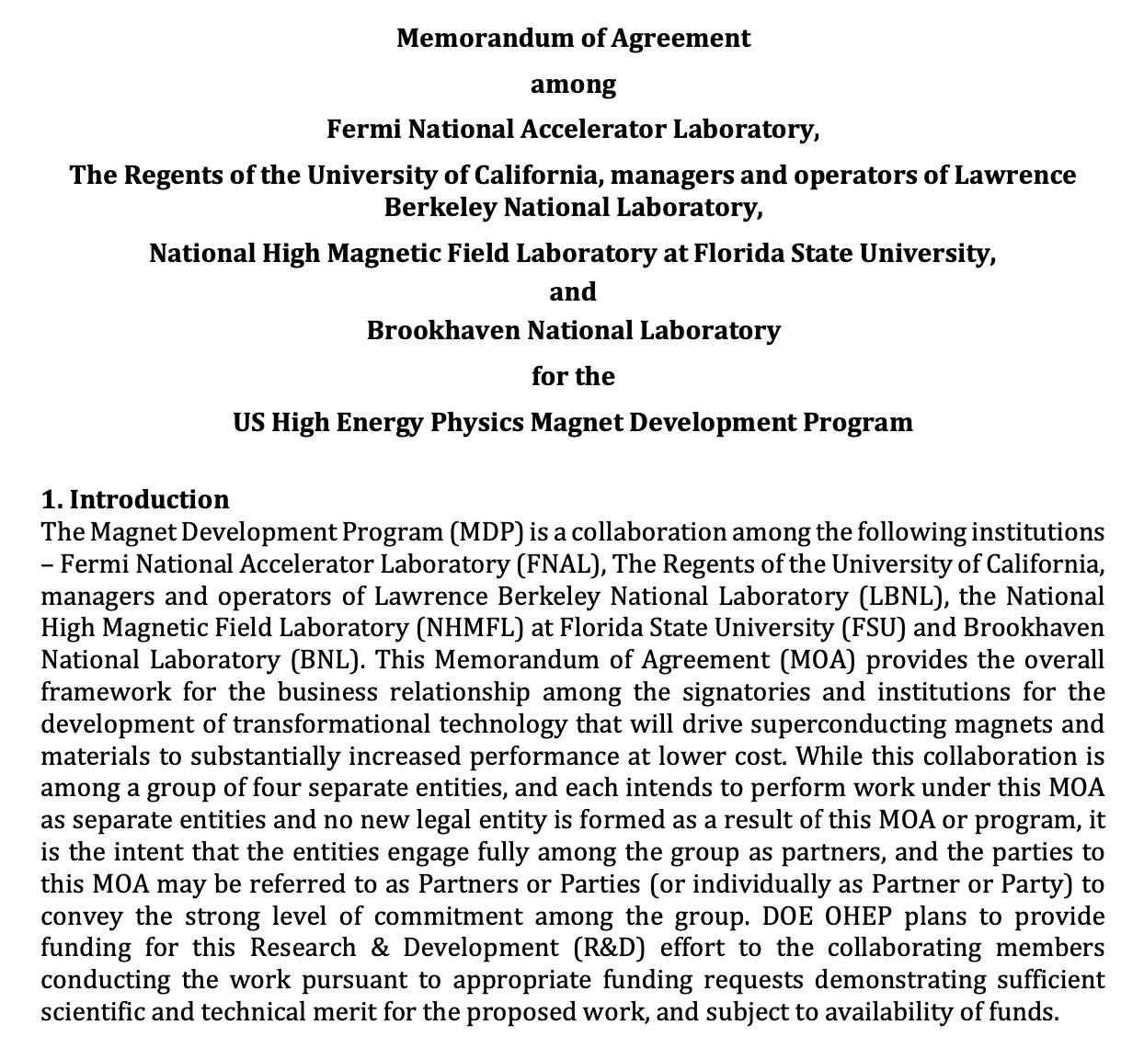
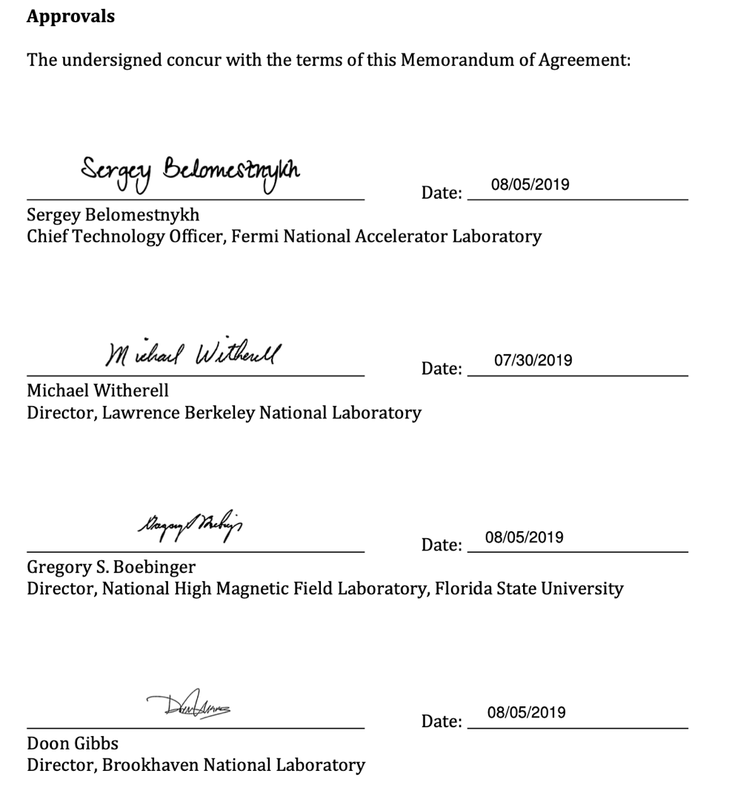
The MDP has Active Guidance and Oversight:
Technical Advisory Committee and Steering Council
The latest Steering Council meeting was held (virtually) October 2, 2020

Slide 6
The US MDP Vision Remains Unchanged – but we have fresh milestones and a defined path forward
Maintain and strengthen US Leadership in high-field accelerator magnet technology for future colliders
Focus on the four primary goals identified in the the original MDP Plan
  Explore the performance limits of Nb₃Sn accelerator magnets…
  Develop and demonstrate an HTS accelerator magnet with a self-field of 5T or greater…
  Investigate fundamental aspects of magnet design and technology…
  Pursue Nb₃Sn and HTS conductor R&D …
Further develop and integrate the teams across the partner laboratories and Universities for maximum value and effectiveness to the program
Identify and nurture cross-cutting / synergistic activities with other programs to more rapidly advance progress towards our goals
The Program Roadmaps are updated,
but the vision and primary goals remains unchanged

Slide 7
The updated roadmaps have a focus on stress-managed concepts and LTS/HTS hybrid magnet development
Major themes of our updated Roadmaps:
  Explore the potential for stress-managed structures to enable high-field accelerator magnets, i.e. structures that mitigate degradation to strain-sensitive Nb₃Sn and HTS superconductors in high-field environments;
  Explore the potential for hybrid HTS/LTS magnets for cost-effective high field accelerator magnets that exceed the field strengths achievable with LTS materials;
  Advance magnet science through the rapid development and deployment of unique diagnostics and modeling tools to inform and accelerate magnet design improvements;
  Perform design studies on high field accelerator magnet concepts to inform DOE-OHEP on further promising avenues for magnet development;
  Advance superconductors through enhanced performance, improved production quality, and reduction in cost - all critical elements for future collider applications.

Slide 8
We have made significant progress on multiple fronts, and our Collaboration Meeting Program addresses MDP goals
Monday: Nb₃Sn magnets: Cos-theta & CCT
Friday: Technology: 20 T hybrid magnet design and comp. analysis
Tuesday: HTS Magnets: Bi2212 & REBCO
Thursday: Technology: Training Reduction; Novel Diagnostics; Magnet Materials
Friday: Technology: Magnet Materials
Wednesday: SC strand and cables (materials)

Slide 9
Our roadmaps are accompanied by milestones that allow us to monitor progress, identify and overcome technical challenges
Milestones include
  Two stress-managed Nb₃Sn variants yielding 11-13T in a 120mm bore
  HTS inserts capable of >5T, compatible with the 120mm bore of the Nb₃Sn magnets
  Hybrid magnet tests exceeding 14.5T
  Test of 15T inner coils in a 120mm more stress-managed magnet yielding ~17T

Slide 10
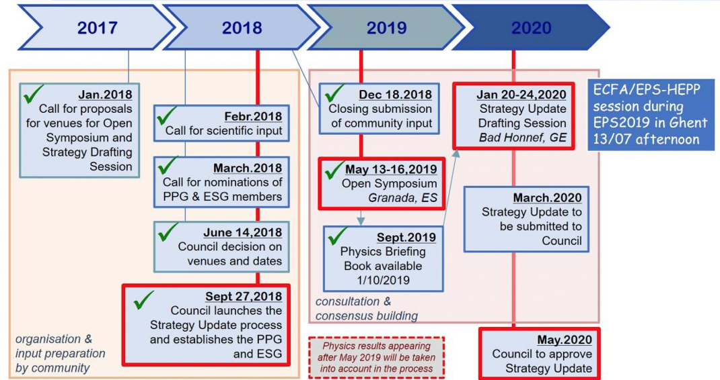
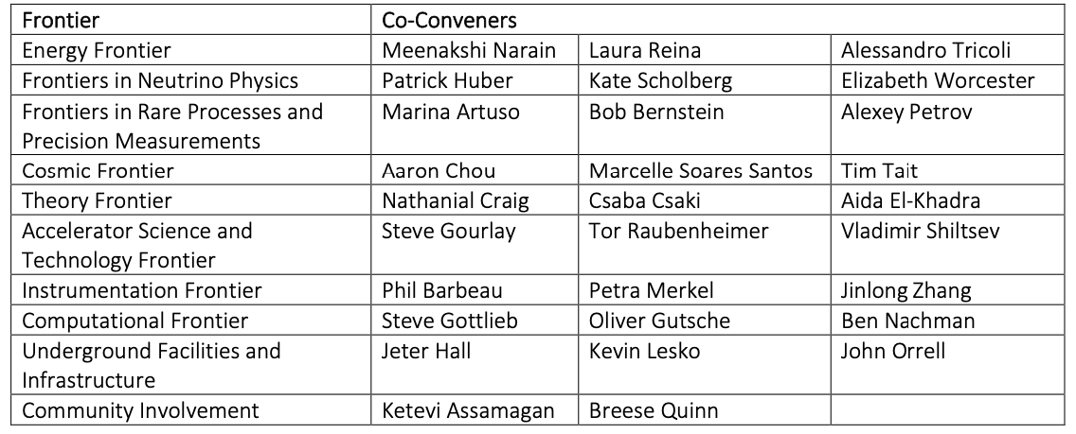
We are actively engaged with the HEP international community and the Snowmass process & planning for the next ”P5”
The MDP strives to be highly collaborative on the international stage
  E.g. “International Meeting on High Field Accelerator Magnet Research and Review of Recent US MDP Progress and Plans”
See Friday session:
Strategic planning for future HF magnets
2022
------
EPPSU Planning Process ✔️
Snowmass Planning and Summer Study (2020-2021)

Slide 11
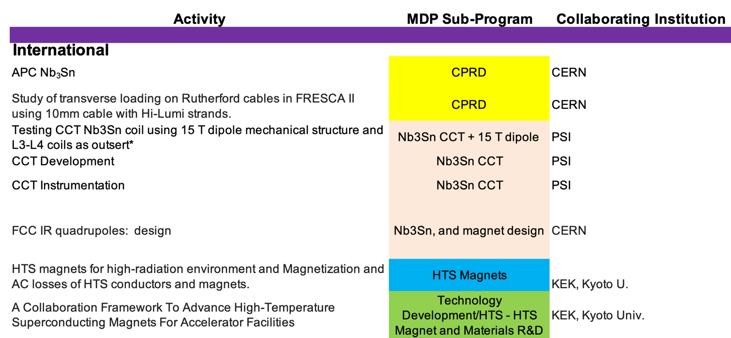
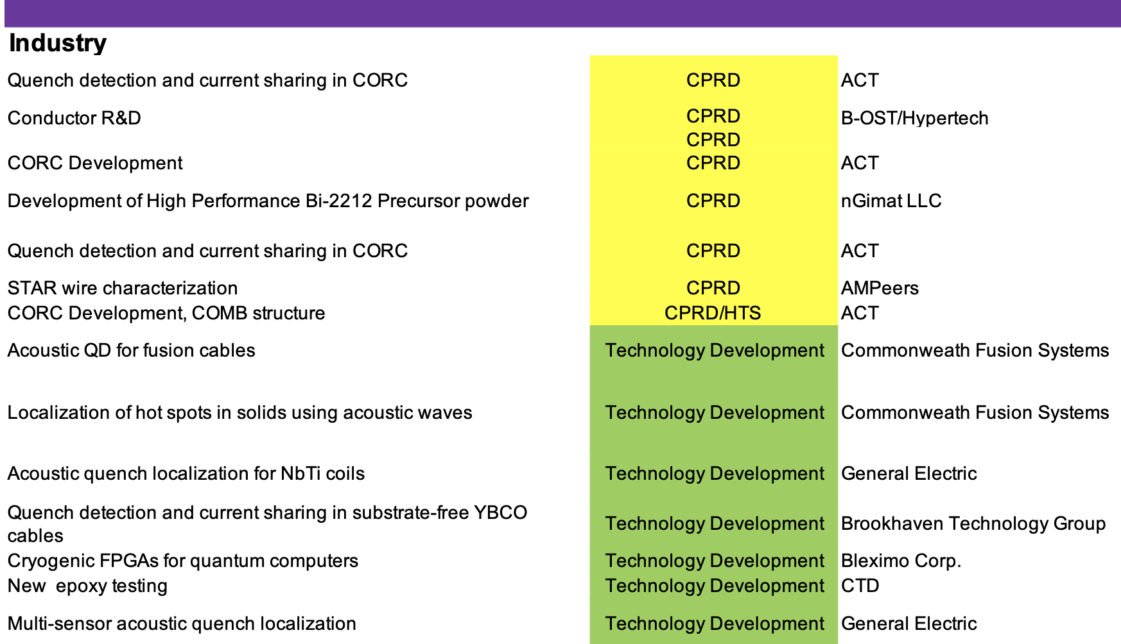
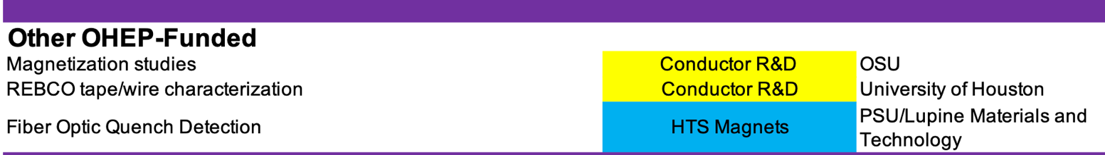
We have strong collaborations with national and international partners, as well as with industry – but plenty of room to grow!
MDP provides the strategic framework for HEP high field magnet and conductor R&D in the US
Leveraging well-organized collaborations is a key component for achieving the MDP goals
International (~8)
  CERN, EuroCirCol, PSI, KEK
Other OHEP-funded programs (~3)
  Ohio State, U. Houston, Penn State
Industry (~13) – Includes procurements

Slide 12
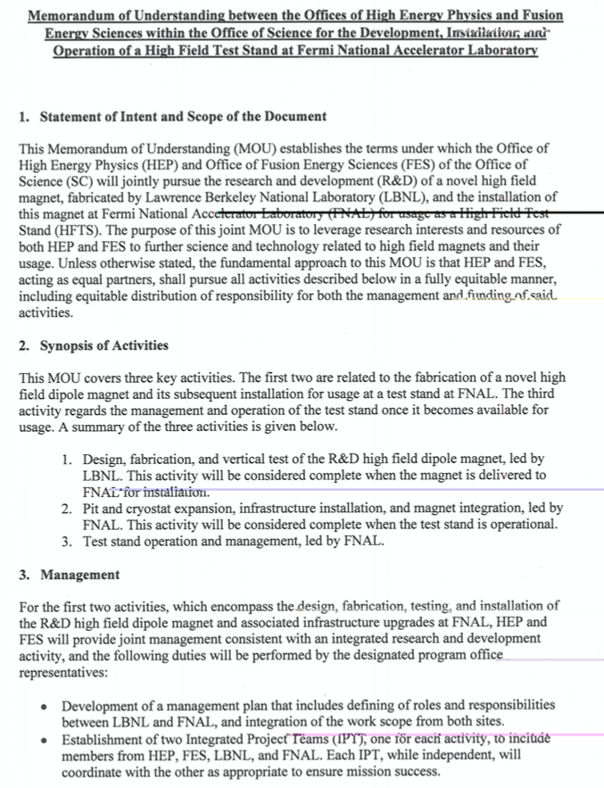
And we are actively engaged in partnering and leveraging synergistic activities
Major development: HEP+FES supporting the development of an HTS Cable Test Facility of mutual interest
  Will enable hybrid magnet testing at 1.9K to meet MDP Milestone deliverables
Additional examples:
  FES support for HTS magnet development
    Recognize strong synergy in REBCO materials and in magnet technology
  BES support for Nb₃Sn undulators
    Leveraging our expertise and MDP-developed modeling
  Industry interest in MDP-developed/relevant technologies
    SBIRs, sponsored projects, etc.

Slide 13
Charge to the Technical Advisory Committee
Evaluate the plans and progress in the MDP Research Areas
  Does each Research Area have an appropriate assessment of present status?
  Are the plans presented for achieving the stated milestones realistic?
  Have the teams identified the major challenges?
  Are they making effective use of capabilities and infrastructure available within the collaboration?
Has MDP adequately identified current bottlenecks to progress, and are the program priorities being addressed by MDP management?
Is the MDP encouraging and appropriately engaging with parallel efforts outside MDP that could synergistically advance MDP goals?
  University programs and SBIR activities supported by OHEP are two prime examples
Is MDP community involvement in the contexts below appropriate? Are there further avenues that should be pursued?
  in the US “Snowmass” HEP planning process
  in the context of international collaboration
  in the context of the industrial ecosystem

Slide 14
Guidance for this week's virtual meeting
See meeting site https://conferences.lbl.gov/event/547/timetable/ for presentations & meeting timeline
Zoom etiquette:
  Mute your microphone when not presenting or asking a question
  Generally turn off your video, but turn it on when presenting or asking a question
  Use the raise-hand feature – in “Reactions” at bottom of zoom screen - if you want to ask a question
    Convener(s) will call on you for your question after the presentation (if time allows)
    Keep your questions concise and to-the-point
Speakers:
  Please stick to the time allotted – focus on the messages you are trying to convey
  More in-depth questions/discussions can be organized “off-line” in one of the breakout rooms

Slide 15
Lets get started!!
Thank you all for coming – this is our opportunity to…
  Brainstorm ideas, share developments, insights, issues, etc.
  Strengthen our interactions and initiate new collaborations
  Identify what we need to achieve our milestones and program goals
Lets strive for vibrant technical discussions – and come out of this collaboration meeting with ideas and plans to advance our program!

