Slide 1
REBCO technology - Part 2
Vadim Kashikhin, Vito Lombardo
MDP Collaboration Meeting
March 2, 2021

Slide 2
REBCO magnet development
The project’s objective is to address the U.S. MDP goal #2: “Develop and demonstrate an HTS accelerator magnet with a self-field of 5 T or greater, compatible with operation in a hybrid HTS/LTS magnet for fields beyond 16T.” This is achieved through a series of steps:
  Short sample studies to determine the bending degradation;
  Initial COMB magnet demonstration (proof of principle) with a CORC® cable made of average-performance REBCO tapes;
  Performance demonstration to reach 5 T self field goal in the HTS accelerator magnet using the CORC® cable made of pre-sorted (high Je) REBCO tapes;
  Demonstration of the hybrid HTS/LTS magnet operation using a Nb₃Sn coil outsert;
  Studies of the magnet parameter space to determine suitable designs and conductor requirements to reach 10 T standalone field and 5 T insert field.
Driving questions for area IIb REBCO magnets to be addressed:
  What performances and architectures should the conductor have? How can we make magnets using these conductors?
  What is the maximum dipole field a REBCO magnet can generate? What is the long-term conductor and magnet performance under cycling Lorentz loads?
  What is the magnet performance? How does it quench? How can one protect the magnet during a quench? What is the field quality of REBCO accelerator magnets?
  How can we characterize the transport performance for long conductors?

Slide 3
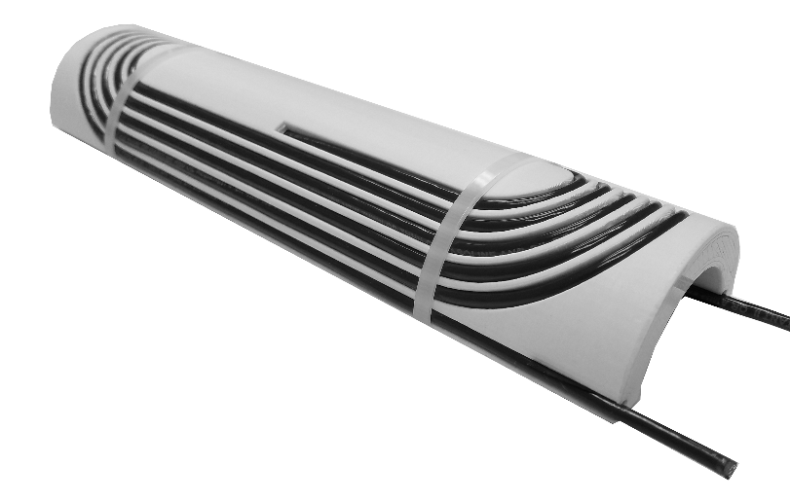
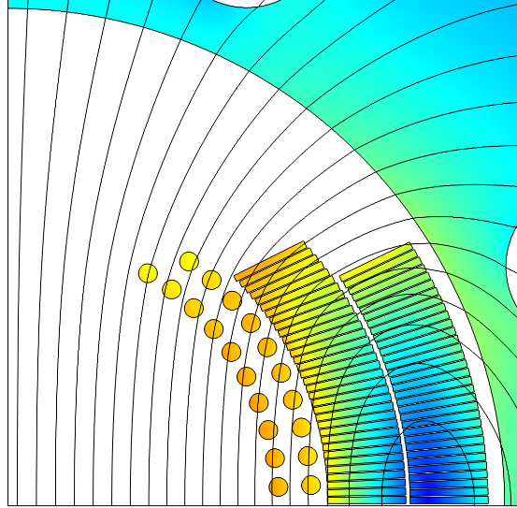

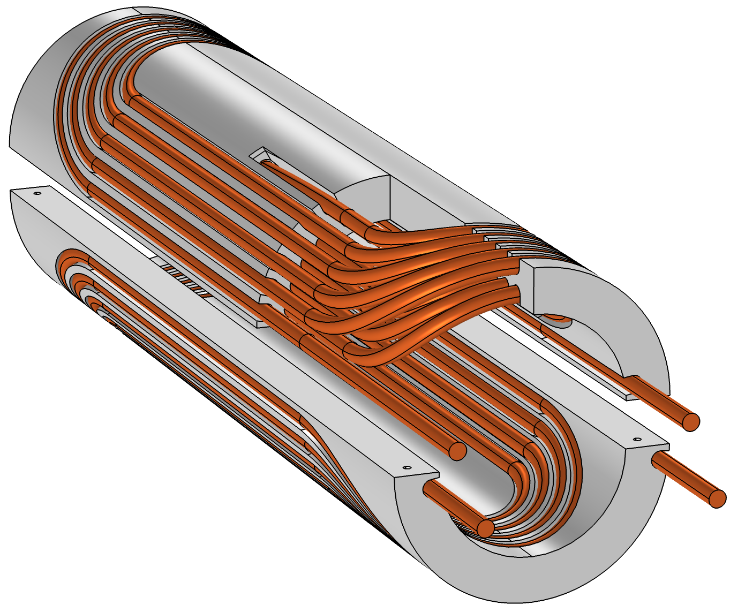
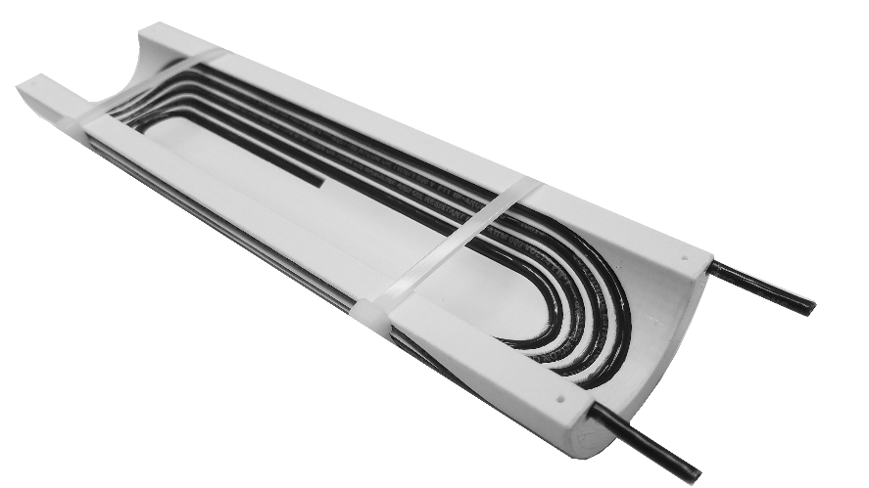
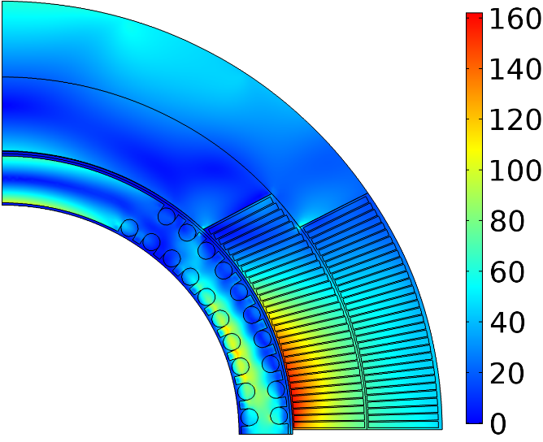
Conductor On Molded Barrel (COMB) magnet technology
Magnetic field (T)
Nb₃Sn coil
HTS coil
+1.25 T in Nb₃Sn 4.4 T standalone
Equivalent stress (MPa)
110 MPa
120-mm OD coil for the first superconducting model
60-mm OD mock-up coil built to demonstrate manufacturability
160 MPa
Within safe limits

Slide 4
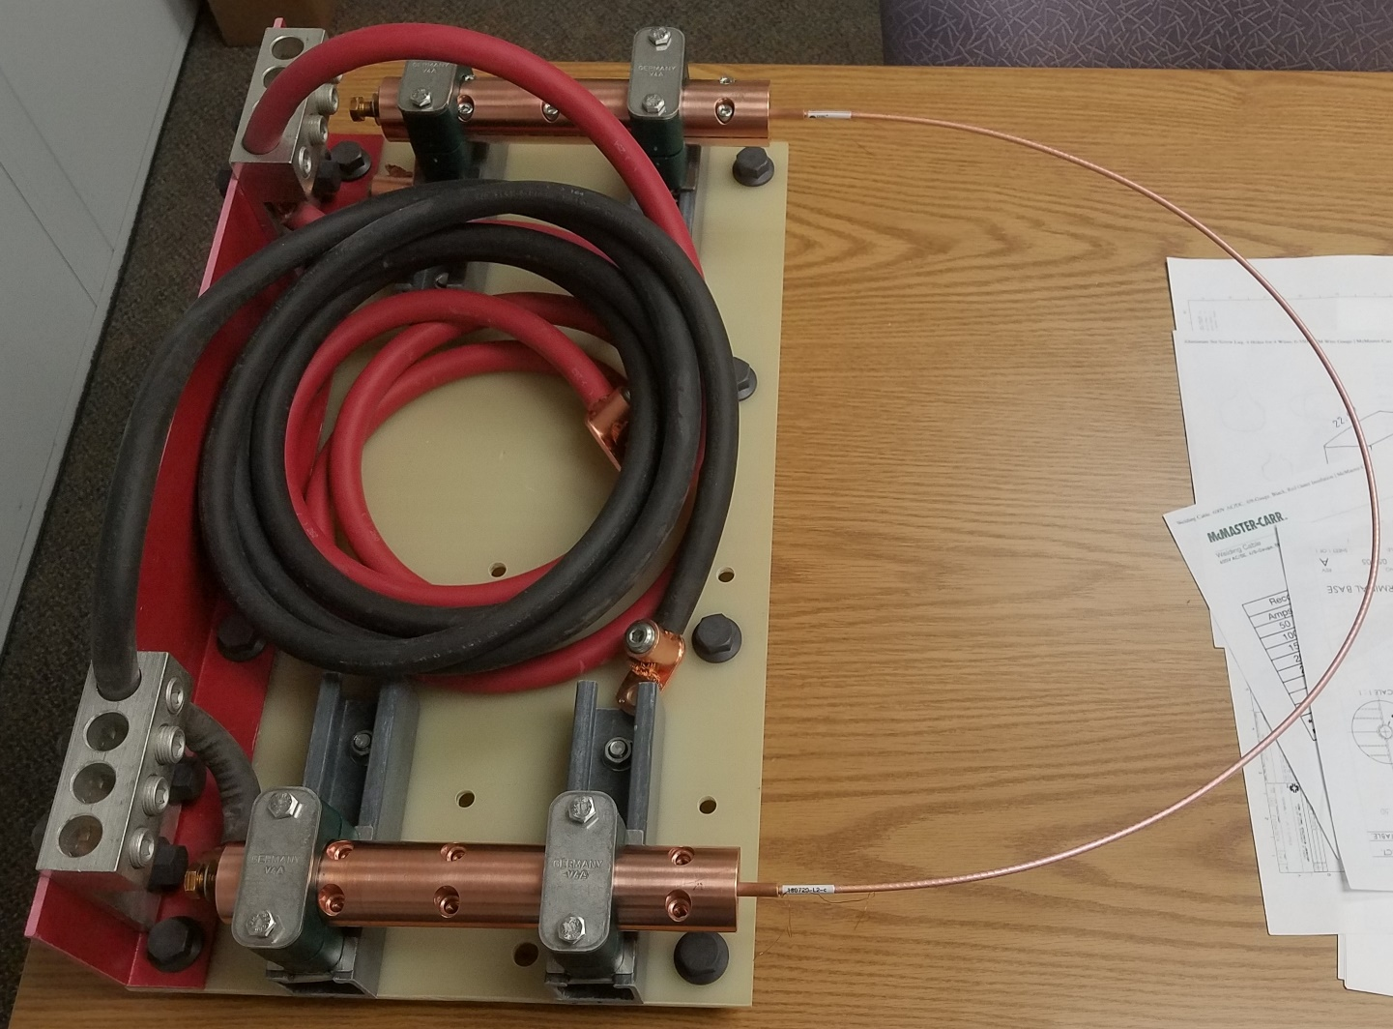
Short-sample test campaign (2020-2021)
LN₂ test setup configured for a large bending diameter
Prior to the final magnet design and fabrication, a series of short sample tests is being performed:
  use short lengths or CORC cable provided by LBL to get a hands-on winding experience of CORC cable into the COMB structure;
  assess the cable degradation due to winding.
Procedure:
  Each piece is first tested in a large U-shape (~0.5 m bending diameter) to measure the undisturbed wire performance.
  Then ~1.5 turns are wound into the inner/outer groves of the COMB structure (~52 mm minimum bending diameter) and retested.
The I_{c} test results before and after winding are compared.
CORC cable sample
Copper adapters, wire terminals and voltage taps provided by ACT

Slide 5
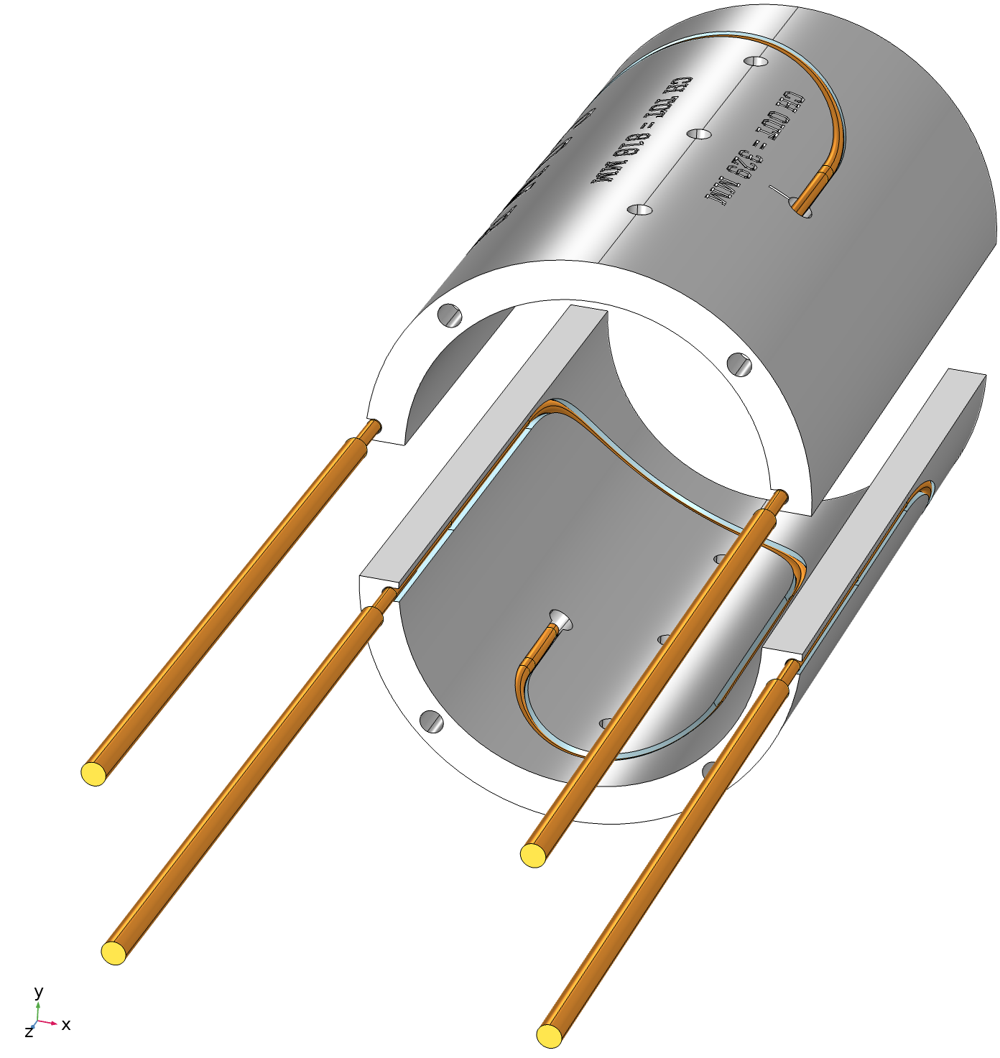
Test model
Coil with 100 mm ID and 121 mm OD – to fit into the outer coil of the 15-T dipole.
A continuous cable channel in the inner and outer surfaces – half a turn on the outer surface and a full turn on the inner surface.
The channel was designed with a “click-lock” shape to lock the cable in its final position during winding.
Half of the inner-most turn of the inner layer was modeled. The maximum degradation is expected in that area.
The other half-turns on the inner and outer surfaces were asymmetric to bring both terminals as the appropriate exit locations in the midplane.
190 mm
84 mm
200 mm
52 mm

Slide 6
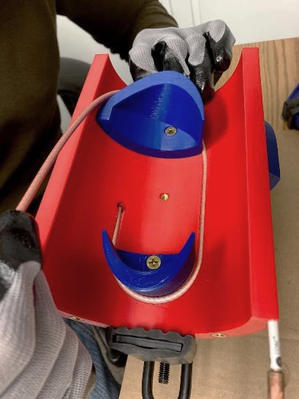
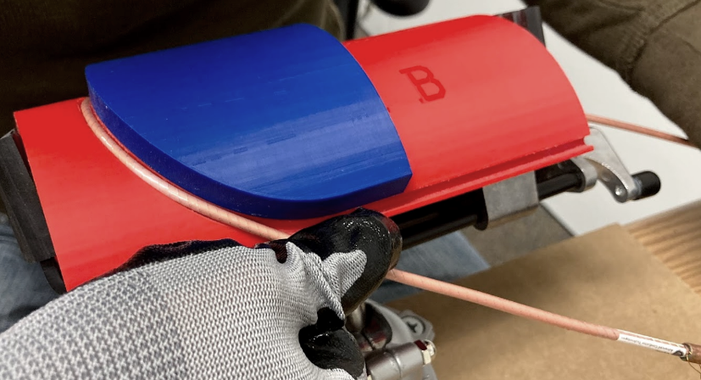
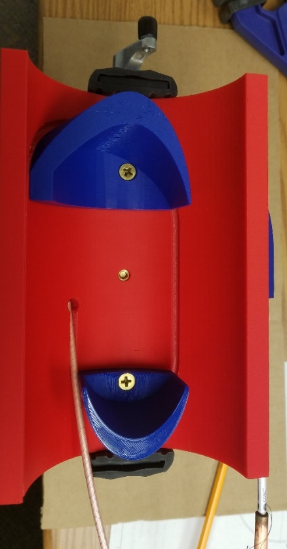
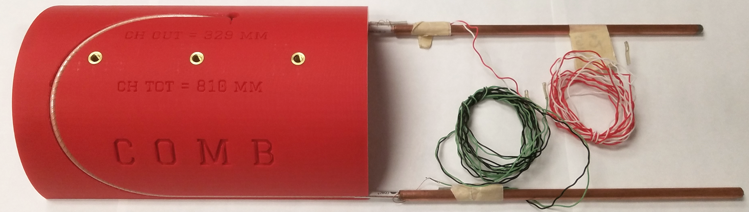
Coil winding
Single-step process for the OL:
The cable is pre-bent around the auxiliary spacer and pushed into the channel at the same time
Two-step process for the IL:
the cable is pre-bent around the auxiliary spacer at the first step and then pushed into the channel at the second step

Slide 7
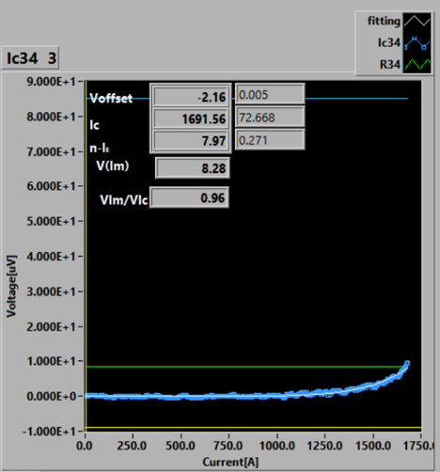
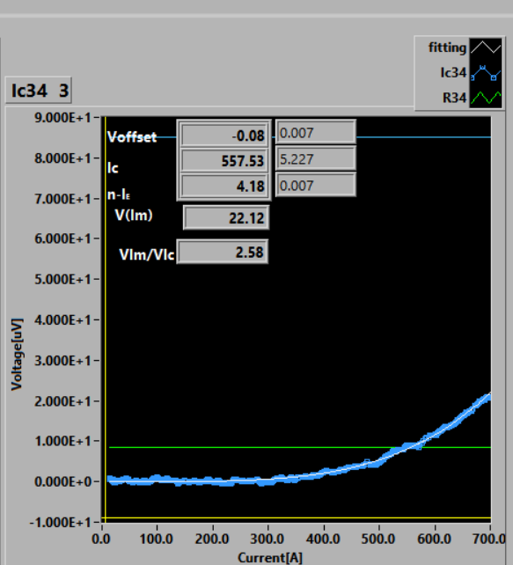
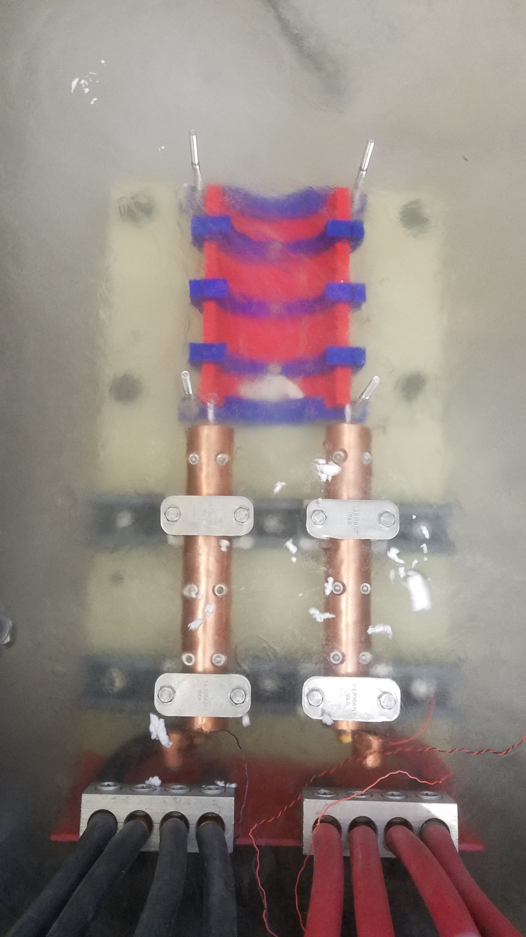
First LN₂ test of the model
Before winding
After winding
Data corrected for resistive component, I_{c} @ 0.1 μV/cm over 850mm length between the taps.
Both samples showed the self-field I_{c} of 1520-1700 A. Sample #2 was used for subsequent winding and re-testing.
A large I_{c} reduction was observed after winding. Also, there was a factor of 2 reduction in n-value.

Slide 8
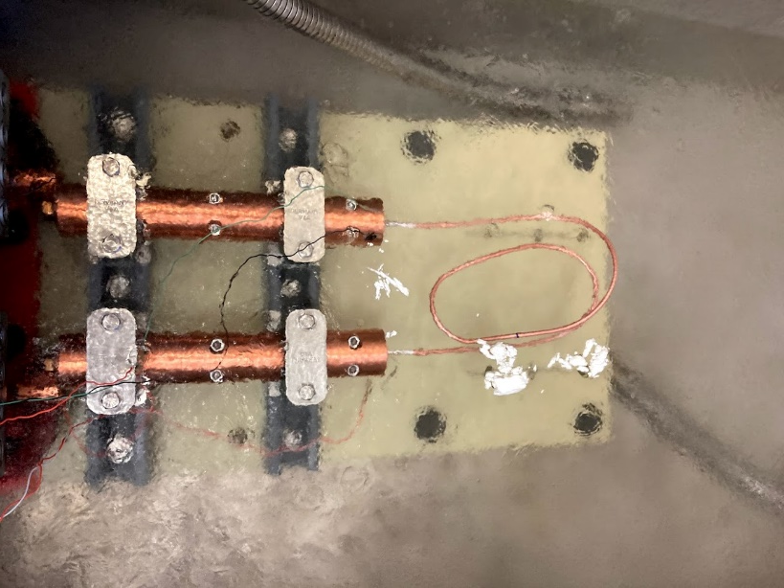
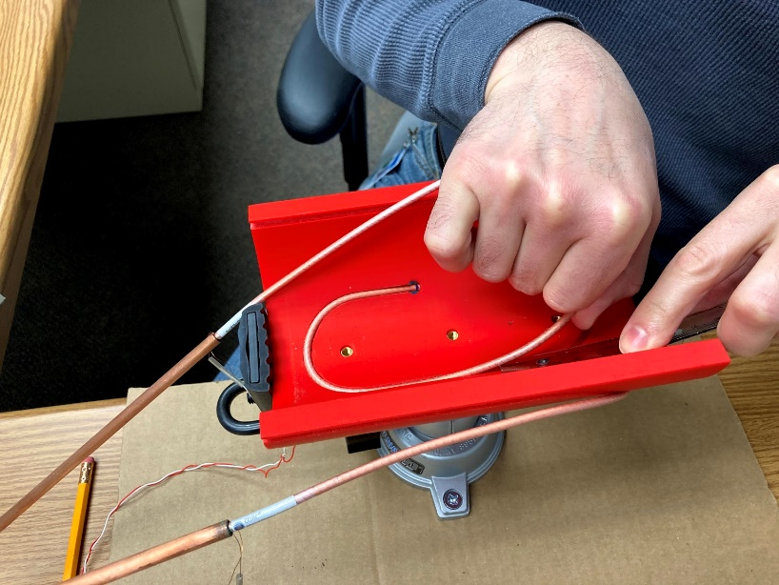
Possible causes of the I_{c} reduction
Damage to the superconducting layer due to excessive bending strain.
Effect of the self-field from the tight bending radii.
Additional strain due to cool-down of the structure:
  The cable was locked in the channel. The large thermal contraction of the plastic structure could induce additional strains in the cable, in particular, at the inner layer;
  That strain could potentially have a reversible component – to test that hypothesis, the cable was extracted from the structure without unbending it and retested.

Slide 9
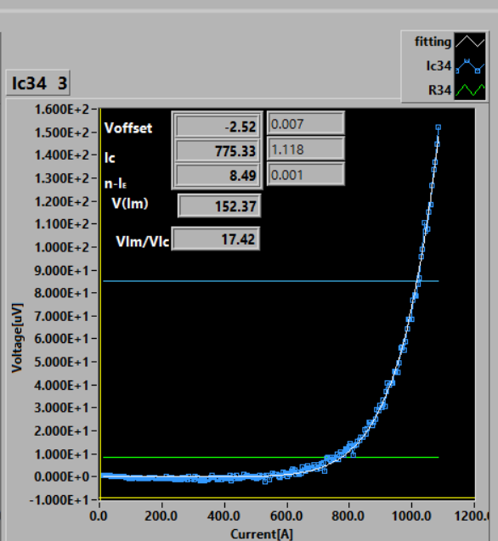
LN₂ test in/out of the structure
Before winding
After winding
In the structure Extracted from the structure
A 43% increase in I_{c} was observed in the extracted sample
Also, the n-value recovered to the original number

Slide 10
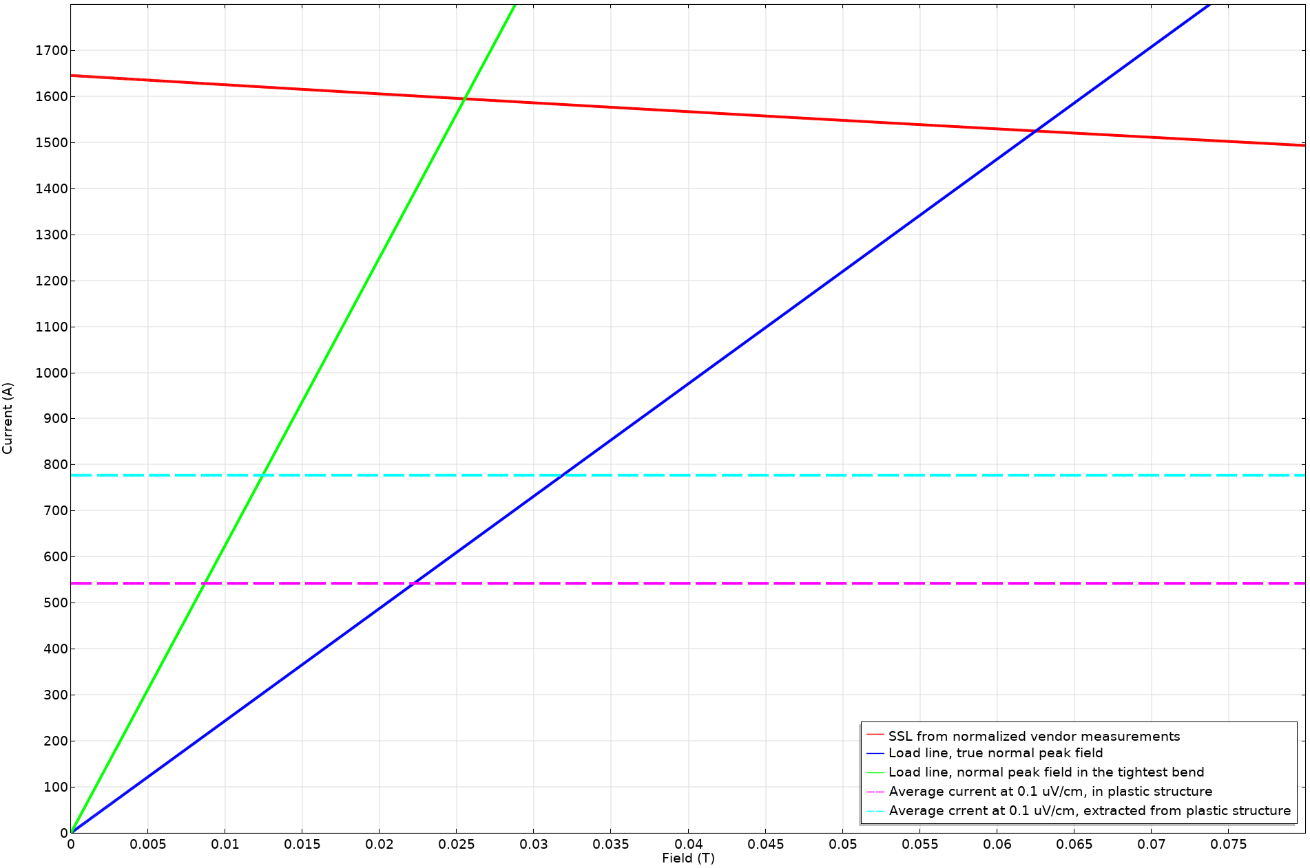
Self-field effect
1595 A
1525 A
49% I_{c} retention
51% I_{c} retention
777 A
542 A

Slide 11
Lessons learned from the short sample tests so far
A large I_{c} reduction was observed after winding the cable into the support structure.
  The majority of the reduction is expected to be due to the primary bend of the cable around the 52 mm pole spacer;
  The secondary bend around the 100 mm ID when the cable was pushed into the channel might have a compound effect on the bending strain and degradation;
  A part of the degradation is likely related to the thermally induced strains due to the differential thermal contraction between the cable and the structure. This can be eliminated by designing the structure that allows the cable motion in the channel and will be easier to accomplish for the metal-based structures.
One sample was severely degraded even without winding it into the structure, which happened in the process of dismounting it from the sample holder, straightening and then bending it again at the same ~0.5m diameter.
The CORC cable is very sensitive to bending and requires an extra careful handling – i.e. treat it as a reacted Nb₃Sn wire!

Slide 12
Next steps
Understand the actual cable performance by reconstructing it from I_{c} vs. B measurements in transverse field on all the layers:
  ACT has a setup and offered to perform these measurements;
  It is expected that the I_{c} will be higher than during the cable tests, but still likely substantially degraded.
In the meantime, increase the minimum bending diameter and use a single-step bending process instead of the two-step to avoid the compound strain effect, which means winding both layers from the outside. Stay with the present OD constraint to fit into Nb₃Sn coil (for now).
There are at least 3 possible outer winding schemes (all have pros and cons), but:
  winding each layer into individual, albeit mechanically coupled mandrels, seems to be the most straightforward way to move forward with minimal risks of damaging the cable.
Repeat the short sample measurements with the redesigned structure considering the lessons learned from the previous tests:
  LBL shared another piece of CORC wire, which will be sufficient for two tests;
  ACT will mount the terminals and install the voltage taps.

Slide 13
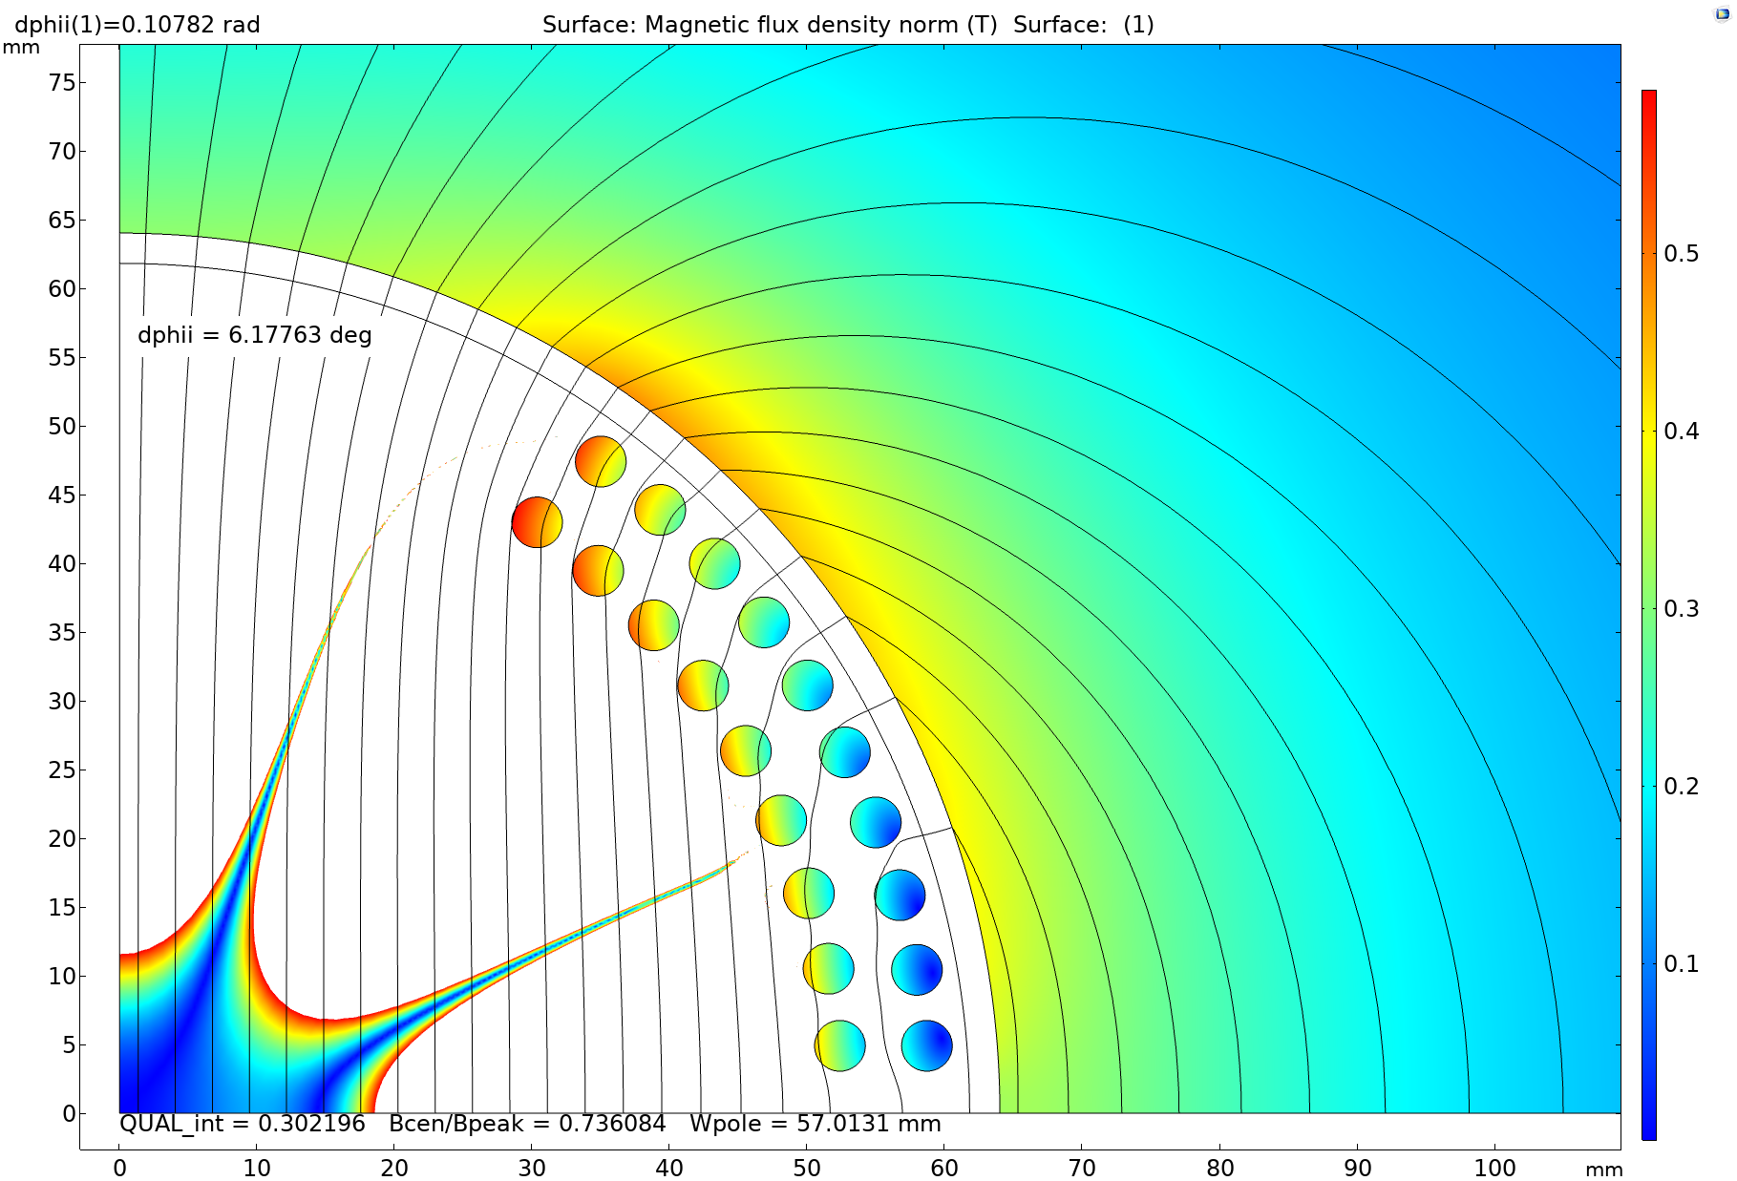
Redesigned coil cross-section
Changes vs. previous design:
Removed one cable per quadrant from the inner layer;
Increased the minimum pole width from 52 mm to 57 mm;
Adjusted the radial layer position to allow two individual mandrels;
Vertical transition between the layers (rather than radial) to maximize the pole width.

Slide 14
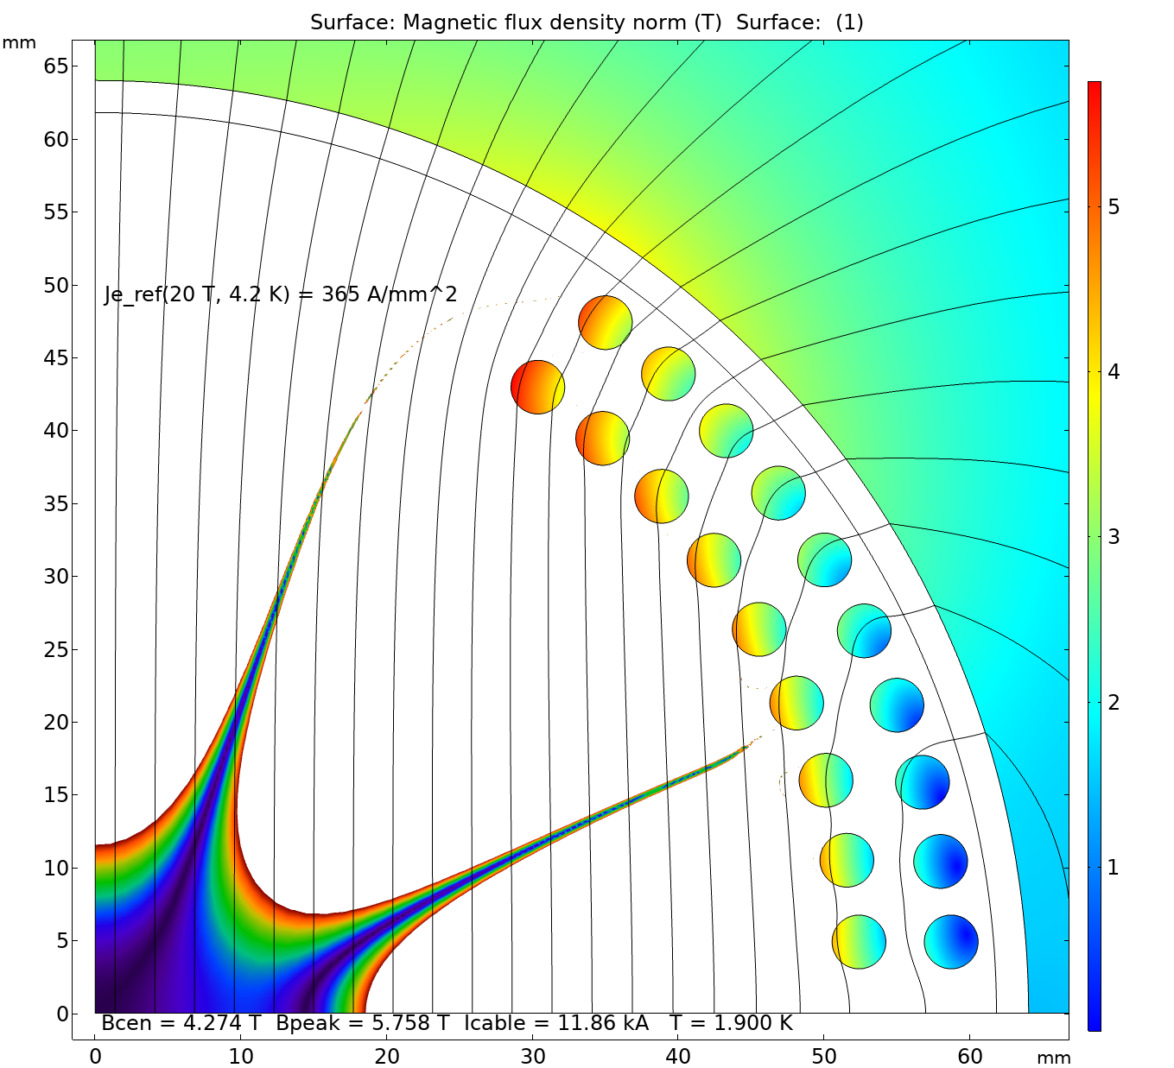
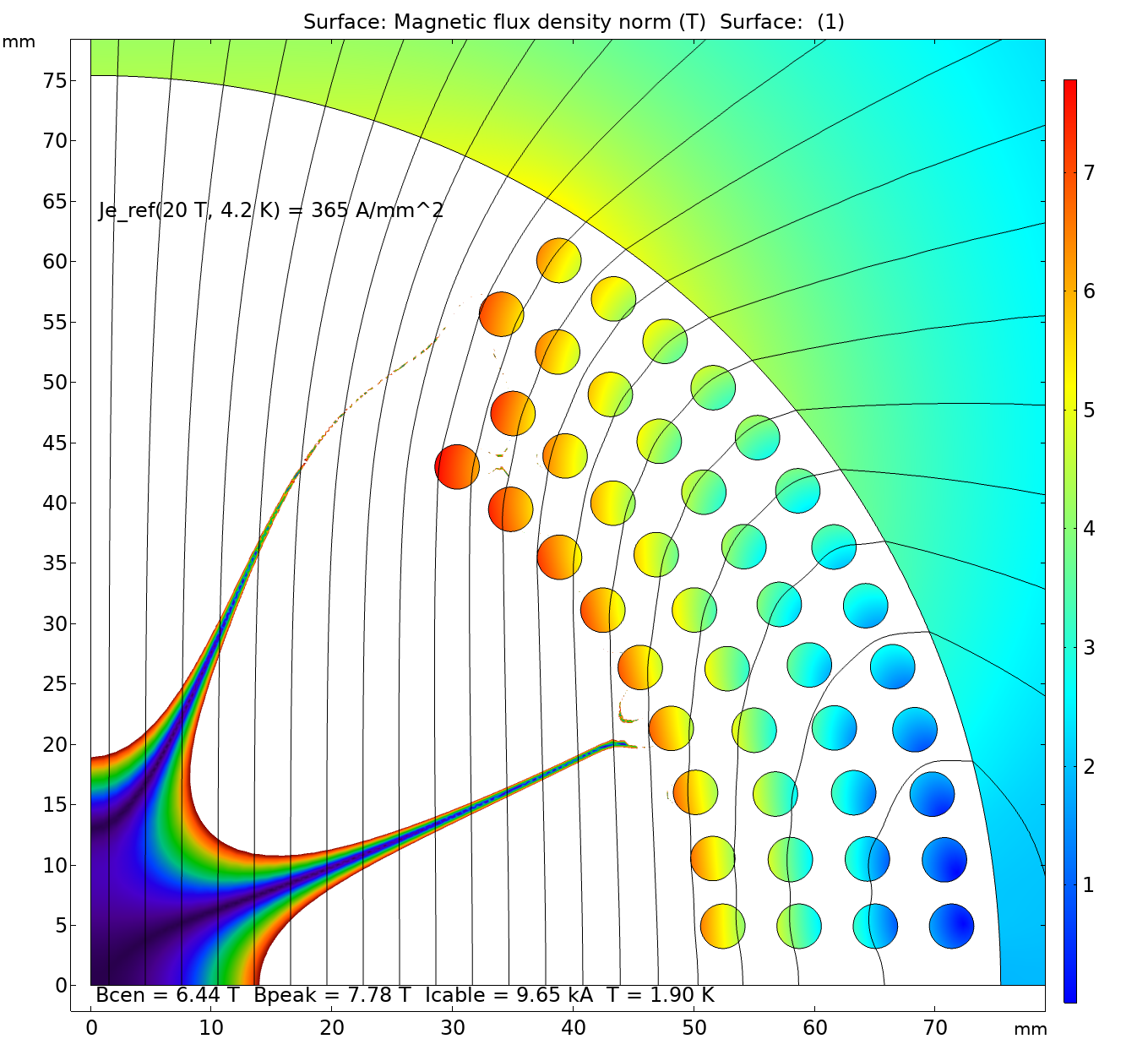
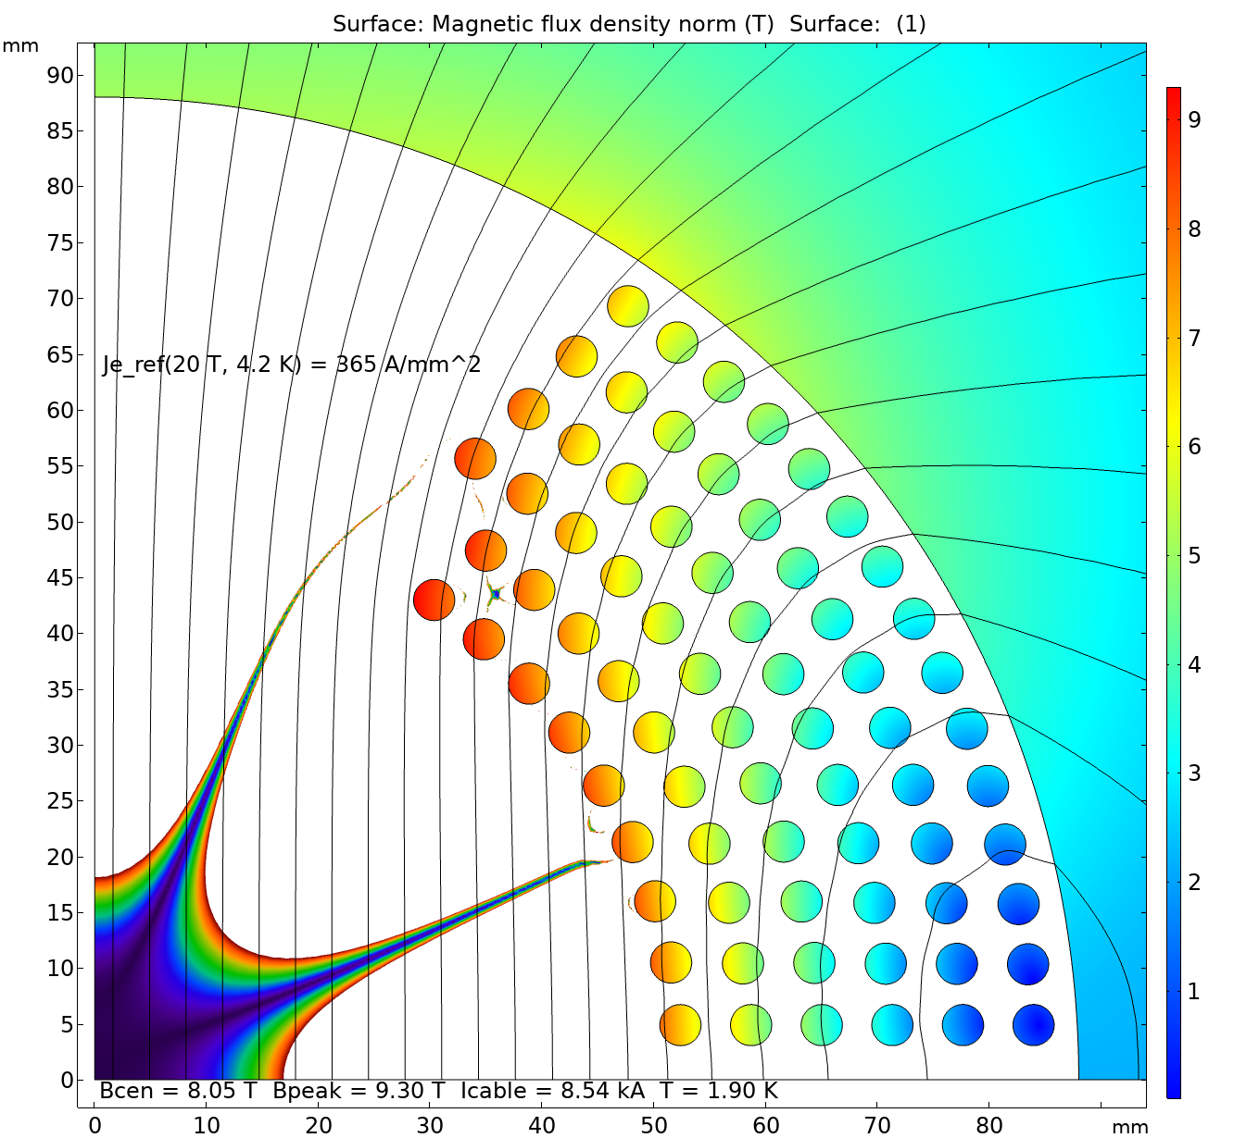
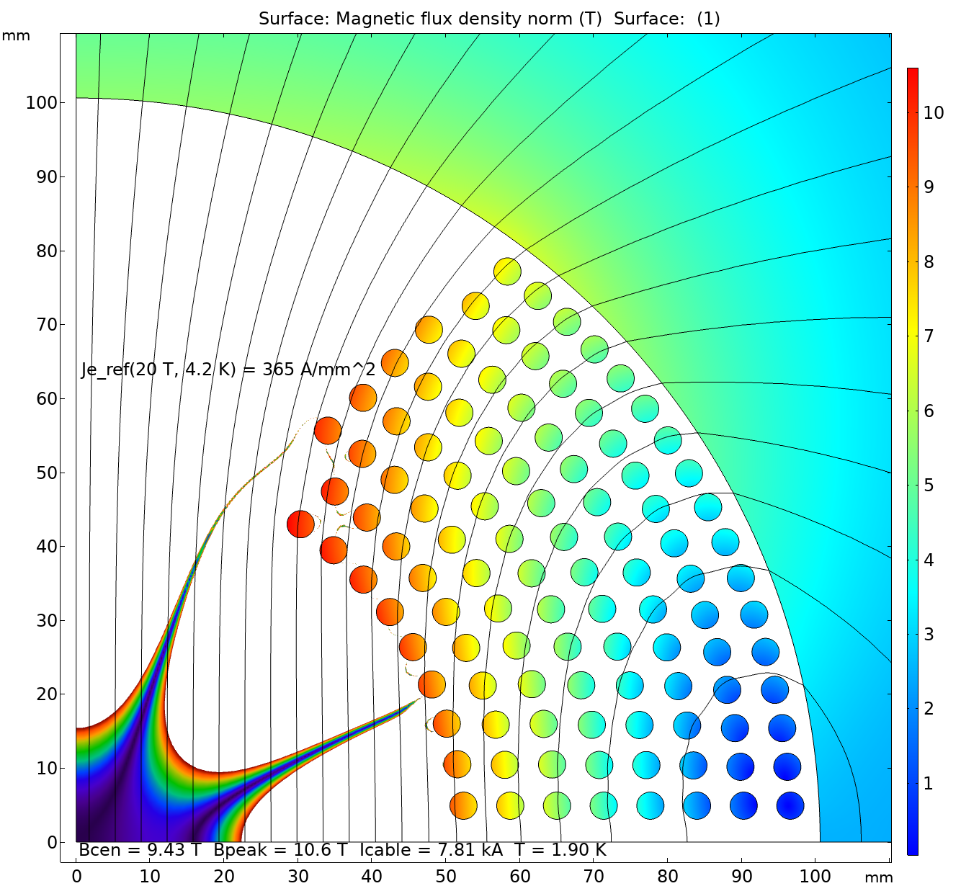
Design scalability – 2-8 layers
Due to the strain limitations, the additional layers can only be added from outside:
  When a more flexible REBCO cable becomes available, the internal space down to 50 mm ID can also be explored;
  The rule of thumb: minimum pole width is ~1/2 of the coil ID.
The double-layer half-coils can be nested one on top of the other and powered independently or in series:
  The prestress is controlled by means of midplane and inter-layer shims.
Grading can be done by reducing the number of tapes per cable:
  Has a minor effect on the cable OD (and the number of turns);
  Main purpose is to save on the conductor costs, rather than to boost the field.

Slide 15
Magnet parameter space – standalone
The studies are done with 100 mm coil ID.
However, since the dipole field is proportional to J_{e} times the coil thickness, the results (i.e. bore field vs the number of layers for a given J_{e}) are independent on the coil ID.
Includes the iron yoke of a “sufficient” thickness.
Presently available
conductors

Slide 16
Magnet parameter space – boost field in 15 T background
Desired J_{e} range for a 5 T insert
Without the iron yoke, since it is far from the HTS insert and is already saturated by the LTS coil field.

Slide 17
REBCO conductor needs
Cable strain sensitivity:
  For the aperture of the next collider of ~50 mm, the cable should be bendable around 25-30 mm diameter poles with preferably no more than 20% degradation.
To produce a 5 T insert in a 15 T background field, the reference J_{e}(20 T, 4.2 K) (after all degradations are taken into account) should be:
  At least 400 A/mm² for an 8-layer design;
  But preferably in 550-850 A/mm² range to enable 4-6 layer designs;
  The J_{e} in that range has an additional benefit of allowing to match the HTS and LTS currents so the coils can work in series.
Conductor length:
  Cable length is 40-60 m per meter of magnet length, which is sufficient to build a 2-layer half-coil;
  Total length is 80-180-300-440 m per meter of magnet length for 2-4-6-8 layer dipole coil.

