Slide 1


This work was in part supported by the US Department of Energy under agreement numbers
DE-SC0014009 and DE-SC0021710.
CORC® wires have become the Nb-Ti
of high-temperature superconductors
by having the REBCO films pretend they’re metallic
Danko van der Laan and Jeremy Weiss
Advanced Conductor Technologies & University of Colorado, Boulder, Colorado, USA
Kyle Radcliff and Sven Doenges
Advanced Conductor Technologies, Boulder, Colorado, USA
Zack Johnson
University of Colorado, Boulder, Colorado, USA
Shreyas Balachandran
Applied Superconductivity Center, NHMFL, Tallahassee, Florida USA
Anvar V.A., Keyang Wang and Arend Nijhuis
University of Twente, Enschede, the Netherlands
USMDP 2021, March 2nd, 2021

Slide 2
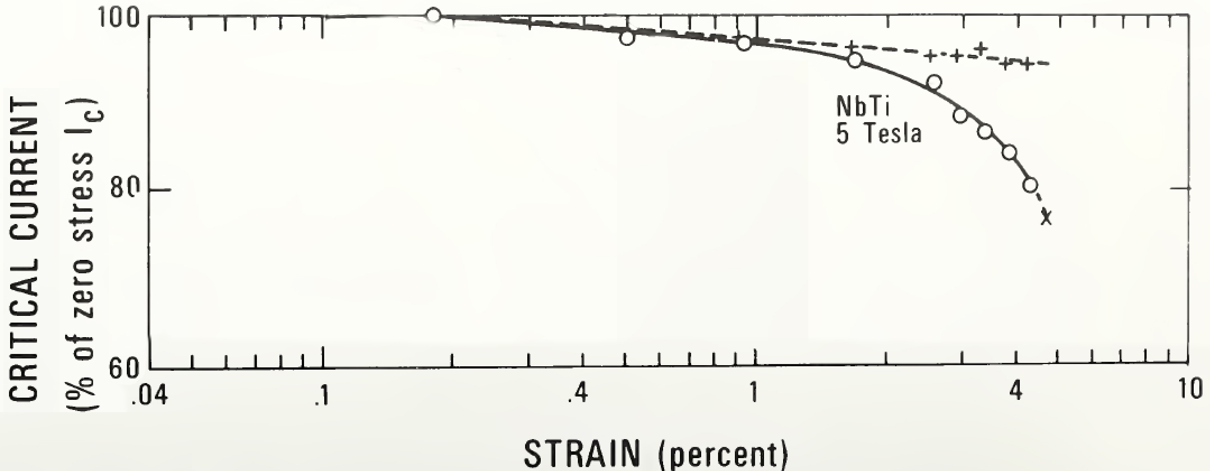
Why is Nb-Ti the workhorse of superconducting magnets?
Nb-Ti is a superconducting magnet workhorse because
It’s a round
It’s fully isotropic (mechanically and electro-magnetically)
Doesn’t require reaction after magnet winding
It’s a transposed, multifilament wire
It’s highly flexible, allowing very tight bends
How about CORC® wires?
✔
✔
✔
✔
(At least partly)
✔
(Not too tight please!)
We know this, so what’s new? To find out, let’s consider this 43 year old plot:
Irreversible strain limit under axial tension (ε_{irr}) exceeds 2 %,
driven by reduction in Nb-Ti cross-section with strain
J.W. Ekin, IEEE Transactions on Magnetics, Vol. MAG-13, No. 1, January 1977
ε_{irr} defined at
I_{c}(ε)/I_{c}(0) < 97-98 %

Slide 3
Irreversible strain limit of practical superconductors
Irreversible strain limit (applied strain)
Nb₃Sn: 0.65 % [1]
Bi-2212 wires: 0.3 % [2]
Bi-2223 tapes: 0.4 % [3]
REBCO CC: 0.6 % [4]
How about CORC® wires?
[1] Najib Cheggour, Theodore C. Stauffer, William Starch, Peter J. Lee, Jolene D. Splett, Loren F. Goodrich & Arup K. Ghosh, Scientific Reports 8, 13048 (2018)
[2] N Cheggour, X F Lu, T G Holesinger, T C Stauffer, J Jiang and L F Goodrich, Superconduct. Sci. Technol. 25, 015001 (2012)
[3] D.C. van der Laan, J.F. Douglas, C.C. Clickner, T.C. Stauffer, L.F. Goodrich, and H.J.N. van Eck, Supercond. Sci. Technol. 24, 032001 (2011)
[4] van der Laan D C and Ekin J W, Appl. Phys. Lett. 90, 052506 (2007)

Slide 4
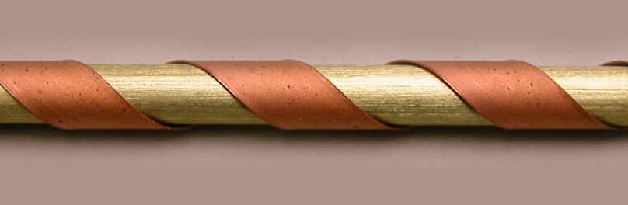
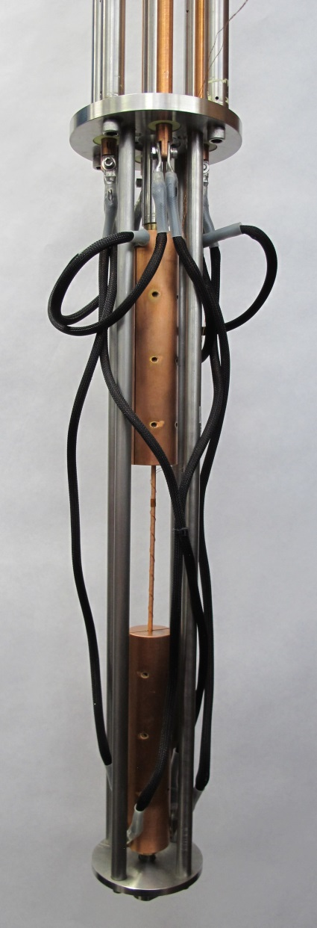
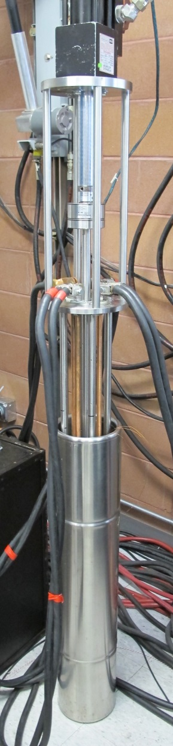
The effect of axial tensile strain on I_{c} of CORC® wires
Simplified description of CORC® wire structure
REBCO tapes wound in a helical fashion on solid core
Tapes behave as springs; extending axially and contracting radially under tensile load
The core acts a central support, but also confines the radial contraction of the springs
Testing CORC® wires under axial tension
Test performed in LN₂ at 77 K
Maximum load of 13 kN applied to terminations
Sample strain measured with pair of clamp-on extensometers

Slide 5
Effect of tape winding angle on ε_{irr}: 40 – 45°
CORC® wire layout with range of higher winding angles
12 tapes of 2 mm width (30 μm substrate)
6 layers wound on 2.55 mm copper former
tape winding angle 40 – 45°, depending on layer
1.2 – 1.3 %
12-tape CORC® wire with 40 – 45° winding angles: ε_{irr} = 1.2 – 1.3 %

Slide 6
Effect of tape winding angle on ε_{irr}: 30 – 36°
CORC® wire layout with range lower of winding angles
12 tapes of 2 mm width (30 μm substrate)
6 layers wound on 2.55 mm copper former
tape winding angle 30 – 36°, depending on layer
second sample strained to 2.8 %
H00-LA-04
3.3 %
12-tape CORC® wire with 30 – 36° winding angles: ε_{irr} = 3.3 %

Slide 7
Verification of tape I_{c} retention after strain
Procedure
Strain CORC® wire to 0.85 x ε_{irr}
Extract tapes from CORC® wire
Measure I_{c} from extracted tapes
ε_{max}=2.8%
Results
CORC® wire retention 98 %
Extracted tape I_{c} retention 98 %
ε_{max}=2.8%
High ε_{irr} of 3.3 % is real!

Slide 8
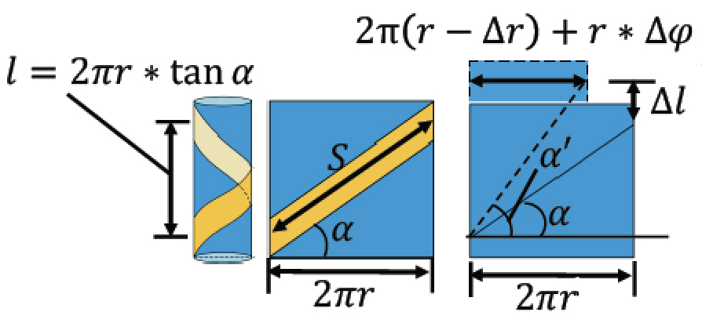
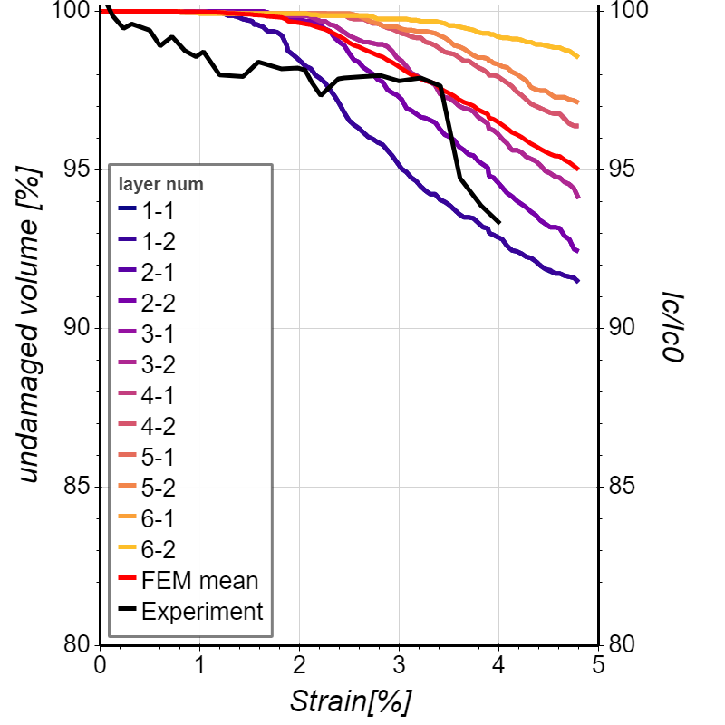
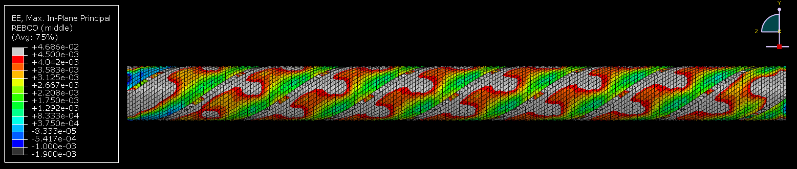
Analytical and FEM verification of results
Analytical approach
Calculate the tape axial strain from change in geometry
Ignore the torsion component
Low-angle CORC® wire
High-angle CORC® wire
FEM approach
Calculate REBCO value exceeding ε_{irr}
Assumes I_{c} correlates to remaining s.c. volume

Slide 9
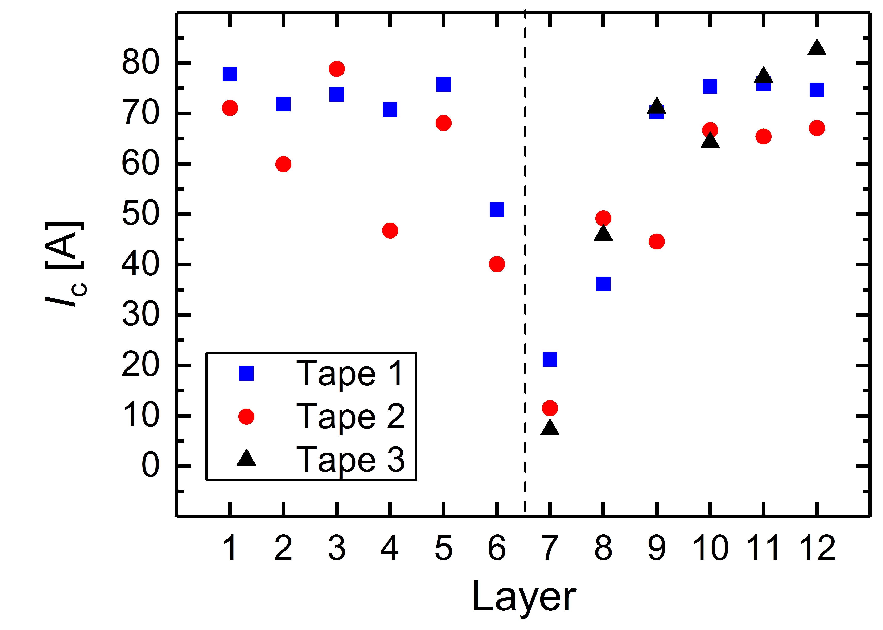
ε_{irr} of non-optimized high tape count CORC® wires
Standard 30-tape CORC® wire layout
30 tapes of 2 mm width (30 μm substrate)
12 layers wound on 2.55 mm copper former
tape winding angle 30 – 47°, depending on layer
higher winding angles
30-tape CORC® wire with standard layout: ε_{irr} = 1.5 %

Slide 10
Extending ε_{irr} of high tape count CORC® wires
Optimized 28-tape CORC® wire layout
28 tapes of 2 mm width (30 μm substrate)
14 layers wound on 2.55 mm copper former
tape winding angle 25 – 35°, depending on layer
Optimized 28-tape CORC® wire : ε_{irr} = 6 – 7 %!!

Slide 11
Verification of tape I_{c} retention after high strain
Optimized 28-tape CORC® wire
CORC® wire I_{c} retention 98 % at 7 % strain
Extracted tape I_{c} retention 99 %
Only tapes in the inner and outer layer damaged
Former location
Highest winding angle
Extensometer location

Slide 12
Axial strain practical superconductors Master Plot
CORC® wires can now be engineered to have ε_{irr}:
twice as high as Nb-Ti
10 times as high as REBCO coated conductors
20 times as high as Nb₃Sn, Bi-2212 and Bi-2223

Slide 13
CORC® wires with improved mechanical tensile strength
Critical stress limit under tension
All tests on 12-tape CORC® wires (2 mm tape width)
Critical stress limit with soft annealed copper former: 134 MPa
Critical stress limit with half hard copper former: 280 MPa
Critical stress limit with CuBe former: 613 MPa
1,036 lbs!
CuBe former
Hardened
Cu former
Annealed
Cu former
76 K
Irreversible tensile stress limit of CORC® wires can be engineered to exceed 600 MPa at 77 K

Slide 14
Summary
Of course, the title of this presentation is slightly misleading
CORC® wires will never match the flexibility of Nb-Ti
On the other hand
CORC® wires allow mechanical uncoupling of the REBCO layer from the former
This allows extremely high irreversible strain limits in CORC® wires of 7 %
Because of this, the CORC® wire strength depends almost entirely on the former
CORC® wires with very high critical stress exceeding 600 MPa have been made
The challenge ahead in creating Goliath CORC®
High irreversible strain limits were demonstrated with pure copper formers that allow high levels of elongation
To combine high ε_{irr} with high σ_{crit}, strong formers that allow elongations to 3 – 7 % need to be applied
Harder formers also typically reduce the CORC® wire flexibility
Specially-engineered formers are key to the creation of Goliath CORC®!

