Slide 1
Fiber-optic diagnostics development
MDP meeting
March 1-5 2021
M. Baldini (FNAL), S. Krave (FNAL), Piyush Joshi (BNL)
US Magnet Development Program

Slide 2
Outline
MDP milestones
Proposed work at BNL
Tensile stress test at FNAL
Short term plan at FNAL

Slide 3
Goals and Milestones
Develop a novel diagnostic tool and analysis technique based on fiber optics sensors.
FBG: validate technology for strain and temperature sensing. Install on MDP magnet to test the performance
AIIId-M9 | Calibration of FBG fibers in a small cryostat. Installation on an MDP magnet and strain measurement during a quench. Design a proof of principle experiment for quench 3D spatial detection and coil azimuthal strain mapping and install fiber on MDP magnet. Use fibers for energy spectrum analysis and HTS quench detection. | December 2022

Slide 4
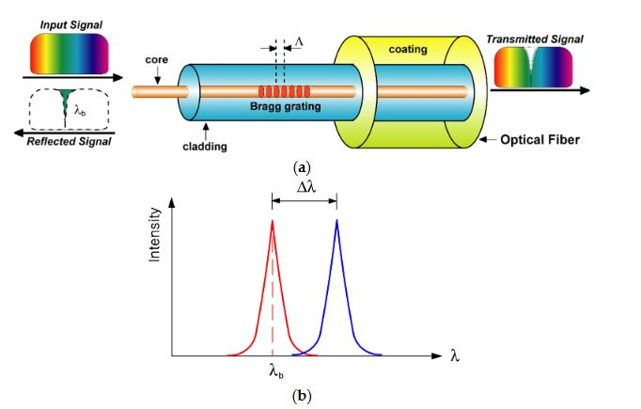
Principle of Fiber Bragg Grating (FBG)

Slide 5
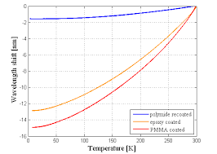

Practical application of FBG Sensor
FBGs are proven to be good sensors for strain measurement up to 4.2K. No data available for 1.8K
FBGs are not very sensitive below 50K for absolute temperature measurement
FBGs need special coating to increase sensitivity at cryogenic temperature.
FBGs can be effectively used up to 550K on high side
$\frac{{∆λ}_{B}}{λ_{B}}$ = $(\text{η}+\text{α})∆T$
𝜂 = the thermo-optic coefficient which represents the temperature dependence of the refractive index
𝛼 = thermal expansion of silica

Slide 6
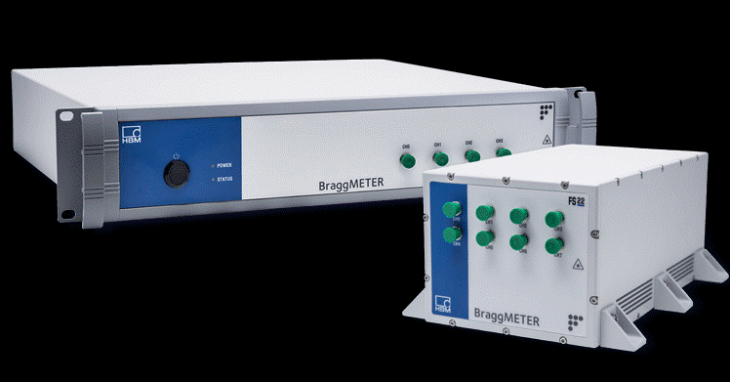
Proposed technology validation test setup at BNL
Aluminum rod ~3ft
Strain Gages
Strain FBGs
Optical Fiber
Cernox Temp Sensors
Spot heaters
Temp FBGs
This assembly will be placed in test dewar with temperature control from 300K to 4.2K
Conventional strain gage readings will be compared with Strain FBG readings during cooldown
Cernox temperature sensor readings will be compared with Temp FBGs
Spot heaters will be used to see thermal response and sensitivity

Slide 7
Work performed at FNAL

Slide 8
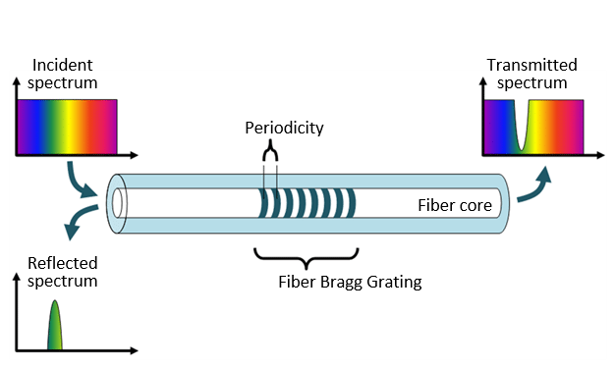
FBG FNAL status
Nominal wavelengths FBG1=1502 nm
FBG2=1508 nm
FBG3=1514 nm
FBG4=1520 nm
500 mm
100 mm
100 mm
4 fibers with 4 FBG sensors
8-ch interrogator
FBG4
FBG3
FBG2
FBG1
Custom made fiber:
# of sensors, position and wavelengths
- 500mm Ormocer coated fiber
1,5 m aramid cable Ø3mm,
FBG sensor lengths is 5 mm
FC-APC connectors
transfer of the FBG technology and perform experiments to calibrate the effect of cooling and mechanical strain with known materials (copper, stainless steel, titanium) using FBG fibers.
Many thanks to Michael Guinchard and his group from CERN for the many suggestions and discussions

Slide 9
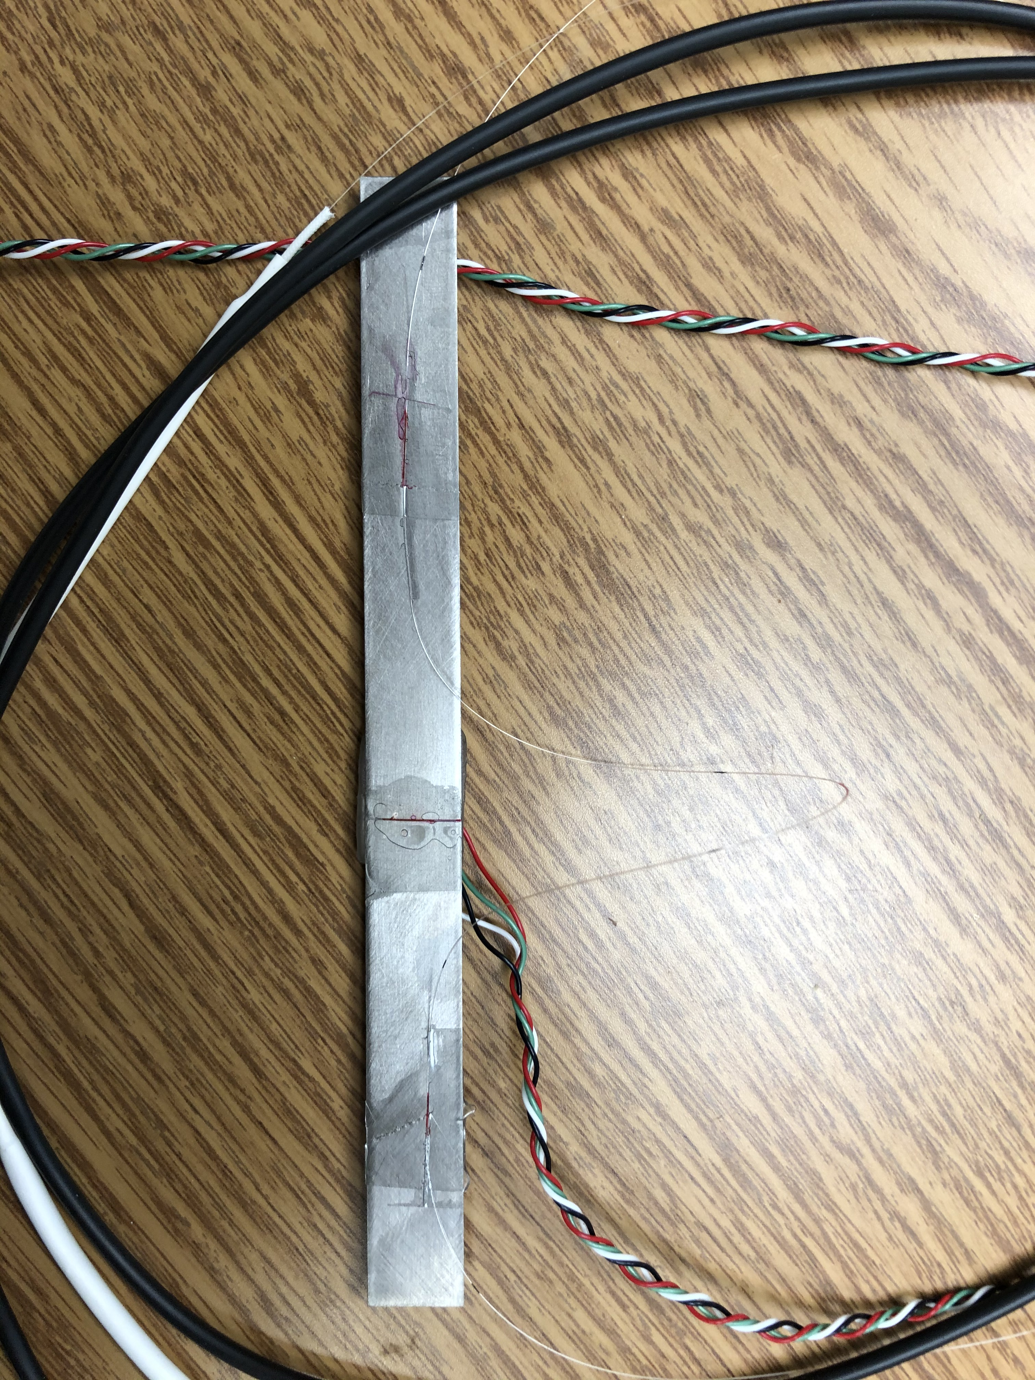
Tensile strain test
Y
x
FBG 3
3 FBG sensors were glued on a Ti bar.
thickness= 0.89 mm; width= 13.06 mm; length= 15 cm
FBG1 and FBG3 sensors along Y axis, FBG2 sensor along X.
Strain gauge along Y on the back of the Ti bar
FBG 2
FBG 1

Slide 10
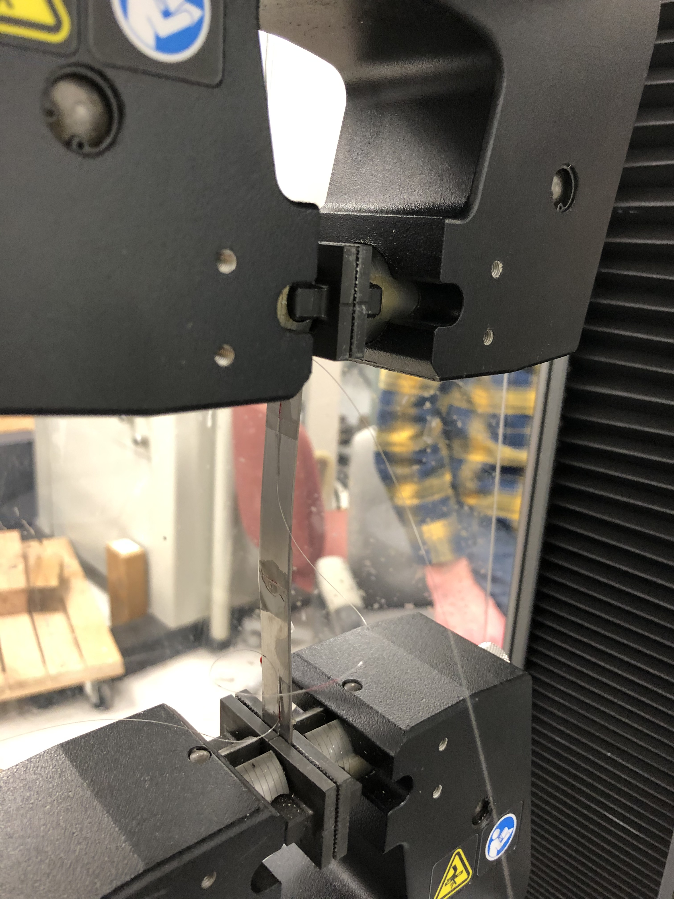
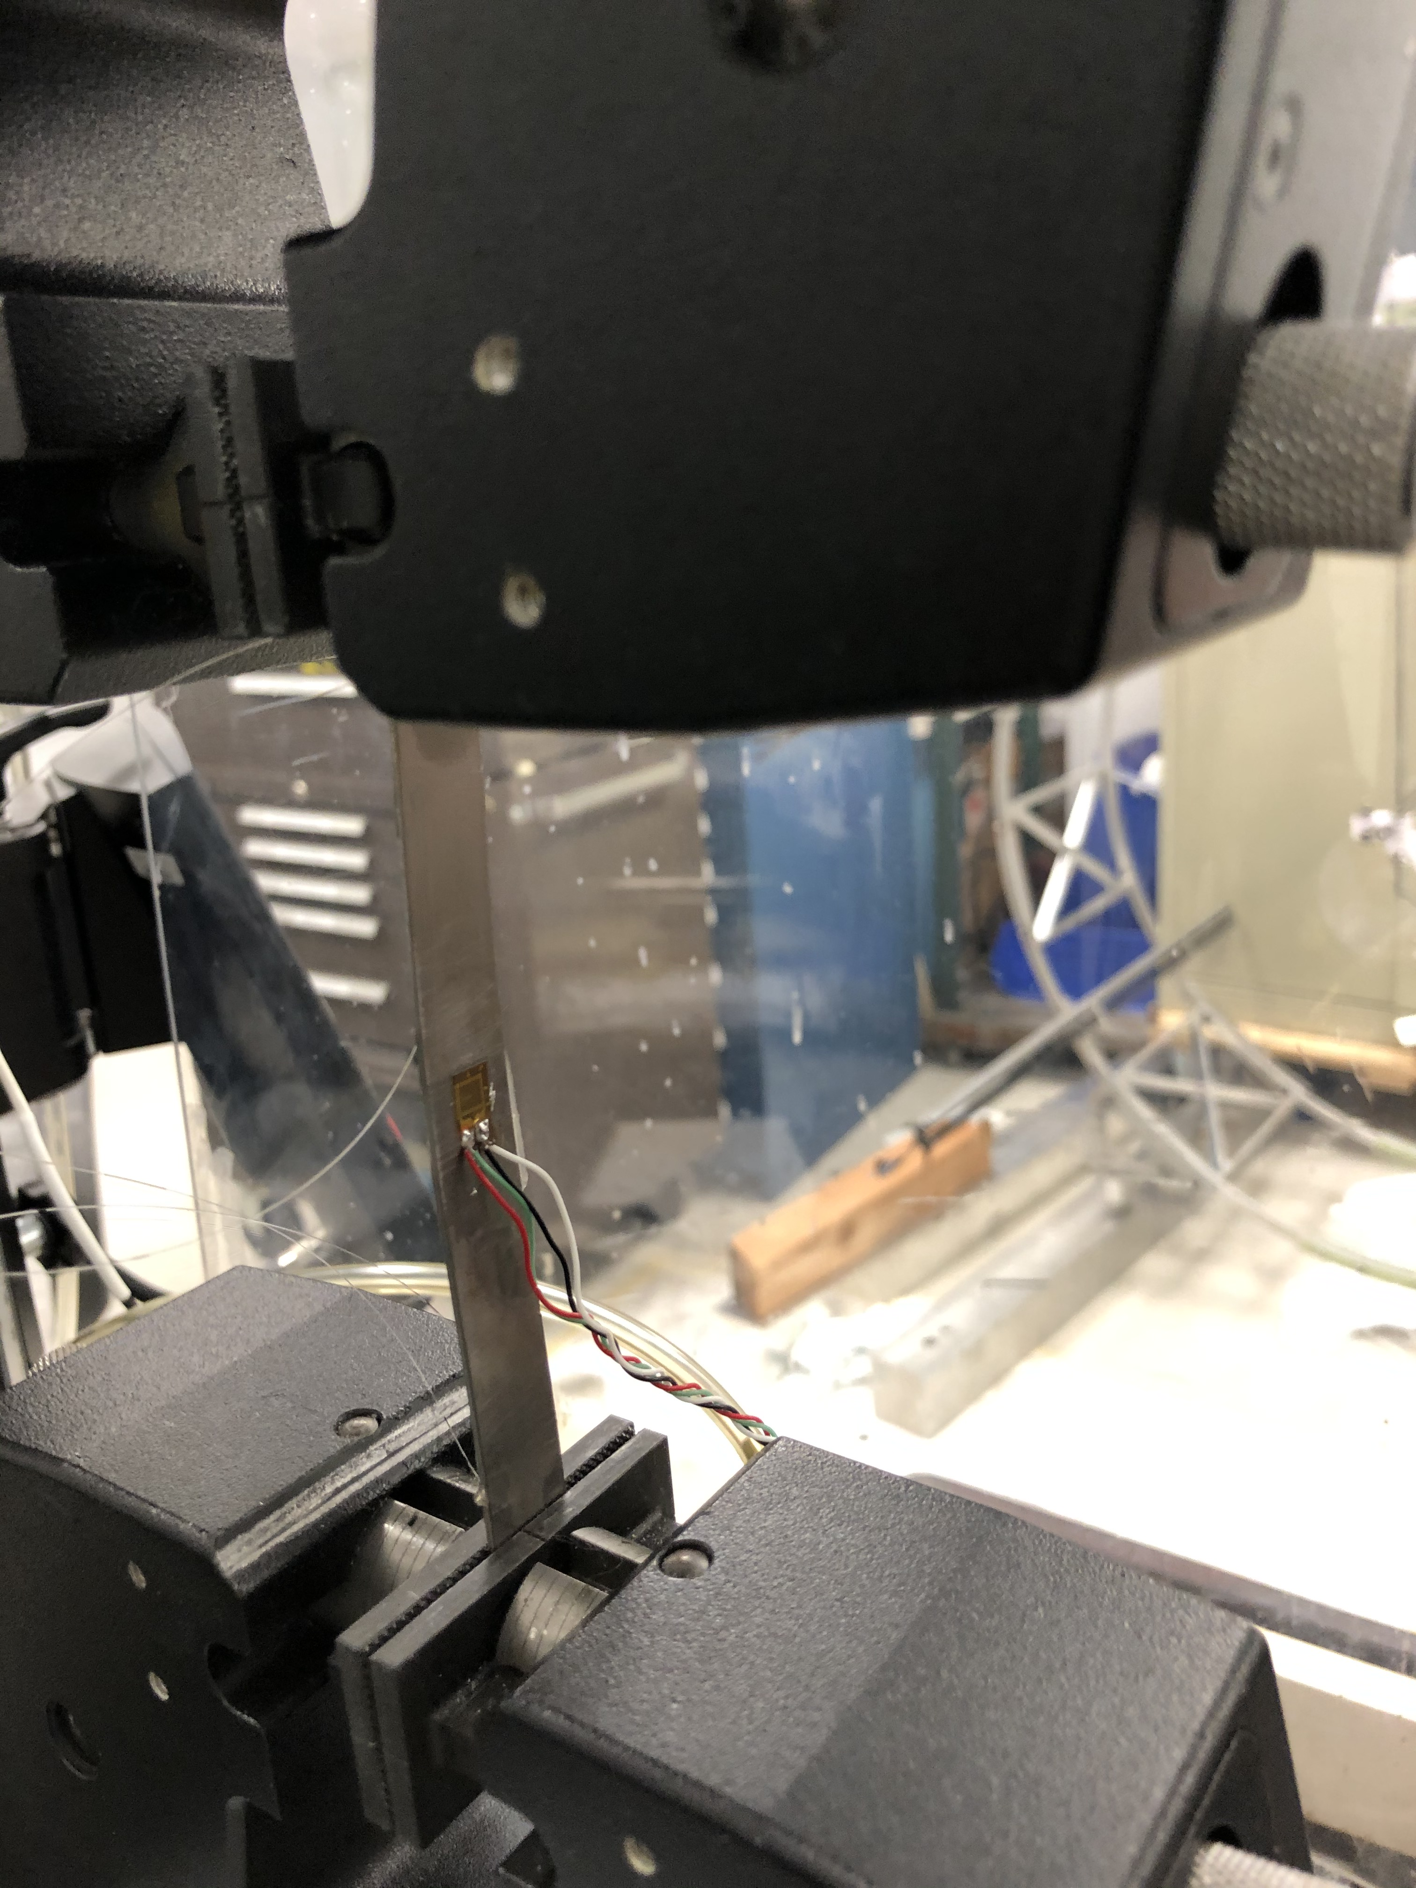
Istron strain test
Fix one of the fiber extremities and pull 200*10⁻⁶ mm/mm. Fibers need to be glued in tension
Sensor along X was not glued well and did not stick to the sample
Fiber was broken during gluing pressing on the edge of the Ti sample

Slide 11
Strain gauge raw data
Test was repeated 3 times.
Each time tension was brought back to 0.
Load applied at 0.1 mm/min

Slide 12
Strain gauge data
Test 1 up to 100 MPa
Tensile stress calculated from applied load and specimen cross section
Ti Young modulus is 114 GPa

Slide 13
Fiber sensors data: test 2
CH0S001 ; 1507.952 ;
CH0S002 ; 1512.732 ;
CH0S003 ; 1519.933 ;
2.5 nm is the maximum allowed wavelength shift to avoid peaks overlap.
Strain is around 2000 um/m
If Dl is above 2.5 nm, interrogator stop collecting meaningful data. This is observed for each sensors around the same time. Loss of data in FBG1
Behavior is very different for FBG1 and FBG3
K=0.78 (provided by the vendor)

Slide 14
Strain gauge vs fiber sensor
strain(t)-strain (t=0)
strain vs time
stress vs strain

Slide 15
Linear fit and young modulus
FBG3 Young modulus is consistent with what is expected for Ti
FBG1 Young modulus is not consistent.
No linear behavior.
Sensors are close to Instron clamps: bending effects

Slide 16
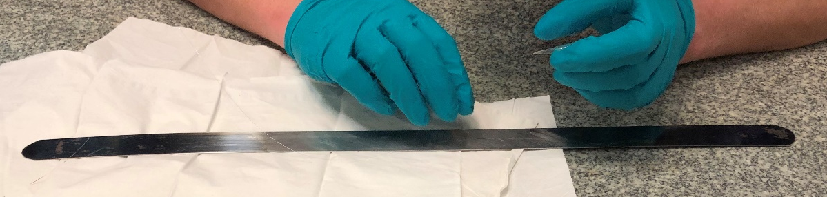
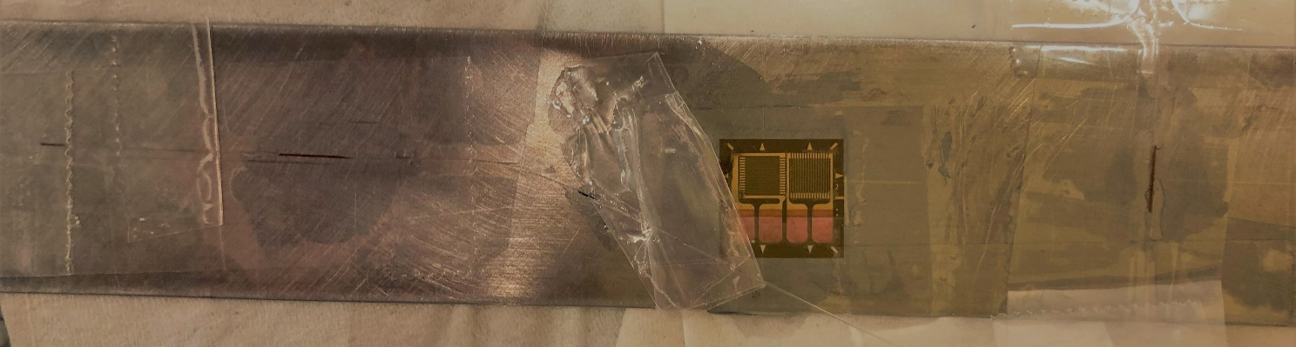
Next test: short term plan
Wider and longer sample: 22 inches long stainless-steel bar
  Sensors in the center of the bar
  avoid to reach maximum Δλ shift
  Get data along X axis
  Reduce bending effects having sensors and strain gauge on both sides of the bar
New data at ambient temperature by the end of the week
Test in liquid Ni by the end of March 2021.

Slide 17
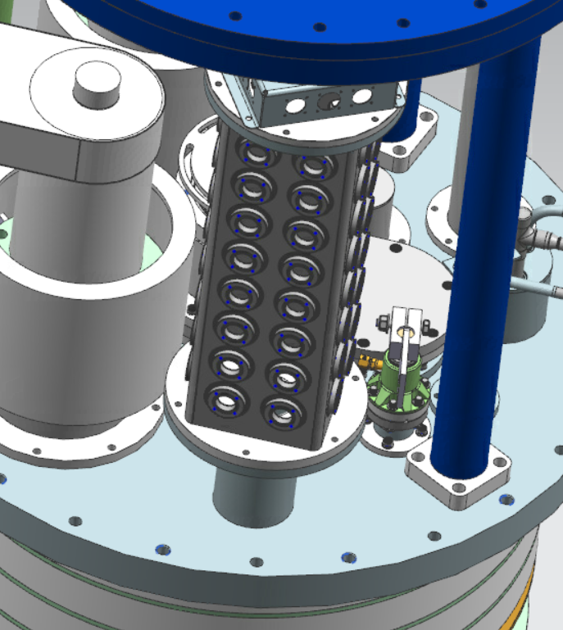
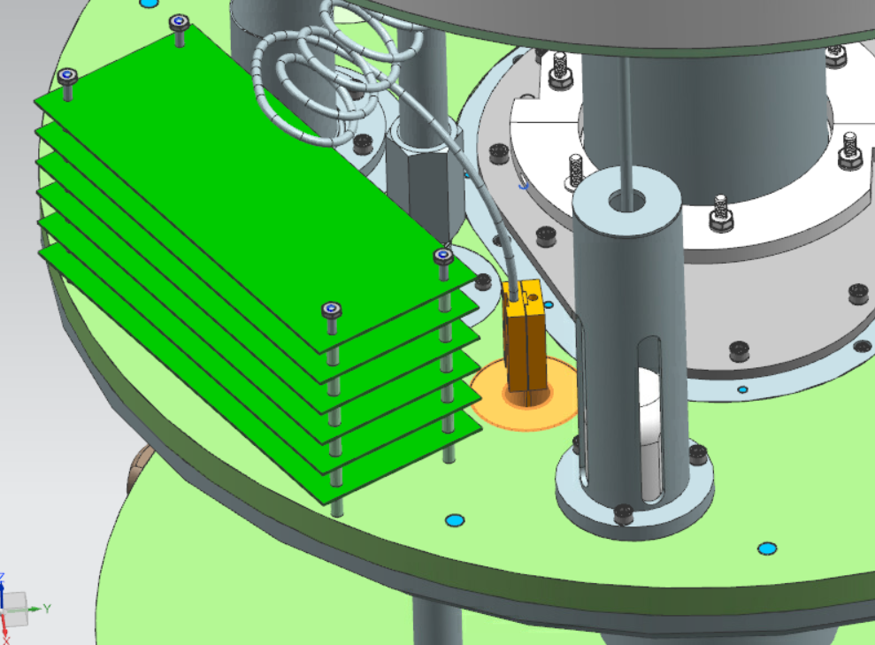
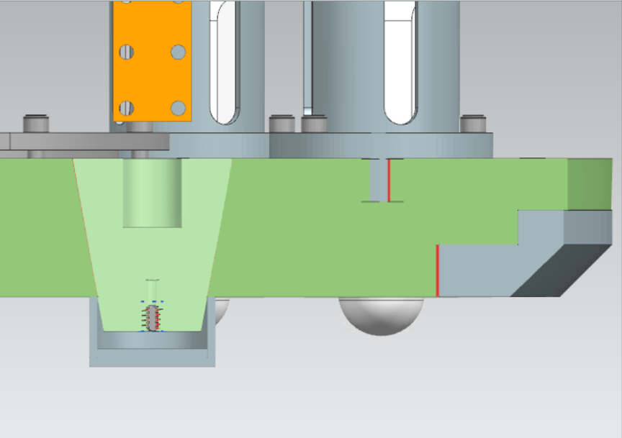
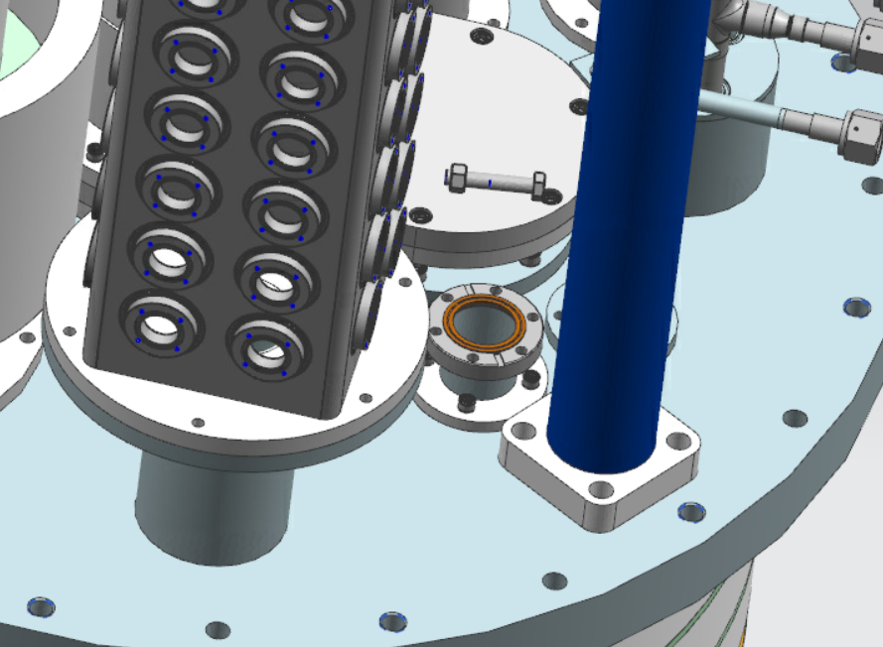
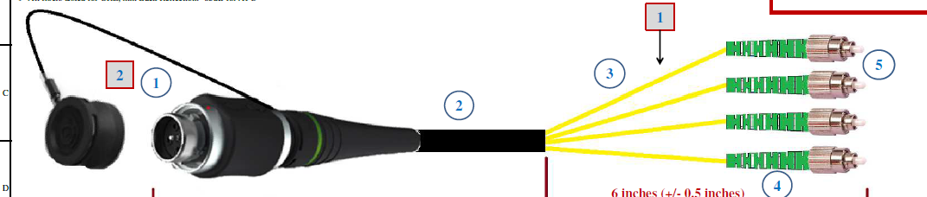
FBG sensors for MDP magnets: VMTF
Modification of the 30 kA top plate are underway
Feedthrough and cabling specs have been identified and purchased.
First test on the structure of a mirror magnet that is being assembled now
Test with 11 T mirror magnet in April

Slide 18
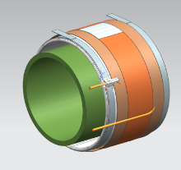
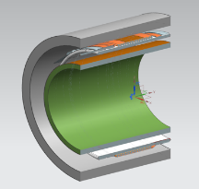
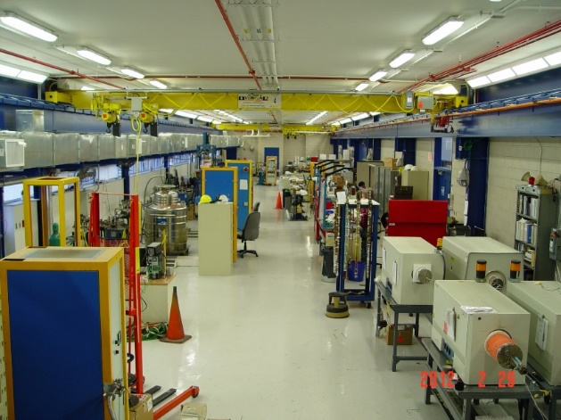
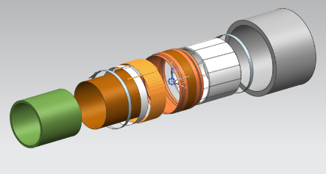
Synergy within MDP partners and other FNAL activities
Custom made FBG fibers has been purchased and will be installed on MQXFA08
Participate to discussion with LBNL colleague on fibers applications: learn from each other
LDRD approved: Purchase distributed fibers and interrogator and perform several experiment use small solenoids made of cheap wires to optimize fiber sensitivity to strain and T and find optimal tradeoff between spatial and time resolution.

Slide 19
Conclusions
Early strain tests are being performed using FBG sensors on known material: Ti and SS.
Perform test at low temperature to measure T effect on strain.
Start using those fibers on MDP magnet tested at FNAL during the rest of 2021
Good synergy with AUP and LDRD project and within the MDP program
Explore current limitation on slow interrogation frequency and low sensitivity of FBG temperature sensor below 50K

Slide 20
Extra slides

Slide 21
Fiber sensors data: test 1 and 3
No wavelength shift measured during test 1 and 3
It is not obvious why at moment

