Slide 1
MDP Collaboration Meeting
20 T hybrid magnet and comparative analysis
P. Ferracin
US Magnet Development Program

Slide 2
Outline
General organization of working group
Goals of working group
Design criteria for a 20 T hybrid magnets
Analytical estimates of general dimensions and stresses
Preliminary magnetic analysis of different design options
Areas of technological development
Next plans and conclusions

Slide 3
General organization of working group
Members
  LBNL: P. Ferracin
  FNAL: G. Ambrosio, E. Barzi, V. Kashikhin, V. Marinozzi, I. Novitski, A. Zlobin
  NHMFL: L. Cooley
  BNL: R. Gupta, B. Yahia
Contributions from
  Diego Arbelaez and Lucas Brower (LBNL)
  Etienne Rochepault (CEA)
  Jillien Stern (TUFTS University, Prof. Luisa Chiesa)

Slide 4
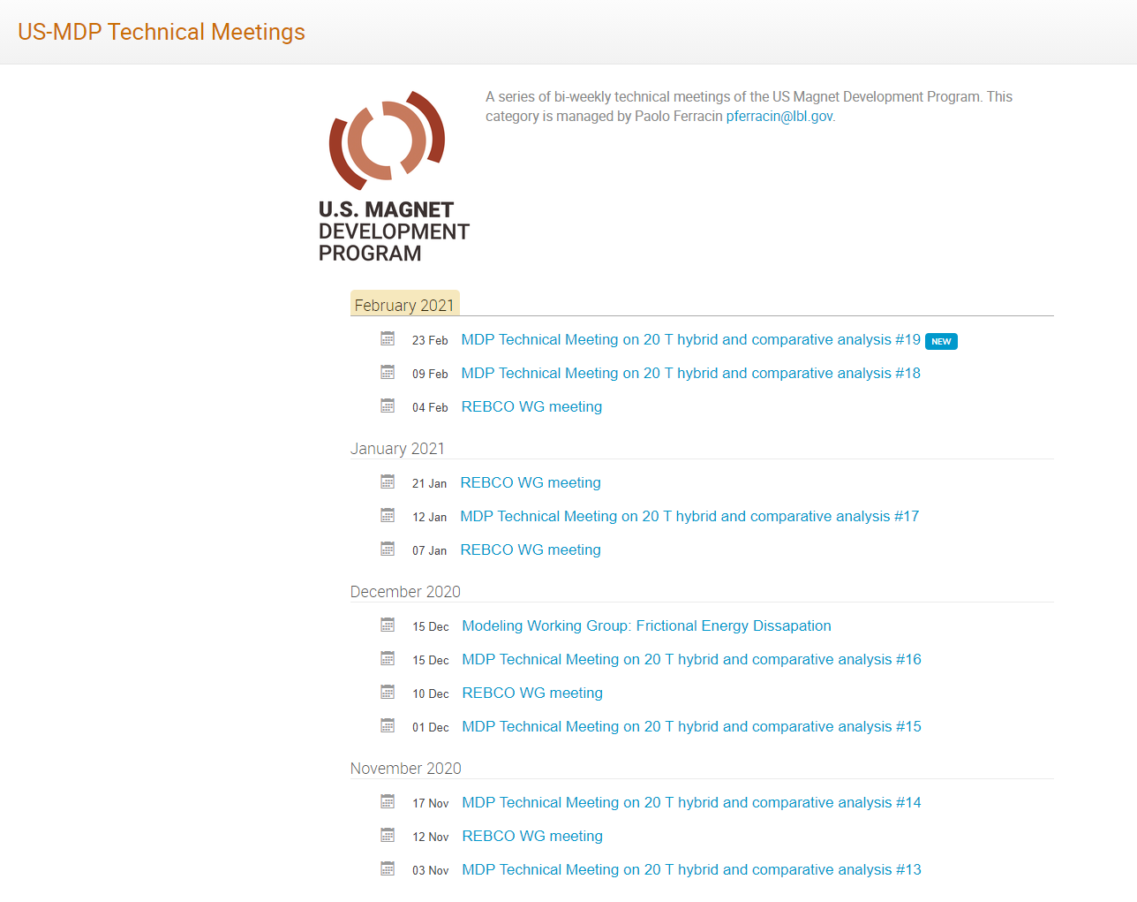
General organization of working group

Slide 5
Outline
General organization of working group
Goals of working group
Design criteria for a 20 T hybrid magnets
Analytical estimates of general dimensions and stresses
Preliminary magnetic analysis of different design options
Areas of technological development
Next plans and conclusions

Slide 6
Goals of the working group
Conceptual design of a 20 T hybrid HTS-LTS magnet
  Comparative analysis of different design options for a 20 T hybrid
    Cosϑ design and its stress-management options
      “Traditional” Cosϑ
      Canted Cosϑ (CCT)
      Stress management Cosϑ (SMCT)
    Block-type coil design (block with flared ends)
    Common-coil design (block with racetrack coils)
  Definition of general design criteria: aperture, field, margin…..
  Analysis of challenges specifically of hybrid magnets
    Integration of LTS/HTS, mechanics, protection, powering, diagnostics, test facility…..
Review and follow-up of current work on hybrid magnets
  Collect and organize information from these programs (responsibility of area I and area II) to provide inputs for 20 T hybrid design

Slide 7
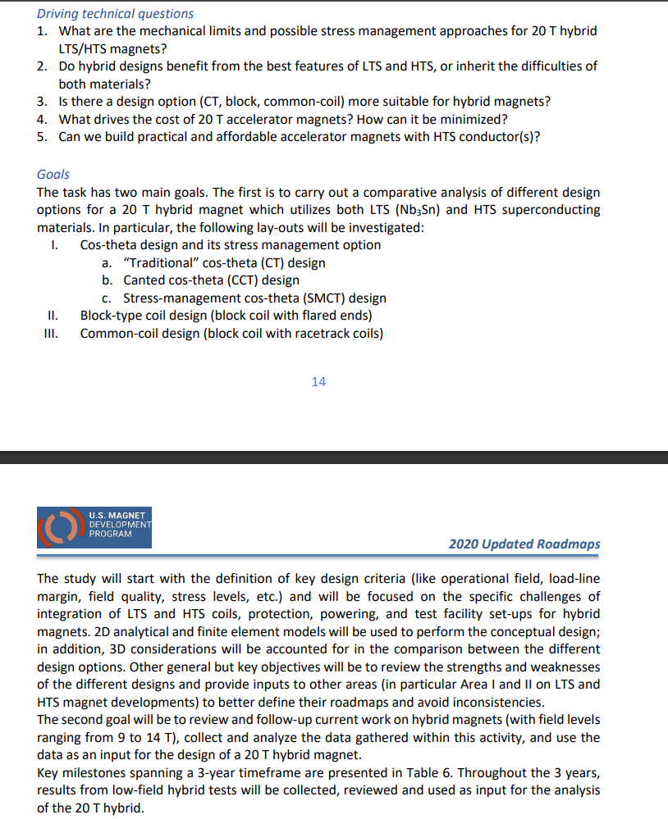
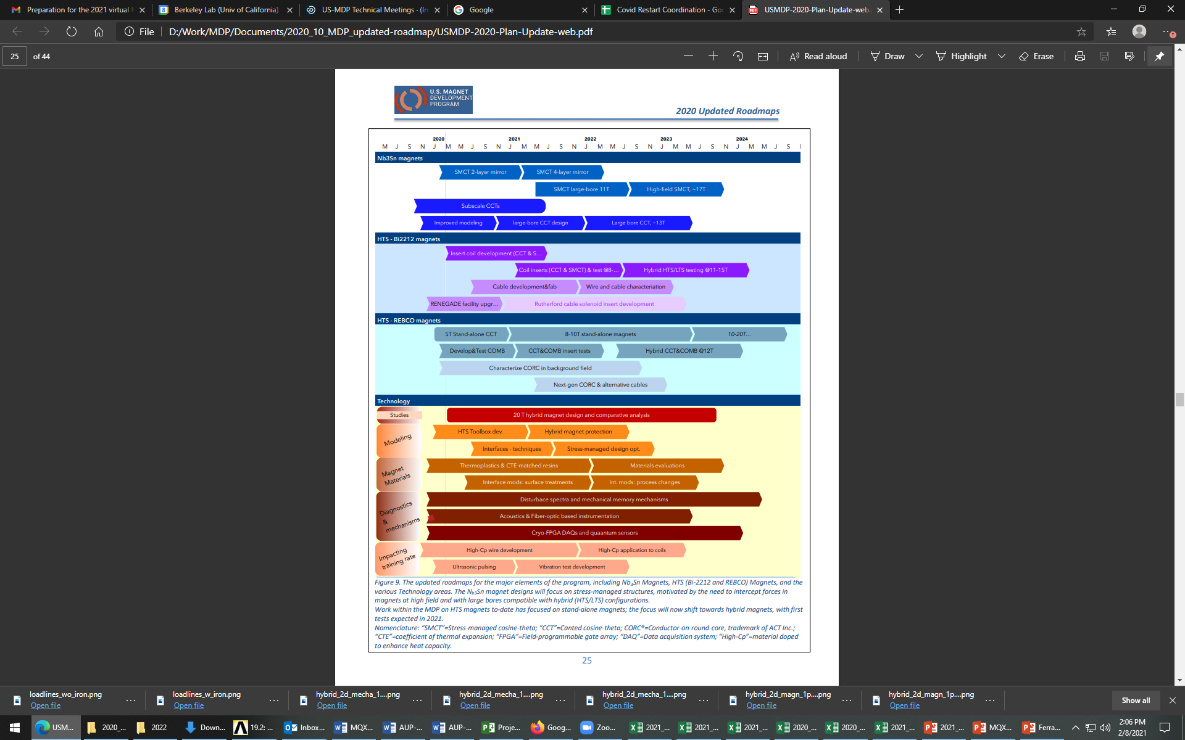
Goals of the working group
(from the updated roadmap)

Slide 8
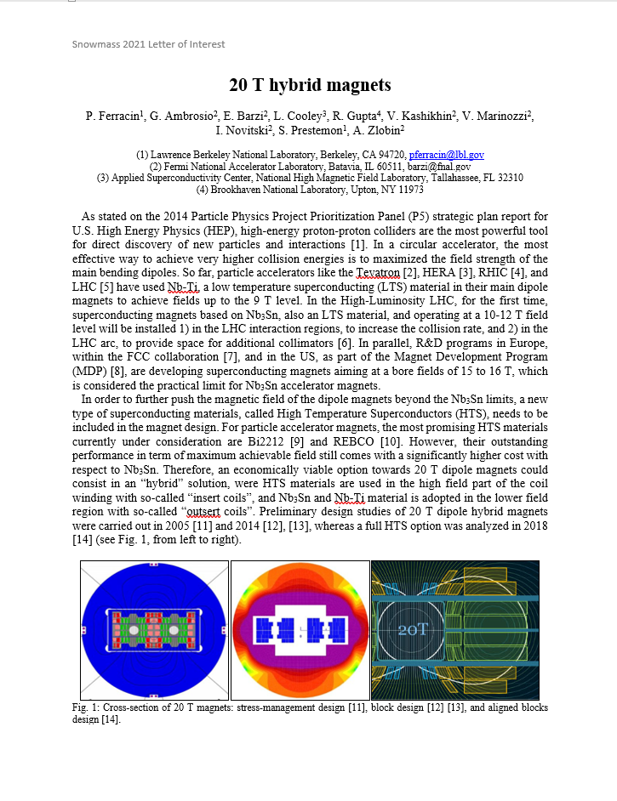
Snowmass LOI

Slide 9
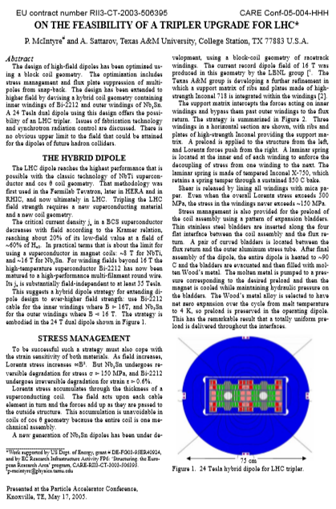
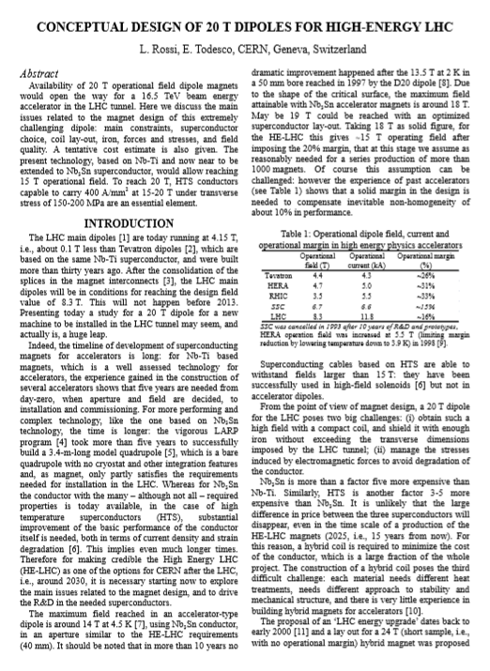
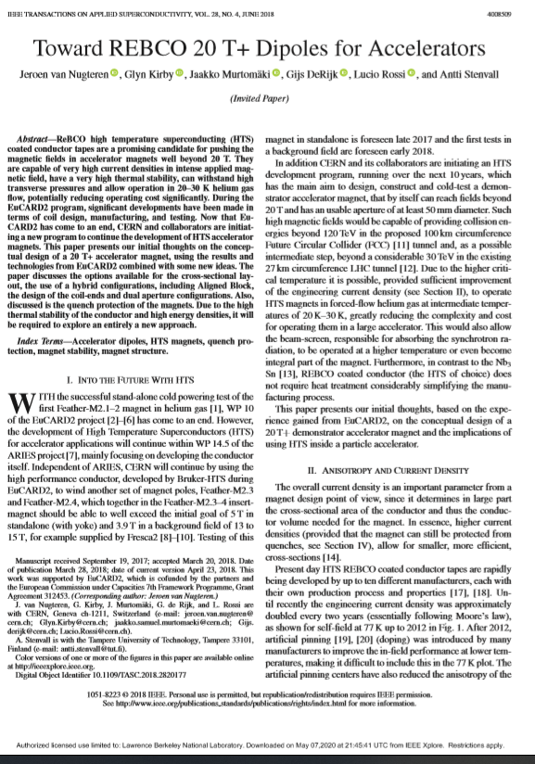
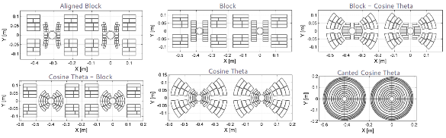
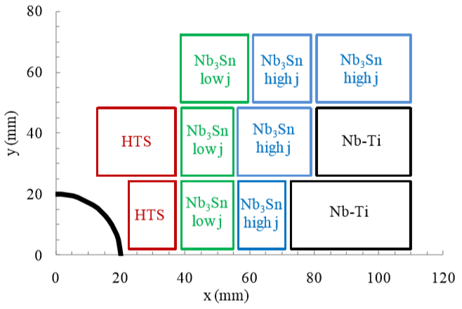
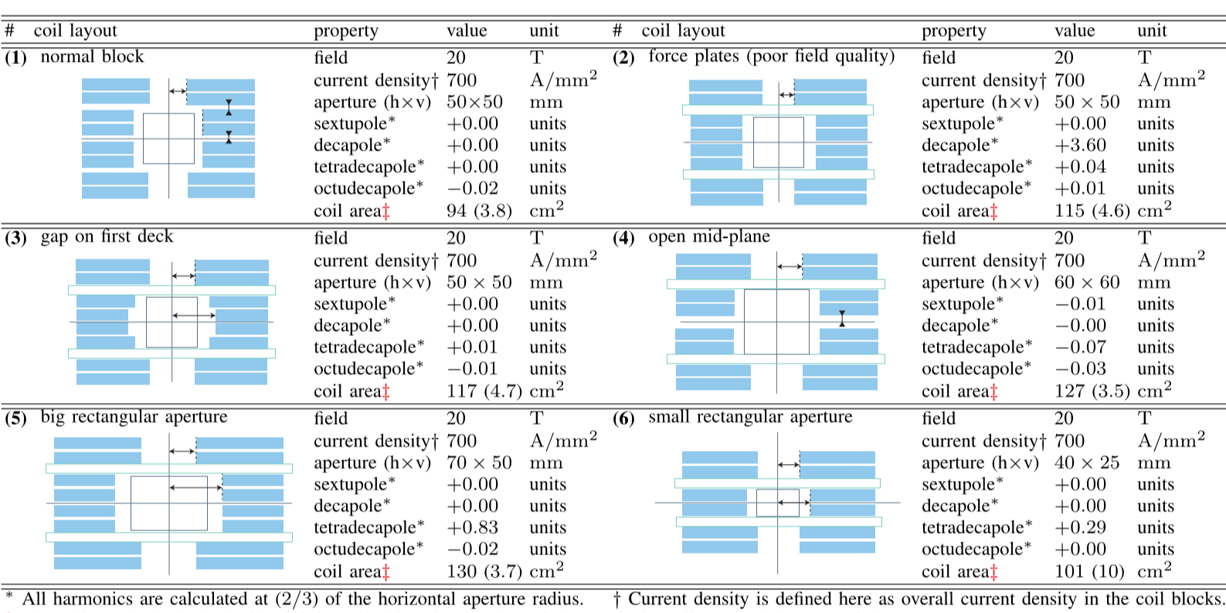
Some references (20 T B_{op})

Slide 10
Outline
General organization of working group
Goals of working group
Design criteria for a 20 T hybrid magnets
Analytical estimates of general dimensions and stresses
Preliminary magnetic analysis of different design options
Areas of technological development
Next plans and conclusions

Slide 11
Design criteria for a 20 T hybrid magnet
Geometrical
  Number of apertures 1
  Free coil aperture 50 mm
Comments
  The common coils will naturally provide 2 apertures
    This will be taken into account on the comparison
  No “strong” constraints on
    Magnet total length (<2 m)
    Magnet straight section (>200 mm)
    Maximum magnet OD
      Reference numbers: 620 mm (FNAL/1.9K), 660 mm (BNL/1.9K), 914 mm (LBNL/4.5K)

Slide 12
Design criteria for a 20 T hybrid magnet
Operational
  Reference temperature 1.9 K
    4.5 K option can be considered: it would impact the ratio of HTS vs LTS
  Operational bore field 20 T
  Margin on the load-line @ 1.9K >= 15 %
    With respect to round strand I_{c} including self field and 5% cabling degradation
  Short sample bore field 23.5 T
  Geometrical harmonics at R_{ref}=17 mm and 20 T: b_{n}<5 for n<10
    Magnet straight section

Slide 13
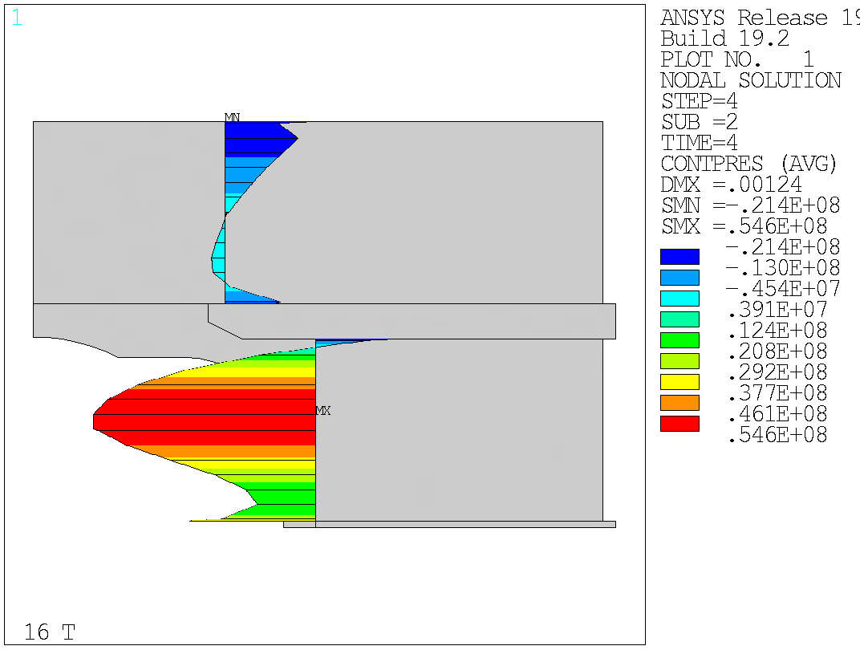
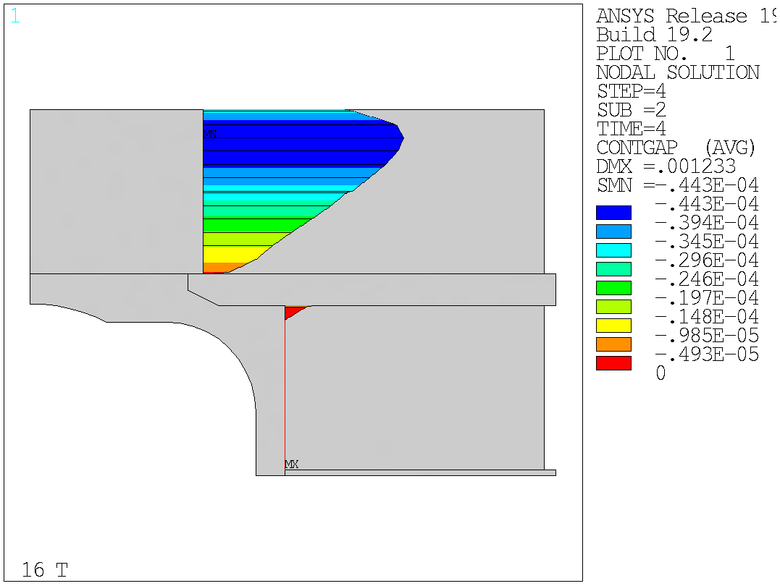
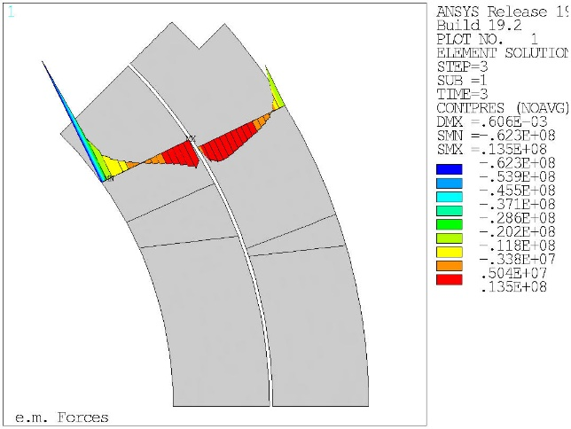
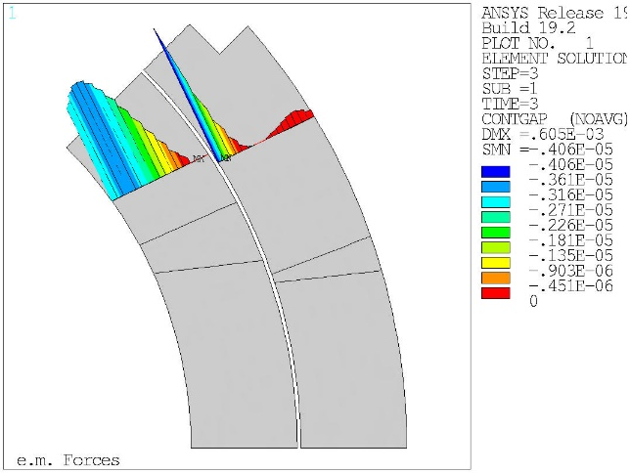
Design criteria for a 20 T hybrid magnet
Operational
  Conditions of coil-pole or rib interfaces at 20 T
    If bonded 20 MPa max. tension
      ‘Corner spikes’ (~1 contact element, 1 mm) neglected
    If separation allowed: Half cable width in contact or < 50 µm max gap
      Conditions may be different depending on the design
Contact pressure
Contact gap
Contact pressure
Contact gap

Slide 14
Design criteria for a 20 T hybrid magnet
Nb₃Sn Conductor and cable
  Strand diameter 0.7-1.2 mm
  Cu:non-Cu ratio 0.8-2.0
  Non-Cu J_{c} round strand with self-field
    12 T, 4.2 K 2980 A/mm2
    15 T, 4.2 K 1640 A/mm2
    16 T, 4.2 K 1250 A/mm2
  RRR (after cabling) >50
  I_{c} degradation due to cabling 5%
  Maximum number of strands in cable 60
  Cable Insulation thickness 0.150 mm

Slide 15
Design criteria for a 20 T hybrid magnet
Nb₃Sn Conductor and cable
  In general, it would be better to stay within already tested parameters (min, max)
Dimension before reaction; In MQXF, assumed expansion during reaction is 4.5 % (th), 1.2 % (w)

Slide 16
Design criteria for a 20 T hybrid magnet
Bi2212 Conductor and cable
  RC5/6 about 20% higher than what is currently “comfortably” produced.
  The wire diameter: from 0.6 mm to 1.5 mm
  Cable width: basically same possibilities as with Nb₃Sn cables

Slide 17
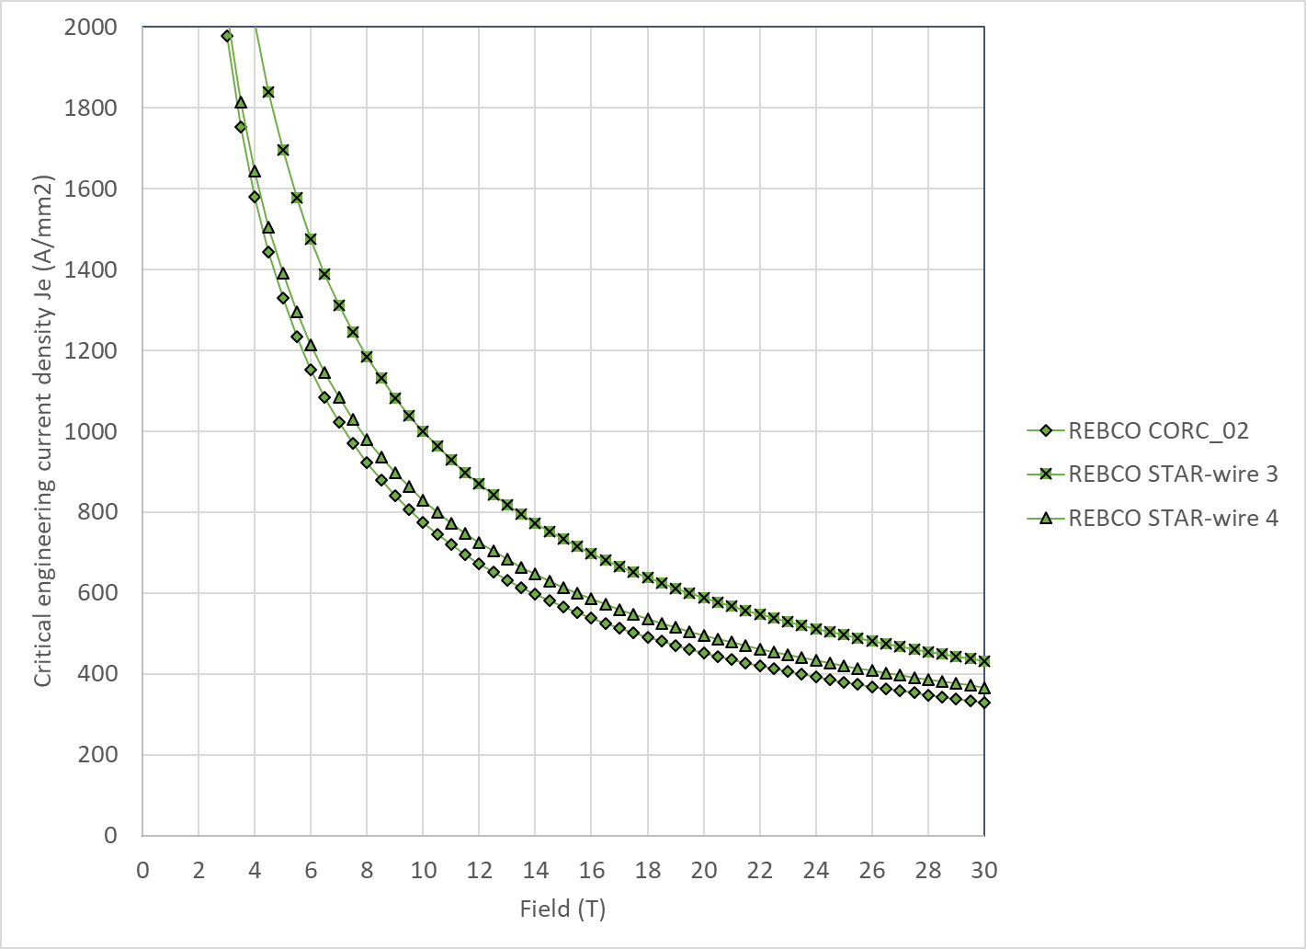
Design criteria for a 20 T hybrid magnet
REBCO Conductor
  We use the following parameterization
    Ic(B, 4.2 K) = 10^( α*log(B)+c)
  Where

Slide 18
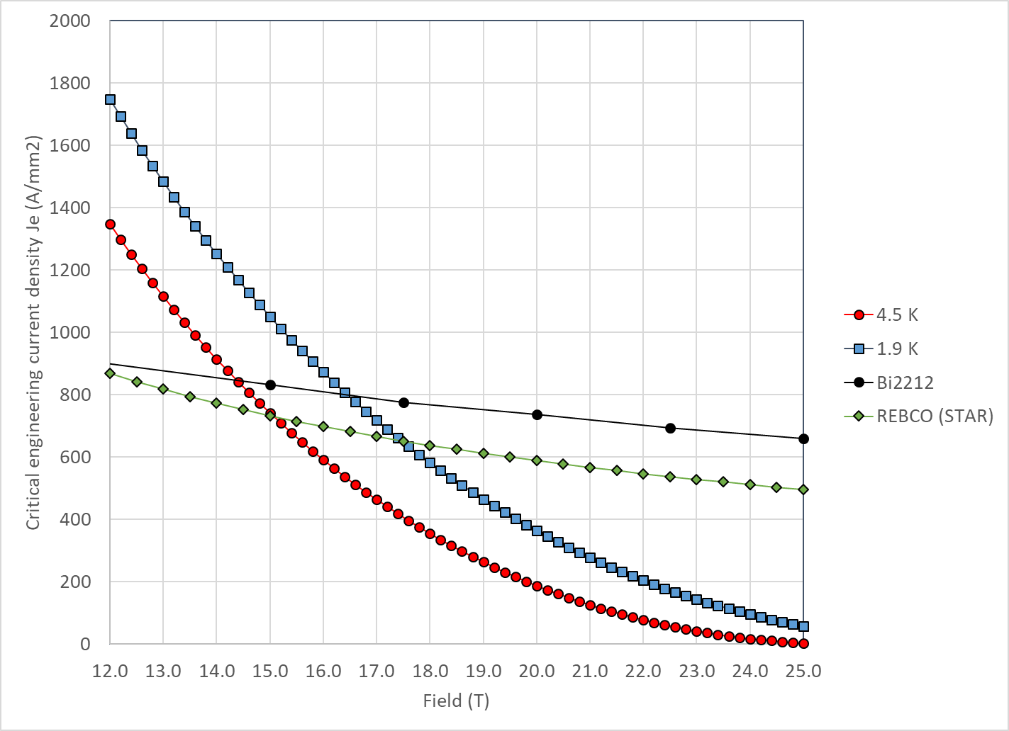
Design criteria for a 20 T hybrid magnet
With properties describe above
  Nb₃Sn and Bi2212 cross at
    14.5 T at 4.2 K
    16.5 T at 1.9 K
  Nb₃Sn and REBCO cross at
    15.0 T at 4.2 K
    17.5 T at 1.9 K

Slide 19
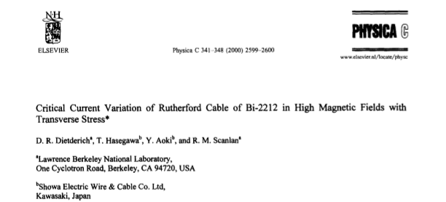
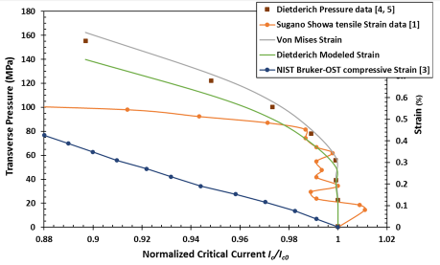
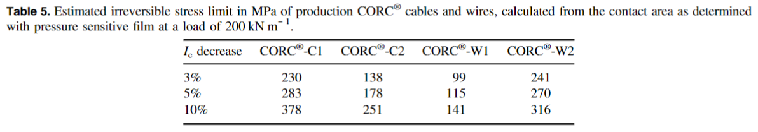
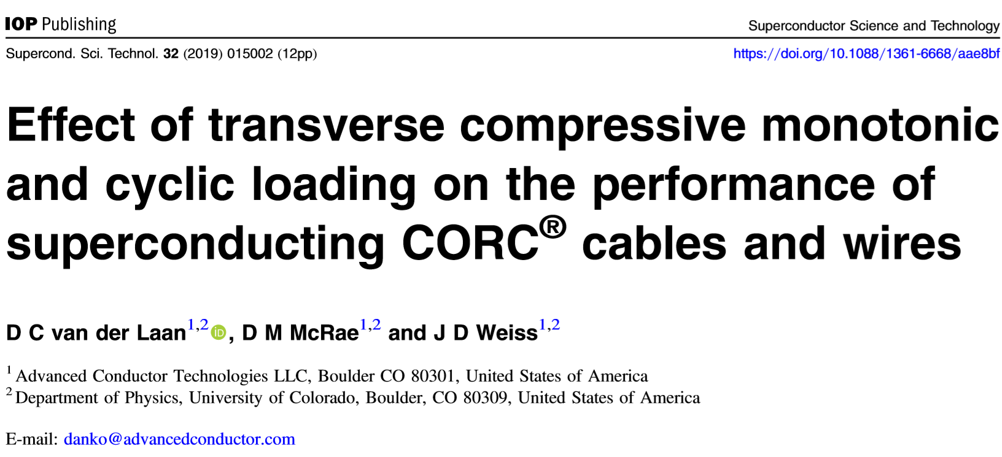
Design criteria for a 20 T hybrid magnet
Stress limits
  Nb₃Sn coil stress <180 (<150) MPa at 1.9 (293) K
  Bi2212 coil stress <120* MPa (293) K
*Lower values found in other publications (review from E. Barzi)
  REBCO CORC coil stress <120-150 MPa (293) K

Slide 20
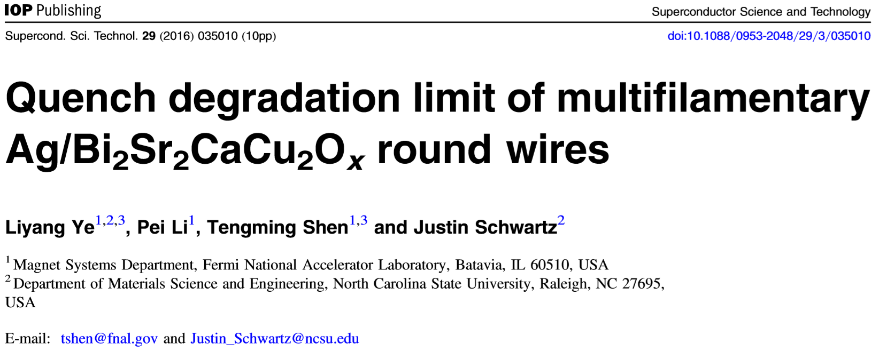
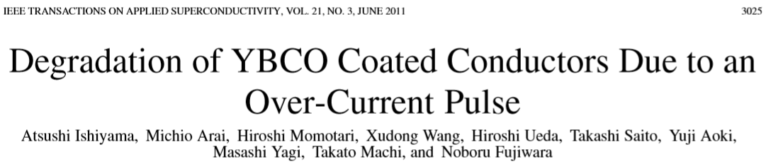
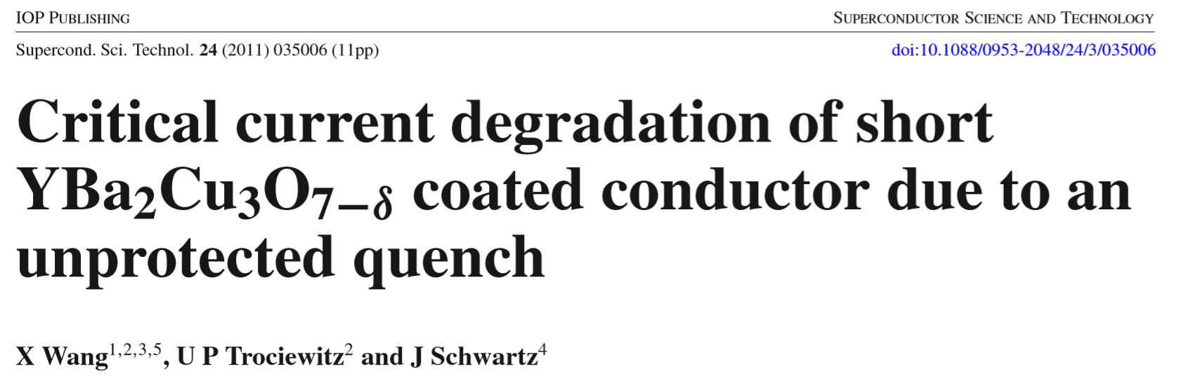
Design criteria for a 20 T hybrid magnet
Quench protection
  Powering in series
  Hot spot temperature
    For all 3 materials, 350 K maximum hot spot temperature appears to be reasonable
  Total time delay 40 ms
  Maximum J in the Cu (Nb₃Sn) 1350 A/mm²
  Maximum voltage to ground @ quench 1.0 kV
  Ground insulation design voltage >5 kV

Slide 21
Outline
General organization of working group
Goals of working group
Design criteria for a 20 T hybrid magnets
Analytical estimates of general dimensions and stresses
Preliminary magnetic analysis of different design options
Areas of technological development
Next plans and conclusions

Slide 22

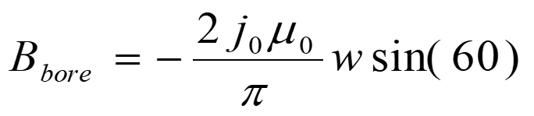
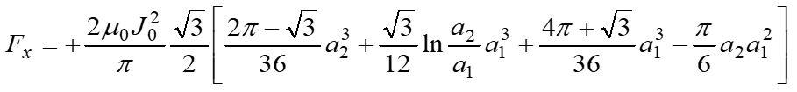
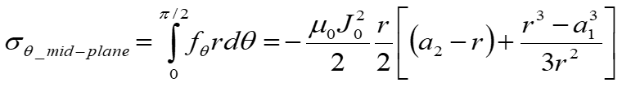
“Sector coil” analytical model
Definitions
  J_{c} = J in superconductor area
  J_{e} = J in strand area
  J_{o} = J in coil area
MQXF/11T cable parameters
  J_{e} = J_{c} * 0.48
  J_{o} = J_{e} * 0.67
  J_{o} = J_{c} * 0.32
No grading
  Same current, same J everywhere
    As if HTS and LTS use the same cable, and are powered in series
Sector coil (60°) with J = J₀ distribution
  No iron
  Constant Jo

Slide 23
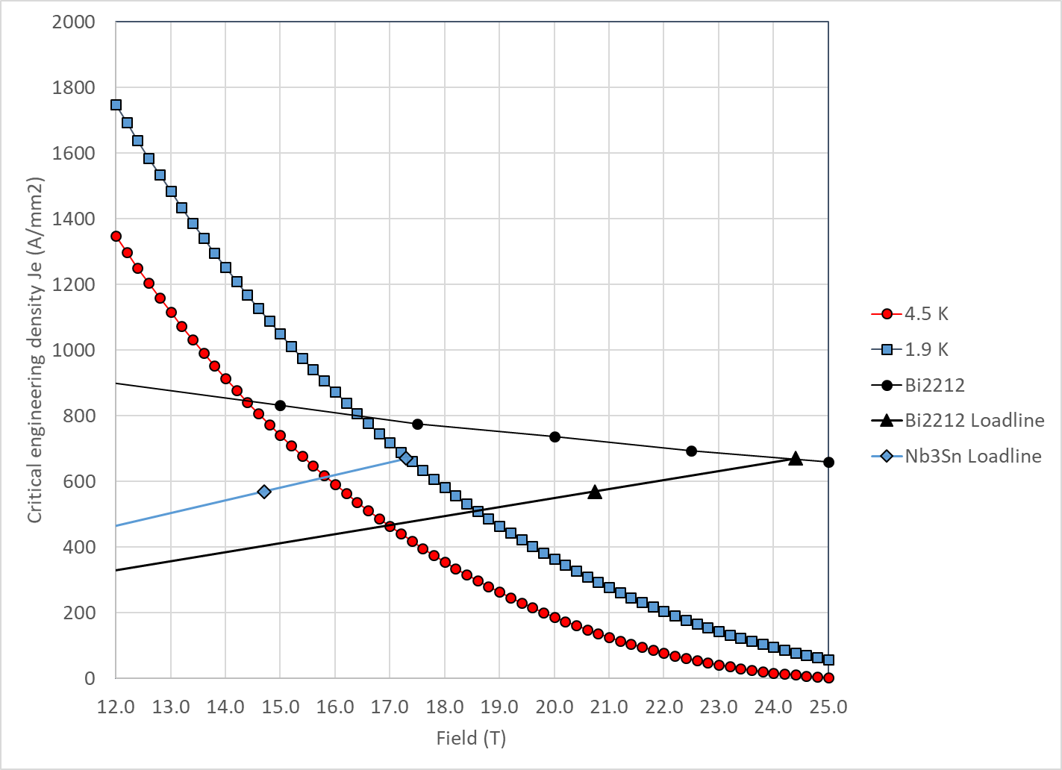
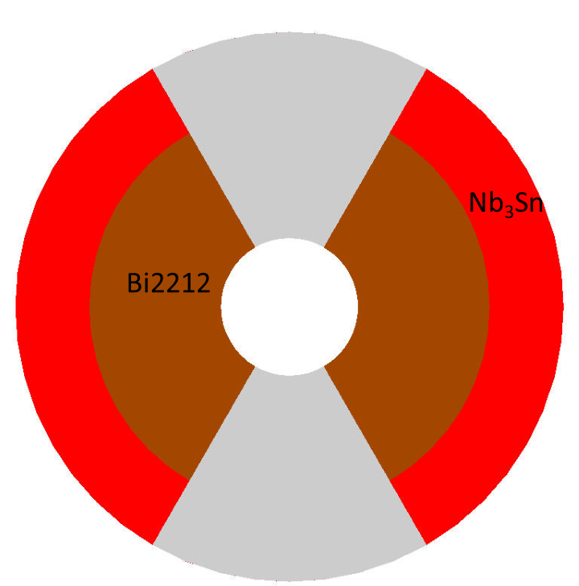
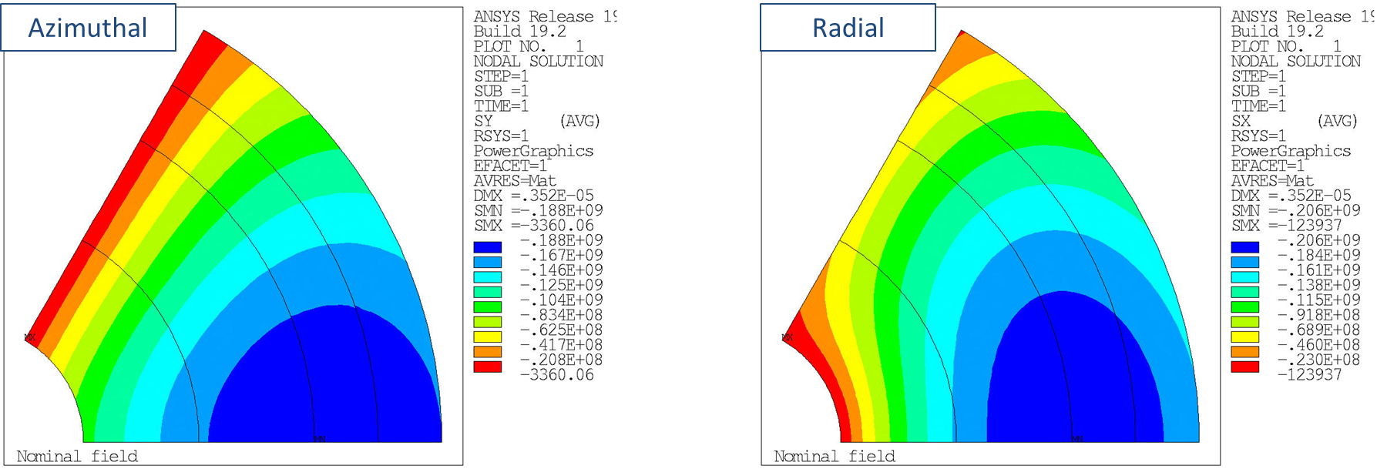
“Sector coil” analytical model
Operation J_{e} → coil size → azimuthal and radial stresses
By J. Stern

Slide 24
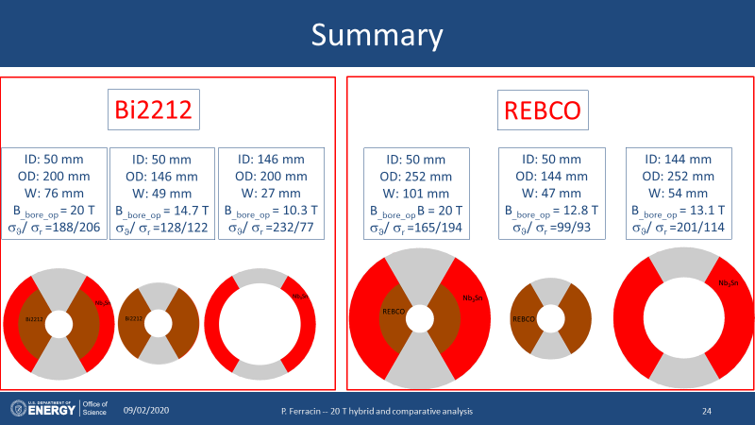
Summary
REBCO hybrid still larger than Bi2212
  Because of a lower J_{e}
    And also with “unrealistic” assumption on J_{o}
We need to build a
  13-14 T HTS magnet (50 mm)
  10-13 T LTS magnet (large bore)
    120 mm seems a good start, but we may need more
In hybrid 20 T, radial stress seems higher than azimuthal
  When tested separately, very high azimuthal stress in LTS

Slide 25
Outline
General organization of working group
Goals of working group
Design criteria for a 20 T hybrid magnets
Analytical estimates of general dimensions and stresses
Preliminary magnetic analysis of different design options
Areas of technological development
Next plans and conclusions

Slide 26
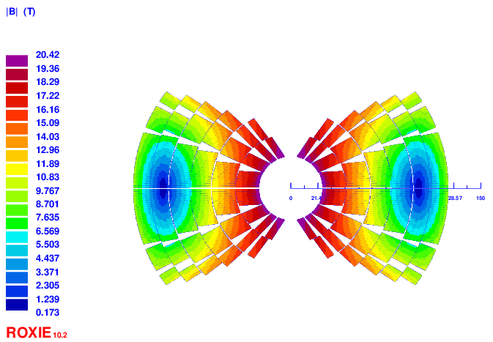
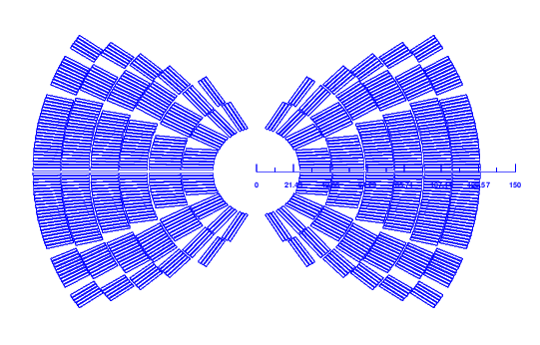
Preliminary magnetic analysis of different design options
By V. Marinozzi
Cos-theta (CT) option
  4 layer HTS, 2 layer LTS
  B_{bore} = 20 T
    14 T from HTS, 6 T from LTS
  Coil width: 105 mm
  Peak field: 20.48 – 15.88 – 12.53 T
  Azim. Lorentz stress 151/142 MPa (LTS/HTS)
  If standalone, i.e. tested separately at 85% of I_{ss}
    16 T HTS magnet, 10 T LTS magnet
LTS
HTS
HTS

Slide 27
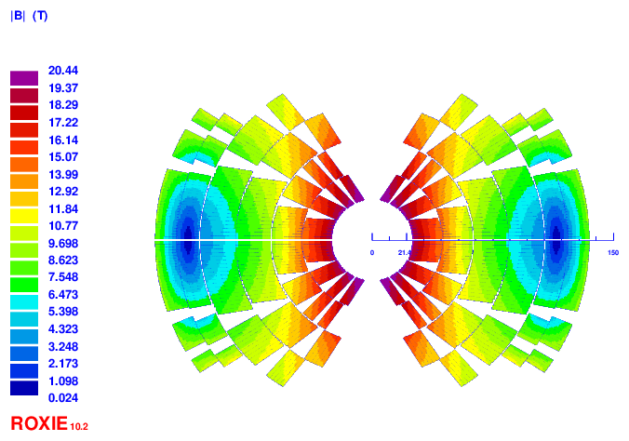
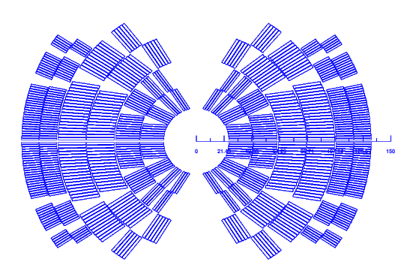
Preliminary magnetic analysis of different design options
By V. Marinozzi
Cos-theta (CT) option
  2 layer HTS, 4 layer LTS
  B_{bore} = 20 T
    8 T from HTS, 12 T from LTS
  Coil width: 110 mm
  Peak field: 20.7 – 15.77 – 11.43 T
  Azim. Lorentz stress 119/162 MPa (LTS/HTS)
  If standalone, i.e. tested separately at 85% of I_{ss}
    10 T HTS magnet, 15 T LTS magnet
LTS
LTS
HTS

Slide 28
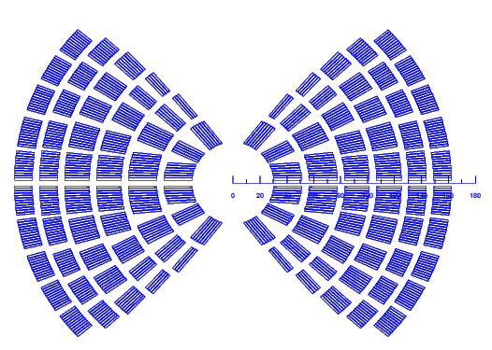
Preliminary magnetic analysis of different design options
Stress management Cos-theta (SMCT) option
  4 layer HTS, 2 layer LTS
  B_{bore} = 20 T
  5 mm spar
  Coil width: 132 mm
  Peak field: 20.54 – 15.39 – 12.78 T
  Stress intercepted
By V. Marinozzi
LTS
LTS
HTS

Slide 29
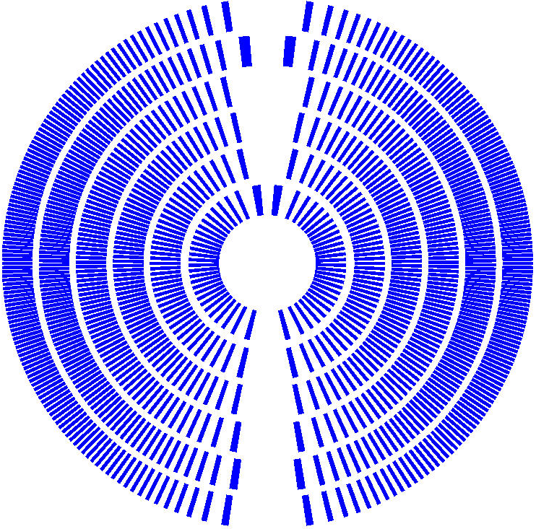
Preliminary magnetic analysis of different design options
By D. Arbelaez and L. Browers
Canted Cos-theta (CCT) option
  4 layer HTS, 2 layer LTS
  B_{bore} = 20 T
  5 mm spar
  Coil width: 139 mm
  Peak field: 21.2 – 17.9 – 14.0 T
  Stress intercepted
LTS
HTS
HTS

Slide 30
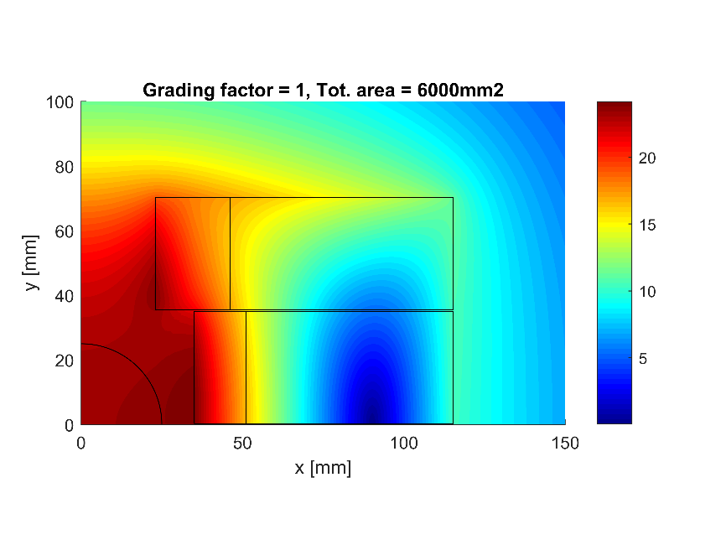
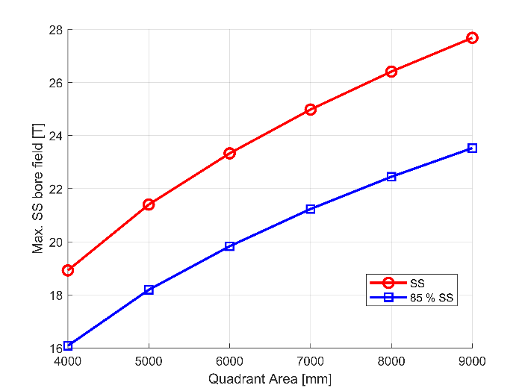
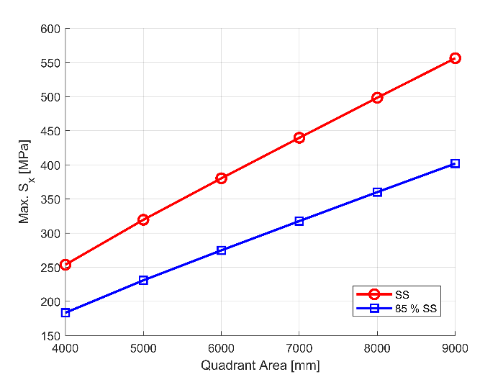
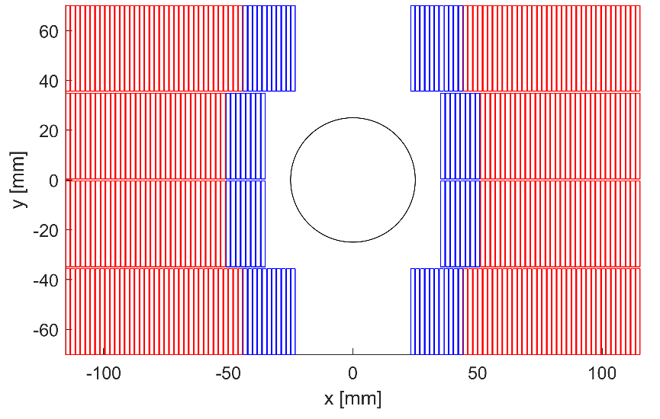
Preliminary magnetic analysis of different design options
By E. Rochepault
Block option
  B₀: 20 T
  Lorentz stress Sx / Sy: 275 MPa / 109 MPa

Slide 31
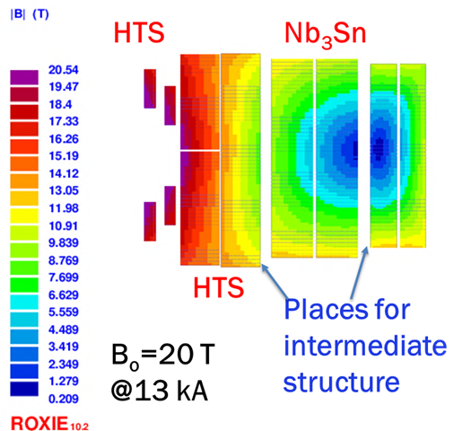
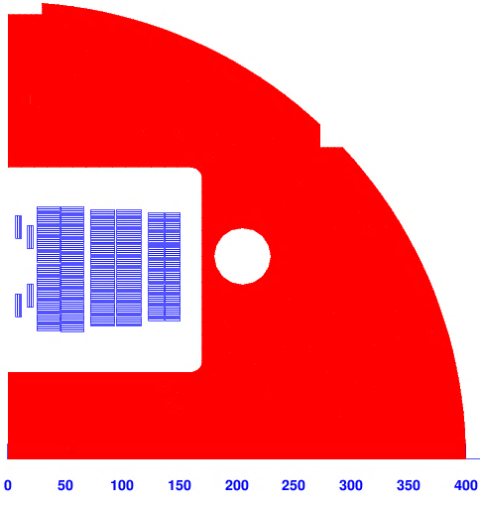
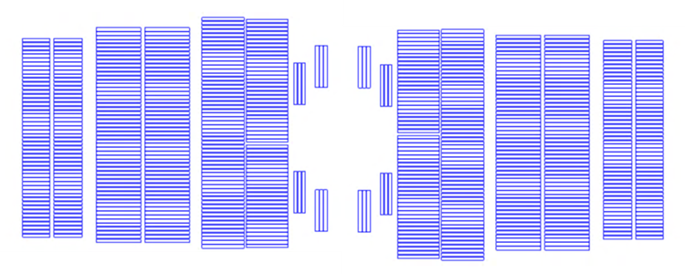
Preliminary magnetic analysis of different design options
Common coil option
  2 layer HTS, 4 layer LTS
  B_{bore} = 20 T
  Stress intercepted horizontally
  “field quality” blocks
By R. Gupta

Slide 32
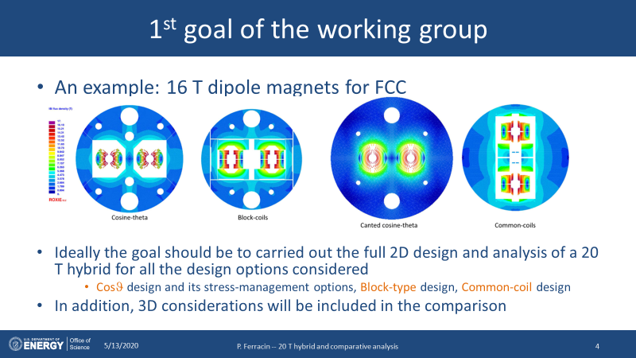
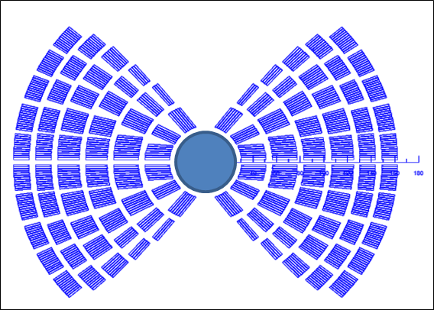
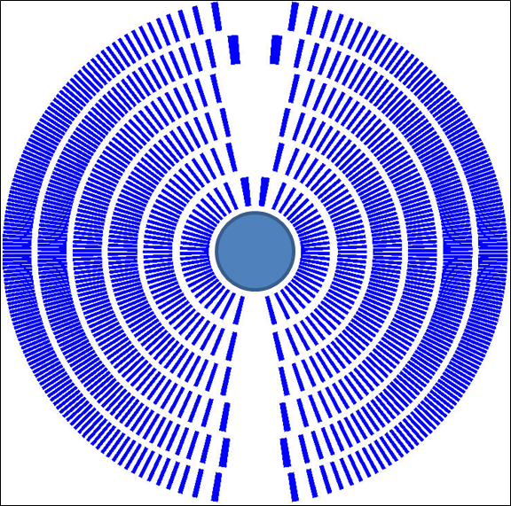
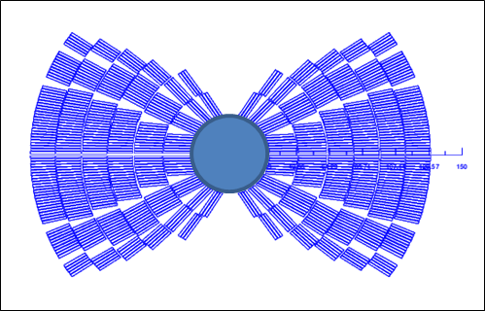
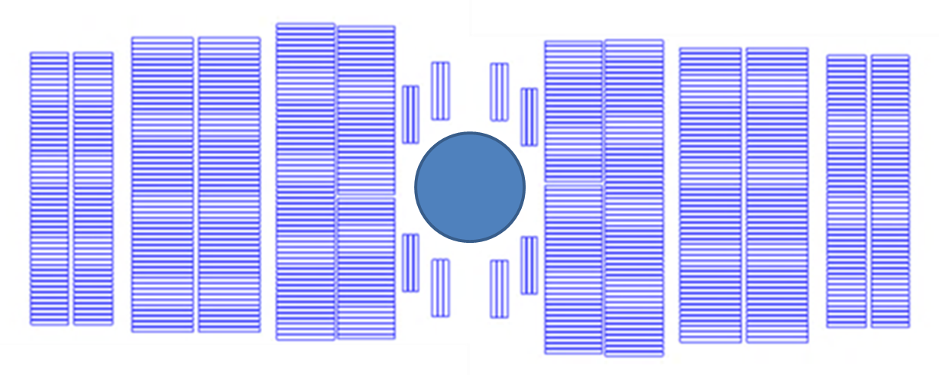
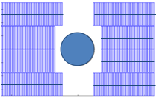
Preliminary magnetic analysis of different design options
Goal of the analysis
  Comparison between different designs, like for FCC →
Designs not comparable yet (not meeting all specs, with and without iron, with and without stress management)
  but getting there…
CT
(no stress manag.)
SMCT
CCT
Block
(no stress manag.)
Common coil
(no stress manag.)

Slide 33
Outline
General organization of working group
Goals of working group
Design criteria for a 20 T hybrid magnets
Analytical estimates of general dimensions and stresses
Preliminary magnetic analysis of different design options
Areas of technological development
Next plans and conclusions

Slide 34
Areas of technological development
Bi2212
  Large cables (cabling degradation) and large coils (heat treatment)
  Better definition of stress limits through measurements
REBCO
  Increase of Je
  Reduction of minimum bending radius
    With current bending radius (and high current requirements)
      Common coil is more compatible (where it is easier to implement large radius)
        Although the “field quality turns” will require some new solutions
      For the other layouts, new design solutions could be investigated (dog bone, clover leaf…)
        Not clear how to do for the CT family
          Although for the CCT one can increase the angle (at the price of efficiency)
    Possible alternative scenario: smaller wires in a multi-wire cable?

Slide 35
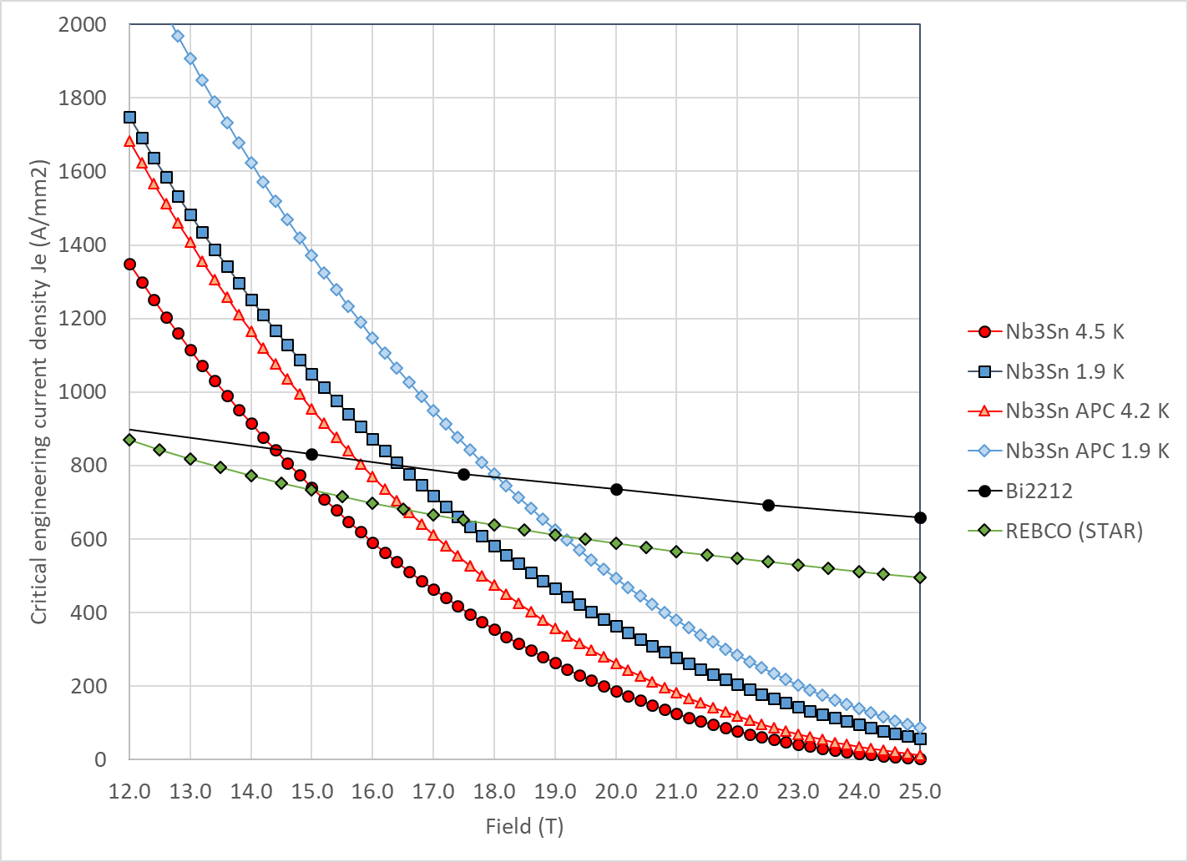
Areas of technological development
Nb₃Sn
  Next generation Nb₃Sn would be extremely beneficial to both for LTS inserts (higher field) and for LTS outserts (smaller coils for 20 T)
    Nb₃Sn and Bi2212 crossing from 16.5 T to 18 T at 1.9 K
APC properties from X. Xu

Slide 36
Areas of technological development
Coil design
  CT-CCT-SMCT
    Stress management, de-bonding, shear, pre-stress….
    Less effective than blocks for HTS-LTS interface
      Only top block in HTS?
    Do we need all the layers with stress management or some can be in CT?
  Block: how to intercept part of horizontal stress
    Something like Tamu stress-managed design
  Common coil: shape of the field quality turns, vertical stress?
  Then
    Is 1.9 K really worth it? Cryogenics cost vs HTS/LTS crossing point
    Is grading really beneficial? Yes smaller coils, but impact on stress and QP
    In general, many coils and layers: integration…interfaces…tolerances…splices

Slide 37
Outline
General organization of working group
Goals of working group
Design criteria for a 20 T hybrid magnets
Analytical estimates of general dimensions and stresses
Preliminary magnetic analysis of different design options
Areas of technological development
Next plans and conclusions

Slide 38
Conclusions and next steps
Goals and design criteria defined
  Aperture, field, margin, stress, QP, and conductor properties
Preliminary magnetic analysis carried out
  5 designs under investigation: CT, SMCT, CCT, block, common-coil
    We try to check both smaller coil (more HTS) and cheaper coil (more LTS) options
    In general, with CCT6/SMCT we are not that far from a good LTS outsert, but we need to aim at >10 T (standalone) for HTS insert
Next steps
  Complete 2D magnetics (to meet all criteria in all designs) and move to mechanical analysis and QP
  Analysis of current hybrids at LBNL, and FNAL and BNL

Slide 39
Appendix

Slide 40


Comparison
V9e
  Peak field HTS: 20.48 T
  Peak field LTS: 15.88 T
  Field with only HTS @ I_{op}: 14.6 T
  Field with only LTS @ I_{op}: 6.5 T
  Field with only HTS @ 85%: 16.3 T
  Field with only LTS @ 85%: 9.9 T
V11:
  Peak field HTS: 20.7 T
  Peak field LTS: 15.77 T
  Field with only HTS @ I_{op}: 8.2 T
  Field with only LTS @ I_{op}: 12.5 T
  Field with only HTS @ 85%: 10.2 T
  Field with only LTS @ 85%: 14.8 T

Slide 41
Preliminary magnetic analysis of different design options
By V. Marinozzi
Cos-theta (CT) option
  4 layer HTS, 2 layer LTS
  Strands: 0.8 mm, 40 – 35 – 36
  Cable width: 18.35 – 16.06 – 15.96 mm
  Coil width: 105 mm
  Current: 10920 A
  Peak field: 20.48 – 15.88 – 12.53 T
  Margin: 82.5 – 82.8 – 74.5 %
  J_{cu} on LTS: 1206 A/mm²
  Azim. Lorentz stress 151/142 MPa (LTS/HTS)
LTS
HTS
HTS

Slide 42
Preliminary magnetic analysis of different design options
By V. Marinozzi
Cos-theta (CT) option
  2 layer HTS, 4 layer LTS
  Strands: 0.8 – 1.1 – 0.8 mm, 40-35-30
  Cable width: 18.35 – 21.3 – 13.3 mm
  Stabilizer/Superconductor: 3 – 1 – 1
  Coil width: 110 mm
  Current: 11650 A
  Peak field: 20.7 – 15.77 – 11.43 T
  Margin: 86.2 – 83.3 – 73.6 %
  J_{cu} on LTS: 700 – 1545 A/mm²
  Azim. Lorentz stress 119/162 MPa (LTS/HTS)
LTS
LTS
HTS

Slide 43
Design criteria for a 20 T hybrid magnet
Previous work within MDP on a 16 T dipole magnet
  GianLuca Sabbi, Alexander Zlobin, MDP General meeting – May 17, 2017
https://conferences.lbl.gov/event/82/

Slide 44
Field in at 20 T hybrid dipole magnet
B_{bore_op} = 20 T with load-line margin of 15% → 85% of I_{ss}
  Same load-line margin for HTS and LTS
B_{peak_op} = 20.8 T
  Assumption: 4% increase B_{bore} to B_{peak}
B_{bore_ss} = 23.5 T
B_{peak_ss} = 24.4 T
  Assumption: 4% increase B_{bore} to B_{peak}

Slide 45
20 T Bi2212-Nb₃Sn hybrid
Bi2212
  At short sample
    B_{p_ss} = 24.4 T
    J_{e_ss} = 670 A/mm2
    J_{o_ss} = 450 A/mm²
  So, at 85% of short sample
    B_{p_op} = 20.8 T
    J_{e_op} = 570 A/mm2
    J_{o_op} = 382 A/mm²

Slide 46
20 T Bi2212-Nb₃Sn hybrid
Nb₃Sn
  At short sample
    B_{p_ss} = 17.3 T
    J_{e_ss} = 670 A/mm2
    J_{o_ss} = 450 A/mm²
  So, at 85% of short sample
    B_{p_op} = 14.7 T
    J_{e_op} = 570 A/mm2
    J_{o_op} = 382 A/mm²

Slide 47

20 T Bi2212-Nb₃Sn hybrid
50 mm aperture
Under the previous assumption (sector coil, constant Jo everywhere, no stress management, no iron)
  ID Nb₃Sn = 146 mm
  OD Nb₃Sn = 200 mm
  76 m total coil thickness
    49 mm thick Bi2212 coil
    27 mm thick Nb₃Sn coil
  Area Bi2212: 2540 mm² (1 quadrant)
  Area Nb₃Sn: 2470 mm² (1 quadrant)
  Stored energy: 2.86 MJ/m (4 quadrants)
20 T = 13 T + 7 T
Nb₃Sn
Bi2212

Slide 48


20 T Bi2212-Nb₃Sn hybrid
Bi2212 “only”
Bi2212
  At short sample
    B_{p_ss} = 18.4 T
    B_{bore_ss} = 17.4 T
    J_{e_ss} = 769 A/mm2
    J_{o_ss} = 515 A/mm²
  So, at 85% of short sample
    B_{p_op} = 15.6 T
    B_{bore_op} = 14.7 T
    J_{e_op} = 653 A/mm2
    J_{o_op} = 438 A/mm²

Slide 49

20 T Bi2212-Nb3Sn hybrid
Nb3Sn “only”
Nb3Sn
  At short sample
    B_{p_ss} = 15.3 T
    B_{bore_ss} = 12.1 T
    J_{e_ss} = 985 A/mm2
    J_{o_ss} = 660 A/mm²
  So, at 85% of short sample
    B_{p_op} = 13.0 T
    B_{bore_op} = 10.3 T
    J_{e_op} = 837 A/mm2
    J_{o_op} = 561 A/mm²

Slide 50

20 T REBCO-Nb₃Sn hybrid
REBCO
  At short sample
    B_{p_ss} = 24.4 T
    J_{e_ss} = 504 A/mm2
    J_{o_ss} = 338 A/mm²
  So, at 85% of short sample
    B_{p_op} = 20.8 T
    J_{e_op} = 429 A/mm2
    J_{o_op} = 287 A/mm²

Slide 51
20 T REBCO-Nb₃Sn hybrid
Nb₃Sn
  At short sample
    B_{p_ss} = 18.7 T
    J_{e_ss} = 504 A/mm2
    J_{o_ss} = 338 A/mm²
  So, at 85% of short sample
    B_{p_op} = 15.9 T
    J_{e_op} = 429 A/mm2
    J_{o_op} = 287 A/mm²

Slide 52

20 T REBCO-Nb₃Sn hybrid
50 mm aperture
Under the previous assumption (sector coil, constant Jo everywhere, no stress management, no iron)
And also, from CORC/STAR Je to Jo like in MQXF → “Rutherford cable with CORC/START wires” (see later)
  ID Nb₃Sn = 144 mm
  OD Nb₃Sn = 252 mm
  101 m total coil thickness
    47 mm thick REBCO coil
    54 mm thick Nb₃Sn coil
  Area Bi2212: 2387 mm² (1 quadrant)
  Area Nb₃Sn: 5532 mm² (1 quadrant)
  Stored energy: 3.92 MJ/m (4 quadrants)
20 T = 9 T + 11 T
Nb₃Sn
REBCO

Slide 53



Size comparison
LHC MQXF FRESCA2 ????

Slide 54

CT- SMCT options
Summary

Slide 55


20 T REBCO-Nb₃Sn hybrid
REBCO “only”
REBCO
  At short sample
    B_{p_ss} = 16.0 T
    B_{bore_ss} = 15.1 T
    J_{e_ss} = 697 A/mm2
    J_{o_ss} = 467 A/mm²
  So, at 85% of short sample
    B_{p_op} = 13.6 T
    B_{bore_op} = 12.8 T
    J_{e_op} = 592 A/mm2
    J_{o_op} = 397 A/mm²

Slide 56

20 T REBCO-Nb₃Sn hybrid
Nb₃Sn “only”
Nb₃Sn
  At short sample
    B_{p_ss} = 17.7 T
    B_{bore_ss} = 15.4 T
    J_{e_ss} = 622 A/mm2
    J_{o_ss} = 417 A/mm²
  So, at 85% of short sample
    B_{p_op} = 15.0 T
    B_{bore_op} = 13.1 T
    J_{e_op} = 529 A/mm2
    J_{o_op} = 354 A/mm²

