Slide 1


Status of CCT at PSI
D. Arbelaez (LBNL), B. Auchmann (CERN/PSI), A. Brem (PSI), L. Brouwer (LBNL), S. Caspi (LBNL), M. Daly (PSI), M. Dhallé (UTwente),
C. Hug (PSI), A. Kario (UTwente), G. Montenero (PSI), S. Otten (UTwente), S. Sidorov (PSI), H. ten Kate (UTwente), D. Tommasini (CERN)
1. March, 2021, US MDP Annual Meeting
Work supported by the Swiss State Secretariat for Education, Research and Innovation SERI.

Slide 2
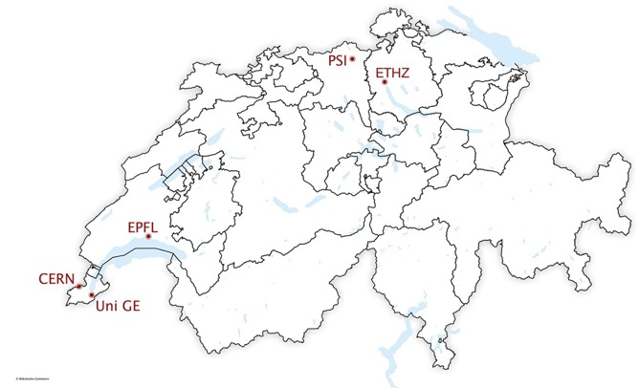
Overview
CHART1 FCC Conceptual Design and CD1
CHART2 MagDev Goals
BOX Program
Summary
MagDev

Slide 3
Overview
CHART1 FCC Conceptual Design and CD1
CHART2 MagDev Goals
BOX Program
Summary
MagDev

Slide 4
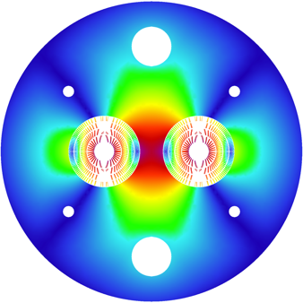
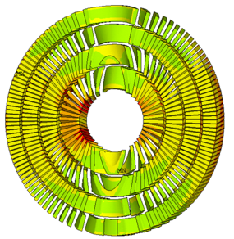
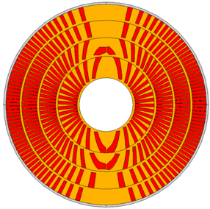
CHART1 Goals
CHART1 goals (mid-2016 to mid-2019) :
  the design of an optimised 16 T Canted Cosine Theta (CCT) dipole magnet,
  as an option for the FCC hadron collider main magnet;
  the development (design and prototype) of a high-field dipole
  magnet with CCT technology; and
[B. Auchmann et al., Electromechanical Design of a 16-T CCT Twin-Aperture Dipole for FCC, IEEE Trans. on Appl. SC 28 (April, 2018) no. 3.]
[M. Benedikt et al., FCC Conceptual Design Report, Vol. 3 – The Hadron Collider (FCC-hh), pp. 50-52, submitted to Eur. Phys. J. ST, (December 2018).]

Slide 5
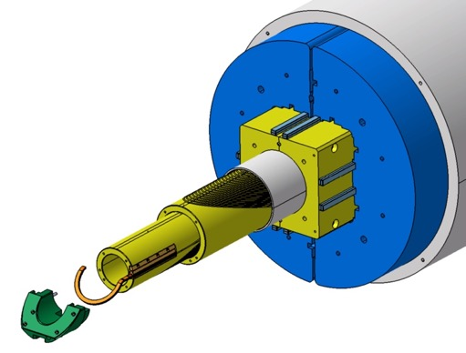
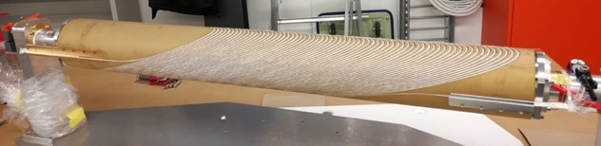
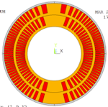
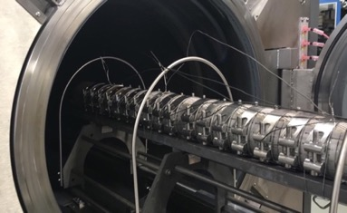
CHART1 Goals
CHART1 goals (mid-2016 to mid-2019):
  the design of an optimised 16 T Canted Cosine Theta (CCT) dipole magnet,
  as an option for the FCC hadron collider main magnet;
  the development (design and prototype) of a high-field dipole
  magnet with CCT technology; and
[G. Montenero et al., Coil Manufacturing Process of the First 1-m-Long Canted-Cosine-Theta (CCT) Model Magnet at PSI, IEEE Trans. on App. SC., Vol 29(5), 2019.]
[G. Montenero et al., Mechanical Structure for the PSI Canted-Cosine-Theta (CCT) Magnet Program, IEEE Trans. on Appl. SC., Vol 28(3), 2018.]

Slide 6
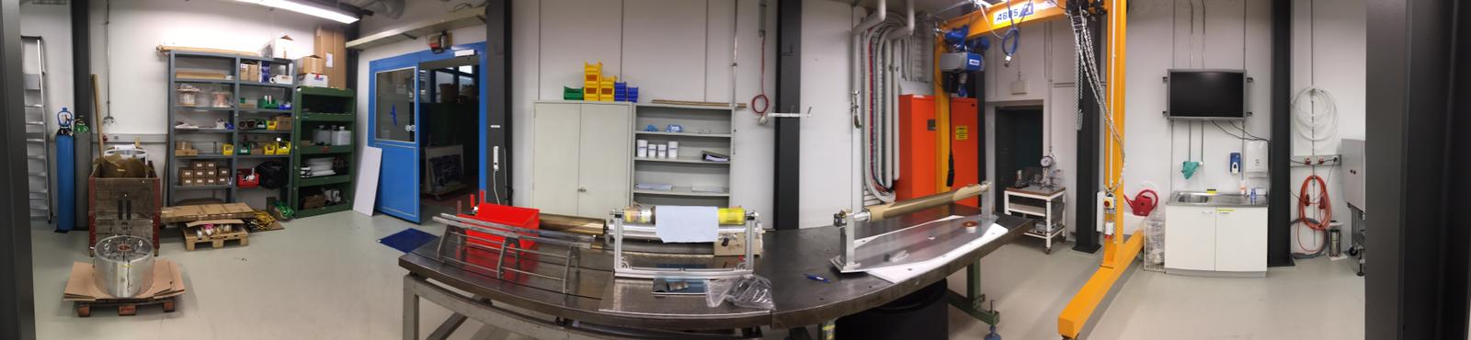
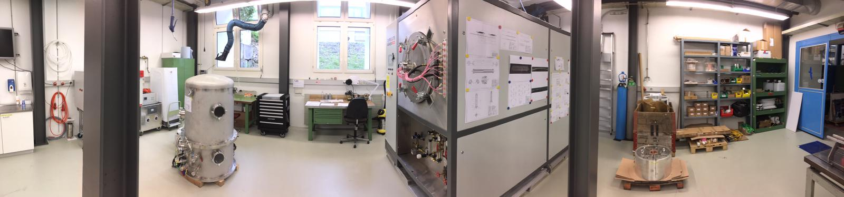
CHART1 MagDev Lab
90 m² laboratory refurbished, equipped, commissioned for construction of CD1.
Production-readiness review (http://indico.psi.ch/event/cd1prr).
Portal crane
Storage
Winding table
4-m winding/instrum/assembly bench
Vacuum Impregnation
Coil reaction

Slide 7
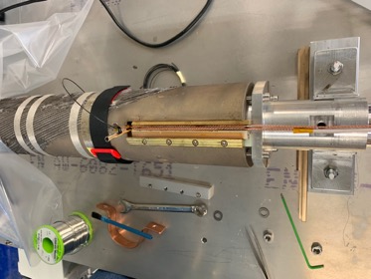
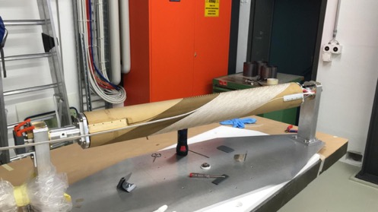
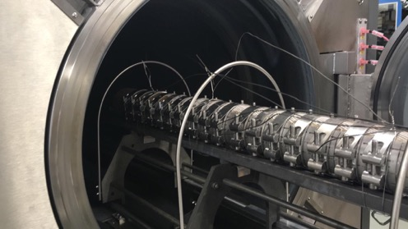
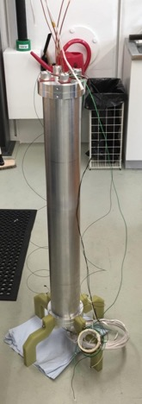
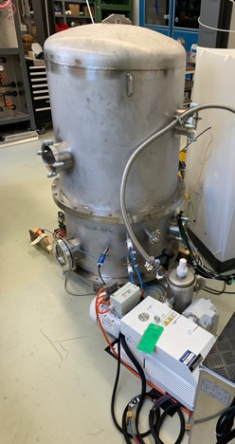
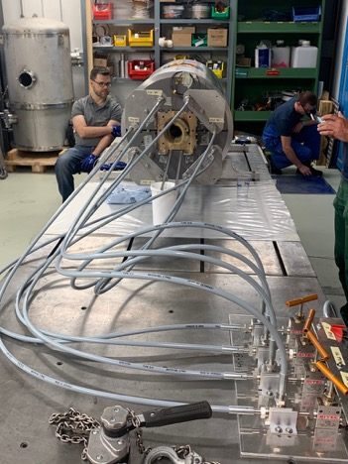
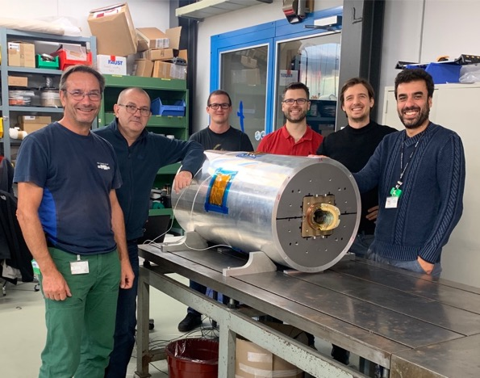
CD1 Construction

Slide 8
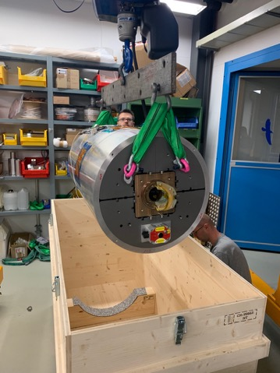
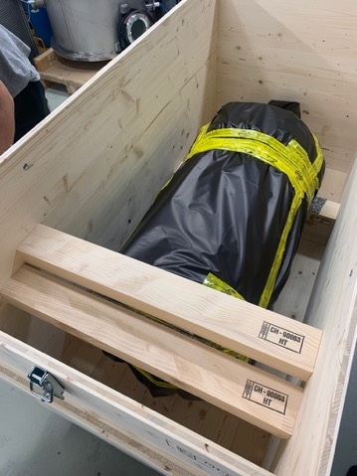
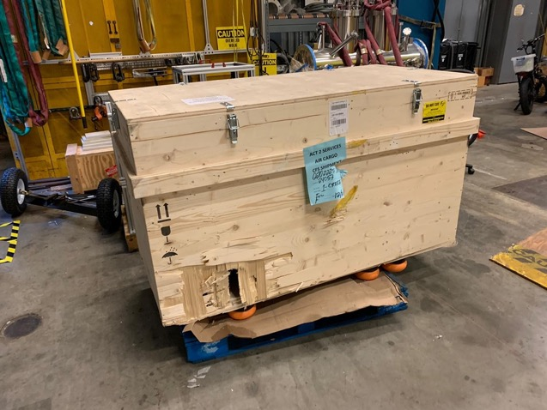
Shipping Odyssey
CD1 construction was finished in Oct. 2019.
The magnet arrived (after problems in transit) in Feb. 2020.

Slide 9

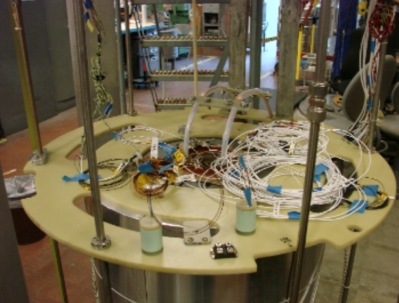
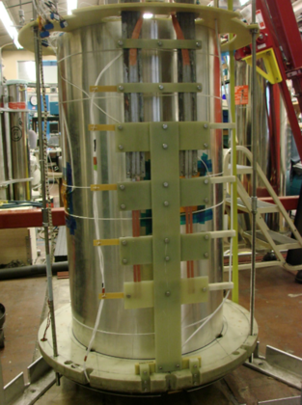
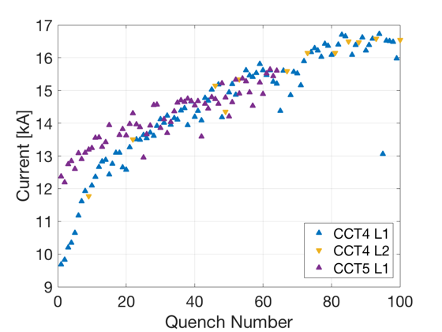
CD1 in Berkeley
The test preparation was interrupted by COVID 19 and resumed in Aug. 2020.
Magnet test started in Sept. 2020 but interrupted by cryo problem.
Max. current after 2 quenches: 11.1 kA or 62.5% of short sample, 6 T in the bore.
PSI has built a magnet (no more and no less can be said at this stage).
LBNL has provided technology transfer, and support, as well as test and -preparation. We cannot thank the LBNL team enough for their generous support and collaboration.
CD1
Courtesy D. Arbelaez, LBNL.

Slide 10
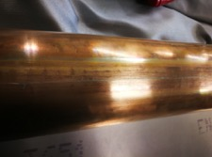
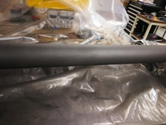
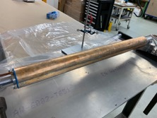
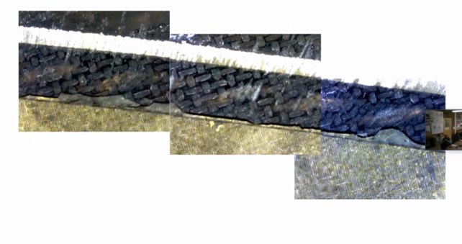
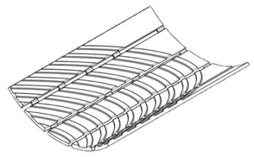
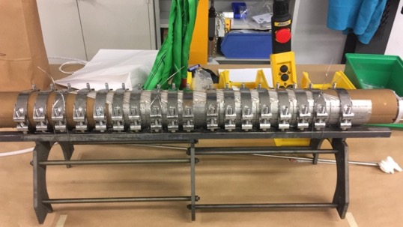
Challenges Identified on CD1
 | CD1 | CCT5
ID | 63.6 mm | 90 mm
Spar | 3/2 mm | 7.4/3 mm
Layer interface | Sliding plane | Bend & Shim
Mechanical structure | Bladder & Key | Al shell
Resin | FSU Mix 61 | FSU Mix 61
CCT-inherent technological challenges:
  bonding of cable in winding channels.
  reliable insulation.
FCC-parameter specific challenges:
  winding and annealing on small diameter.
  plastic deformation of thin mandrel
  at 665ºC.
[Cable-channel delamination in CCT5 after testing. Photo courtesy of LBNL]

Slide 11
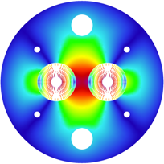
CCT4FCC Pros and Cons
Design:
  Mechanical support of each turn
  → reduced coil stress and avoidance of stress-induced degradation.
  Easy field quality (on paper).
  Ideally suited for LTS/HTS hybrid magnets due to easy stacking of heterogeneous layers.
  Simpler external mechanical structure → more iron between the apertures and better magnetic separation → less cross-talk.
  Hope to fix training: getting one turn “right”, the entire magnet would work; no discontinuities towards the end regions
Fabrication:
  Simple and safe coil-manufacturing process; little tooling needed; coil always protected by former.
Instrumentation and protection:
  Efficient CLIQ protection as every turn is a high-field turn.
  Co-winding of instrumentation (fibers, wires, etc.) is supposedly easy.
Design:
  Every turn must be glued to metal surfaces; delamination would preclude good performance.
  Reduced efficiency by winding angle, rib thickness, and spar thickness.
  Check FQ variation along z-axis due to lack of control on turn position.
  Some axial strain on cable in every turn.
  No radial pre-compression possible.
Fabrication:
  Tricky winding on small ID with wide cable.
  Difficult to obtain reliable insulation.
  Difficult to keep cable in groove on small IDs.
  Interplay between former and cable during reaction.
Instrumentation and protection
  No heater protection possible.
Scaleup:
  Involved former manufacturing; cost and time consuming; difficult to scale to 15 m.
  Difficult assembly for long magnets – assembly gaps reduce performance.

Slide 12
Overview
CHART1 FCC Conceptual Design and CD1
CHART2 MagDev Goals
BOX Program
Summary
MagDev

Slide 13
CHART MagDev Embedded Timeline
2020
2021
2022
2023
2024
2025
2026
2027
ESPP Update
ESPP Update
CHART1
CHART2
CHART3
Infrastructure
Furnace, VI
MagDev Lab, CF Test Station Upgrade
Welding Press
Improved Testing
Enabling Technologies
Resins and constitutive modeling
Sizing, Curing, Coil composite analysis
Interfaces Bonding, Sliding
LTS Magnt R&D
Processes
CD1
BOX Program
SM Collaboration US-MDP
HFM Concept Study
Tech. Coil
Tech. Coil
Tech. Coil
16 T Technology Program
Subscale sample manufacturing
HTS Magnt R&D
SuperBend Technology Demo
HFM CableTech
20 T Technology Program
HTS Feasibility Study

Slide 14
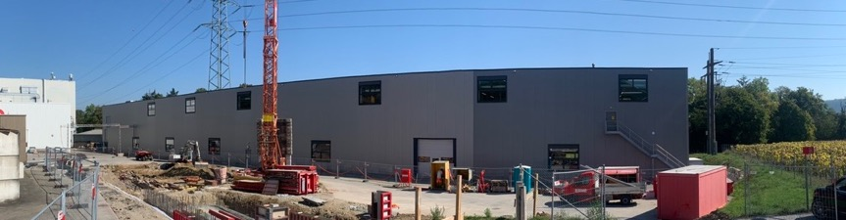
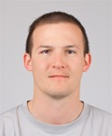

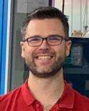
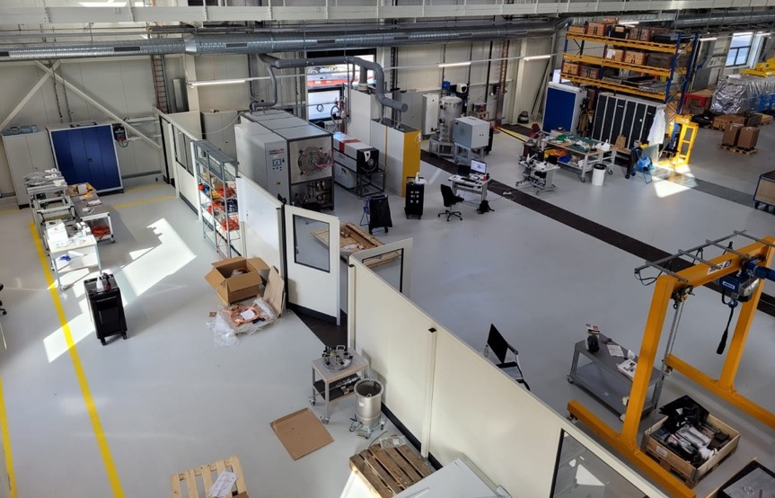
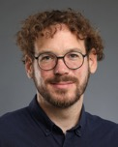
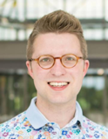

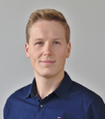
MagDev Laboratory and Team
Christoph Hug
Technician
Michael Daly
LTS, BOX
Heat Treatment
André Brem
Materials
Impregnation
HTS Winding
Jaap Kosse
REBCO
Assembly, Loading, Metrology
Dariusz Pullikowksi
LTS, starting June
LTS Winding

Slide 15
Overview
CHART1 FCC Conceptual Design and CD1
CHART2 MagDev Goals
BOX Program
Summary
MagDev

Slide 16
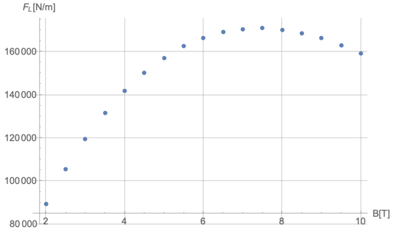
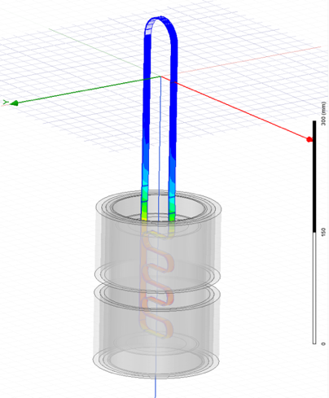

BOX Concept
MagDev1 conceived the below
BOnding eXperiment (BOX) to test
technological solutions to the bonding problem.
University of Twente tests the BOX samples with a
SC transformer in up to 11 T background field.
For the CCT cable, the maximum pull-out force is
reached with 7.5 T background field.
Courtesy M. Daly et al.

Slide 17

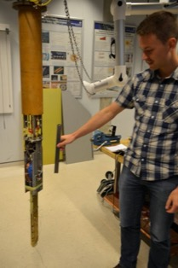
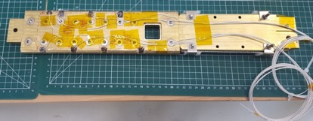
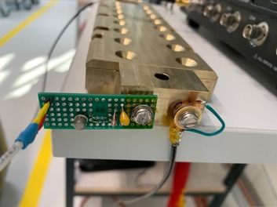

BOX1 & 2
BOX1 mounted
on SC transformer
BOX1 and BOX2 were produced at PSI and tested U-Twente
as a proof of concept and baseline for future improvements.
Acoustic sensors with cryogenic pre-amplifiers have been built and successfully deployed at PSI following LBNL design with
support from Maxim – many thanks!
The BOX is a true fast-turnaround R&D platform:
  Material cost per BOX is < 1 kCHF, and test cost is ~ 5 kCHF.
  Manufacturing of a standard BOX takes ~ 2 weeks.
    More innovative BOXes require process R&D.
BOX1
Accoustic sensors
with (left) and
without (right)
cryoamplyfier.
BOX2
Courtesy M. Daly, C. Hug, A Kario, S. Otten, et al.

Slide 18
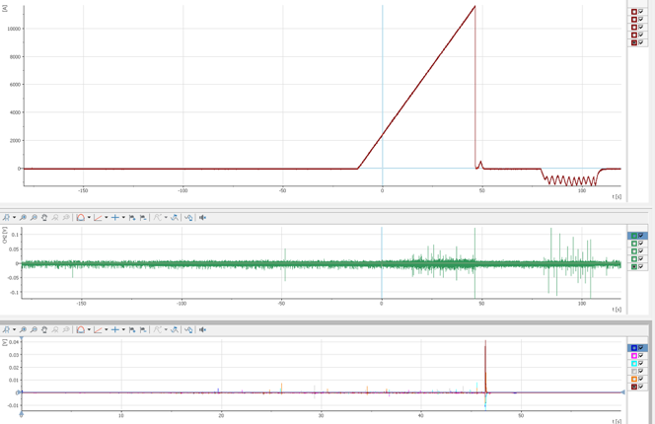
BOX Powering
Powering and accoustic signals during a typical test.
Current ramp-up
(200 A/s)
Quench !
Current ramp
Current discharge
Primary ramp-down + cool down +
]preparation for next ramp-up (10mins)
Acoustics
Vtaps
Courtesy M. Daly, C. Hug, A Kario, S. Otten, et al.

Slide 19
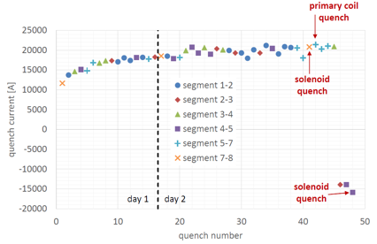
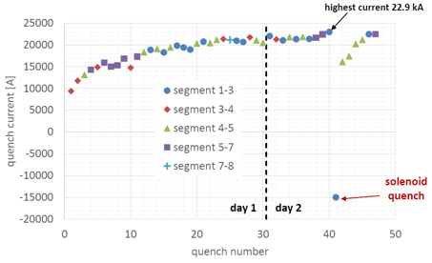
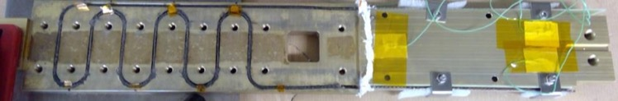
BOX1 & 2 Results
Consistent training in BOXes 1 and 2.
All sample segments see quenches. No quenches in leads.
BOX 1
BOX 2
Vtap flags
Magnetic Field
8
6
4
2
Current direction
AE Sensor
7
5
3
1
Courtesy M. Daly, C. Hug, A Kario, S. Otten, et al.

Slide 20

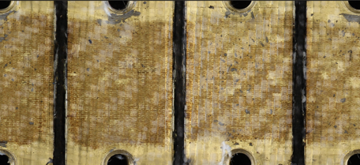
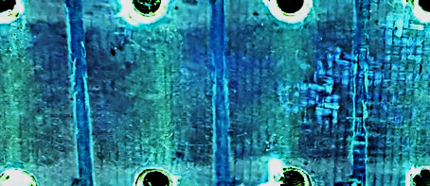
BOX1 Post Mortem
Initial microscopy and dye penetrant test appears to
confirm debonding and cracking as main causes for quenches.
Additional analyses are under way.
[Cable-channel delamination in CCT5 after
testing. Photo courtesy of D. Arbelaez]
Courtesy M. Daly, C. Hug, et al.

Slide 21
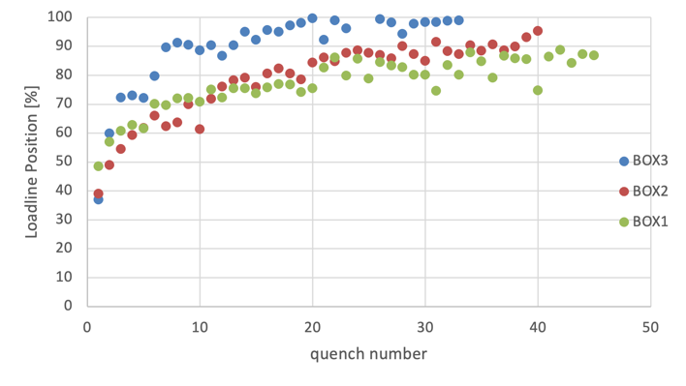
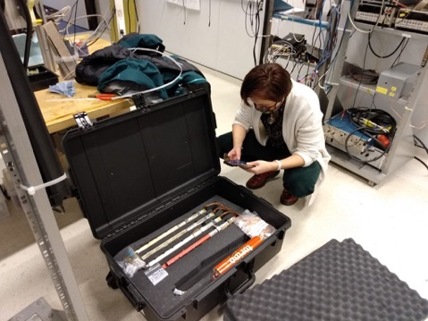
BOX3 and Outlook
BOX3 is a ”cleaner” version of BOX2
  sandblasted channel walls, ultrasound
  cleaned cable (following FSU advice),
  and air+heat cleaned glass insulation layer.
Performance to 90% of loadline was
much improved.
BOX 3 recorded V-I transitions at
background fields of 7.5 T and 10 T.
BOXes at uTwente, ready for testing:
  anodized-Al, CTD101K Nb-Ti (MQM cable)
  Shlomo BOX (non-impregnated NB₃Sn)
  Paraphine wax impregnated NB₃Sn.
Next BOXes in the pipline:
  anodized-Al, MY750 Nb-Ti (MQM cable).
  anodized-Al, Stycast Nb-Ti (filling tests under way).
  Alumina-coated bear-cable NB₃Sn with Stycast
  or MY750 (filling and coating tests under way).
  Ultimate cleaning version of BOX1-3. (studies for
  O₂ + heat cleaning, acid or base cleaning under way).
  Mullite+TiO slurry + Mix61 for a pre-filled system
  (thanks for Tengming for providing material).
BOXes 3-6 arrive arrive at uTwente.
Courtesy of S. Otten and A. Kario

Slide 22
Overview
CHART1 FCC Conceptual Design and CD1
CHART2 MagDev Goals
BOX Program
Summary
MagDev

Slide 23
Summary
Besides the MagDev LTS program, there are other CHART ASC activities:
  MagDev has an HTS REBCO tape program, initially focused on demonstrating
  NI technology for an SLS2.0 superbend magnet, in collaboration with Tokamak Energy Ltd.
  Nb₃Sn conductor characterization and development is carried out at UniGE,
  MagRes at ETHZ studies resin systems ,
  MagAM at ETHZ studies additive manufacturing of interpenetrating phase layers
  for reliable bonding to 3D printed parts,
  MagDev at PSI studies reaction residues, heat-resistant coatings, 10-stack properties, manufacturing processes, etc.
  MagNum at ETHZ, pending approval, shall produce a framework for sustainable multiphysical model development and design.
In parallel to the BOX program, and awaiting futher results from CD1, we are working (with
G. Vallone) on an alternative proposal for a CHART MagDev 16-T Nb₃Sn roadmap. A decision point is expected by the end of this year. We foresee to consult US-MDP for feedback in the process.
Independent of the next Nb₃Sn coil type that will be built at PSI, the BOX program will continue and shall produce relevant technology R&D for, among others, the stress-management R&D roadmap in US-MDP at LBNL and FNAL.

