Slide 1
Modeling the stability of high-Cp Nb3Sn in context of other magnet conductors
MDP Collaboration Meeting
March 2021
Daniel S. Davis, Ulf P. Trociewitz, David C. Larbalestier
Applied Superconductivity Center - National High Magnetic Field Laboratory, Tallahassee, FL, USA
Thanks to DOE-OHEP support, the MagLab Core Grant support from NSF, the State of Florida
and the US Magnet Development Program Collaboration.

Slide 2
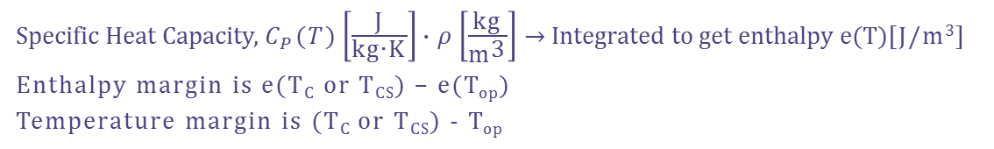
Margin, Stability, and Current Sharing…
Margin: volumetric enthalpy [mJ/cm³] and local temperature change [K] at which deposited energy in the conductor causes some or all the transport current to generate Ohmic heating
Stability: How hard it is for small heat disturbances to generate propagating normal zones. Requires locally overcoming the margin and cooling vs Ohmic heating balance. Stability also refers to how much high conductivity normal metal is available for the current density shifting out of the superconductor.
Current Sharing: When the operating current exceeds I_{C}(B,T) some, but not all of the current is carried in the normal metal stabilizer. The current balance is inherently dynamic, with I_{C}(B,T), ρ_{sc}(I, T) and ρ_{metal}(T) varying as Ohmic heating changes the temperature, but the relative impact of this behavior depends upon the critical temperature and margin (T_{C}-T_{CS}), stabilizer current density (1-f_{sc}), and stabilizer resistivity (RRR).
Specific Heat Capacity, $C_{P}(T)\left[\frac{\text{J}}{\text{kg}\text{∙}\text{K}}\right]∙ρ\left[\frac{\text{kg}}{{\text{m}}^{\text{3}}}\right]$ → Integrated to get enthalpy e(T)[J/m³]
Enthalpy margin is e(T_{C} or T_{CS}) – e(T_{op})
Temperature margin is (T_{C} or T_{CS}) - T_{op}

Slide 3
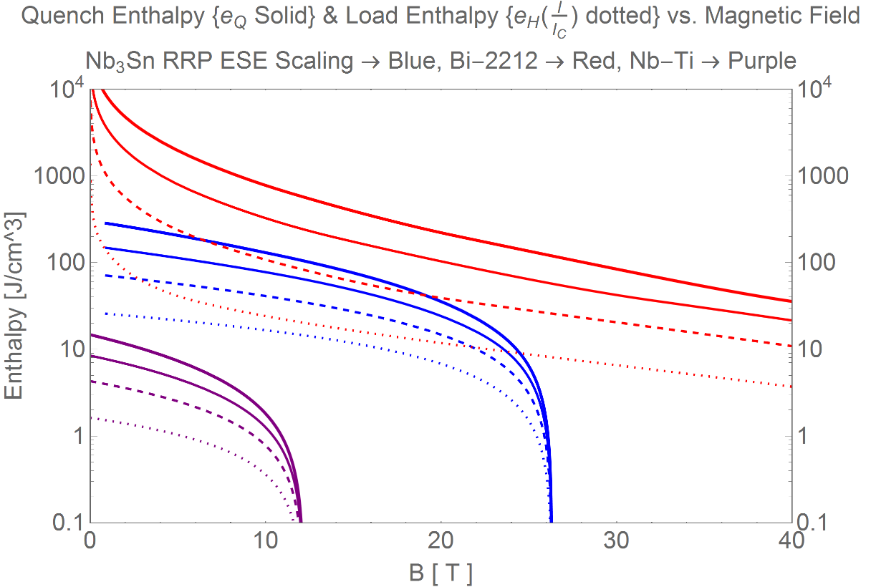
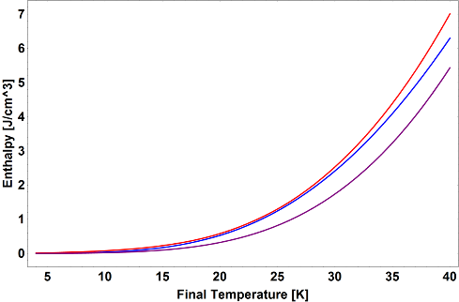
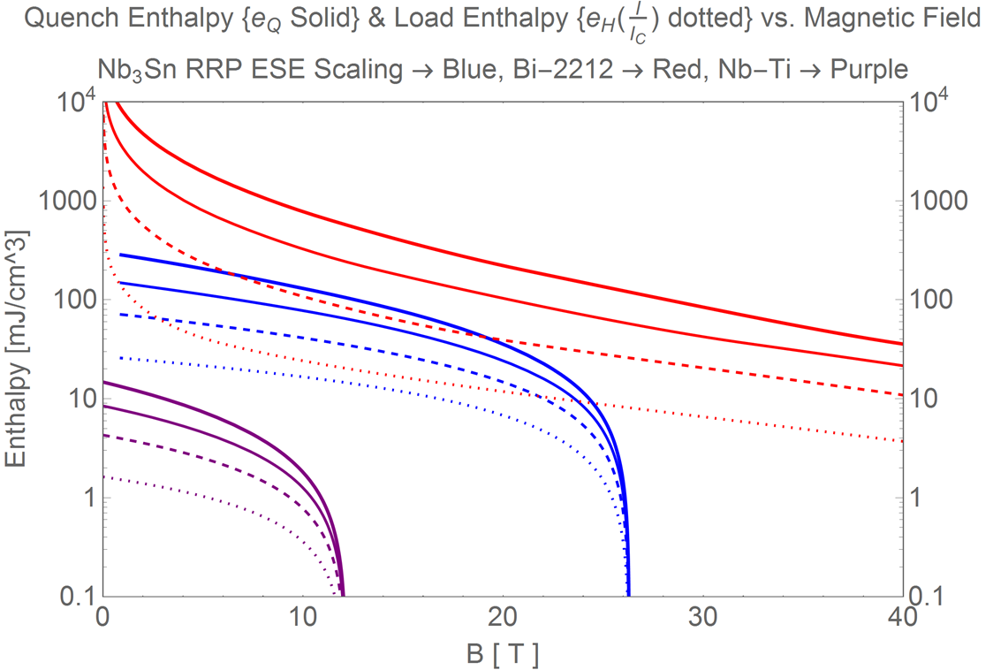
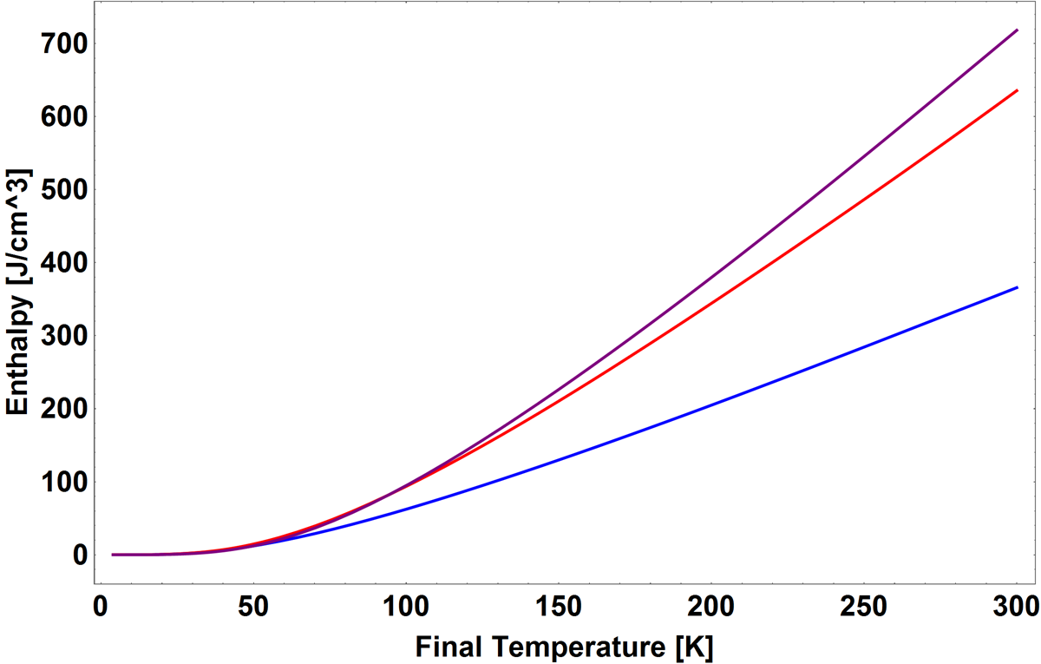
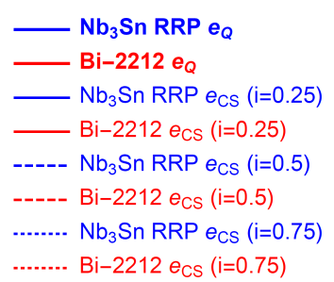



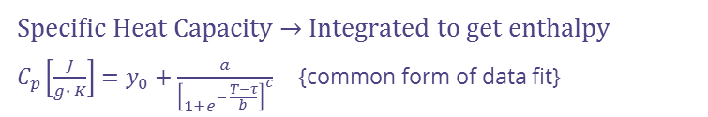





Nb₃Sn margin is limited by field and Cu fraction, current sharing is limited by T_{C}
Cu
Bi-2212
10,000
Bi-2212
Nb₃Sn
$$e_{q}$$
$$\frac{I}{I_{C}}$$
0
0.25
0.5
0.75
$$e_{cs}$$
Increasing
Current
Nb-Ti
Nb₃Sn
Specific Heat Capacity → Integrated to get enthalpy
$C_{p}\left[\frac{J}{g∙ K}\right]=y_{0}+\frac{a}{{\left[1+e^{− \frac{T−τ}{b}}\right]}^{c}}$ {common form of data fit}
A deposited heat of e_{CS} will generate dissipation and current sharing until fully normal for e_{q} deposited
  Current sharing region ~5x larger for HTS (970 mJ) than LTS (180 mJ) at 10 T
Bi-2212 e_{CS} at 30 T (or e_{q} at 40 T) same as Nb₃Sn at 20 T
An order of magnitude drop in margin from 5 T to 30 T for Bi2212 for quench margin
Current Sharing Temperature
$T_{cs}[K]=T_{C}\left(B\right)−i∙\left[T_{C}\left(B\right)−T_{op}\right]$ {linear dependence is common}
Enthalpy to Current Sharing {T_{CS}}
$$e_{cs}[J]≡h\left(T_{cs}\left(B,i\right)\right)−h\left(T_{op}\right)$$
Enthalpy to Quench {T_{C}}
$$e_{Q}[J]≡h\left(T_{C}\left(B\right)\right)−h\left(T_{op}\right)$$

Slide 4
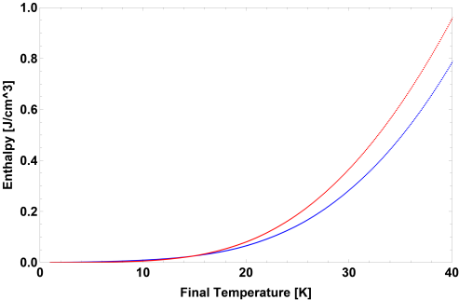
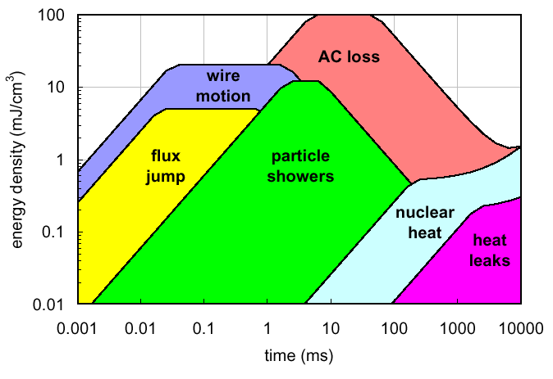
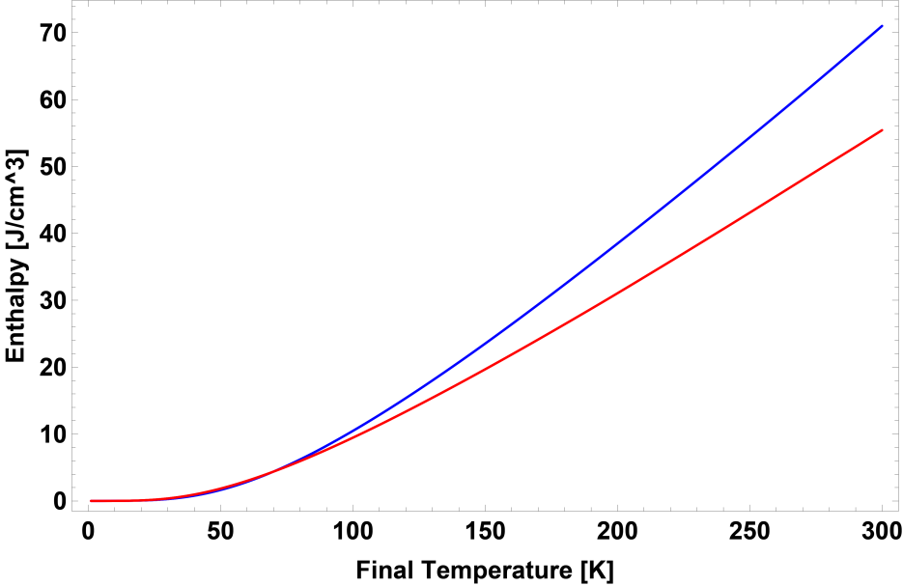



Bi-2212 is Like a Higher Field Nb₃Sn with More Current Sharing
L. Bottura, “Margin, Stability and Quench Models and Simulation,” presented at the 1st International School on Numerical Modeling for Applied Superconductivity, Lausanne, Switzerland, 23-Jun-2016.
Nb₃Sn
10,000
Bi-2212
$$e_{q}$$
$$\frac{I}{I_{C}}$$
0
0.25
0.5
0.75
Bi-2212
$$e_{cs}$$
Increasing
Current
Nb-Ti
Nb₃Sn
Specific Heat Capacity → Integrated to get enthalpy
$C_{p}\left[\frac{J}{g∙ K}\right]=y_{0}+\frac{a}{{\left[1+e^{− \frac{T−τ}{b}}\right]}^{c}}$ {common form of data fit}
A deposited heat of e_{CS} will generate dissipation and current sharing until fully normal for e_{q} deposited
  Current sharing region ~5x larger for HTS (970 mJ) than LTS (180 mJ) at 10 T
Bi-2212 e_{CS} at 30 T (or e_{q} at 40 T) same as Nb₃Sn at 20 T
An order of magnitude drop in margin from 5 T to 30 T for Bi2212 for quench margin
Current Sharing Temperature
$T_{cs}[K]=T_{C}\left(B\right)−i∙\left[T_{C}\left(B\right)−T_{op}\right]$ {linear dependence is common}
Enthalpy to Current Sharing {T_{CS}}
$$e_{cs}[J]≡h\left(T_{cs}\left(B,i\right)\right)−h\left(T_{op}\right)$$
Enthalpy to Quench {T_{C}}
$$e_{Q}[J]≡h\left(T_{C}\left(B\right)\right)−h\left(T_{op}\right)$$

Slide 5


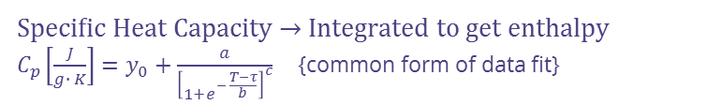

Bi-2212 is Like a Higher Field Nb₃Sn with More Current Sharing
L. Bottura, “Margin, Stability and Quench Models and Simulation,” presented at the 1st International School on Numerical Modeling for Applied Superconductivity, Lausanne, Switzerland, 23-Jun-2016.
Nb₃Sn
10,000
Below Bi-2212 Margin
Bi-2212
$$e_{q}$$
$$\frac{I}{I_{C}}$$
0
0.25
0.5
0.75
$$e_{cs}$$
Increasing
Current
Specific Heat Capacity → Integrated to get enthalpy
$C_{p}\left[\frac{J}{g∙ K}\right]=y_{0}+\frac{a}{{\left[1+e^{− \frac{T−τ}{b}}\right]}^{c}}$ {common form of data fit}
A deposited heat of e_{CS} will generate dissipation and current sharing until fully normal for e_{q} deposited
  Current sharing region ~5x larger for HTS (970 mJ) than LTS (180 mJ) at 10 T
Bi-2212 e_{CS} at 30 T (or e_{q} at 40 T) same as Nb₃Sn at 20 T
An order of magnitude drop in margin from 5 T to 30 T for Bi2212 for quench margin
Always ramp LTS first to lower margin on HTS
Current Sharing Temperature
$T_{cs}[K]=T_{C}\left(B\right)−i∙\left[T_{C}\left(B\right)−T_{op}\right]$ {linear dependence is common}
Enthalpy to Current Sharing {T_{CS}}
$$e_{cs}[J]≡h\left(T_{cs}\left(B,i\right)\right)−h\left(T_{op}\right)$$
Enthalpy to Quench {T_{C}}
$$e_{Q}[J]≡h\left(T_{C}\left(B\right)\right)−h\left(T_{op}\right)$$

Slide 6
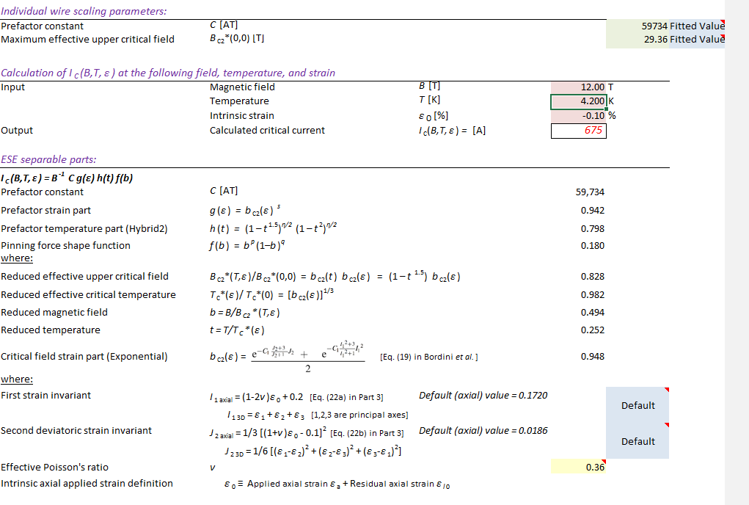
Nb₃Sn and high Cp Nb₃Sn modelled I_{C}(B,T,ε) Fit
ESE Spreadsheet - Ian Pong and Jack Ekin v2.1
  Replicated model and fit parameters into margin calculation
As a comparable modern wire, I chose a
Larp QXF conductor,
  0.85 mm, 108/127
  I_{C}(12 T) =674 A
J. W. Ekin, N. Cheggour, L. Goodrich, J. Splett, B. Bordini, D. Richter, and L. Bottura, "Extrapolative Scaling Expression: A fitting equation for extrapolating full I_{C}(B,T,ε) data matrixes from limited data", Applied Superconductivity Conference 2016, IEEE Trans. Appl. Supercond., vol. 27, no. 4, Art. no. 8400607, June 2017.

Slide 7
Calculation Inputs
Rule of mixtures for specific heat capacity
  ~4.12% Area fraction Gd₂O₃ elements
  1% and 10% also run for comparison
 | Density [g/cm^3]
Nb3Sn | 8.95
Bi-2212 | 6.6
Ag | 10.49
Cu | 8.94
Figure 5. Measured specific heat of Gd2O3 [18].
X. Xu, A. V. Zlobin, E. Barzi – Fermilab; C. Buehler, M. Field, B. Sailer, M. Wanior, H. Miao – Bruker EST; C. Tarantini – Florida State University. “Enhancing specific heat of Nb3Sn conductors to improve stability and reduce training”. Presented at CEC-ICMC 2019

Slide 8
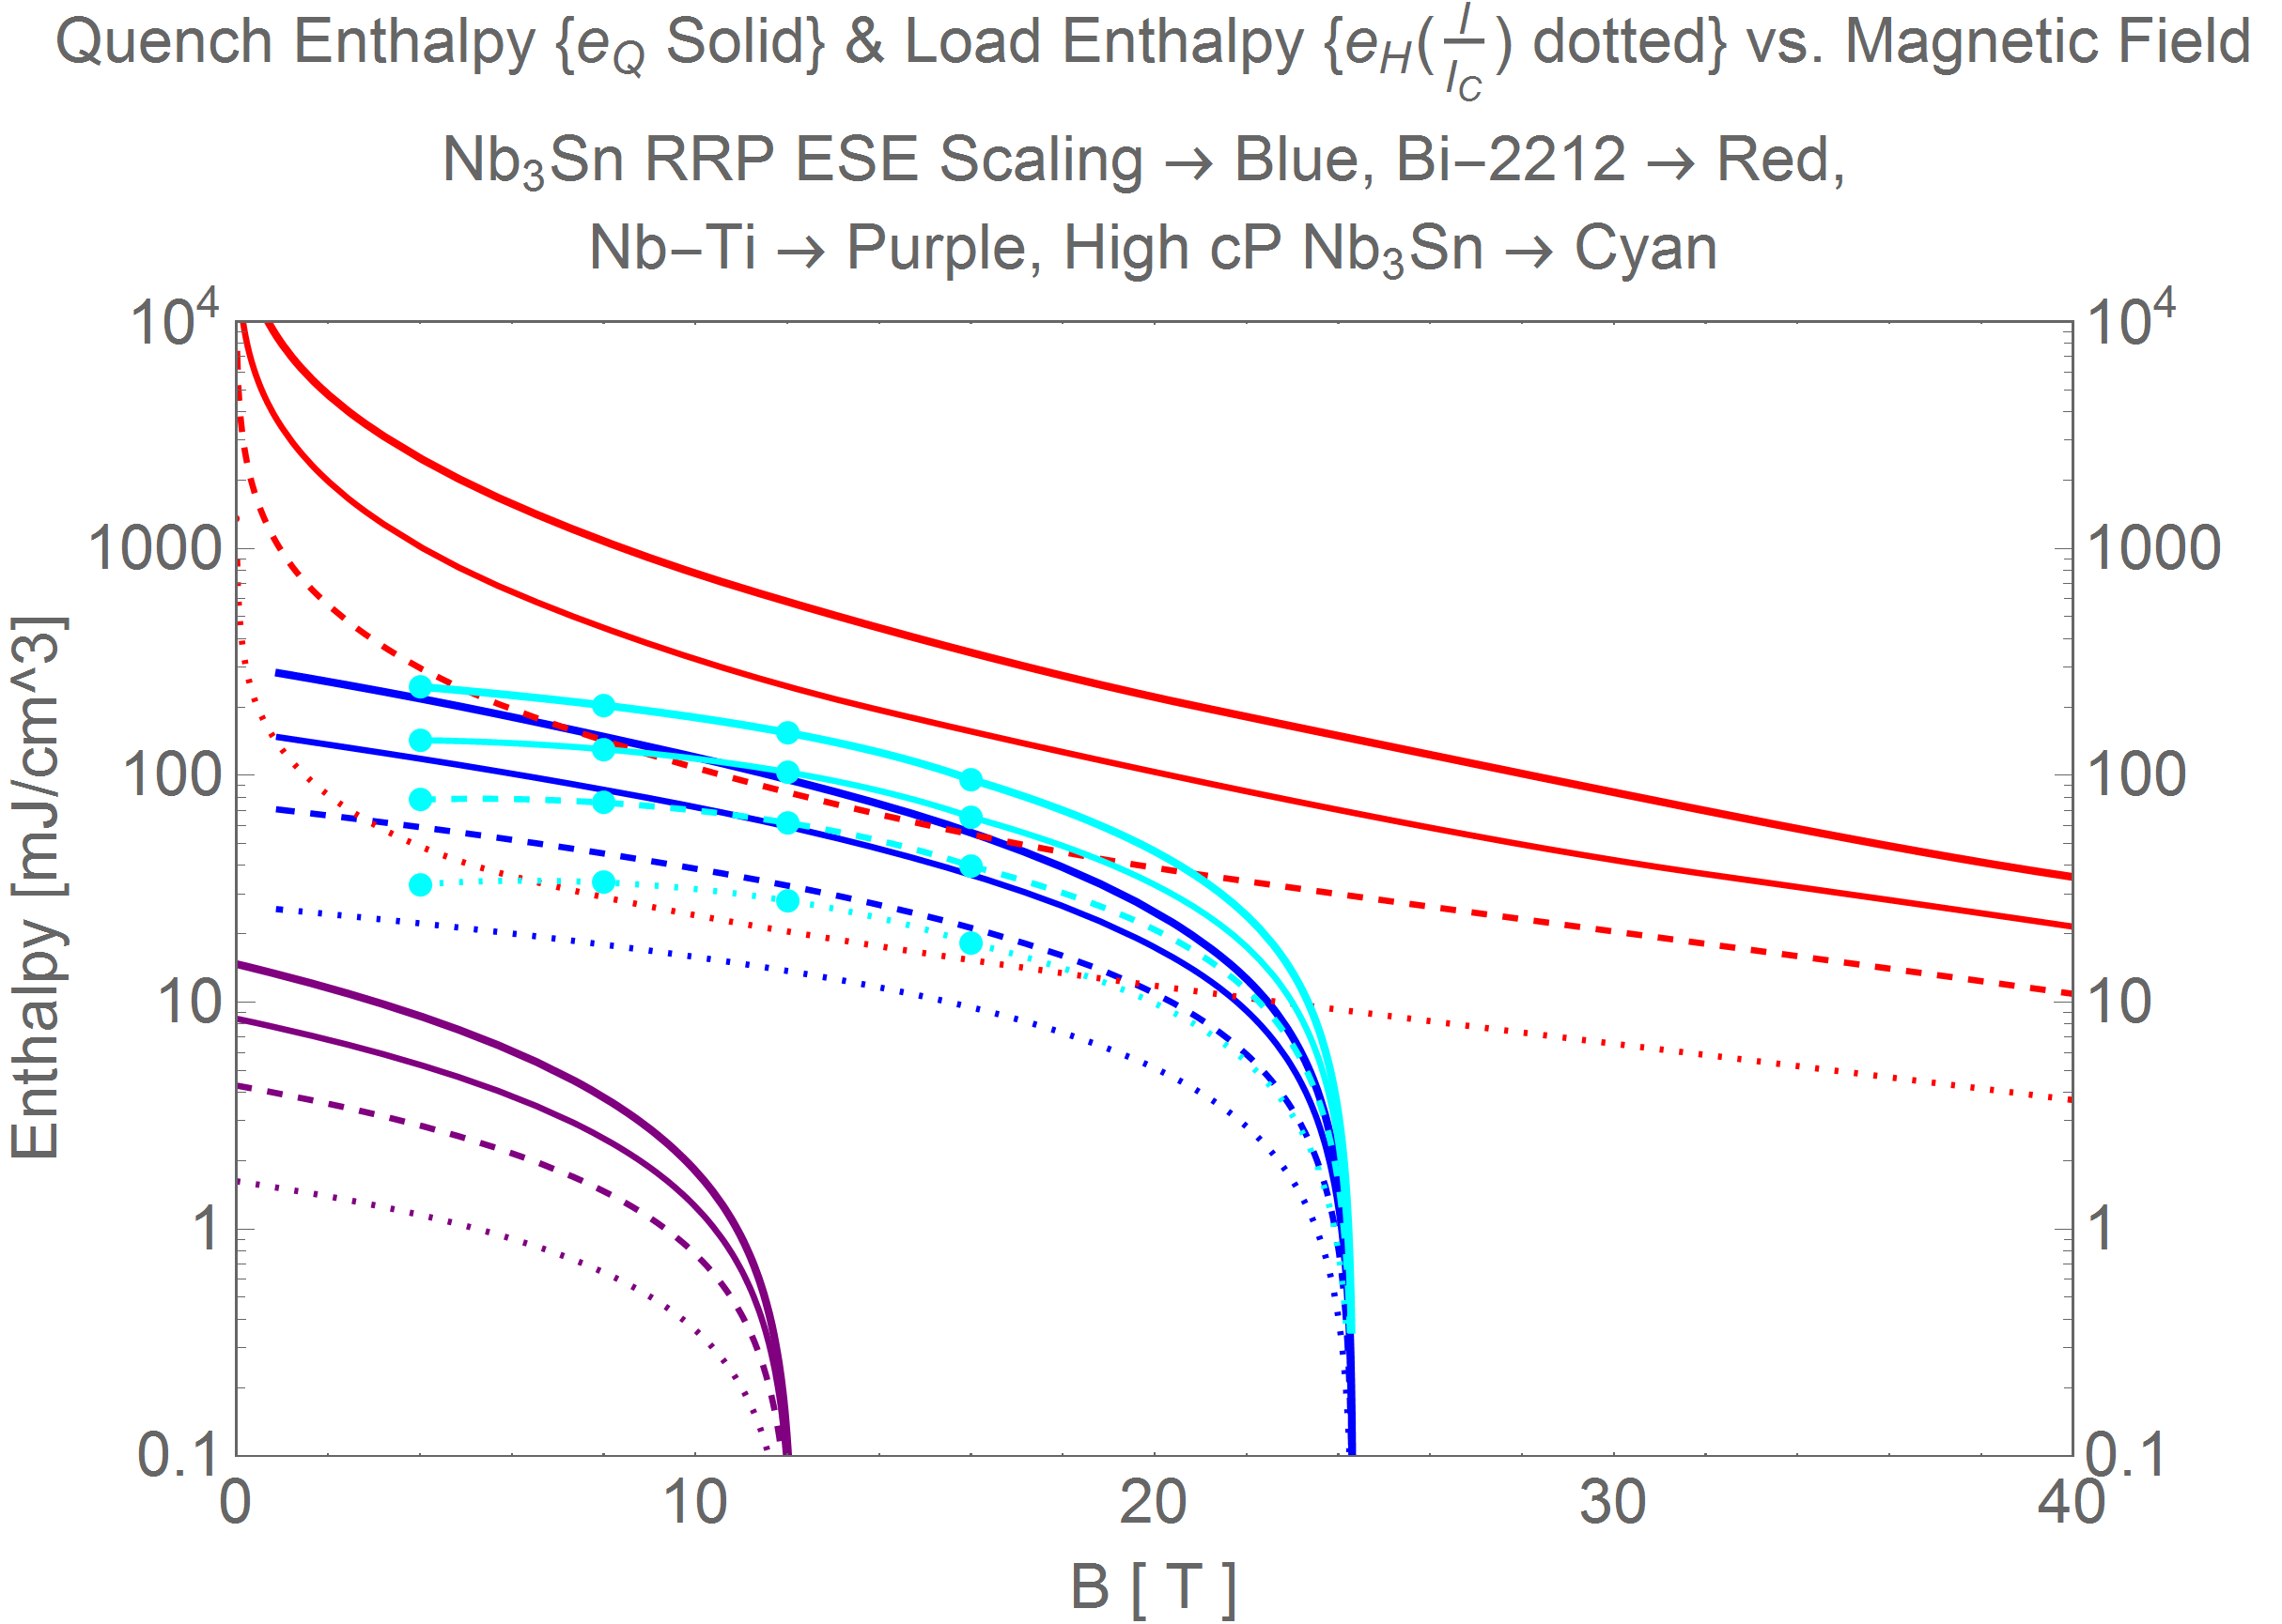
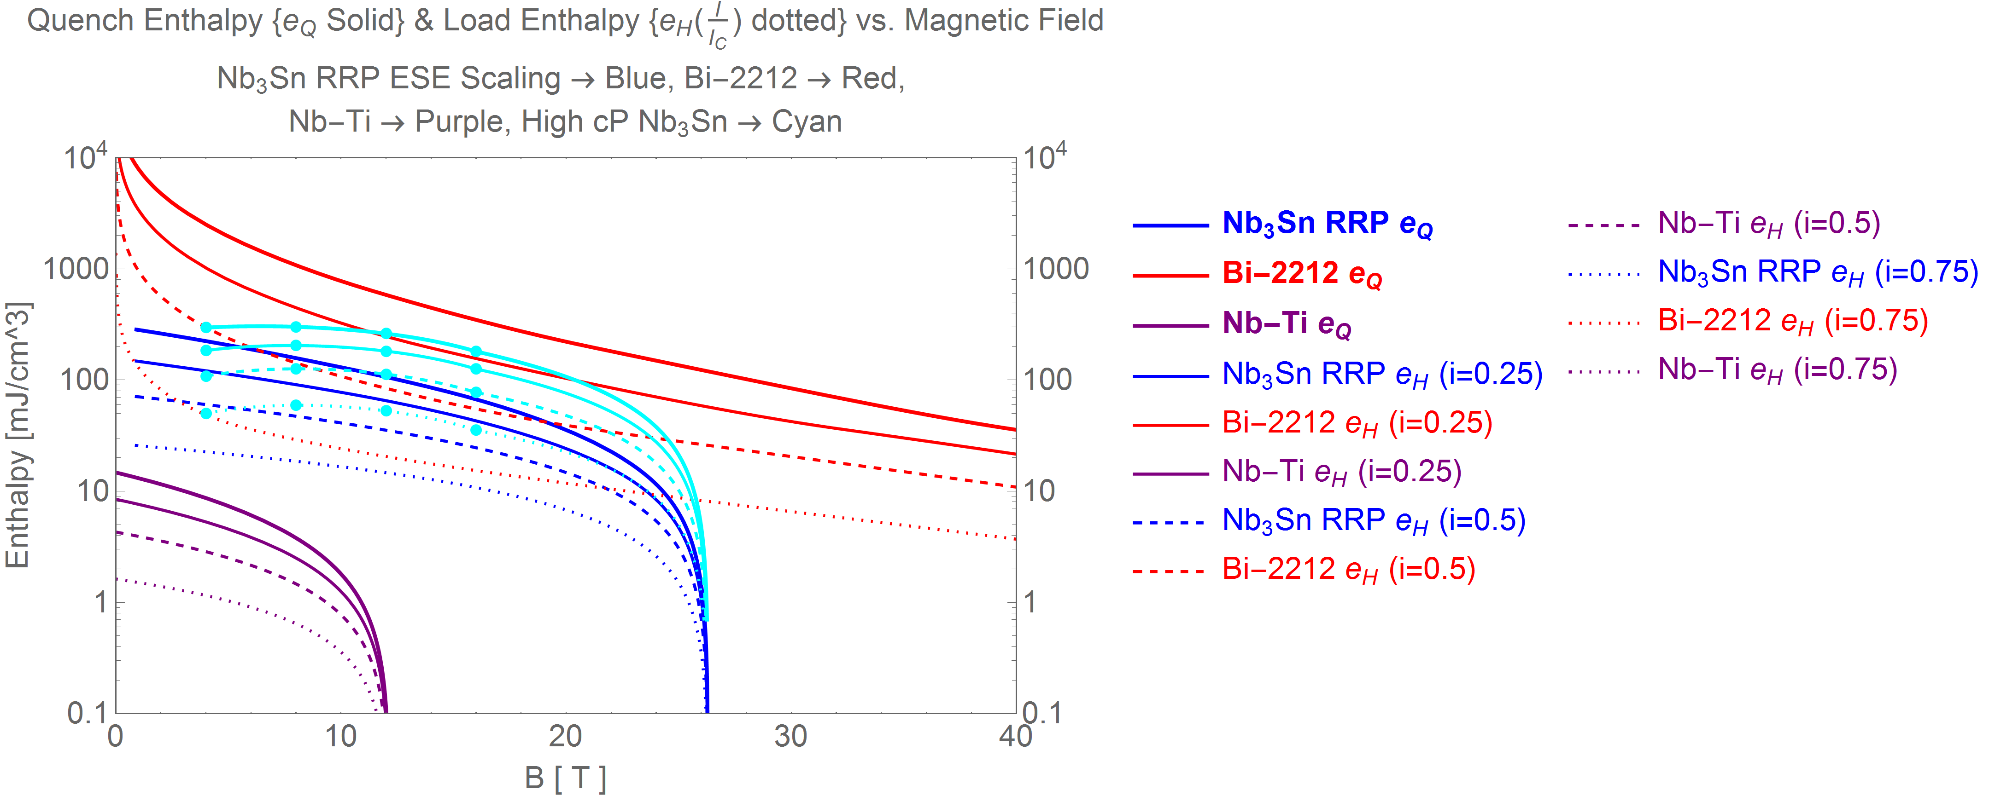

4 % High Cp Nb₃Sn additions provide a moderate boost to the margin
High Cp in Nb3Sn magnets development
Points for 4% Gd₂O₃
Helps utilization of JC
Does not decrease stabilizer current density at the same current
Addresses disturbance spectrum
Does not increase current sharing region to as much as Bi-2212 (higher T_{C})
Strongest impact at high current fraction i=I_{op}/I_{C}
Bi2212
i=$\frac{I}{I_{C}}$
0
0.25
0.5
0.75
High field extrapolated from 16T high Cp data
Increasing
Current
Nb-Ti
Nb3Sn
X. Xu, A. V. Zlobin, E. Barzi – Fermilab; C. Buehler, M. Field, B. Sailer, M. Wanior, H. Miao – Bruker EST; C. Tarantini – Florida State University.
“Enhancing specific heat of Nb₃Sn conductors to improve stability and reduce training.“ Presented at CEC-ICMC 2019

Slide 9
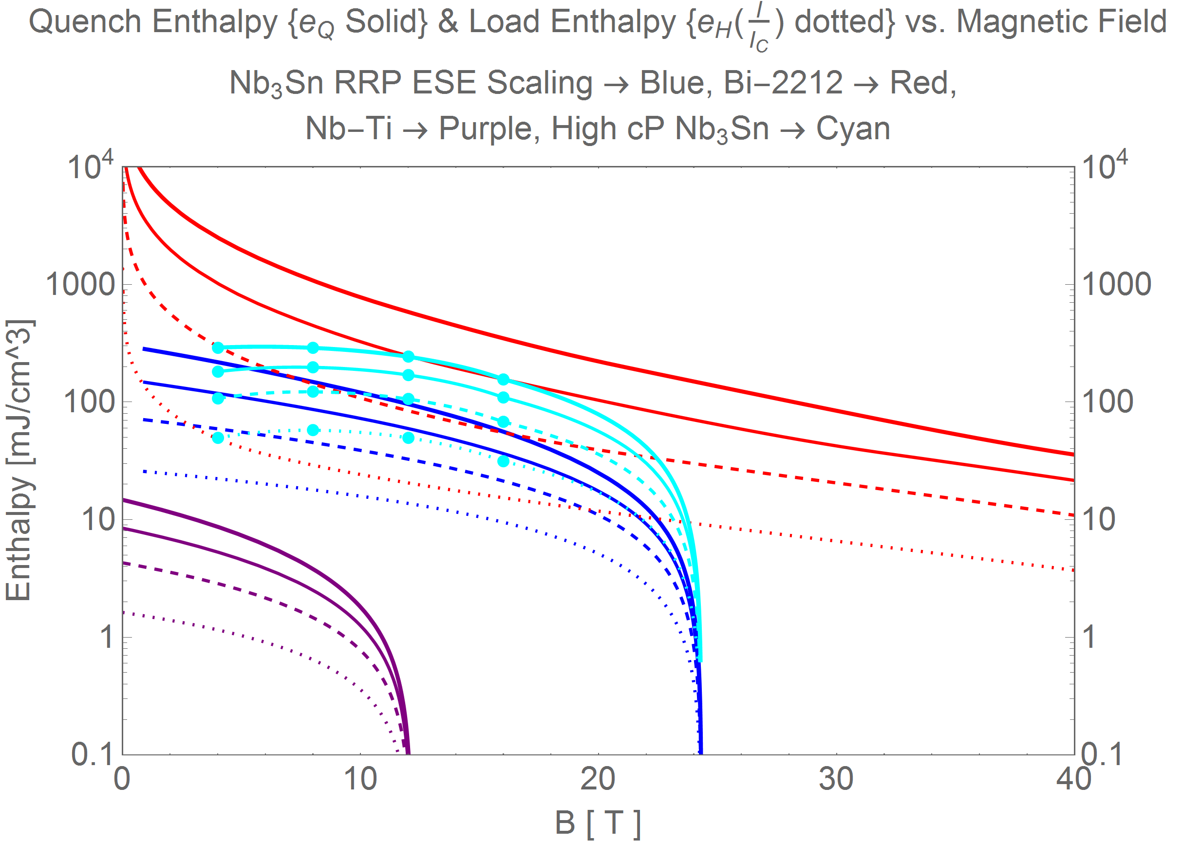
10 % High Cp Nb₃Sn additions would help close the gap between Nb₃Sn and Bi-2212
High Cp in Nb3Sn magnets development
Points for 10% Gd₂O₃
Helps utilization of JC
Does not decrease stabilizer current density at the same current
Addresses disturbance spectrum
Does not increase current sharing region to as much as Bi-2212 (higher T_{C})
Bi2212
i=$\frac{I}{I_{C}}$
0
0.25
0.5
0.75
High field extrapolated from 16T high Cp data
Increasing
Current
Nb-Ti
Nb3Sn
X. Xu, A. V. Zlobin, E. Barzi – Fermilab; C. Buehler, M. Field, B. Sailer, M. Wanior, H. Miao – Bruker EST; C. Tarantini – Florida State University.
“Enhancing specific heat of Nb₃Sn conductors to improve stability and reduce training.“ Presented at CEC-ICMC 2019

Slide 10
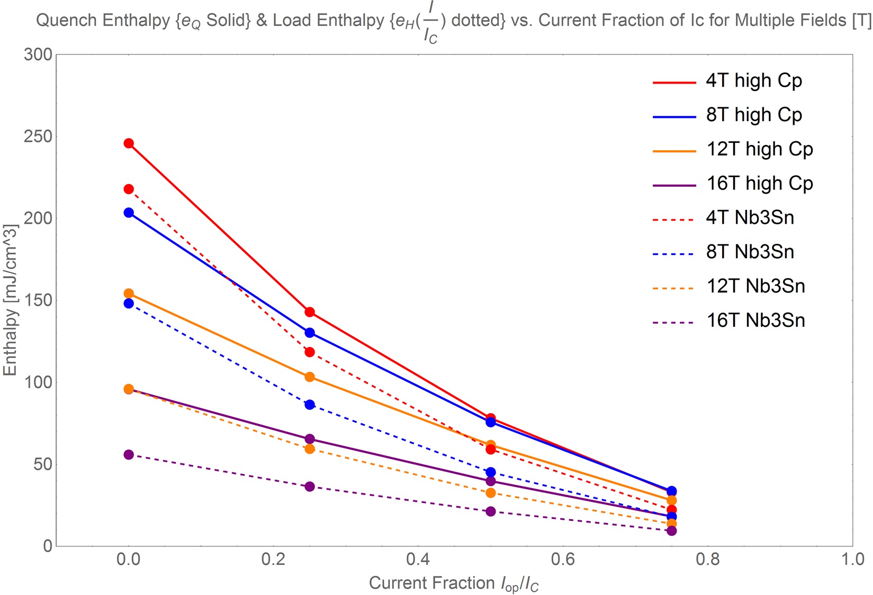
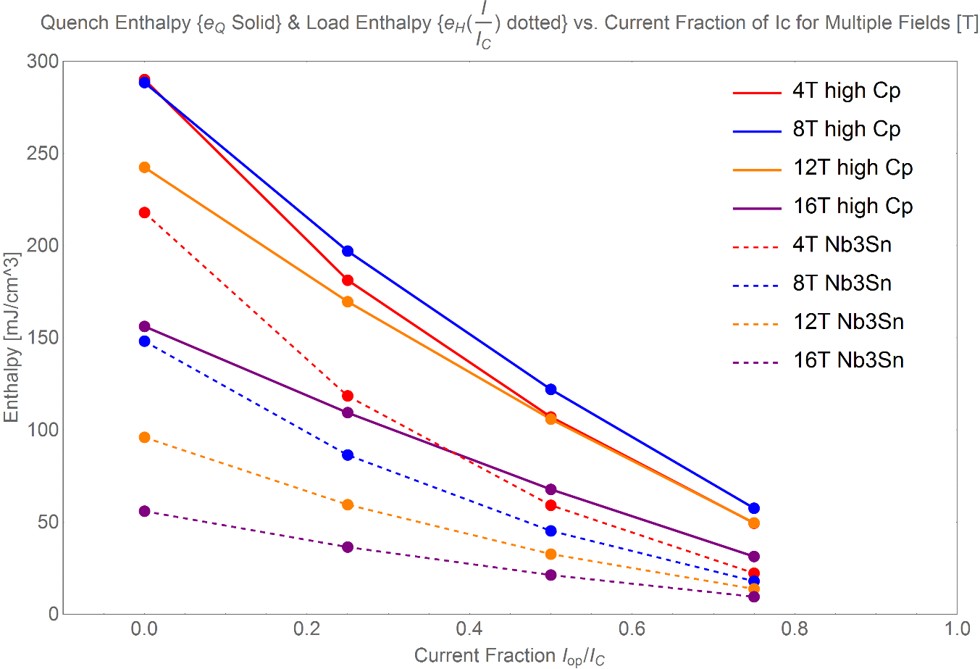
Comparison with MQE data
L. Bottura, “Margin, Stability and Quench Models and Simulation,” presented at the 1st International School on Numerical Modeling for Applied Superconductivity, Lausanne, Switzerland, 23-Jun-2016.
4% Gd₂O₃
10% Gd₂O₃
[1]E. Barzi, F. Berritta, D. Turrioni, and A. V. Zlobin, “Heat Diffusion in High-Cp Nb3Sn Composite Superconducting Wires,” Instruments, vol. 4, no. 4, p. 28, Sep. 2020, doi: 10.3390/instruments4040028.

Slide 11
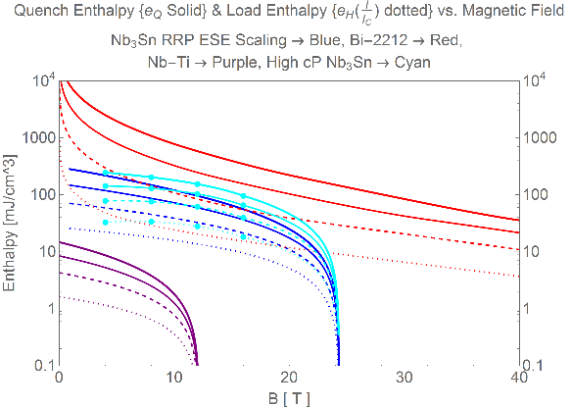
Stability is a mix of margin and stabilizer area fraction
  Example Cases:
  Same Margin, Practical Fields: The enthalpy margin of both conductors is 15.8 mJ/cm³ for Nb3Sn at 10 T, Bi2212 at 15.53 T, and high Cp Nb3Sn at 17.16 T
    Bi-2212 at 0.75*I_{C} (4.2 K, 15.53 T)(319 A) the Ag stabilizer current density is 847 A/mm²
    Nb3Sn at 0.75*I_{C} (4.2 K, 10 T)(750 A) the Cu stabilizer current density is 2521 A/mm²
    High Cp at 0.75*I_{C} (4.2 K, 17.16 T)(143 A) the Cu stabilizer current density is 520 A/mm²
  Same field as previous Nb3Sn (10 T), same current as that for Bi-2212 at 10 T
    High Cp at 0.75*I_{C} (4.2 K, 10 T)(750 A) the Cu stabilizer current density is 2730 A/mm²
    Bi-2212 at 0.75*I_{C} (4.2 K, 10 T)(370 A) the Ag stabilizer current density is 981 A/mm²
    Nb3Sn at 0.75*I_{C} (4.2 K, 13.5 T)(368 A) the Cu stabilizer current density is 1239 A/mm²
    High Cp at 0.75*I_{C} (4.2 K, 13.5 T)(368 A) the Cu stabilizer current density is 1341 A/mm²
  Higher Fields: The enthalpy margin of both conductors is 5.1 mJ/cm³ for Nb3Sn at 20 T, Bi-2212 at 34.35 T, and high Cp Nb₃Sn at 22.16 T
    Nb3Sn at 0.75*I_{C} (4.2 K, 20 T)(48 A) the Cu stabilizer current density is 162 A/mm²
    Bi-2212 at 0.75*I_{C} (4.2 K, 34.35 T)(228 A) the Ag stabilizer current density is 605.1 A/mm²
    High Cp at 0.75*I_{C} (4.2 K, 22.16 T)(11.5 A) the Cu stabilizer current density is 41 A/mm²
  Bi-2212 has a higher stabilizer fraction of Ag rather than Cu, has a flat J_{E}(B), combined with the higher enthalpy margin and slow normal zone propagation makes it more stable than Nb₃Sn over a large field range up to 40 T or more low-stability but huge margin of single-strand YBCO)
  (compare to low-stability but huge margin of single-strand YBCO)
  Bi-2212 (PMM170123), 0.8 mm I_{C}(4.2K,5T) = 600 A (1193 A/mm²); superconducting fraction f_{sc}=0.25
    →Ag fraction 75% (newest Engimat wires closer to 80% Ag)
  Nb3Sn –LARP QXF conductor, 0.85 mm, 108/127, I_{C}(4.2K,12T)= 674 A. RRR>150
    Cu fraction >52.4%,
    High Cp, assume reduction in Cu fraction by 4% to 48.4%
Closer to Nb₃Sn B_{c2}

Slide 12
Extra time to protect for the same margin, from Tcs to Tc
In addition to larger margin from T_{CS} to T_{C} for HTS:
Slower heating through that transition
  Resistance rises progressively from T_{CS} to T_{C} :
    (lower index n-value of I-V transition)
      Property distribution, flux creep, multifilament & multistrand & high RRR Ag matrix current sharing
  Less ohmic heat will be generated near T_{CS} than near T_{C}
  This allows more stable operation near T_{CS}
Higher MQE, slower normal zone propagation
I_{matrix}
LTS
HTS
1
I_{magnet}/I_{C}
Ohmic Heating
LTS
HTS
$$MQE \left[J\right]=E_{Q}−E_{Ω}+E_{cool}=\int{\left[h\left(T_{C}\left(B\right)\right)−h\left(T_{op}\right)\right]dV}−\int_{T_{CS}}^{T_{C}}{I^{2}R dT}+E_{cool}$$
T_{cs}
T_{c}
T
Notes:
Another layer of complexity in HTS is the broad V-I transition with a low power-law index or n-value, which results in superconductor/stabilizer current sharing well beyond the critical current.
The delayed stabilizer current rise reduces the integrated Ohmic heating, increasing the minimum quench energy and slowing the normal zone propagation.
This results in more stable operation near the current sharing temperature even for minimal cooling

Slide 13
Can we find a stable balance between LTS and HTS?

Slide 14
Extra Slides

Slide 15

1% High Cp Nb₃Sn additions provide a moderate boost to the margin
High Cp in Nb3Sn magnets development
Points for 1% Gd₂O₃
Helps utilization of JC
Does not decrease stabilizer current density
Addresses disturbance spectrum
Does not increase current sharing region to as much as Bi-2212 (higher T_{C})
Bi2212
i=$\frac{I}{I_{C}}$
0
0.25
0.5
0.75
High field extrapolated from 16T high Cp data
Increasing
Current
Nb-Ti
Nb3Sn
X. Xu, A. V. Zlobin, E. Barzi – Fermilab; C. Buehler, M. Field, B. Sailer, M. Wanior, H. Miao – Bruker EST; C. Tarantini – Florida State University.
“Enhancing specific heat of Nb₃Sn conductors to improve stability and reduce training.“ Presented at CEC-ICMC 2019

Slide 16
We have only observed two types of quench limitations in Bi-2212 Coils. Can high Cp Nb₃Sn behave similarly?
Broad V-I Transitions
Local degradation/low-I_{C}
Power-Law V-I voltages clear at 80% or less of quench current
Quench currents can be slightly increased with faster ramp rates
  Low AC losses & NZPV so outrun thermal run-away
Quench currents follow S.S. I_{C}(B) trend
  Only small, saturating (<5%), drops in I_{Q}
Quench detection and protection less challenging
Characterized by rapid high n-value transition.
  Short length normal zone
Quench currents following are the same or lower
  Combination of Lorentz force induced mechanical or fabrication/processing degradation (mitigation: OPHT witness samples, Fabrication R&D of RC-program)
Field dependence is more rapid than S.S. I_{C}(B)
Protection challenging, but degradation precedes quench.
Neither case
requires training
Only need to focus on LTS initiated quenches
If below operation current: new coil.
Else, focus on LTS initiated quenches

