Slide 1
MDP Collaboration Meeting
20 T hybrid magnet and comparative analysis
P. Ferracin
US Magnet Development Program

Slide 2
Outline
General organization of working group
Goals of working group
Design criteria for a 20 T hybrid magnets
Analytical estimates of general dimensions and stresses
  Thick shell with cos-theta current distribution
Preliminary magnetic analysis
  CT, SMCT, CCT
  Block, Common-coil
Next plans and conclusions

Slide 3
General organization of working group
Members
  LBNL: P. Ferracin
  FNAL: G. Ambrosio, E. Barzi, V. Kashikhin, V. Marinozzi, I. Novitski, A. Zlobin
  NHMFL: L. Cooley
  BNL: R. Gupta, B. Yahia
Contributions from
  Diego Arbelaez and Lucas Brower (LBNL)
  Etienne Rochepault (CEA)
  Jillien Stern (TUFTS University, Prof. Luisa Chiesa)

Slide 4
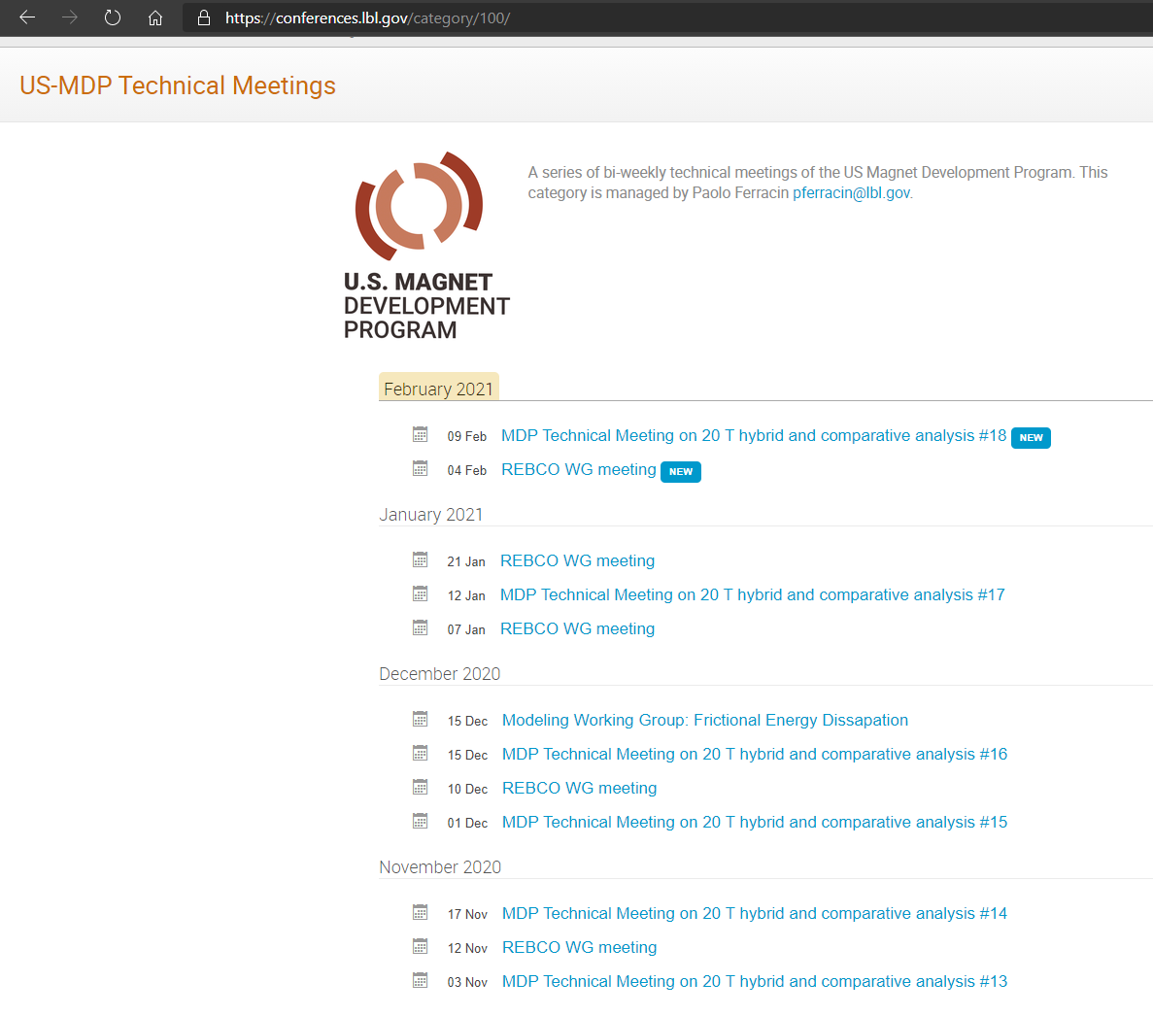
General organization of working group

Slide 5
Outline
Goals of the working group
Model and assumptions
Estimates of radiuses, dimensions, and stresses
  Bi2212 and REBCO cases
Preliminary cos-theta and common coil cross-sections
Appendix
  Design criteria for a 20 T hybrid magnet
  Details of REBCO case

Slide 6
Goals of the working group
Conceptual design of a 20 T hybrid HTS-LTS magnet
  Comparative analysis of different design options for a 20 T hybrid
    Cosϑ design and its stress-management options
      “Traditional” Cosϑ
      Canted Cosϑ (CCT)
      Stress management Cosϑ (SMCT)
    Block-type coil design (block with flared ends)
    Common-coil design (block with racetrack coil)
  Definition of general design criteria: aperture, field, margin…..
  Analysis of challenges specifically of hybrid magnets
    Integration of LTS/HTS, mechanics, protection, powering, diagnostics, test facility…..
Review and follow-up of current work on hybrid magnets
  Collect and organize information from these programs (responsibility of area I and area II) to provide inputs for 20 T hybrid design

Slide 7
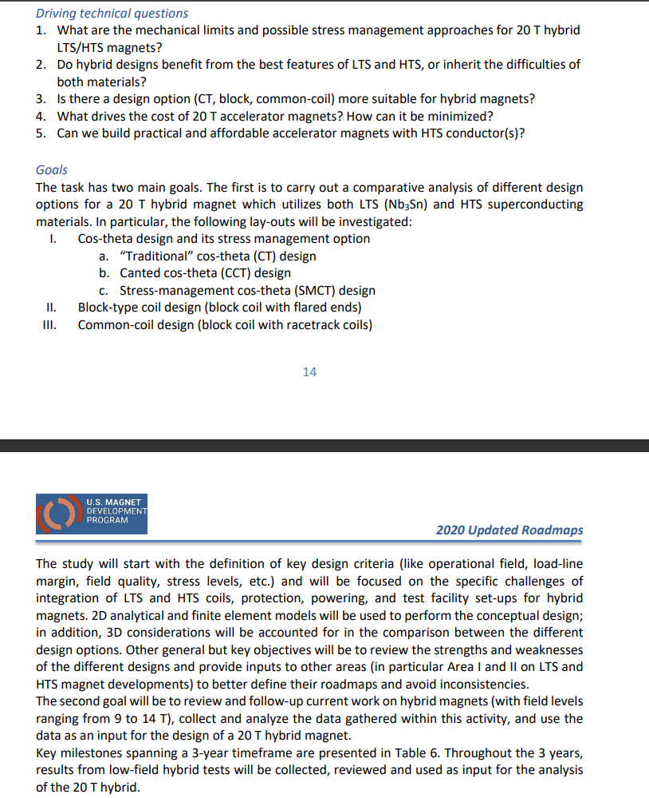
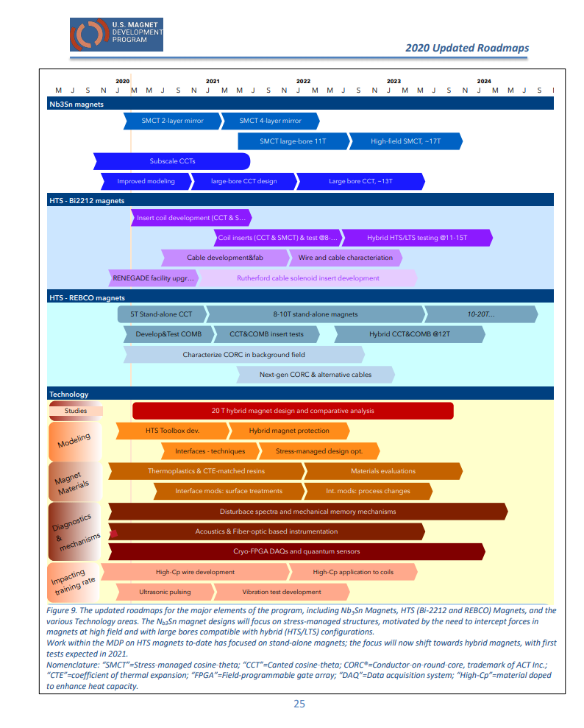
Goals of the working group
(from the updated roadmap)

Slide 8
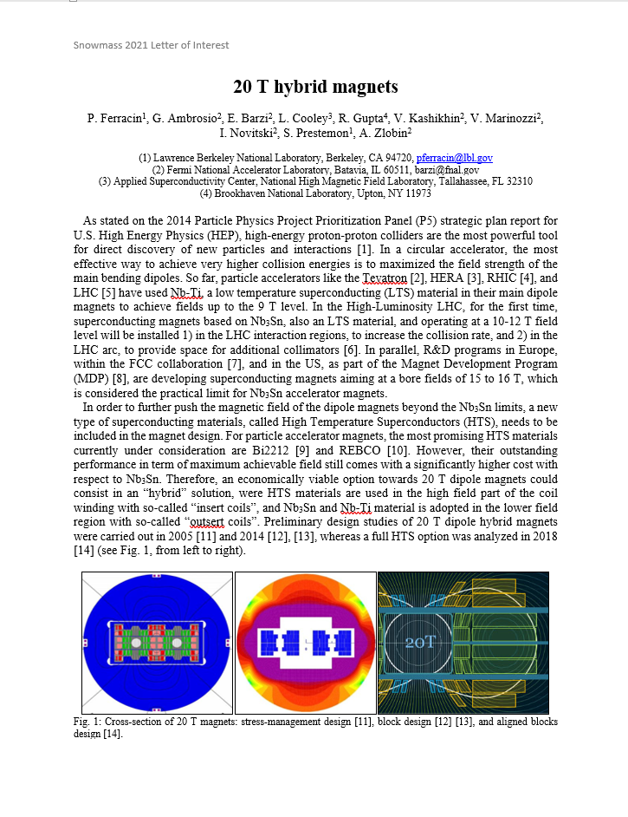
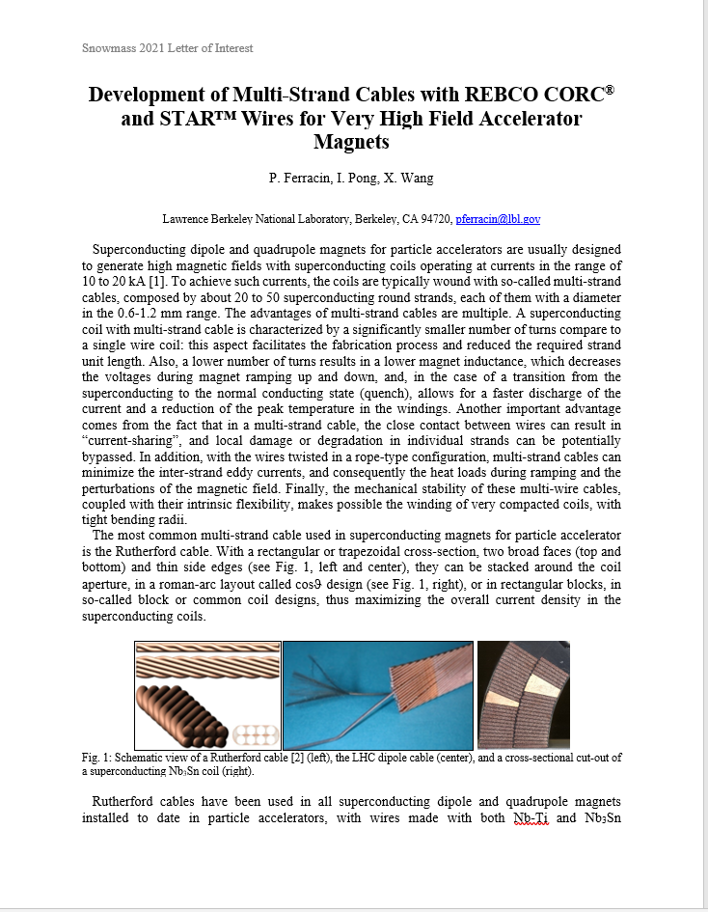
Snowmass LOI

Slide 9
Design criteria for a 20 T hybrid magnet
Previous work within MDP on a 16 T dipole magnet
  GianLuca Sabbi, Alexander Zlobin, MDP General meeting – May 17, 2017
https://conferences.lbl.gov/event/82/

Slide 10
Design criteria for a 20 T hybrid magnet
Geometrical
  Number of apertures 1
  Free coil aperture 50 mm
Comments
  The common coils will naturally provide 2 apertures
    This will be taken into account on the comparison
  No “strong” constraints on
    Magnet total length (<2 m)
    Magnet straight section (>200 mm)
    Maximum magnet OD
      Reference numbers: 620 mm (FNAL/1.9K), 660 mm (BNL/1.9K), 914 mm (LBNL/4.5K)

Slide 11
Design criteria for a 20 T hybrid magnet
Operational
  Reference temperature 1.9 K
    4.5 K option can be considered: it would impact the ratio of HTS vs LTS
  Operational bore field 20 T
  Margin on the load-line @ 1.9K >= 15 %
    With respect to round strand I_{c} including self field and 5% cabling degradation
  Short sample bore field 23.5 T
  Geometrical harmonics at R_{ref}=17 mm and 20 T: b_{n}<5 for n<10
    Magnet straight section
  Target design field 20 T

Slide 12
Design criteria for a 20 T hybrid magnet
Operational
  Maximum Nb₃Sn coil stress >180 (<150) MPa at 1.9 (293) K
  Conditions of coil-pole or rib interfaces at 20 T
    If bonded 20 MPa max. tension
      ‘Corner spikes’ (~1 contact element, 1 mm) neglected
    If separation allowed: Half cable width in contact or < 50 µm max gap
      Conditions may be different depending on the design

Slide 13
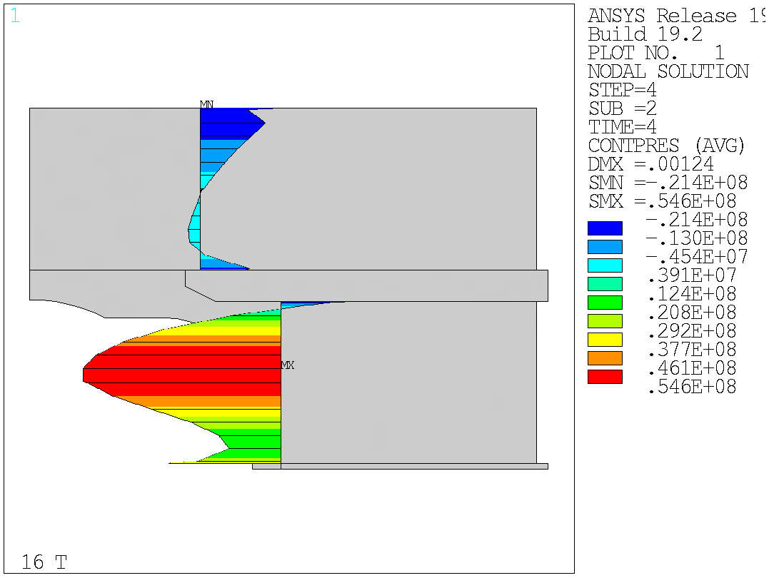
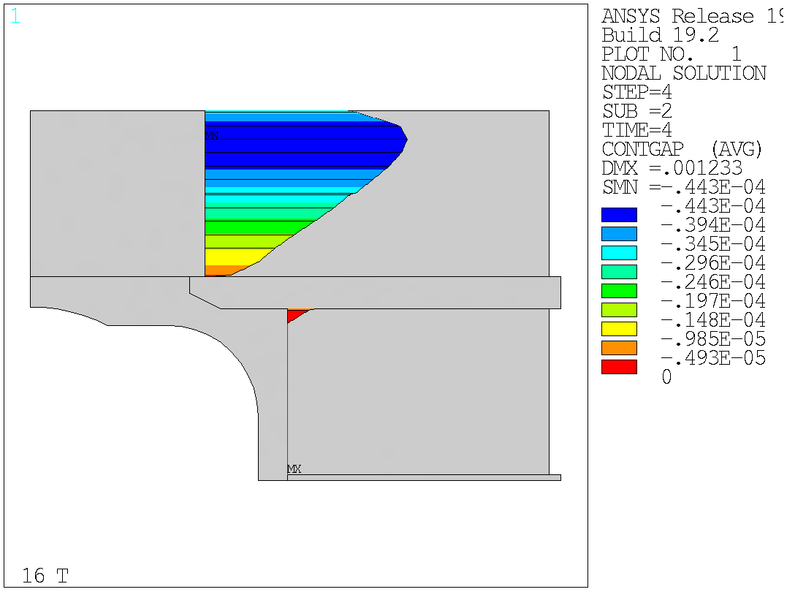
Design criteria for a 20 T hybrid magnet
Bonded vs separation-allowed
  Test Facility Dipole (by G. Vallone)

Slide 14
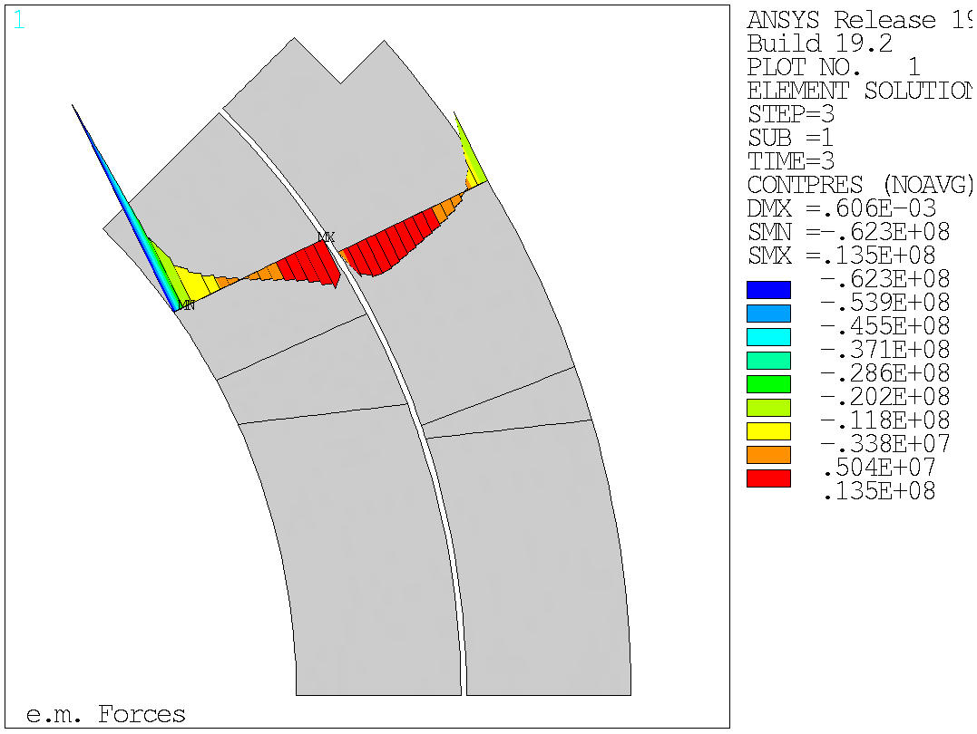
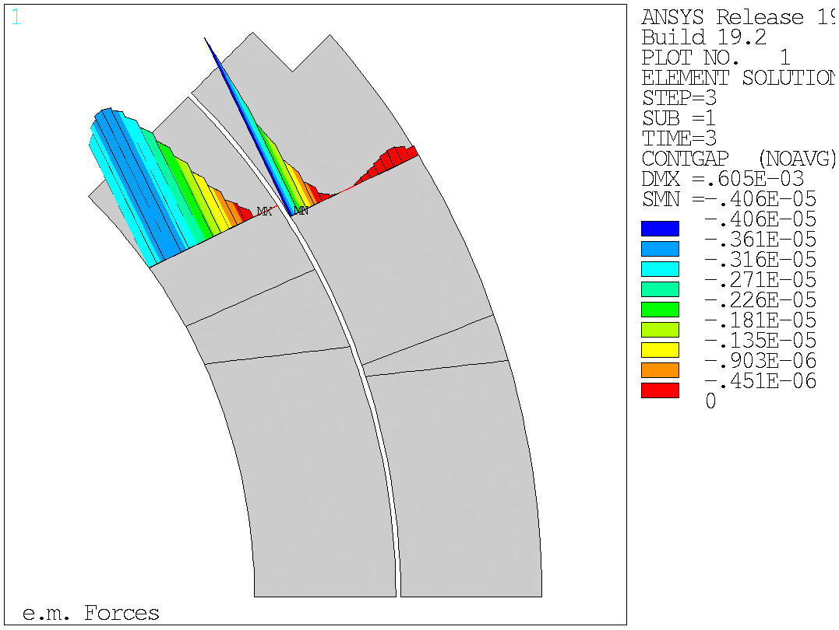
Design criteria for a 20 T hybrid magnet
Bonded vs separation-allowed
  MQXF (by G. Vallone)

Slide 15
Material limits
(by Giorgio Vallone)

Slide 16
Design criteria for a 20 T hybrid magnet
Nb₃Sn Conductor and cable
  Strand diameter 0.7-1.2 mm
  Cu:non-Cu ratio 0.8-2.0
  Non-Cu J_{c} round strand with self-field
    12 T, 4.2 K 2980 A/mm2
    15 T, 4.2 K 1640 A/mm2
    16 T, 4.2 K 1250 A/mm2
      See next slide for reference fit
  RRR (after cabling) >50
  I_{c} degradation due to cabling 5%
  Maximum number of strands in cable 60
  Cable Insulation thickness 0.150 mm

Slide 17
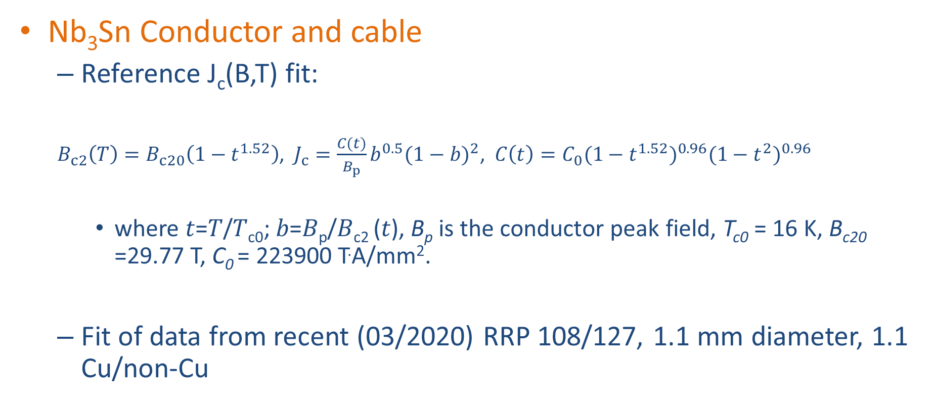
Design criteria for a 20 T hybrid magnet
Nb₃Sn Conductor and cable
  Reference J_{c}(B,T) fit:
  $B_{c2}\left(T\right)=B_{c20}\left(1−t^{1.52}\right)$, $J_{c}=\frac{C(t)}{B_{p}}b^{0.5}{(1−b)}^{2}$, $C\left(t\right)=C_{0}{(1−t^{1.52})}^{0.96}{(1−t^{2})}^{0.96}$
    where 𝑡=𝑇/𝑇_{c0}; 𝑏=𝐵_{p}/𝐵_{c2} (𝑡), B_{p} is the conductor peak field, T_{c0} = 16 K, B_{c20} =29.77 T, C₀ = 223900 T.A/mm².
  Fit of data from recent (03/2020) RRP 108/127, 1.1 mm diameter, 1.1 Cu/non-Cu

Slide 18
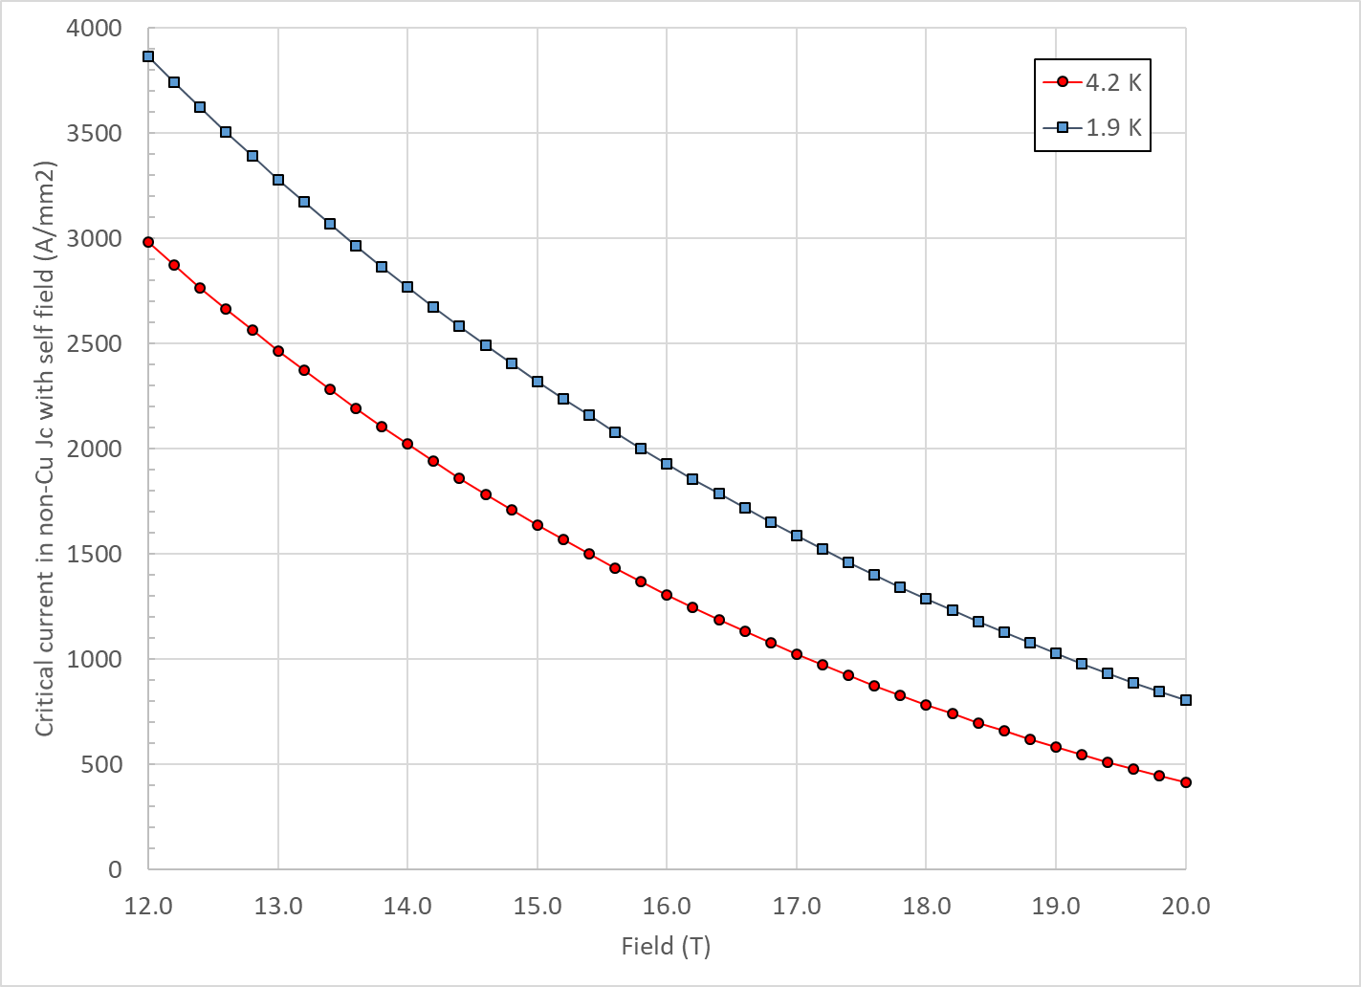
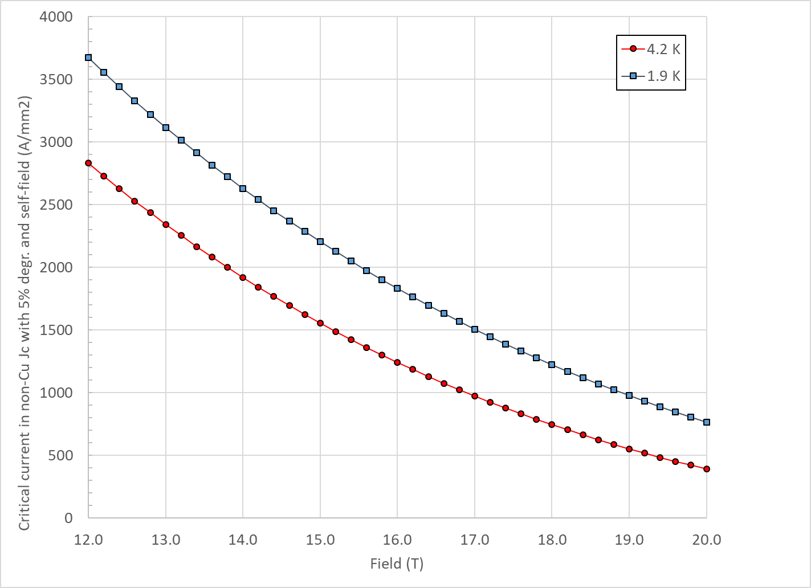
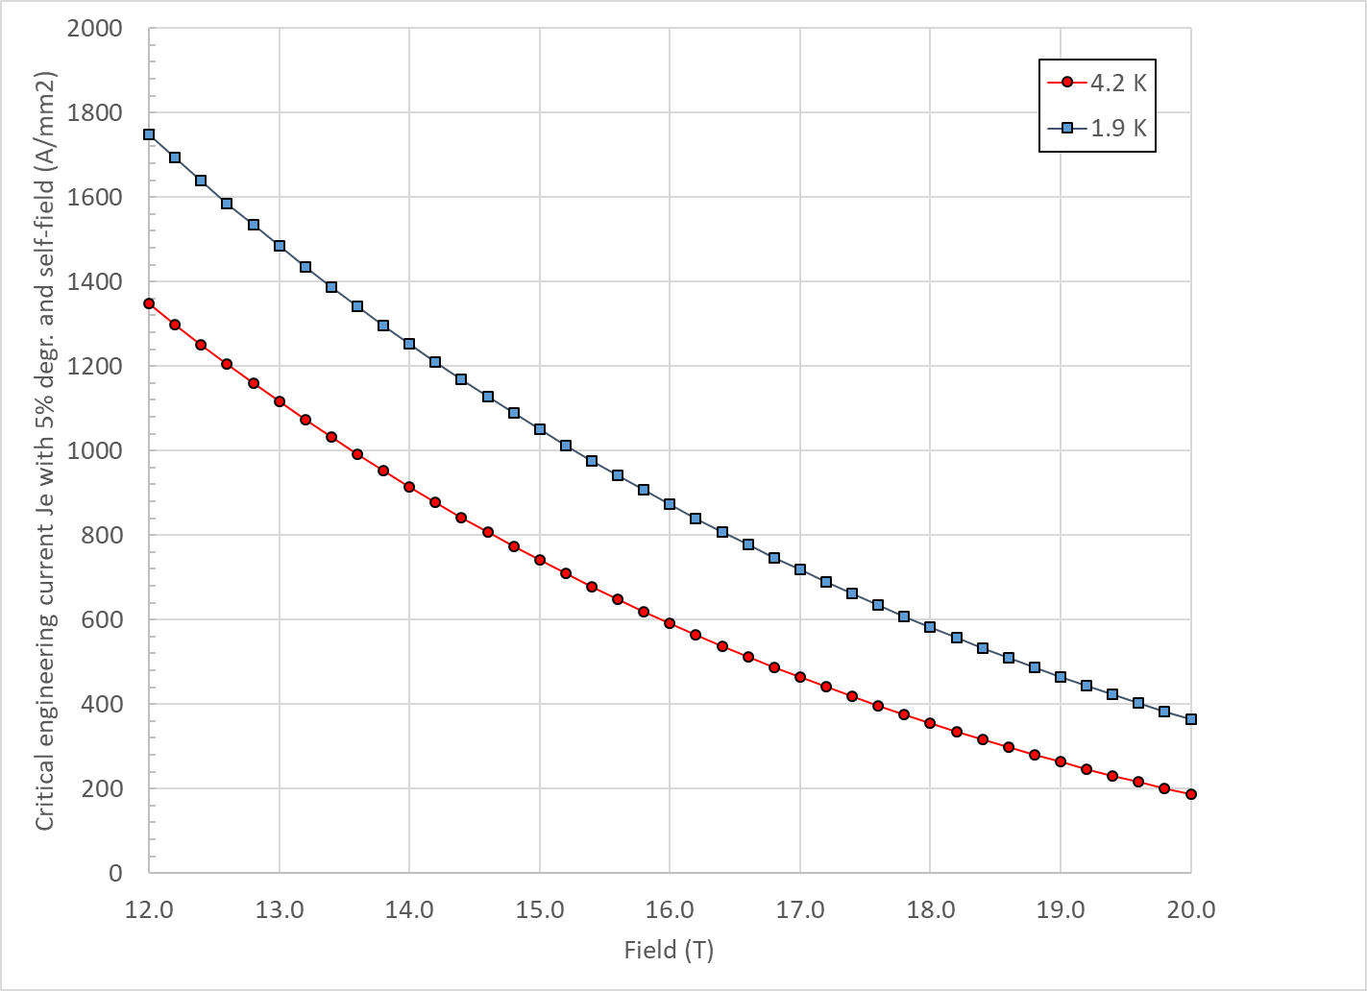
Design criteria for a 20 T hybrid magnet
Nb₃Sn Conductor and cable
  “3000” A/mm² kind of conductor, round, with self field
J_{c} round
J_{c} , 5% deg.
J_{e} , 5% deg.

Slide 19
Design criteria for a 20 T hybrid magnet
Nb₃Sn Conductor and cable
  In general, it would be better to stay within already tested parameters (min, max)
Dimension before reaction; In MQXF, assumed expansion during reaction is 4.5 % (th), 1.2 % (w)

Slide 20
Design criteria for a 20 T hybrid magnet
Bi2212 Conductor and cable (input from T. Shen and L. Garcia Fajardo)
  The wire diameter:
    from 0.6 mm to 1.5 mm
  Cable width: basically same possibilities as with Nb₃Sn cables

Slide 21
Design criteria for a 20 T hybrid magnet
Bi2212 Conductor and cable (input from T. Shen and L. Garcia Fajardo)
  Record performance strand RC5/6 about 20% higher than what is currently “comfortably” produced.

Slide 22
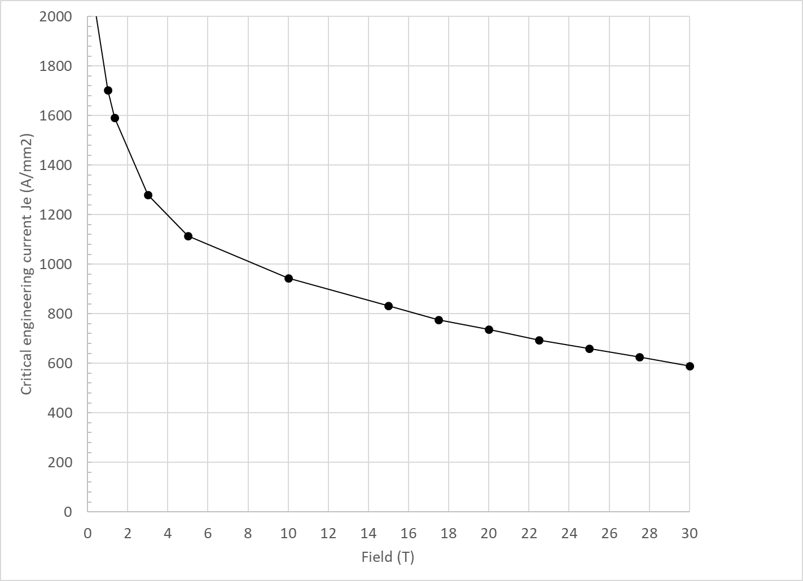
Design criteria for a 20 T hybrid magnet
Bi2212 Conductor and cable (input from T. Shen and L. Garcia Fajardo)

Slide 23
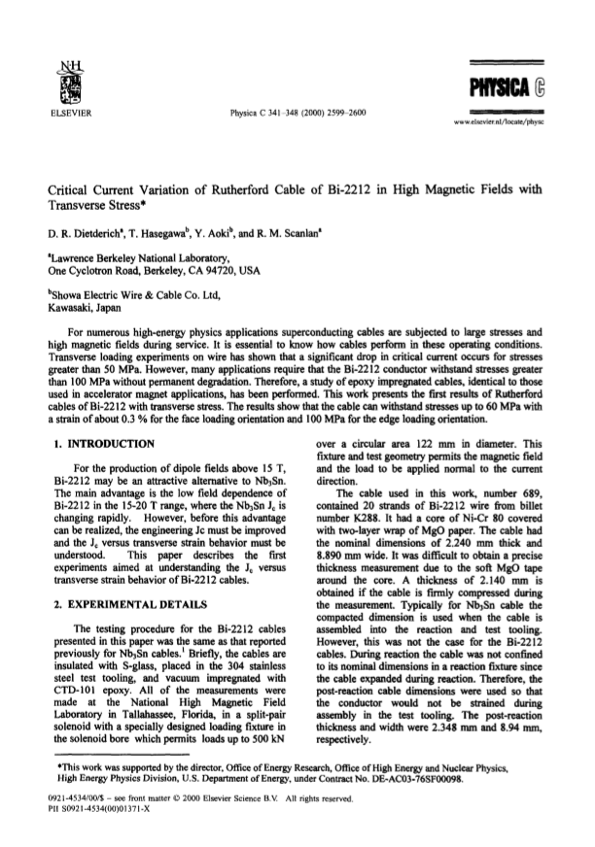
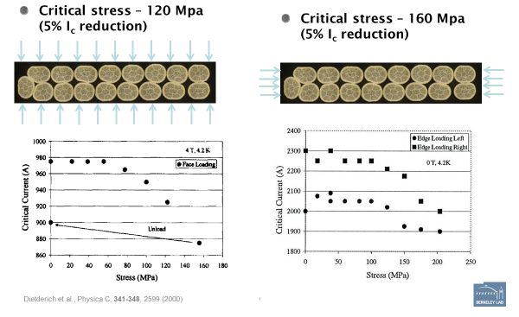
Design criteria for a 20 T hybrid magnet
Bi2212 Conductor and cable
  Maximum Nb₃Sn coil stress: <120 MPa (293) K

Slide 24
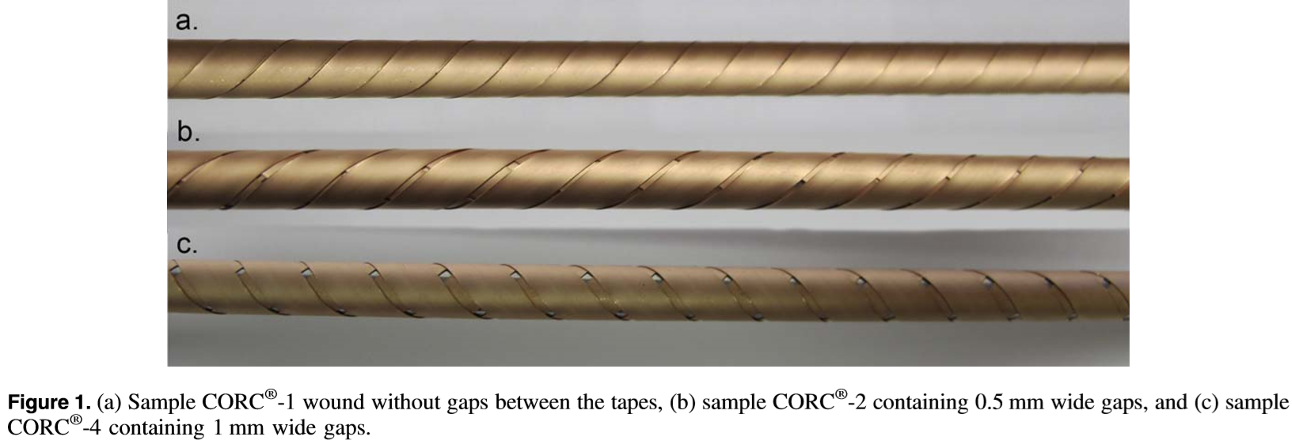
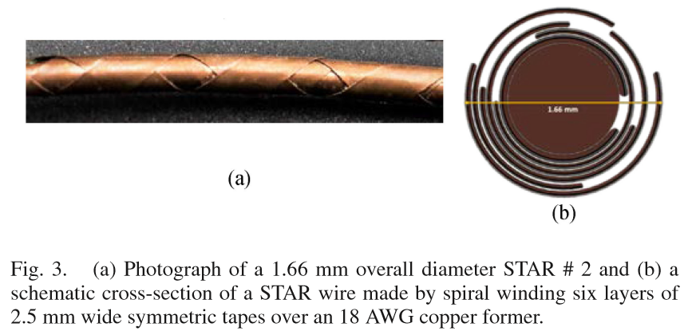
Design criteria for a 20 T hybrid magnet
REBCO Conductor
  CORC cable
    3.42mm diameter including 30 micron thick insulation.
  STAR cable
    1.3 mm diameter without insulation (#3)
    2.04 mm diameter without insulation (#4)

Slide 25
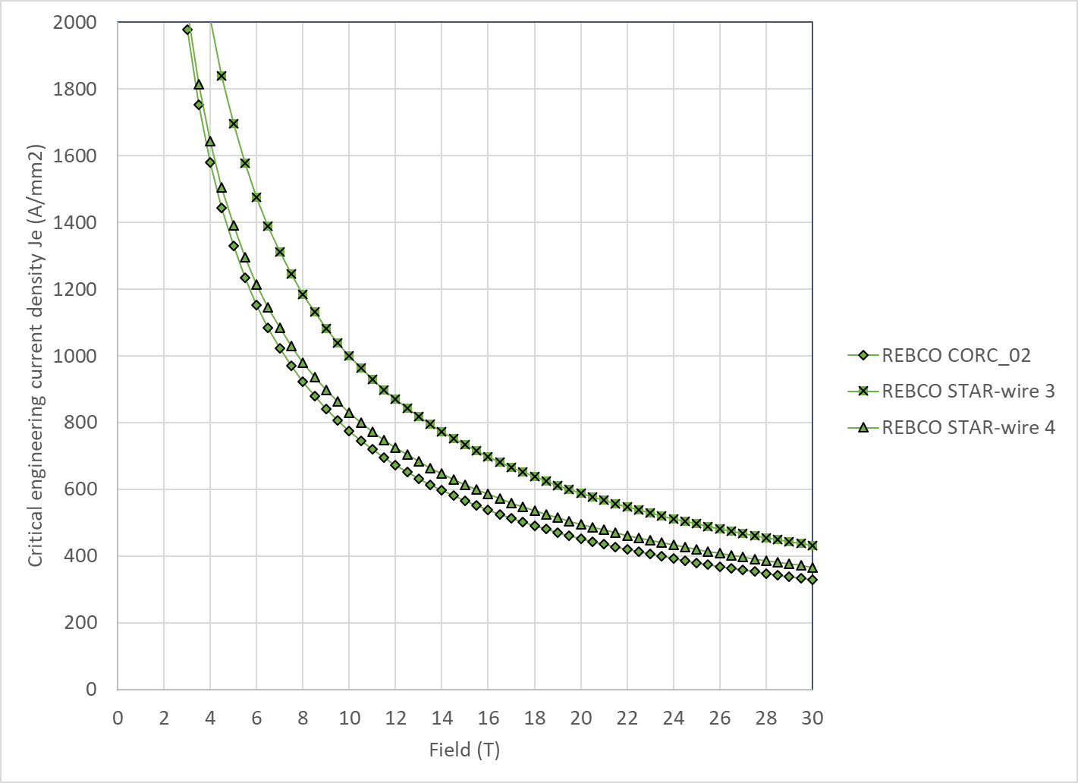
Design criteria for a 20 T hybrid magnet
REBCO Conductor
  We use the following parameterization
    Ic(B, 4.2 K) = 10^( α*log(B)+c)
  Where

Slide 26
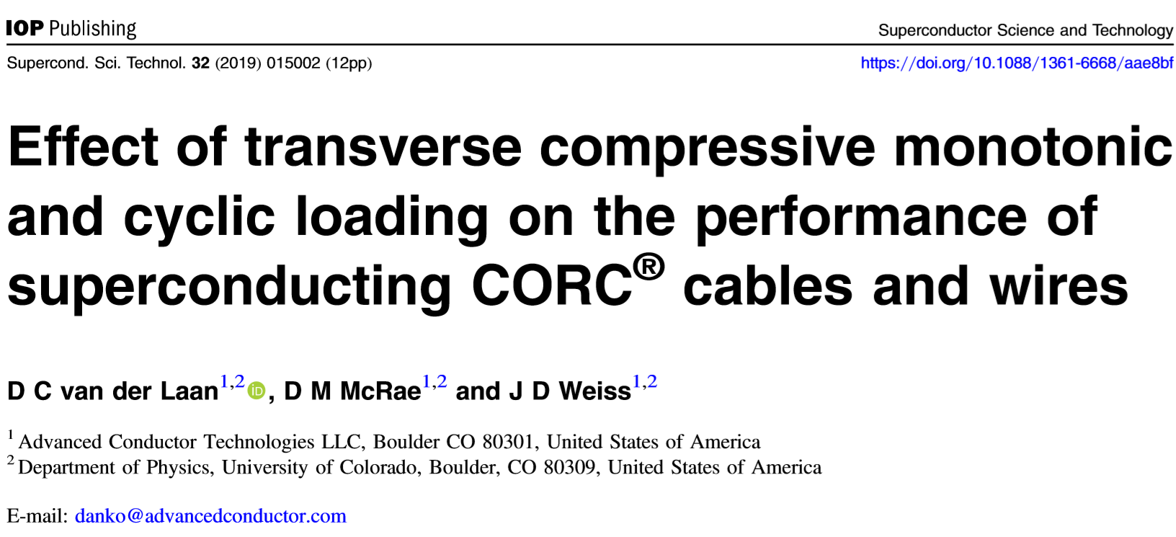
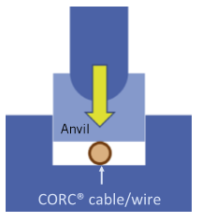
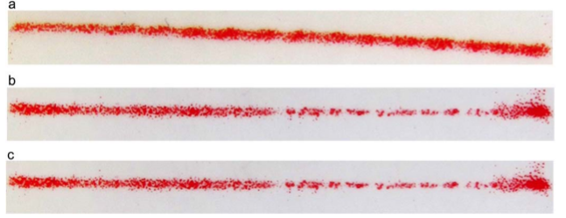
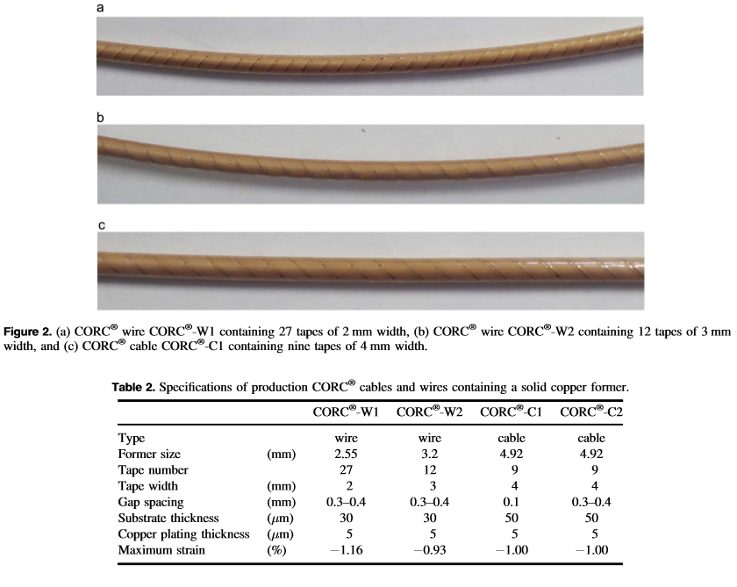
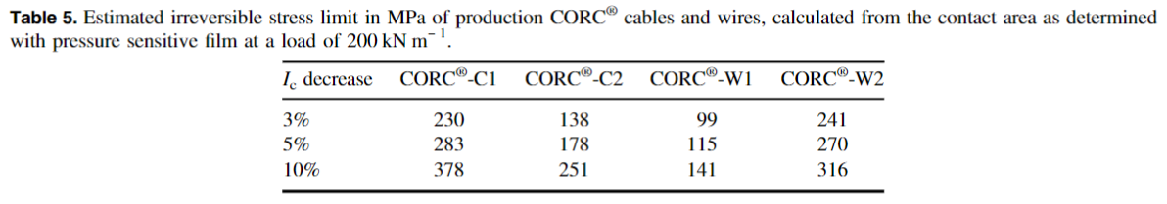
Design criteria for a 20 T hybrid magnet
REBCO Conductor
  Stress degradation

Slide 27
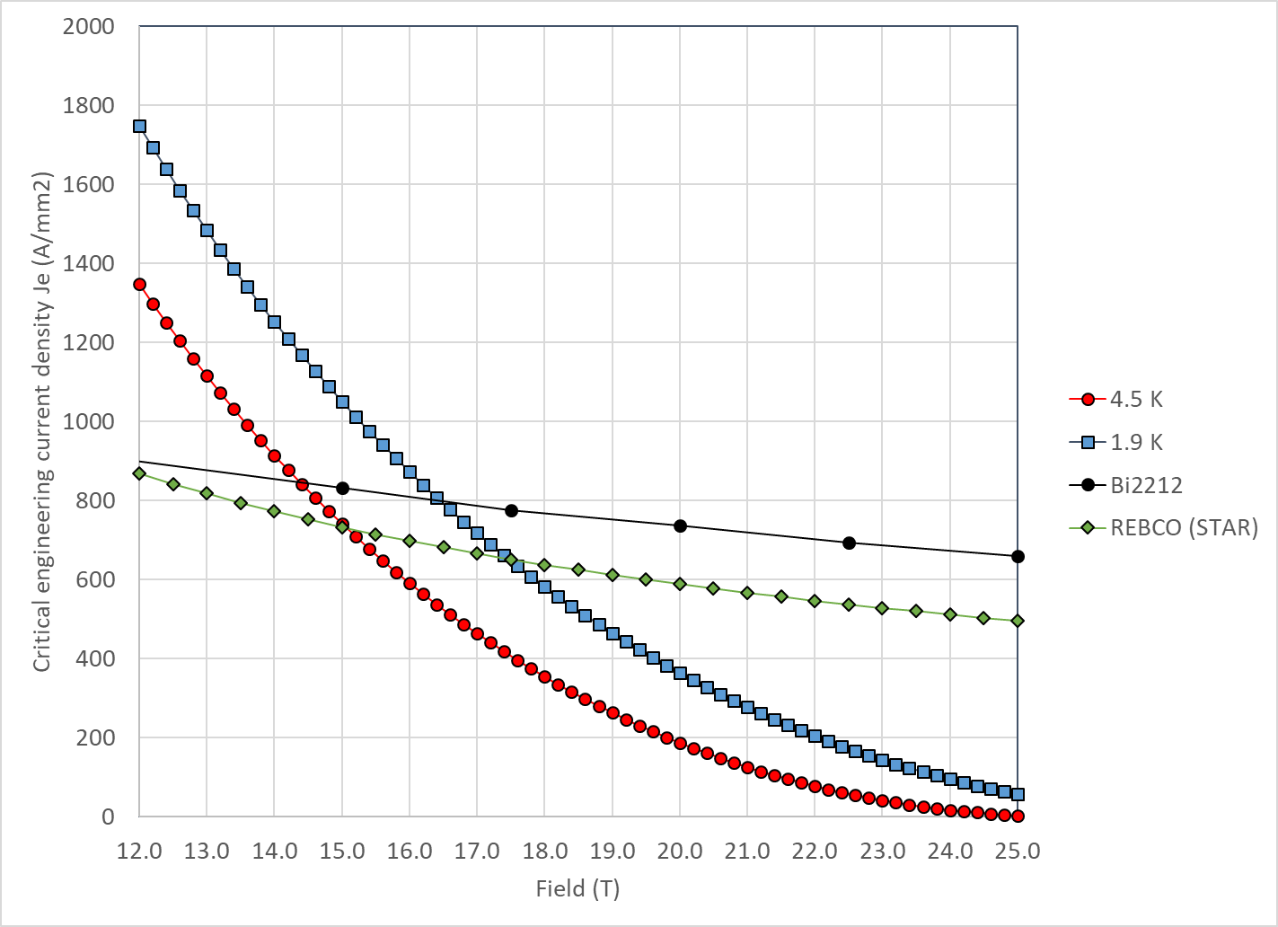
Design criteria for a 20 T hybrid magnet
With properties describe above
  Nb₃Sn and Bi2212 cross at
    14.5 T at 4.2 K
    16.5 T at 1.9 K
  Nb₃Sn and REBCO cross at
    15.0 T at 4.2 K
    17.5 T at 1.9 K

Slide 28
Design criteria for a 20 T hybrid magnet
Quench protection
  Nb₃Sn
    Maximum hot spot temperature 350 K
    Total time delay 40 ms
    Maximum J in the Cu 1350 A/mm²
    Maximum voltage to ground @ quench 1.0 kV
    Ground insulation design voltage >5 kV
  Bi2212 and REBCO
    See next slides
  Powering in series

Slide 29
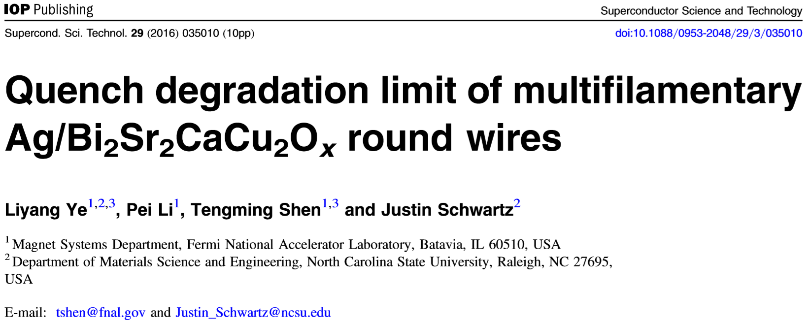
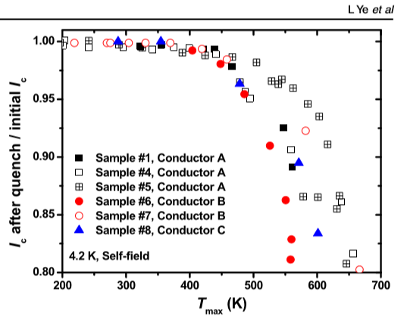
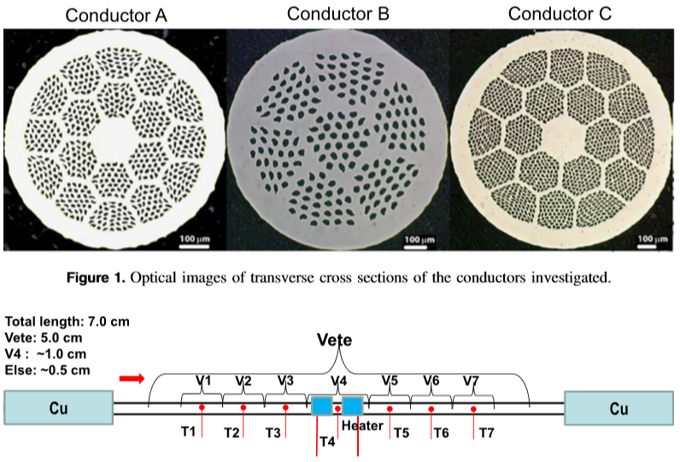
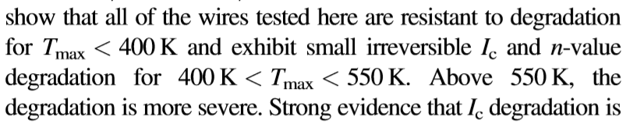
Design criteria for a 20 T hybrid magnet
Quench protection
  Bi2212: T_{max}= 400-450 K

Slide 30
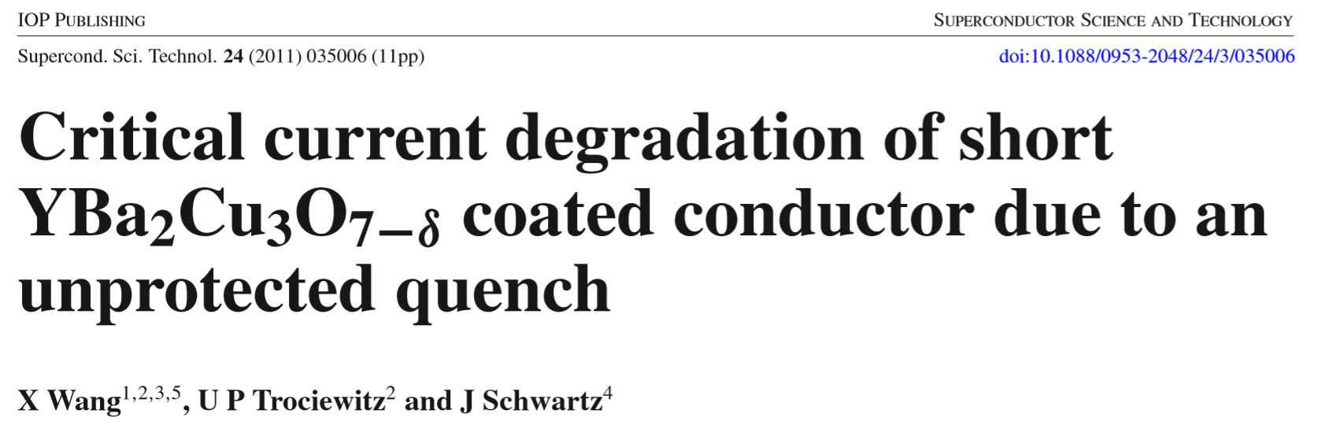
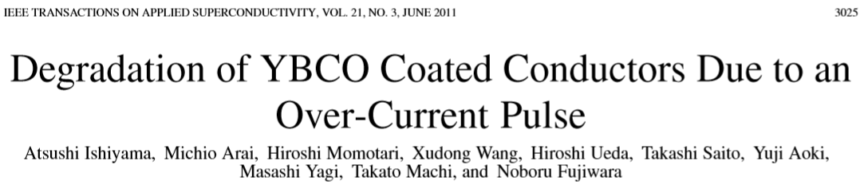
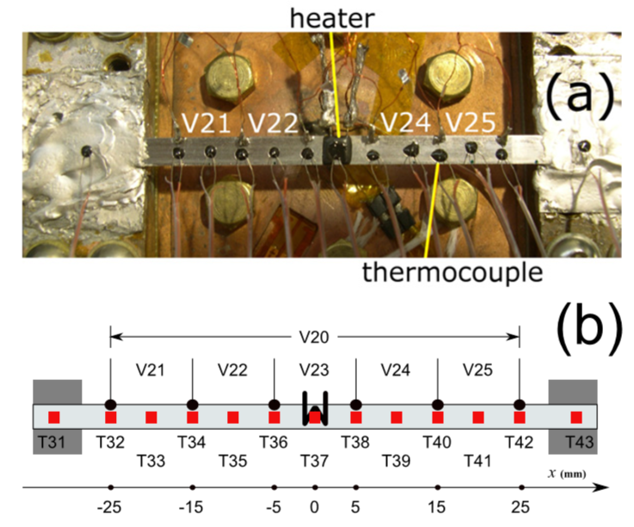
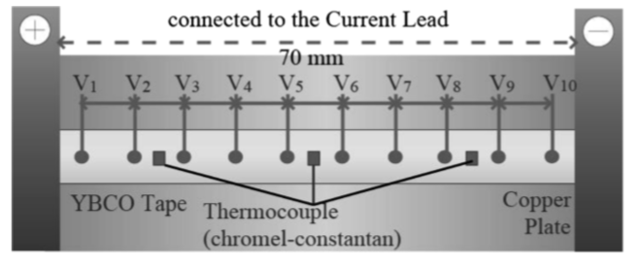
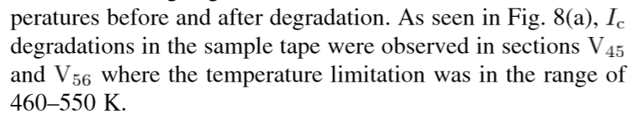
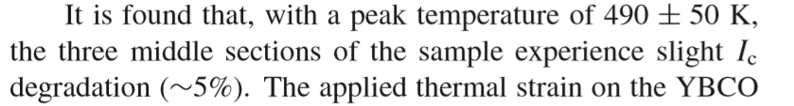
Design criteria for a 20 T hybrid magnet
Quench protection
  REBCO

Slide 31
Design criteria for a 20 T hybrid magnet
Summary on Hot spot temperature
  For all 3 materials, 350 K maximum hot spot temperature appears to be a reasonable value

Slide 32
Outline
Goals of the working group
Model and assumptions
Estimates of radiuses, dimensions, and stresses
  Bi2212 and REBCO cases
Preliminary cos-theta and common coil cross-sections
Appendix
  Design criteria for a 20 T hybrid magnet
  Details of REBCO case

Slide 33
Field in at 20 T hybrid dipole magnet
B_{bore_op} = 20 T with load-line margin of 15% → 85% of I_{ss}
  Same load-line margin for HTS and LTS
B_{peak_op} = 20.8 T
  Assumption: 4% increase B_{bore} to B_{peak}
B_{bore_ss} = 23.5 T
B_{peak_ss} = 24.4 T
  Assumption: 4% increase B_{bore} to B_{peak}

Slide 34

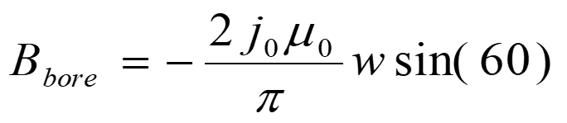
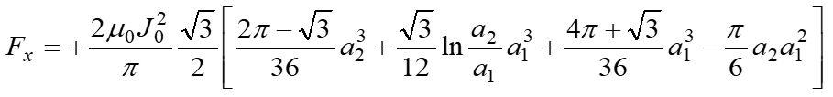
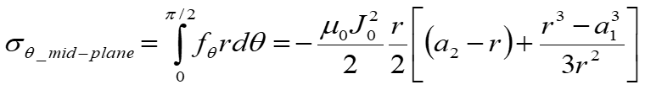
“Sector coil” analytical model
Definitions
  J_{c} = J in superconductor area
  J_{e} = J in strand area
  J_{o} = J in coil area
MQXF/11T cable parameters
  J_{e} = J_{c} * 0.48
  J_{o} = J_{e} * 0.67
  J_{o} = J_{c} * 0.32
No grading
  Same current, same J everywhere
    As if HTS and LTS use the same cable, and are powered in series
Sector coil (60°) with J = J₀ distribution
  No iron
  Constant Jo

Slide 35
Outline
Goals of the working group
Model and assumptions
Estimates of radiuses, dimensions, and stresses
  Bi2212 and REBCO cases
Preliminary cos-theta and common coil cross-sections
Appendix
  Design criteria for a 20 T hybrid magnet
  Details of REBCO case

Slide 36
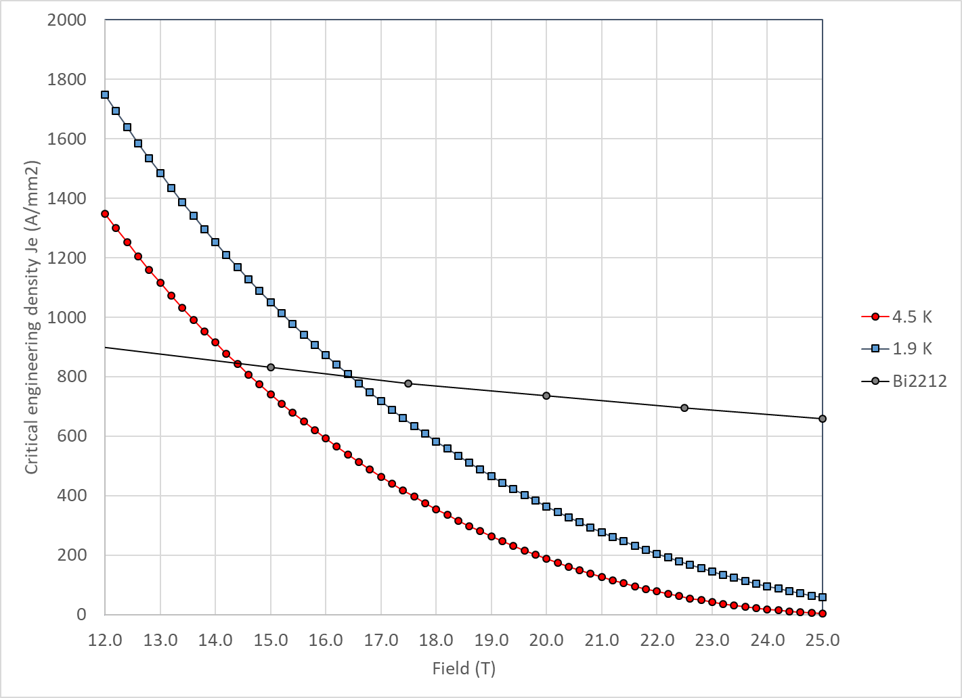
Nb₃Sn vs Bi2212
With properties describe in appendix, Nb₃Sn and Bi2212 cross at 14.5 T at 4.2 K and 16.5 T at 1.9 K

Slide 37
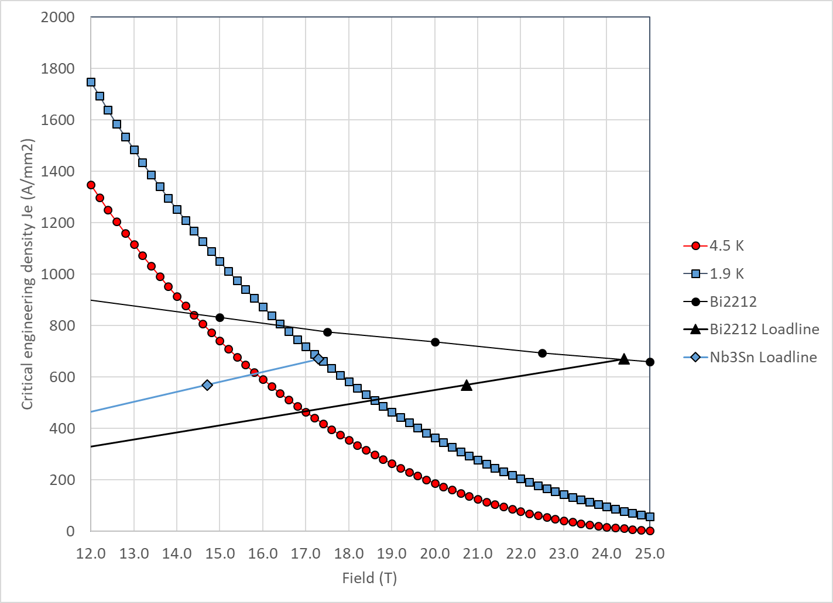
20 T Bi2212-Nb₃Sn hybrid
Bi2212
  At short sample
    B_{p_ss} = 24.4 T
    J_{e_ss} = 670 A/mm2
    J_{o_ss} = 450 A/mm²
  So, at 85% of short sample
    B_{p_op} = 20.8 T
    J_{e_op} = 570 A/mm2
    J_{o_op} = 382 A/mm²

Slide 38
20 T Bi2212-Nb₃Sn hybrid
Nb₃Sn
  At short sample
    B_{p_ss} = 17.3 T
    J_{e_ss} = 670 A/mm2
    J_{o_ss} = 450 A/mm²
  So, at 85% of short sample
    B_{p_op} = 14.7 T
    J_{e_op} = 570 A/mm2
    J_{o_op} = 382 A/mm²

Slide 39
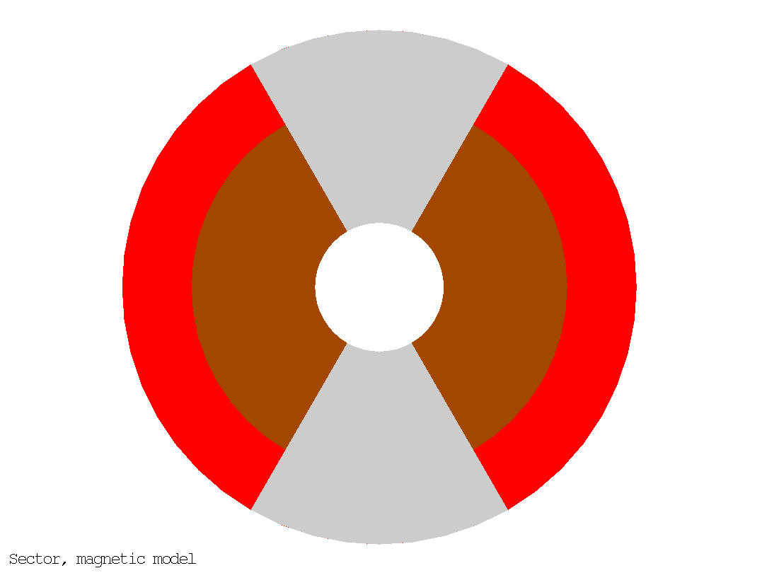
20 T Bi2212-Nb₃Sn hybrid
50 mm aperture
Under the previous assumption (sector coil, constant Jo everywhere, no stress management, no iron)
  ID Nb₃Sn = 146 mm
  OD Nb₃Sn = 200 mm
  76 m total coil thickness
    49 mm thick Bi2212 coil
    27 mm thick Nb₃Sn coil
  Area Bi2212: 2540 mm² (1 quadrant)
  Area Nb₃Sn: 2470 mm² (1 quadrant)
  Stored energy: 2.86 MJ/m (4 quadrants)
20 T = 13 T + 7 T
Nb₃Sn
Bi2212

Slide 40
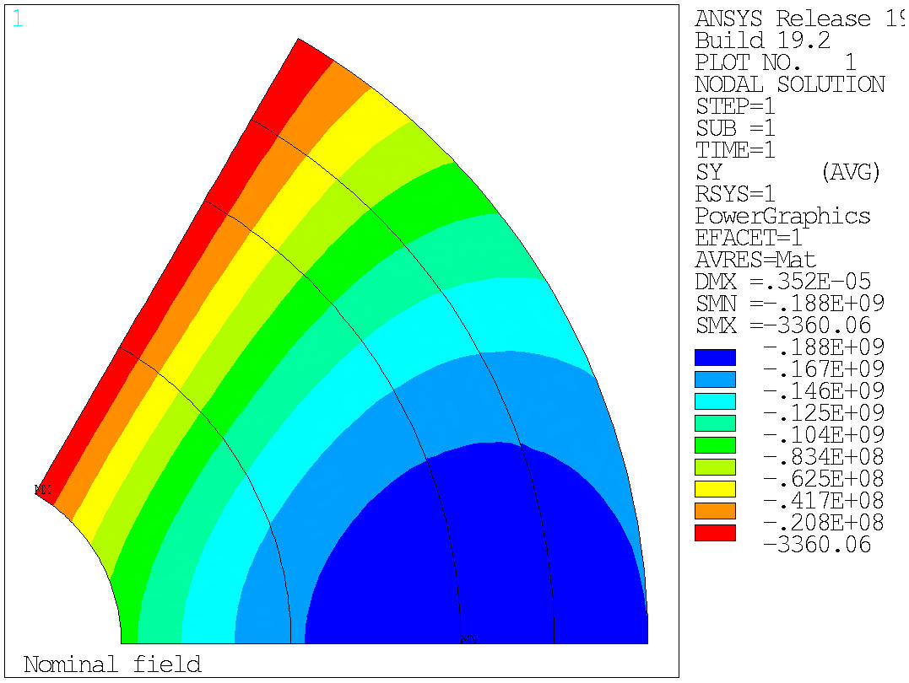
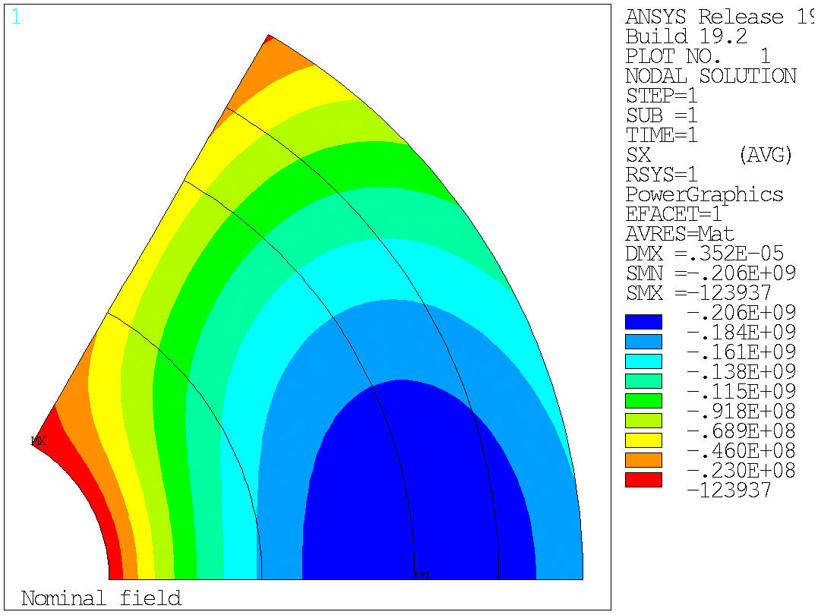
20 T Bi2212-Nb₃Sn hybrid
Stress at B-bore = 20 T
Azimuthal stress on the mid-plane → Max: 188 MPa
Radial stress → Max: 206 MPa
  No shear, no bending….
Azimuthal
Radial

Slide 41
20 T Bi2212-Nb₃Sn hybrid
Test separately the Nb₃Sn and the Bi2212 coils
ID: 50 mm
OD: 200 mm
W: 76 mm
ID: 50 mm
OD: 146 mm
W: 49 mm
ID: 146 mm
OD: 200 mm
W: 27 mm
Nb₃Sn
Nb₃Sn
Nb₃Sn
Bi2212
Bi2212
Bi2212

Slide 42
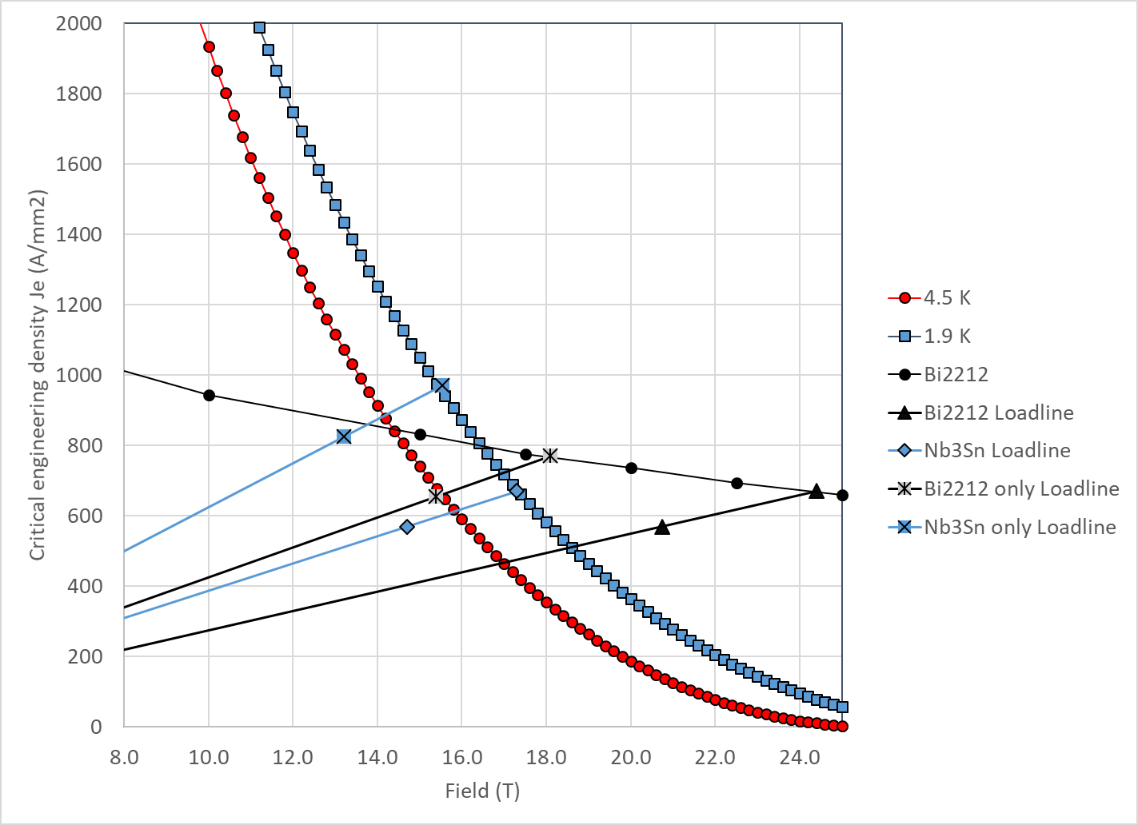
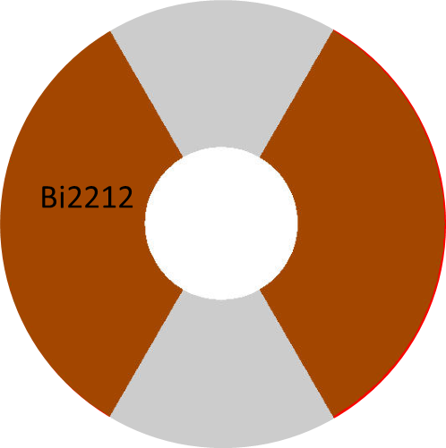
20 T Bi2212-Nb₃Sn hybrid
Bi2212 “only”
Bi2212
  At short sample
    B_{p_ss} = 18.4 T
    B_{bore_ss} = 17.4 T
    J_{e_ss} = 769 A/mm2
    J_{o_ss} = 515 A/mm²
  So, at 85% of short sample
    B_{p_op} = 15.6 T
    B_{bore_op} = 14.7 T
    J_{e_op} = 653 A/mm2
    J_{o_op} = 438 A/mm²

Slide 43
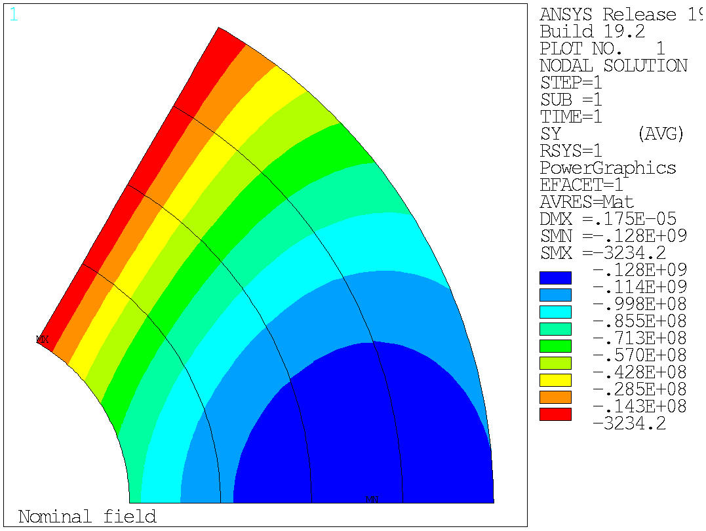
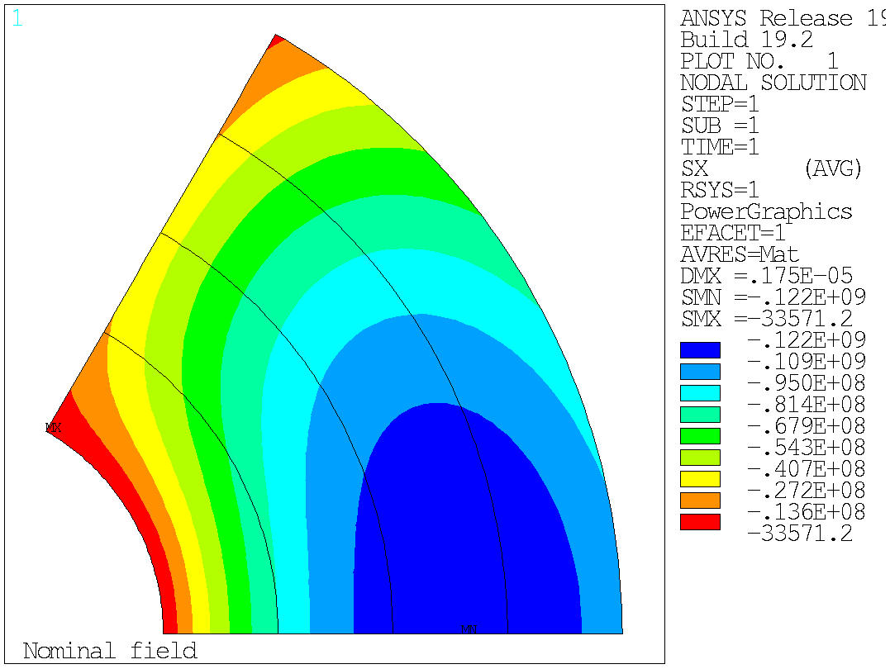
20 T Bi2212-Nb₃Sn hybrid
Bi2212 “only”, Stress at B-bore = 14.7 T
Azimuthal stress on the mid-plane → Max: 128 MPa
Radial stress → Max: 122 MPa
  No shear, no bending….
Azimuthal
Radial

Slide 44
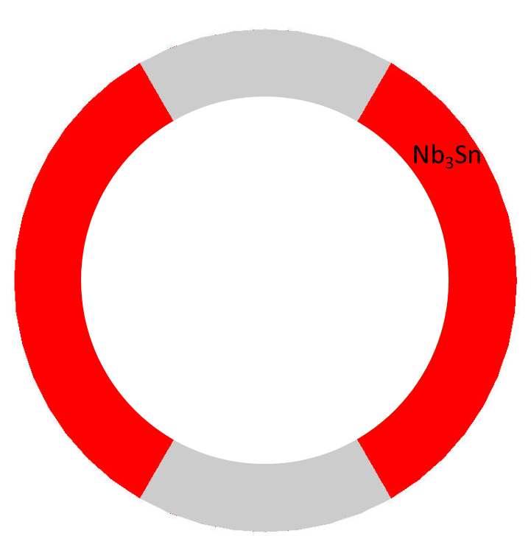
20 T Bi2212-Nb3Sn hybrid
Nb3Sn “only”
Nb3Sn
  At short sample
    B_{p_ss} = 15.3 T
    B_{bore_ss} = 12.1 T
    J_{e_ss} = 985 A/mm2
    J_{o_ss} = 660 A/mm²
  So, at 85% of short sample
    B_{p_op} = 13.0 T
    B_{bore_op} = 10.3 T
    J_{e_op} = 837 A/mm2
    J_{o_op} = 561 A/mm²

Slide 45
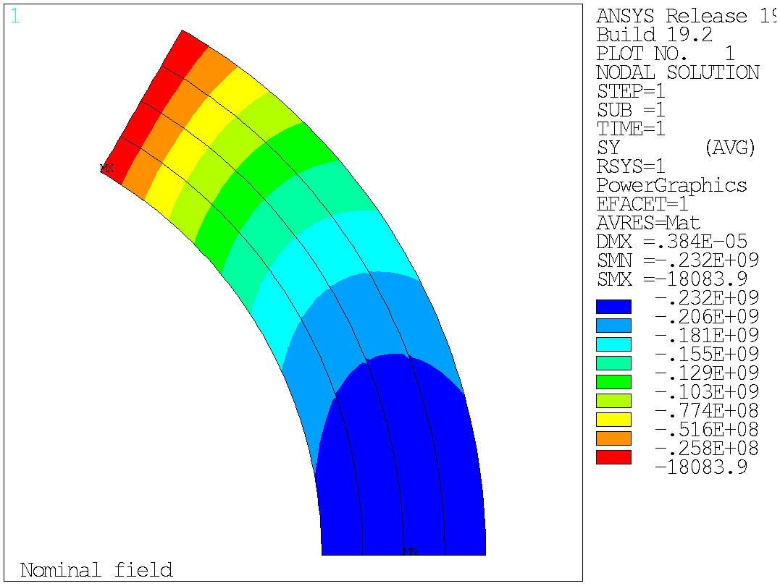
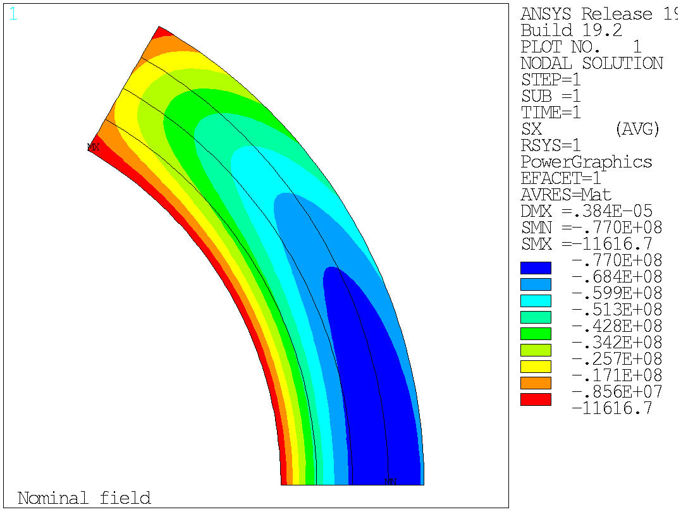
20 T Bi2212-Nb₃Sn hybrid
Nb₃Sn “only”, Stress at B-bore = 10.3 T
Azimuthal stress on the mid-plane → Max: 232 MPa
Radial stress → Max: 77 MPa
  No shear, no bending….
Azimuthal
Radial

Slide 46
Outline
Goals of the working group
Model and assumptions
Estimates of radiuses, dimensions, and stresses
  Bi2212 and REBCO cases
Preliminary cos-theta and common coil cross-sections
Appendix
  Design criteria for a 20 T hybrid magnet
  Details of REBCO case

Slide 47
20 T REBCO-Nb₃Sn hybrid (work in progress…)
With properties describe in appendix
  Nb₃Sn and Bi2212 cross at
    14.5 T at 4.2 K
    16.5 T at 1.9 K
  Nb₃Sn and REBCO cross at
    15.0 T at 4.2 K
    17.5 T at 1.9 K

Slide 48

20 T REBCO-Nb₃Sn hybrid
REBCO
  At short sample
    B_{p_ss} = 24.4 T
    J_{e_ss} = 504 A/mm2
    J_{o_ss} = 338 A/mm²
  So, at 85% of short sample
    B_{p_op} = 20.8 T
    J_{e_op} = 429 A/mm2
    J_{o_op} = 287 A/mm²

Slide 49
20 T REBCO-Nb₃Sn hybrid
Nb₃Sn
  At short sample
    B_{p_ss} = 18.7 T
    J_{e_ss} = 504 A/mm2
    J_{o_ss} = 338 A/mm²
  So, at 85% of short sample
    B_{p_op} = 15.9 T
    J_{e_op} = 429 A/mm2
    J_{o_op} = 287 A/mm²

Slide 50

20 T REBCO-Nb₃Sn hybrid
50 mm aperture
Under the previous assumption (sector coil, constant Jo everywhere, no stress management, no iron)
And also, from CORC/STAR Je to Jo like in MQXF → “Rutherford cable with CORC/START wires” (see later)
  ID Nb₃Sn = 144 mm
  OD Nb₃Sn = 252 mm
  101 m total coil thickness
    47 mm thick REBCO coil
    54 mm thick Nb₃Sn coil
  Area Bi2212: 2387 mm² (1 quadrant)
  Area Nb₃Sn: 5532 mm² (1 quadrant)
  Stored energy: 3.92 MJ/m (4 quadrants)
20 T = 9 T + 11 T
Nb₃Sn
REBCO

Slide 51


20 T REBCO-Nb₃Sn hybrid
Test separately the Nb₃Sn and the Bi2212 coils
ID: 50 mm
OD: 252 mm
W: 101 mm
ID: 50 mm
OD: 144 mm
W: 47 mm
ID: 144 mm
OD: 252 mm
W: 54 mm
Nb₃Sn
Nb₃Sn
REBCO
REBCO

Slide 52


Summary
Bi2212
REBCO
ID: 50 mm
OD: 200 mm
W: 76 mm
B_{_bore_op} = 20 T
σ_{ϑ}/ σ_{r} =188/206
ID: 50 mm
OD: 146 mm
W: 49 mm
B_{_bore_op} = 14.7 T
σ_{ϑ}/ σ_{r} =128/122
ID: 146 mm
OD: 200 mm
W: 27 mm
B_{_bore_op} = 10.3 T
σ_{ϑ}/ σ_{r} =232/77
ID: 50 mm
OD: 252 mm
W: 101 mm
B_{_bore_op} B = 20 T
σ_{ϑ}/ σ_{r} =165/194
ID: 50 mm
OD: 144 mm
W: 47 mm
B_{_bore_op} = 12.8 T
σ_{ϑ}/ σ_{r} =99/93
ID: 144 mm
OD: 252 mm
W: 54 mm
B_{_bore_op} = 13.1 T
σ_{ϑ}/ σ_{r} =201/114

Slide 53

Summary
REBCO hybrid still larger than Bi2212
  Because of a lower J_{e}
    And also with “unrealistic” assumption on J_{o}
We need to build a
  13-14 T HTS magnet (50 mm)
  10-13 T LTS magnet (large bore)
    120 mm seems a good start, but we may need more for an hybrid magnet
In hybrid 20 T, radial stress seems higher than azimuthal
  When tested separately, very high azimuthal stress in LTS

Slide 54

Very…very…preliminary magnet size
20 mm collar
250 mm thick yoke
  However, for a single short model, higher stray field could be accepted
50 mm thick shell
  F_{x}/t = 200 MPa
OD: 850 mm

Slide 55


Size comparison
LHC MQXF FRESCA2 ????

Slide 56


Action items
Update thick shell analysis with iron (by J. Stern)

Slide 57

CT- SMCT options
Summary

Slide 58

CT option
4 HTS 2 LTS
v9b : 4 HTS 2 LTS
  increase cable LTS to 16 to reduce stress (right now 170 MPa)

Slide 59

V9e: wider LTS conductor
v9e : 4 HTS 2 LTS
4 layer HTS, 2 layer LTS
Strands: 0.8 mm, 40 – 35 – 36
Cable width: 18.35 – 16.06 – 15.96 mm
Stabilizer/Superconductor: 3 – 3 – 1
Coil width: 105 mm
Current: 10920
Peak field: 20.48 – 15.88 – 12.53 T
Margin: 82.5 – 82.8 – 74.5 %
J_{cu} on LTS: 1206 A/mm²
Peak azimuthal Lorentz force: 151/142 MPa (LTS/HTS) (151/170 MPa in v9b)

Slide 60

CT option
2 HTS 4 LTS
- v11: CT option with 2 HTS 4 LTS
  - Try with a larger HTS cable to increase margin
  - Optimize layer 3-4: try removing top blocks and larger cable

Slide 61

V11b: larger HTS conductor
I want to reduce layer 1 and 2 width, slightly increase layer 3-4, increase layer 5-6
2 layer HTS, 4 layer LTS
Strands: 1.1/1.1/0.8 mm, 40 – 35 – 30
Cable width: 25.23 –21.3 – 13.3 mm
Stabilizer/Superconductor: 3 – 3 – 1
Coil width: 123 mm
Current: 14200
Peak field: 20.26 – 15.96 – 13.72 T
Margin: 66 – 86 – 89 %
J_{cu} on LTS: 1883 A/mm²
Peak azimuthal Lorentz force: 92/233 MPa (LTS/HTS)

Slide 62

SMCT option
4 HTS 2 LTS
- v12: SMCT option with 4 HTS 2 LTS
  - Increase margin
  - Smaller ribs
  - Increase top angle
V12b: same but with mid-planes ribs
  - to be done with 2mm per side

Slide 63

v12b
Increase layer 5-6 width?
4 layer HTS, 2 layer LTS
Strands: 0.8 mm, 46 – 40 – 30
Cable width: 21.1 – 18.35– 13.3 mm
Stabilizer/Superconductor: 3 – 3 – 1.5
Coil width: 132 mm
Current: 11820 A
Peak field: 20.5 – 16.18 – 13.95 T
Margin: 79.5 – 80.2 – 85.8 %
J_{cu} on LTS: 1567 A/mm²

Slide 64

v12c: 2 mm rib on midplane
Bore field: 19.94 T

Slide 65
Additional cases
- v13: SMCT option with 2 HTS 4 LTS
  - to be done
- v9b with only top blocks of layer 3-4 with HTS, the rest LTS (4-5 with lower angle to allow splice)

Slide 66

CT preliminary design (D. Arbelaez)
6 layers, same cable
MQXF cable
With Iron
5 mm thick spars

Slide 67


CT preliminary design (D. Arbelaez)

Slide 68

CT preliminary design (D. Arbelaez)
Coil OR: 165 mm

Slide 69


Block option

Slide 70



Common-coil option
Designs to be updated

Slide 71
Next plans and conclusions
Next plans and conclusions
Continue the analysis of each option until a complete design study is carried out
  Then, start with the comparison
    Comparison criteria to be further defined
Resources……
  A student/Post-doc available to work for a significant fraction of his/her time is strongly needed.

Slide 72
Appendix
Design criteria
Details of REBCO case

Slide 73


20 T REBCO-Nb₃Sn hybrid
Stress at B-bore = 20 T
Azimuthal stress on the mid-plane → Max: 165 MPa
Radial stress → Max: 194 MPa
  No shear, no bending….
Azimuthal
Radial

Slide 74


20 T REBCO-Nb₃Sn hybrid
REBCO “only”
REBCO
  At short sample
    B_{p_ss} = 16.0 T
    B_{bore_ss} = 15.1 T
    J_{e_ss} = 697 A/mm2
    J_{o_ss} = 467 A/mm²
  So, at 85% of short sample
    B_{p_op} = 13.6 T
    B_{bore_op} = 12.8 T
    J_{e_op} = 592 A/mm2
    J_{o_op} = 397 A/mm²

Slide 75


20 T REBCO-Nb₃Sn hybrid
REBCO “only”, Stress at B-bore = 12.8 T
Azimuthal stress on the mid-plane → Max: 99 MPa
Radial stress → Max: 93 MPa
  No shear, no bending….
Azimuthal
Radial

Slide 76

20 T REBCO-Nb₃Sn hybrid
Nb₃Sn “only”
Nb₃Sn
  At short sample
    B_{p_ss} = 17.7 T
    B_{bore_ss} = 15.4 T
    J_{e_ss} = 622 A/mm2
    J_{o_ss} = 417 A/mm²
  So, at 85% of short sample
    B_{p_op} = 15.0 T
    B_{bore_op} = 13.1 T
    J_{e_op} = 529 A/mm2
    J_{o_op} = 354 A/mm²

Slide 77


20 T REBCO-Nb₃Sn hybrid
Nb³Sn “only”, Stress at B-bore = 13.1 T
Azimuthal stress on the mid-plane → Max: 201 MPa
Radial stress → Max: 114 MPa
  No shear, no bending….
Azimuthal
Radial

