Slide 1
20 T Hybrid Common Coil Design
Preliminary Investigations
February 23, 2021
Ramesh Gupta
BNL

Slide 2
Contents
Preliminary Investigations
Two designs
one with optimized field quality
other the way it would be for the desired margin
Need better computation on field margin
this one with the linear fit as Vittorio Marinozzi did – based on his file (used correctly? free to share files)
Comparisons should have the same parameters, same way of computing margin, etc., etc.
Should be ready in time for inclusion for Paolo’s presentation at the annual collaboration meeting

Slide 3
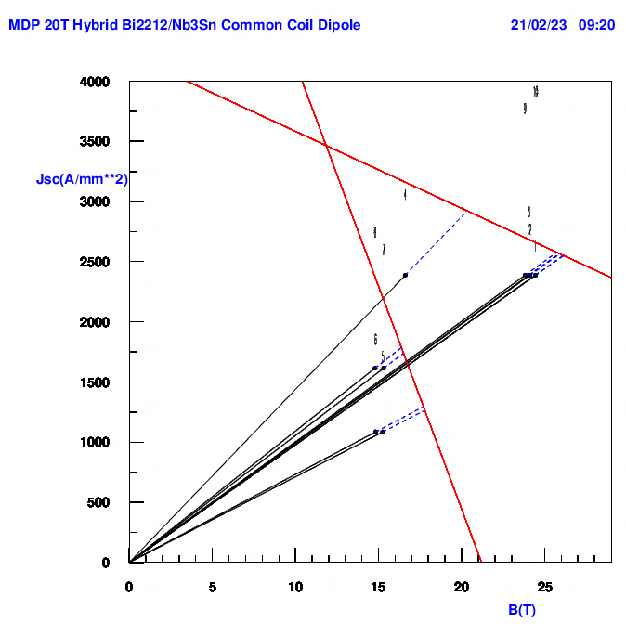
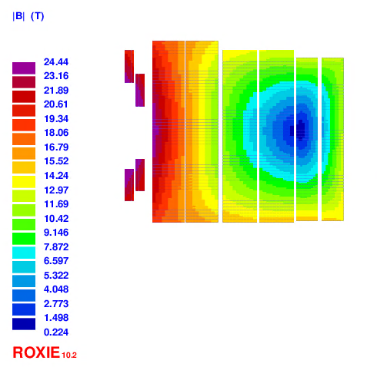
Desired Design Type
HTS
Nb₃Sn
HTS
Places for intermediate structure
Bo=24.1 T
@15 kA
Benefit of the common coil design: easier to modularize, easier to incorporate intermediate structure and layers move as a unit which allows large movement (as a whole) with less strain on the conductor

Slide 4
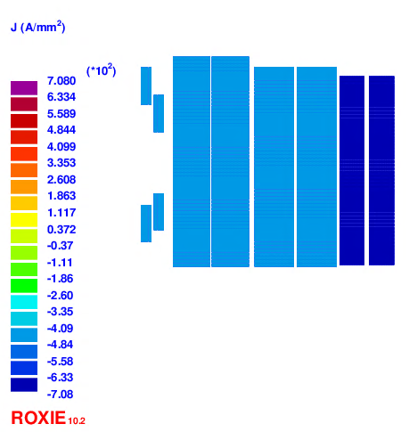
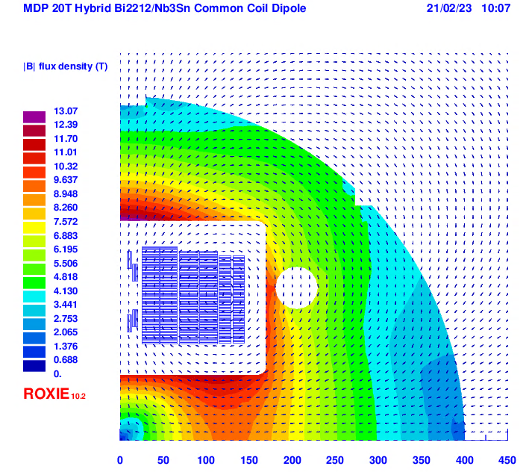
Desired Design Type

Slide 5
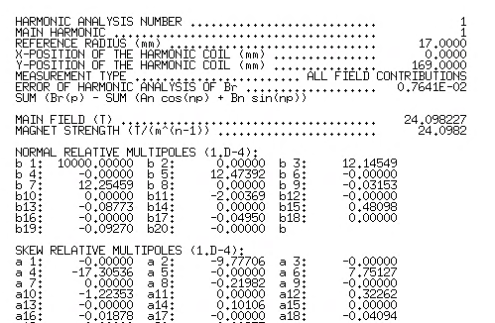
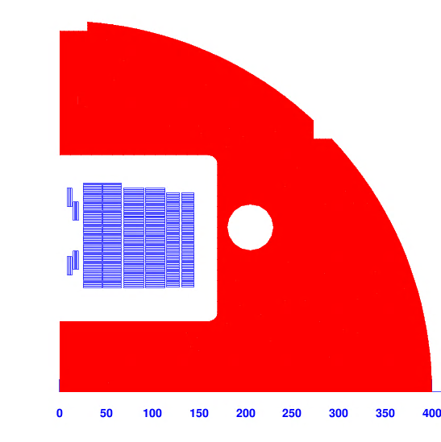
Desired Design Type
Current : 15 kA, all conductor in series

Slide 6
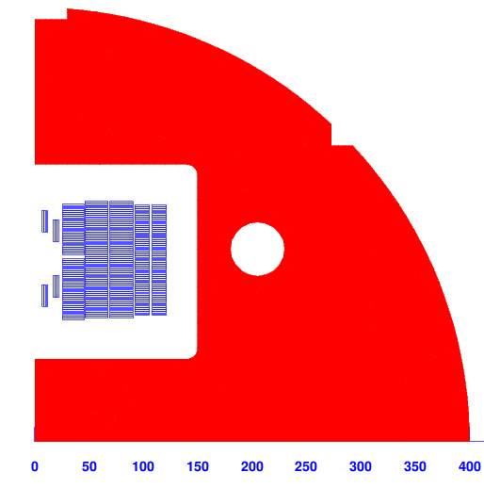
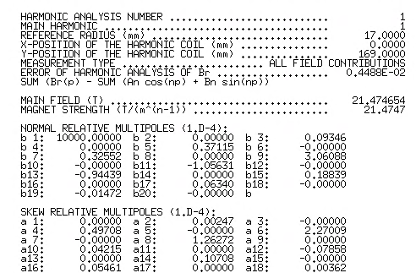
Optimized Field Quality Design
Current : 14.7 kA, all conductor in series
B=21.88 T @15 kA

Slide 7
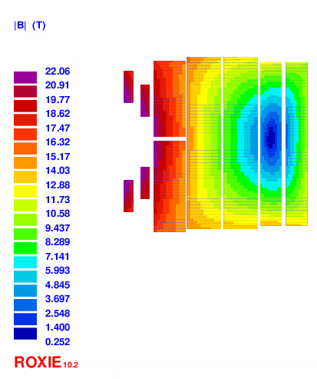
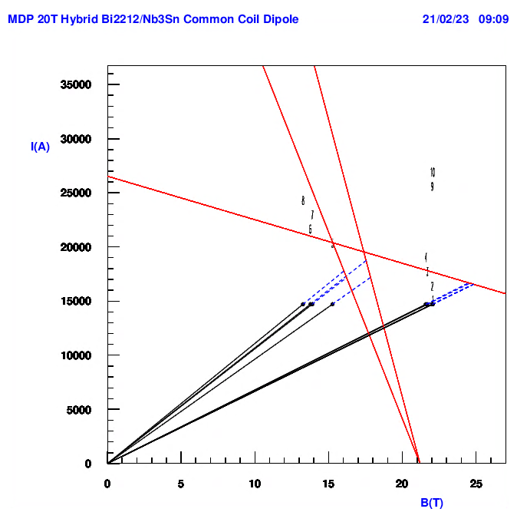
Optimized Field Quality Design
HTS
Nb₃Sn
HTS
Places for intermediate structure
Bo=21.5 T
@14.7 kA
Benefit of the common coil design: easier to modularize, easier to incorporate intermediate structure and layers move as a unit which allows large movement (as a whole) with less strain on the conductor

Slide 8
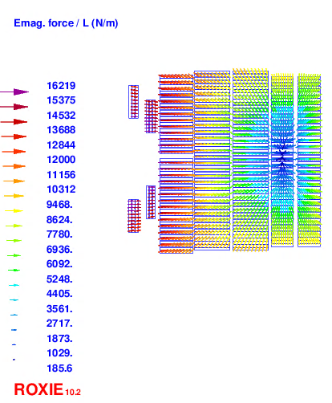
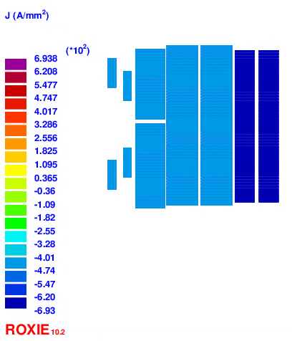
Optimized Field Quality Design
Current : 14.7 kA,
all conductor in series

Slide 9
Summary
Preliminary Investigations
Two designs
one with optimized field quality
other the way it would be for the desired margin
Need better computation on field margin
this one with the linear fit as Vittorio Marinozzi did – based on his file (used correctly? free to share files)
Comparisons should have the same parameters, same way of computing margin, etc., etc.
Should be ready in time for inclusion for Paolo’s presentation at the annual collaboration meeting

