Slide 1
EIC Silicon Consortium
Tracking needs
Membership
Current Status
Plans

Slide 2
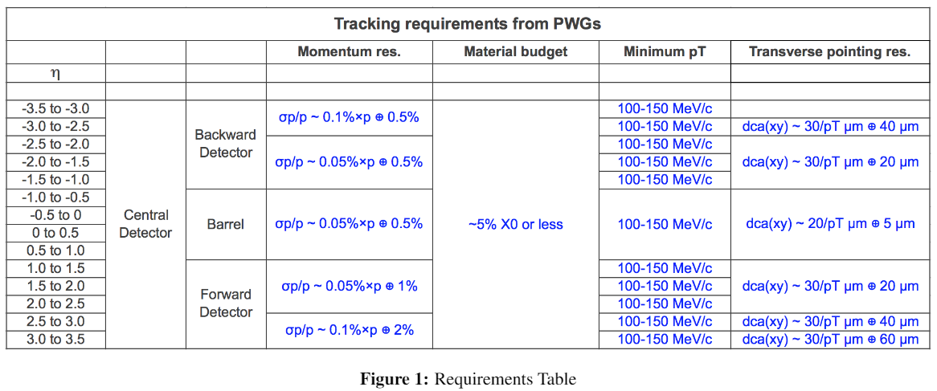
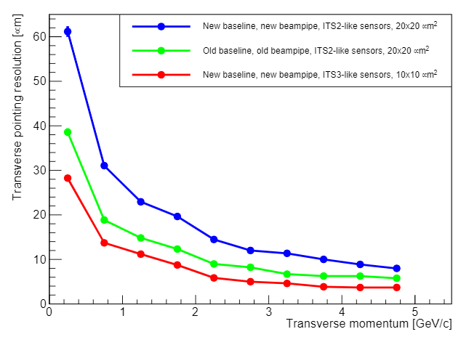
EICSC need
Tracking / Sensor requirements:
Yellow Report
Currently only MAPS meet this requirement.
The newly defined size of the beam pipe shows the need for the sensor pixel size to be < 20 um to meet central tracking requirements.
Other sensor candidates either can not be modified to meet the requirements or do not appear to have sufficient support to be available by the time needed.
The path of using synergy with the CERN ITS3 effort is, in my opinion, the best path to success.
The EICSC goal of developing a full detector solution using sensors based on the ITS3 design is a critical and time sensitive effort for tracking at the EIC

Slide 3
EICSC Genesis
ALICE had been working on a next generation thinned and bent MAPs concept for 2018-2019.
The initial specifications looked very good and had possible application outside of ALICE.
The ALICE conceptual development culminated in an LOI that was endorsed by the LHCC at CERN.
This led to a kickoff meeting at CERN for the ITS-3 detector development (December 4, 2019).
Unlike previous CERN based sensor development projects the ITS-3 sensor project would welcome outside institutions and consortiums as collaborators in the chip design and would make an agreement to share the IP that is to come from this effort.
The specifications for the sensor were had significant overlap with the needs of the EIC.
It was proposed to form an EIC Silicon Consortium to work on adopting this sensor at the December 12-13, 2019 EICYR meeting at MIT https://indico.jlab.org/event/348/sessions/1224/attachments/4665/5789/open-mic.pdf

Slide 4
Main Effort
Unlike previous CERN based sensor development projects the ITS-3 sensor project would welcome outside institutions and consortiums as collaborators in the chip design and would make an agreement to share the IP that is to come from this effort.

Slide 5
New sensor design – compared to existing ALPIDE

Slide 6
EICSC Goals
EICSC Goals from the response to the Call for Expressions of Interest for Potential Cooperation on the EIC Experimental Program - November 2, 2020
“The goal of this consortium is to develop a MAPS sensor and associated powering, support structures, control and ancillary parts as necessary to produce a detector solution for silicon tracking for the central tracking parts of an EIC detector.”
“The members of this consortium believe that the most successful path to achieve this goal is to join the ongoing effort at CERN to develop a new MAPS sensor based on the Tower-Jazz 65 nm process for use in the upcoming ALICE ITS3 upgrade. The requirements for the ITS3 and what is needed for an EIC tracking sensor have very broad overlap and the synergies of joining an already funded effort strongly increase the probabilities of success. A more detailed description of the current path that leads to an EIC optimized sensor and associated infrastructure can be found in the ERD-25 proposal, https://wiki.bnl.gov/conferences/images/6/6d/ERD25-Report-FY21Proposal-Jun20.pdf”
We are developing two detector concepts:
ITS3 like for the vertexing layers.
EIC variant for the staves and discs.
We will need to develop the capabilities to bring both detector concepts and the associated infrastructure to completion.

Slide 7
EICSC Membership
Current EICSC Members:
LBNL,
BNL instrumentation division,
UK collaboration (currently University of Birmingham, RAL, Brunel University - London),
JLAB,
ORNL,
CCNU – Wuhan,
Groups from INFN (currently Bari, Trieste),
Institute of Modern Physics (IMP, China).
We have been contacted by other groups expressing interest in working together but as yet EIC Silicon Consortium membership has not been formalized.

Slide 8
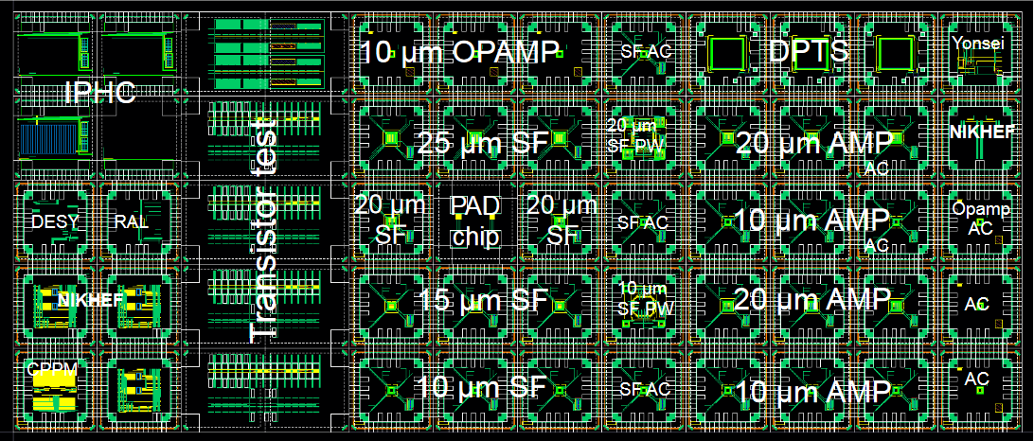
Current Status
The RAL contribution to MLR1 is the LVDS receiver and CML line driver for use in the digital output stage of the final sensor
Contributed to the first ITS-3 MLR submission with RAL.
Negotiations underway for access to the process design kit and framework IP sharing agreement for the other chip design institutions (BNL, LBNL). This will allow significantly more sensor design effort from EICSC.
In process of gathering proposals for task work in the coming year as we need to engage fully with the ITS3 work packages.
Engaging with EIC management at BNL for R&D funding (project and general).
Latest EICSC meeting presentations can be found at https://drive.google.com/drive/folders/1vHzNspd6sjdDTsvOOY0AntAkASeeXgZo?usp=sharing

Slide 9
Plans – (strongly tied to ITS-3 schedule)
2021 –
Testing and characterization of MLR1
Sensor design for MLR2 or ER
R&D into powering, stave/disc construction, cooling, overall infrastructure
MLR2 submission
2022 -
Testing and characterization of MLR2
Sensor design for ER
R&D + prototyping into powering, stave/disc construction, cooling, overall infrastructure
ER submission
2023 -
Testing and characterization of ITS3 ER and assessment of yield
Assessment and planning for EIC sensor fork of ITS3 design
Fork off sensor design and work on EIC variant for staves and discs (may move to next year depending on results)
Detailed prototyping into powering, stave/disc construction, cooling, overall infrastructure
ER submission for EIC variant sensor for staves and discs (may move to next year depending on results)
Investigation of adaptation of ITS3 design for use in EIC inner layers (different radii, # layers, services from both ends to meet length requirements, etc.
2024 –
Testing and characterization of EIC ER and assessment of yield
Si design for EIC ER2
Detailed prototyping into powering, stave/disc construction, cooling, overall infrastructure using EIC ER1 prototypes.
ER2 submission for EIC variant sensor for staves and discs
adaptation of ITS3 design for use in EIC inner layers and integration of design into ER2 if necessary.
We are developing two detector concepts:
ITS3 like for the vertexing layers.
EIC variant for the staves and discs.
We will need to develop the capabilities to bring both detector concepts and the associated infrastructure to completion.

Slide 10
Backup

Slide 11
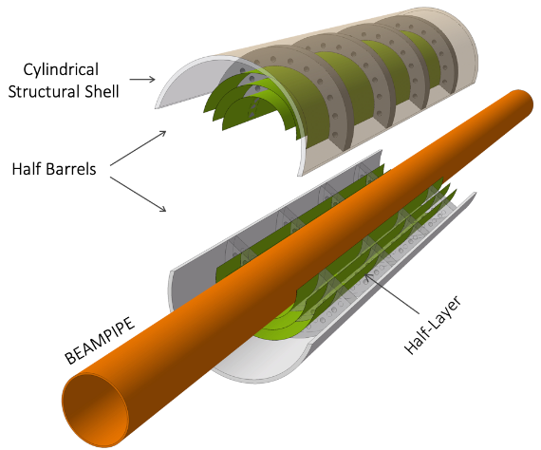
Yellow Report driven detector concepts
As part of the YR exercise, detector concepts were developed and optimized for EIC tracking.
These concepts drive the direction that is needed to move forward in sensor and detector development to realize these concepts. Conceptual layouts are presented below
Vertexing inner layers are based on the ITS3 development at CERN
BUT – the length of the inner staves and the diameters at which these layers sit are markedly different from the ITS3 base design
ITS3 length = 30 cm. This is set by the length of stitched sensors on a 12” wafer.
EIC length (hybrid) = 42 cm
ITS3 radii = 18 mm, 24 mm, 30 mm – these radii are set by the integer width of rows of stitched sensors.
EIC radii = 36.4 mm and 44.5 mm
EIC strawman design (modification of ITS3)
Reach larger radii by using 3 bent sections
Services exit from both sides of inner layers
Engineering work needs to begin
Services exit from one end

Slide 12
Yellow Report driven detector concepts
Staves and discs will be based on a forked EIC specific sensor design based on the ITS3 sensor. The primary concern is yield for long rows of stitched sensors. The plan is to assess yield in the first engineering run and adjust the EIC sensors to optimize yield for the number of stitched sensors in a row.
Staves – Use shorter lengths of stitched sensors to form staves. Power and signal will need to be propagated along the stave with flex PCBs over the stave length.
DC-DC converter?
Flex PCB for power/signal
Power/signal exit
Stitched
sensors
Stave support structure
Discs - could be formed with overlapping staves that conform to the disc diameters or with sensors mounted to half-disc low mass plates.
For both of these solutions we will need to optimize the stitched sensor layout on the wafers to provide the right number of stitched sensor lengths to give the proper needed lengths for each stave/disc. This needs study and optimization.

Slide 13
Expanded task list for 2021 (applies to following years as well)
These tasks compliment and are in addition to robust participation in the ITS3 work packages to prepare for the EIC vertexing layers design.
2021
Testing and characterization of MLR1
design of testing system that extends into the testing of the next submissions. Beam testing, Latch-up testing, SEU testing, radiation tolerance testing (kRAD, NIEL), firmware, software, mechanical carriers, alignment stations, analysis, etc. This work is starting in ITS3, we can/should join this effort.
Sensor design for MLR2 or ER
Inclusion of other silicon design sites into the design process (in progress), Assessment of the testing results and incorporation into the new designs, significant digital design (in pixel logic, readout structures and architecture), design for stitching, significantly more complex structures and pixel layout studies, design for yield, etc.
R&D into powering, stave/disc construction, cooling, overall infrastructure
Take up DC-DC converter and serial powering R&D, studies of stave and disc design, cooling studies (air for inner layers, liquid? For outer layers and discs), investigation of on detector data multiplexing and implications for single point failure and redundancy studies, initial studies for carbon fiber designs for overall mechanical support structures, services routing studies, radiation length minimization, etc.
MLR2 submission
Detailed silicon design as per sensor design section, layout and DRC, integration into MLR, etc.

Slide 14
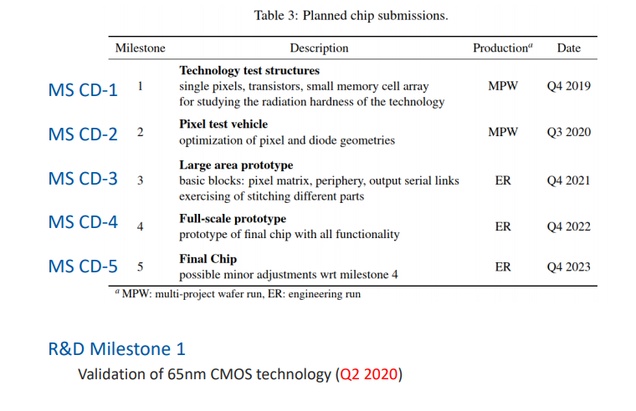
Sensor development milestones

Slide 15
Organization of effort
ITS3-WP1: Physics studies, Simulation and Reconstruction alice-its3-wp1@cern.ch
Physics performance studies
Detector functional requirements
Detector model and simulation
Reconstruction
ITS3-WP2: Pixel chip design alice-its3-wp2@cern.ch
Test structures and validation of the technology
Optimization of the pixel layout
Large area building block prototypes
Full scale prototypes
Final chip
ITS3-WP3: Pixel chip characterization alice-its3-wp3@cern.ch
Development of hardware and software for the pixel chip characterization
Laboratory, Beam and Radiation tests
Pixel chip device simulation

Slide 16
Organization of effort
ITS3-WP4: Pixel sensor thinning, bending and interconnection alice-its3-wp4@cern.ch
Tests with existing material (ALPIDE wafers)
Tests with 300 mm dummy wafers
Test with full-scale prototypes
Mechanical, electrical and functional validation of the procedures
ITS3-WP5: Mechanics and cooling alice-its3-wp5@cern.ch
Selection and characterization of carbon materials (structural and thermal properties)
Development and production of support structures
Development, production and validation of the Engineering Module based on dummy chips
Development, production and validation of the Qualification Module based on prototype chips
Production of the Final Module based on final chips

Slide 17
Group Efforts in this development
We are joining the sensor R&D effort to optimize the sensor characteristics (to the extent that they are not already) for use at the EIC.
We will soon be selecting work packages to join officially but expect to the active in WP2, WP3 with lesser directed efforts in WP4, WP5.
It is hoped that this effort should have significant overlap with the EIC efforts in the infrastructure of building of the silicon tracking detectors.

