Slide 1
MDP Collaboration Meeting 20 T hybrid magnet and comparative analysis
P. Ferracin
US Magnet Development Program

Slide 2
Action items
New additions
Mariusz Juchno, LBNL
Milan Majoros, Ohio State University
Mike Sumption, Ohio State University
Design of a support structure
Sector coils with grading
And what if they are full Nb3Sn?
And what if they are full APC Nb3Sn?
Update on magnetic designs
MDP path to 20 T

Slide 3
Goals of the working group
Conceptual design of a 20 T hybrid HTS-LTS magnet
Comparative analysis of different design options for a 20 T hybrid
Cosϑ design and its stress-management options
“Traditional” Cosϑ
Canted Cosϑ (CCT)
Stress management Cosϑ (SMCT)
Block-type coil design (block with flared ends)
Common-coil design (block with racetrack coils)
Definition of general design criteria: aperture, field, margin…..
Analysis of challenges specifically of hybrid magnets
Integration of LTS/HTS, mechanics, protection, powering, diagnostics, test facility…..
Review and follow-up of current work on hybrid magnets
Collect and organize information from these programs (responsibility of area I and area II) to provide inputs for 20 T hybrid design
Design of a support structure for test of hybrid magnets with CCT6 and SMCT outsert coils

Slide 4
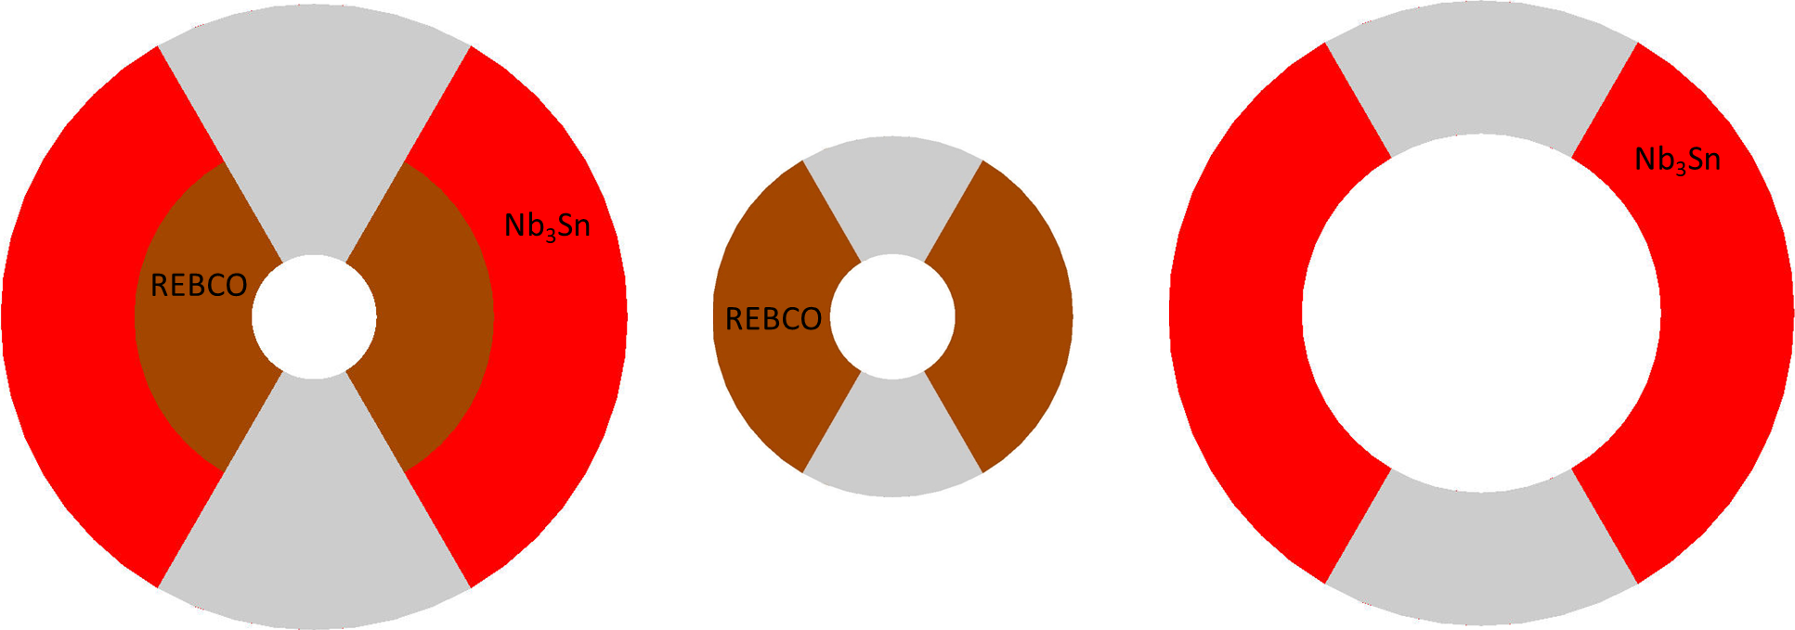
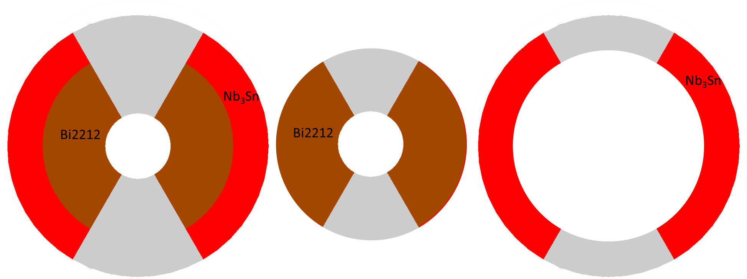
Summary
Bi2212
REBCO
ID: 50 mm
OD: 200 mm
W: 76 mm
B_{_bore_op} = 20 T
σ_{ϑ}/ σ_{r} =188/206
ID: 50 mm
OD: 146 mm
W: 49 mm
B_{_bore_op} = 14.7 T
σ_{ϑ}/ σ_{r} =128/122
ID: 146 mm
OD: 200 mm
W: 27 mm
B_{_bore_op} = 10.3 T
σ_{ϑ}/ σ_{r} =232/77
ID: 50 mm
OD: 252 mm
W: 101 mm
B_{_bore_op} B = 20 T
σ_{ϑ}/ σ_{r} =165/194
ID: 50 mm
OD: 144 mm
W: 47 mm
B_{_bore_op} = 12.8 T
σ_{ϑ}/ σ_{r} =99/93
ID: 144 mm
OD: 252 mm
W: 54 mm
B_{_bore_op} = 13.1 T
σ_{ϑ}/ σ_{r} =201/114

Slide 5
CT- SMCT options
Summary

Slide 6
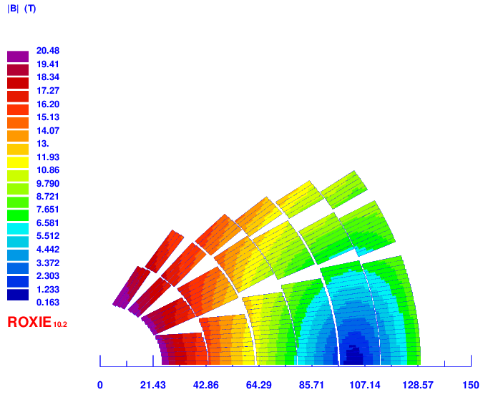
CT V9e: 4 HTS 2 LTS
Overall ok, but make sure that the wedge are more than ~1.5 mm thick
4 layer HTS, 2 layer LTS
Strands: 0.8 mm, 40 – 35 – 36
Cable width: 18.35 – 16.06 – 15.96 mm
Stabilizer/Superconductor: 3 – 3 – 1
Coil width: 105 mm
Current: 10920
Peak field: 20.48 – 15.88 – 12.53 T
Margin: 82.5 – 82.8 – 74.5 %
J_{cu} on LTS: 1206 A/mm²
Peak azimuthal Lorentz force: 151/142 MPa (LTS/HTS) (151/170 MPa in v9b)

Slide 7
CT V11b: 2 HTS 4 LTS
V11b
Reduce cable HTS to reduce margin (0.9 mm, 40 strand)
Increase both LTS coils for margin and protection and stress (especially outermost)
make sure that the wedge are more than 1.5 mm thick

Slide 8
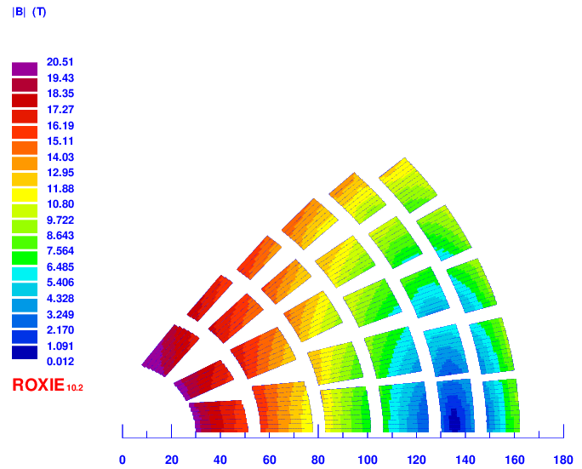
SMCT V12c: 4 HTS 2 LTS
make sure that the wedge are more than 1.5 mm thick
Increase outer layer cable to decrease Jcu

Slide 9
To be done
SMCT 2 HTS 4 LTS - V13 to be done
Common coil
Re-run Ramesh model
Block coil - Make a roxie model based on Etienne file
“CCT as a field quality "fixer" for a simple boosted outset” by L. Browers

Slide 10
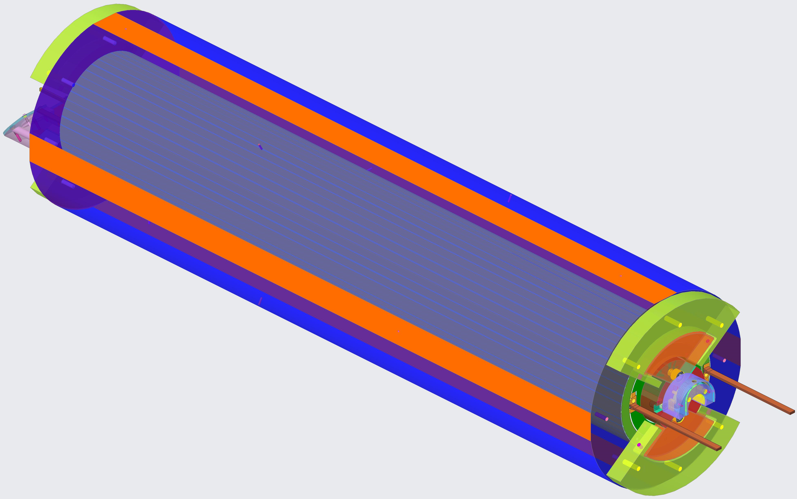
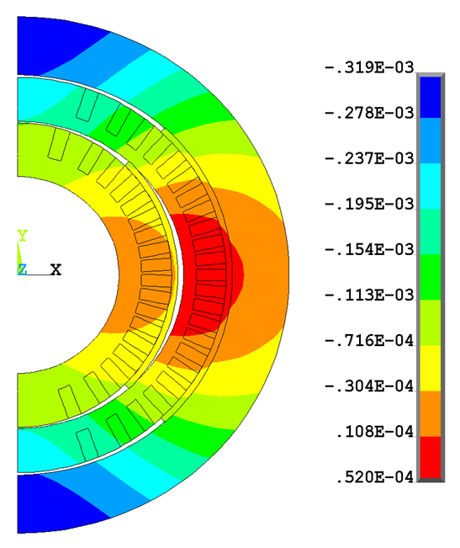
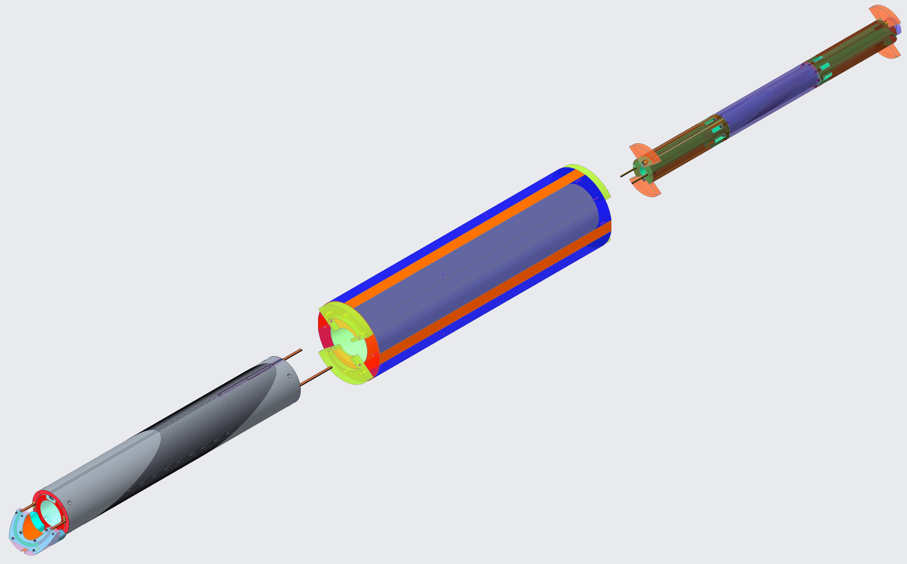
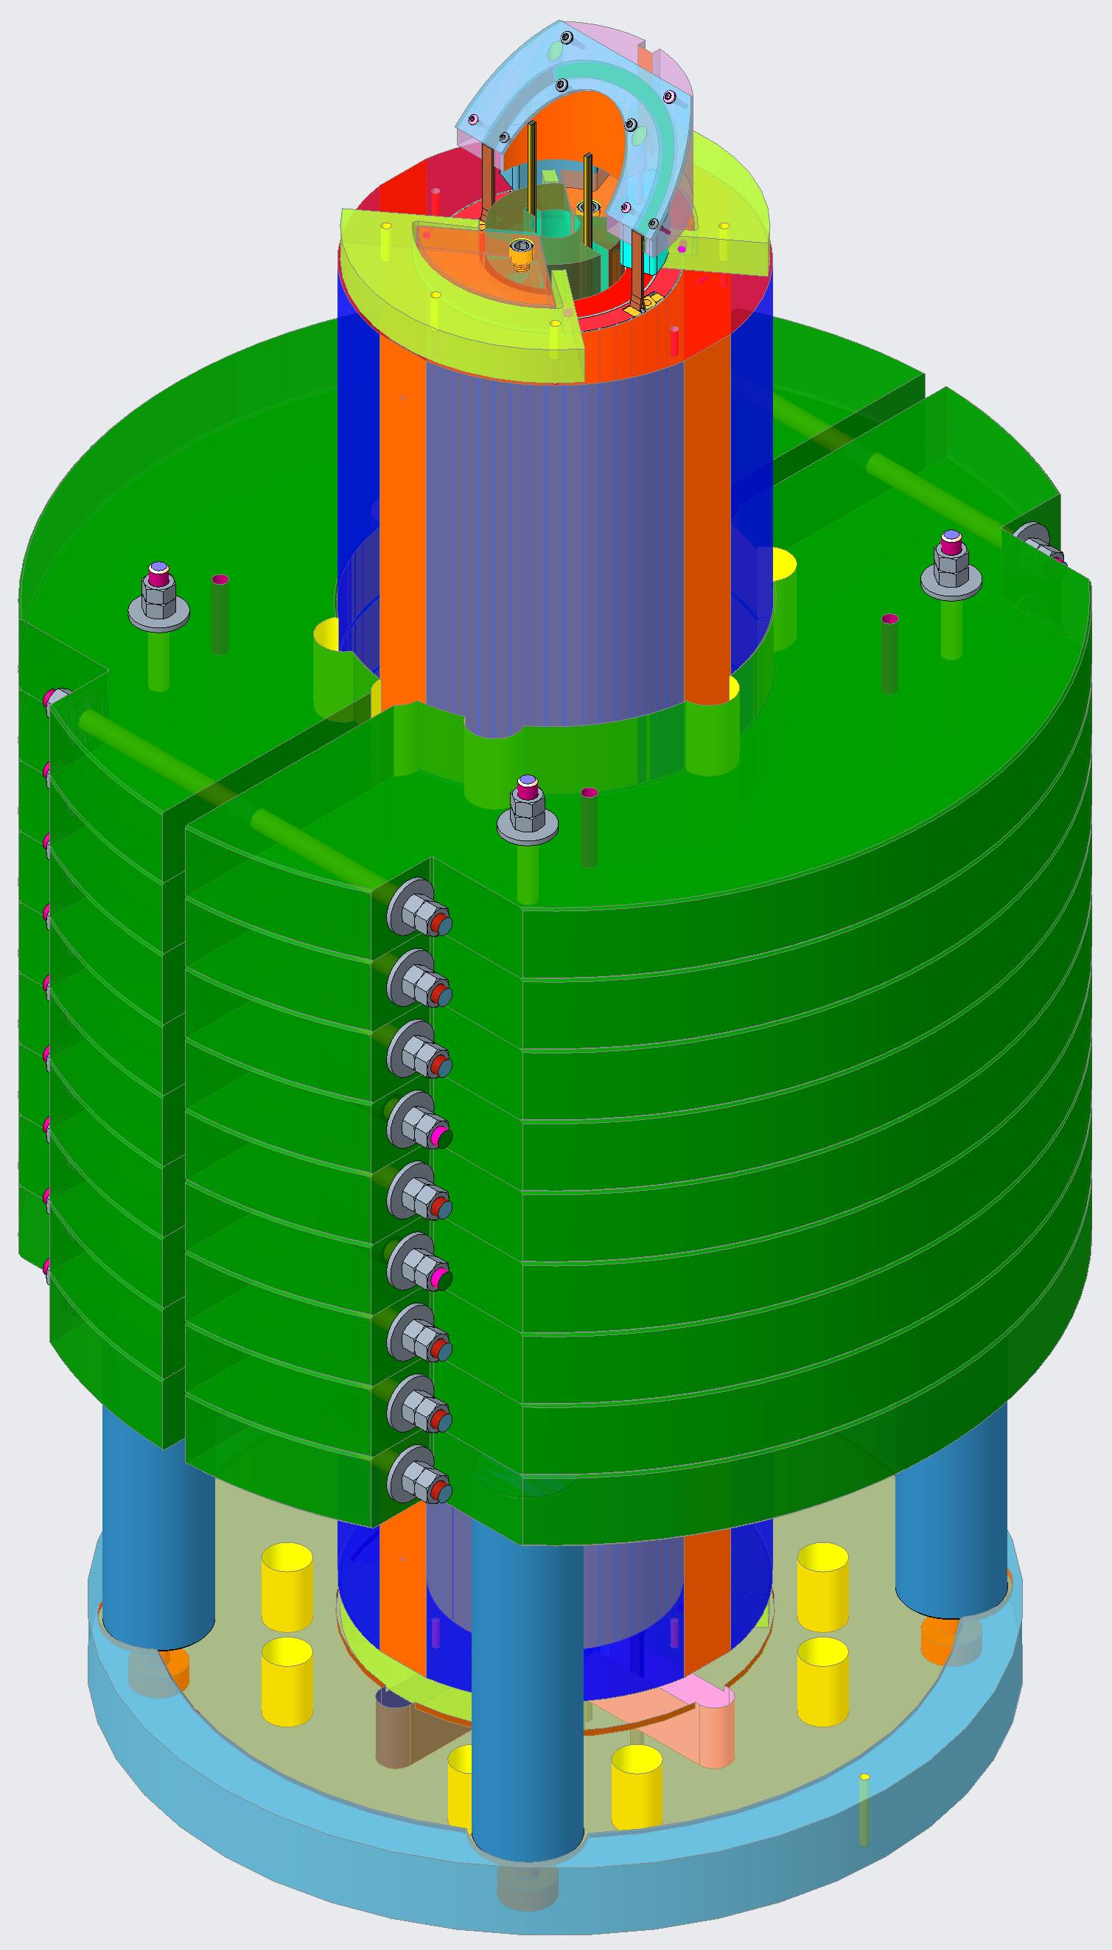
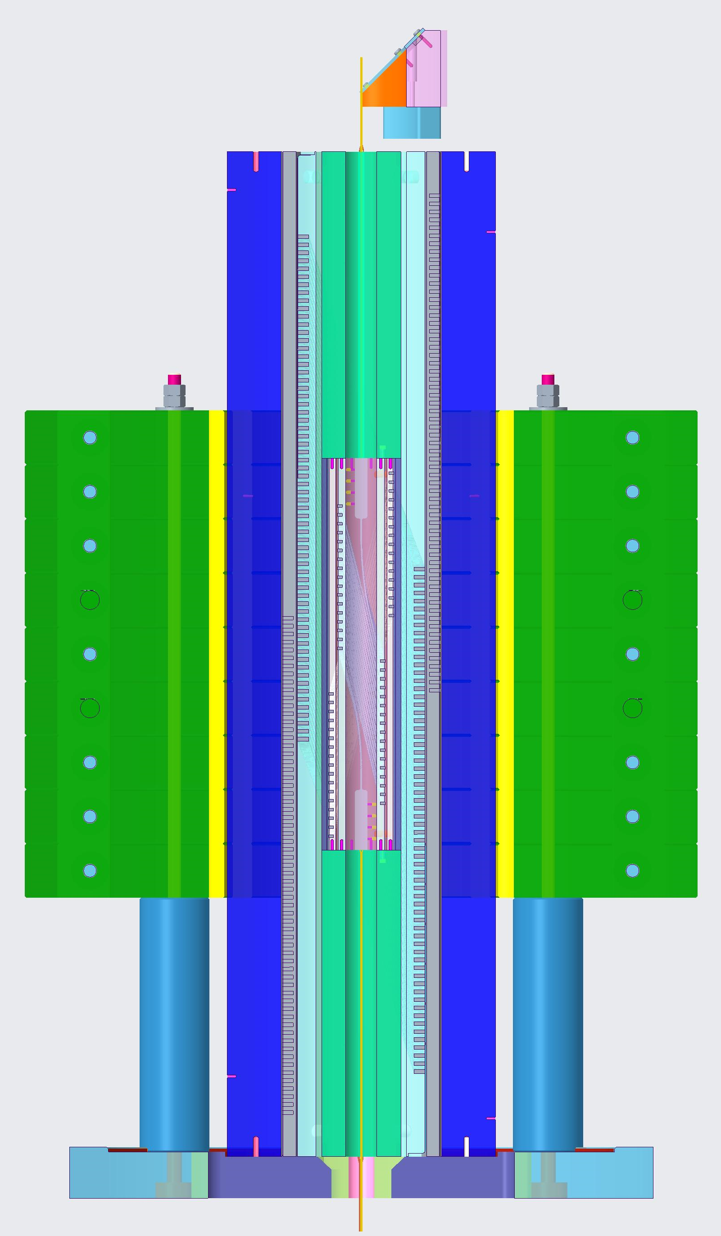
Preparation for BIN5c test #3: Hybrid magnet (BIN5c inside CCT5) at 4.2 K Introducing this topic first in order to understand the steps towards the preparation for the standalone test (test #2)
BIN5c and CCT5 will be assembled and aligned using end plates
BIN5c will be assembled to the Al shell using smart shims, covering +/-45 deg from the midplane
Assembly using end plates will allow mechanical decoupling between the magnets, easiness in the assembly process and counteraction of the torque about x-axis between the magnets
There is a gap in the midplane of BIN5c during operation inside CCT5
End plates
BIN5c
End plates
Layer jump of CCT5
CCT5 aluminum shell
Iron yoke
CCT5
Radial displacement of BIN5c (m) under the background field of CCT5

Slide 11
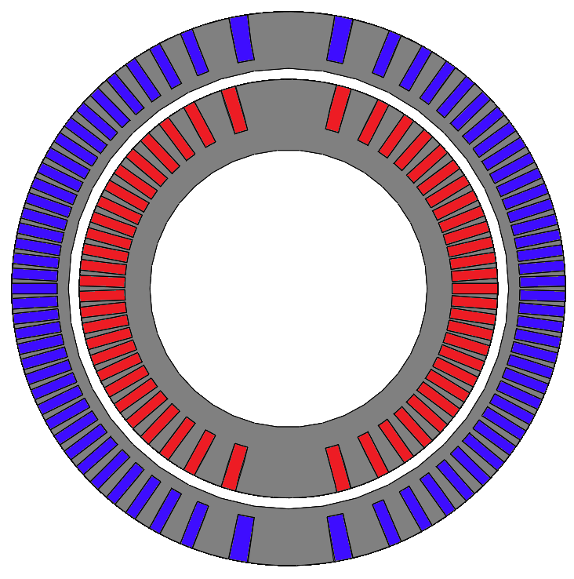
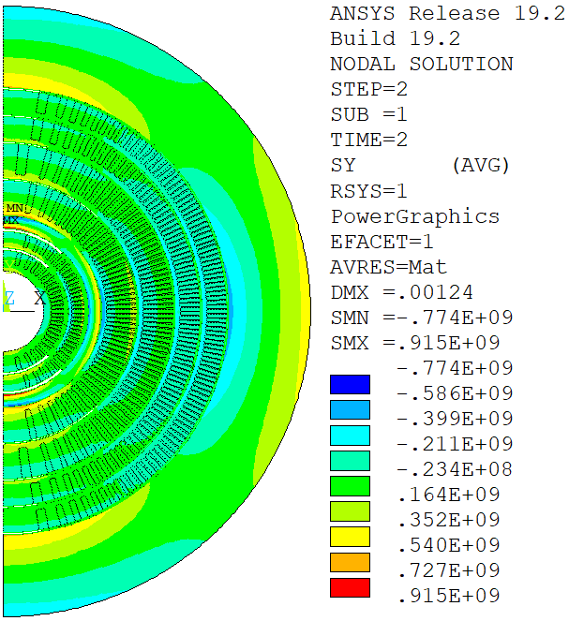
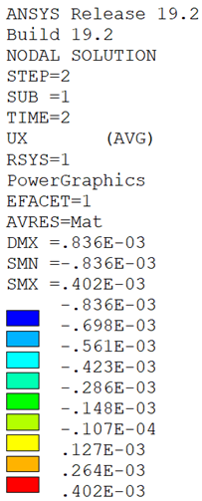
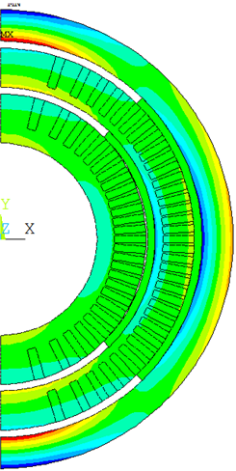
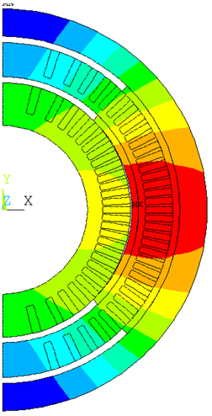
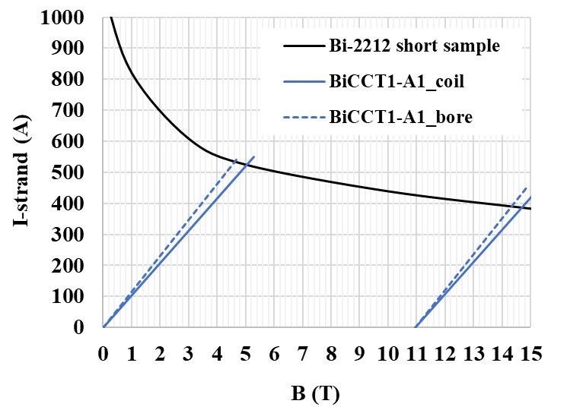
BiCCT1-A1: First candidate of a 5 T Bi-2212 CCT insert dipole
BICCT1-A1 first candidate design:
0.8 m long
11 cm straight section
48 turns per layer
17-strand cable, 7.8 x 1.44 mm (Because we already have enough of this cable for one magnet)
Total cable length for one magnet: ~64 m
Will use 5 kg billet ➔ valuable for conductor development
The OD of BiCCT1-A1 with the Al shell is 120 mm. Fits in the aperture of CCT6
The BiCCT-A1 coils will be assembled using smart shims covering +/-45 deg from the midplane. No shims between the insert and the outsert
High stresses in BiCCT1-A1 under background field and gap in the midplane between the coils suggest revisiting and modifying this design
OD: 99.8 mm (Fits in a 120 mm bore dipole like CCT6)
BD: 50 mm
There is a gap in the midplane during operation inside CCT6
High stress is mandrel and Al shell
Loadlines
Bore field produced by CCT6 at 80% SSL
Azimuthal stress of BiCCT-A1 (Pa) under the background field of CCT6
Radial displacement of BiCCT-A1 (m) under the background field of CCT6
Notes:
All this work relies on the good functioning of the Renegade OPHT furnace at FSU
CCT6 produces 11 T working at 80% of SSL. Considering BiCCT5-A1 reaches 90% of SSL, the hybrid would produce a bit more than 14 T
Standalone mechanical analysis was presented last year. Stresses in mandrel and conductor are low in standalone configuration
Insert and outsert touch
The gap created in BiCCT1-A1 could lead to conductor motion in the midplane since the forces are radial in that location

Slide 13
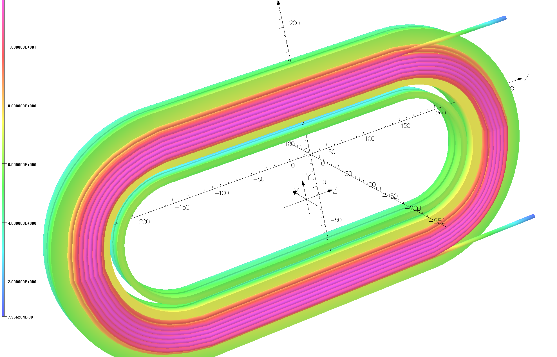
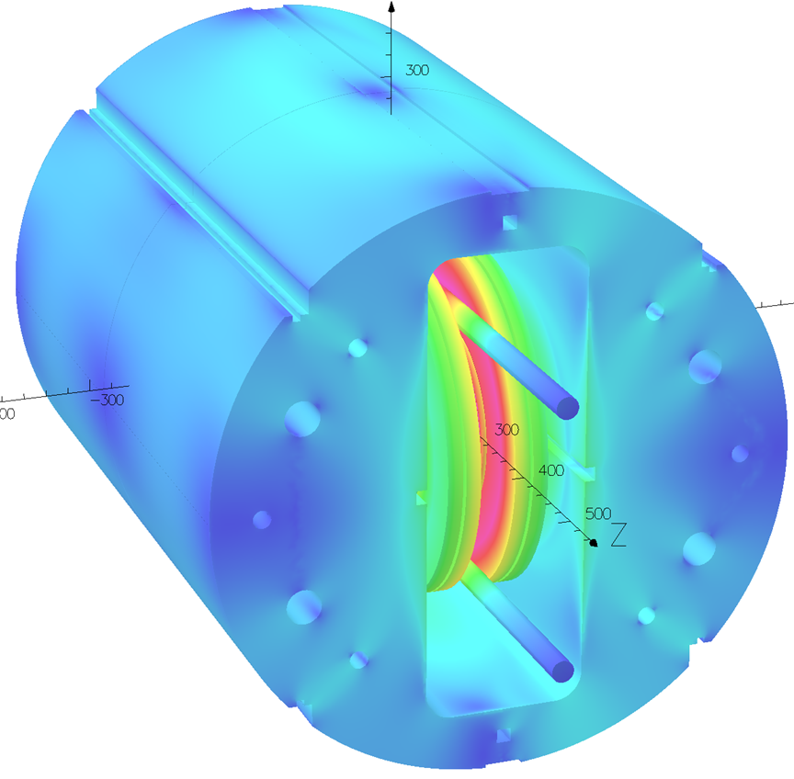
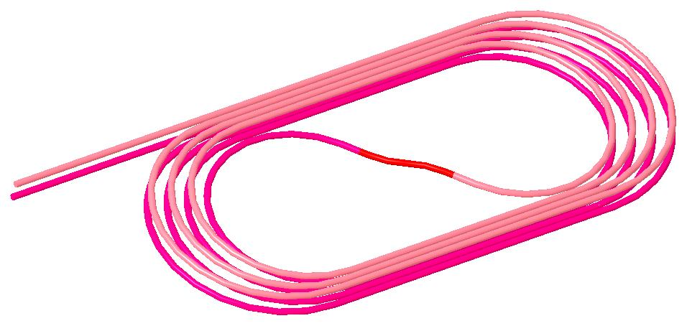
CORC Coil Programs with the Common Coil Dipole
STTR Coils two sets:
Each with 6 and 8 turns
STTR: High field Demo
MDP: Quench studies and technology demo
MDP Coil
4+4 turns
with an S-turn

Slide 14
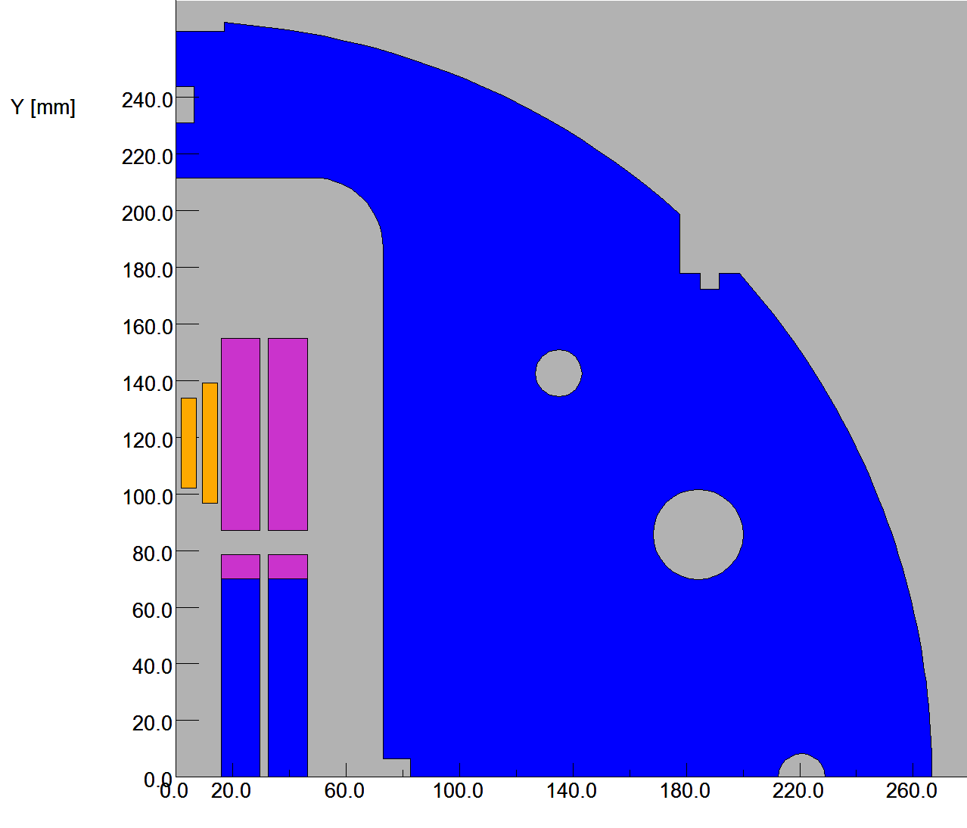
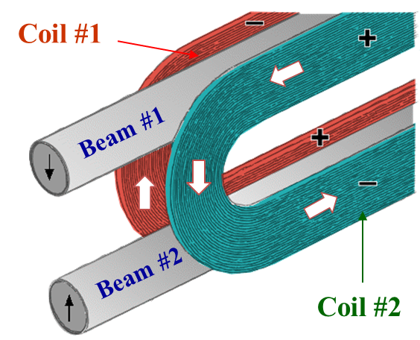
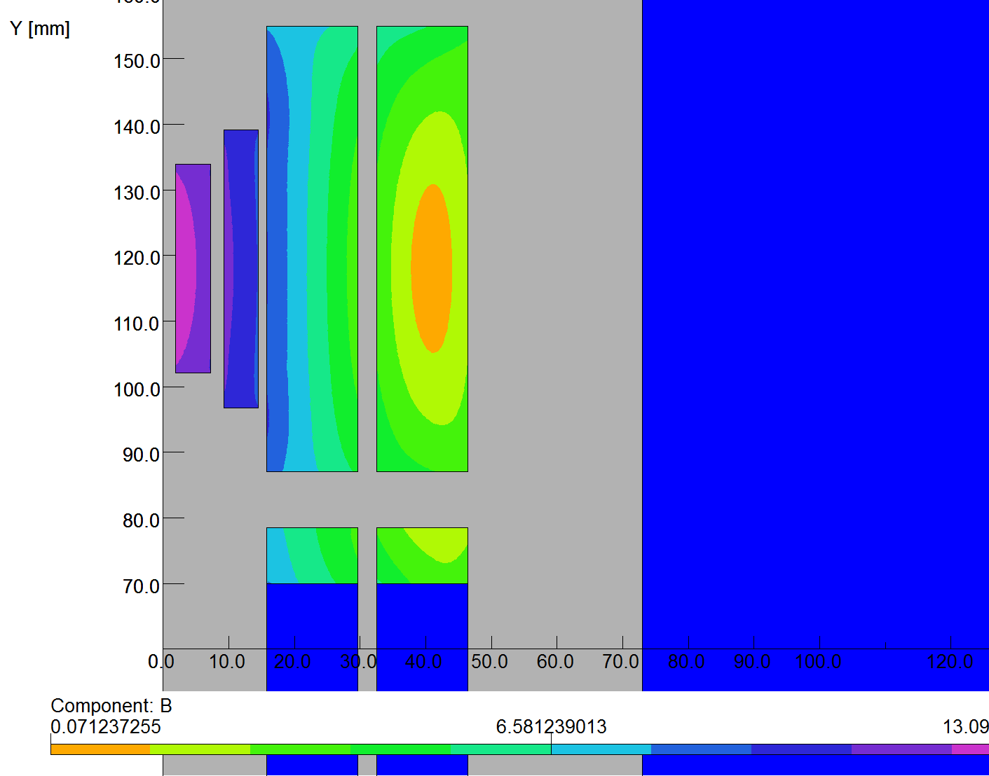
CORC Coil based HTS/LTS Hybrid Dipole STTR
High current CORC coils in series with the Nb₃Sn coils
Desired for quench protection
Large radii of common coil allows high J_{e} CORC cables
CORC coils:
6 and 8 turns, running
in series with Nb₃Sn coils
Hybrid field: 13.1 T @10 kA
: 14.4 T @11 kA
(peak field in Nb₃Sn coils reduced by CORC coils)
2-d model
Nb₃Sn Coils
CORC Coils

Slide 15
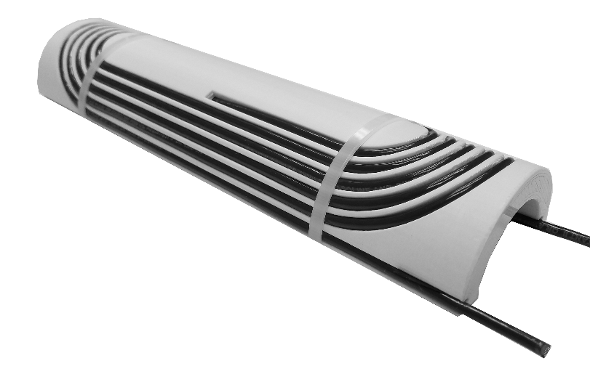
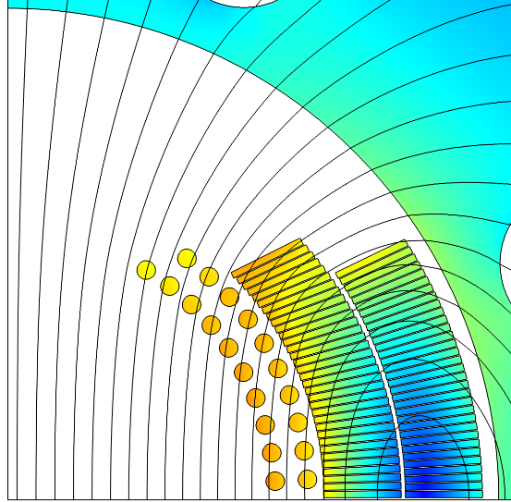
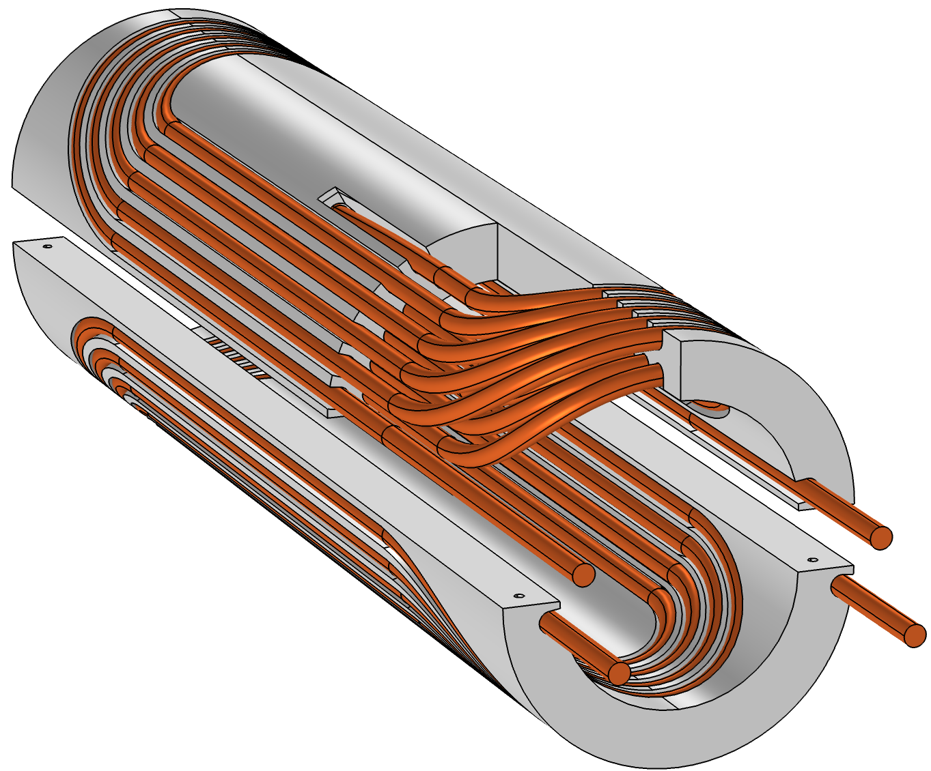
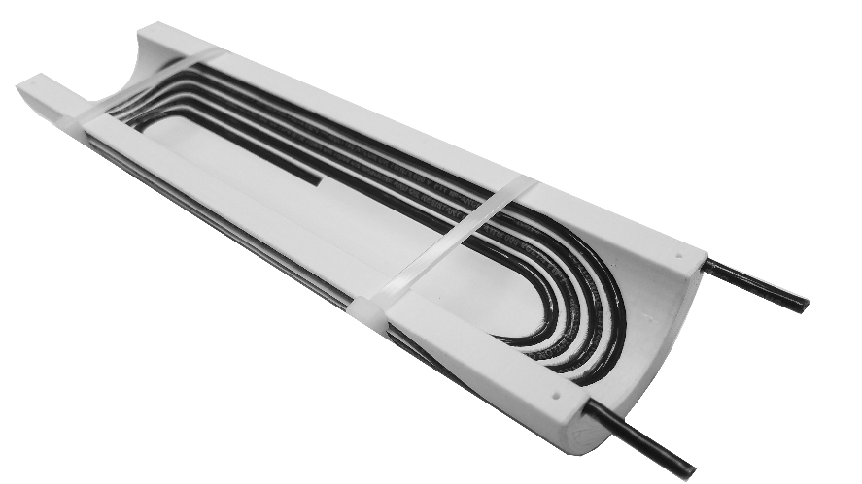
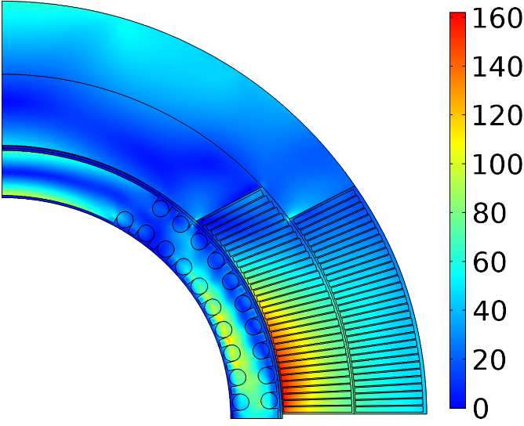
Conductor On Molded Barrel (COMB) magnet technology
Magnetic field (T)
Nb₃Sn coil
HTS coil
+1.25 T in Nb₃Sn 4.4 T standalone
Equivalent stress (MPa)
110 MPa
120-mm OD coil for the first superconducting model
60-mm OD mock-up coil built to demonstrate manufacturability
160 MPa
Within safe limits

Slide 16
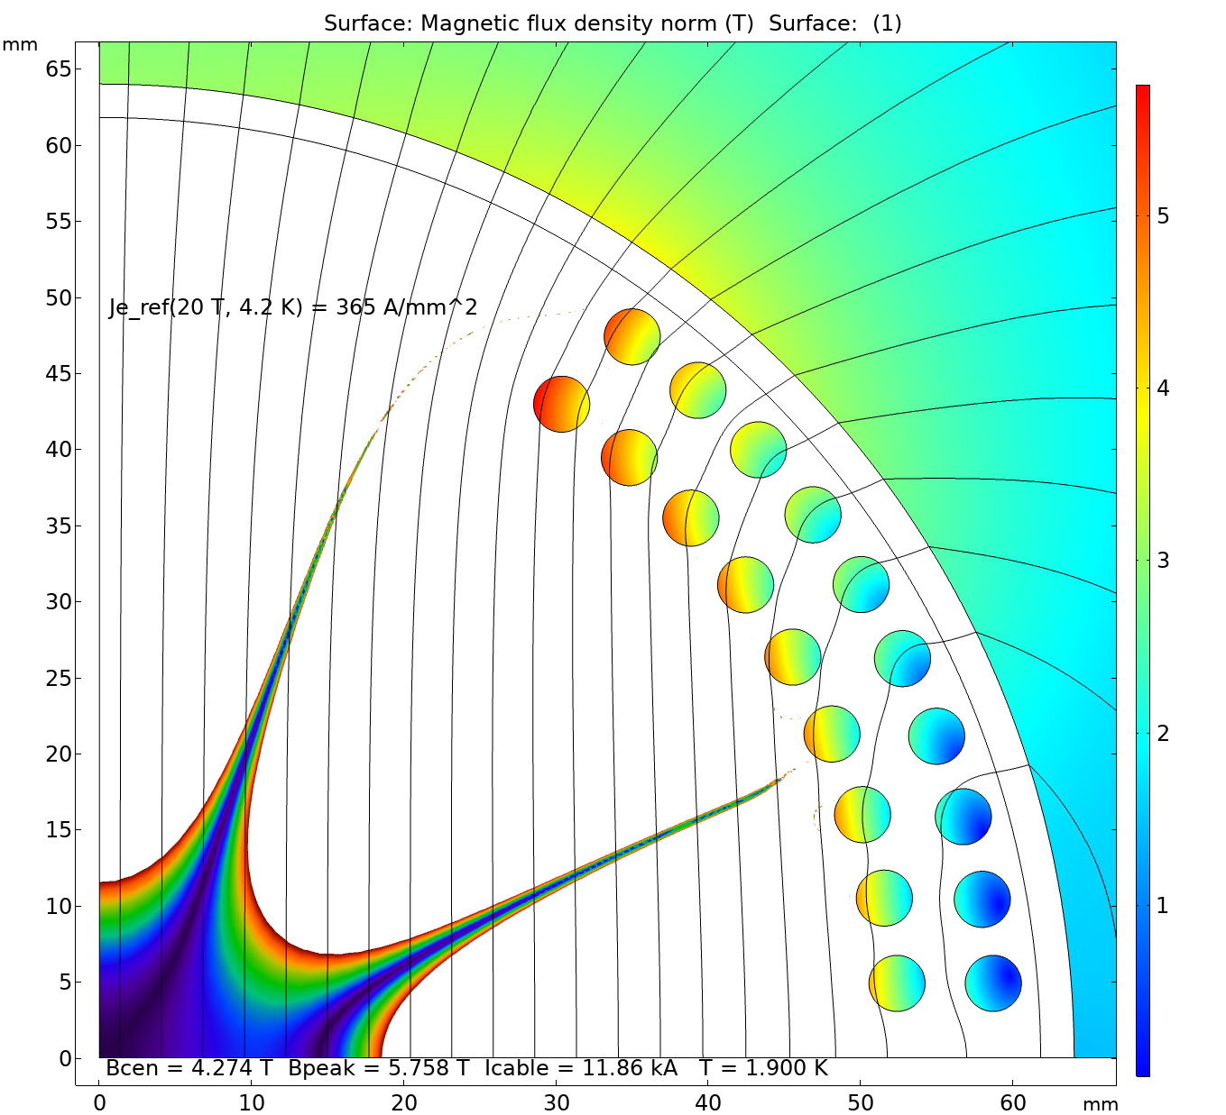
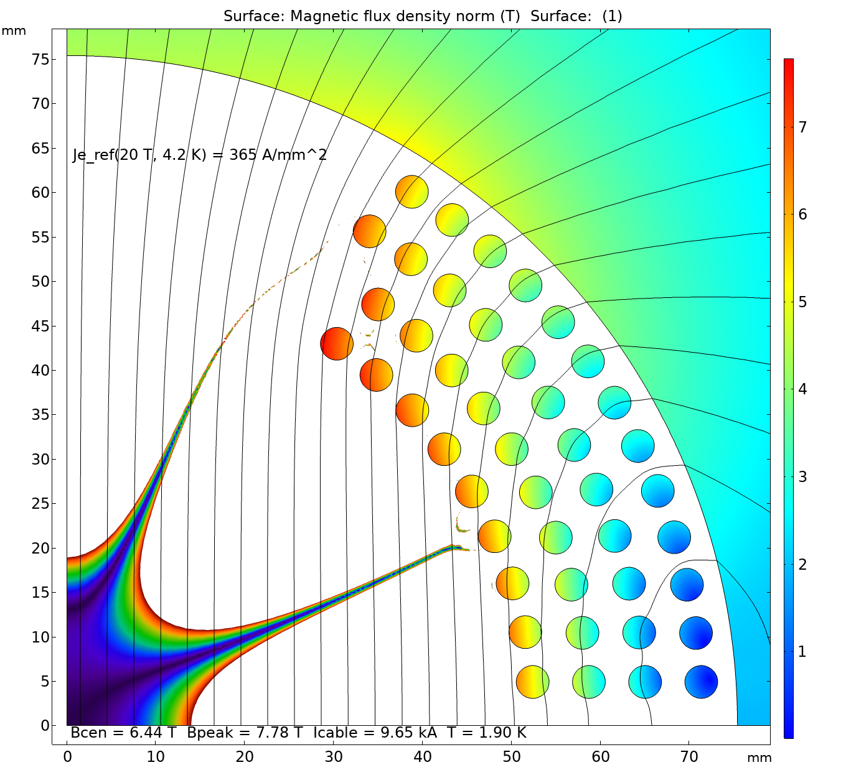
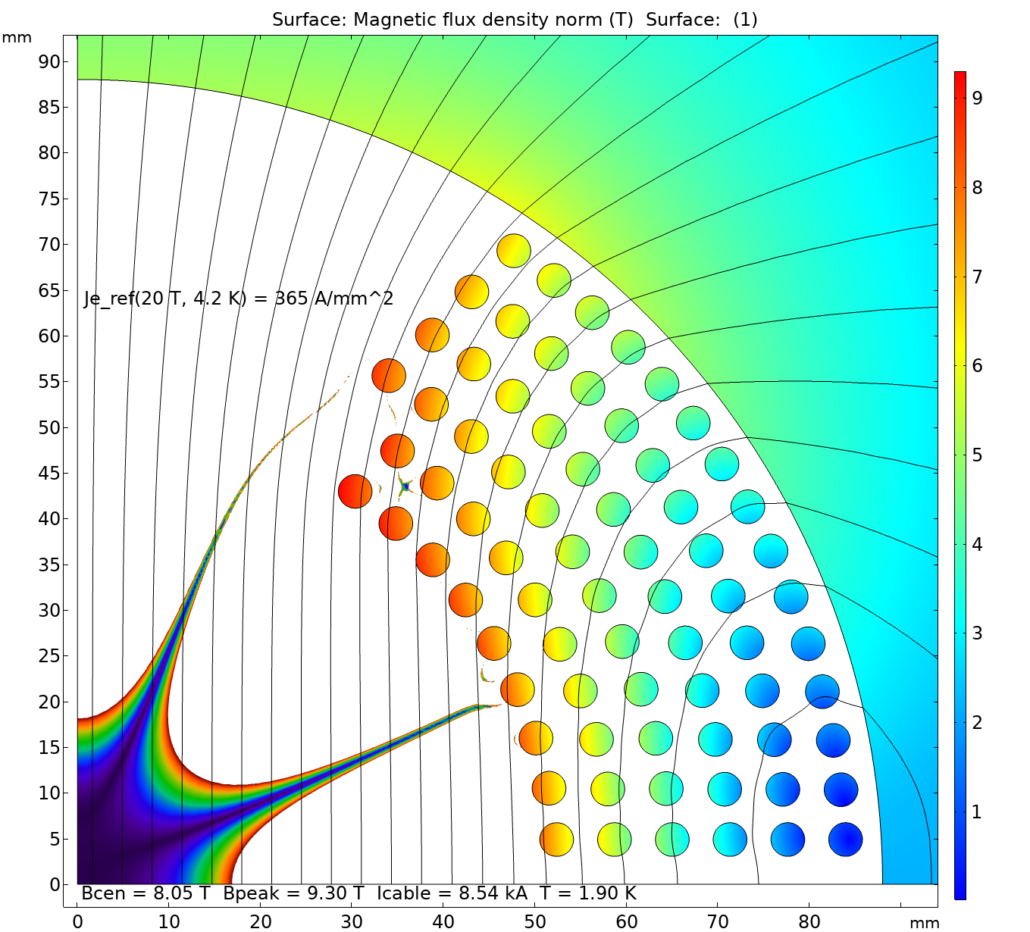
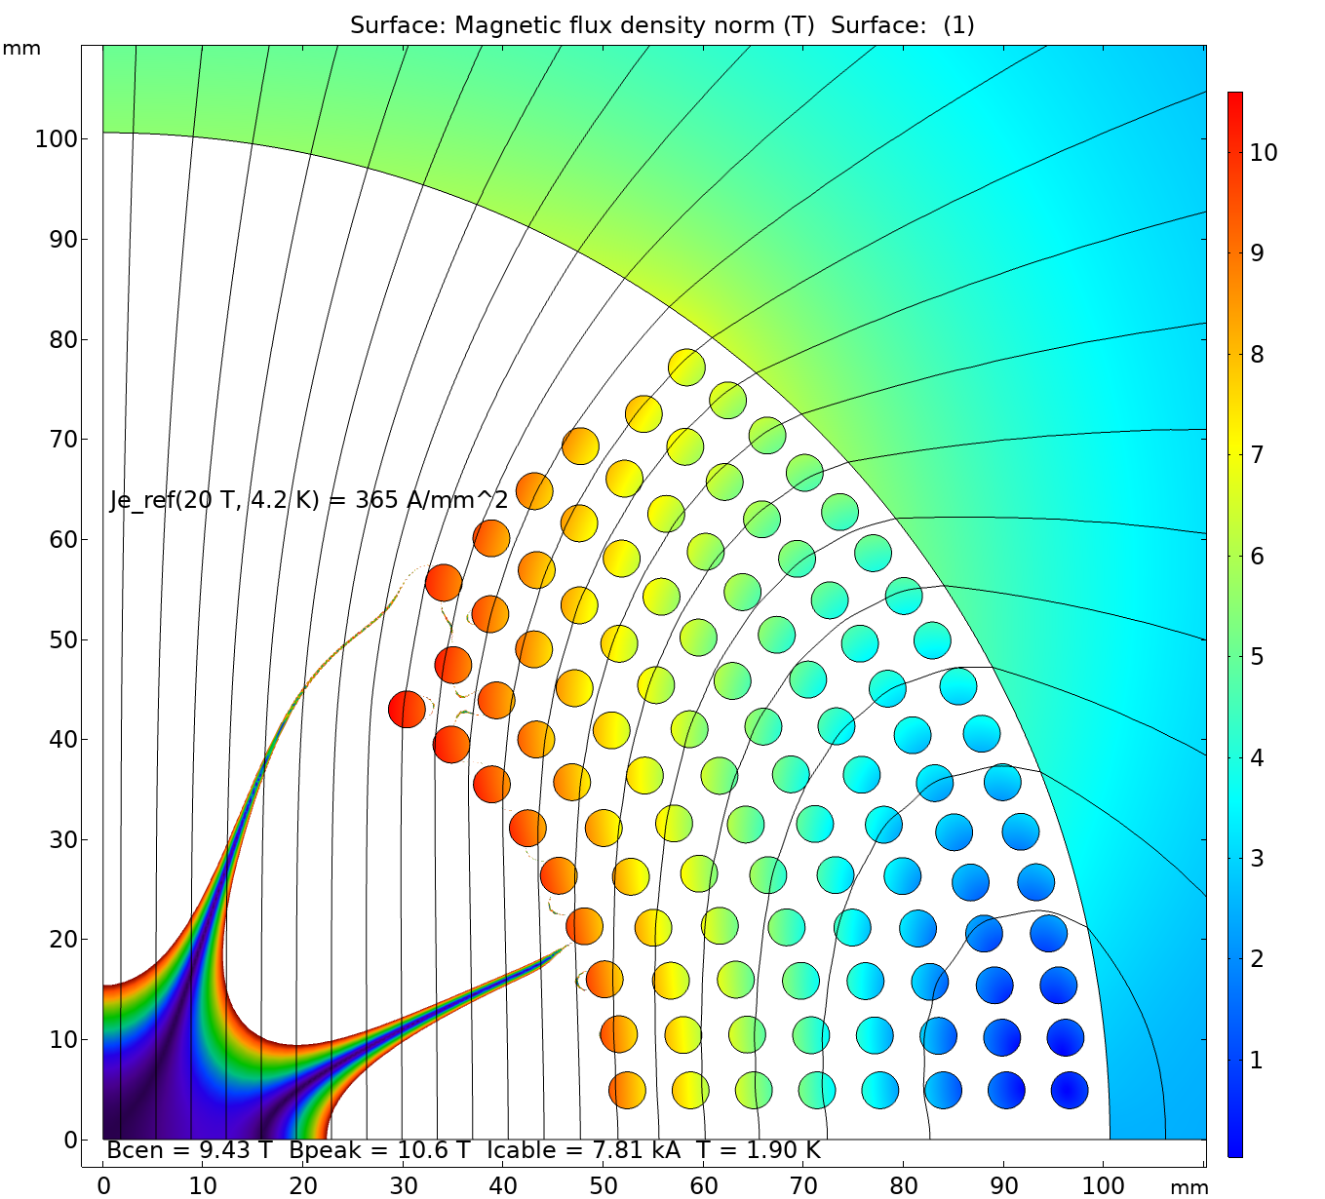
Design scalability – 2-8 layers
Due to the strain limitations, the additional layers can only be added from outside:
When a more flexible REBCO cable becomes available, the internal space down to 50 mm ID can also be explored;
The rule of thumb: minimum pole width is ~1/2 of the coil ID.
The double-layer half-coils can be nested one on top of the other and powered independently or in series:
The prestress is controlled by means of midplane and inter-layer shims.
Grading can be done by reducing the number of tapes per cable:
Has a minor effect on the cable OD (and the number of turns);
Main purpose is to save on the conductor costs, rather than to boost the field.

Slide 17
Mechanical analyses show that coupling between layers and an aluminum outer shell are necessary for C3 to reduce mandrel deformation under Lorentz forces
Peak azimuthal stress reduces by 50% to 0.25 GPa with a 25 mm thick aluminum shell
Radial displacement at the midplane reduces by 70% to 0.128 mm with the shell
Shell
Shell
Analysis assumes all layers mechanically coupled: need impregnation or radial shims
An aluminum shell helps to prevent bending displacement / stress
L. Brouwer

Slide 18
Continue improving the wire flexibility towards a 25 mm minimum bending radius and increasing the transport current towards 6 kA at 20 T, 4.2 K at the minimum bending radius
Based on the 6-layer C3 design
ID: 70 mm, OD: 153 mm. Coil thickness: ~ 42 mm.
More flexible wire is needed for a CCT design
Require 200 – 300 m long CORC® wire
J_{e} ~ 660 A mm⁻² for a 3.4 mm wire diameter

Slide 19
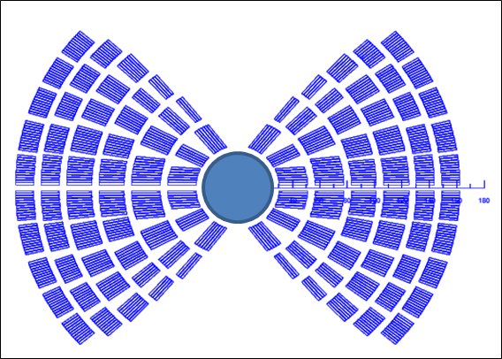
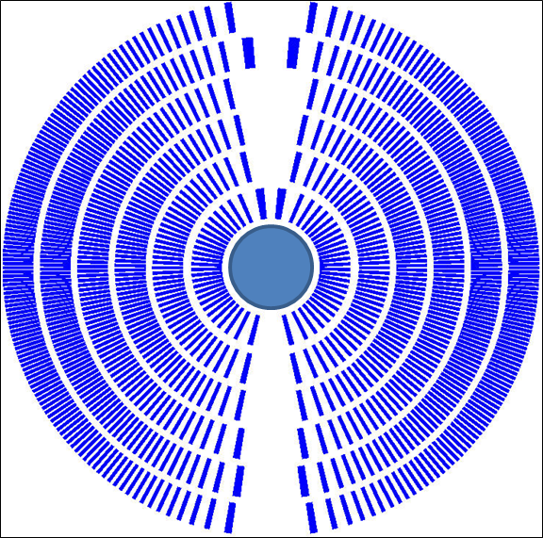
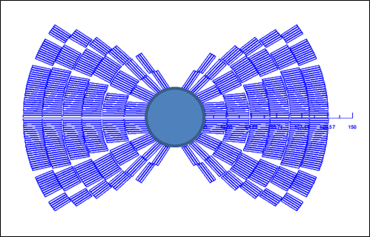
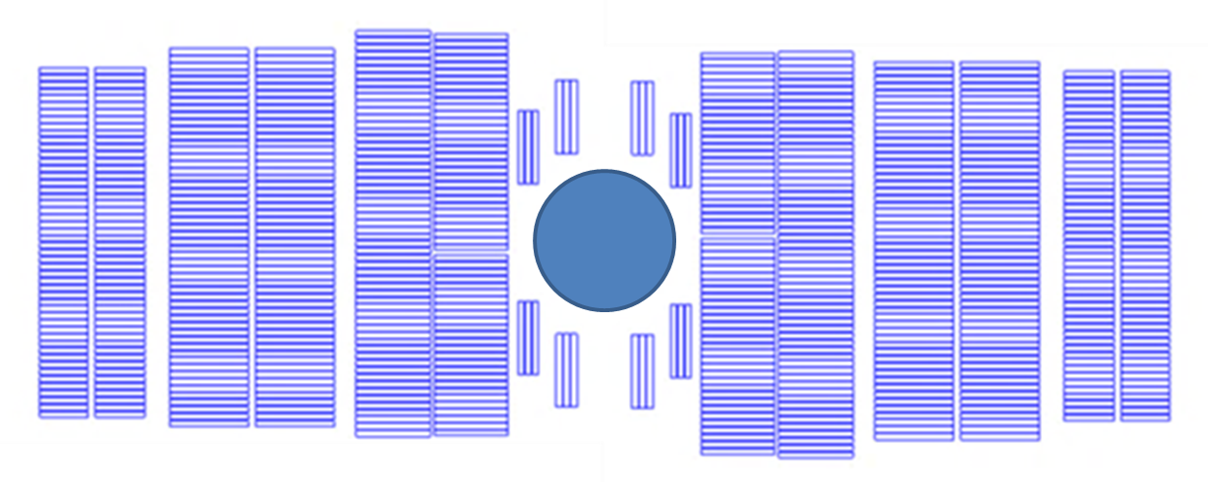
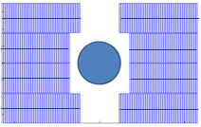
Preliminary magnetic analysis of different design options
Goal of the analysis
Comparison between different designs, like for FCC →
Designs not comparable yet (not meeting all specs, with and without iron, with and without stress management)
but getting there…
CT
(no stress manag.)
SMCT
CCT
Block
(no stress manag.)
Common coil
(no stress manag.)

Slide 20
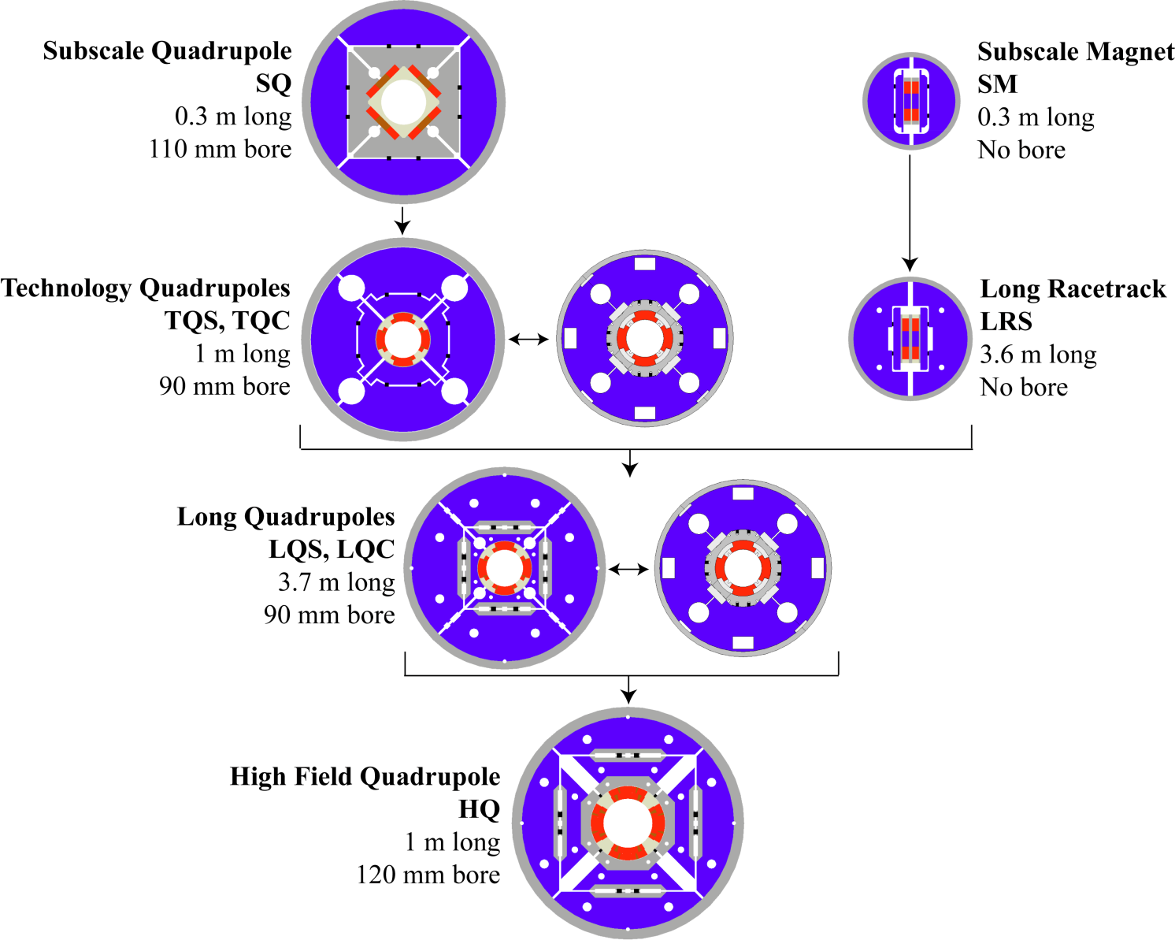
LARP Magnet Program overview
“S”: Shell-based support structure
“C”: Collar-based support structure

Slide 21
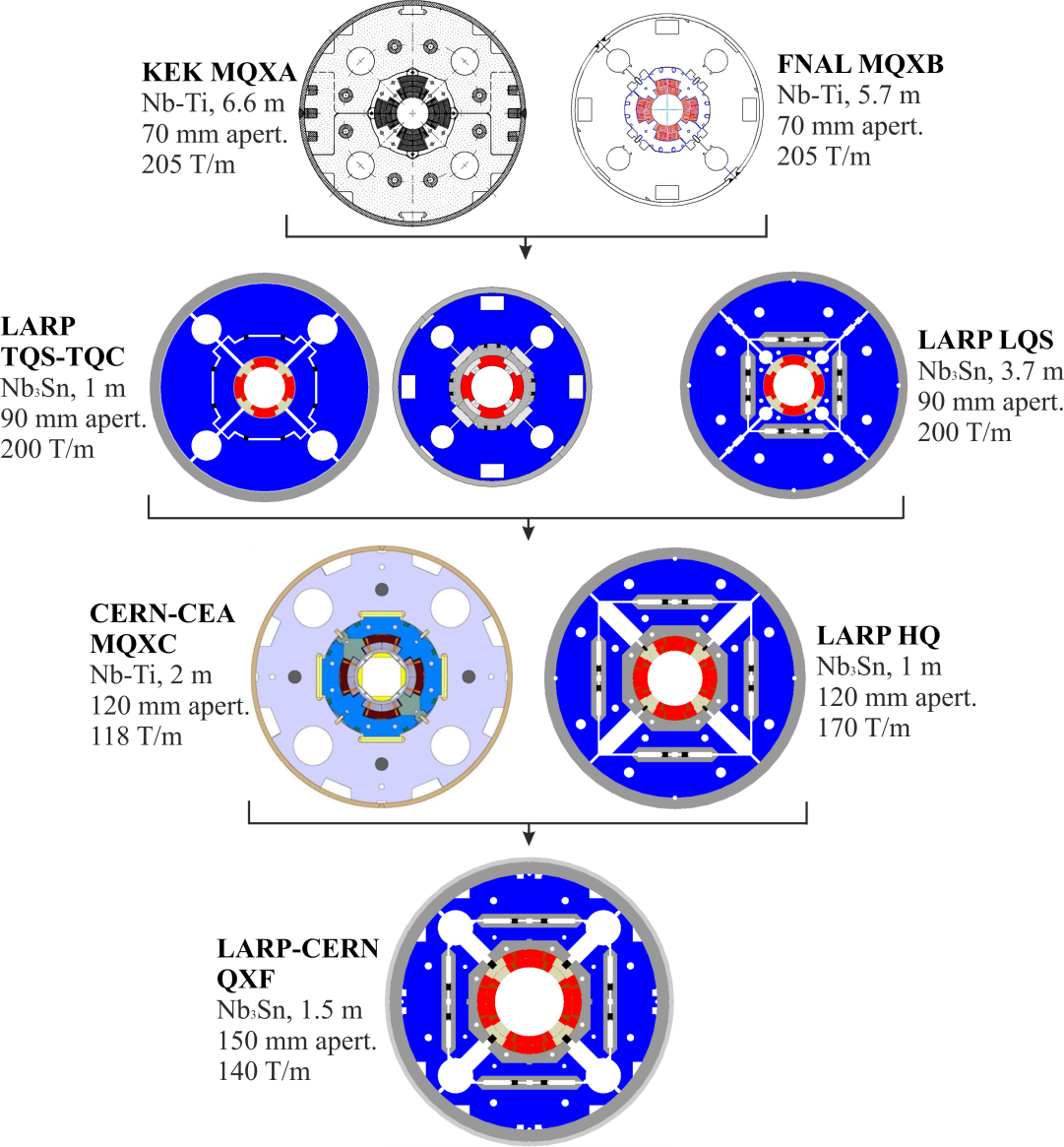
The 11-13 T level The MQXF project
Present Nb-Ti low-β quadrupole
Nominal luminosity L₀ = 10³⁴ cm⁻² s⁻¹
Integrated L ∼300 fb⁻¹ by 2021
2004, start of LARP Nb₃Sn program
Same gradient in larger aperture for ultimate luminosity (2-3 ⋅ L₀)
2008, two-phase upgrade
Phase-I, NbTi for ultimate
Phase-II, Nb₃Sn for higher L
2012, large aperture Nb₃Sn design
Increase the peak luminosity by a factor of 5 and reach 3000 fb⁻¹ of integrated luminosity

