Slide 1
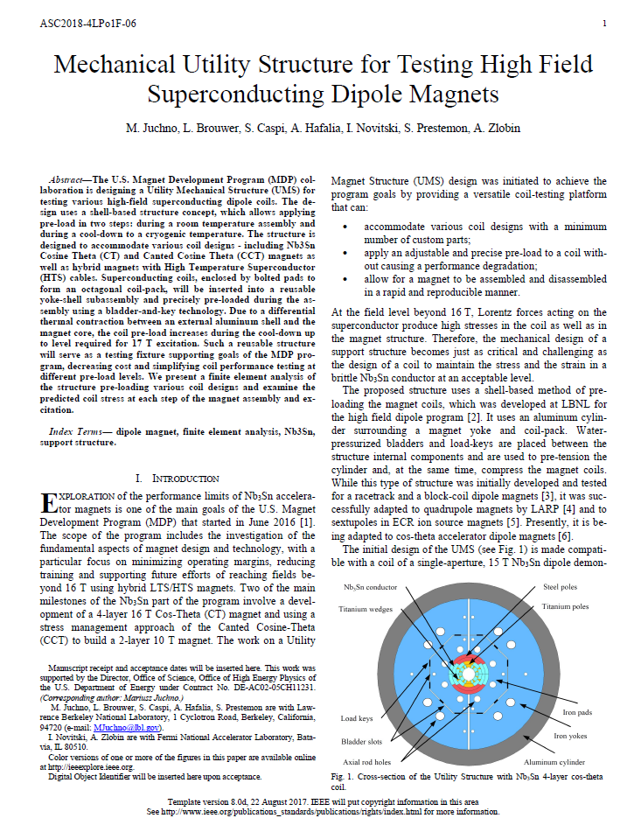
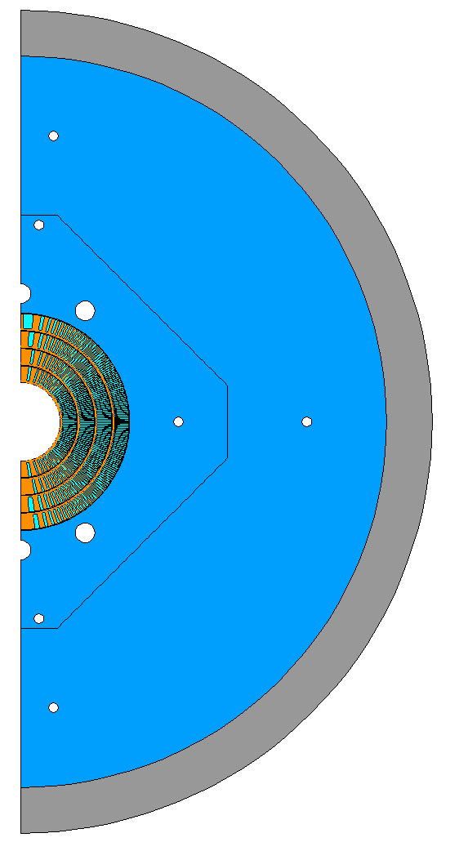
Utility Structure
Previously used for analysis with Fermilab Cos-theta coils
“Mechanical Utility Structure for Testing High Field Superconducting Dipole Magnets”
Utility Structure for future coils
Applied to CCT6 coil geometry
Shell dimensions match the LD1
(OD 1260 mm, TH 70 mm, L 1750mm)
New “real estate” gives more flexibility for adjusting the structure for future (bigger) coils
Geometry requires optimization
LD1 + CCT6

Slide 2
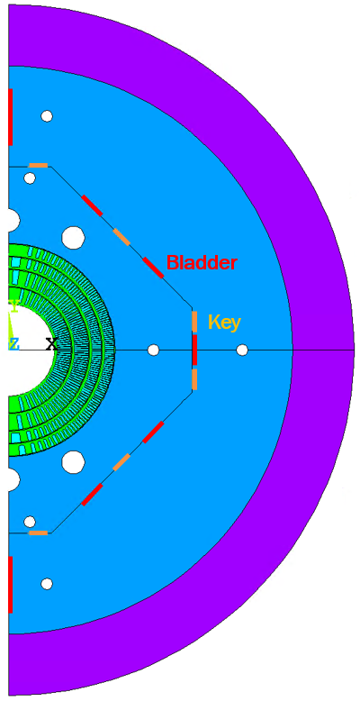
Model overview (based on 800mm OD geometry)
CCT6 – same as in Lucas’ input files
Conductor – Nb3Sn
Mandrel – Aluminum Bronze
Shim – Aluminum Bronze
More rigid shim for idealized cases
Mechanical Structure
Pad and yoke – Iron
Shell – Aluminum
Keys – Only with contact elements
Bladders – Pressure applied to nodes on bladder slot (LINE)
Shared lines/nodes No contact elements

Slide 3
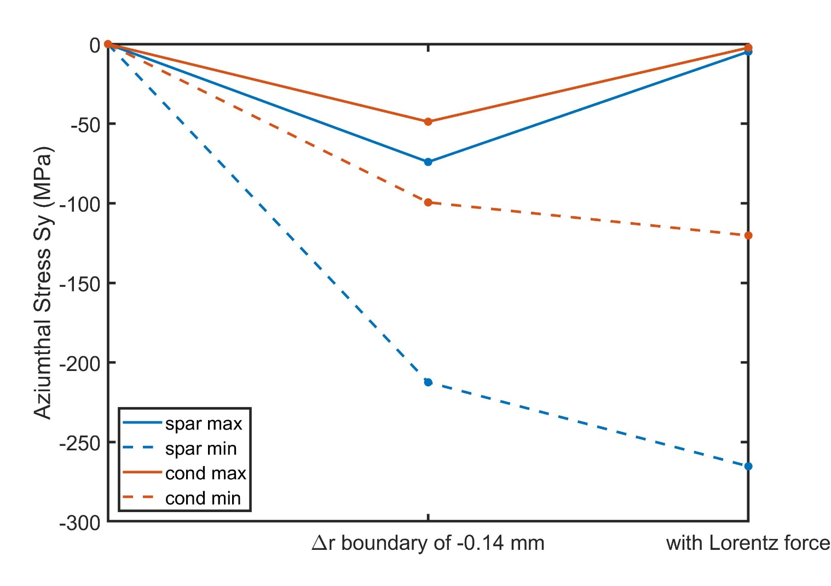
A rigid boundary with pre-stress gives a 2D estimate of peak conductor azimuthal stress of order 120 MPa
boundary is brought in 0.14 mm to keep coil barely in compression at 12.0 kA, 12.0 T bore field
after prestress
prestress+LF
3
1
2
Peak spar -265 MPa
Conductor +0/-120 MPa
1. Due to rigid radial displacement, the ID of the coil is almost uniformly compressed to 90ish MPa (mid-plane and pole alike)
2. When magnetic forces are applied the compression due to displacement gets accumulated with Lorentz forces on the mid-plane and goes to about 120 MPa (about 30 MPa increase?)
3. Pole gets unloaded due to magnetic forces compensating the initial azimuthal compression due to radial displacement. There is no bending because the boundary is fixed

Slide 4
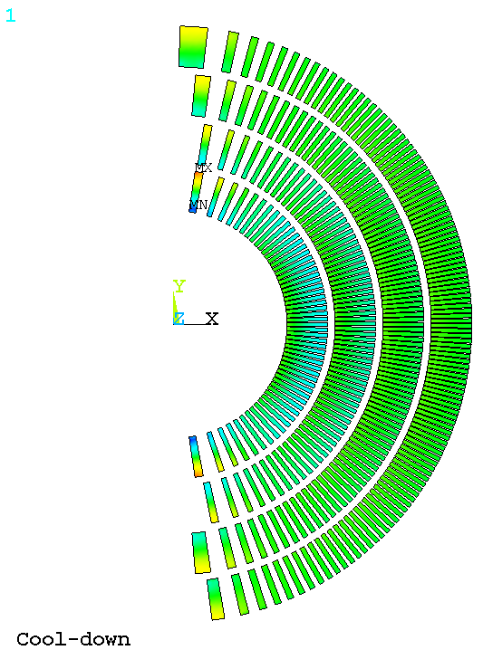
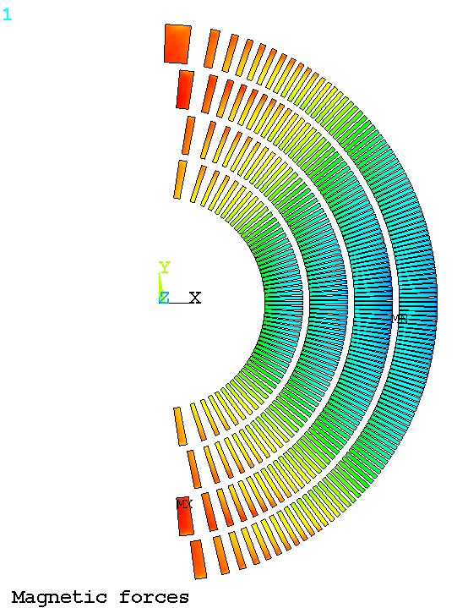
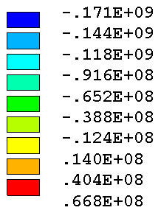
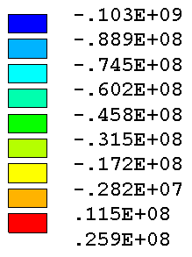
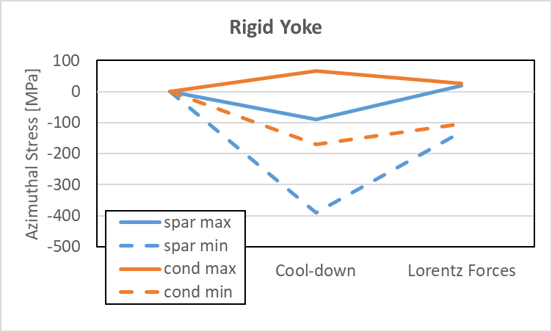
Utility Structure with CCT6 coils Rigid yoke (vertical interface displ. without bending)
Radial boundary displacement (Lucas)
4
7
Rigid Yoke
Azimuthal Stress [Pa]
Azimuthal Stress [Pa]
5
Peak spar -265 MPa
Conductor +0/-120 MPa
6
4. After cool-down, the pole turns see compression on the inner side and some tension on the outer side due to bending
5. Mid plane sees compression but lower than in Lucas case because part of the compression is compensated by bending
6. When magnetic forces are applied the mid-plane sees higher compression, as expected (about 30 MPa increase?)
7. Pole region gets unloaded but the coils still has the "vertical" ellipse deformation from the cool-down but with tension higher in the outer turns and lower in the inner turns (rigid boundary does not allow it to have "horizontal" ellipse shape typical for the case with magnetic forces)
Peak spar -390 MPa
Conductor +68/-172 MPa

Slide 5
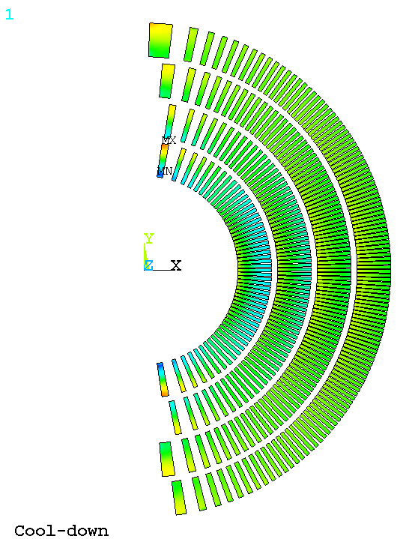
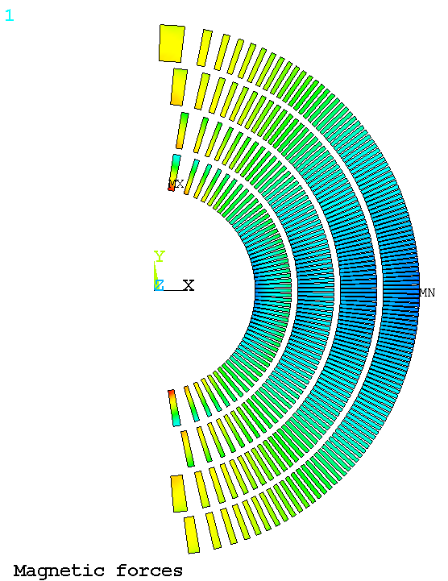
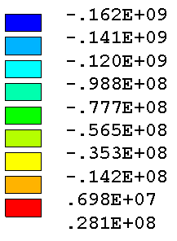
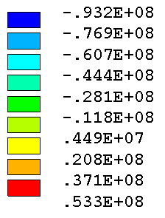
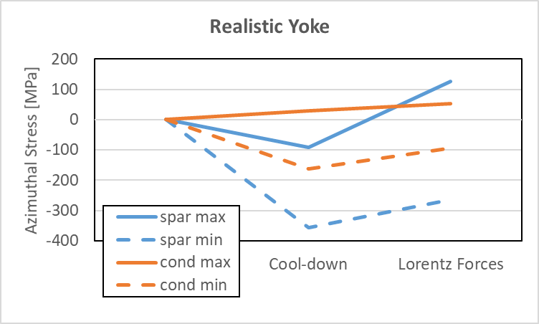
Utility Structure with CCT6 coils realistic yoke (vertical interface displ. with bending)
Radial boundary displacement (Lucas)
8
11
Realistic Yoke
Azimuthal Stress [Pa]
Azimuthal Stress [Pa]
9
Peak spar -265 MPa
Conductor +0/-120 MPa
10
8. is similar to 4 after cool-down due to coil having "vertical" ellipse shape
9. is similar to 5 after cool-down
10. Mid-plane sees increased compression like in 6
11. Pole region gets unloaded but now the boundary is compliant and the coil is deformed into "horizontal" ellipse so due to bending the higher tension develops on the inner side of the first layer.
Peak spar -357 MPa
Conductor +53/-162 MPa

Slide 6
Next steps
Defining maximum coil OD (CCT6, SMCT or other?)
Sharing SMCT/Structure input files?
Defining pre-load goals
CCT6 coil to mandrel contact elements (with debonding?)
Revisiting square pads with no diagonal keys/bladders
Pad thickness and bladder/key location optimization
Controlled closure of yoke to yoke interface
Pancake rod with CTE/key optimization

