Slide 1



Nuclear-Plasma Experiments using Lasers
L.A. Bernstein
BELLA-I workshop
Lawrence Berkeley National Laboratory
January 20-22, 2016
This work was performed under the auspices of the U.S. Department of Energy by Lawrence Livermore National Laboratory under contract DE-AC52-07NA27344 and Lawrence Berkeley National Laboratory under contract # DE-AC02-05CH11231.

Slide 2
Summary
Introduction to nuclear-plasma interactions (NPI)
Lessons learned and future plans for isomer depopulation experiments in laser plasmas
The influence NPI-induced spin differences on nuclear reaction rates
  Isomer-to-ground state ratios as a NPI measurement tool
Experiments using short- and long-pulse lasers

Slide 3
Nuclear-Plasma Interactions (NPI) can excite nuclear states with energies comparable to those of the surrounding plasma
Photo-absorption
Time Reverse: γ-ray decay
Well understood
Atomic-nuclear (electron) interactions
NEEC, NEET, IES
Time Reverse: IC-decay
e_{free/bound}
e_{free/bound}
NEET: measured once*
NEEC: never observed
N
N*
N
N*
Photons
Radiative Dielectronic
B(Ε/Μ λ)
F(E_{γ}), ρ(E_{x},J^{π})
HEDP
electrons
Atom
photons
Nucleus
Recombination
Photons
*Phys. Rev. Lett. 85 1381 (2000), Phys. Rev. C74 031301R (2006)

Slide 4
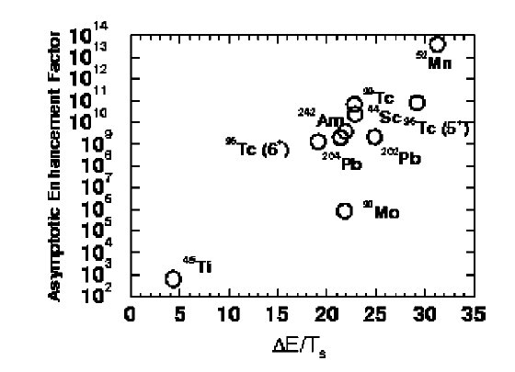
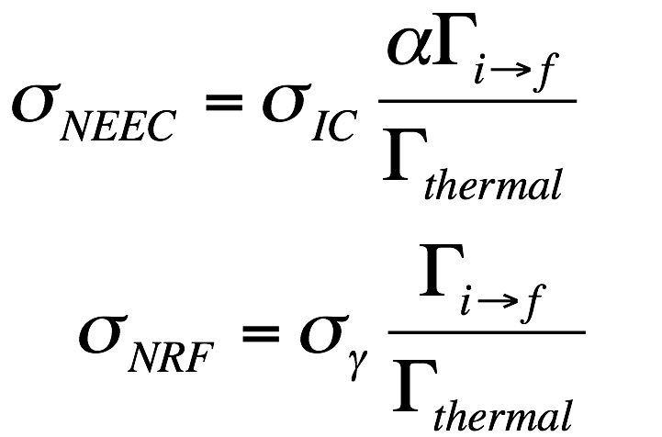
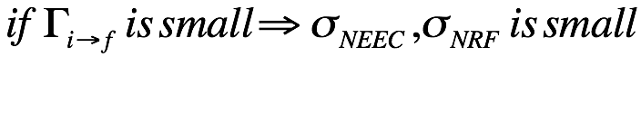
Gosselin proposed that isomers could be de-excited using NEE*/NRF in 2004* and we examined their candidates
Isomer de-excitation mechanism
Isomer decay enhancement factor
X+ΔE keV
f
X keV
X
X
t_{1/2} > 20 ps
e⁻ γ
i
X
^{A}Z
g
X
Ideal case for isomer de-excitation: Γ_{f→i} ≈ Γ_{f→g}
Gosselin & Morel might have the right mechanisms, but they didn’t properly consider nuclear rates
*G. Gosselin & P. Morel Phys. Rev. C 70 064603 (2004)

Slide 5
What I’ve learned as an ≈8 year interloper
Concentrate on experiments that cannot be more easily done somewhere else
Experiments should be consequential -
Never forget two cardinal rules of nuclear physics:
  Rule #1: Nuclei are small (and have small cross sections)
  Rule #2: Nuclear states are narrow (1 ns ≈ 1 eV)
    Corollary: Isomeric transitions are REALLY narrow
Who cares if it’s never been seen before!
How will our view of the world change?
Case in point: ^{84m}Rb
(Hannachi, Meot, Gosselin, Morel)

Slide 7
Thanks to Fazia Hannachi!

Slide 8
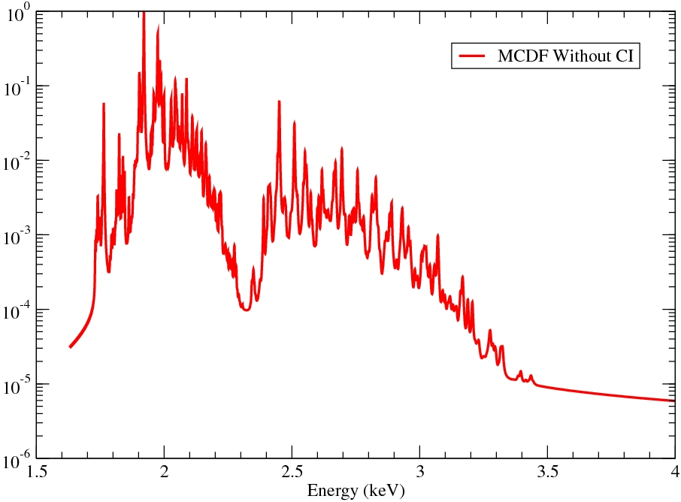
What is the effect of the new
transition energy on the NEEC rate?
T_{e} = 270 eV
ΔE=3,05 keV
ΔE=3,50 keV
There is an important lesson here
Atom
Nucleus
n=4 ➔n=2
n=3 ➔n=2
n=5 ➔n=2
n=6 ➔n=2
NEET Rate drops by more than an order of magnitude!!!
Gilbert GOSSELIN San Francisco 2014

Slide 9
OK, let’s consider the new, “better” example: ⁹³Mo
A population of the 21/2⁺ isomer is made at the cyclotron via the ⁹³Nb(p,n) or ^{90,92}Zr(α,n/3n) reactions
The foils are subjected to different plasma conditions using BELLA (diagnostics needed)
Samples are retrieved post-shot and counted using the local low-background counting facility to get the isomer population
The samples are then sent to the low-background counting facility in South Dakota to have their ground state population measured as well.
(17/2)⁺
3.53 ns
2429.80 keV
t_{½}=6.85 hours
t_{½}=4000 years
Wait 15 more minutes for the talk by Gunst*!
Gunst, Litvinov, Keitel and Palffy, PRL 112, 082501 (2014)

Slide 10
The branching ratio for the 4.91 keV transition is very small due to its low energy relative to the competing 267.97 line
A
B
(17/2)⁺
3.53 ns
Quantity (source) | Value
A Branching Ratio (ENSDF) | 0%
B Branching Ratio (ENSDF) | 100%
E2 Conversion coef. ratio (BRICC) | 4.1 x 10⁵
E2 intensity ratio (4.92⁵/268⁵) | 2.1 x 10⁻⁹
Predicted “partial lifetime” | 4.1 µs
Predicted width | 0.24 neV
2429.80 keV
t_{½}=6.85 hours
t_{½}=4000 years
How many photons (NRF) or electrons (NEEC) do we have in this energy window?
…and for how long?

Slide 11
An alternate approach would be to use the high n flux in an ICF capsule to explore NPIs on very short-lived nuclear states in a HEDP
NIF capsule/hohlraum
10⁴⁰
Step #1
Step #2
Capsule electrons
10²⁷⁻³³{
Dense
1-1000 g/cm³
Hot
kT=1-100 keV
Hohlraum electrons
Capsule
Reactions on
excited nuclear
states
10²²⁻²⁴{
Flux (/s/cm²)
10²⁰
Hohlraum
10⁰
High Neutron Flux
≈10²⁷⁻³³ cm⁻² s⁻¹
(fluence=10¹⁷⁻²²cm⁻²)
Hohlraum Capsule Capsule Hohlraum
Plasma Neutrons
Excite a target nucleus with the plasma then hit it with neutrons
OR, excite a target nucleus with neutrons then interact with the plasma

Slide 12
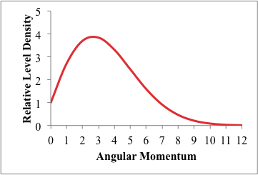

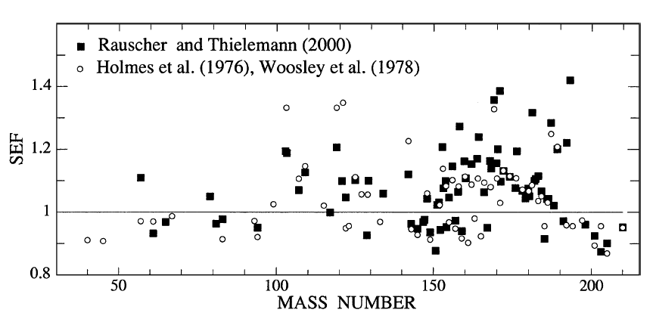
NPI-induced population of low-lying excited states prior to neutron absorption alters the spin of the compound nuclear state
S_{n}
(n,γ) populates
Compound states
3/2⁺
NEEC/T
1/2⁺
^{A}Z
^{A+1}Z
The population of these low-lying states in astrophysics is parameterized by a Stellar Enhancement Factor (SEF)
Why is the SEF mostly > 0?
*Bao & Kappeler At. Dat. Nucl. Dat. Tables 76, 70–154 (2000)

Slide 13
Hauser-Feshbach modeling can be used to show the influence of angular momentum on states formed in neutron capture
neutrons + ¹⁹⁷Au
Neutron escape threshold
τ_{s-wave}(1 ≤ J ≤ 2)=6.5 fs (RIPL)
The “centrifugal barrier” retards neutron emission
Thanks to Ian Thompson (LLNL – Nuclear Theory and Modeling Group)

Slide 14
We’ve also seen these effects in hot nuclei populated via (d,pγ) reactions
Can we change the spin of these compound states by
Putting them in a HEDP?
Si ΔE-E
telescopes
12 MeV
deuterons
Proton
⁹⁴Mo
STARS-LIBERACE
⁹⁴Mo(d,pγ)
M. Wiedeking et al., Phys. Rev. Lett. 108, 162503 (2012)
and accepted for publication in Phys. Rev. C (January 2016)

Slide 15
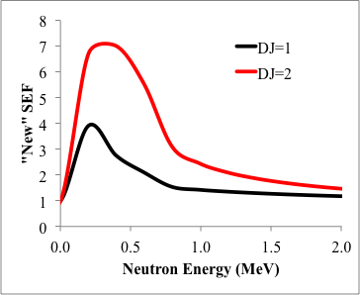
NPIs acting on highly-excited compound nuclear states could also alter the likelihood of the neutron remaining in the nucleus
The situation could be even more complicated if fission is an open channel (e.g., the r-process)
B_{f}
???
NPI
???
S_{n}+E_{n}
S_{n}
Neutron capture
^{A}Z
^{A+1}Z
The interaction of compound nuclear states with a HEDP can be parameterized as a “New SEF”
Thanks to again to Ian Thompson!

Slide 16
Our newly approved NIF shot plan will attempt to observe these “new SEF” effects on the isomer-to-ground state ratio in ¹³³Xe
Time Sequence
  An Indirect Drive Exploding Pusher loaded with a small dopant level of ¹³⁴Xe is shot while a “non-plasma” sample is loaded on a DIM
  Radioactive ¹³³Xe is pumped out of the chamber post-shot using RAGS.
  The DIM is removed and Xe samples collected and transported to Building 151 counting facility
  The Double-Isomer-to-Ground-State ratio is used to search for NPI-induced spin changes
Fig. 2 Geometry of NIF chamber and internal components modeled to quantify neutron downscatter in the gas-cell xenon. The NIF chamber and target bay (left) surround the DIMs and cryo-TARPOS (right). Each DIM holds a gas-cell (bottom left) and the capsule is contained within a hohlraum in the thermomechanical package (bottom right) at the end of the cryo- TARPOS. RAGS sits below the NIF chamber.
Thanks to Laura Berzak-Hopkins and Darren Bleuel!
9

Slide 17
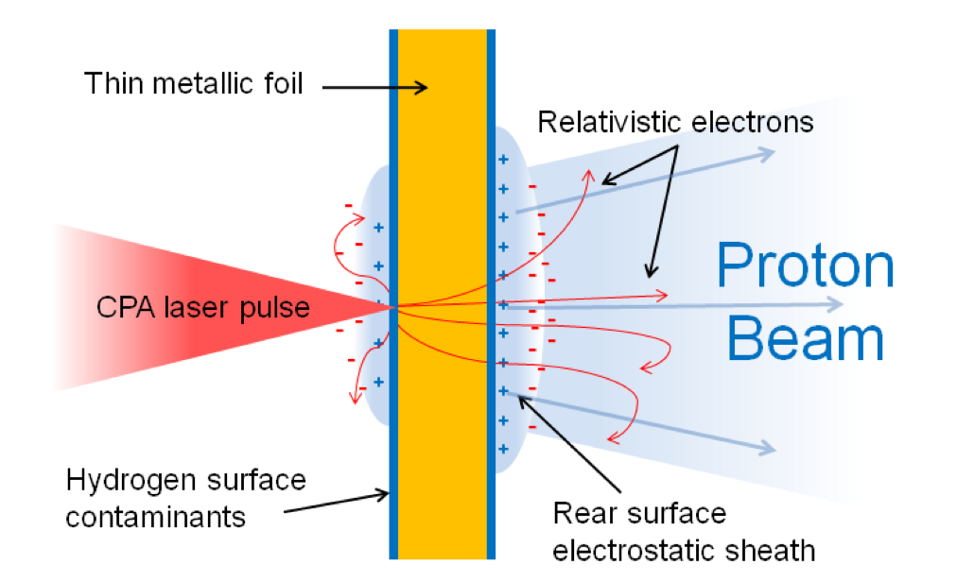
We have also explored using protons from a petawatt laser to perform similar measurements on highly-excited states in ^{196m,g}Au
Target Normal Sheath Acceleration
K. Markey

Slide 18
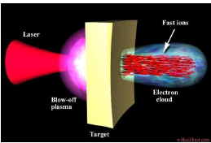
TNSA proton based nuclear-plasma experiment make ^{196m,g}Au using the ¹⁹⁸Pt(p,3n) reaction
Use TNSA protons from a petawtt laser to make an excited nucleus via the
¹⁹⁸Pt(p,3n)^{196m,g}Au
Use a long pulse (ns) laser to place the target nuclides into an HED plasma state a fixed amount of time after the TNSA protons arrive
P
t
f
o
i
l
≈1 mm
First experiment: Platinum in a plasma state when the protons hit
Control experiment: Platinum put into a plasma state after the protons hit
Experiments require a “two-arm” short-pulse laser facility

Slide 19
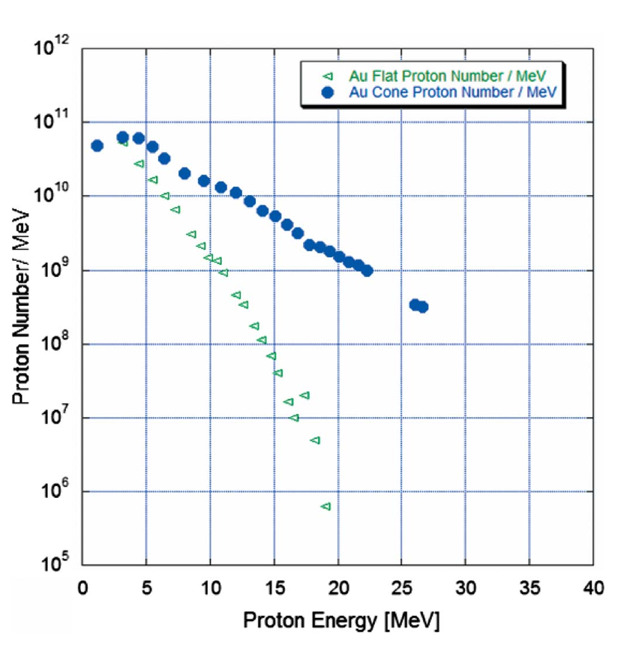
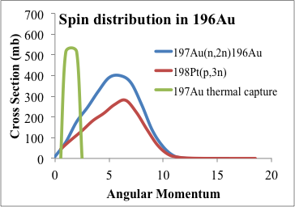
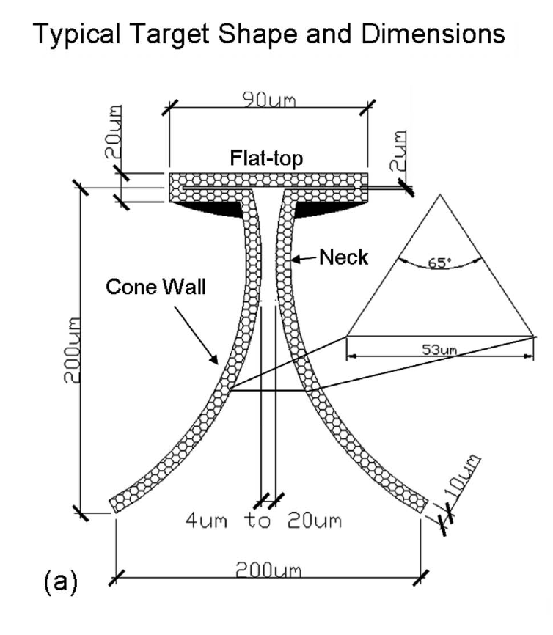
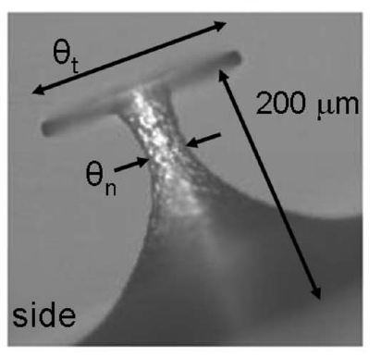
The TNSA proton spectrum can be estimated using recent “state of the art” results
Results from Flippo (2008) at LANL show >10-fold increase in high-energy proton production in shaped targets. Laser power < 100 TW.
¹⁹⁶Au Spin Distribution (EMPIRE)
The ¹⁹⁸Pt(p,3n) reaction is best drive by protons with
20 < E_{p} (MeV) < 30
N_{p} ≈ 5x10⁹
¹⁹⁷Au(n,2n)
¹⁹⁸Pt(p,3n)
¹⁹⁷Au(n_{th},γ)
Results from Roth suggest an even harder proton flux
From the related BOA mechanism (Break Out Afterbuner)

Slide 20
Conclusions
Nuclear-plasma interactions (NPIs) have been a challenging field of studies for > 20 years
  Altering isomer population is a favored approach, but is very sensitive to ΔE values and matrix elements!
The angular momentum of the absorbed photon (real or virtual) is the key element for these measurements
HEDPs from both short and long pulse lasers offer opportunities to observe NPIs
Dual-arm short pulse laser systems offer more flexibility and can exploit the exquisite laser timing

Slide 21


Collaborators on this work
D.L. Bleuel¹, L. Berzak-Hopkins¹, R.M. Clark²,
P.F. Davis³, B.L. Goldblum³, G. Gosselin⁴,
D.H.G. Schneider¹, K.A. Van Bibber³
¹ Lawrence Livermore National Laboratory
² Lawrence Berkeley National Laboratory
³ University of California-Berkeley Dept. of Nuclear Engineering
Another potentially useful resource for people interested in this topic is our ACS 2014 workshop:
http://bang.berkeley.edu/events/acs-nif

Slide 22
Backup slides

Slide 23


Conclusion & Perspectives
  Experimental spectrum is well restituted
      MCDF calculations with or without CI
      Very time consuming
      Agreement with AVERROES calculations
  Rubidium 84 is probably not the best candidate
      n=4,5,6 ➔n=2 nearly impossible with ΔE=3,50 keV
      Higher transition energy than expected
      Optimum Charge state for NEET is now 30⁺/32⁺
  Future NEET calculations
      Will require MCDF with CI
      Alternate ADAM model (see next talk with M. Comet)

Slide 24
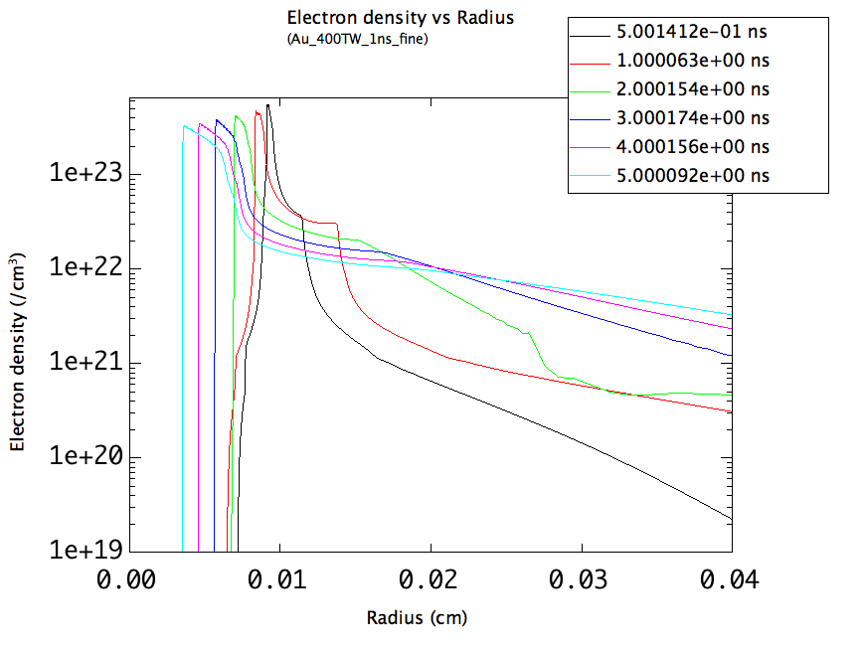
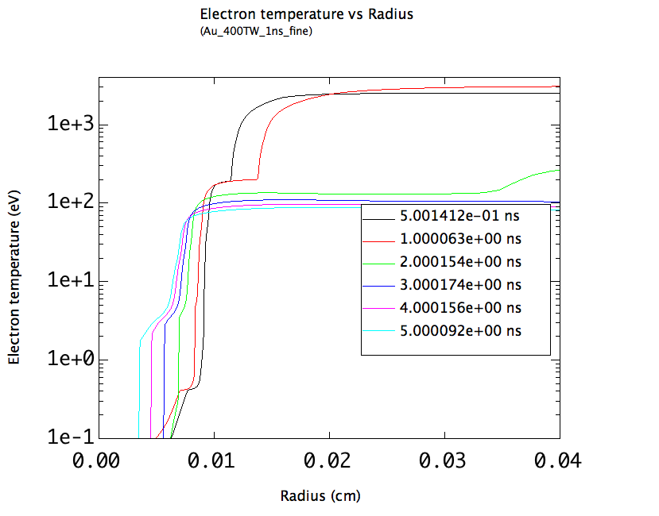
Long-pulse laser produces a variety of plasma conditions
1D Radiation Hydrodynamics simulations complements of P.F. Davis
Electron density vs. Radius
Electron temperature vs. Radius
Laser
Laser
Plasma Properties | NIF | TNSA
Electron Fluence (cm⁻²) | ≈3x10²² | ≈10²⁰⁻²¹
Temperatures (keV) | T_{e}≈5-50,T_{g}=0.3 | T_{e}≈0.2-3,T_{g}=0.2

Slide 25
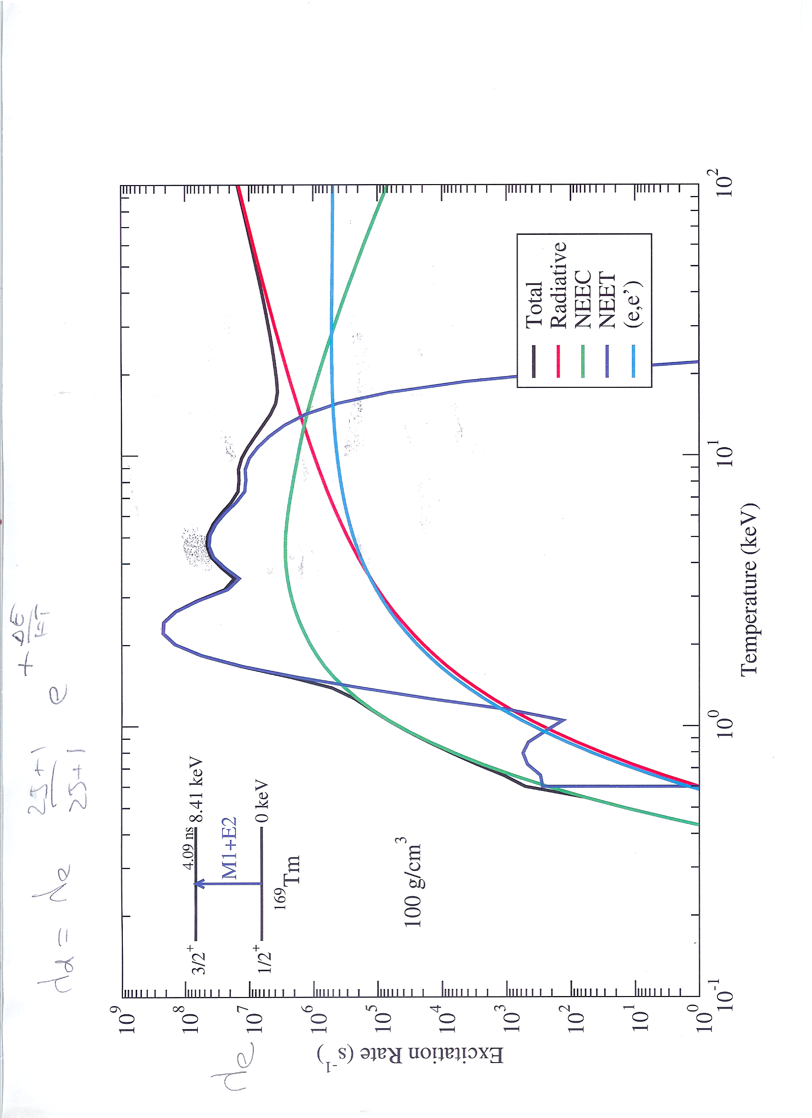

What are the magnitudes of NPI cross sections?
3/2⁺
1/2⁺
8.6 keV
4.1 ns
G. Gosselin, CEA
¹⁶⁹Tm
267 b
1.27 kb
M. Chen/A. Kritcher

Slide 26
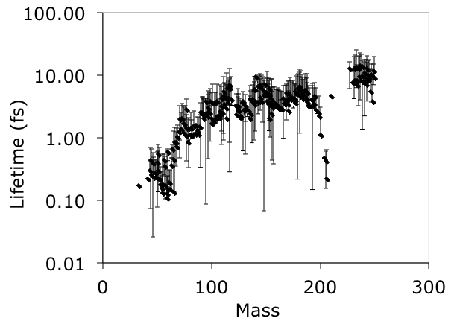
Are the rates fast enough?
Maybe in a massive nucleus
Limiting case: Assume that the σ_{NPI} scales as the lifetime (1/Γ_{partial}) of the transition
Use nuclear level density from RIPL-3 (≈10³ levels/keV)
Assume that there is always a quasi-continuum transition that has the energy match to an atomic transition as the above example and that ρ_{e}≈500 g/cm³
3/2⁺
1/2⁺
8.641 keV
4.09 ns
1/2⁺
3/2⁺
9.4 keV
37 ps
M1+E2
M1+E2
¹⁶⁹Tm
²³¹Pa
Nuclear
Atomic

Slide 27
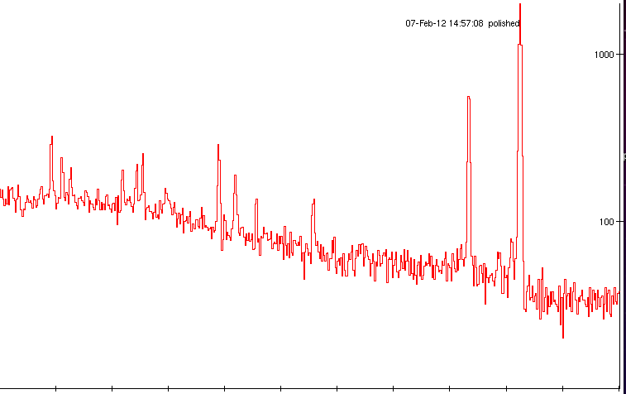
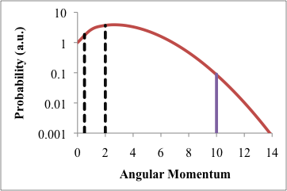
The 9.7 hour 12⁻ isomer in ¹⁹⁶Au might be showing us the first hints of highly-excited states interacting with a HEDP
¹⁹⁷Au(n,2n)^{196m}Au
¹⁹⁷Au(n,2n)^{196g}Au
1000
100
Counts
Fraction feeding isomer
N111103 SRC data
DT cryo with Y₁₄=5x10¹⁴
{
Energy (keV)
125 175 225 275 325 375
ρ≈1 eV⁻¹
Γ≈1 eV
S_{n}=6.642 MeV
Ground
State
Isomer
Isomer
Ground
State
{
(n,2n) populates
“quasi-continuum”
Vacant
electron
orbital
ρ≈1 eV⁻¹
12⁻
2⁻
¹⁹⁷Au
¹⁹⁶Au
Thanks to Dawn Shaughnessy and the SRC team

