Slide 1
Making Gamma-Ray Bursts @10²¹W.cm⁻²
Pair and Gamma-Ray Creation Using the Texas Petawatt Laser
Edison Liang, Rice University
Rice Team: Henderson, Fu, Chaguine, Taylor, Clarke, Lo, Cen, Zhou,
Hua, ,Hasson, Wang
UT Team: Dyer, Riley, Serratto, Donovan, Ditmire
Paper to appear in Nature Scientific Reports (Online Journal)
Work supported by DOE, FIF, MDAnderson, LSU-MBPCC.

Slide 2
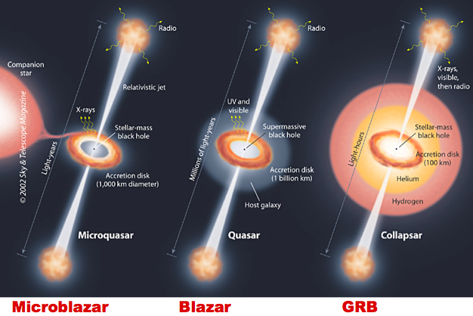
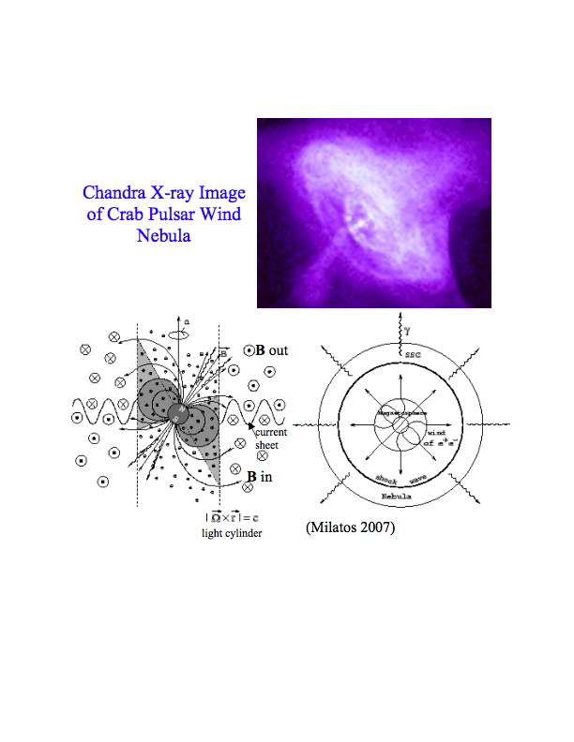
Relativistic outflows in astrophysics emit intense gamma-rays
and are dominated by e+e- pairs
Γ ~ few 10’s 1000’s >10⁴
pulsar wind
n₊~10¹³/cc
ε_{γ}~10 ¹¹⁻¹² erg/cc
Need for laboratory platforms to study such phenomena in a
controllable setting

Slide 3
Besides astrophysics, other applications of ultra-intense
~ MeV electron, positron and gamma-ray sources include:
Medical therapy
Homeland security
Photo-nuclear reactors
Inertial fusion
Material science
Positronium BEC and GRASAR
Antimatter propulsion and space travel
Warm Dense Antimatter
Probing many-body effects in QED vacuum
……….

Slide 4
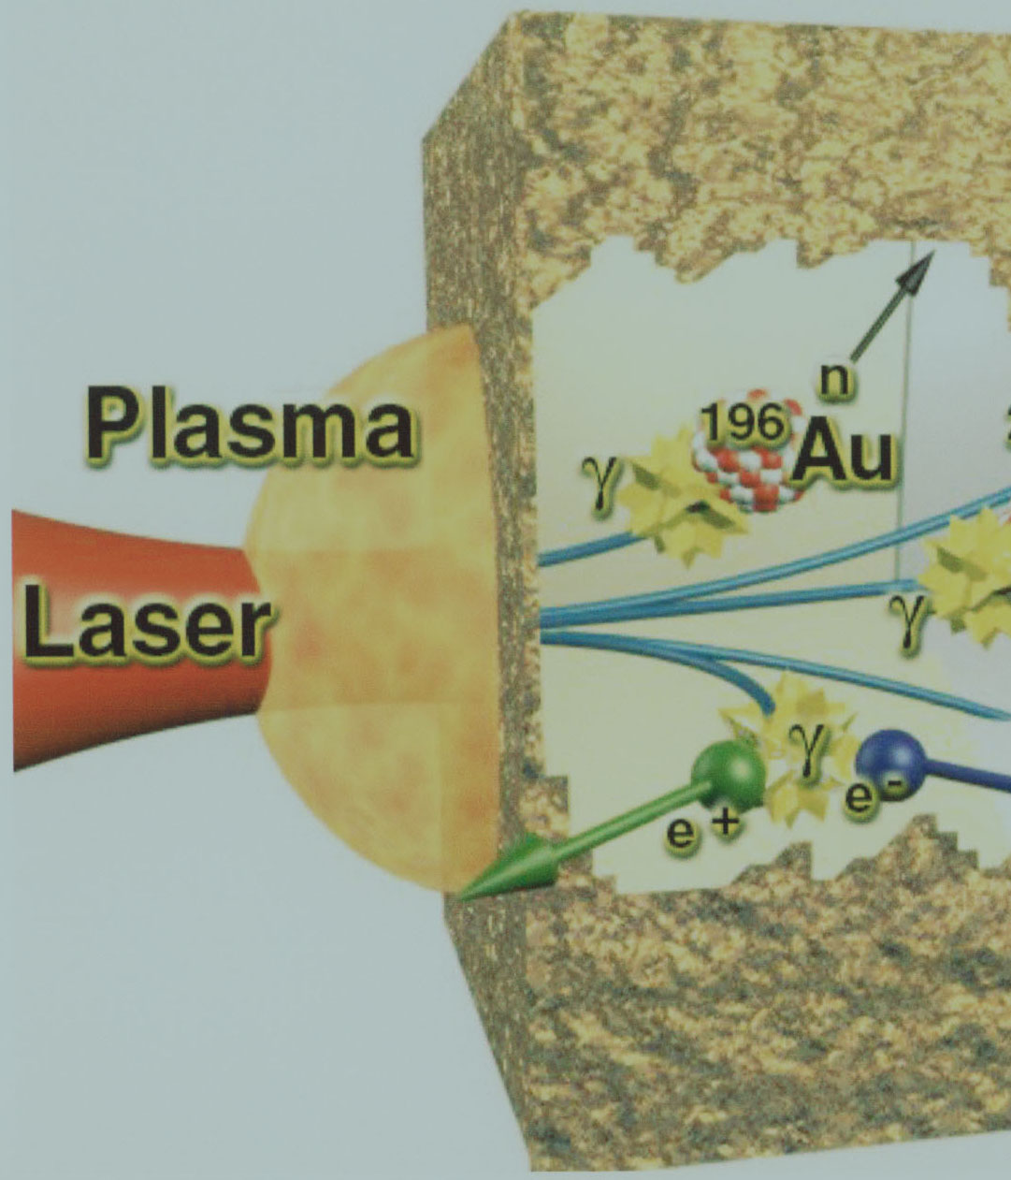
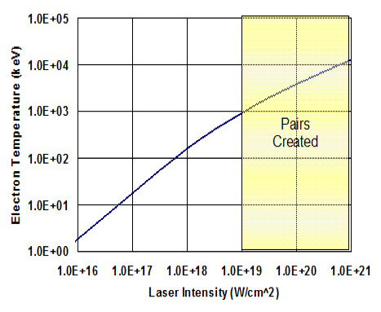
Ultra-intense laser is the most efficient tool to
create intense gammas & pairs in the laboratory
(Cowen 1999, Chen 2009…)
Bethe-
Heitler
e+e-
γ
MeV e-
e+e-
Trident
Lasers with intensity > 10¹⁹ W.cm⁻² irradiating solid targets
couple 10-50% of their energy to “hot electrons”
with kT_{e} > MeV.

Slide 5
Ultra-intense laser is the most efficient tool to
create dense gammas & pairs in the laboratory
(Cowen 1999, Chen 2009, 2010, Gahn 2000, Sarri 2015)
Bethe
Heitler
e+e-
1-step laser-solid
approach
BH dominates
in thick target
γ
LASER
MeV e-
MeV e-
e+e-
Trident
high-Z solid target
higher laser intensity => hotter electrons =>
higher energy gammas => pair creation in thicker target

Slide 6
1-step (laser-solid) vs 2-step (laser-gas jet+converter):
Both approaches can achieve pair-dominated plasmas with
high e+/e- > 50% and Rw₊/c >1.
Key Differences:
2-step (Sarri et al 2015): higher pair energy (≥ GeV),
narrow beam, higher density, lower yield
1-step: higher pair yield, lower pair energy ( ~ MeV),
broad beam

Slide 7
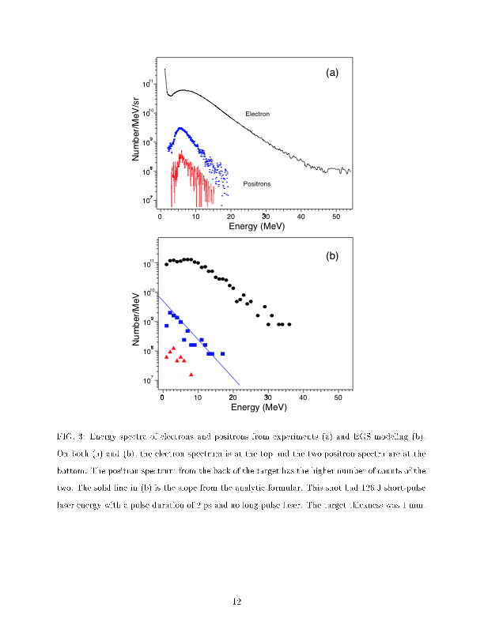
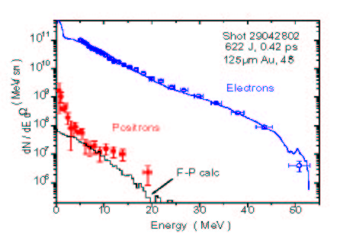
Laser pair creation was demonstrated by Cowan et al (1999) and
Chen et al (2009, 2010) at laser intensities ~ few x10¹⁹ - 10²⁰ W.cm⁻².
Chen et al 2009
Cowan et al 1999

Slide 8
with over
100 J

Slide 9
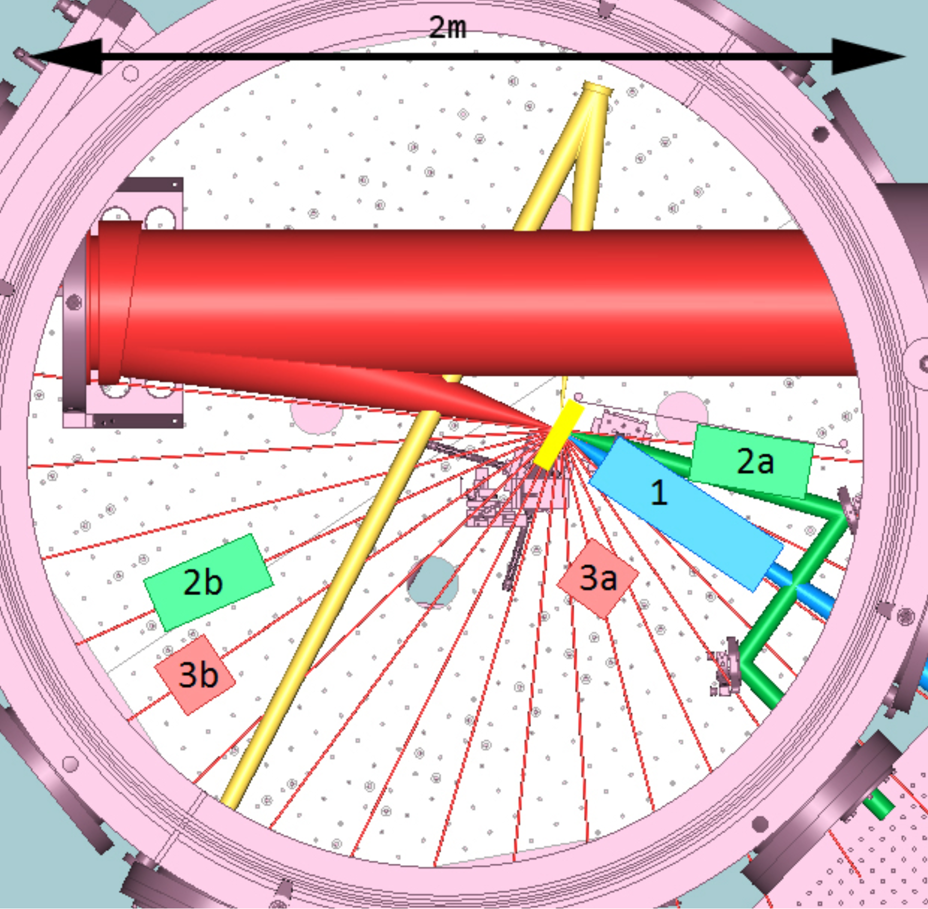
T1 with f/3 mirror

Slide 10
We performed ~130 TPW shots on Au, Pt
disk and rod targets
E = 81 -130 J , <E> ~ 103 J
ΔT = 128 - 245 fs, <ΔT> ~ 166 fs
P = 450 - 800 TW, <P> ~ 640 TW
%E in 10 μm circle = 40 - 80%, <%E> ~ 65%
Laser Incident angle θ =□ 0□, θ  □
Peak I = 3x10²⁰ - 1.9x10²¹ W.cm⁻², <I> ~ 7x10²⁰W.cm⁻²
15% of all shots had I ≥ 10²¹ W.cm⁻²

Slide 11
Most Important Results
1. We inferred emergent pair density ~ 10¹⁵/cm³
== > Rω₊/c ~ 4, marginally qualifying as a “pair plasma”.
2. e+/e- ratio exceeded 15% in many shots, with
the highest ratio reaching ~ 50% for Pt, close to
“pair domination” regime.
Pt targets produced higher e+/e- ratios than Au targets
4. Rod targets produced higher e+/e- ratios than disk targets.
*****************************************************************************
5. Gamma-ray yield reached ~ 4% of laser energy.
6. Gamma-ray density ~10¹¹erg/cc ~ those inferred in GRB.
7. Gamma-ray fluence ~ seen by ISM at ~ 10’s pc from a GRB
8. Gamma-rays beamed into a ~15º cone between laser forward
and target normal directions.

Slide 13
e+/e- for Au disk targets

Slide 14
cutoff above 4mm thickness is due to small disk diameter

Slide 15
Thick Pt disk targets produce higher e+/e- than Au targets

Slide 16
Ratio of Pair Jet transverse size R to “pair skin depth”
Rc/ω₊ ~ (N₊/Δt)^{1/2}
Rc/γ^{1/2} ω₊ ~ (N₊/γΔt)^{1/2}
Max (Rc/ω₊) ~ 4, for 0.35 mm thick Au disks
Max (Rc/γ^{1/2} ω₊) ~ 1.1, for 1mm thick Au disks
We are at the threshold of creating a “pair plasma”

Slide 17
long narrow rod targets can optimize emergent e+/e- ratio by maximizing absorption of primary electrons and gamma rays along rod axis while allowing more pairs to escape sideways

Slide 18
Pt rods give higher e+/e- ratio than Au rods
3mm diameter rods give higher e+/e- ratio than 2mm diameter rods
The highest Pt e+/e- ratio reached 52%

Slide 19
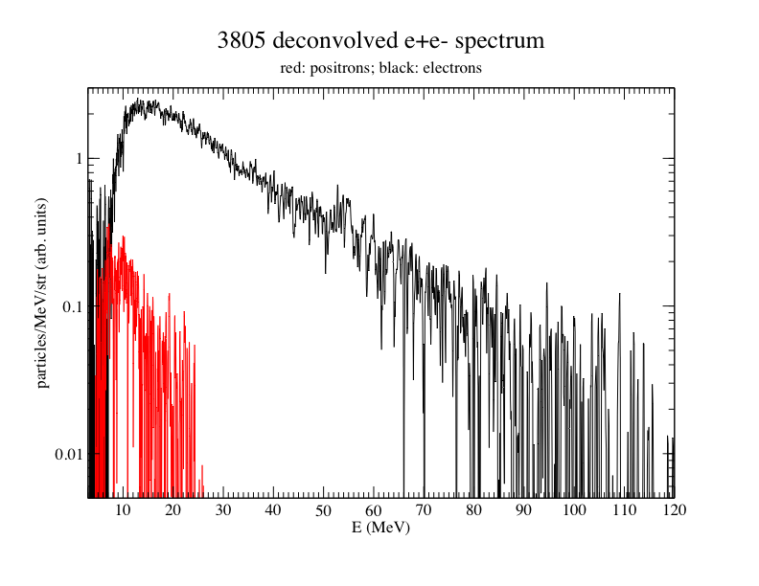
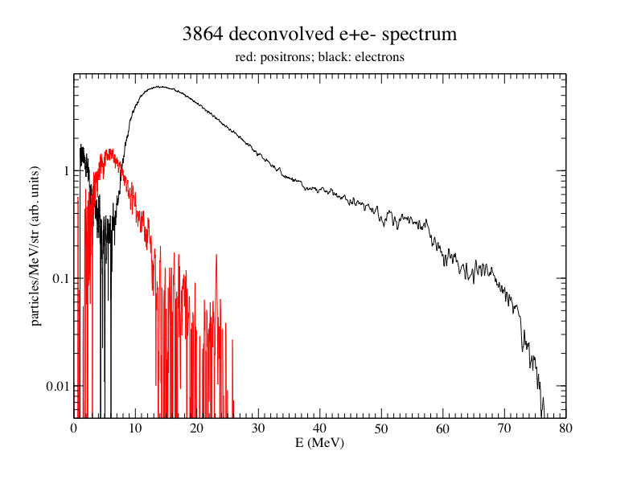
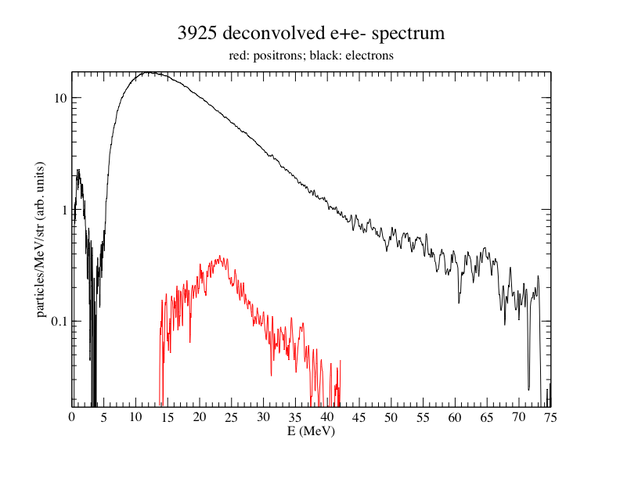
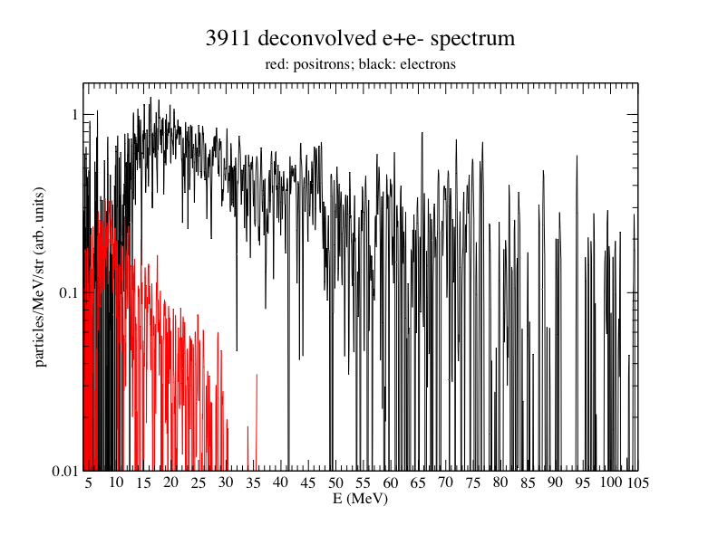
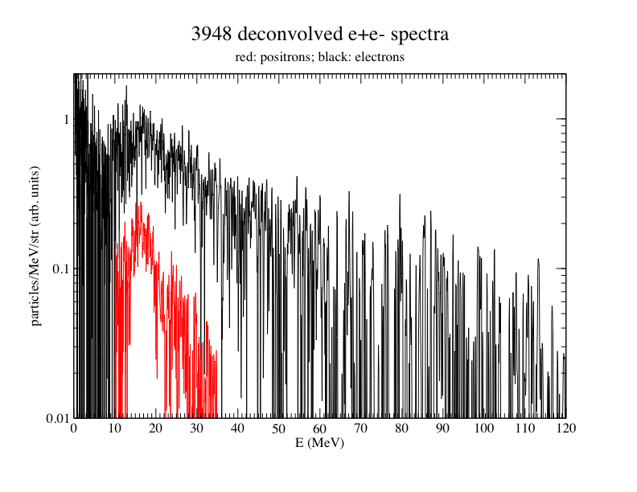
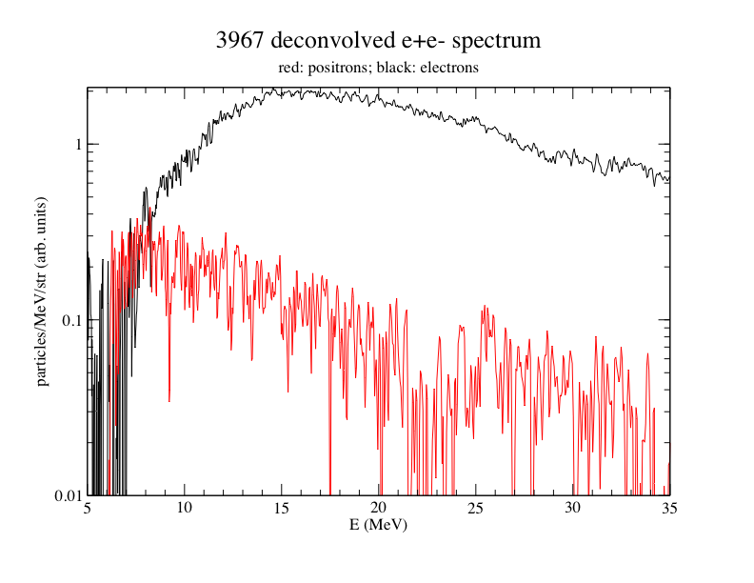
For Au, e- spectra always peak at 12-15 MeV,
while e+ spectral peaks vary from ~ 6 - 23 MeV
2mm
1mm
0.35mm
3mm
4mm
8mm rod
Rod target e+ spectra are harder than disk target spectra

Slide 20
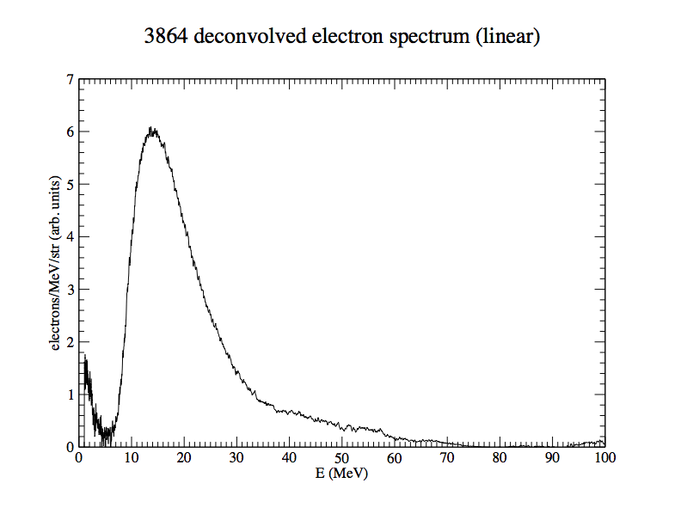
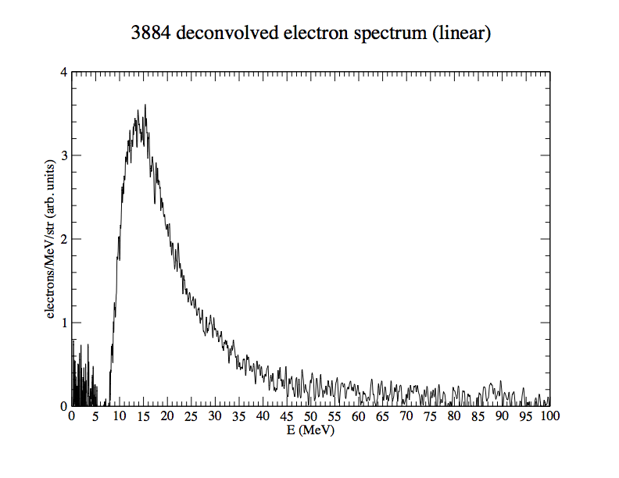
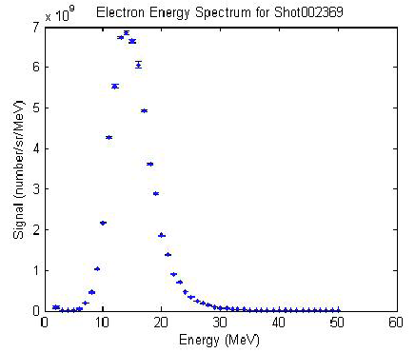
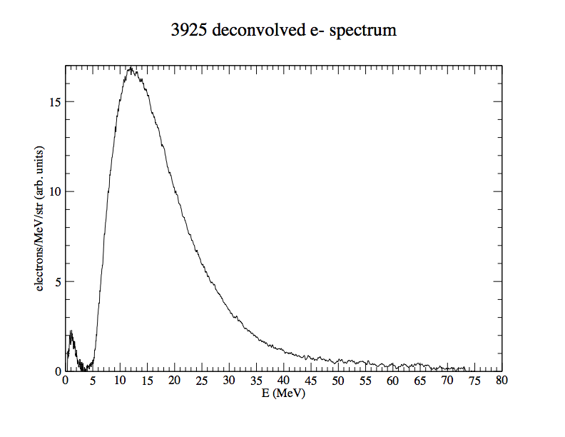
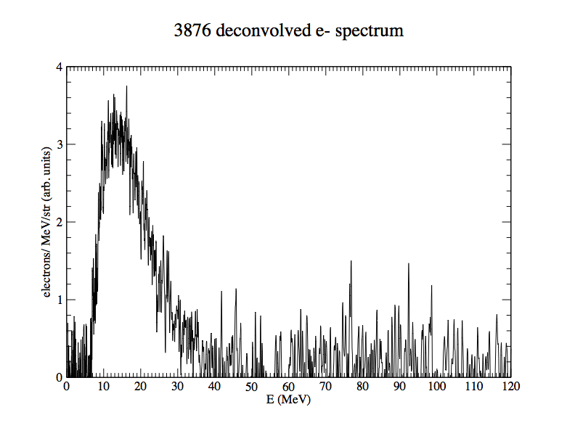
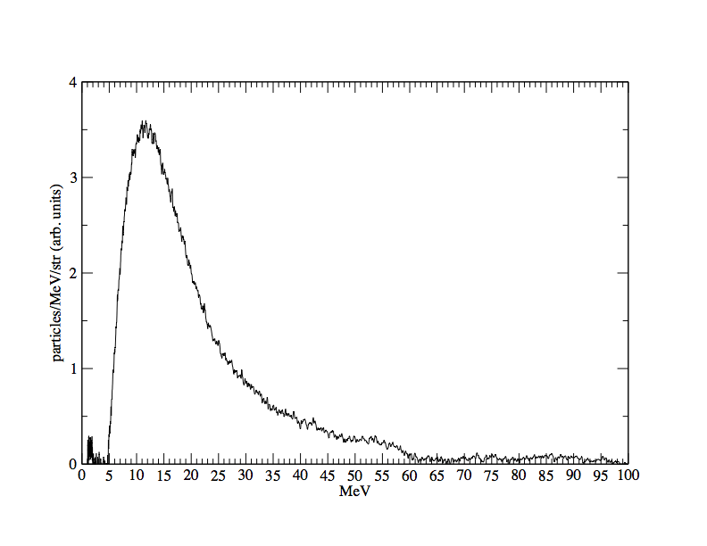
1mm8e19TN
1mm6e20TN
1mm1e21LF
Narrow-band hot electron spectra remarkably similar: E_{pk}~12-15 MeV, FWHM~10 MeV wide peak followed by exponential tail.
Origin of constant E_{pk} value a mystery.
.35mm6.6e20LF
2mm1.1e21TN
1mmPtLF

Slide 21
Au positron energy peak varies between ~ 6 and 23 MeV

Slide 22
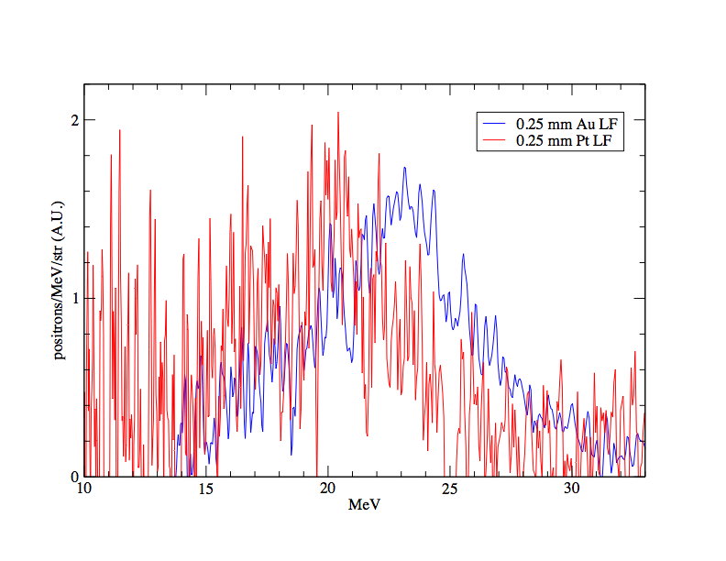
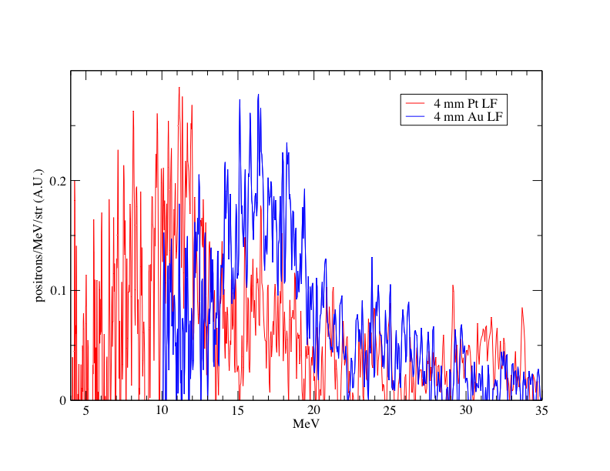
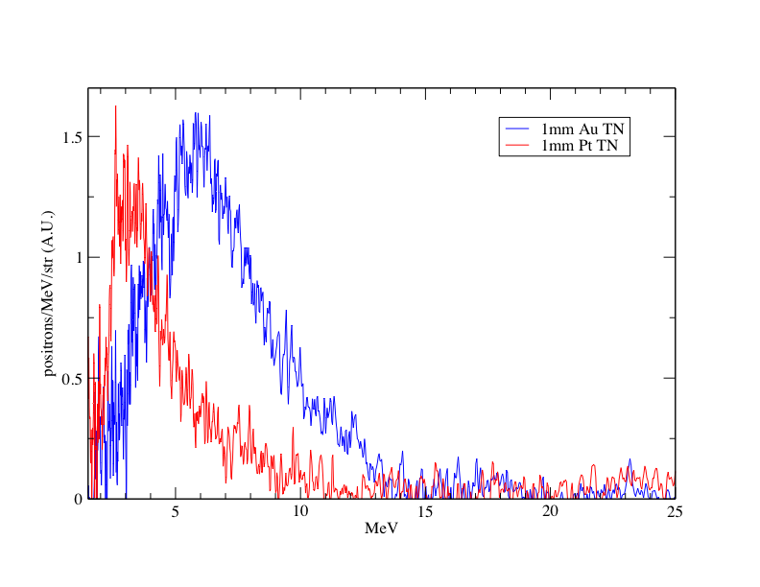
Pt e+ energy peak lower than
Au, suggesting lower sheath
potential due to fewer escaping electrons

Slide 23
Proton peak energies are much lower than positron peak energies
LF
TN

Slide 24
2D PIC
simulations
with EPOCH
explains
low sheath energy
of protons

Slide 25
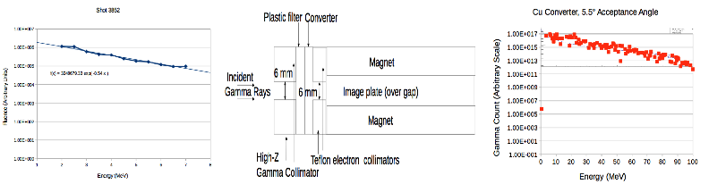
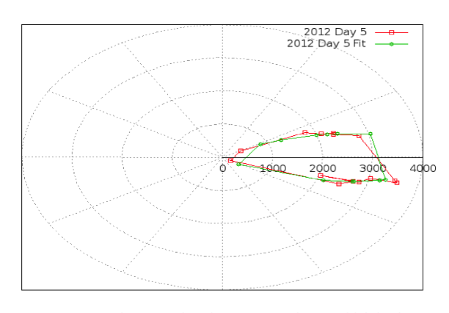
Dosimeter data show forward
gamma-ray beam of ~15º .
Total gamma yield ~ 2% - 4%
of laser energy
FCES
FCES spectrum
FSS spectrum
bremsstrahlung consists of 2 components: soft (MeV) + hard (10’s MeV)

Slide 27
Upgrade of FSS
How to detect the 511 keV annihilation line?
2 new approaches
Highly pixelated
scintillators to
create 2D image
of light pattern

Slide 28
Recap of Most Important Results
1. We achieved emergent pair density ~ 10¹⁵/cm³
with pair skin depth < pair plasma size,
and emergent e+/e- ratio ≥ 50% .
2. Gamma-ray yield reached ~ 4% of laser energy with density ~ those in GRB and fluence ~ seen by ISM at ~ 10’s pc from a GRB and ~15º forward
cone.

Slide 29
Besides astrophysics, other applications of ultra-intense
~ MeV electron, positron and gamma-ray sources include:
Medical therapy
Homeland security
Photo-nuclear reactors
Inertial fusion
Material science
Positronium BEC and GRASAR
Antimatter propulsion and space travel
Warm Dense Antimatter
Probing many-body effects in QED vacuum
……….

Slide 30
Bella-I key advantage over TPW: Higher rep rate, up to 1 Hz
In principle, we can accumulate yields from many shots.
For e+e-, we can combine dose from many shots for biomedical
applications. Also we can imagine separating and collecting
positrons from many shots in a high-vacuum magnetic cage to
Reach a critical e+ number for astrophysical applications or making
high-density Ps.
Similarly, for gamma-ray applications, we can reach much
higher total gamma-ray dose, e.g. for photo-nuclear reactions,
medical applications etc.

