Slide 1
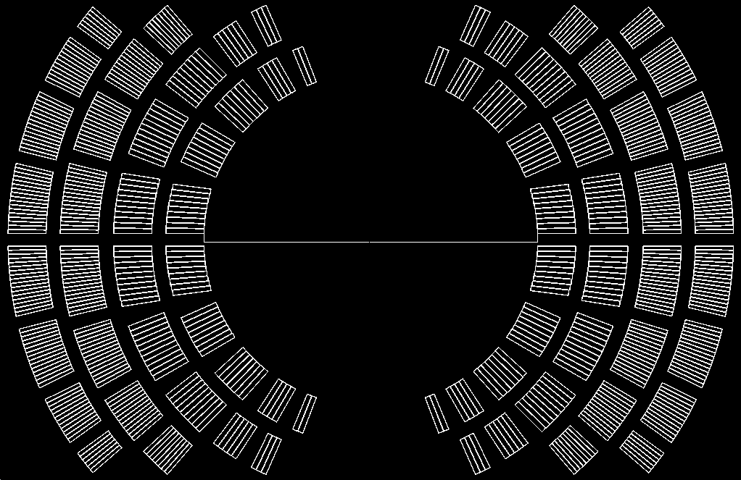
SMCT geometry and forces form Roxie output
Geometry (blocks)
Insulated cable height 15.4 mm
Inner radius 66.8 mm
Outer radius 145.4 mm
Magnetic field
Conductor current 12.5 kA
Bore field 15.4 T
100% of conductor Ic
Forces per quadrant
Fx = 12.38 MN/m
Fy = -8.01 MN/m
LD1 shell thickness 75 mm
Expected shell stress 165 MPa
Layer | IR [mm] | OR [mm]
1 | 66.8 | 82.2
2 | 87.7 | 103.1
3 | 109.1 | 124.5
4 | 130.0 | 145.4

Slide 2
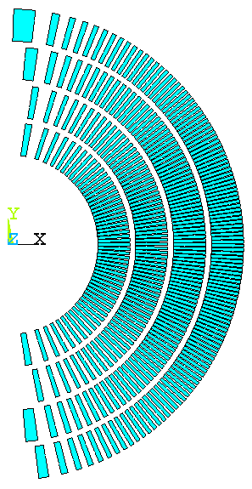
CCT6 geometry and magnetic forces
Geometry (layers)
Insulated wire height 22.6 mm
Inner radius 63 mm
Outer radius 165 mm
Magnetic field
Conductor current 12.0 kA (15 kA?)
Bore field 12.8 T (16 T?)
80% (100%?) of conductor Ic
Forces per quadrant
Fx = 10.36 MN/m (16.86 MN/m?)
Fy = -4.93 MN/m (-7.70 MN/m?)
LD1 shell thickness 75 mm
Expected shell stress 138 MPa (224.8 MPa?)
Layer | IR [mm] | OR [mm]
1 | 63.0 | 85.6
2 | 89.6 | 112.0
3 | 116 | 139
4 | 143 | 165

Slide 3
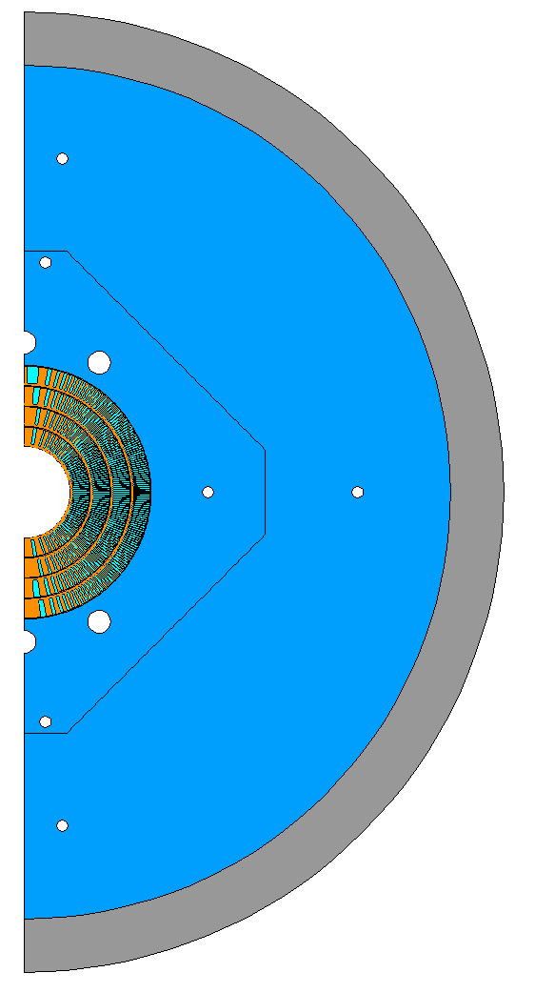
Next steps
Defining maximum coil OD (CCT6, SMCT or other?)
SMCT DWG geometry and ROXIE output
SMCT ANSYS input
Defining pre-load goals
CCT6 coil to mandrel contact elements (with debonding?)
Revisiting square pads with no diagonal keys/bladders
Pad thickness and bladder/key location optimization
Controlled closure of yoke to yoke interface
Pancake rod with CTE/key optimization

