Slide 1
Update on Nb₃Sn CCT Subscale Magnet Program
D. Arbelaez, T. Bogdanof, L. Brouwer, S. Caspi, P. Ferracin, R. Hafalia, M. Krutulis, M. Martchevskii, M. Maruszewski, T. Shen, K. McCombs, M. Reynolds, J. Rudeiros Fernandez, J. Swanson, J. Taylor, R. Teyber, M. Turqueti, S. Prestemon
US Magnet Development Program
Lawrence Berkeley National Laboratory

Slide 2
Outline
Motivation
Design Parameters
Thin/Thick spar test results
Subscale program plans
Details on mechanical analysis (Lucas)
Details on fabrication process and strain gage measurements (Jose Luis)
Details on instrumentation / diagnostics (Maxim)

Slide 3
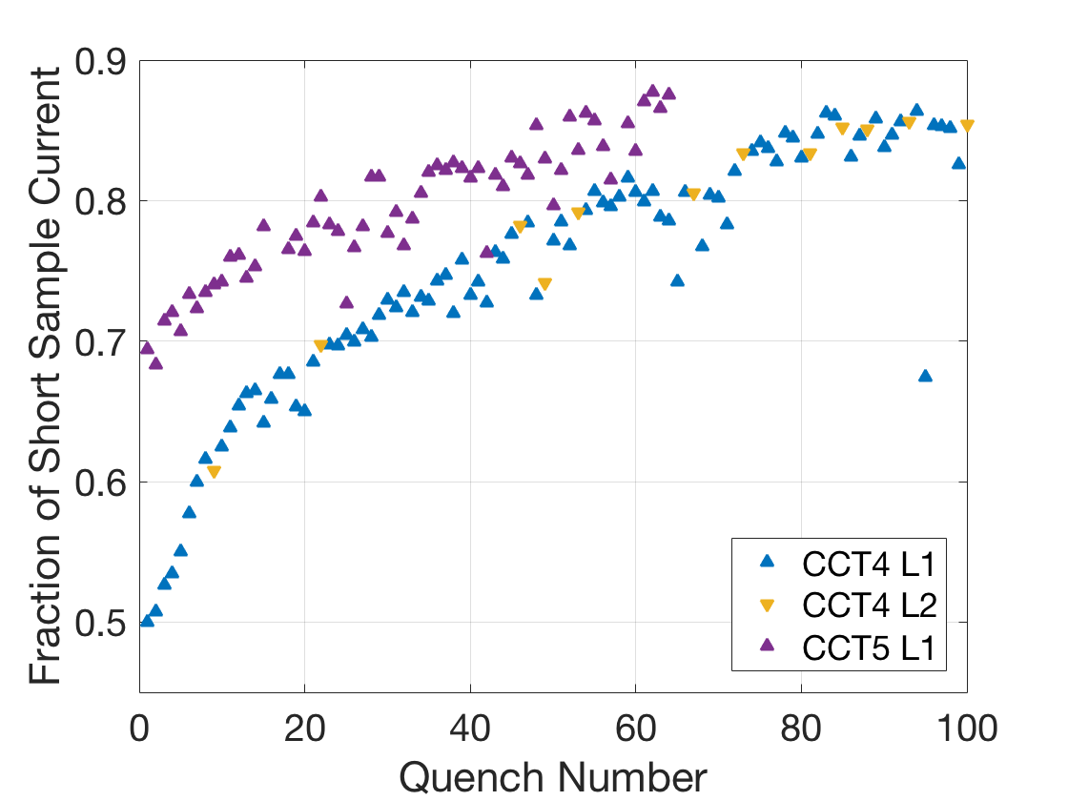
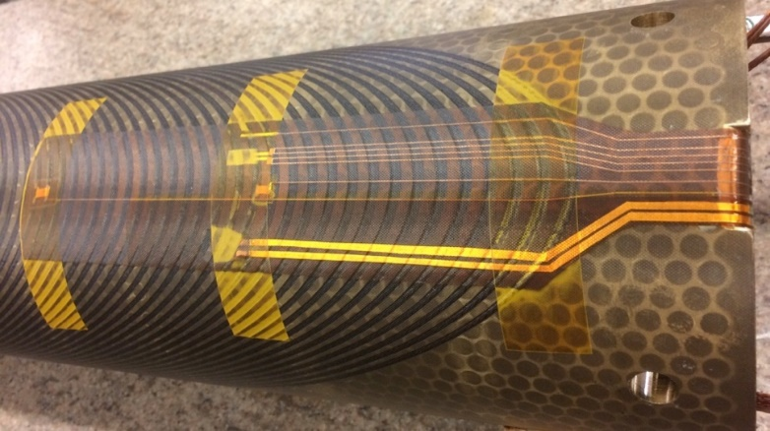
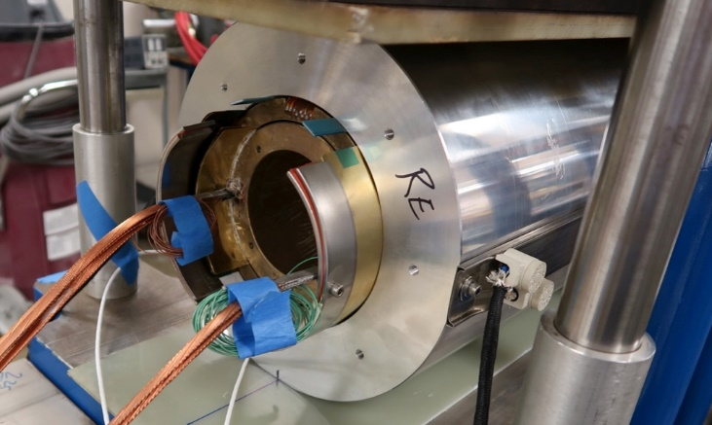
Brief Review of Previous Nb₃Sn CCT Magnets
CCT4
Coils and shell impregnated together
CTD101K epoxy
CCT5
Bend-and-Shim assembly of individually impregnated coils (bending of Al shell provides some preload)
Mix61 epoxy from FSU
Quench Current Relative to SSL
Training rate after “fast” segment is similar for CCT4/5
Individually Potted Coil
Bend and Shim Assembly
Initial “fast” training eliminated in CCT5

Slide 4
CCT Subscale Program Will Focus On Understanding And Reduction of Training
Subscale models can lead to faster turnaround for dedicated training experiments, for example:
Epoxy (or other impregnation materials) influence on training
Structural influences
Interface conditions
Subscale models are complementary to overall CCT program and will give feedback to design of future large CCT models

Slide 5
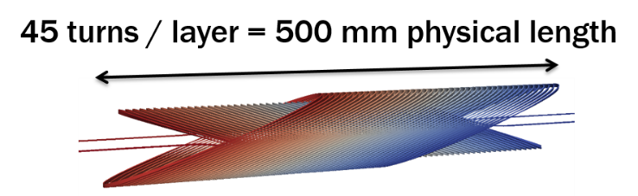
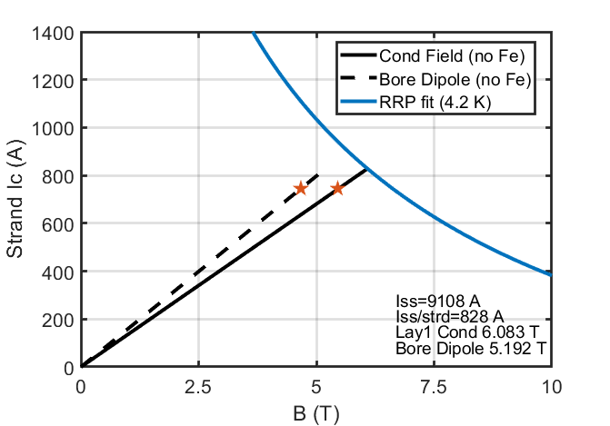
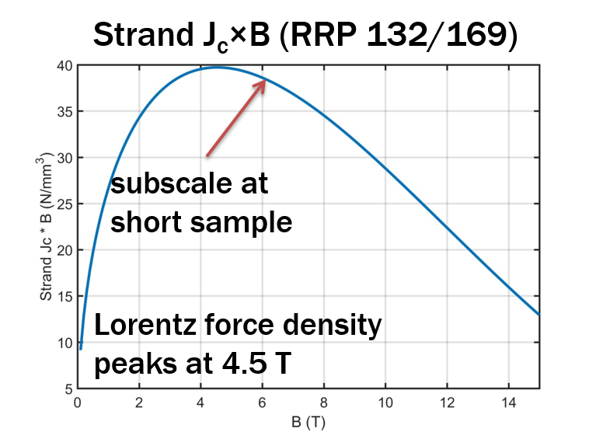
Subscale CCT Magnet Parameters
11 strand Nb3Sn cable
Strand diameters is 0.6 mm
Cable dimensions (1.1 x 4.0 mm)
9100 A short sample current
Cable length ~ 50m
Nominal inner bore diameter is 50 mm (thin spar)
Bore dipole field is approximately 5.2 T as short sample current
Peak conductor field is approximately 6.1 T at short sample current
Magnet Load Line*
* Short sample measurements are based on similar wire used for superconducting undulators

Slide 6
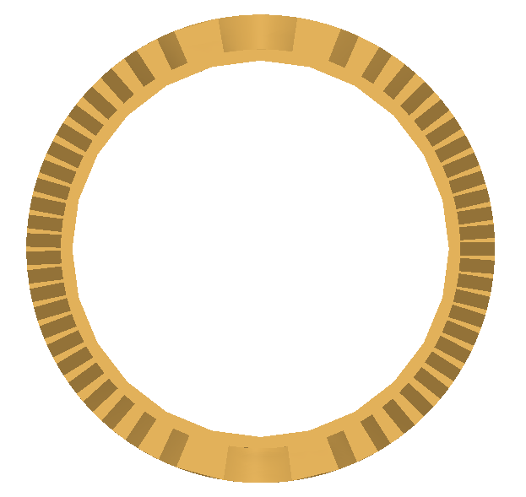
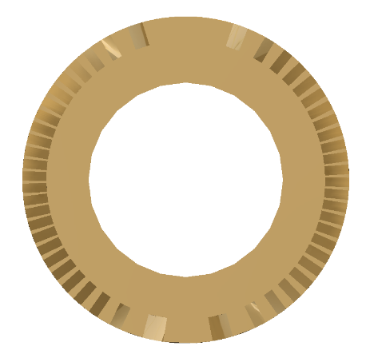
First Subscale Tests Focus on Understanding effect of cable and cable/groove interface stress on training
Can use geometry of CCT coils to modify the stress in the cable and cable/groove interface
Shear stress can be reduced by reducing spar thickness but normal stress will increase (accumulation of azimuthal force towards midplane + bending of layers)
First set of tests will be of inner layers with thin and thick spars
Thin spar → reduced interface shear stress and increased normal stress due to bending
Thick spar → increased interface shear stress and reduced normal stress due to bending
Thin Spar
Thick Spar
This spar is the baseline configuration which was chosen to replicate stress state in previous 2 layer models

Slide 7
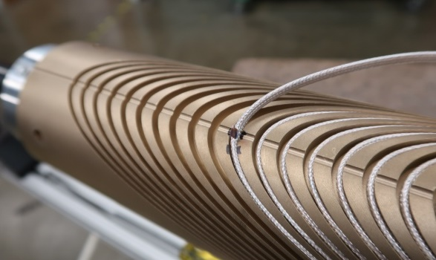
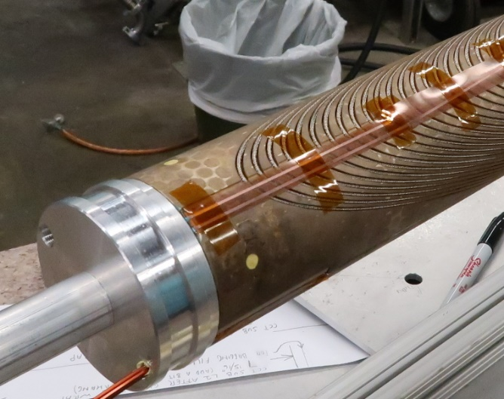
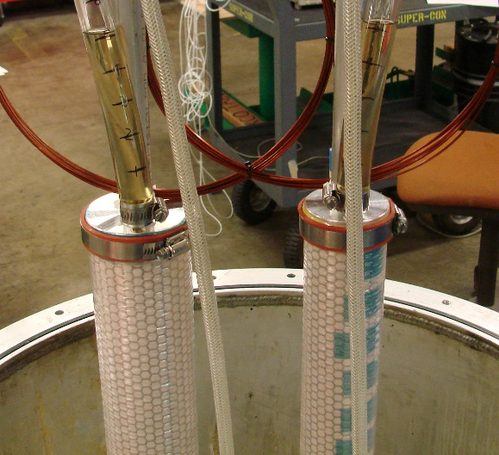
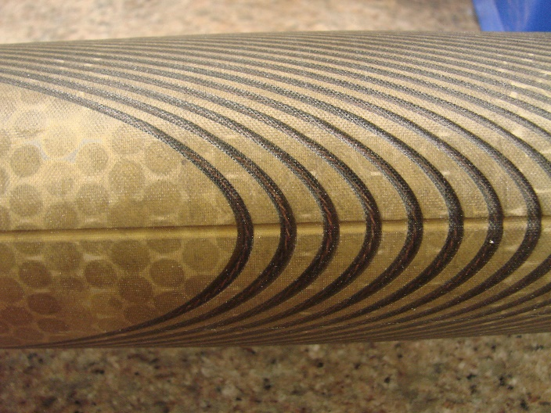
Fabrication Methods
Winding performed with light cable tension (by hand) as conductor is placed in groove
Coils are wrapped in perforated stainless steel sheet for heat treatment
Coil potting procedure is the same as for CCT5 (individual layer impregnation)
All potting materials are consumable except for end caps
FSU Mix 61 was used for impregnation as with CCT5
Epoxy curing performed in an oven
Coil Winding with Vtap Flag
Potting Tooling
Potting Materials
Impregnated Coil

Slide 8
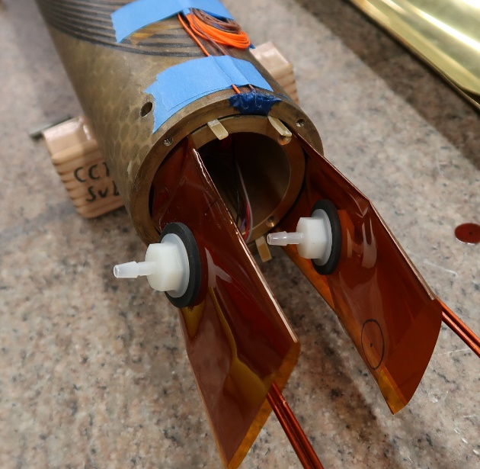
Assembly Method
Contact location between layers is controlled by using shims and Kapton bags that are filled with glass and epoxy
Allows for control of contact location
Fracture in interface epoxy does not propagate to the coil
Improved cooling at the pole regions from direct contact with LHe
Directional preload to reduce energized stress can be applied by bending layers or shell, filling and curing epoxy in bent state, releasing bending pressure
Layer 1,2 Assembly
epoxy filled Kapton bag
Force Release After Cure
shell
Directional
Pre-Load on Coils
layer 1
layer 2
Applied Force

Slide 9
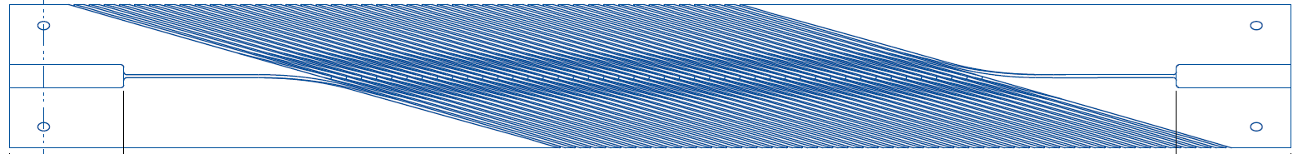

CCT subscale voltage tap arrangement (Baseline Layout)
A12 - lead
High field / stress region
A6
A5
A4
A3
A2
A1
IL
Lead on back side
A11
A10
A9
A8
A7
19.75
14.75
9.75
4.75
0.75
Lead on back side
A6
A5
A4
A3
A2
46
0
A12
C1
A1
A11
A10
A9
A8
A7
45.25
41.25
36.25
31.25
26.25
B2
B3
N
OL
B6
B1 +lead
S
8.75
17.75
B4
B5
Tap
turn #
B2
B3
turn #
0
45
B1
B4
B5
B6
27.25
36.25

Slide 10
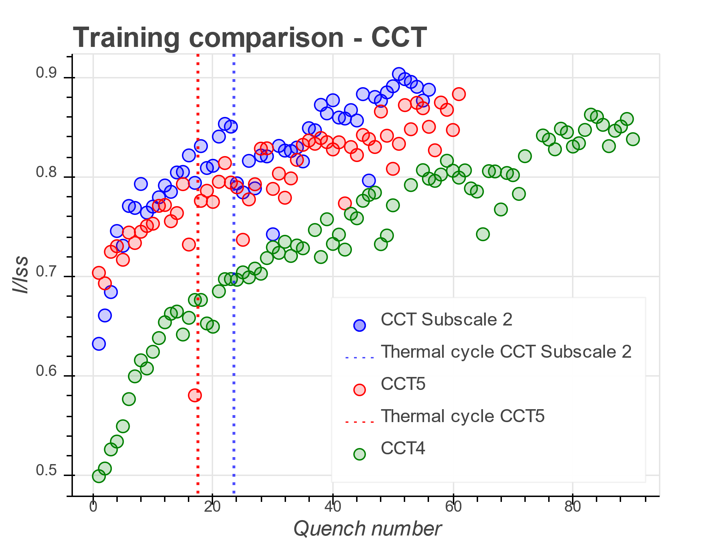
Results of Thin Spar Test Demonstrates That Subscale CCTs Can Reproduce Training Behavior Seen In Larger CCT Magnets
Training slope for subscale (relative to SSL) is somewhat higher when compared with CCT5 but overall training behavior is similar
Reach 80% of SSL after 14 quenches in subscale
Reach 80% of SSL after 22 quenches in CCT5
Thin spar subscale CCT has similar normal stress to CCT5 but lower shear stress
Fast training segment is seen for first several quenches as was the case for CCT4

Slide 11
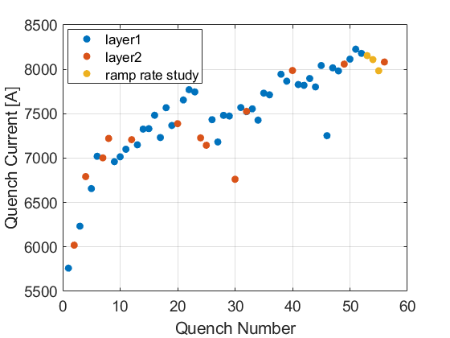
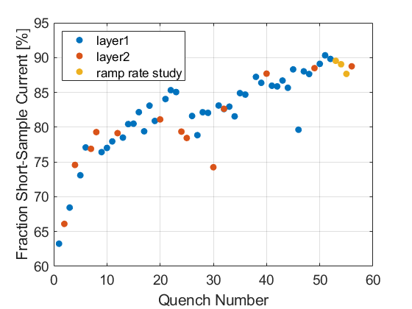
CCT Subscale 2 (Thin Spar) Training Results
Magnet reached 90 % of short sample current (bore field is 4.67 T at 8200 A)
Reach 80% of SSL after 14 quenches
Reach 85% of SSL after 22 quenches
Thermal cycle was performed after initial training (reached 85% of SSL after 22 quenches)
Training continues after thermal cycle
Some memory is lost after thermal cycle (training starts at 78% of SSL, previous level of 85% reached after ~12 training quenches)
Quench Current
Normalized Quench Current
Thermal Cycle
Thermal Cycle

Slide 12
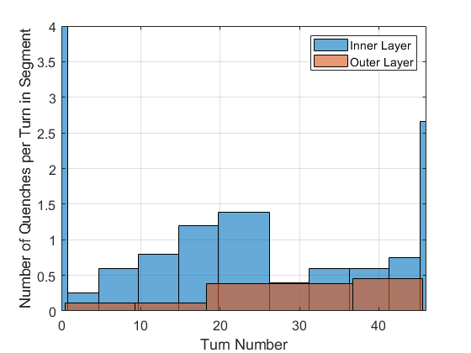
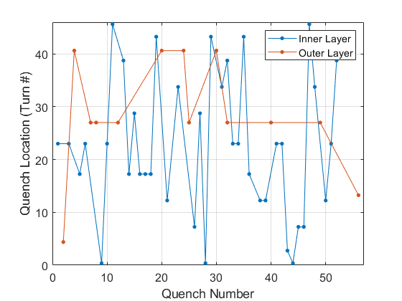
CCT Subscale 2 (Thin Spar) Quench Segment Location
75% of quenches are in the inner layer
Quench distribution is tabulated in terms of quench per number of turns in a segment
End turn sees higher fraction of quenches per turn
Quenches are relatively evenly distributed after the first turn
Somewhat higher number of quenches on the lead end half of the magnet
Quench Segment Distribution
Quench Location vs Quench Number

Slide 13
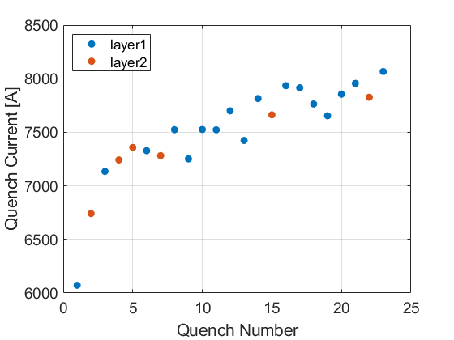
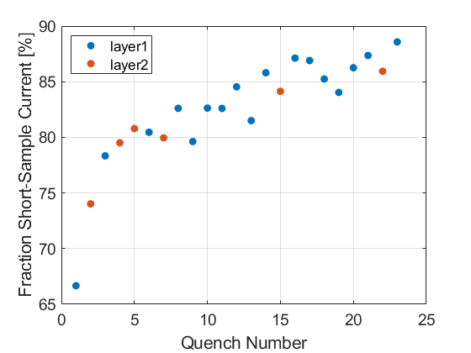
CCT Subscale 3 (Thick Spar) Training Results
Magnet reached 88 % of short sample current (bore field is 4.60 T at 8070 A)
Reach 80% of SSL after 5 quenches
Reach 85% of SSL after 14 quenches
Quench Current
Normalized Quench Current

Slide 14
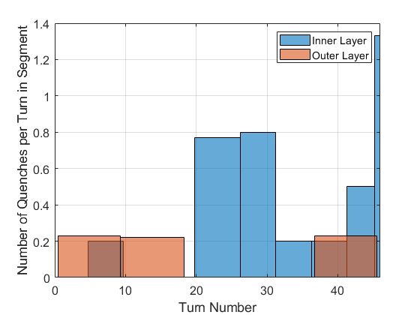
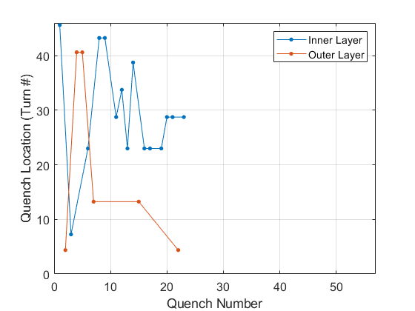
CCT Subscale 3 (Thick Spar) Quench Segment Location
74% of quenches are in the inner layer
Quench distribution is tabulated in terms of quench per number of turns in a segment
Return end turn sees higher fraction of quenches per turn (none seen in lead end)
Higher number of quenches in the center segments of the magnet than in the ends (excluding the end turn)
Somewhat higher number of quenches on the return end half of the magnet
Quench Segment Distribution
Quench Location vs Quench Number

Slide 15
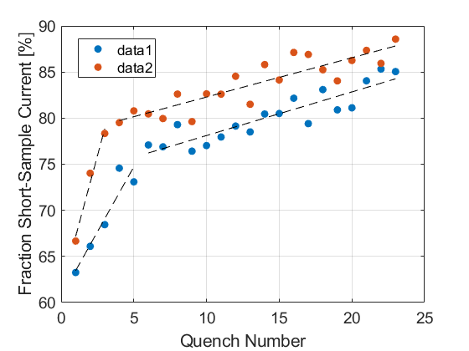
CCT Subscale 2 and 3 Training Comparison
Subscale 3 starts at higher current quench current and trains faster initially
Similar training rate is seen between subscale 2 and 3 after the fast training segments with ~ 4% offset
Comparison of training locations from quench antennas is still work in progress
CCT Subscale 2/3 training comparison

Slide 16
Future Test Plan
Test of subscale 3 thick spar magnet after thermal cycle
Test of subscale 4, first CTD SBIR magnet with CTD-701X resin (T. Shen)
Test of CCT subscale 2 (thin spar) after disassembly and reassembly
Determine effect of assembly process on training
Determine if outer layers can be reused in the future
Following tests (not in chronological order)
Wax impregnation (motivated by PSI box experiment that showed no training)
Non-impregnated coil
Cable with high Cp tape (collaboration with FNAL)
Magnets 2 and 3 for CTD SBIR
Thin spar magnet with stiff external structure (thick stainless steel or bronze tube)

