Slide 1

CCT Subscale Mechanical Analysis for Thin vs. Thick Spar
L. Brouwer
US Magnet Development Program
Lawrence Berkeley National Laboratory

Slide 2
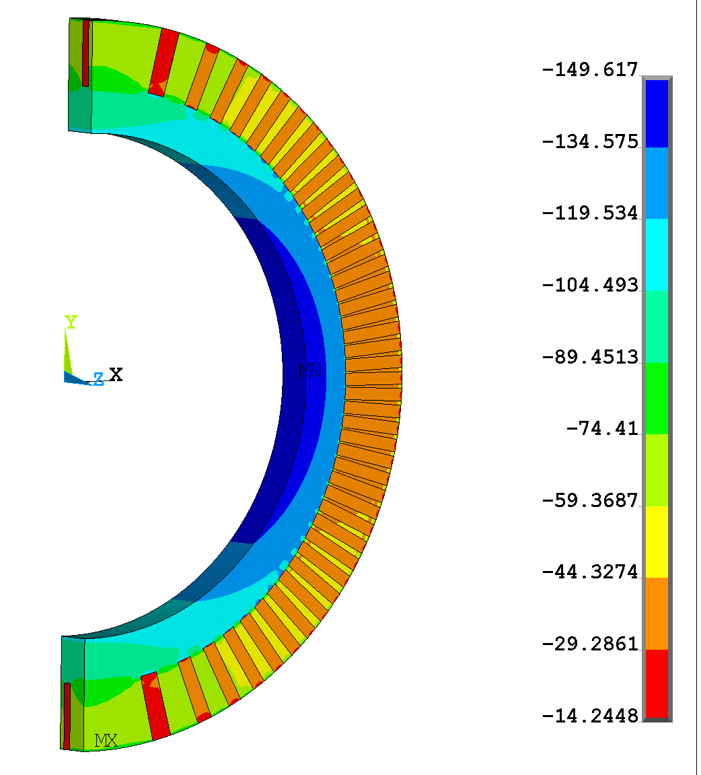
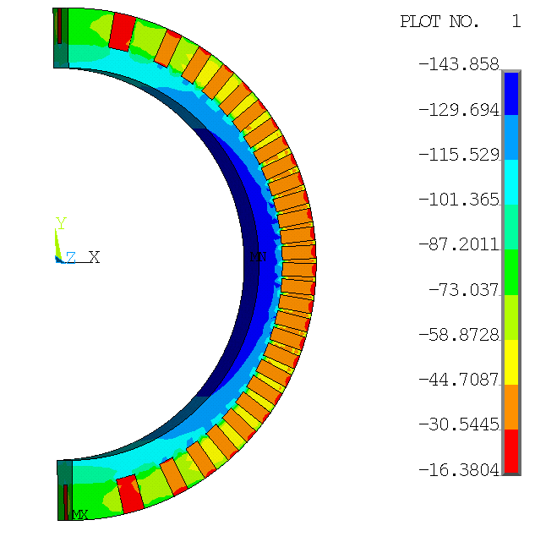
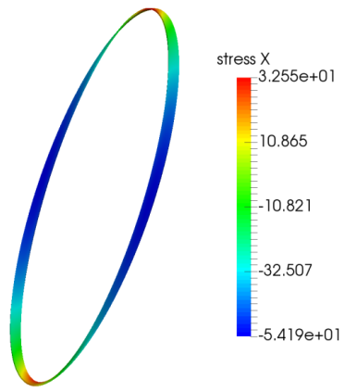
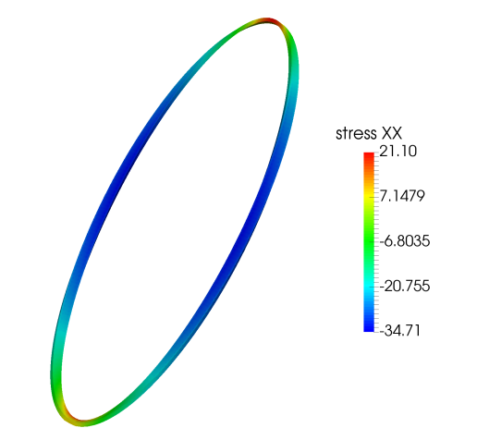
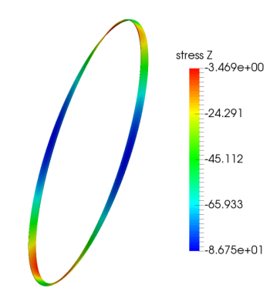
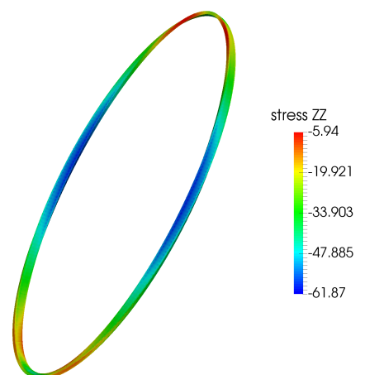
Reminder: nominal subscale was designed to probe a similar normal stress state as 10 T CCT’s (CCT3-5)
CCT4 σ_{θ}
CCT Subscale σ_{θ}
Normal Stress along cable
-150 MPa
-143 MPa
CCT4
33 MPa
-54 MPa
-14 MPa
-16 MPa
Subscale
Normal Stress transverse to cable
21 MPa
Subscale
CCT4
-3 MPa
-6 MPa
-35 MPa
-62 MPa
-87 MPa

Slide 3
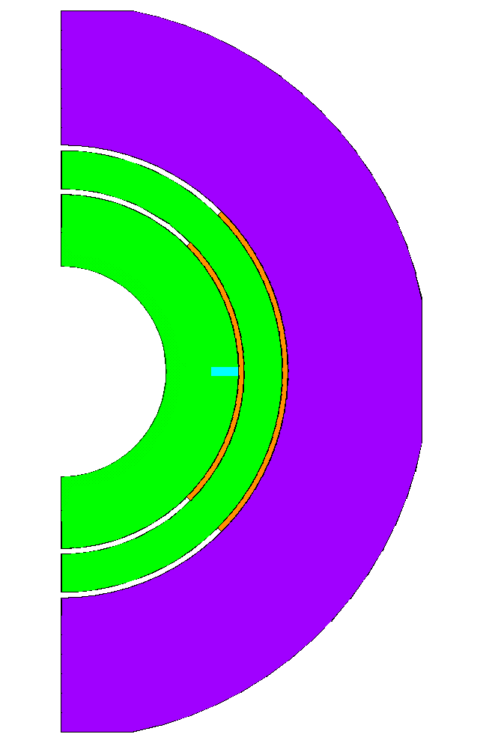
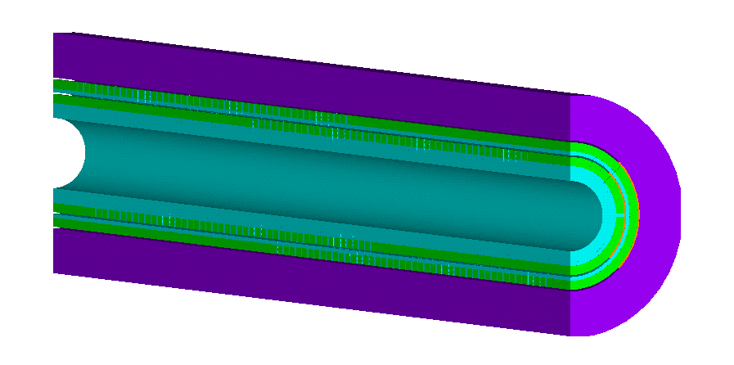
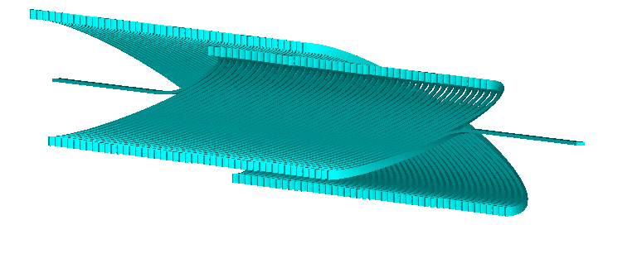
Use 3D model to study the impact of spar thickness
1” Aluminum Shell (no pre-stress) and 45 deg shims
conductor stays bonded in channel
load steps: cooldown, Lorentz forces at 8.84 kA (90% of SS)
vary innermost spar radial thickness: 1 mm, 2 mm, 8 mm
  look at impact on normal and shear stress

Slide 4
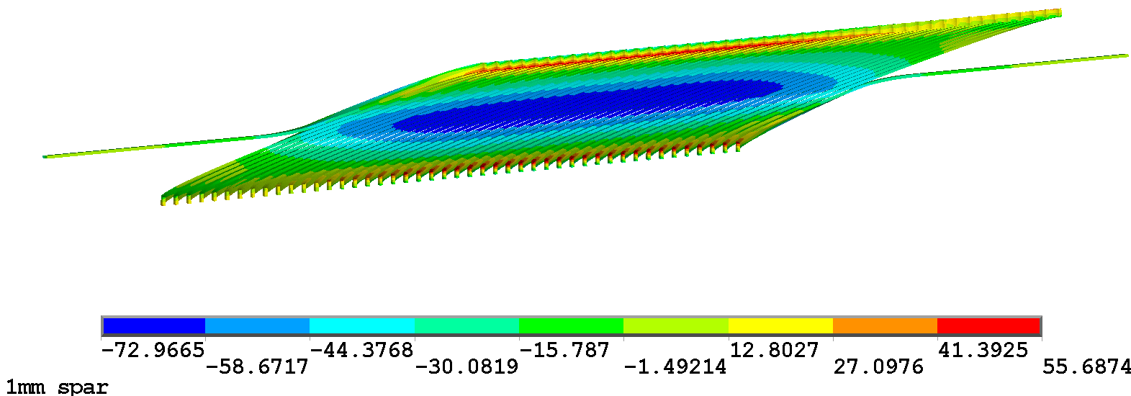
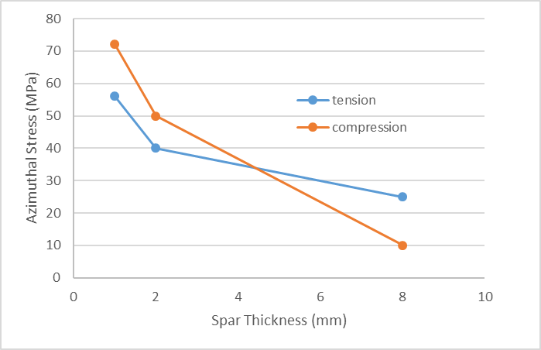
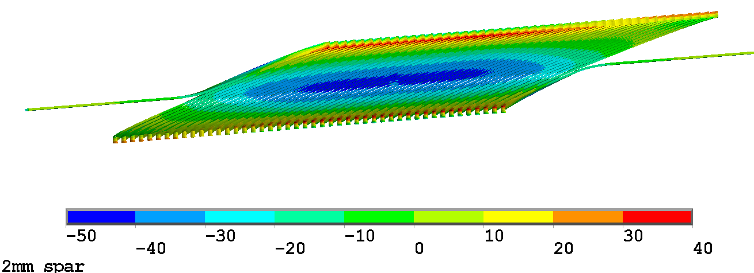
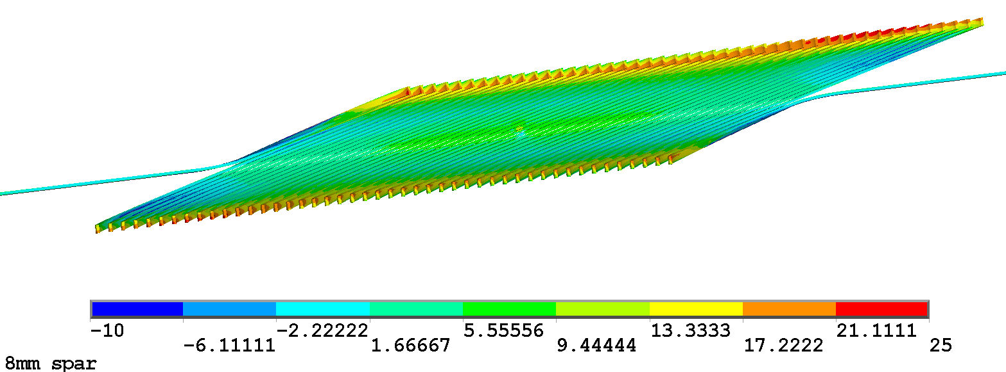
Layer 1: Conductor Azimuthal Stress
A larger spar results in less azimuthal compression and tension
Sθ

Slide 5
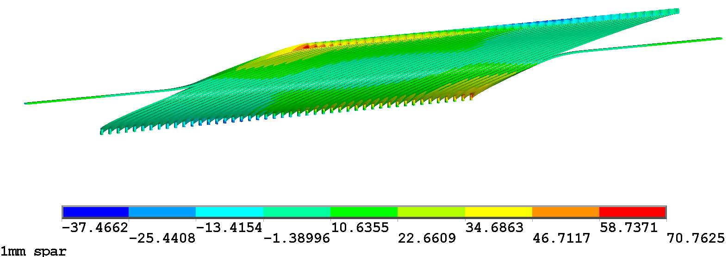

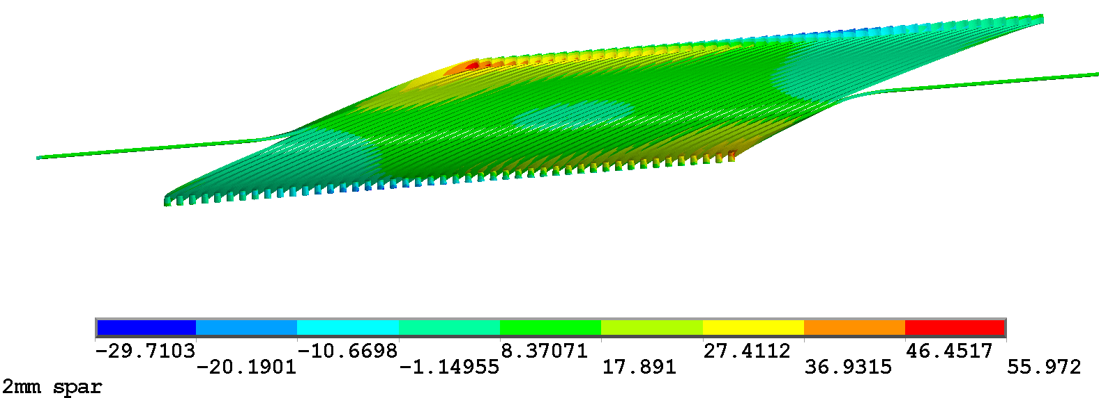
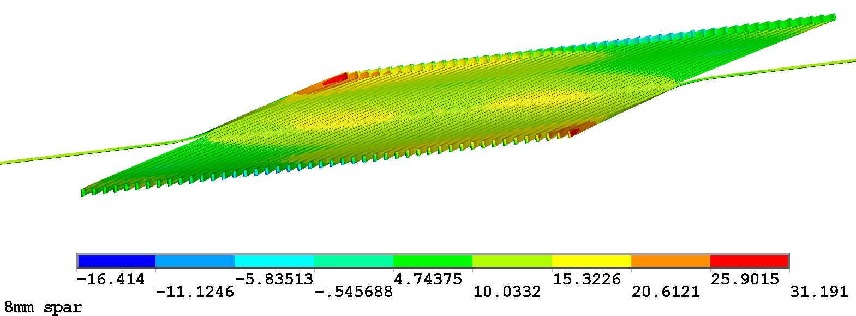
Layer 1: Conductor Axial Stress
A larger spar results in less axial compression and tension
Sz

Slide 6
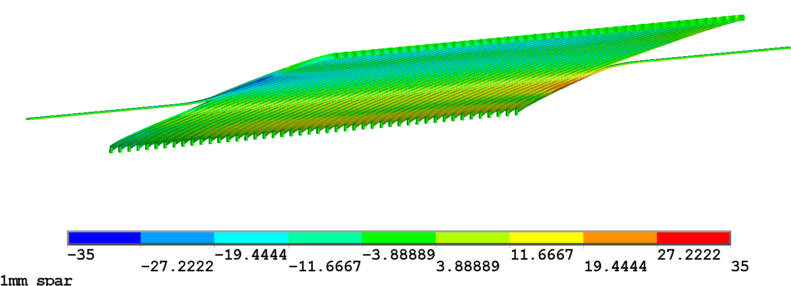
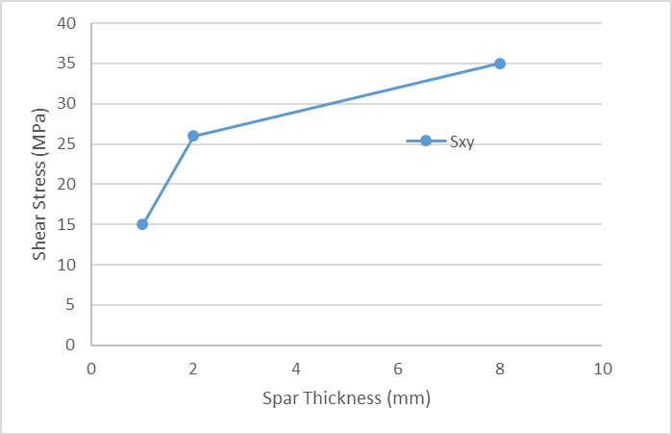
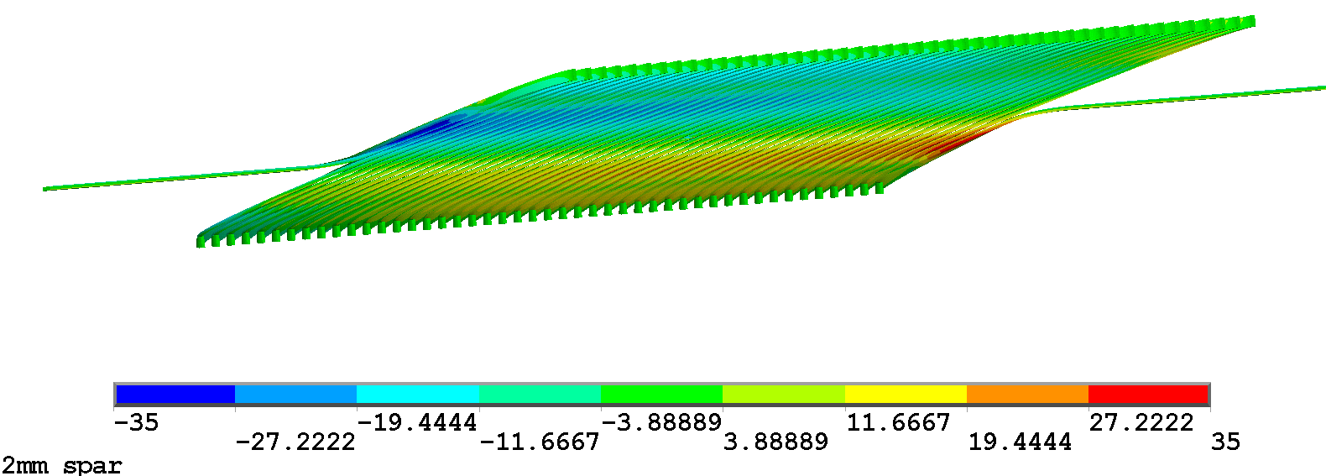
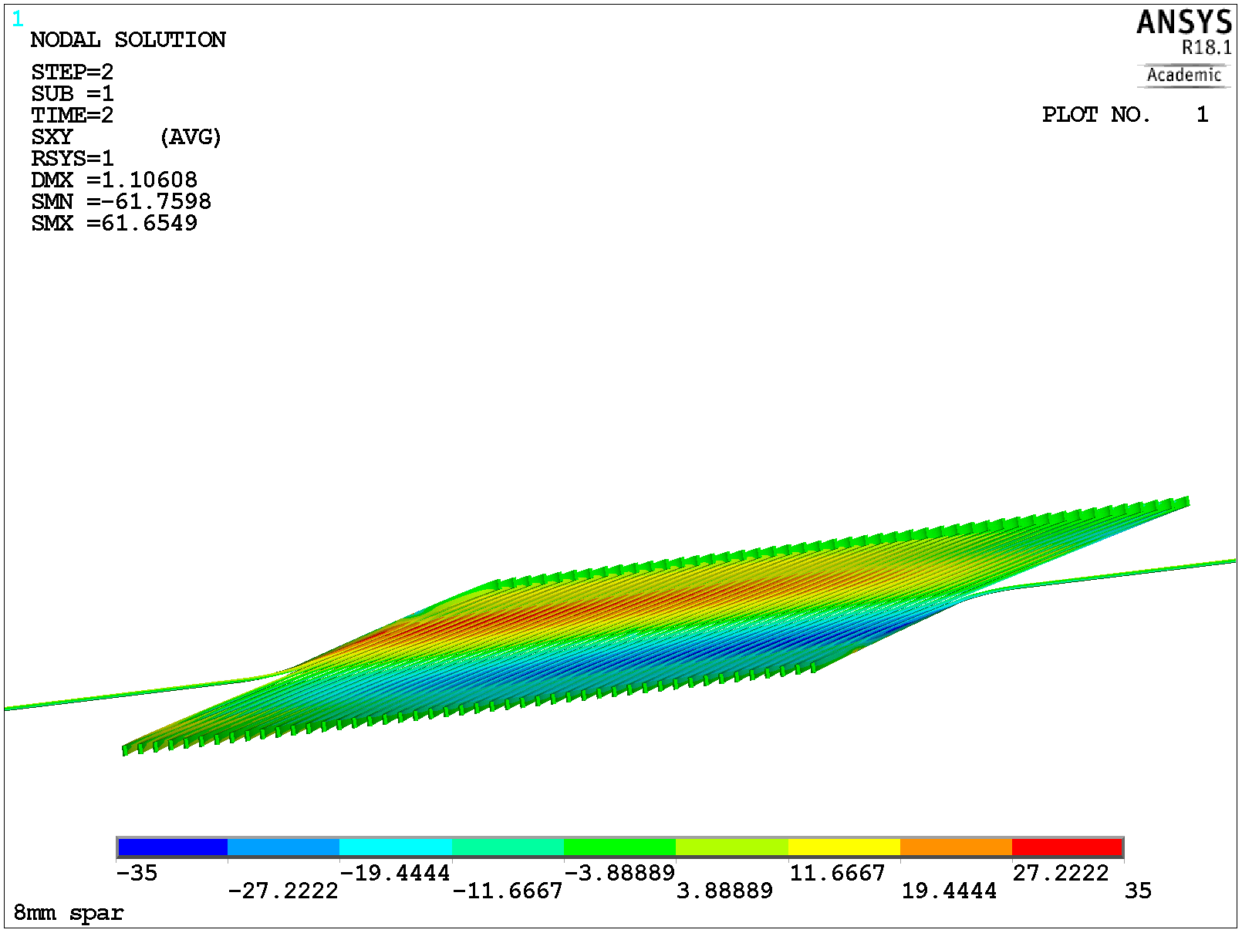
Layer 1: Conductor Shear Stress (Srθ)
A larger spar results in more shear
Srθ

Slide 7
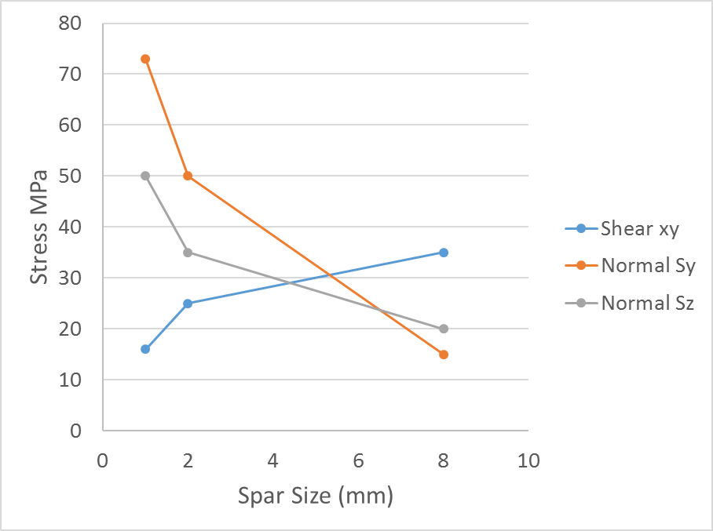
The shear stress tradeoff between thin and thick spar probes the CCT5 training regime
Srθ (radial-azimuthal)
Thin spars
Low shear
High normal
Thick spars
High shear
Low normal
CCT5 Sxy training from 12-16 kA

Slide 8
Potential “trouble locations” for shear and normal stress are different
Shear stress is concentrated at +/- 45 deg
Srθ
Motivates instrumentation for thick/thin spar tests which can resolve quench location by azimuthal angle
Normal stress is concentrated at pole and midplane
Sθ
Sz

