Slide 1
CCT Subscale
Fabrication methods and strain gage analysis
J. Rudeiros Fernandez*
D. Arbelaez, L. Brouwer, P. Ferracin, M. Krutulis, M. Reynolds, J. Swanson, S. Prestemon
US Magnet Development Program
Lawrence Berkeley National Laboratory

Slide 2
Outline
Fabrication methods
Strain gage results

Slide 3
1. Fabrication methods
General assembly sequence
Shell
L2
Calibration of aluminum shell deformation.
Insertion of L1 into L2 and insertion of interlayer components.
Injection of resin in the S1 and curing.
Insertion of the assembly in the shell.
Deformation of the shell under pressure, injection of resin in the S2 and curing.
Release of the force exerted by the press, completing the Bend-and-Shim process
L1
S1
S2
List of acronyms:
Outer layer (L2)
Inner layer (L1)
Inner smart shim (S1)
Outer smart shim (S2)

Slide 4
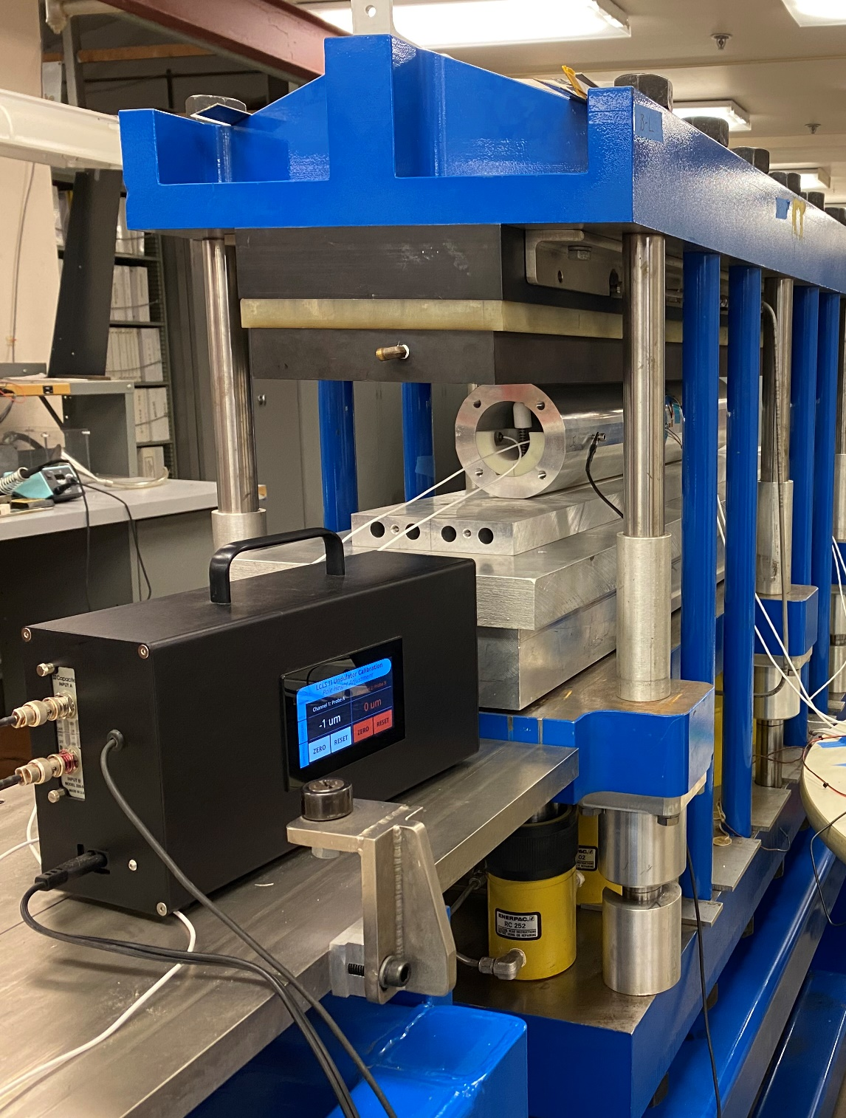
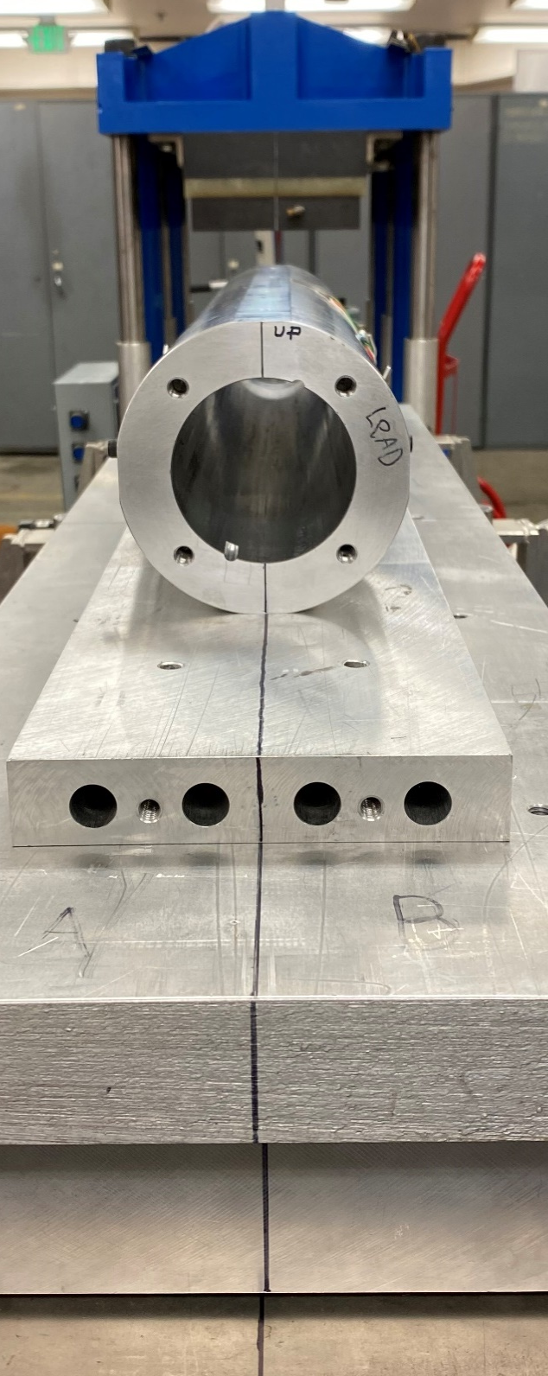
1. Fabrication methods
1. Calibration of aluminum shell deformation
Main objectives
Measure the deformation of the aluminum shell under certain force exerted by the press.
Check the instrumentation, i.e. strain gages.
Ensure uniform deformation along the length.
Shell
Materials and methods:
Measurements of the radial deformation of the inner diameter based on capacitive displacement sensors.
Monitoring of axial and azimuthal strain in the center location of the shell.

Slide 5



1. Fabrication methods
1. Calibration of aluminum shell deformation
$$F_{press}$$
$$\frac{δ_{h}}{2}$$
Strain gauges
$ε_{axial}$, $ε_{azimuthal}$
LE
The deformation is characterized by the relative variation of distance between two capacitive sensors fixed to an inner rigid thermoplastic bore, and the corresponding inner surface of the hollowed aluminum shell.
Left
Measuring bore
Right
RE
The variation of strain in the shell was characterized by two sets of strain gauges placed at both sides of the shell (i.e. left and right) placed on the central plane.

Slide 6
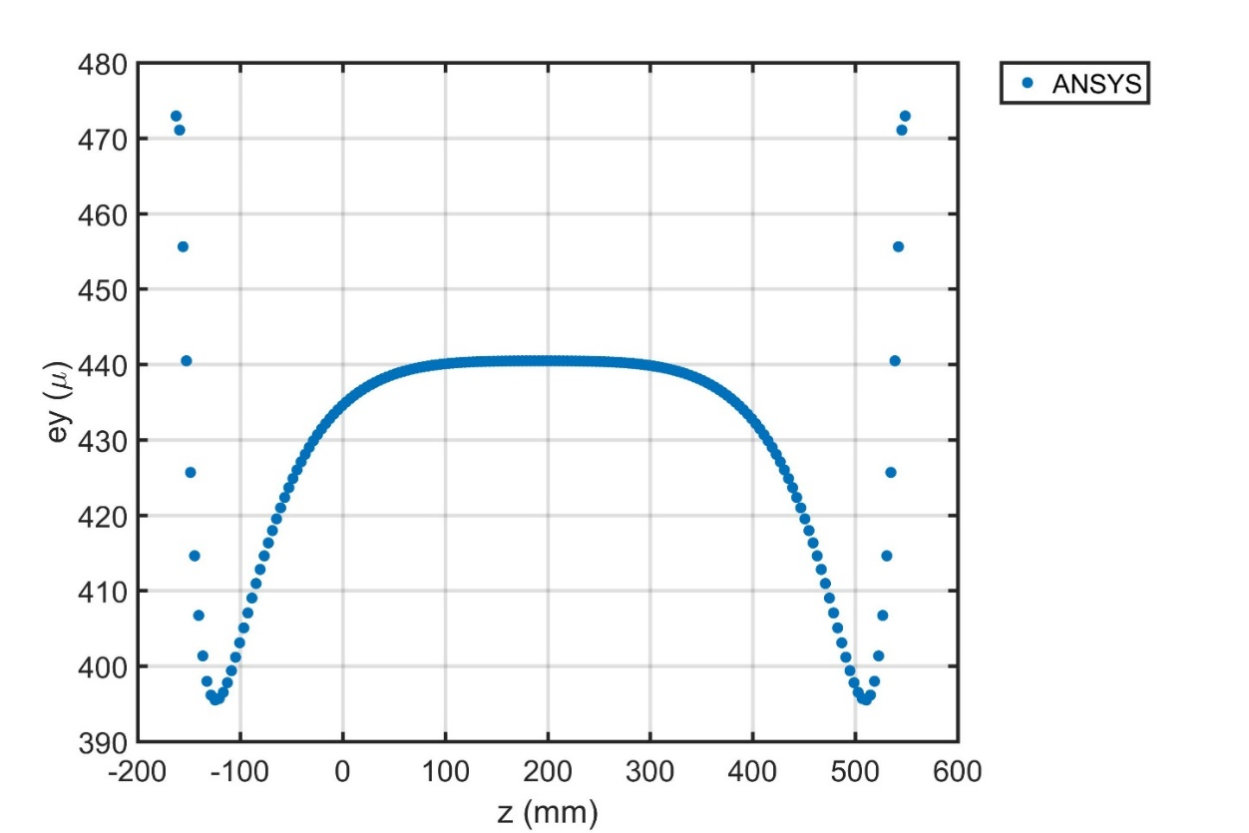
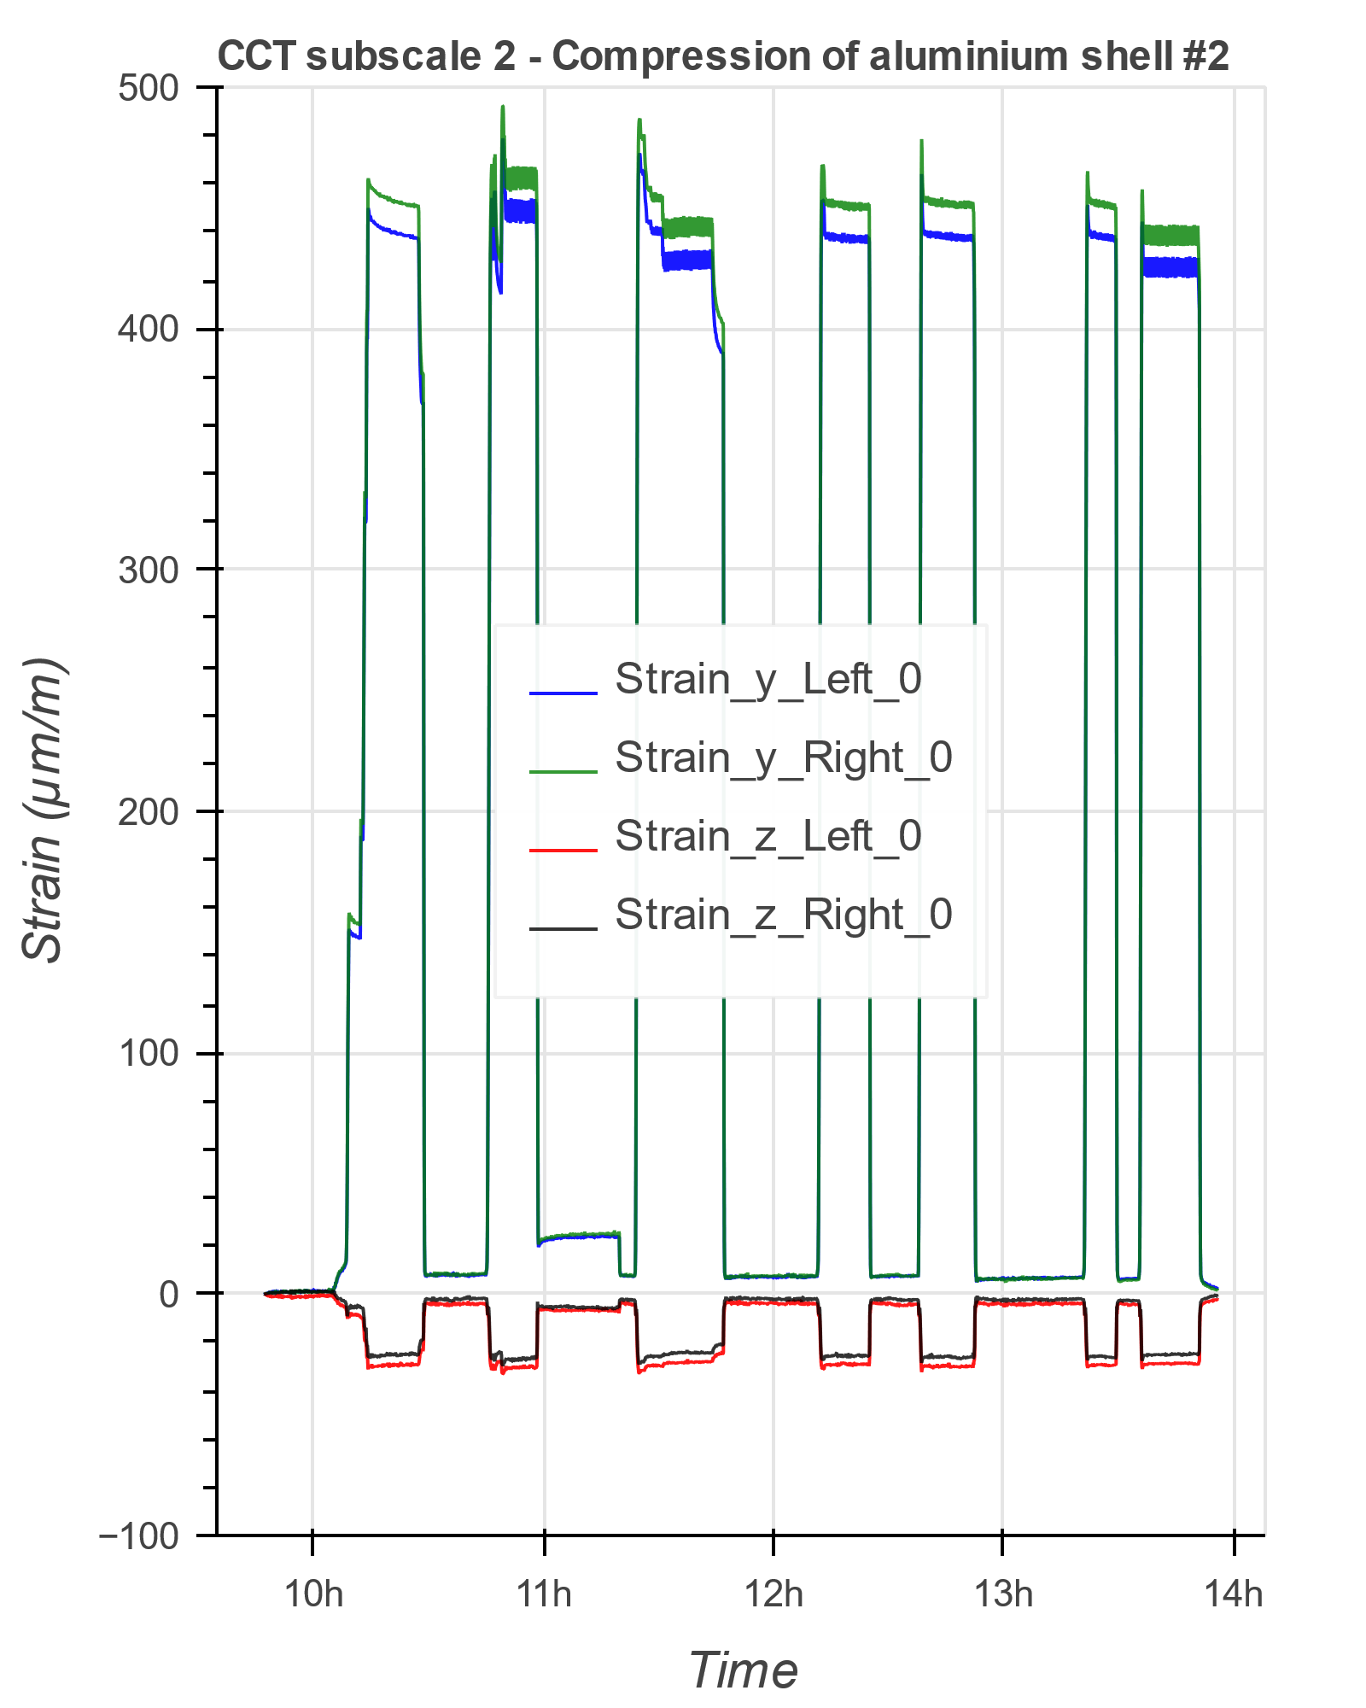
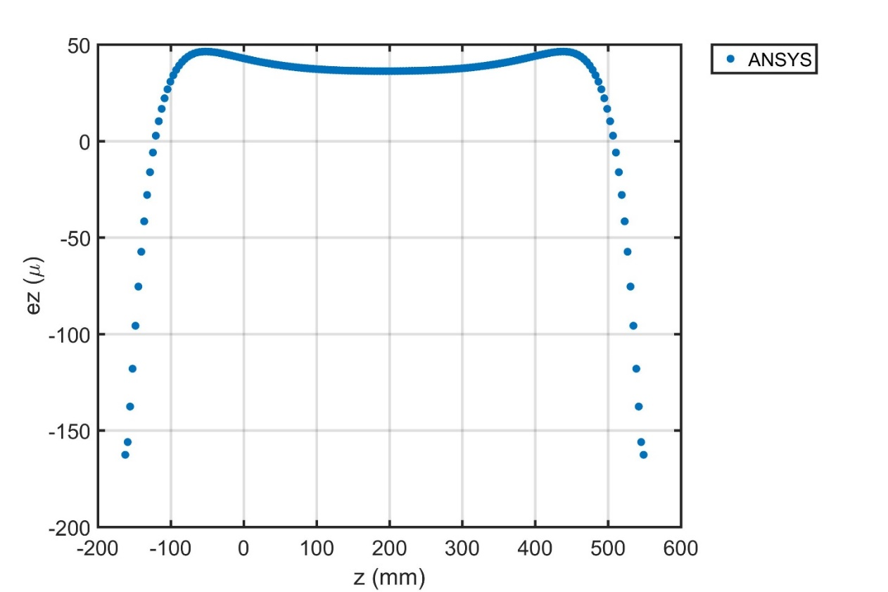
1. Fabrication methods
1. Calibration of aluminum shell deformation
Relatively good correlation was found between the FE prediction and actual strain measurements.
FE model
Measurement
Central region

Slide 7
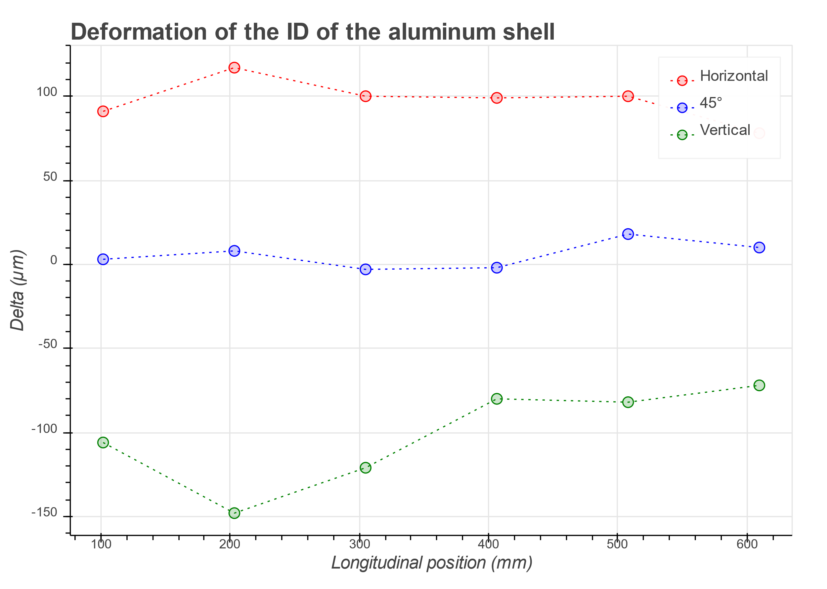
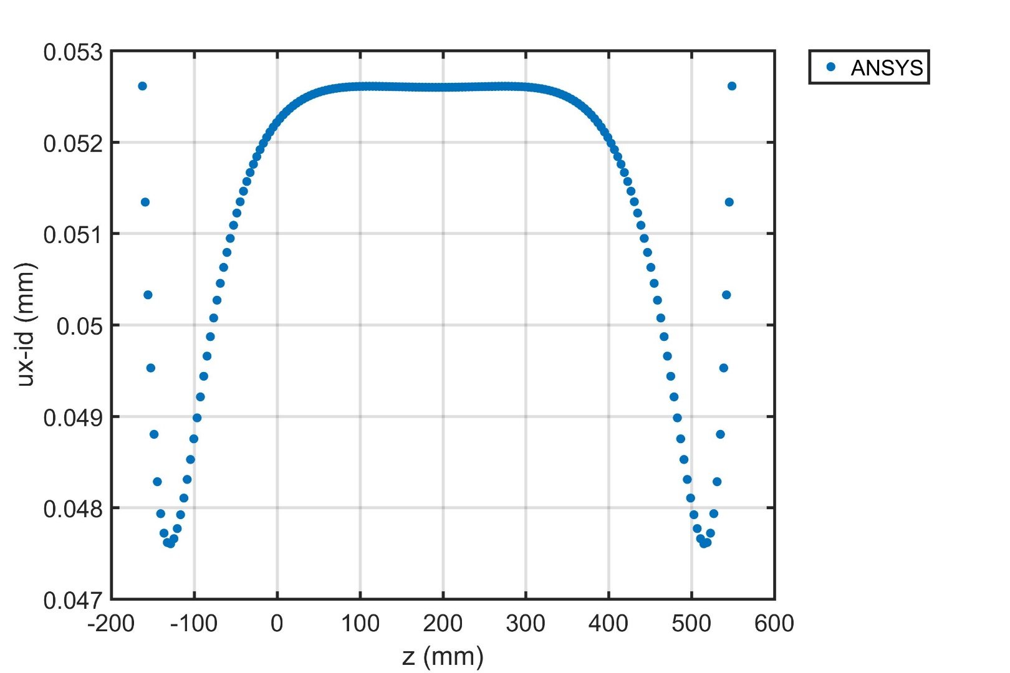





1. Fabrication methods
1. Calibration of aluminum shell deformation
$$δ_{h},δ_{45},δ_{v}$$
$$\frac{δ_{h}}{2}$$
$$\frac{δ_{h}}{2}$$
$$\frac{δ_{v}}{2}$$
FE model
Measurement
$$\frac{δ_{45}}{2}$$
Relatively good agreement between the FE prediction and actual deformation.

Slide 8
1. Fabrication methods
2. Insertion of L1 into L2 and insertion of interlayer components.
Once in position, the axial and angular alignment between IL and OL is ensured by two pairs of
pins, placed at LE and RE.

Slide 9
1. Fabrication methods
3. Injection of resin in the IS and curing
A low level of vacuum is created inside the S1.
Resin is injected in the polyimide S1.
The assembly is placed inside an oven for curing at ~ 50 °C.
While curing a relative pressure of ~ 1 bar is exerted on the resin.
S1

Slide 10
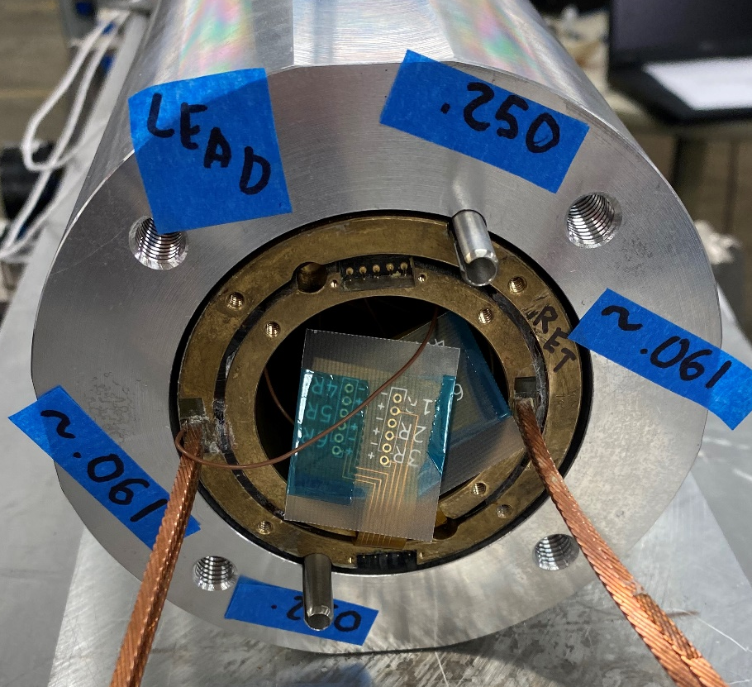
1. Fabrication methods
4. Insertion of the assembly in the shell
Once in position, the axial an angular alignment between L1+L2 and the shell is ensured by two pairs of
pins, placed at LE and RE.

Slide 11
1. Fabrication methods
5. Deformation of the shell under pressure, injection of resin in S2 and curing.
The aluminum shell is deformed under the press with a pressure of
650 psi (380 kN).
The polyimide bag (smart shim) is evacuated creating vacuum.
Resin is injected in the polyimide S2.
The full assembly is heated up to curing temperature by the actions of heaters attached directly to the aluminum shell.
While curing a relative pressure of ~ 1 bar is exerted on the resin.
Bend-and-Shim
I
II
III
Assembly placed in the press
Force exerted by the press deforms the shell
Shim is inserted, resin is injected and cured in the deformed state

Slide 12
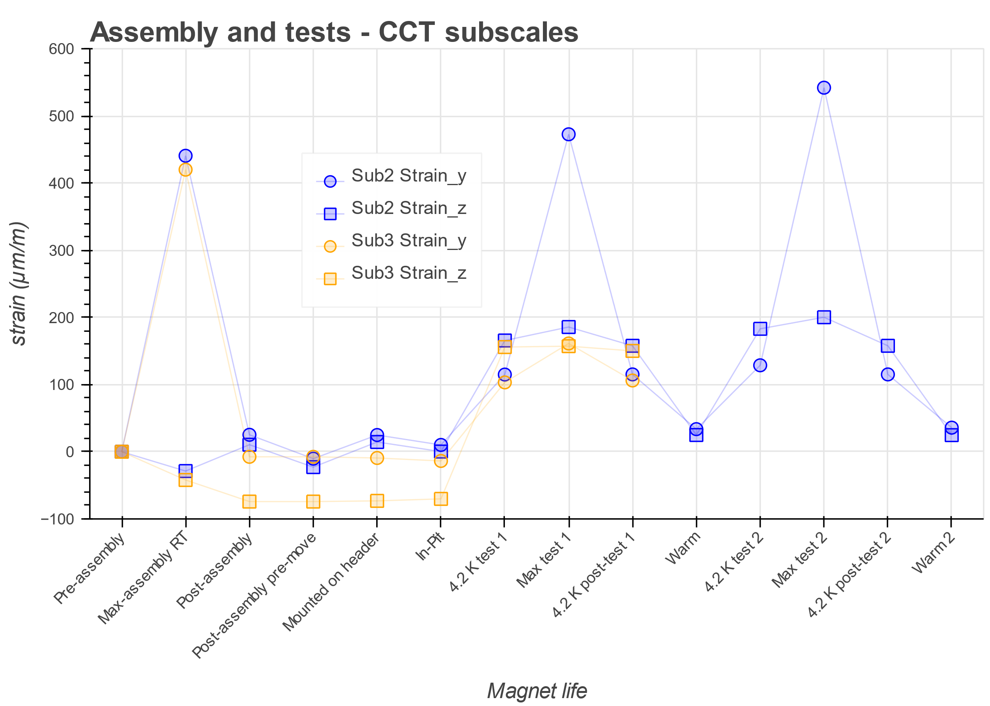

2. Strain gage results
Strain gauges
$ε_{axial}$, $ε_{azimuthal}$
LE
Left
Right
RE
*Max-assembly is computed before heating starts
Sub2
Sub3

Slide 13
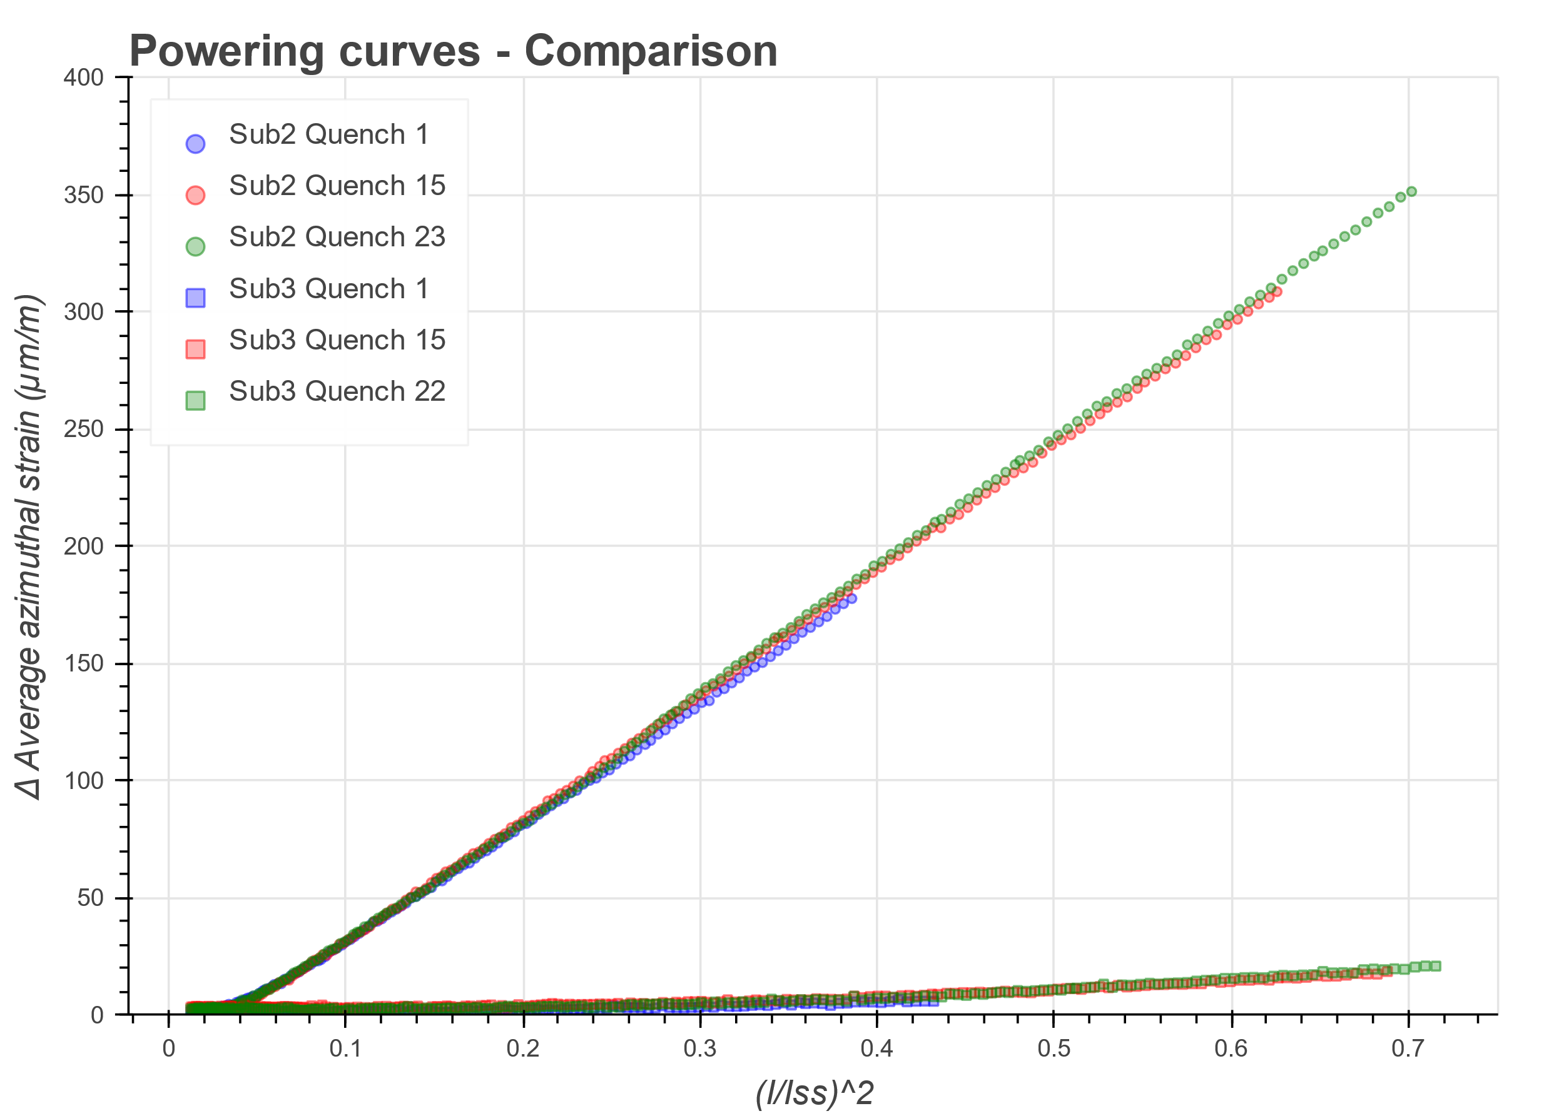

2. Strain gage results
Strain gauges
$ε_{axial}$, $ε_{azimuthal}$
LE
Sub2
Left
Right
RE
Sub3
Sub2
Sub3

Slide 14
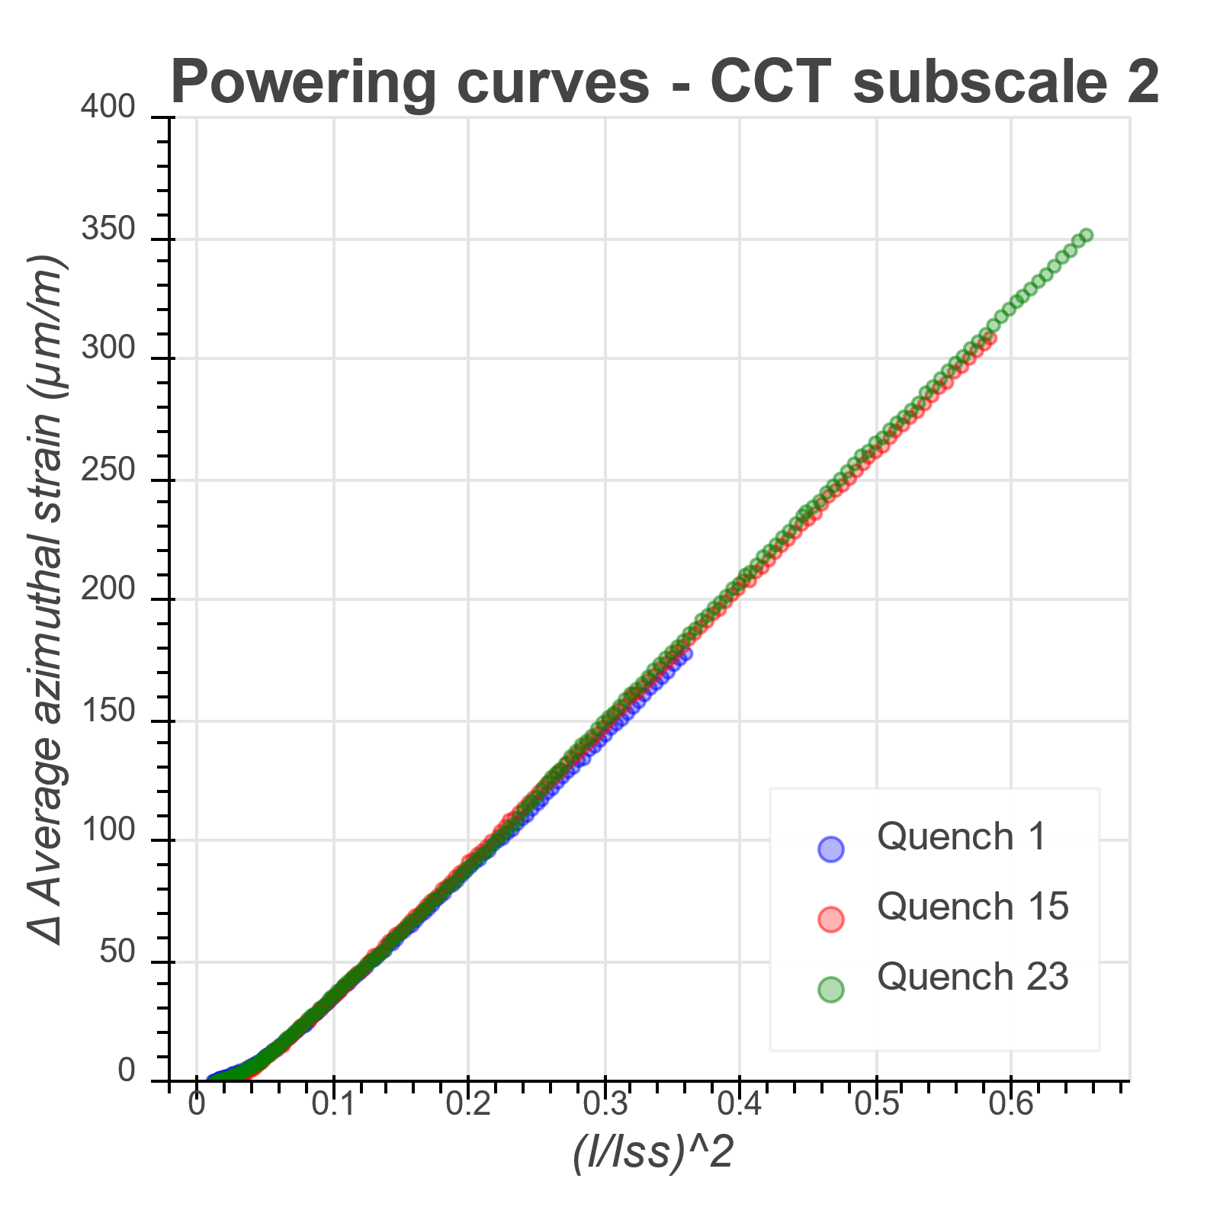

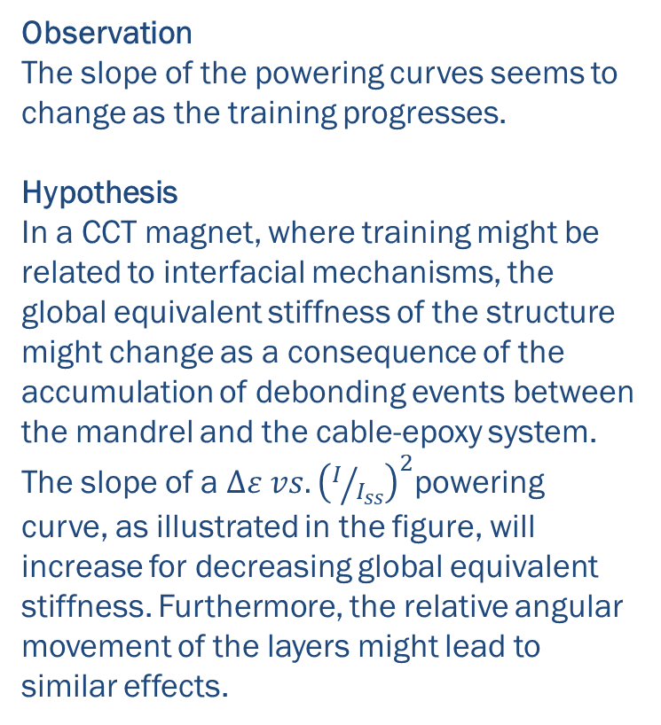
2. Strain gage results
Observation
The slope of the powering curves seems to change as the training progresses.
Hypothesis
In a CCT magnet, where training might be related to interfacial mechanisms, the global equivalent stiffness of the structure might change as a consequence of the accumulation of debonding events between the mandrel and the cable-epoxy system. The slope of a $∆ε vs. {\left(I/{I_{ss}}\right)}^{2}$powering curve, as illustrated in the figure, will increase for decreasing global equivalent stiffness. Furthermore, the relative angular movement of the layers might lead to similar effects.
Shell
L1
Mid-plane
L2
$$ε_{azimuthal}$$

Slide 15
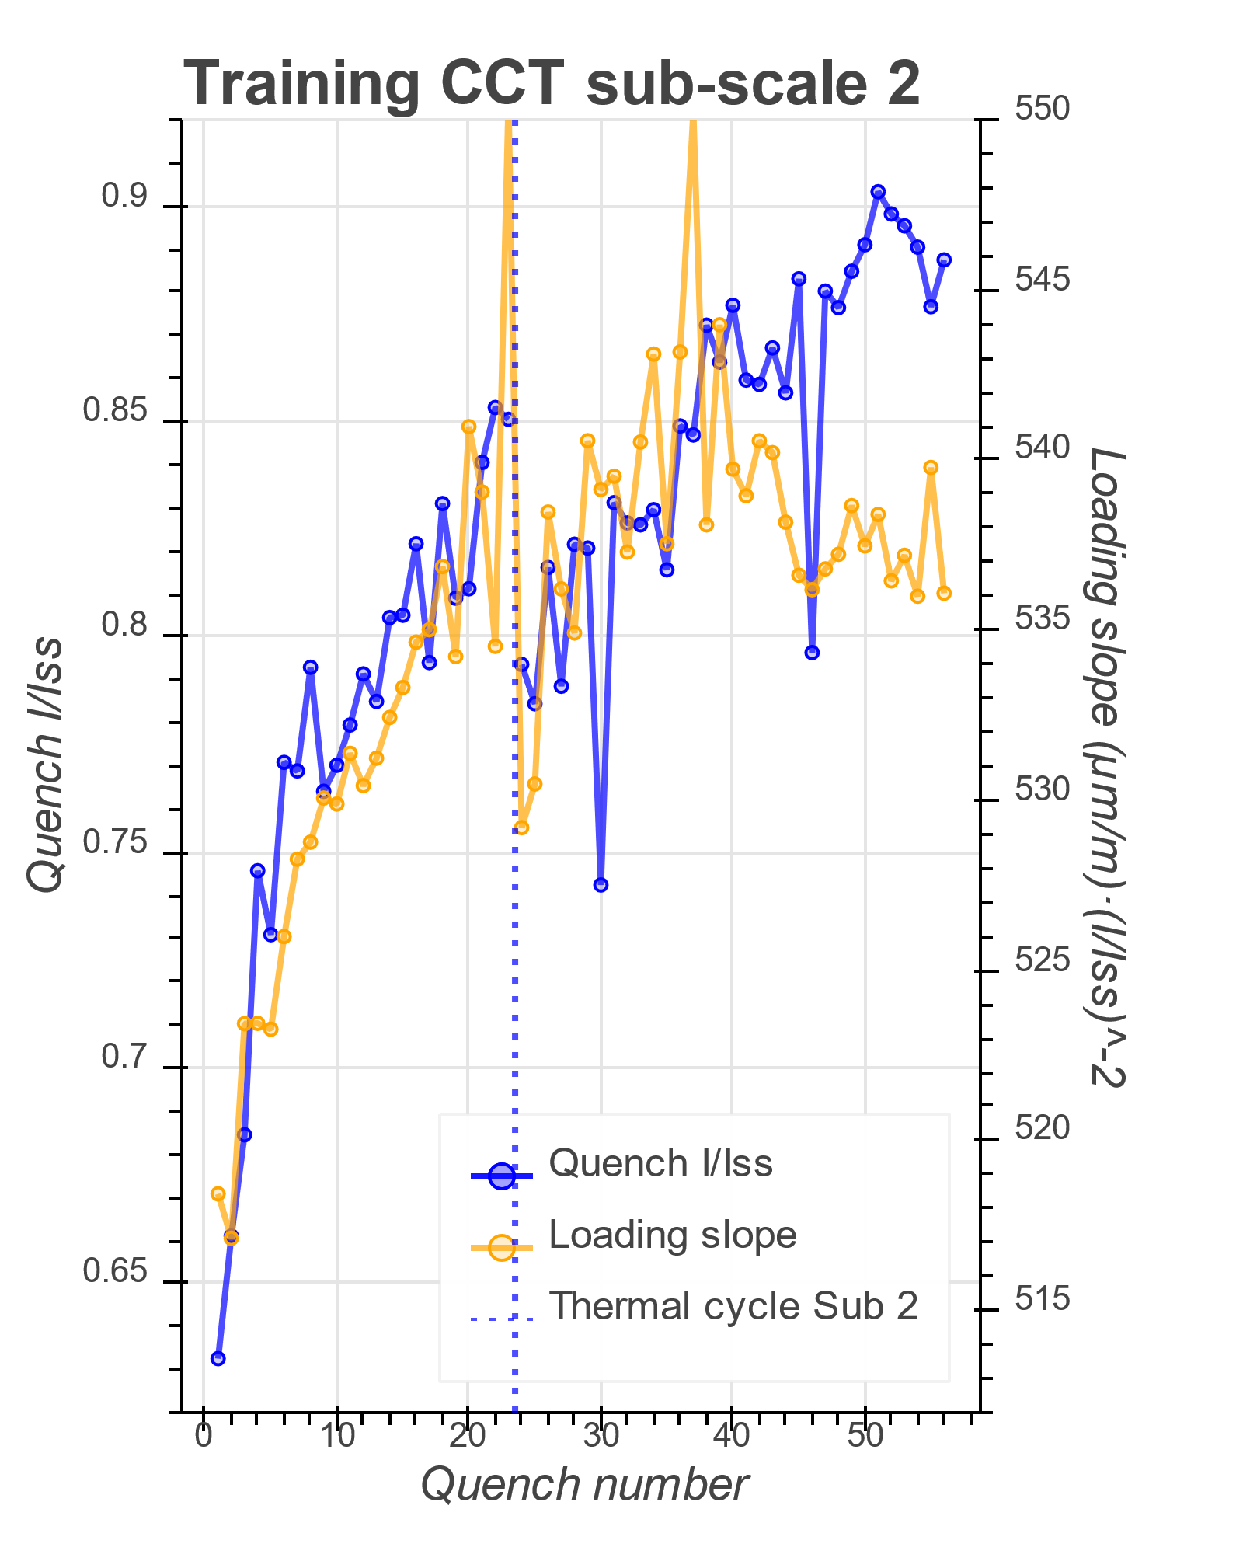
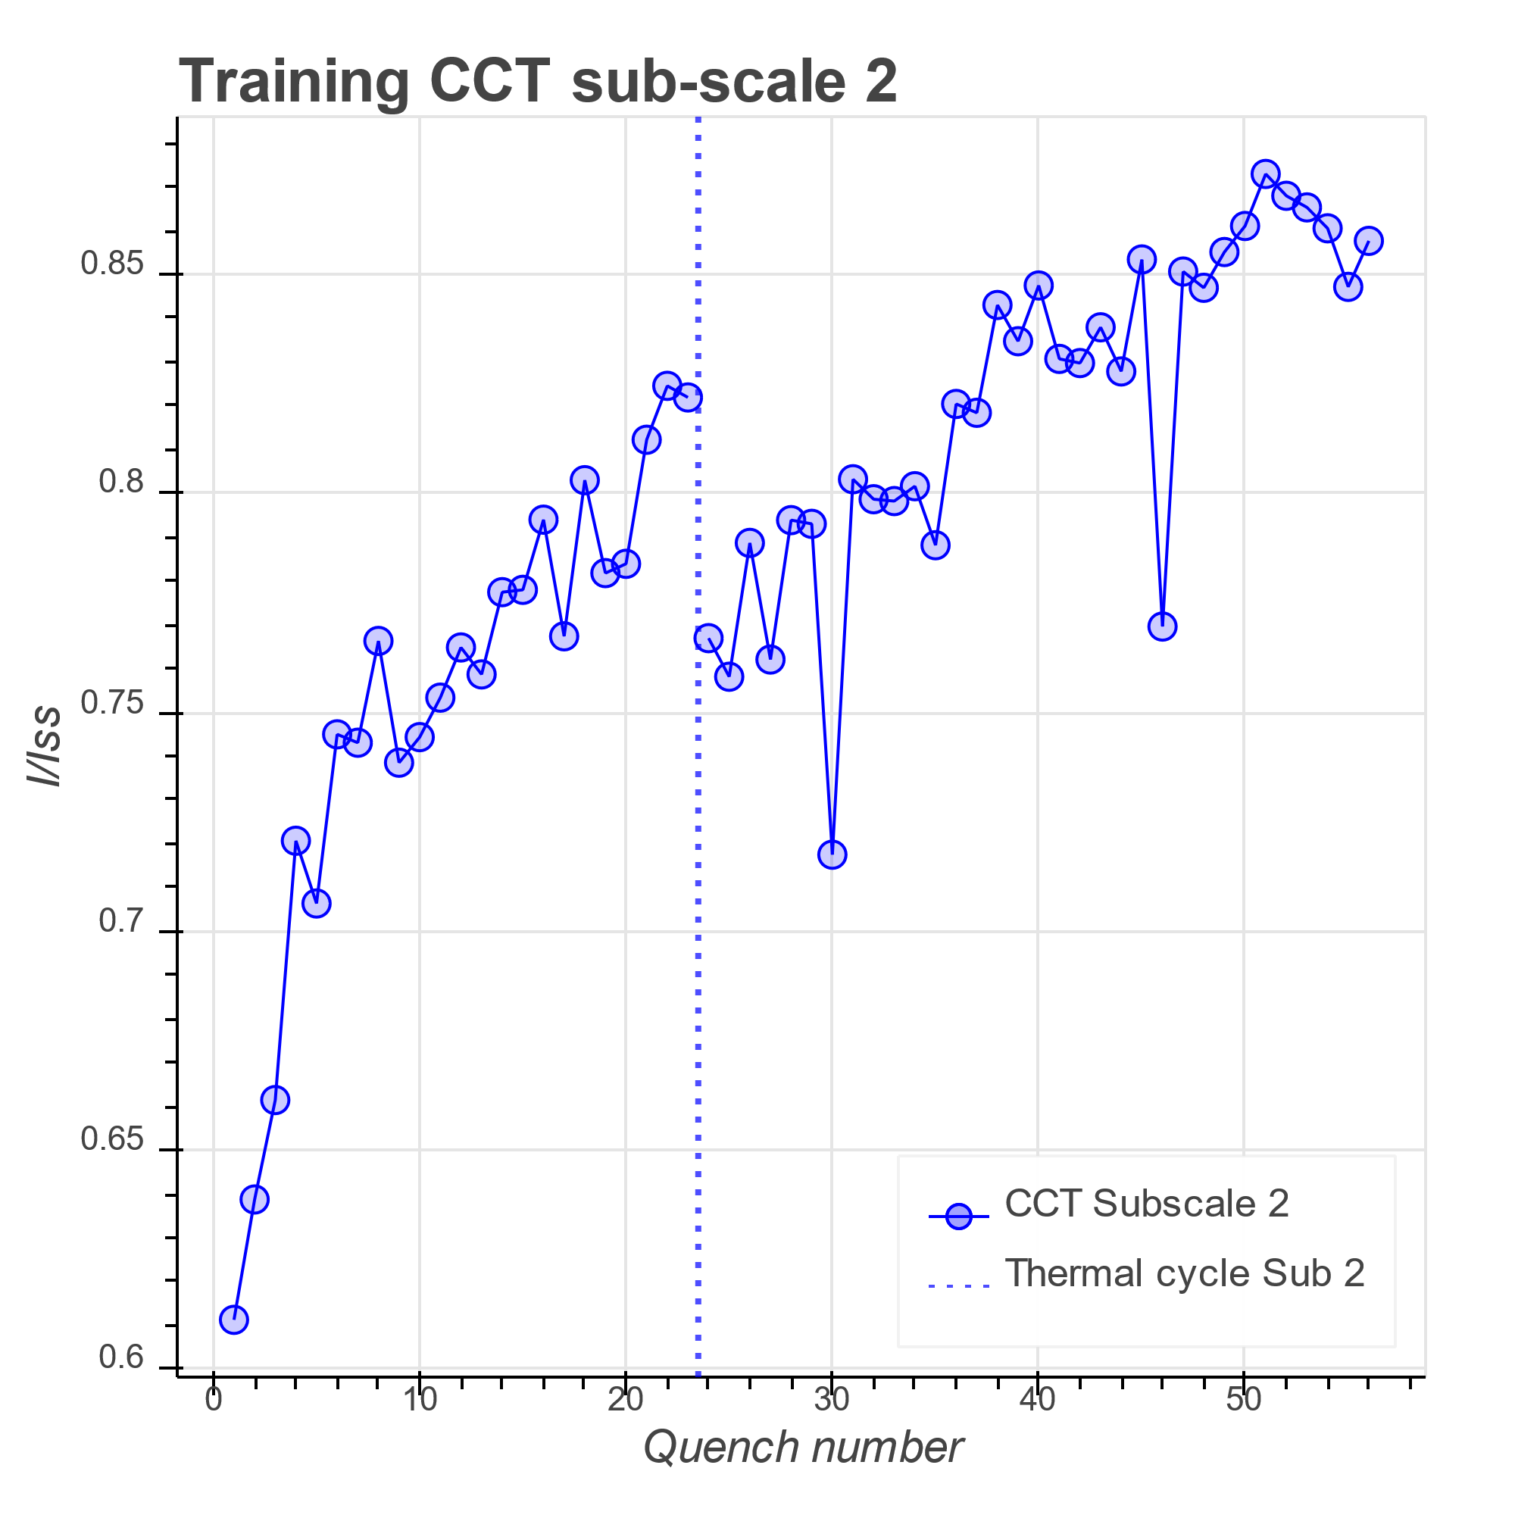
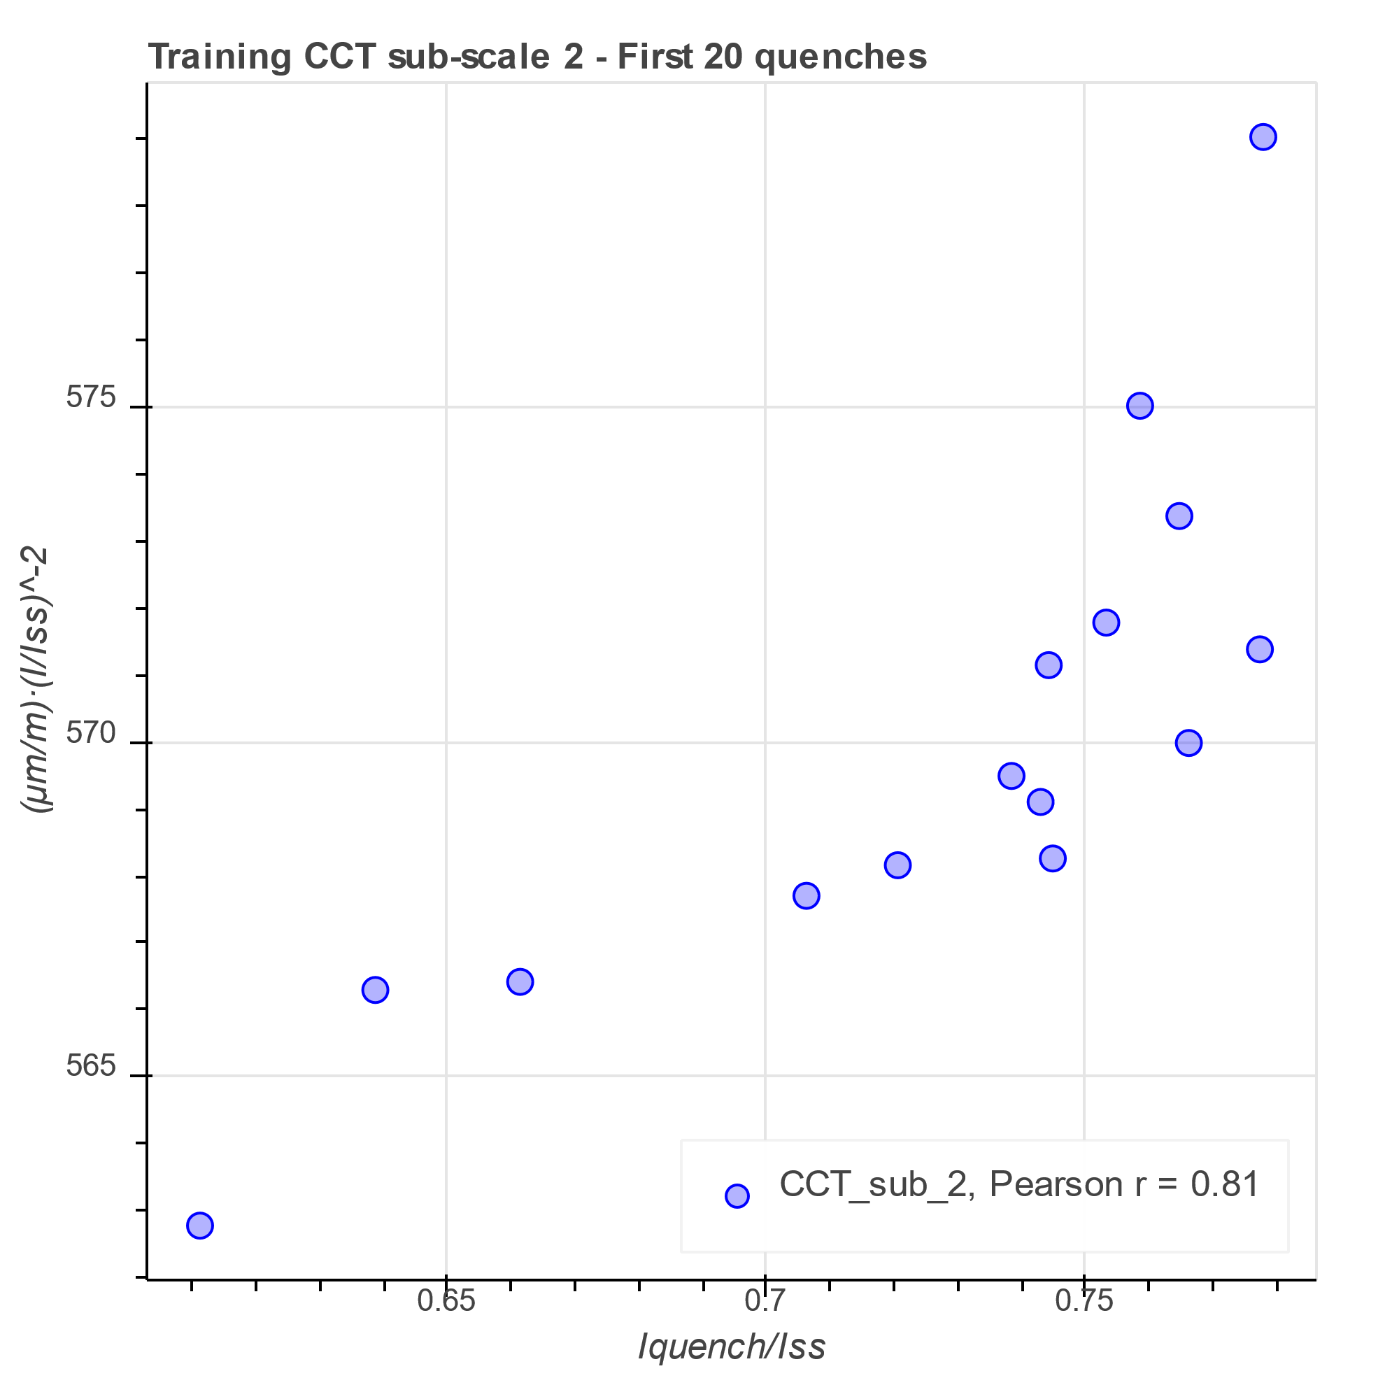
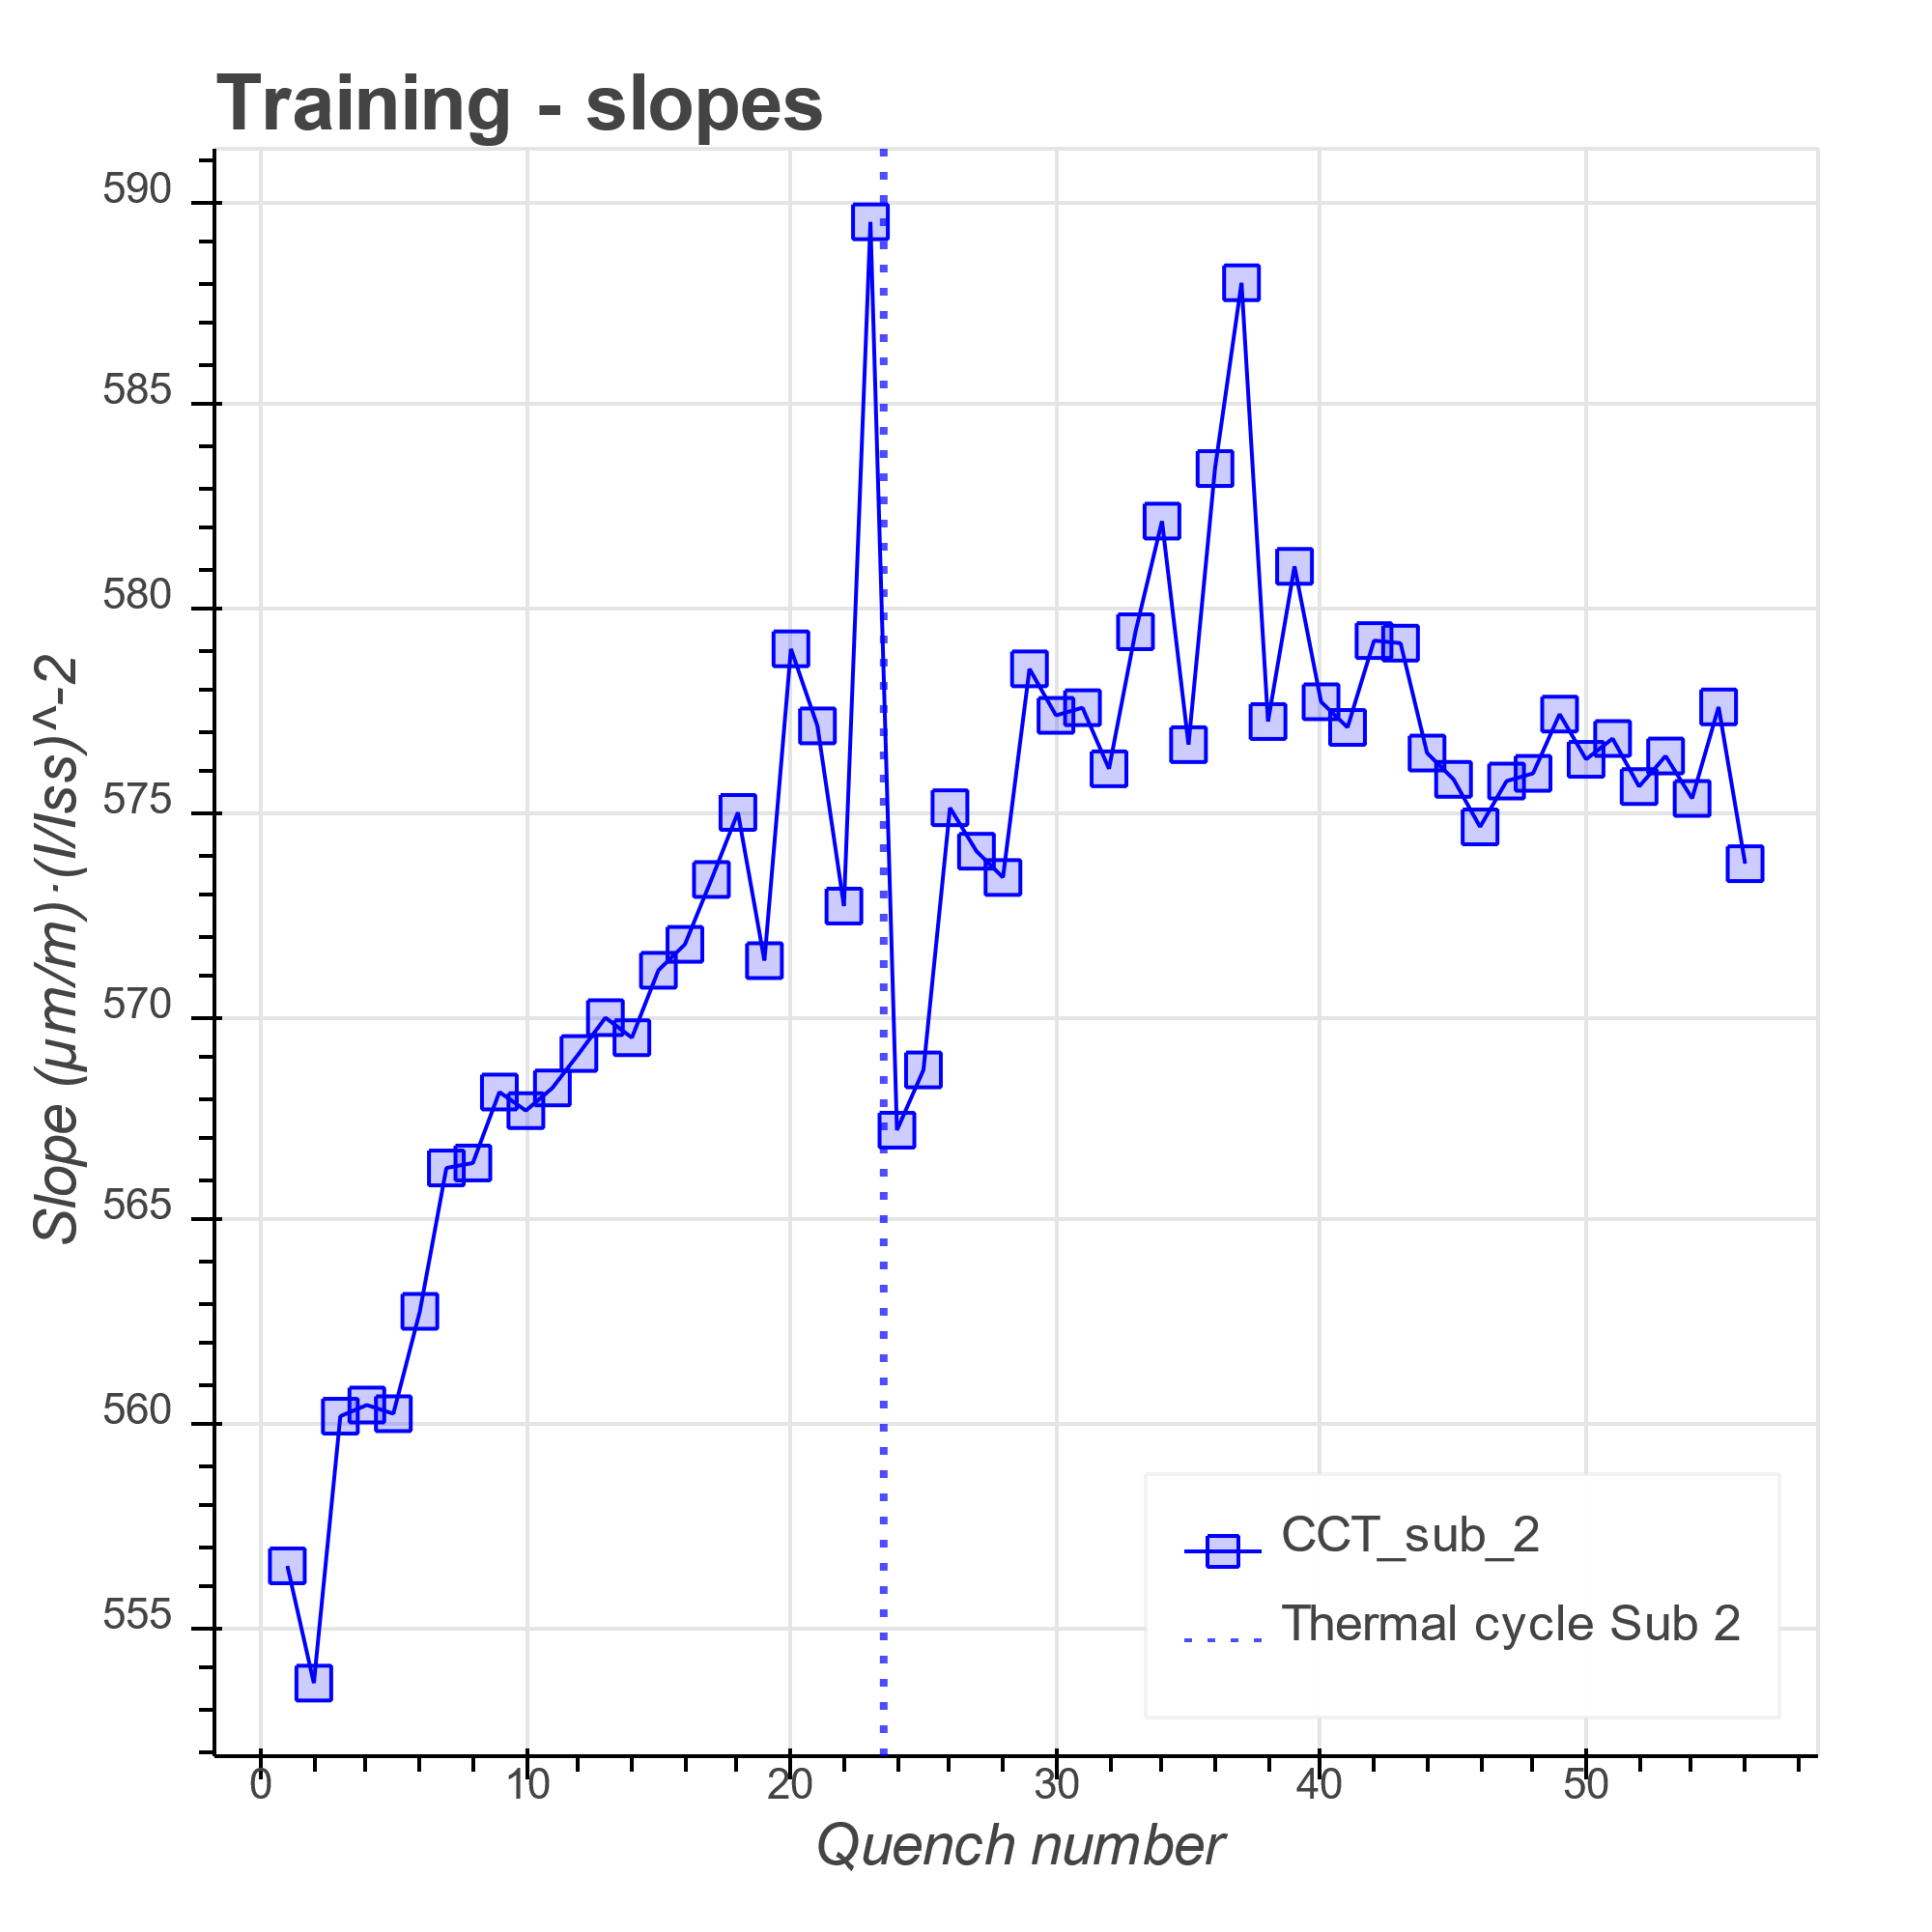
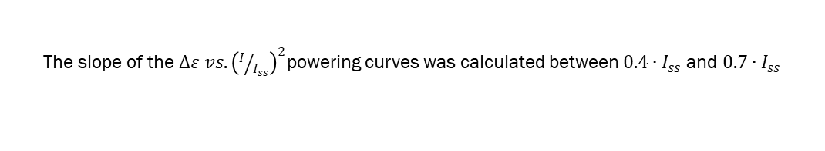
2. Strain gage results
The slope of the $∆ε vs. {\left(I/{I_{ss}}\right)}^{2}$powering curves was calculated between $0.4∙I_{ss}$ and $0.7∙I_{ss}$

Slide 16
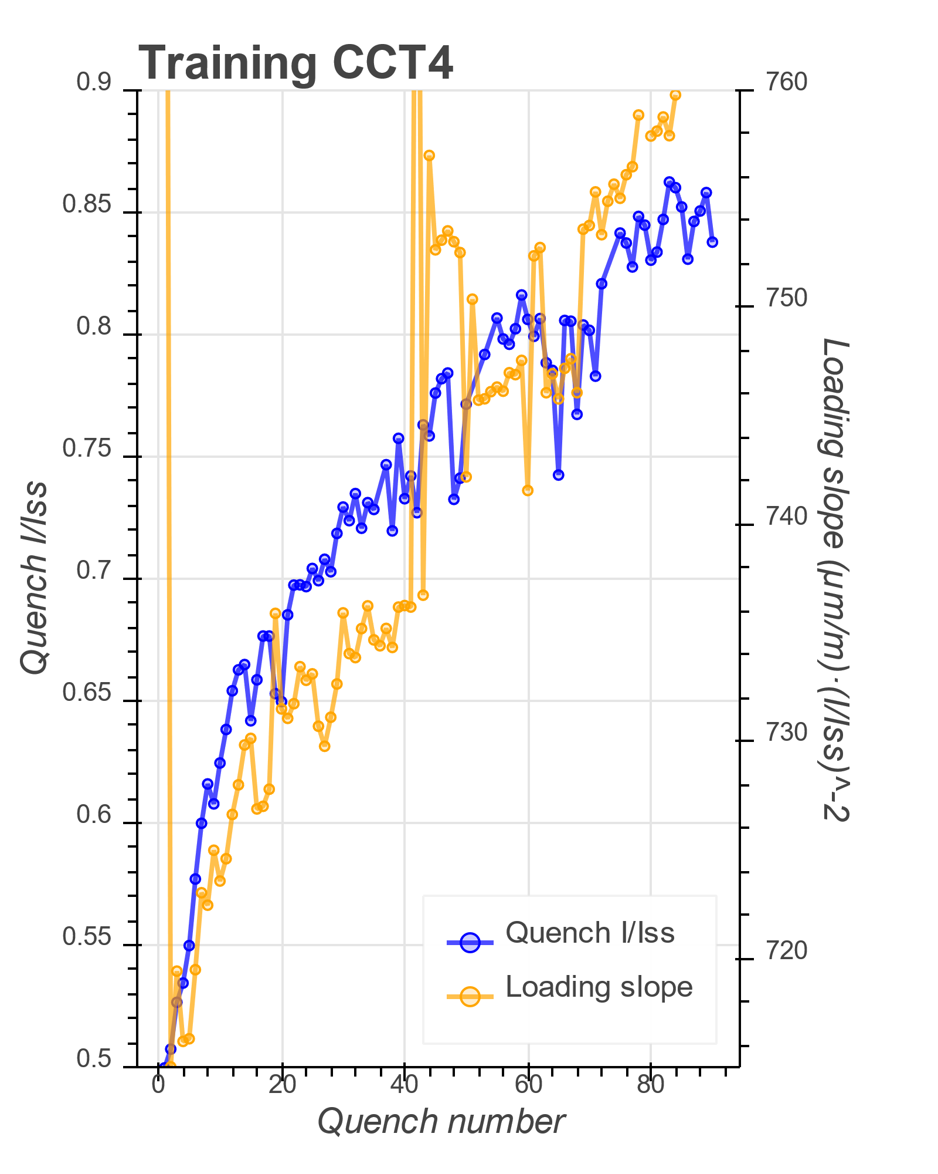
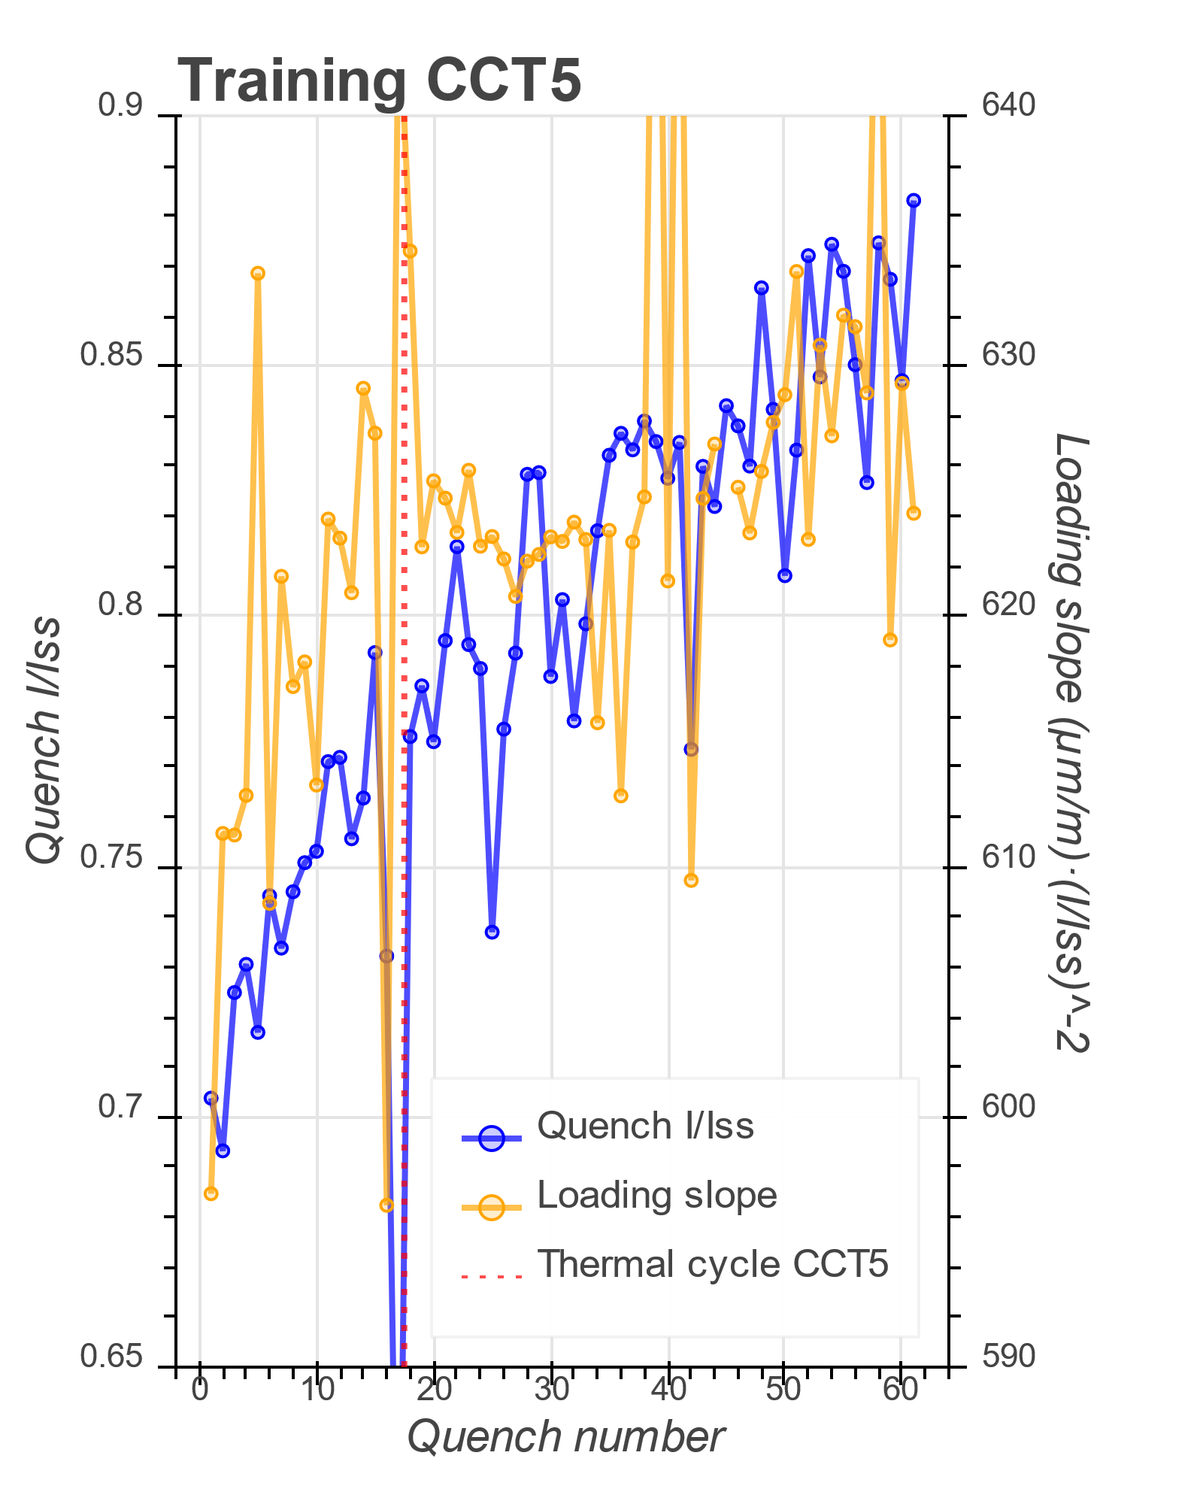
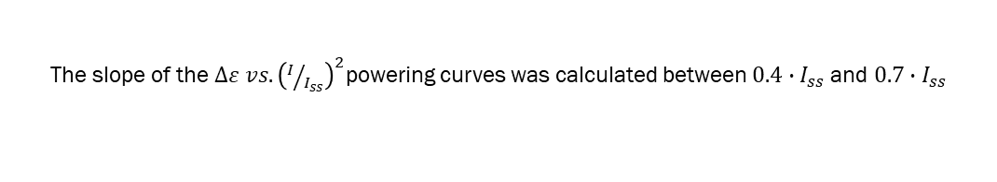
2. Strain gage results
The slope of the $∆ε vs. {\left(I/{I_{ss}}\right)}^{2}$powering curves was calculated between $0.4∙I_{ss}$ and $0.7∙I_{ss}$

Slide 17
Thanks!

