Slide 1
FBG optical fibers: calibration test results
Maria Baldini, Steve Krave and Sean Johnson

Slide 2
Outline
Main Goal: How to Handle fibers and make sure to get reliable data
Several calibration tests using fiber and strain gauge
  Tensile stress tests at room T: steel and Ti
  Strain effect with cooling
  Tensile stress at 77 K
Future plans

Slide 3
Fiber configuration
100 mm
100 mm
500 mm
FBG4
FBG3
FBG2
FBG1
FBG1=1502 nm
FBG2=1508 nm
FBG3=1514 nm
FBG4=1520 nm
Sensor length= 6 mm
< 200 um diameter
Fiber length = 4 m

Slide 4
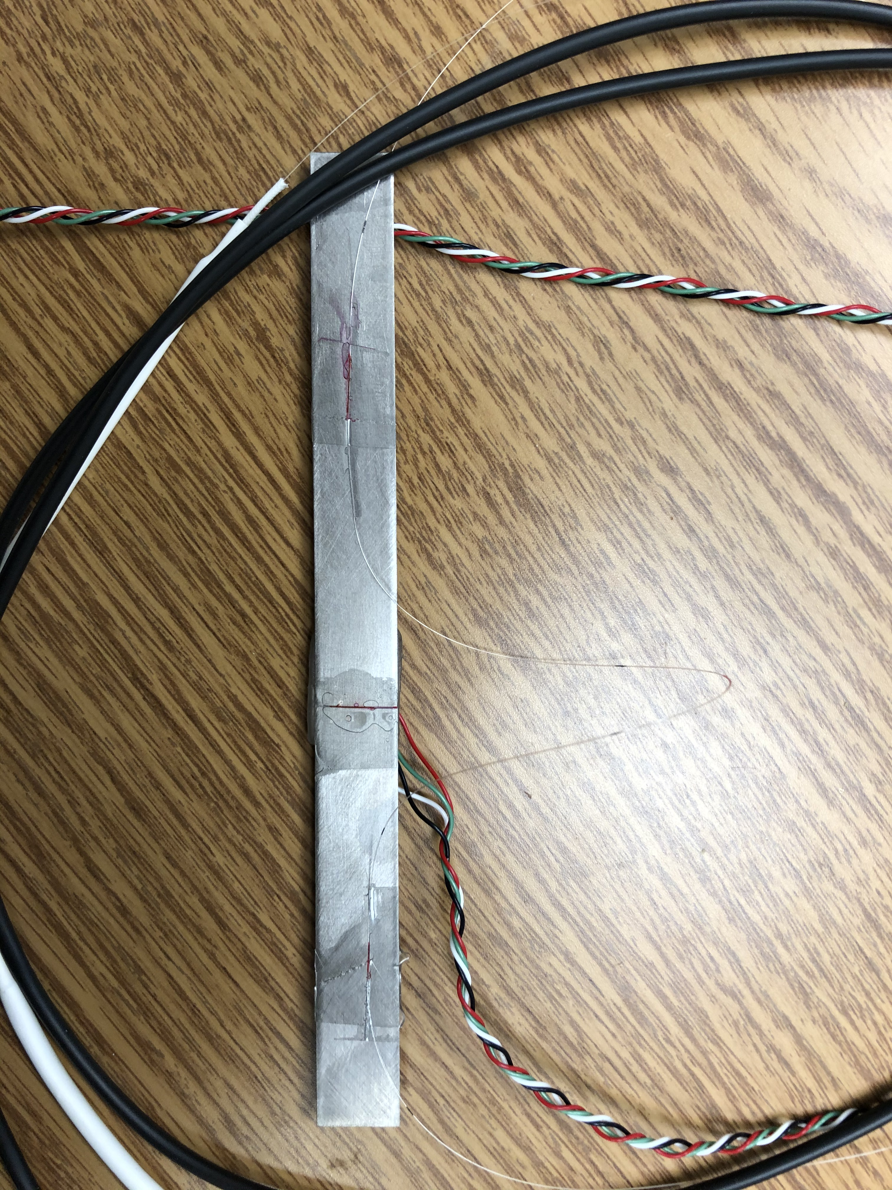
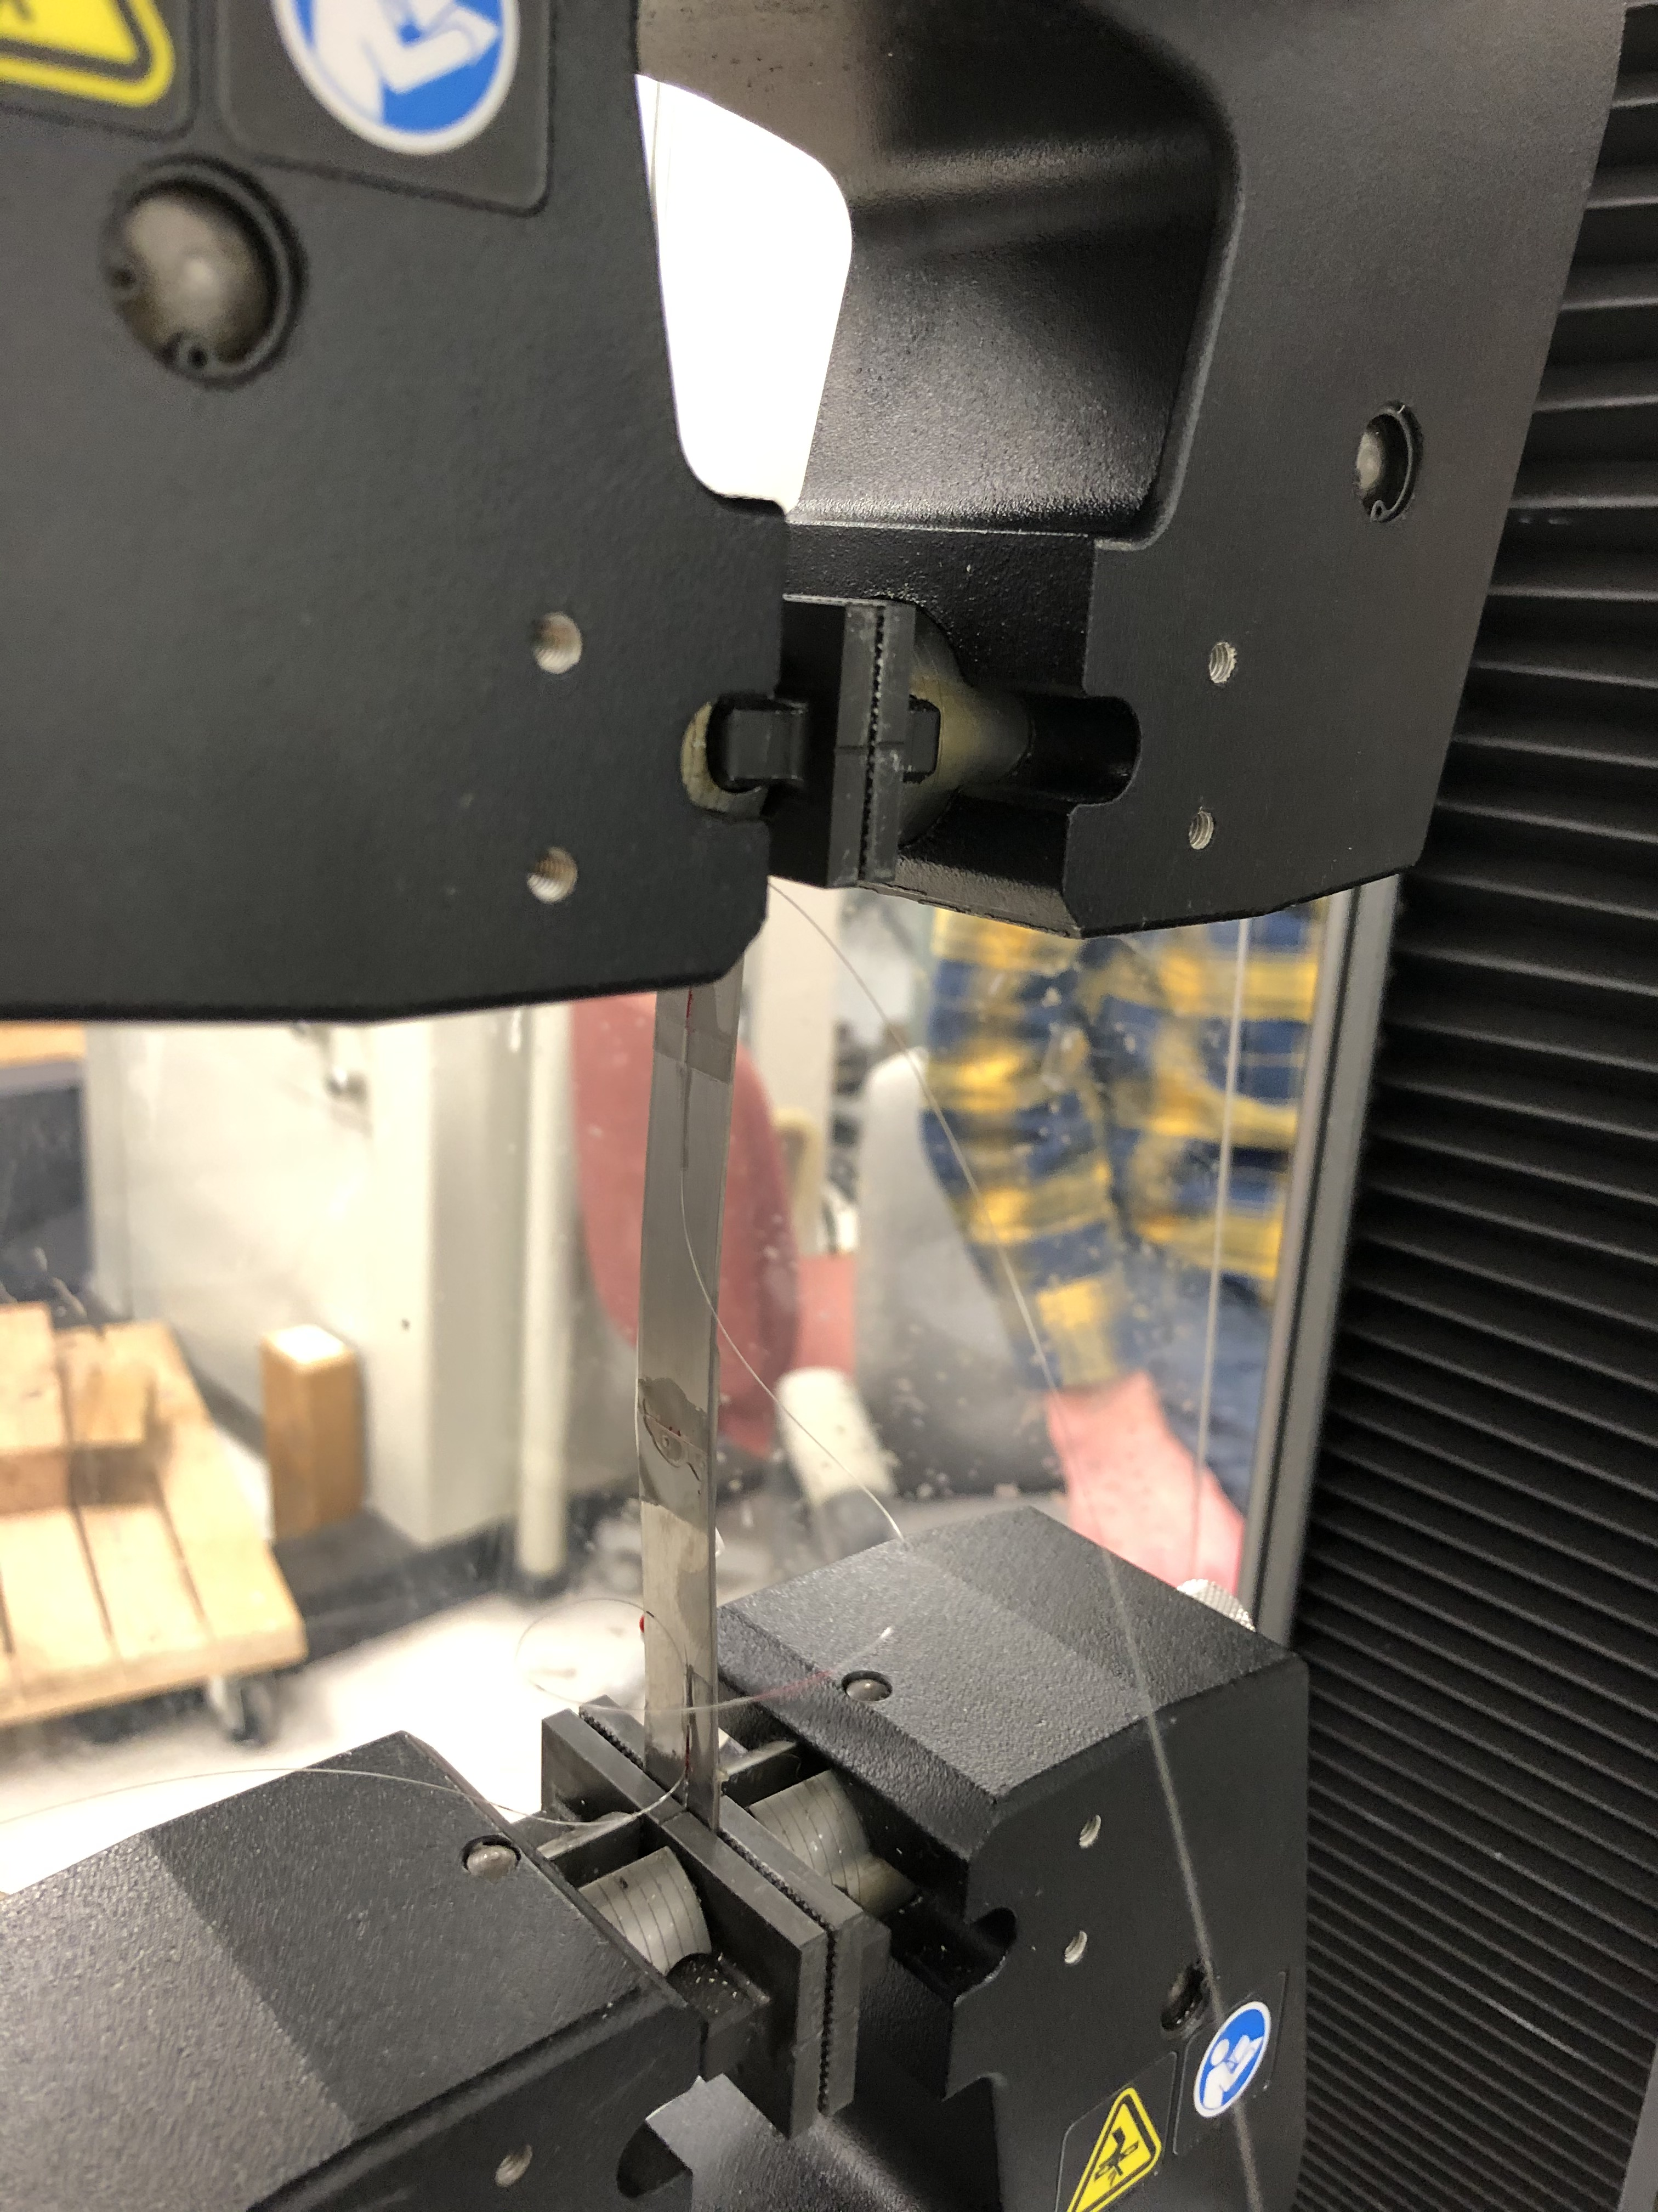
Tensile strain test
3 FBG sensors were glued on a piece of Ti.
2 sensors along Y
1 sensor along X.
There is a strain gauge glued along Y on the back of the Ti piece
Thickness=0.89 mm
Width= 13mm
Length= 15 cm
Y
x
FBG 3
FBG 2
Data were not linear
Sample was too small
Strong bending effects were observed
FBG 1

Slide 5
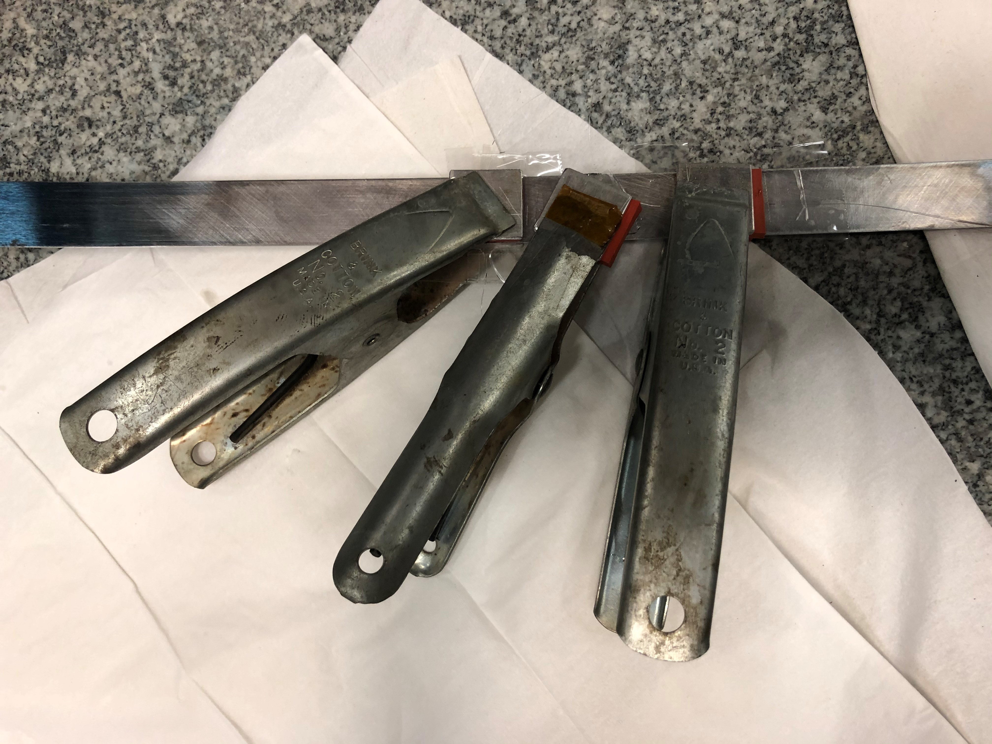
Lesson learned from handling and gluing
The routing path & distance between sensors need to be carefully identified
We used small spring clamps to apply force
    Silicon pads with metal backing over sensor
Treat sensors like strain gauge
  Surface prep the same
  Alignment was the same
  Clamping during adhesive drying the same
  Fiber need to be stretched before gluing. This step requires some learning curve. We used tape to “fix the sensor” before gluing
  Observed fibers breaks were at the edge of the bar (more details later)

Slide 6
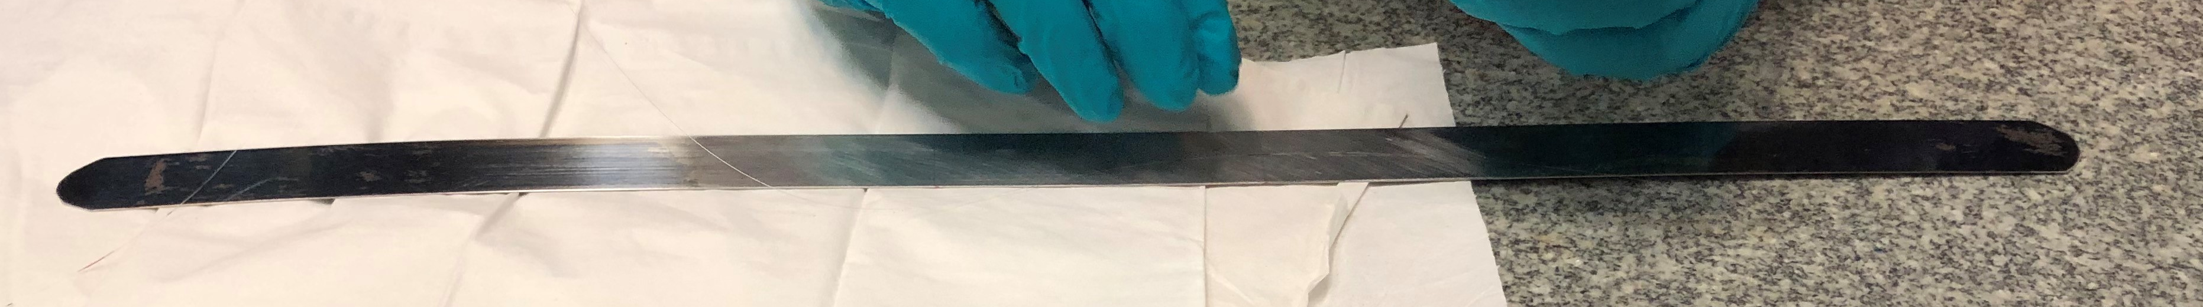
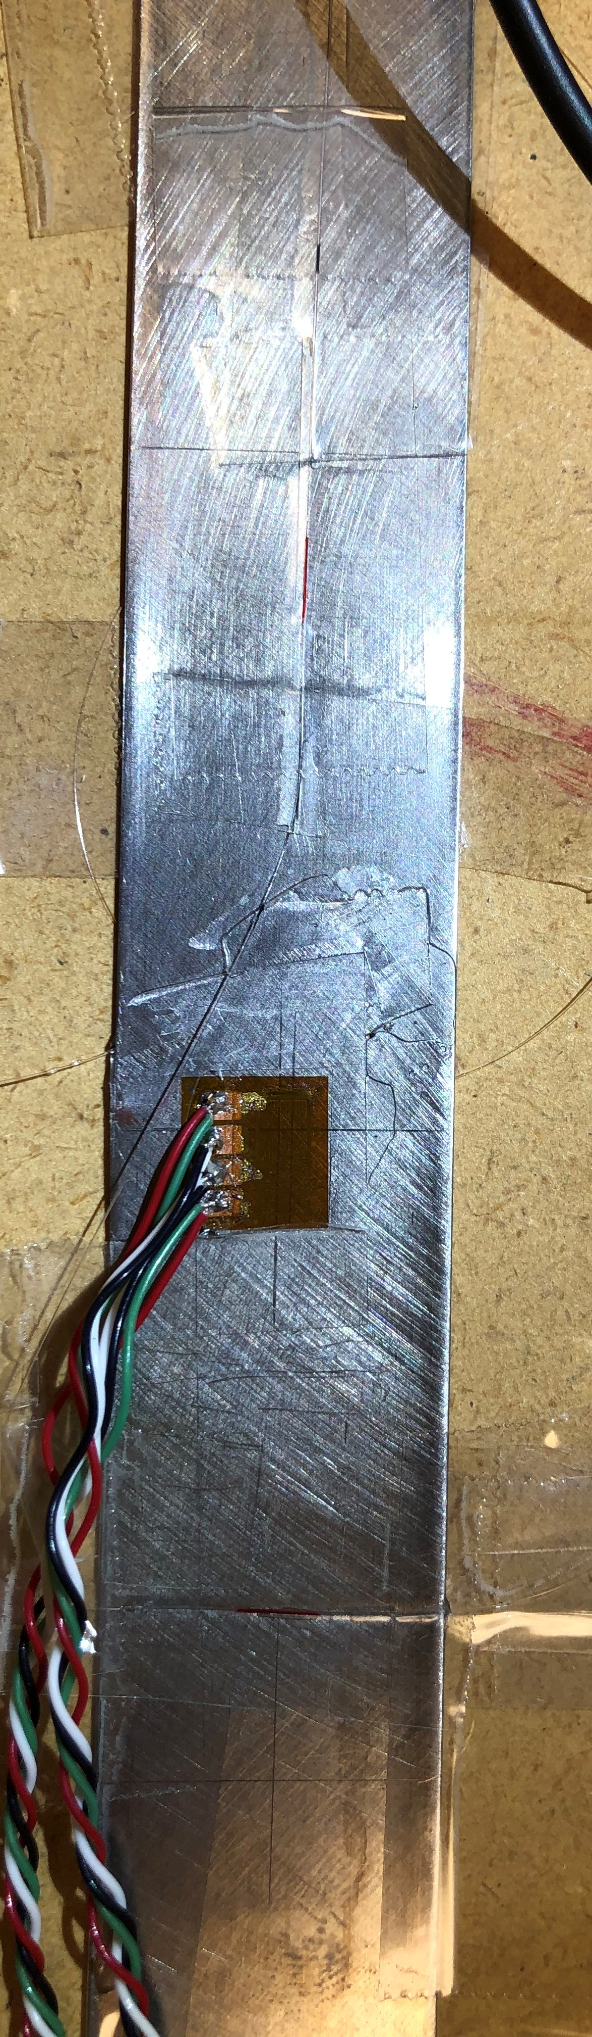
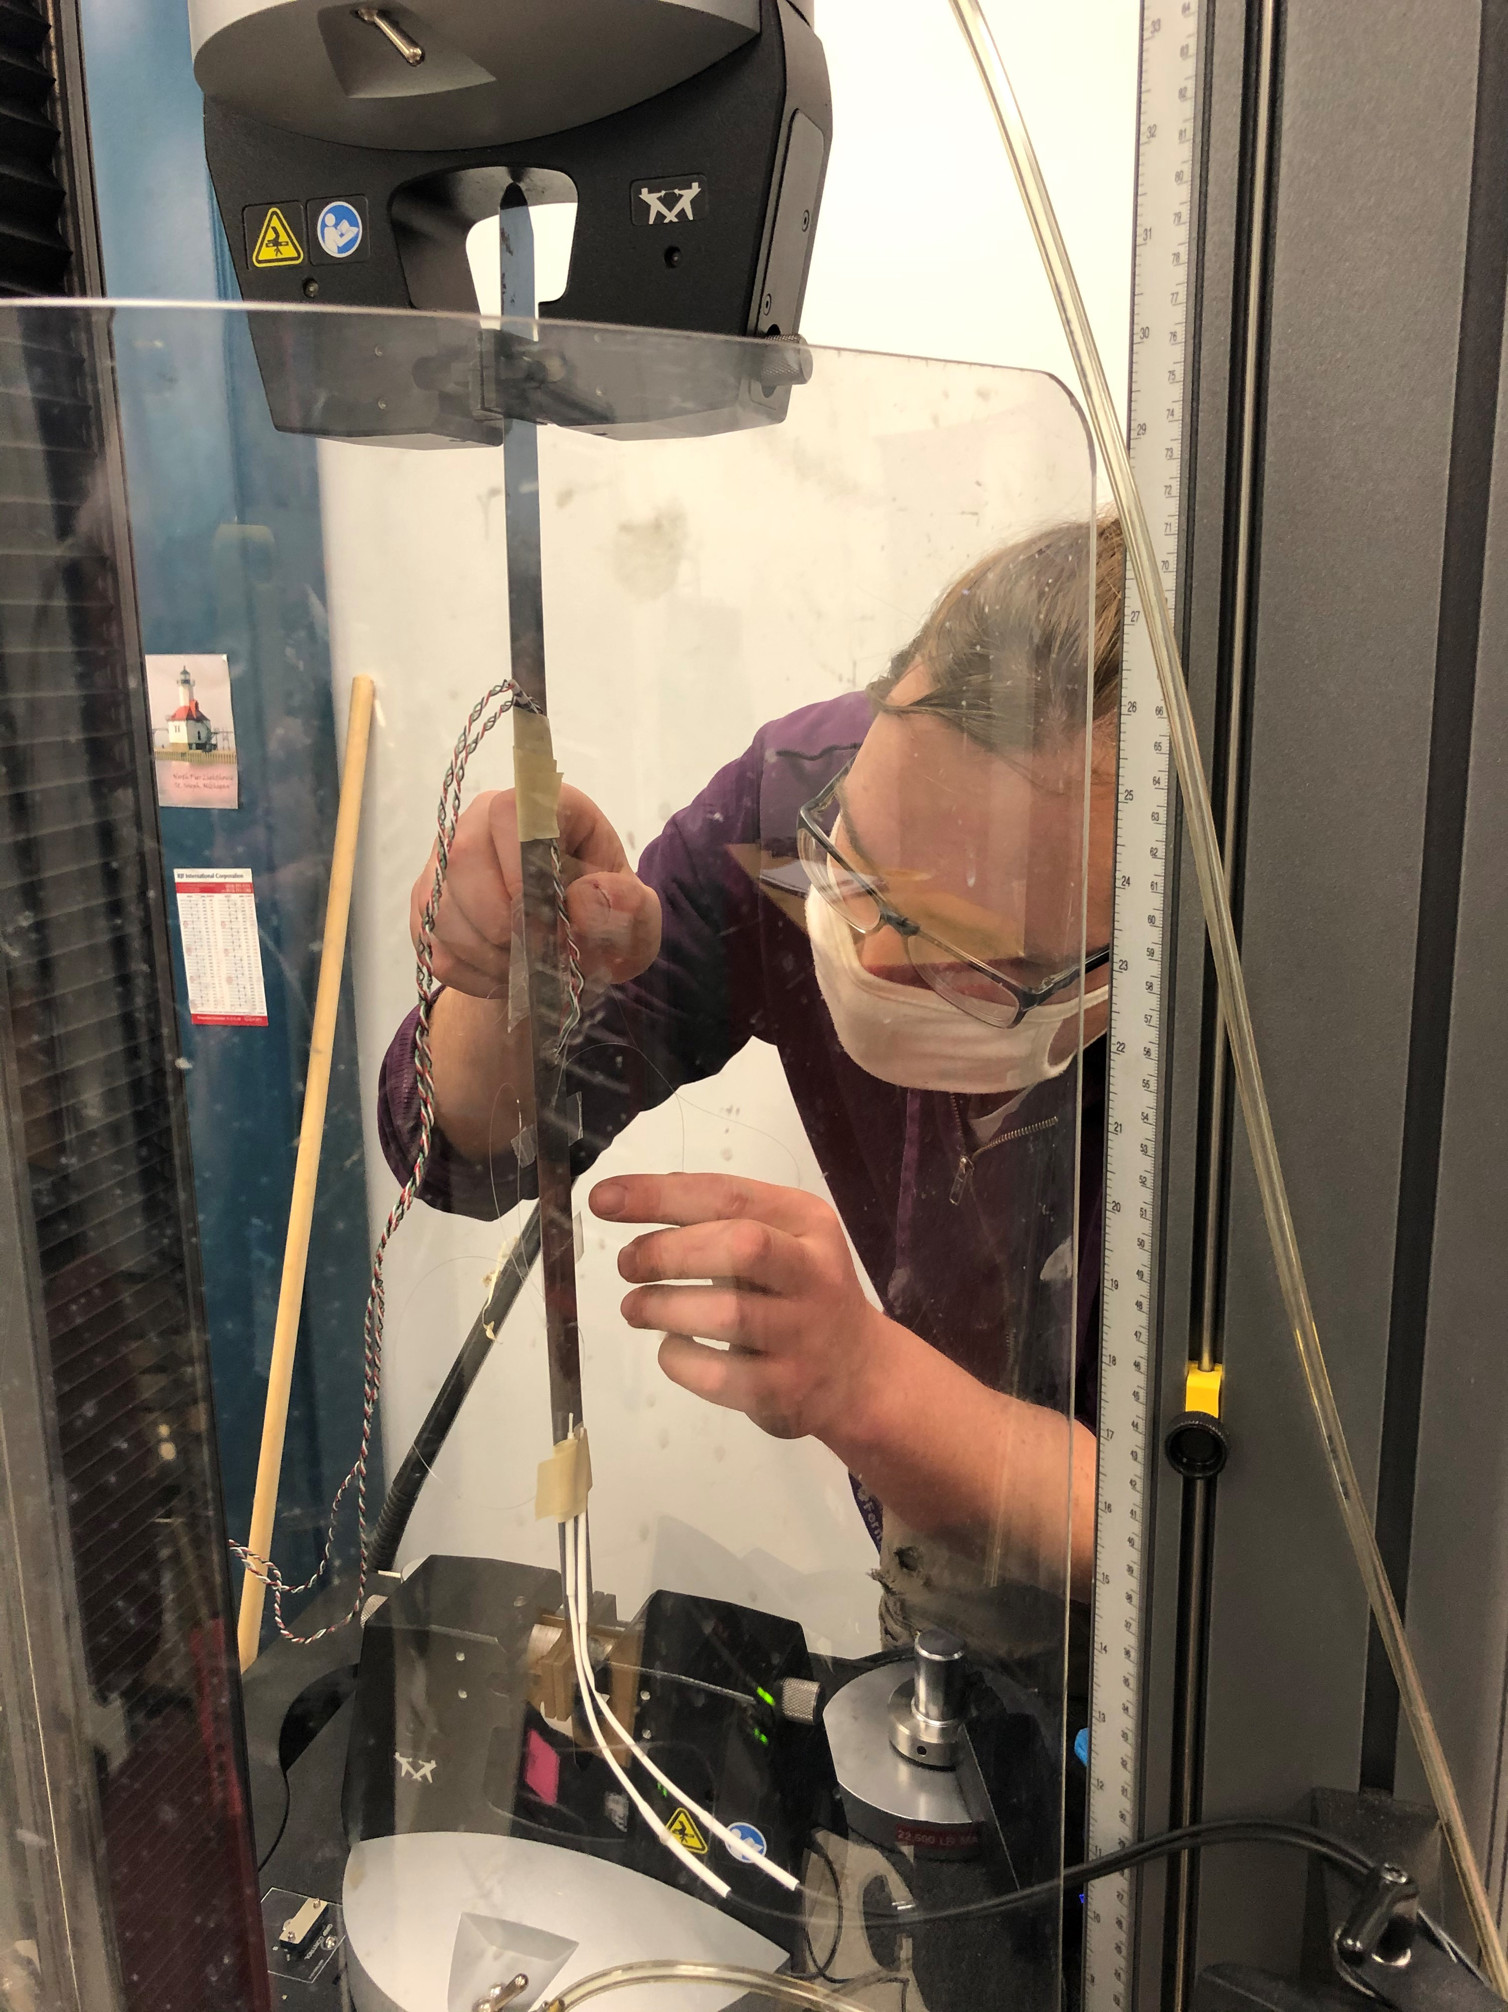
Tensile strain test with AISI 1080 steel
Y
x
Length: 470 mm
Thickness: 0.508 mm
Width: 25.4 mm
Both sides of the steel bar were instrumented with fibers
Sensors were installed in the middle of the bar
Strain gauge measuring data along Y and X on one side only
Instron press in IB3 was used for the test

Slide 7
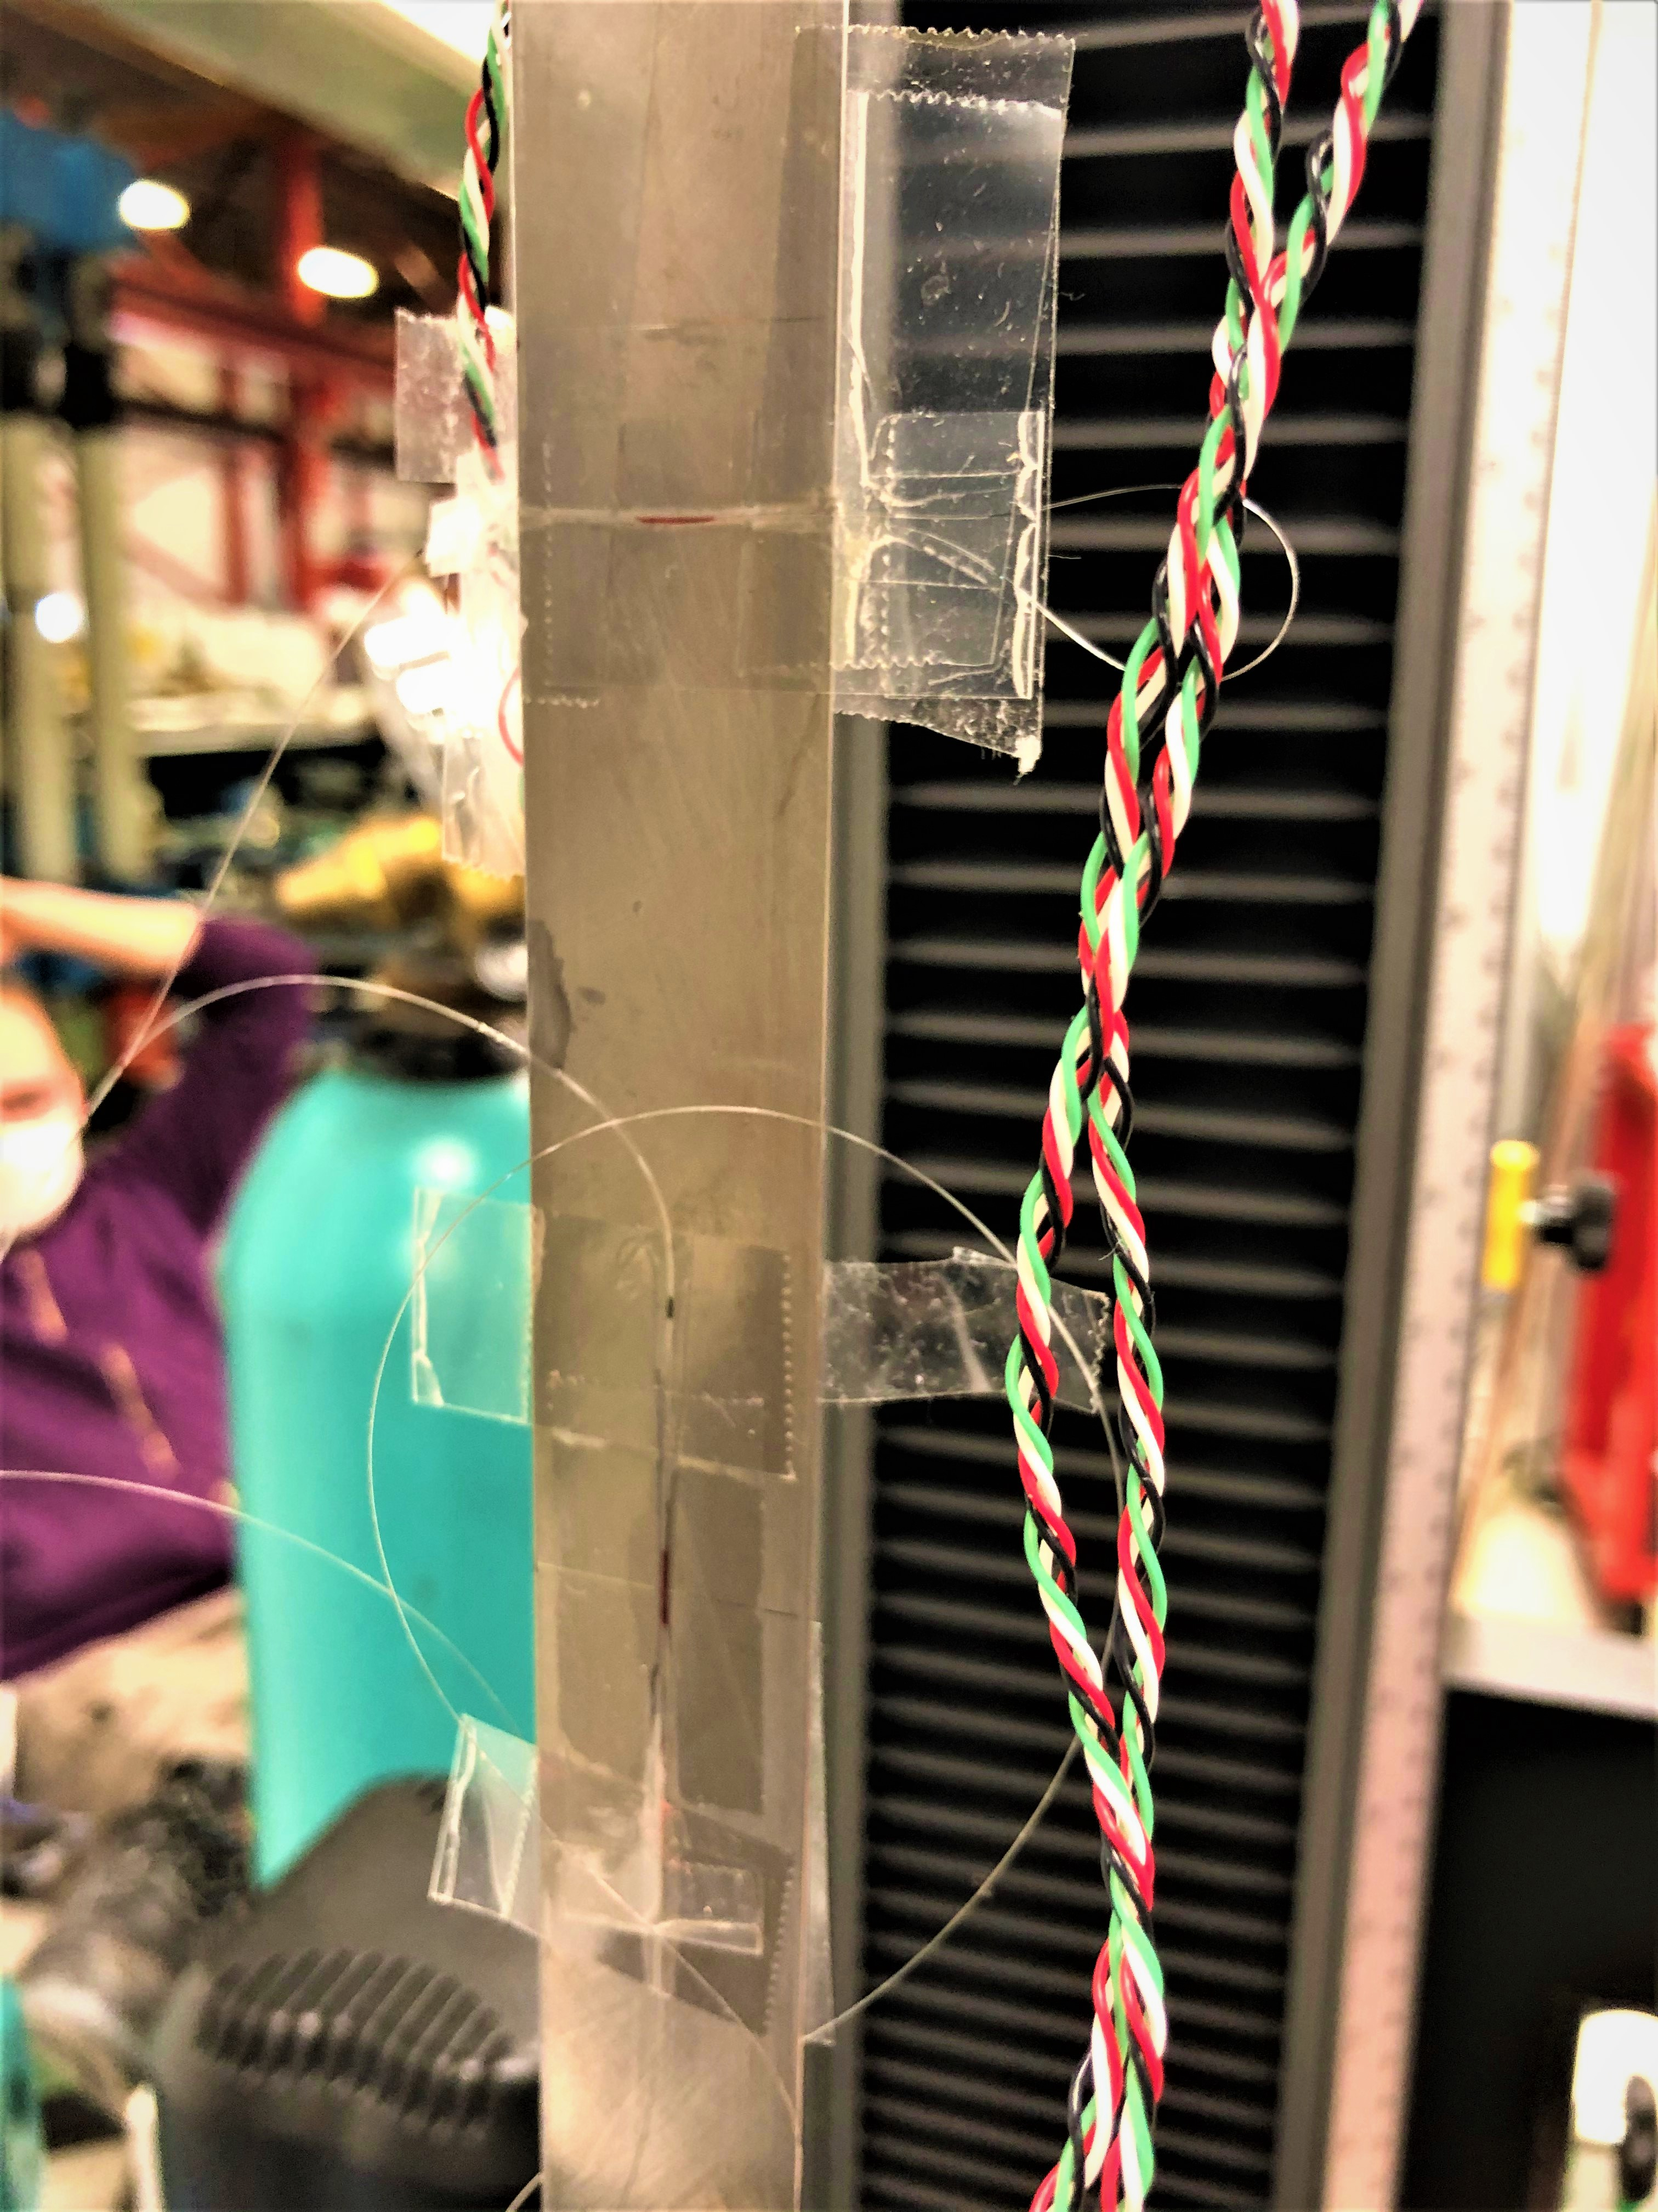
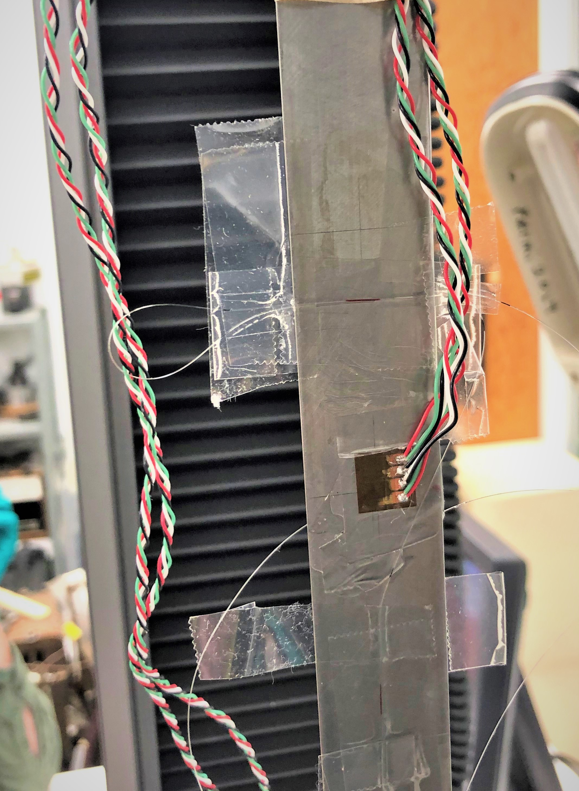
Fiber sensor labels
FBG1 and FBG4: tensile strain
FBG2 and FBG3: Poisson strain
FBG3
FBG2
FBG4
FBG1
Fiber break at the end in between FBG1 and FBG2 (small loop)
Signal was not lost because it is collected from both extremities

Slide 8
Test details
Data were collected increasing tensile stress up to:
32 MPa @ 0.1mm/m
50 MPa
100 MPa
200 MPa
Load was brought back to 0 at the end of each ramp up.
Strain gauge data along tensile stress direction were not saved
Tensile strain was estimated using the bar elongation measured by the Instron press (20% error for the press frame)
Fiber optic sensors recording rate was 1 kHz for each test
Recording rate was 50 Hz for the 200 MPa test

Slide 9
Instron data
Data are linear and well consistent with each other

Slide 10
FBG fiber raw data
K=0.78 (provided by the vendor)

Slide 11
Tensile strain FBG data
FBG1 and FBG4 are basically identical.
Expected Young’s modulus value for steel is 190-210 GPa

Slide 12
Tensile vs Poisson strain with FBG fibers
Expected Poisson ratio for steel: 0.27-0.30

Slide 13
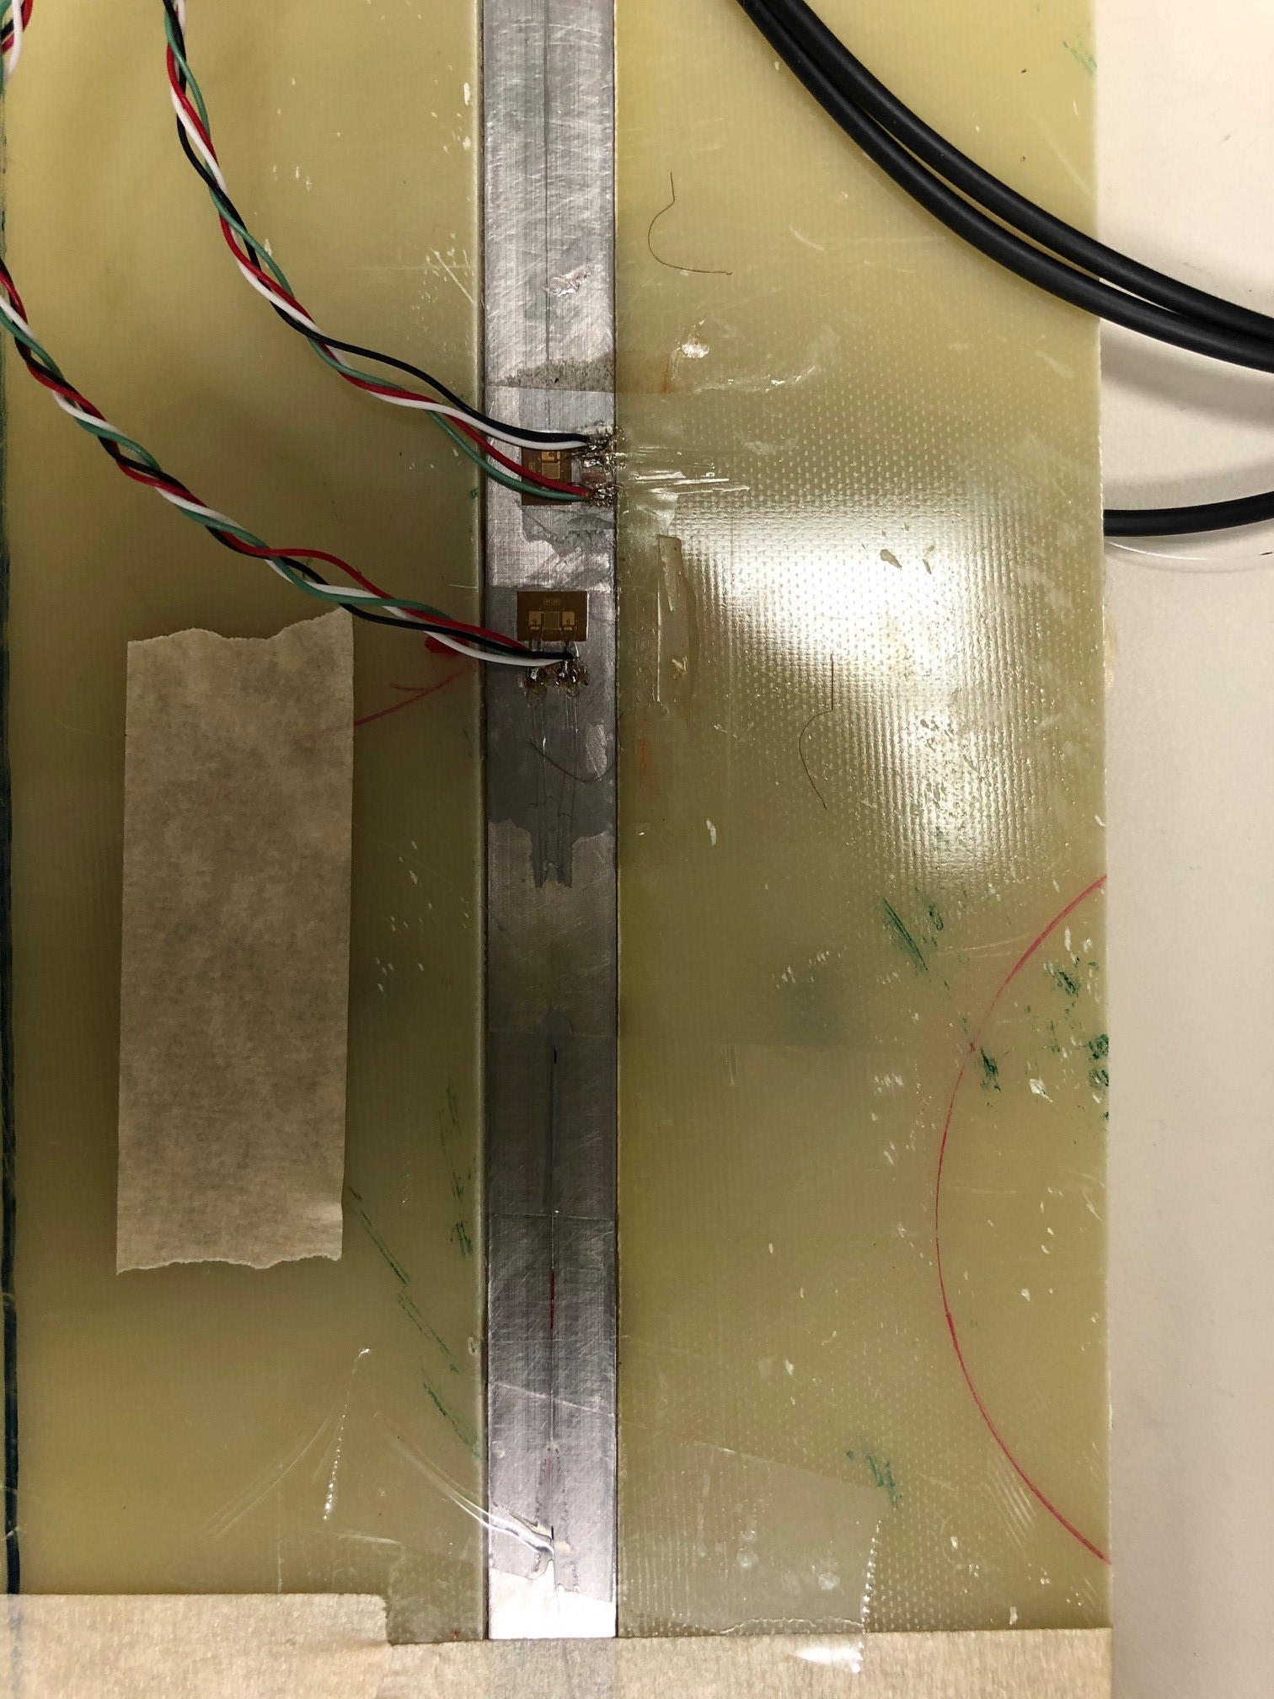
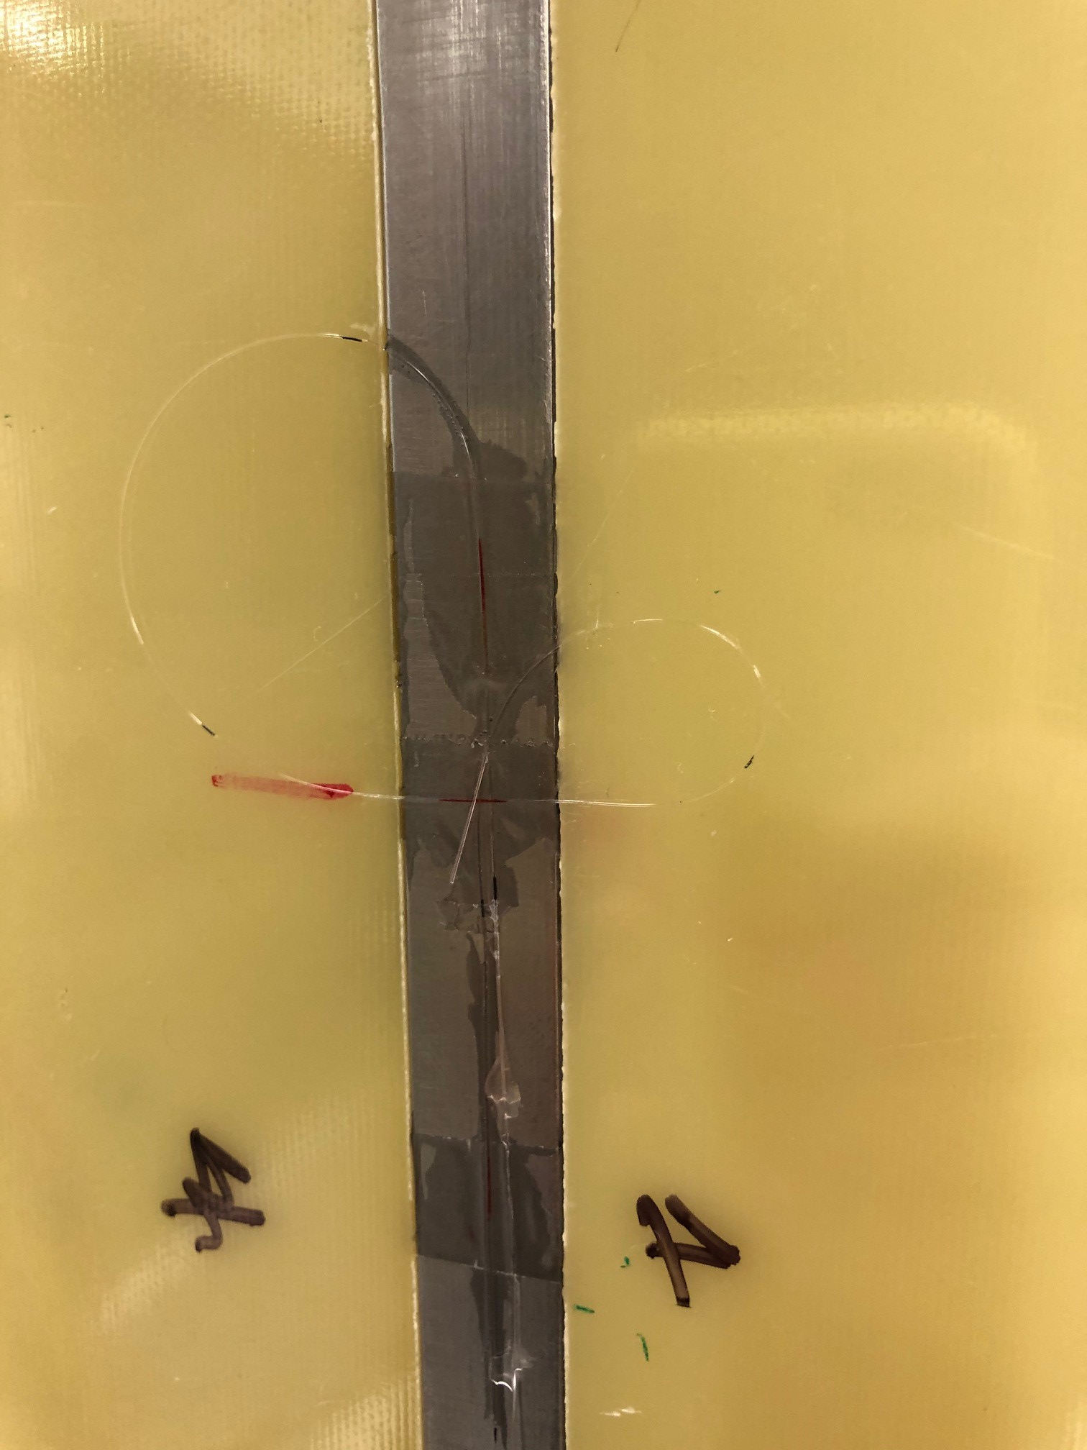
Ti Bar test on Instron
Y
FBG1 was lost because fiber was broken
x
Length: 406 mm
Thickness: 13.5 mm
Width: 12.7 mm
FBG3
FBG2
Not straight cut
0.5 mm difference in width (x-direction)
FBG4
FBG1

Slide 14
Test details
Data were collected increasing tensile stress up to:
25 MPa @ 0.1mm/m
50 MPa
100 MPa
200 MPa
Load was brought back to 0 at the end of each ramp up.
Fiber optic sensors recording rate is 50 Hz for each test

Slide 15
Tensile strain vs Stress
FBG2: 1508.144 nm ; 3.5
FBG3: 1514.030 nm ; 3.5
FBG4: 1520.100 nm ; 3.5
Strain gauge behavior is in a very good agreement with the FBG sensor installed on the same side of the bar

Slide 16
Young modulus calculation
FBG3 and FBG4= 123 and 121 GPa
Strain gauge= 131 GPa
Expected value 110-120 GPa

Slide 17
Tensile vs Poisson
Poisson ratio= 0.3-0.37

Slide 18
Conclusions
Tensile stress tests performed at ambient temperature were successful
FBG sensors behavior is in very good agreement with what is expected for steel and Ti
Gluing has been performed correctly

Slide 19
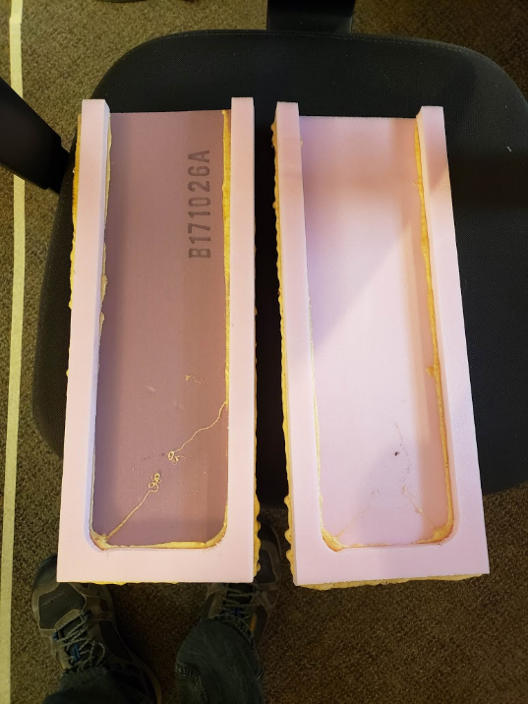
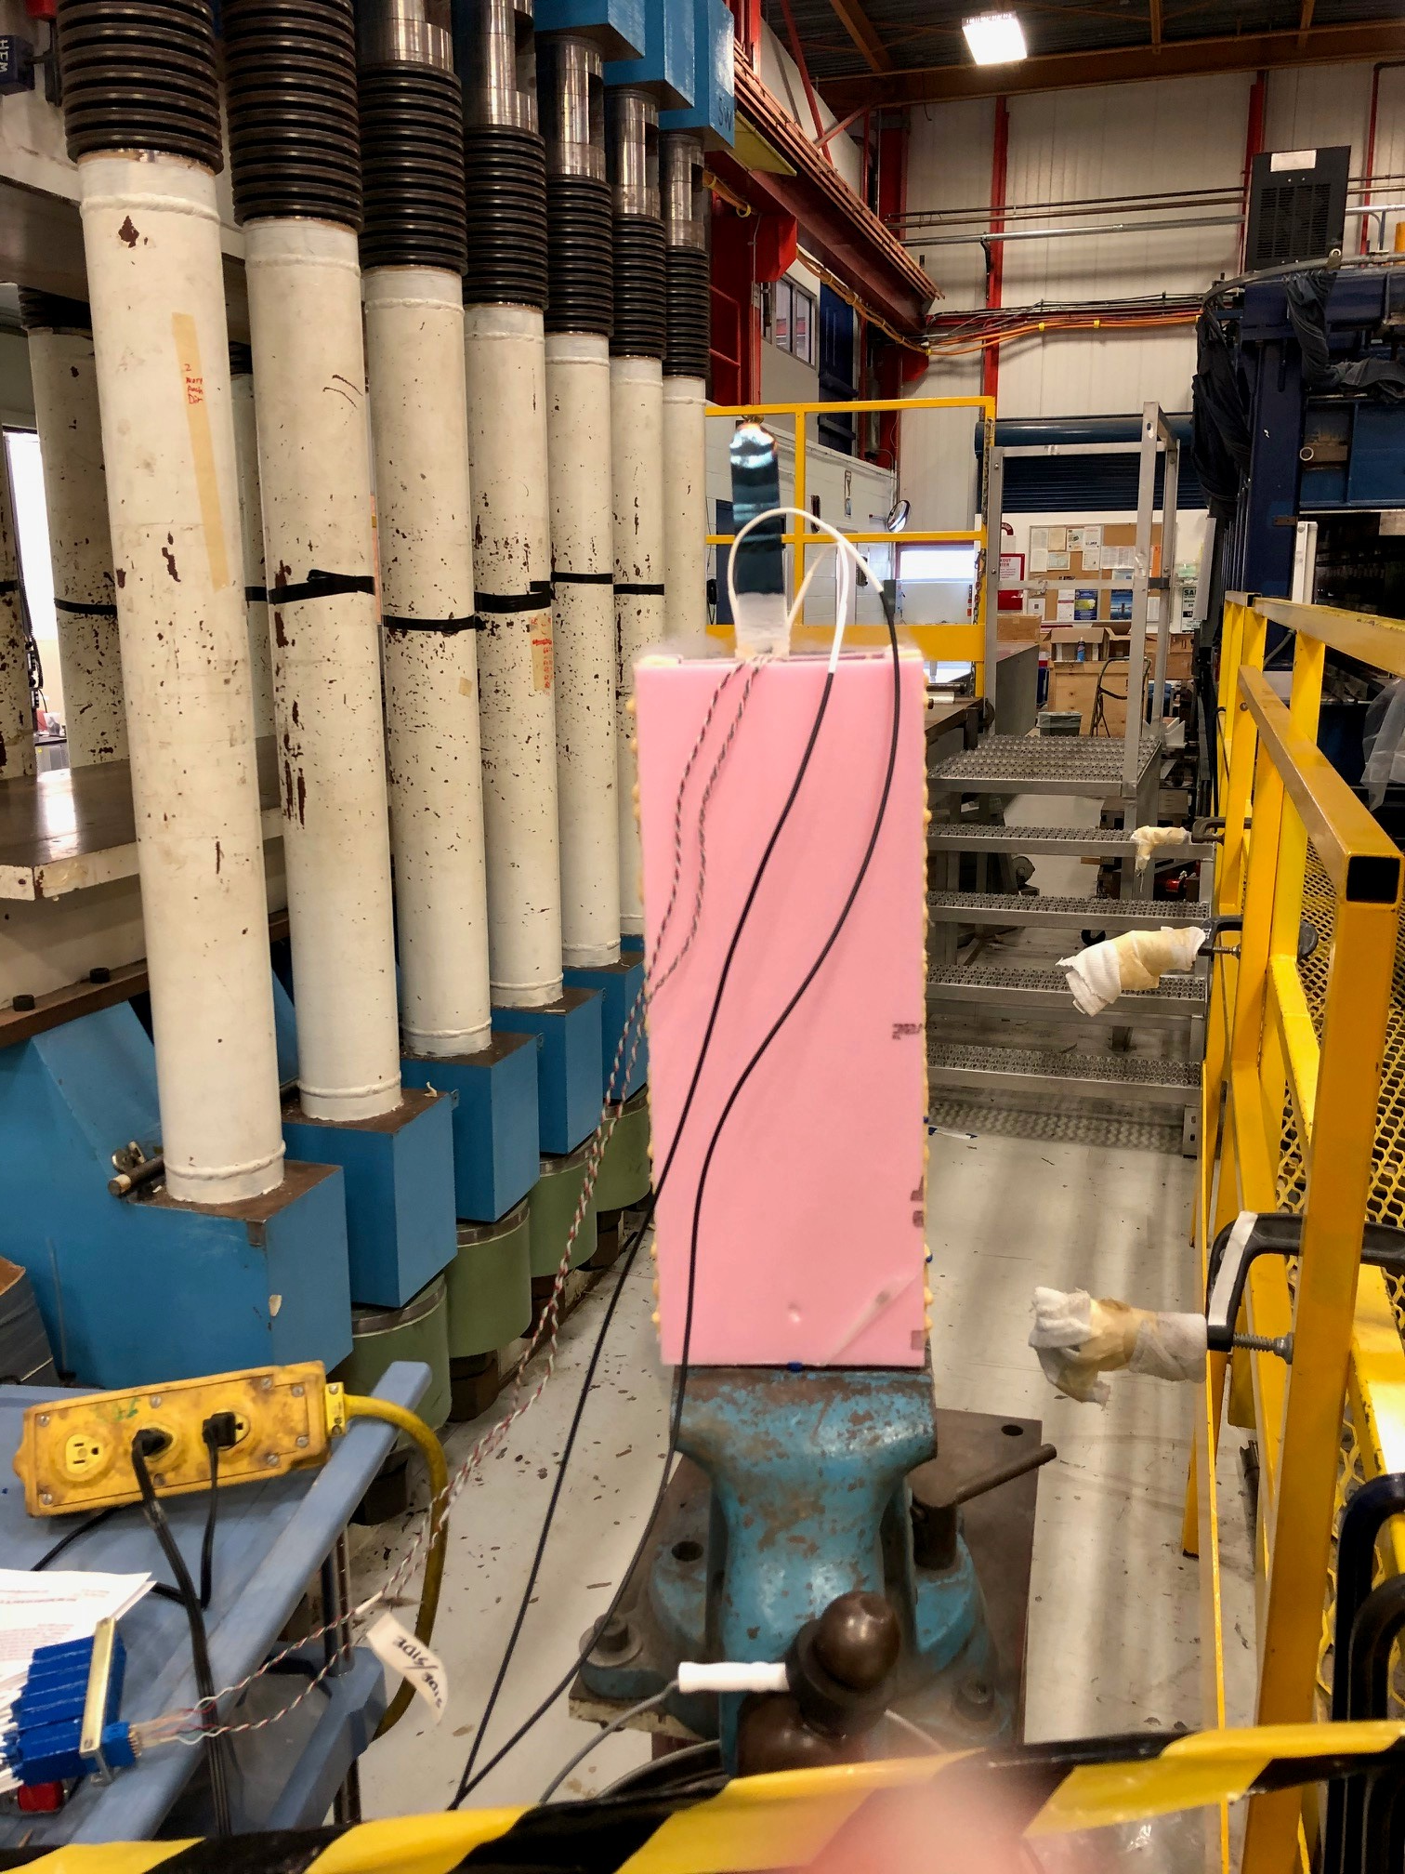
Portable cryostat design
LN2 setup: sealing test
Steel and Ti bar used for ambient T tests were inserted in the foam cryostat and everything was sealed with stycast
Cryostat sealing was verified before cooling down the N2 setup inserted in the istron test

Slide 20
Steel bar cooling
1st cooling
FBG2: 1507.977 nm
FBG3 1513.813 nm
FBG4: 1520.238 nm
FBG1: 1501.753 nm
2cooling
FBG2 ; 1507.995 nm
FBG3 ; 1513.826 nm
FBG4 ; 1520.310 nm
FBG2 ; 1501.727 nm
Y
FBG3/2
x
FBG4/1

Slide 21
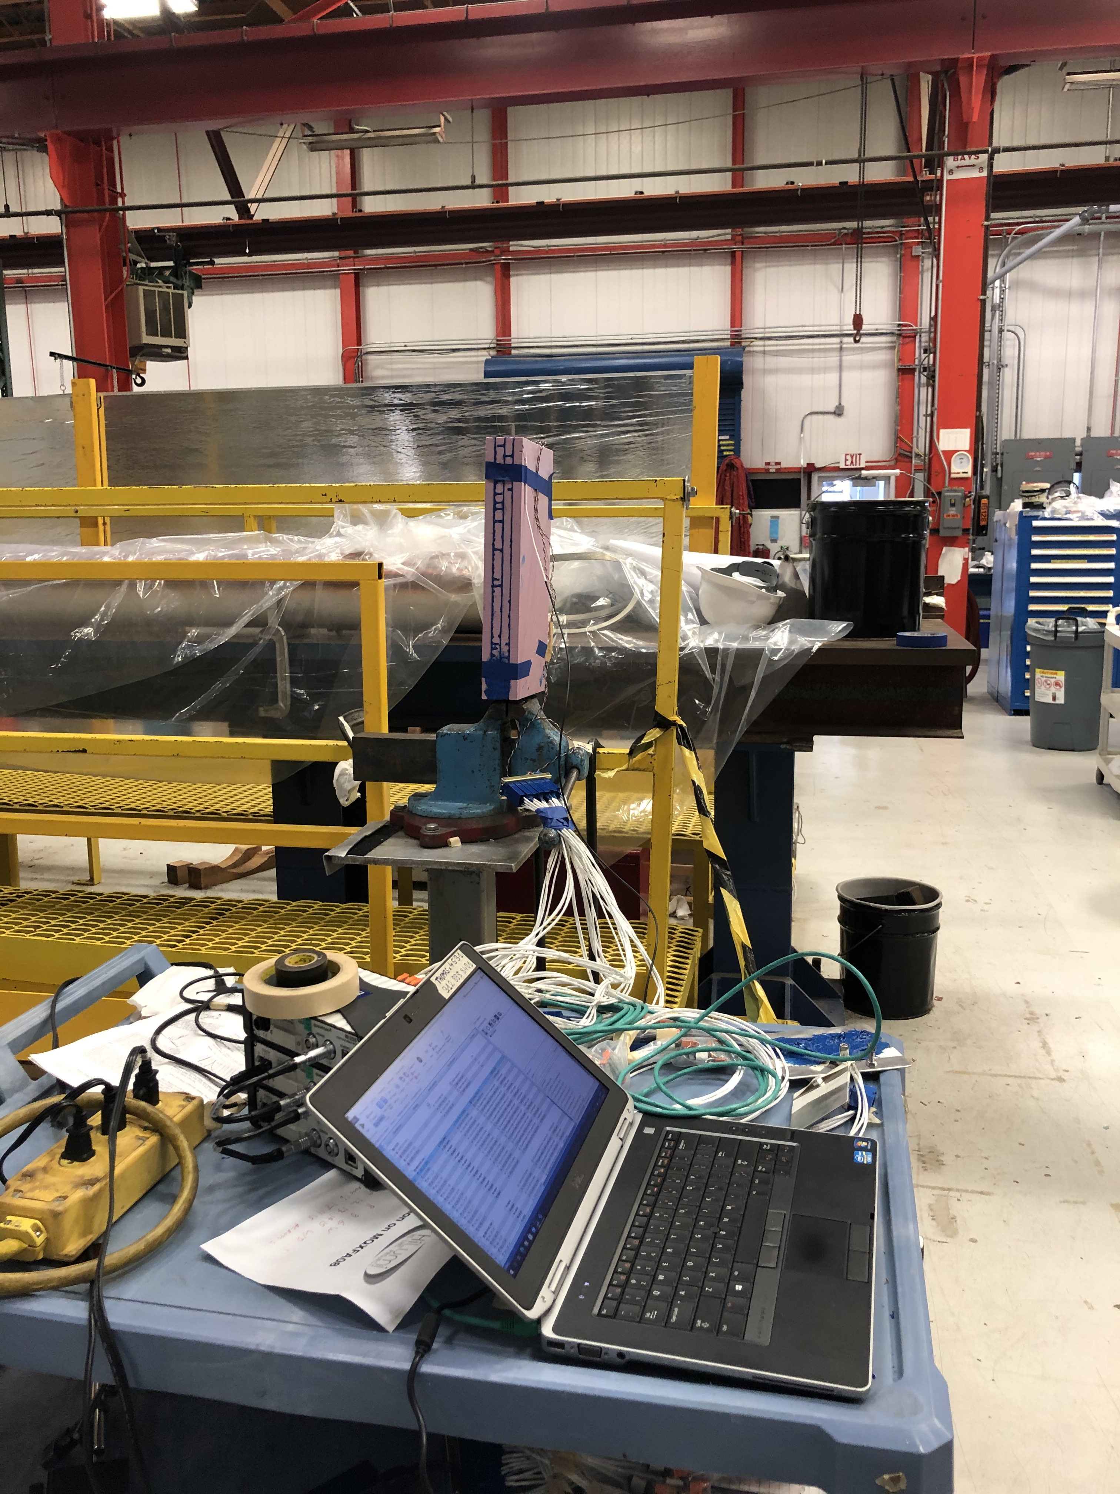
Ti bar cooling

Slide 22
Changing wavelengths range
FBG signal is lost > 2700 με
One of the possible reason for signal disappearing is the allowed wavelength shift
This feature can be modified
6 nm wavelength range was selected for each sensor
4nm shift corresponds to around 3500 με variation

Slide 23
Ti bar second cooling
Strain Values at t=0s have been subtracted.
Strain gauges
Fibers
Thermal contraction measured with fibers is higher
Those values do not take into account sensor contraction, resistance change with T

Slide 24
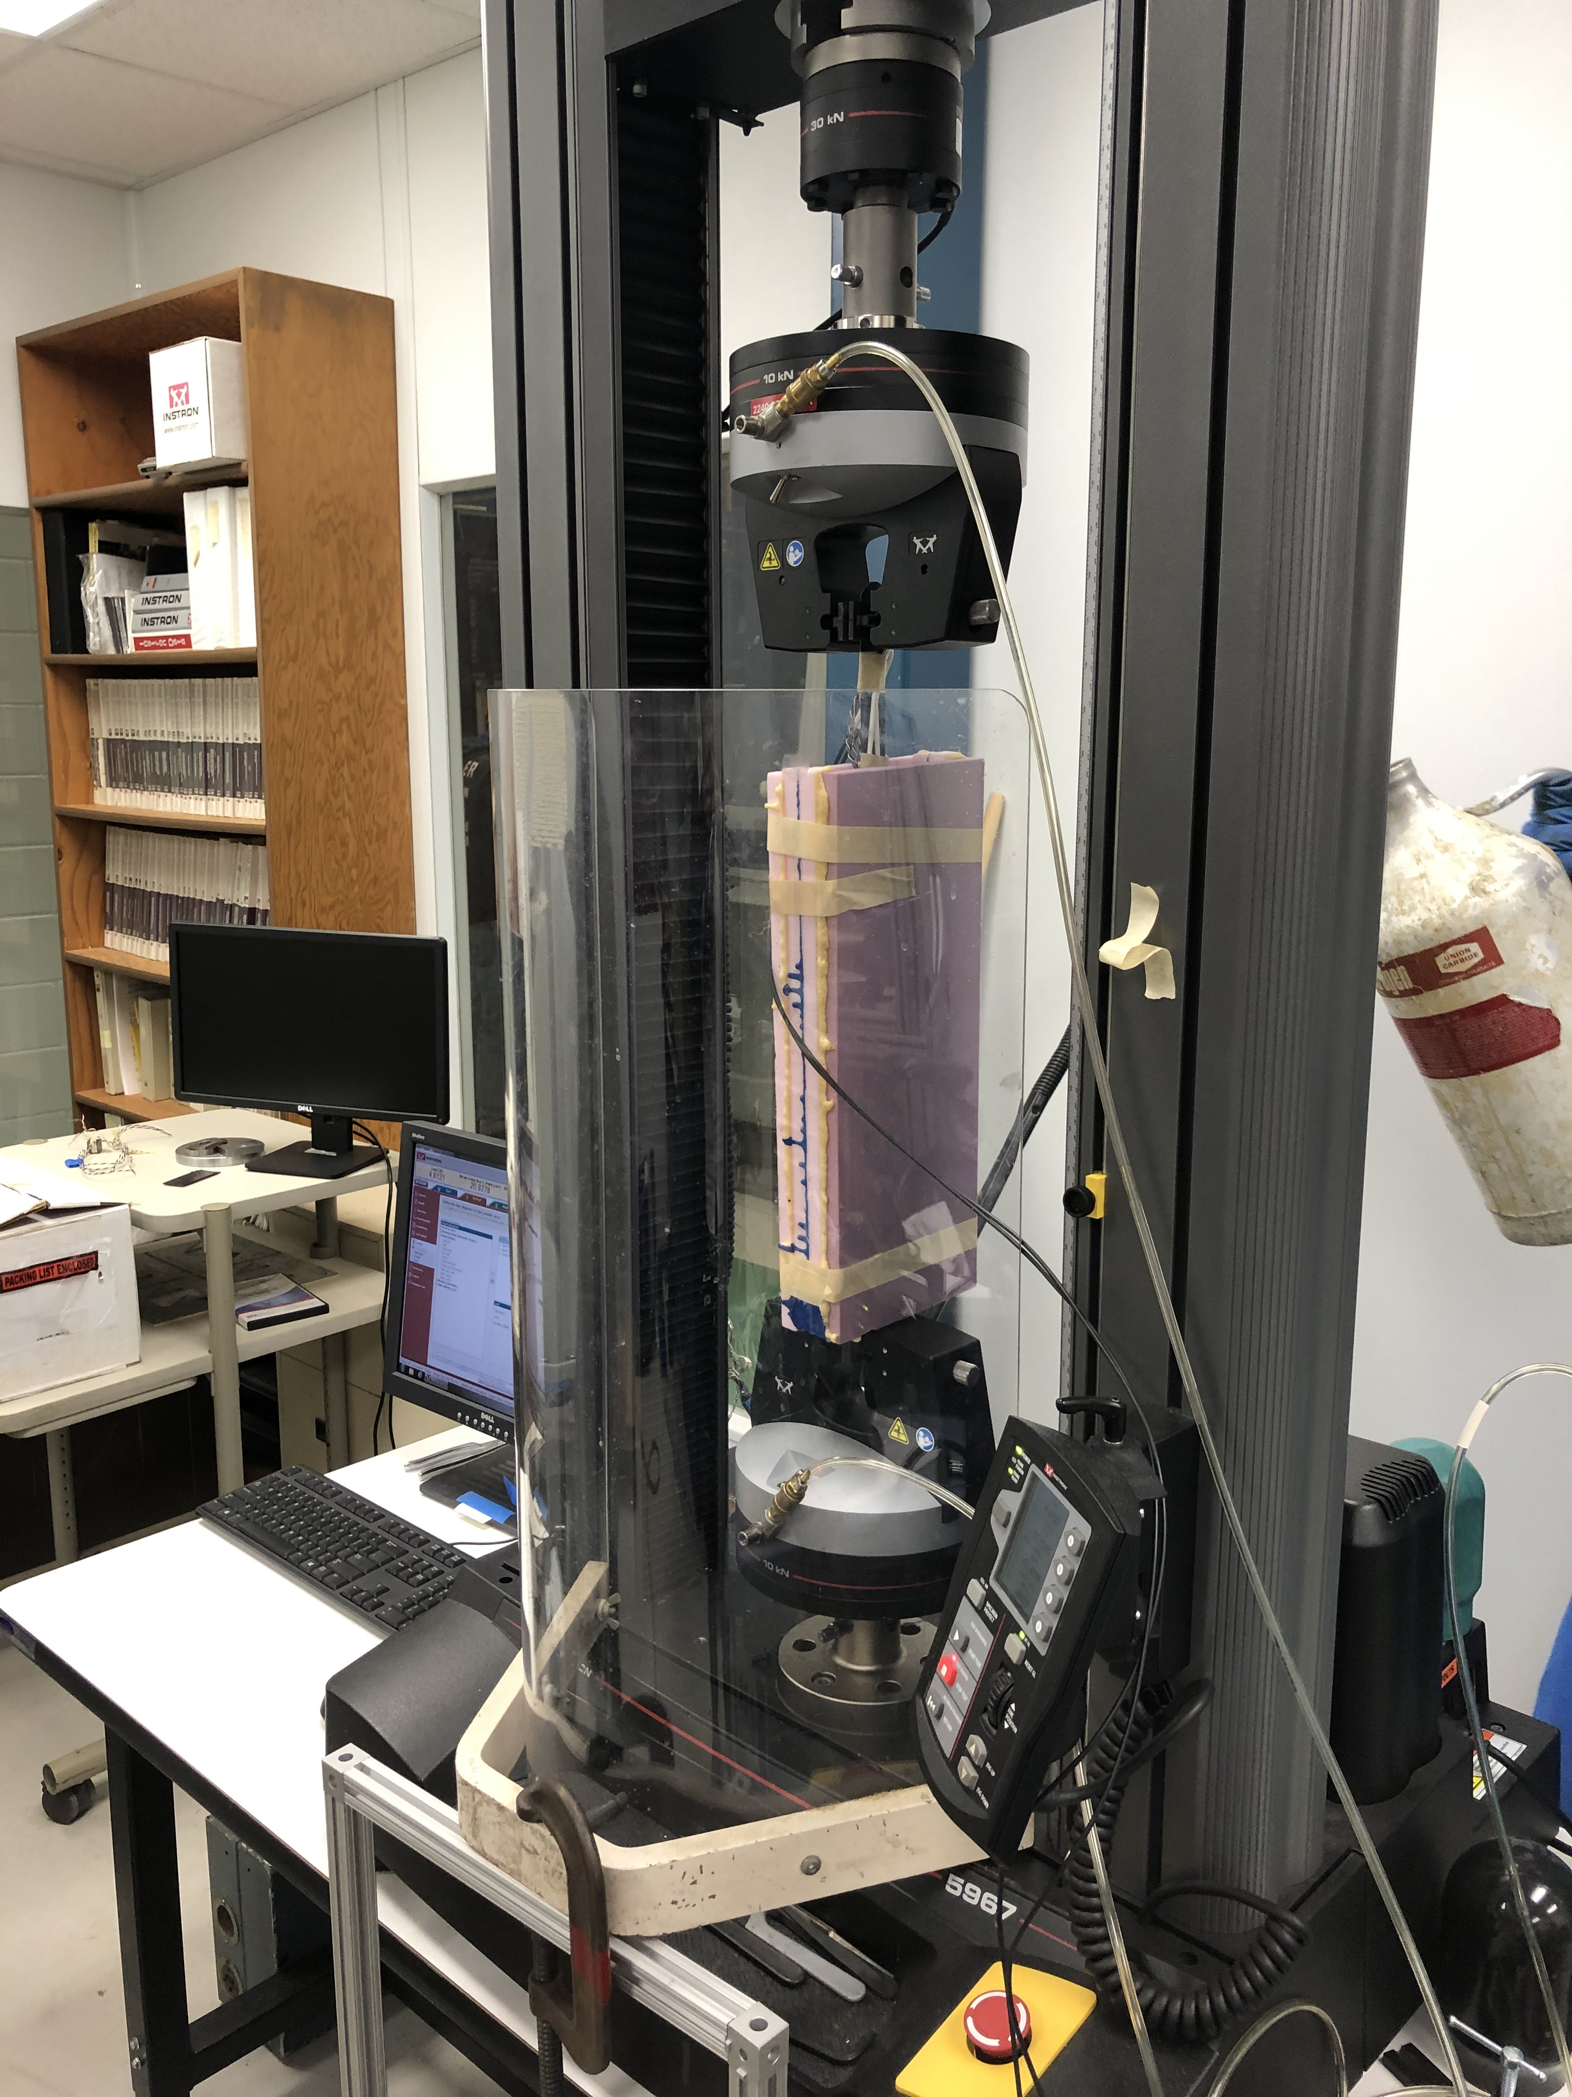
Steel bar tensile stress test at 77 K
Signal was lost on FBG1 and FBG4 (tensile sensors)
FBG2 sensor (Poisson) survived but strain absolute value jumped to 2000 με
Absolute Measure value is not correct
It is still possible to verify if mechanical strain variation applied at 77 K and measured with FBG sensor is consistent with what is measured with strain gauge

Slide 25
Strain gauge vs FBG fiber at 77 K
Strain gauges
FBG sensors
Tensile stress was applied up to 200 MPa
FBG4 signal (tensile) came back after 300 sec
Strain variation is around 800 με for both strain gauge and fibers
Poisson ratio is 0.3

Slide 26
Young Modulus
Strain gauges
FBG sensors
Young Modulus: 223 GPa
Young Modulus: 213 GPa
Expected value 190-210 GPa

Slide 27
Conclusion
Tensile stress tests were performed using the instron press on Ti and Steel bar
Tensile tests performed at ambient temperature and at 77 K were successful
  Young modulus are in good agreement with expected values
  Strain gauges and FBG behaviors are consistent
Ongoing issue: FBG fiber sensor signals were lost during cooldown

Slide 28
FBG future work: investigating the loss of signal during cooldown
Make sure that sensor range do not bled over into the range the next sensor
This is probably not the case, but we need to make sure
Cooling
Mechanical strain @77 K

Slide 29
investigating the loss of signal during cooldown
Investigating the disappearance of FBG signals during cooldown
Study the spectrum behavior:
  non-uniform strain transfer along the length of the sensor:
  Widen of the peak, loss of signal
  Splitting of a peak: loss of signal
Use shorter sensor (3mm lenght)
Chiuchiolo et al., IEEE TRANSACTIONS ON APPLIED SUPERCONDUCTIVITY, VOL. 26, NO. 4, JUNE 2016
Chiuchiolo et al., IEEE TRANSACTIONS ON APPLIED SUPERCONDUCTIVITY, VOL. 28, NO. 4, JUNE 2018
Next step: the goal is to study the spectral behavior during cooldown
fully synchronize HBK strain gauge and fibers with CATMAN software
We got a new license and module. Next week we plan to setup the new system
  Repeat the cooldown saving the spectrum

