Slide 1
Overview of “Technology” topics from SoftA Workshop
S. Krave
12 May 2021
US Magnet Development Program

Slide 2
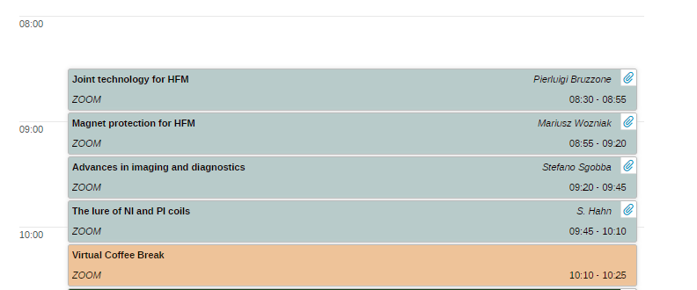
Outline
Since much of the technology section consisted of MDP topics, I will cover a little on non-MDP work, as well as related work touched on in other sections
Timetable can be found below:
https://indico.cern.ch/event/1012691/timetable/?layout=room#20210414.detailed

Slide 3
Joints for accelerator HFM
Pierluigi Bruzzone,
based on materials from
Vincenzo D’Auria, Mithlesh Kumar, Xabier Sarasola, Davide Uglietti

Slide 4
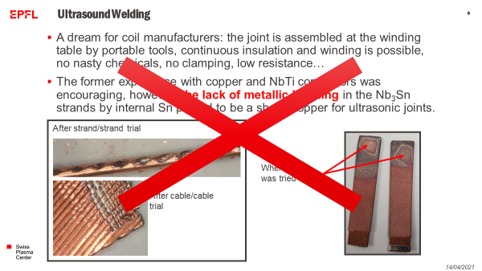

Slide 5
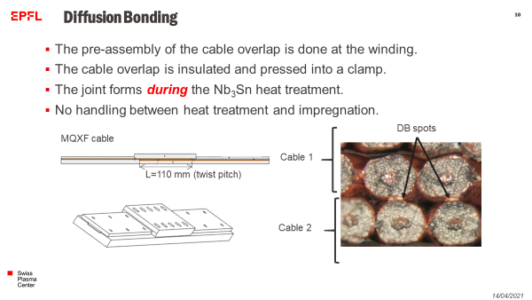

Slide 6
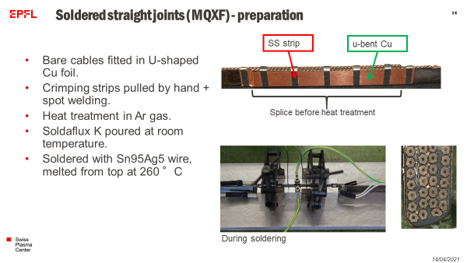
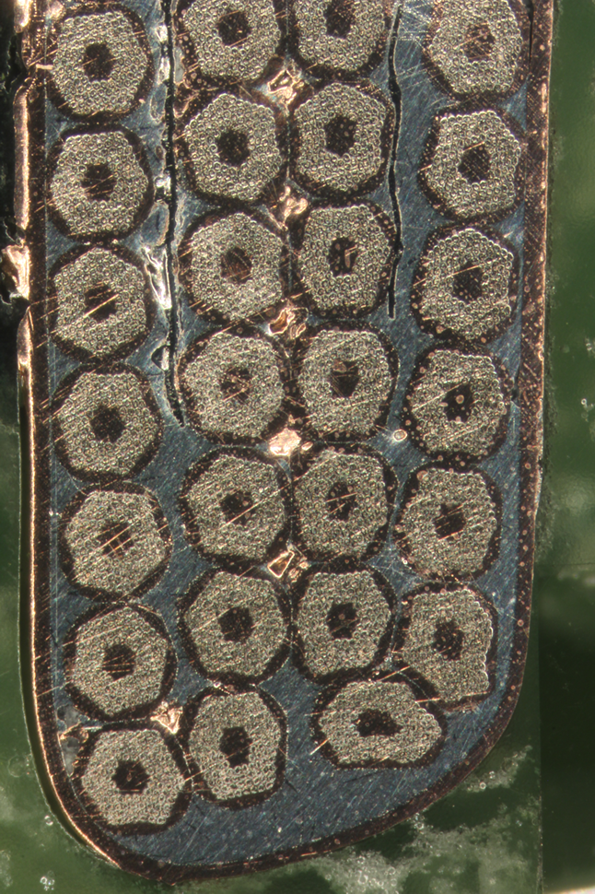

Slide 7
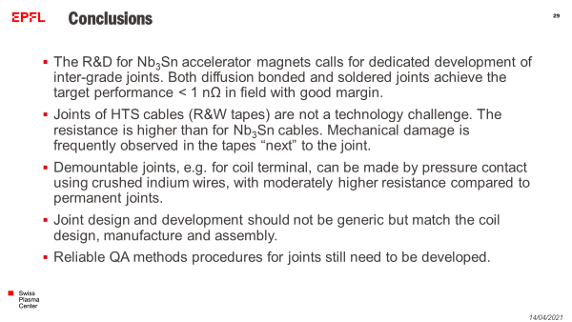
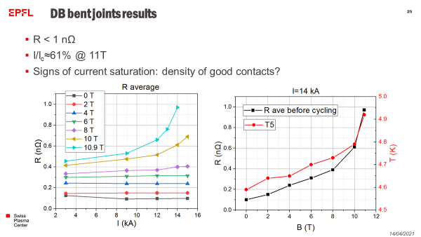

Slide 8
High Field Magnets Quench Detectino and Protection
Mariusz Wozniak

Slide 9
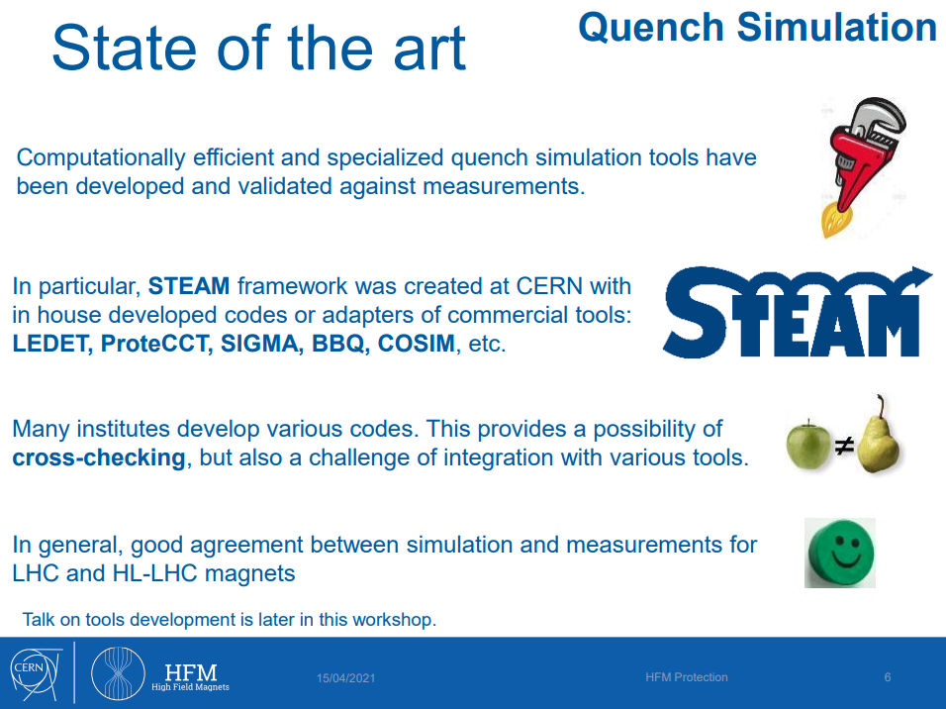

Slide 10
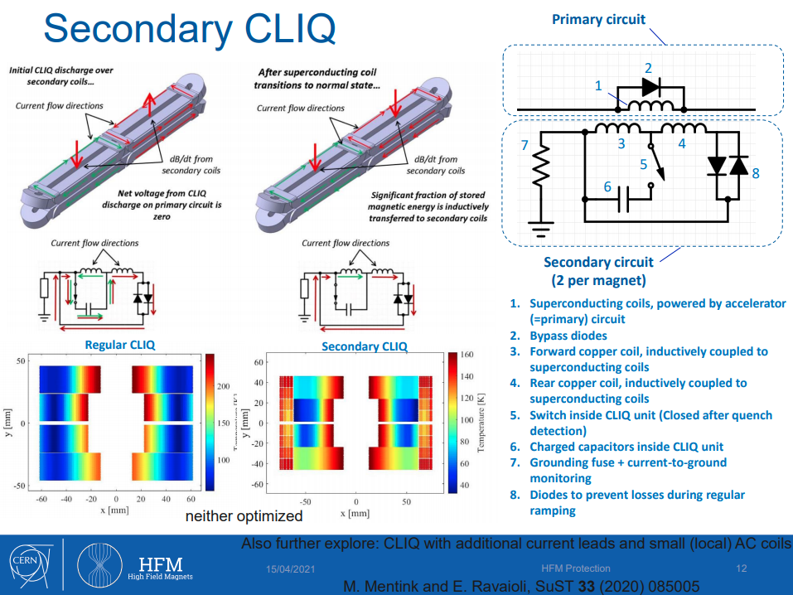

Slide 11
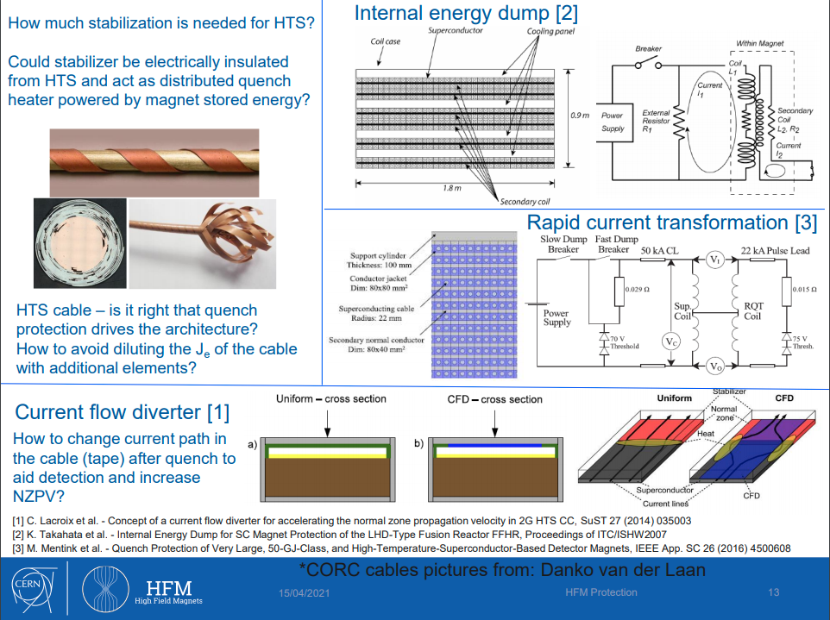

Slide 12
Advances in Imaging and Diagnostics
S. Sgobba, M. Jędrychowski, M. Crouvizier, I. Aviles, G. Arnau

Slide 13
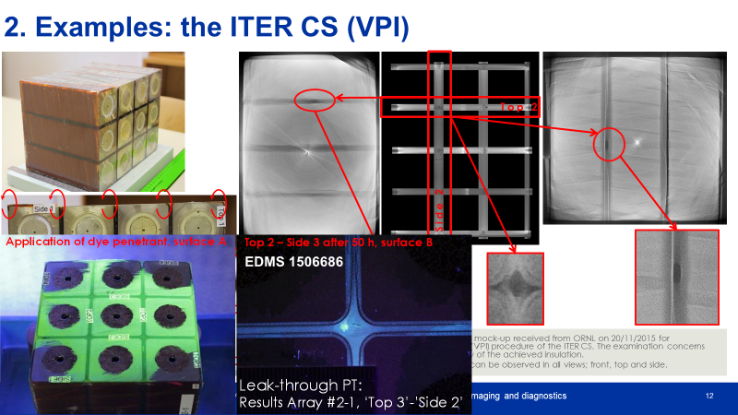

Slide 14
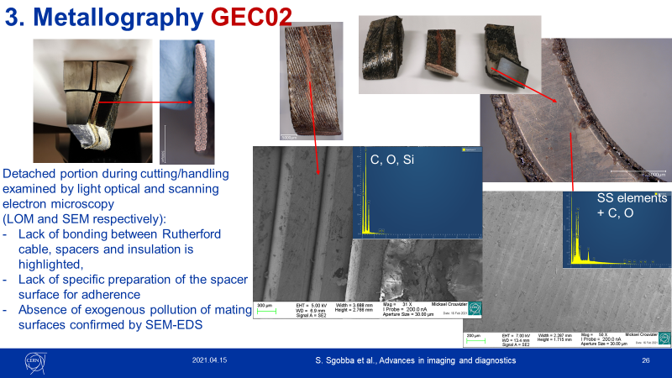

Slide 15
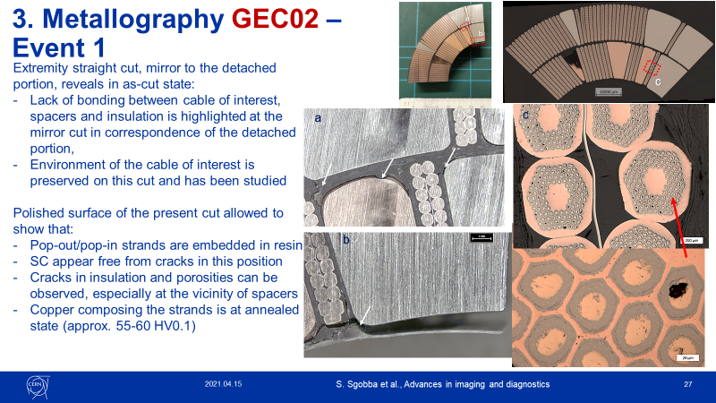

Slide 16
The Lure(?) of NI and PI Coils:
Current Status and Challenges
NI-HTS Team, S. Hahn1 and D. Larbalestier

Slide 17
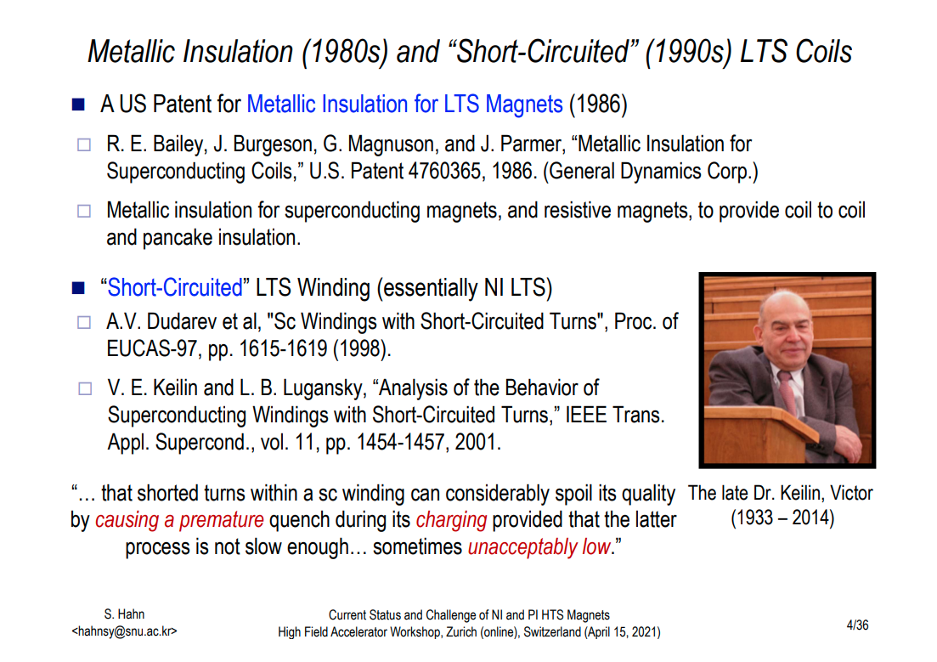

Slide 18
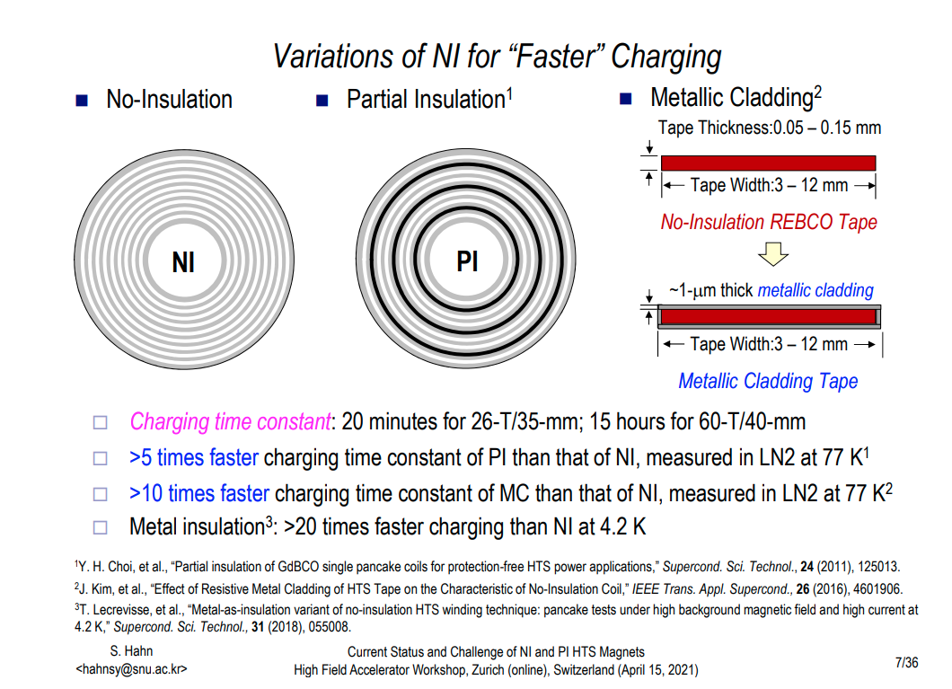

Slide 19
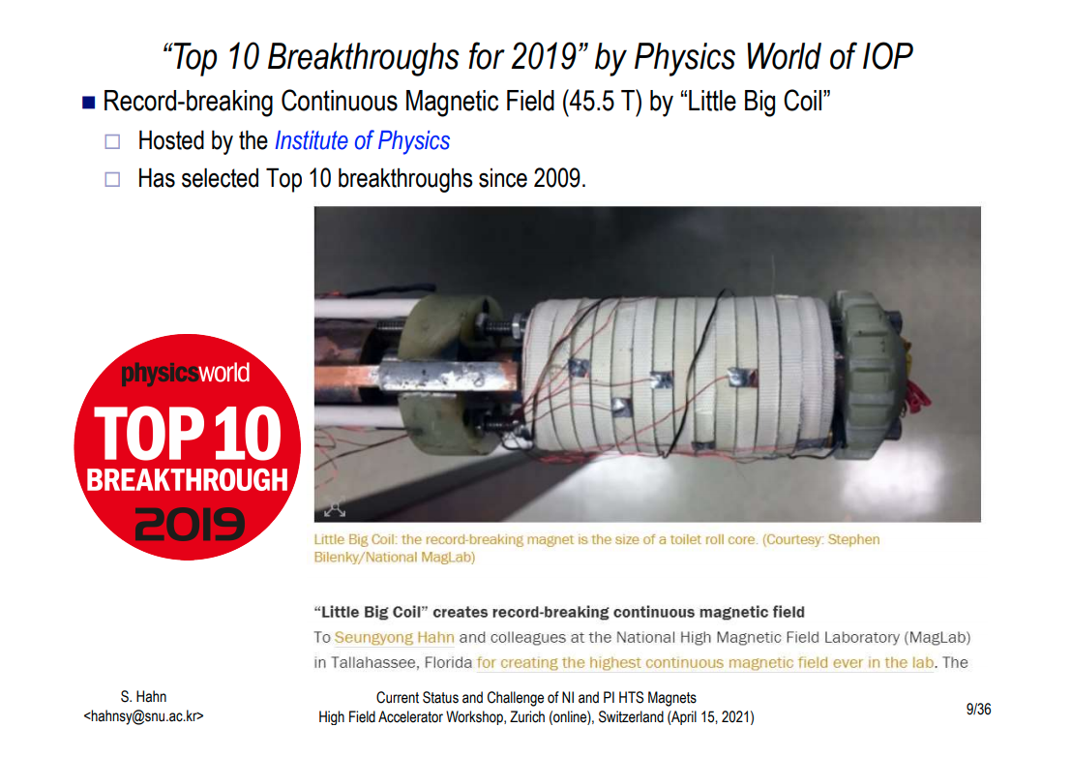

Slide 20
Nb₃Sn Conductor Characterization -a selection of critical issues -
Marc Dhalle & Herman ten Kate

Slide 21
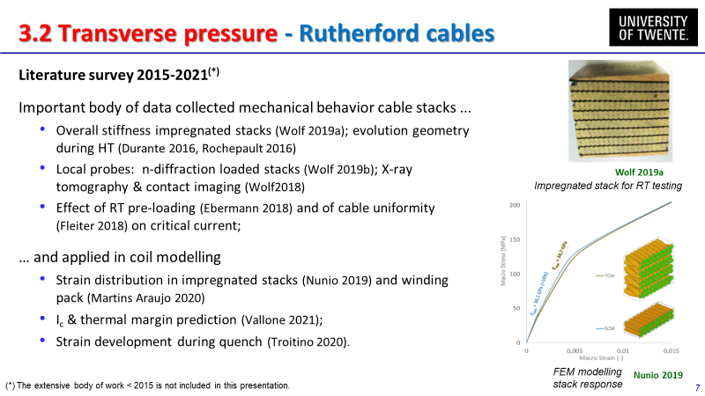

Slide 22
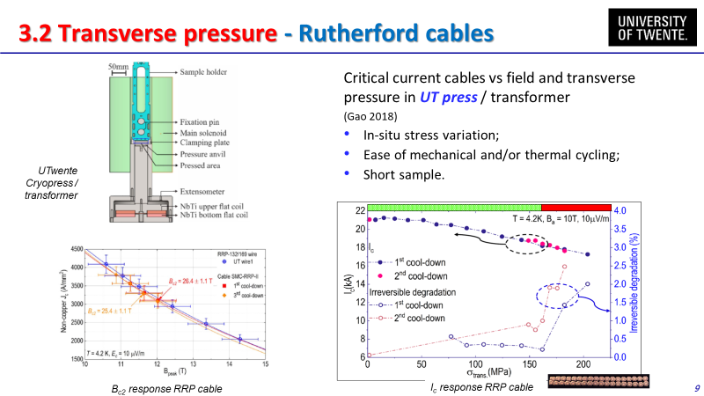
From M. Dhalle Nb3Sn Conductor Characterization- a selection of critical issues

Slide 23
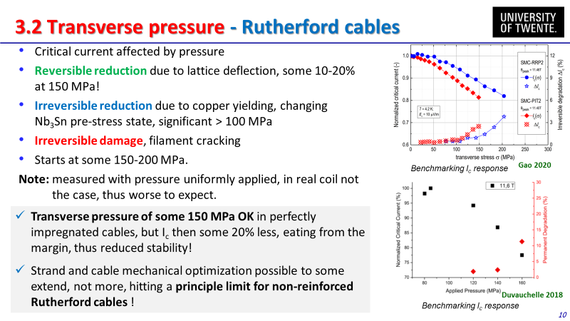
From M. Dhalle Nb3Sn Conductor Characterization- a selection of critical issues

Slide 24
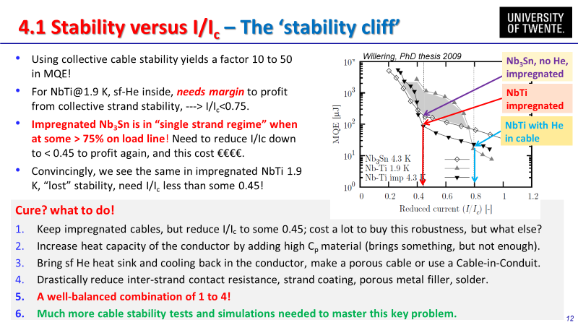
From M. Dhalle Nb3Sn Conductor Characterization- a selection of critical issues

Slide 25
Racetrack and Block Coils
Gijs de Rijk

Slide 26
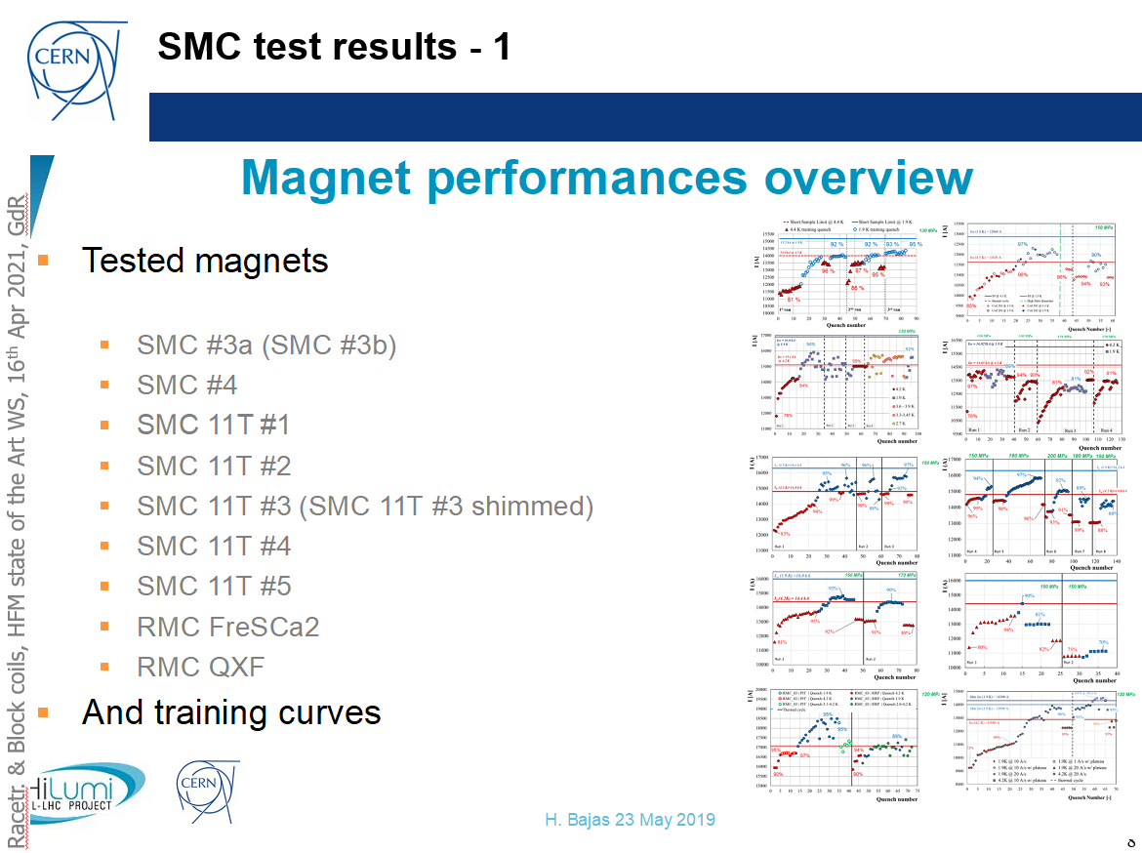

Slide 27
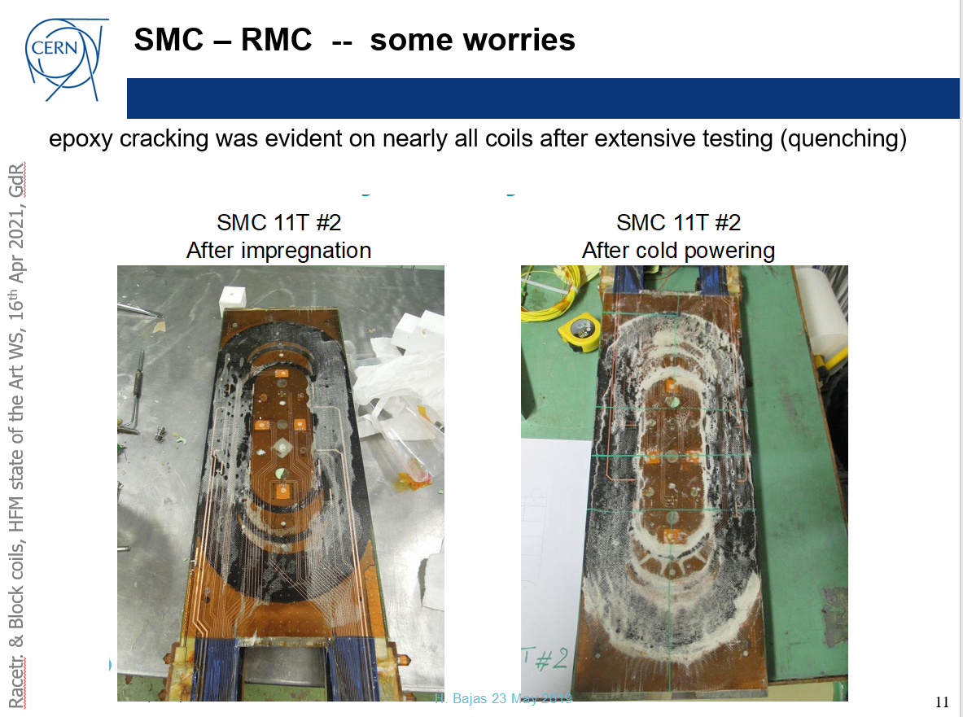

Slide 28
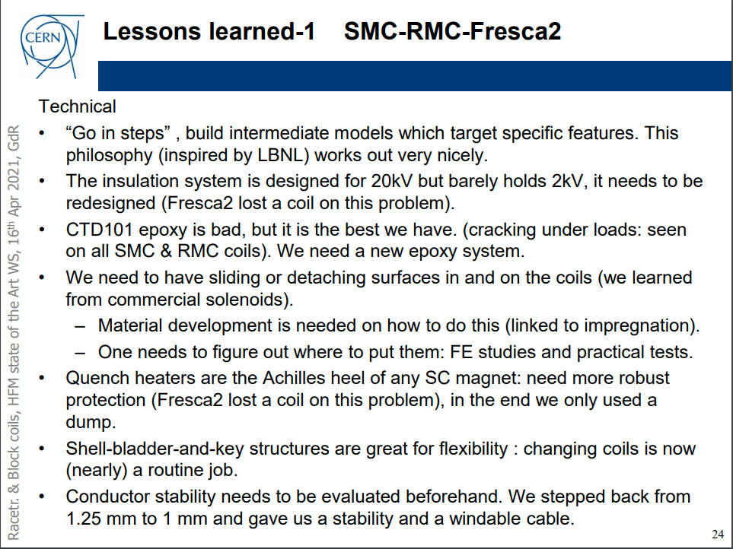
My emphasis…

