Slide 1
MDP Diagnostics
Inter Layer Quench Antennas – May 14, 2021
Reed Teyber, Maxim Marchevsky, Diego Arbelaez, Matt Reynolds, Bob Memmo

Slide 2
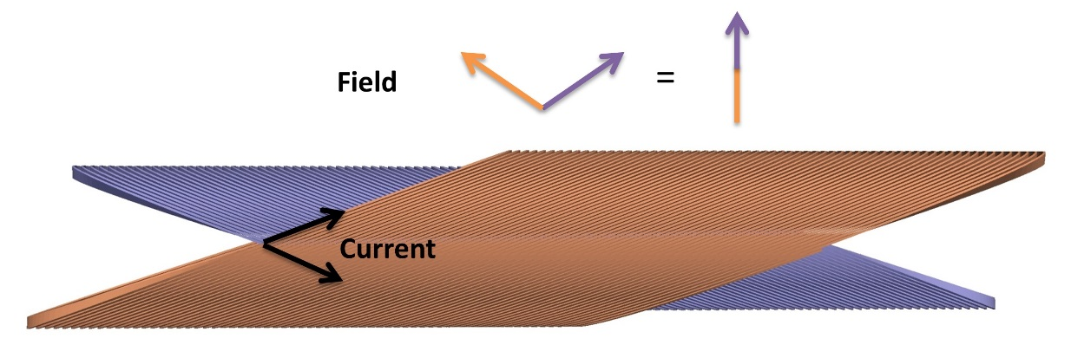
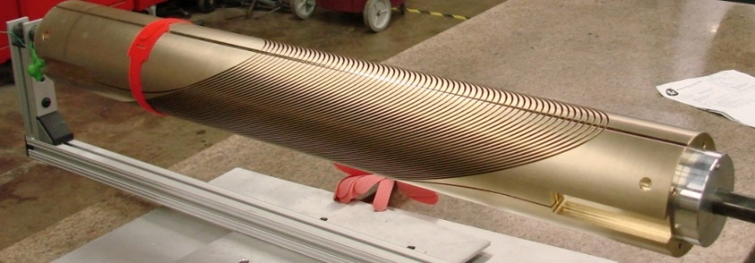
Motivation
CCT subscale program
Parametric variations in mandrel mechanics, epoxy systems
Seek to identify (azimuthal) quench locations in magnet tests
Voltage tap quench localization challenging with CCT
Inter-tap distance covers multiple turns, covering large field and stress variations
Have been developing quench antennas as one method to improve understanding of azimuthal quench locations
Supplement acoustic sensors

Slide 3
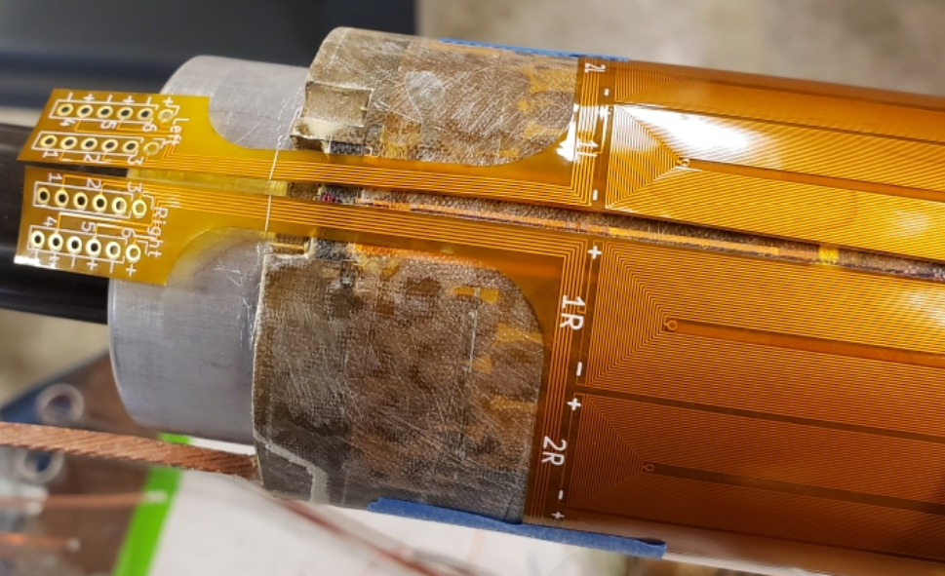
Flexible Quench Antennas
B
Flex Cut
1L
1R
Mandrels wrapped in flex PCB antenna arrays
Scripted / automated generation of antenna arrays
Low cost – two ~$60-75 sheets per magnet test
Close proximity to cable - high sensitivity
Dipole (Left-right) bucking of each coil
One sheet covers half of magnet
2L
2R
3L
3R
4L
4R
5L
5R
6L
6R

Slide 4
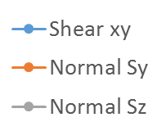
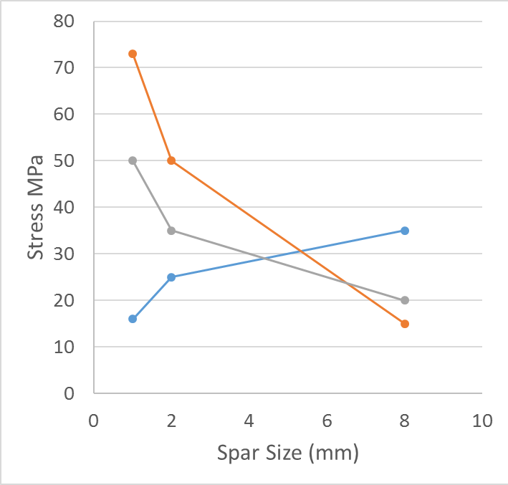
Subscale tests
Two tests have been completed
Thin spar (baseline) – higher normal stresses
Thick spar test – higher shear stresses
Where do quenches come from?
Thin spar test
Thick spar test

Slide 5
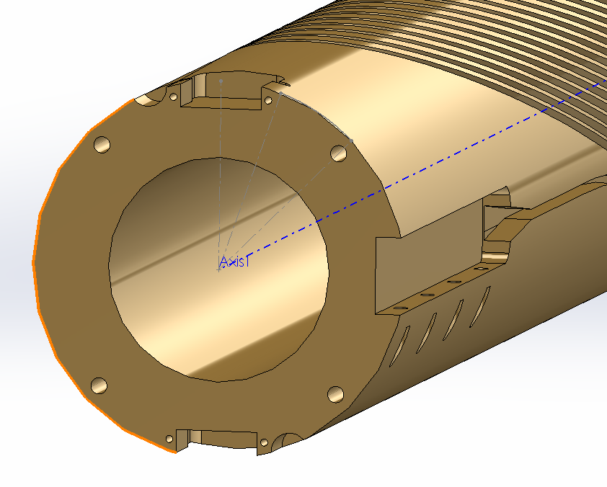
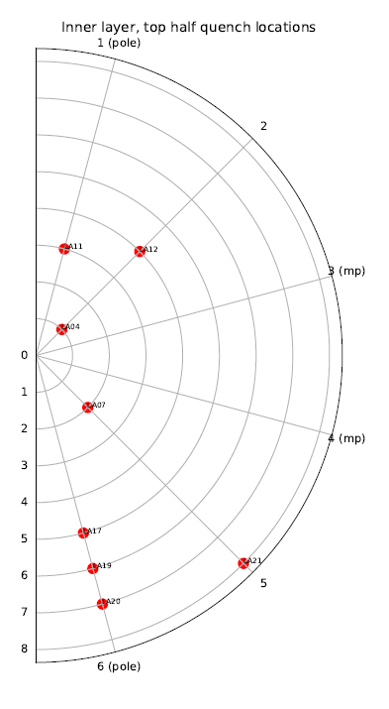
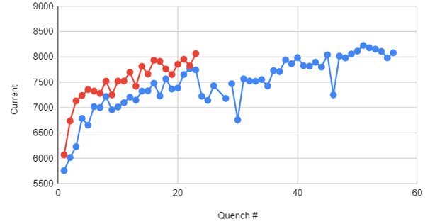
Comparison of quench locations
Thin spar (SUB2)
Thick spar (SUB3)
Left: thin spar (S2), full magnet (inner layer = red)
Right: thick spar (S3), lead half of magnet, inner layer only
Lack of midplane quenches in thick spar!
Thick spar
Thin spar

Slide 6
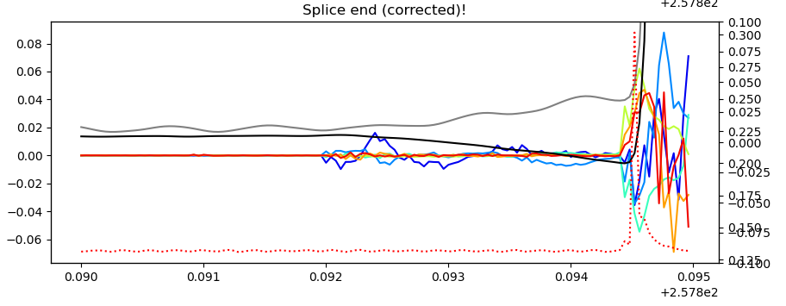
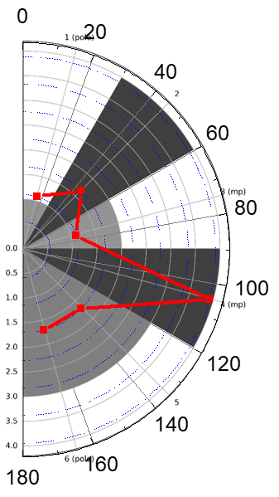
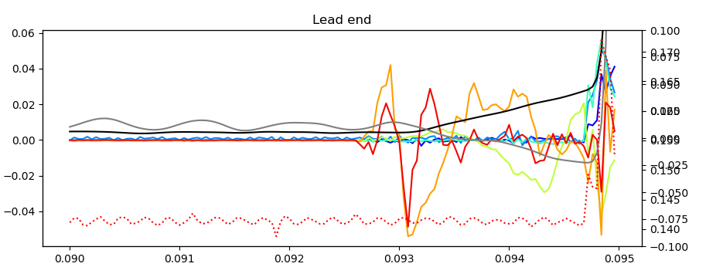
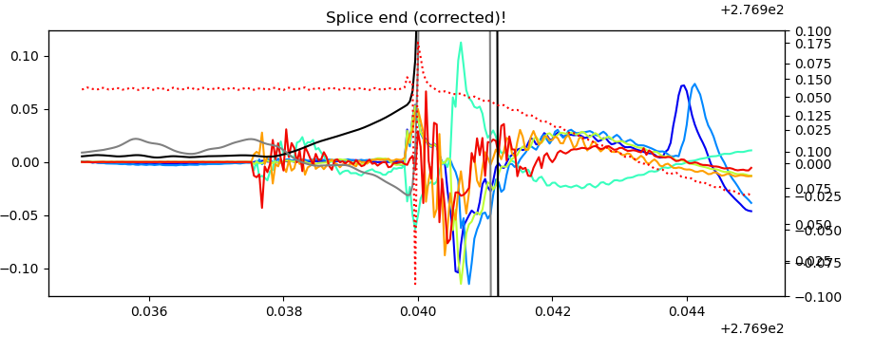
Quench Antenna Confidence
Thick spar quenches
Thin spar: comparison of inter-layer and in-bore quench antenna for thin spar

Slide 7
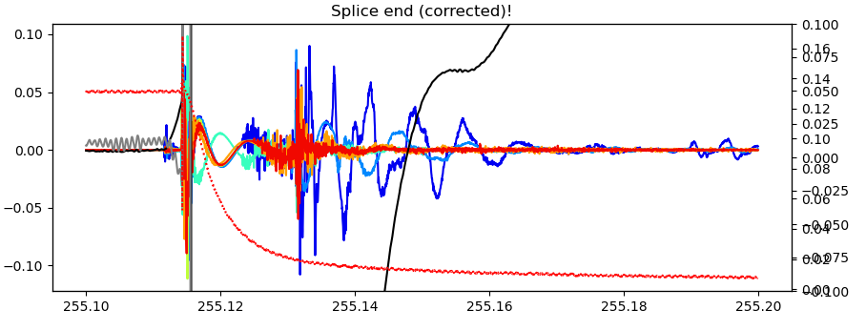
Activity clearing – thick spar
In addition to quench locations, see lots of interesting behavior with quench antennas
Sawtooth ramp profile (below)
Disturbances “reset” below some current (no Kaiser effect)
Similar activity observed as noise onset at low current during extraction (right)

Slide 8
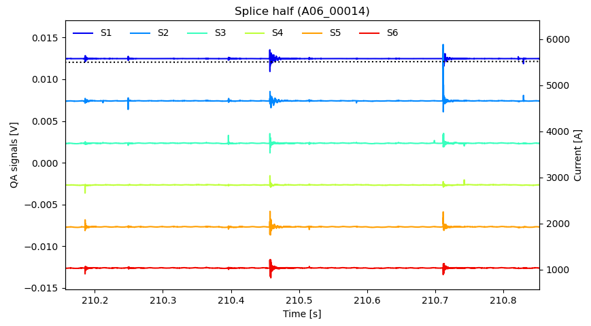
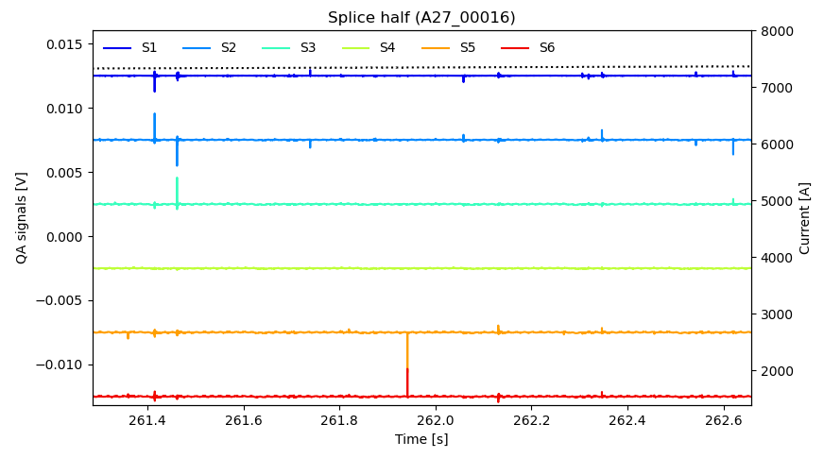
Ramps – Thin spar
Data recorded continuously throughout ramps
Thin spar – 10 kHz recording, thick spar – 25 kHz recording, would benefit from faster DAQ
Close proximity to cable – sensitive to spectrum of activity
Thin spar current ramp
(Left) Early in training, signals ringing down across channels
(Right) Later in training, signal pairs move in coordinated direction
Virgin ramp (Q1)
Later ramp (Q22)

Slide 9
Outlook
Antennas have provided a lot of value with relatively low cost & effort
Can be challenging to derive absolute understanding, but great for comparing changes between similar tests (CCT subscale program)
Today’s talk has been on inter-layer flex antennas, however also exploring R&D on other antennas
See Maxim’s “MDP Collaboration meeting” presentation – promising data from in-bore antenna!
Moving forward, need to derive more understanding from measurements via basic modeling
What types of current redistribution / motion could cause what types of signals?

