Slide 1
MDP Collaboration Meeting
20 T hybrid magnet and comparative analysis
P. Ferracin
US Magnet Development Program

Slide 2
Action items
MDP path to 20 T hybrid
  Bi2212
    LBNL
      Bin5 in CCT5
      BiCCT1 in CCT6
    FNAL
      Bi SMCT in 11T
      Bi SMCT in 15T
  REBCO
    LBNL
      CORC
    FNAL
      COMB
    BNL
      Racetrack

Slide 3
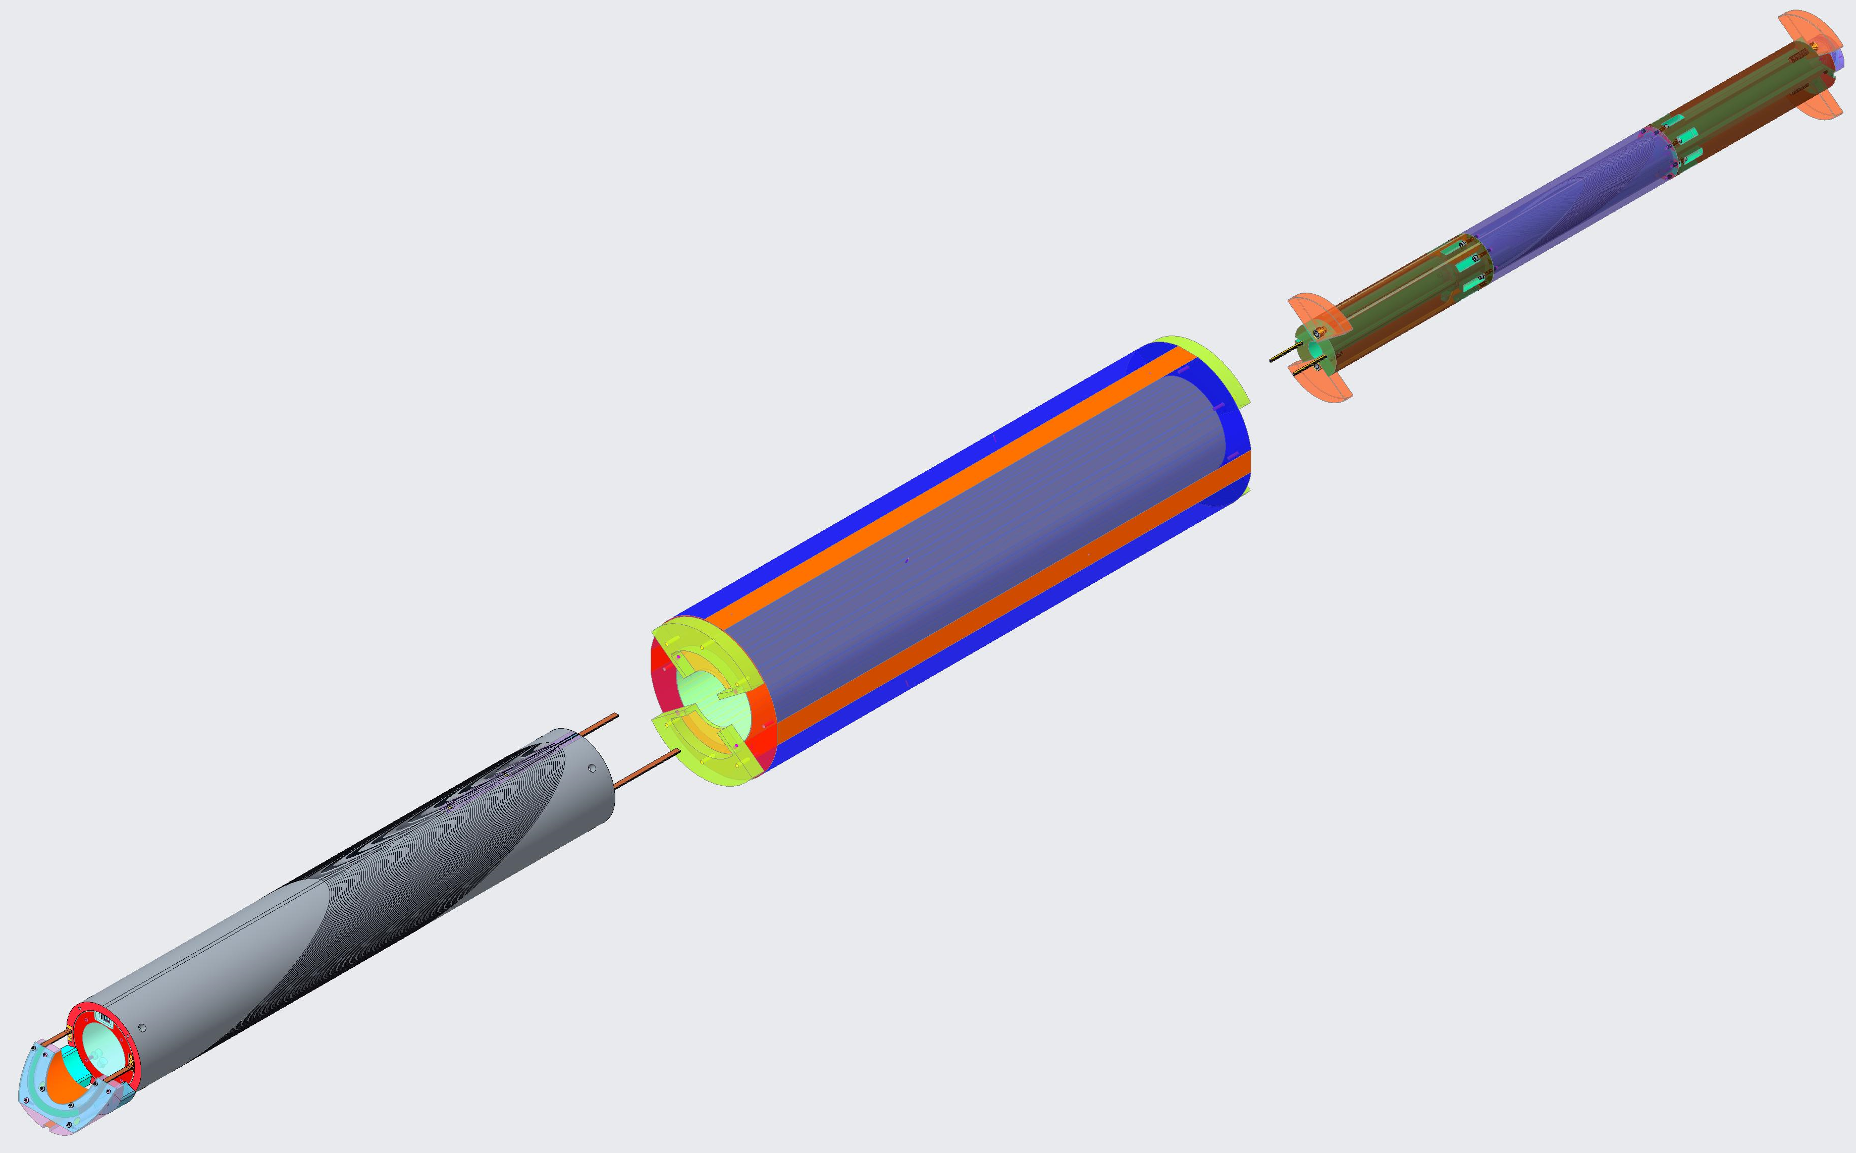
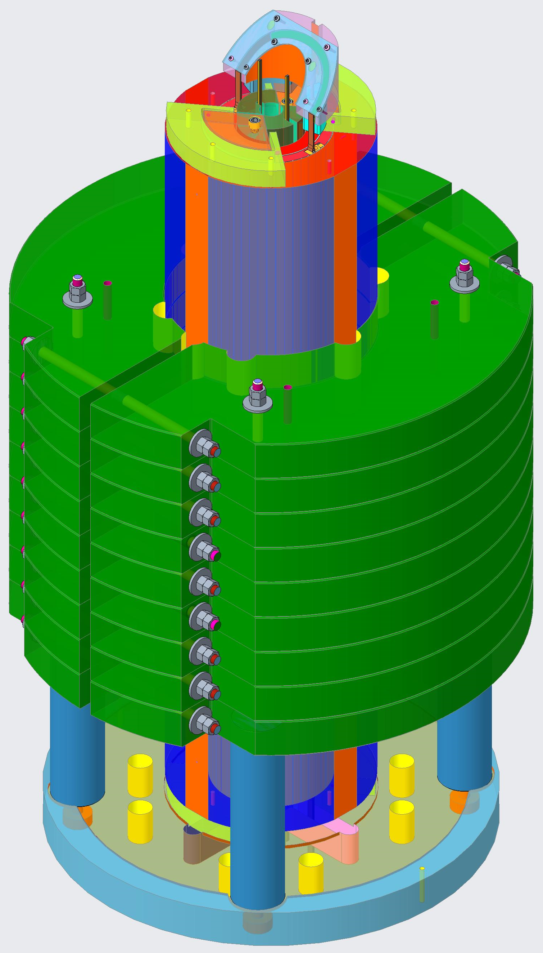
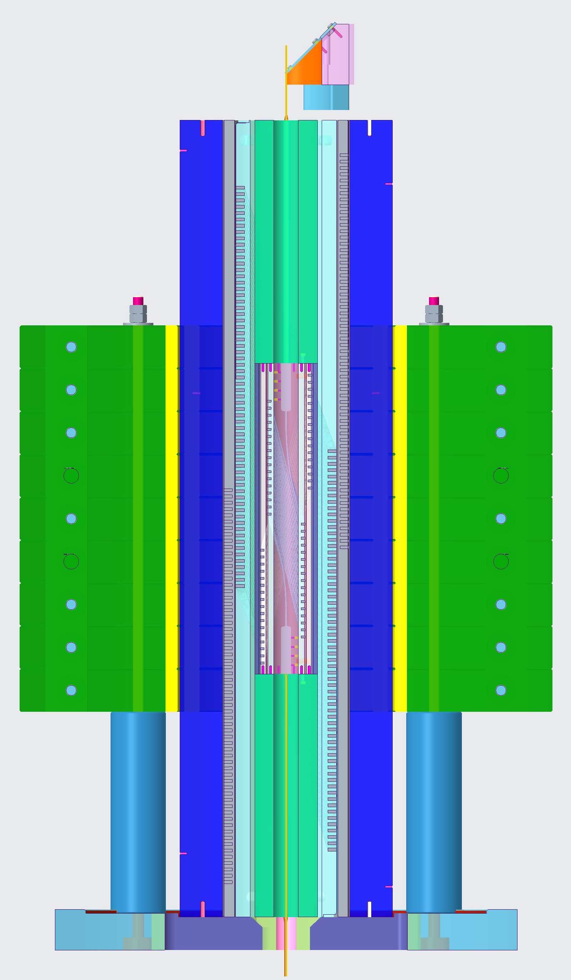
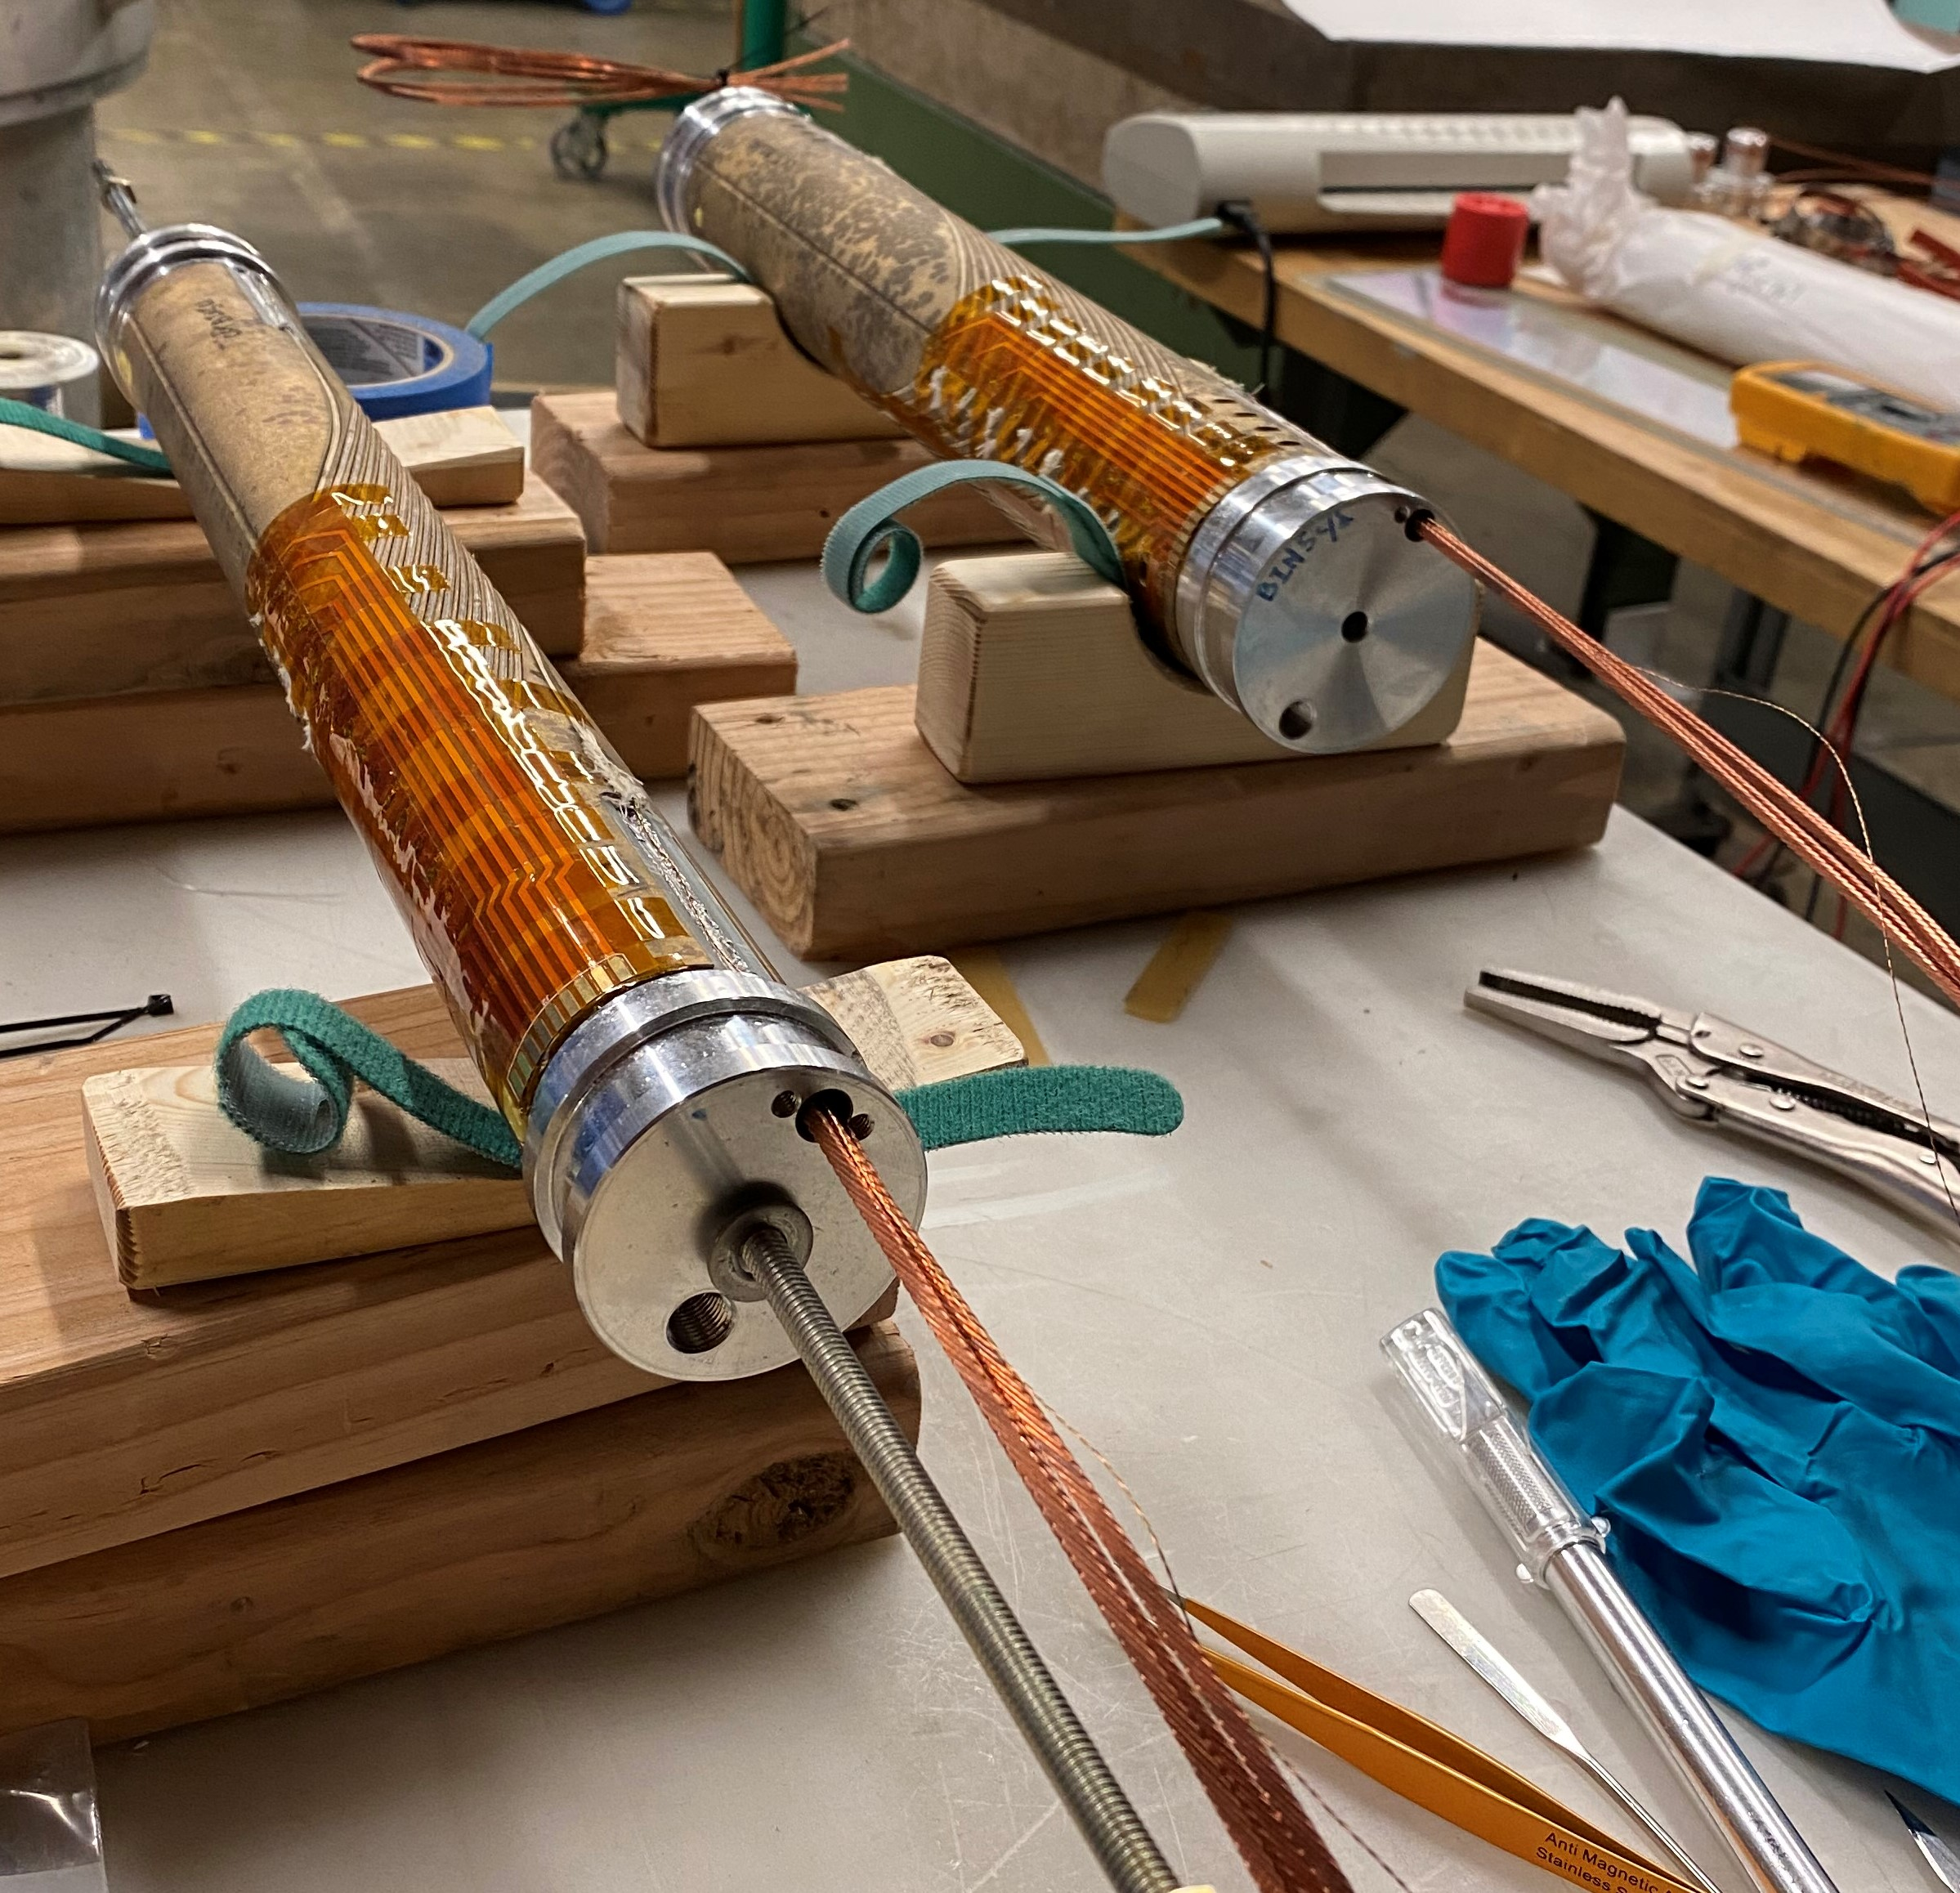
Bin5 in CCT5
Bin5: 1-2 T
CCT 5: 8-9 T
Bmax: 9-10 T
Aperture 30 mm

Slide 4
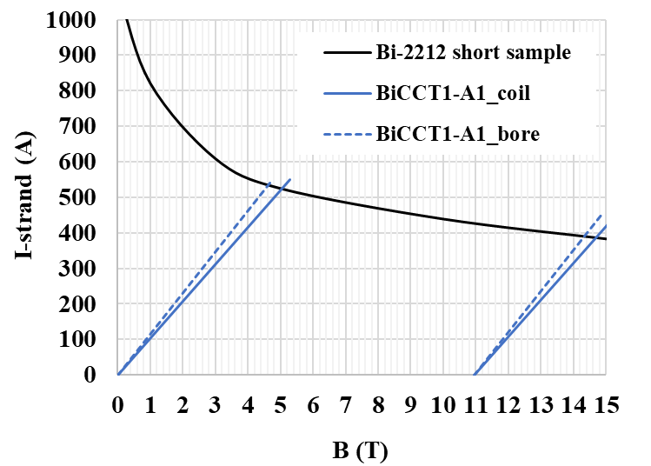
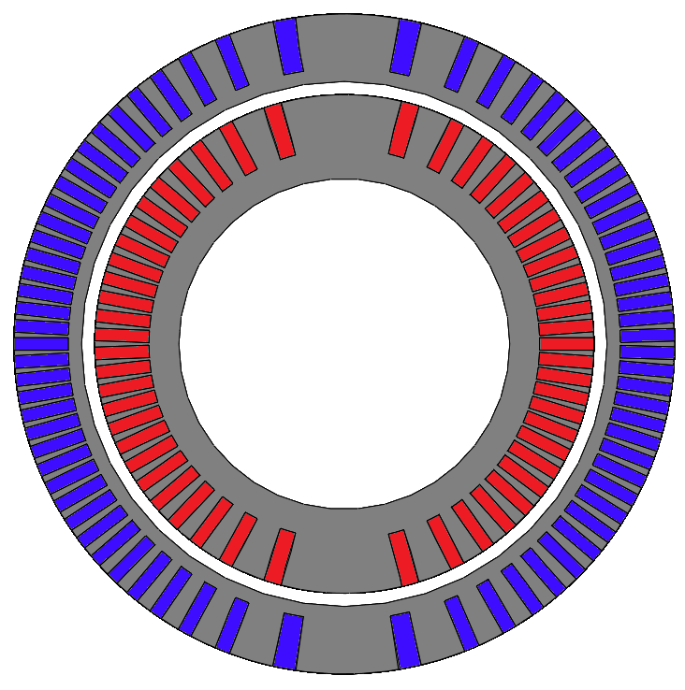
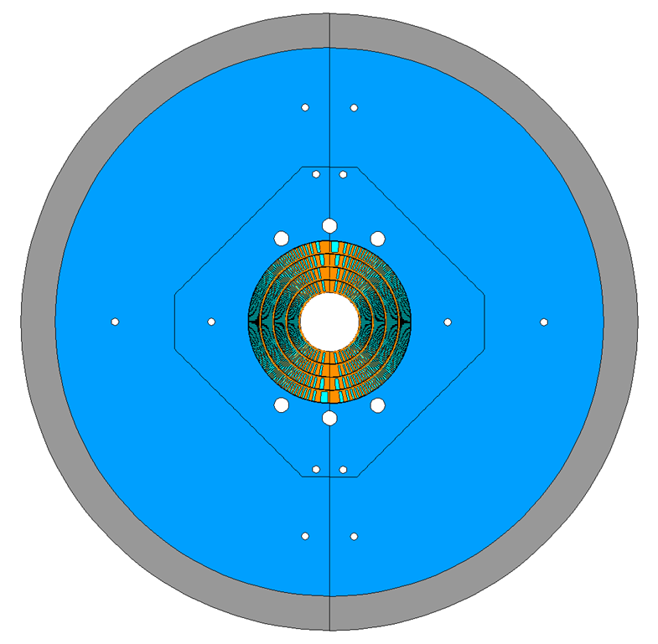
BiCCT1 in CCT6
BiCCT1: 5 T
CCT6: 12 T
Bmax: 14-15 T
Aperture 50 mm

Slide 5
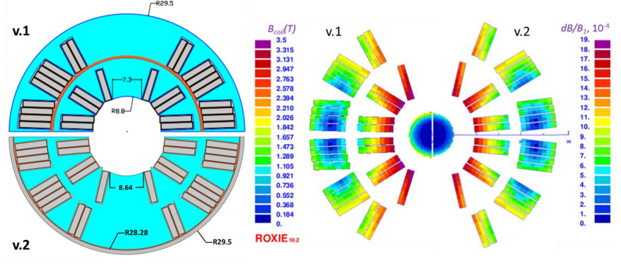
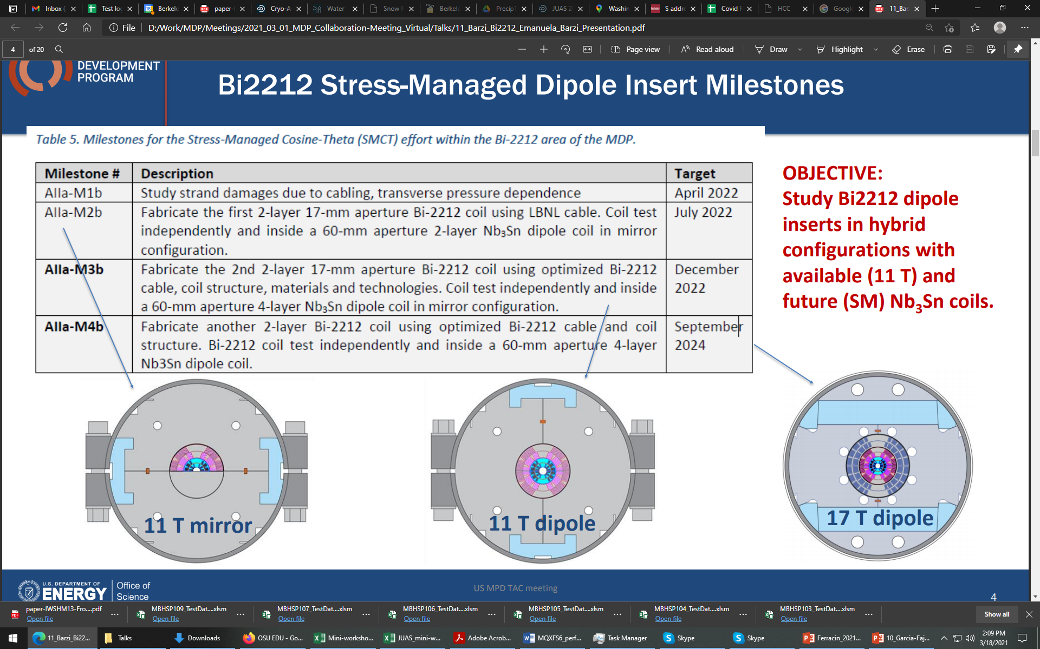
Bi SMCT in 11T
Bi SMCT: 4-5 T
11 T Nb3Sn coils
Bmax: 12 T
Aperture: 19 mm

Slide 6
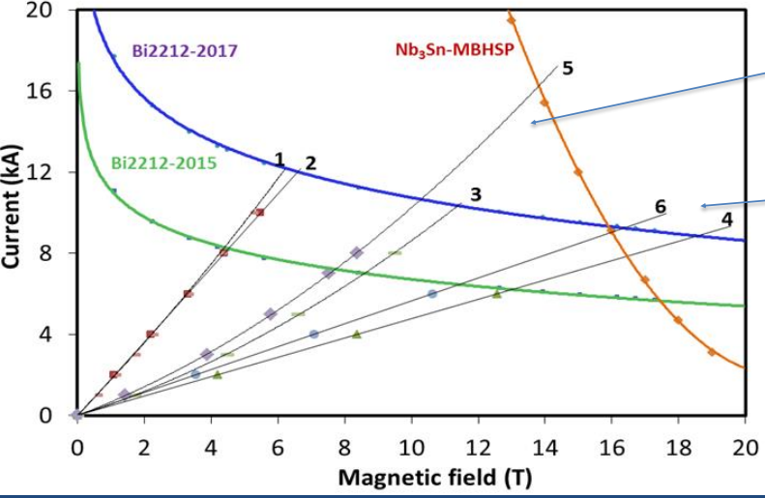
Bi SMCT in 15T
Bi SMCT: 4-5 T
14-15 T Nb3Sn coils (CT and SMCT)
Bmax: ~17 T
Aperture: 19 mm

Slide 7
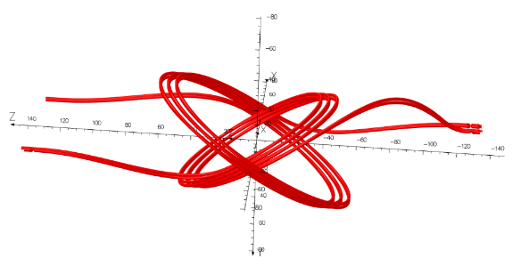
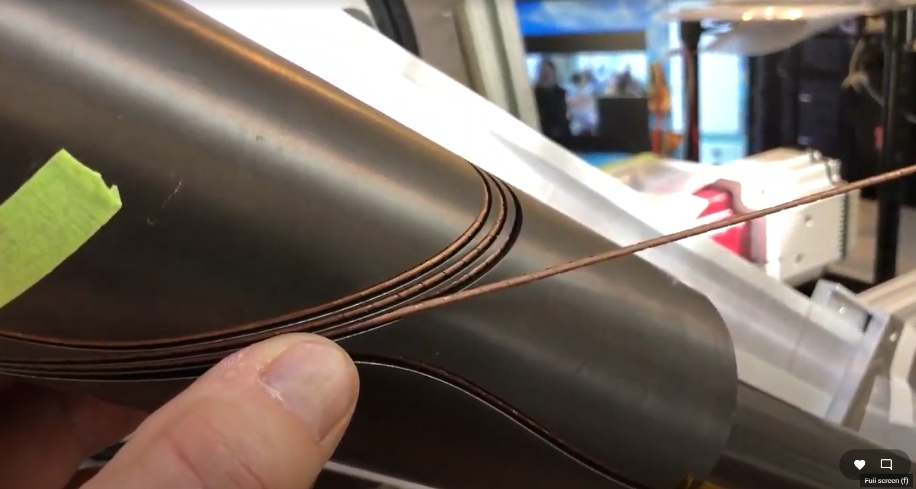
S0 (2 wires in 1 groove) in CCT5
S0: 1T (ID: 50 mm, OD: 77 mm)
CCT 5: 8-9 T
Bmax: 9-10 T
Aperture 50 mm
Next possible step for “S” series
  Insert of S1 for CC5 two layer 2-3 T
  Insert of CCT6: S2 5 T

Slide 8
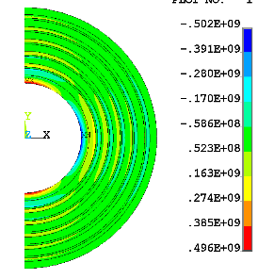
C3 and CCT5
C3: 5 T, 6 layers
  ID layer 1 65
  OD layer 2 99
  OD layer 4 127
  OD layer 6 156
CCT 5: 8-9 T
In CC5 5 only layer 1
In CCt6 layer 1-2 (1 T)

Slide 9
C3 and CCT6
C3: 5 T, 6 layers
  ID layer 1 65
  OD layer 2 99
  OD layer 4 127
  OD layer 6 156
CCT6: 12 T
In CCt6 layer 1-2 (1 T)
Bmax: ~13 T
Aperture 65 mm

Slide 10
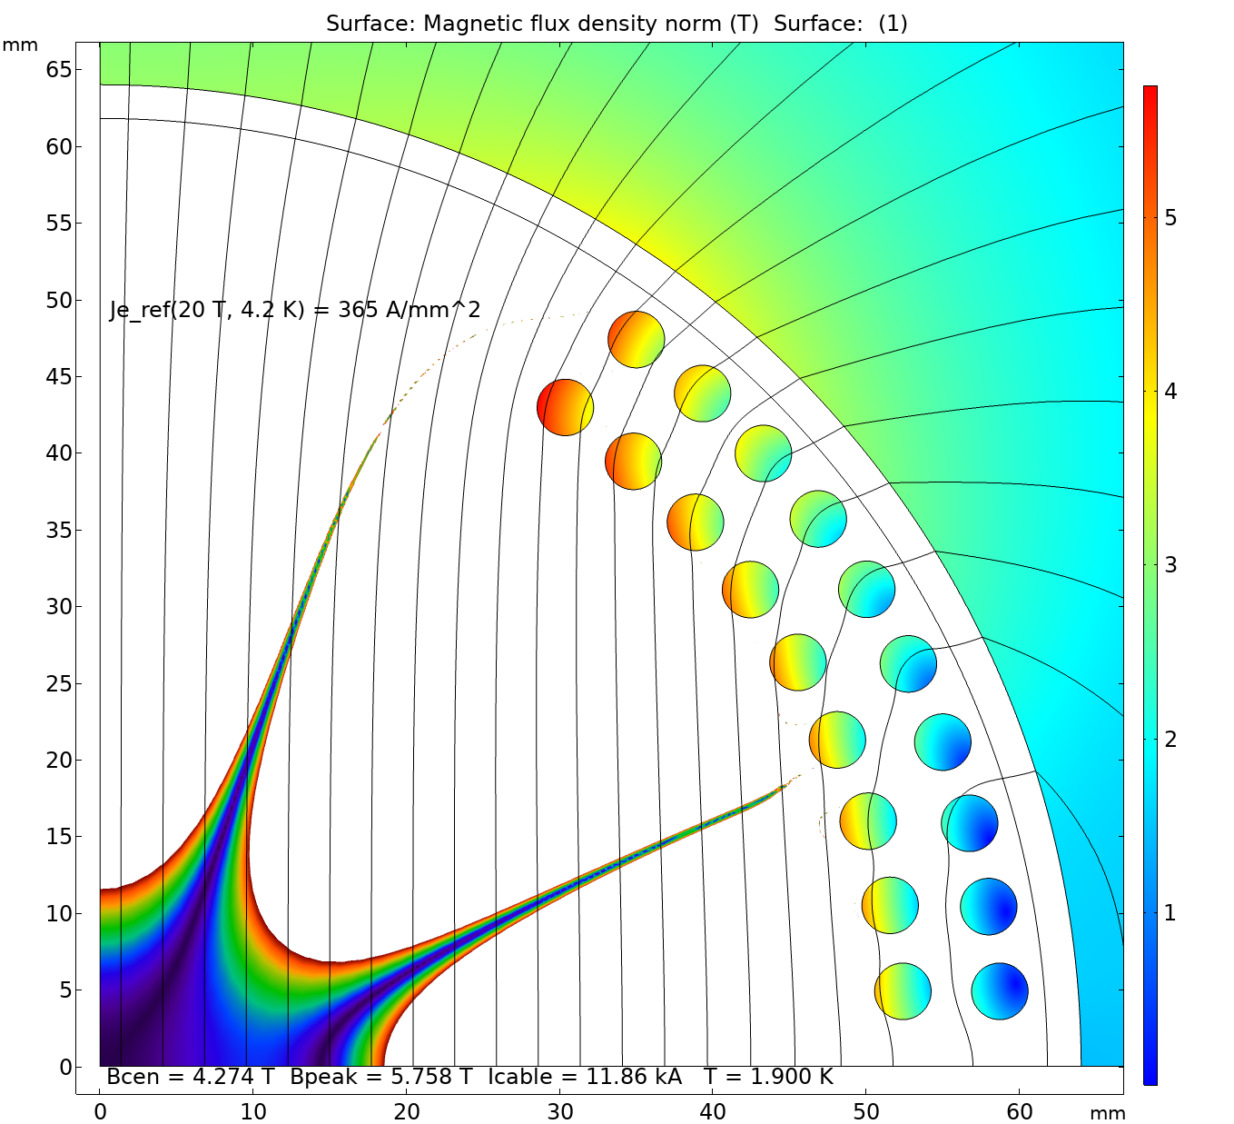
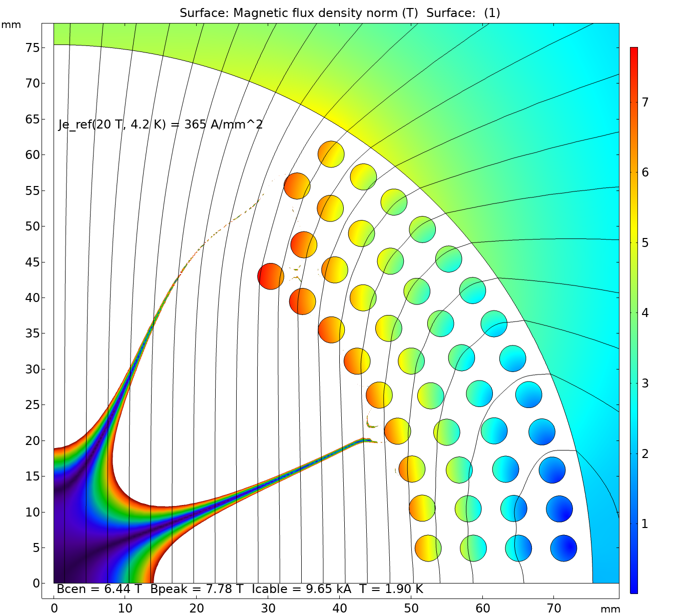
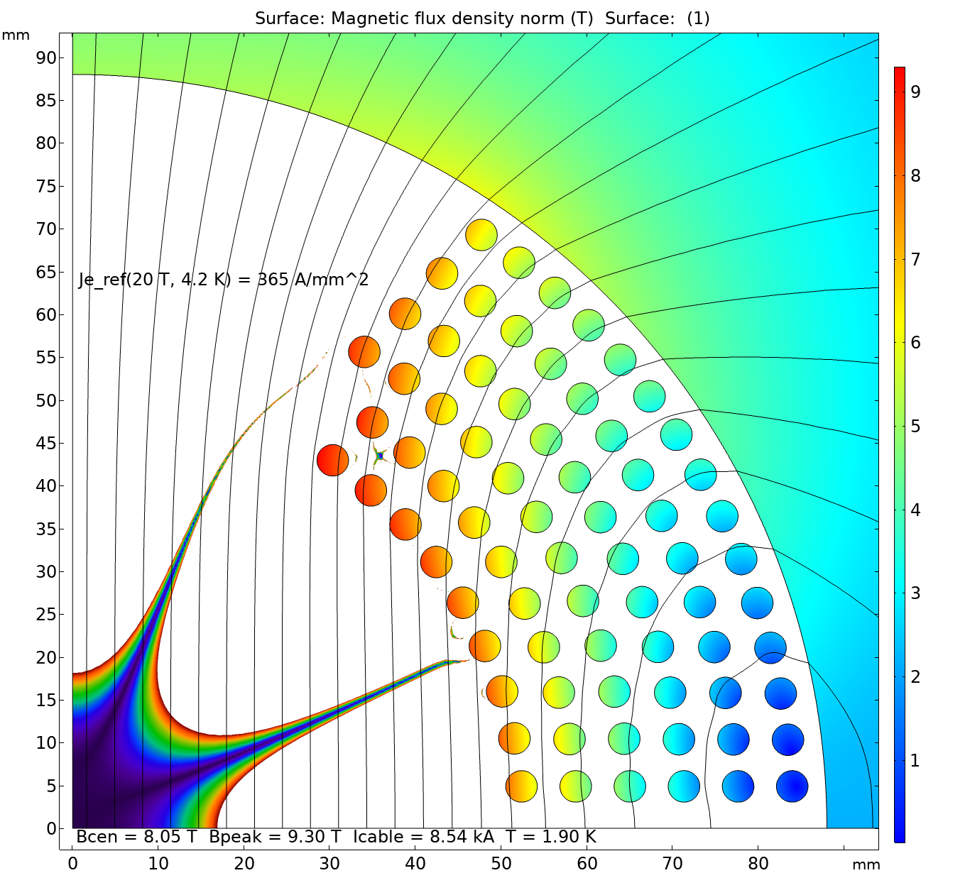
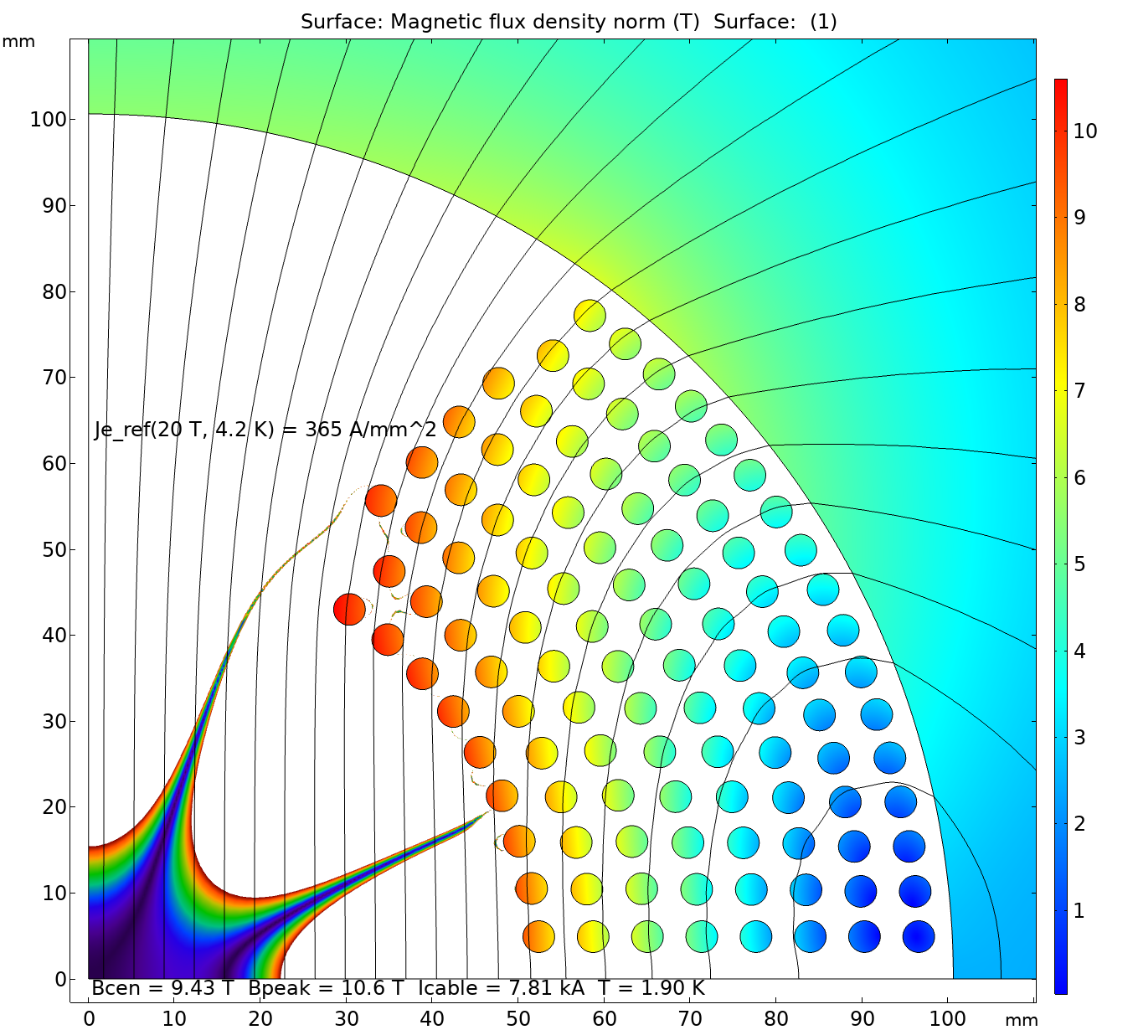
Design scalability – 2-8 layers
Due to the strain limitations, the additional layers can only be added from outside:
  When a more flexible REBCO cable becomes available, the internal space down to 50 mm ID can also be explored;
  The rule of thumb: minimum pole width is ~1/2 of the coil ID.
The double-layer half-coils can be nested one on top of the other and powered independently or in series:
  The prestress is controlled by means of midplane and inter-layer shims.
Grading can be done by reducing the number of tapes per cable:
  Has a minor effect on the cable OD (and the number of turns);
  Main purpose is to save on the conductor costs, rather than to boost the field.

Slide 11
Magnet parameter space – standalone
The studies are done with 100 mm coil ID.
However, since the dipole field is proportional to J_{e} times the coil thickness, the results (i.e. bore field vs the number of layers for a given J_{e}) are independent on the coil ID.
Includes the iron yoke of a “sufficient” thickness.
Presently available
conductors

Slide 12
Magnet parameter space – boost field in 15 T background
Desired J_{e} range for a 5 T insert
Without the iron yoke, since it is far from the HTS insert and is already saturated by the LTS coil field.

Slide 13
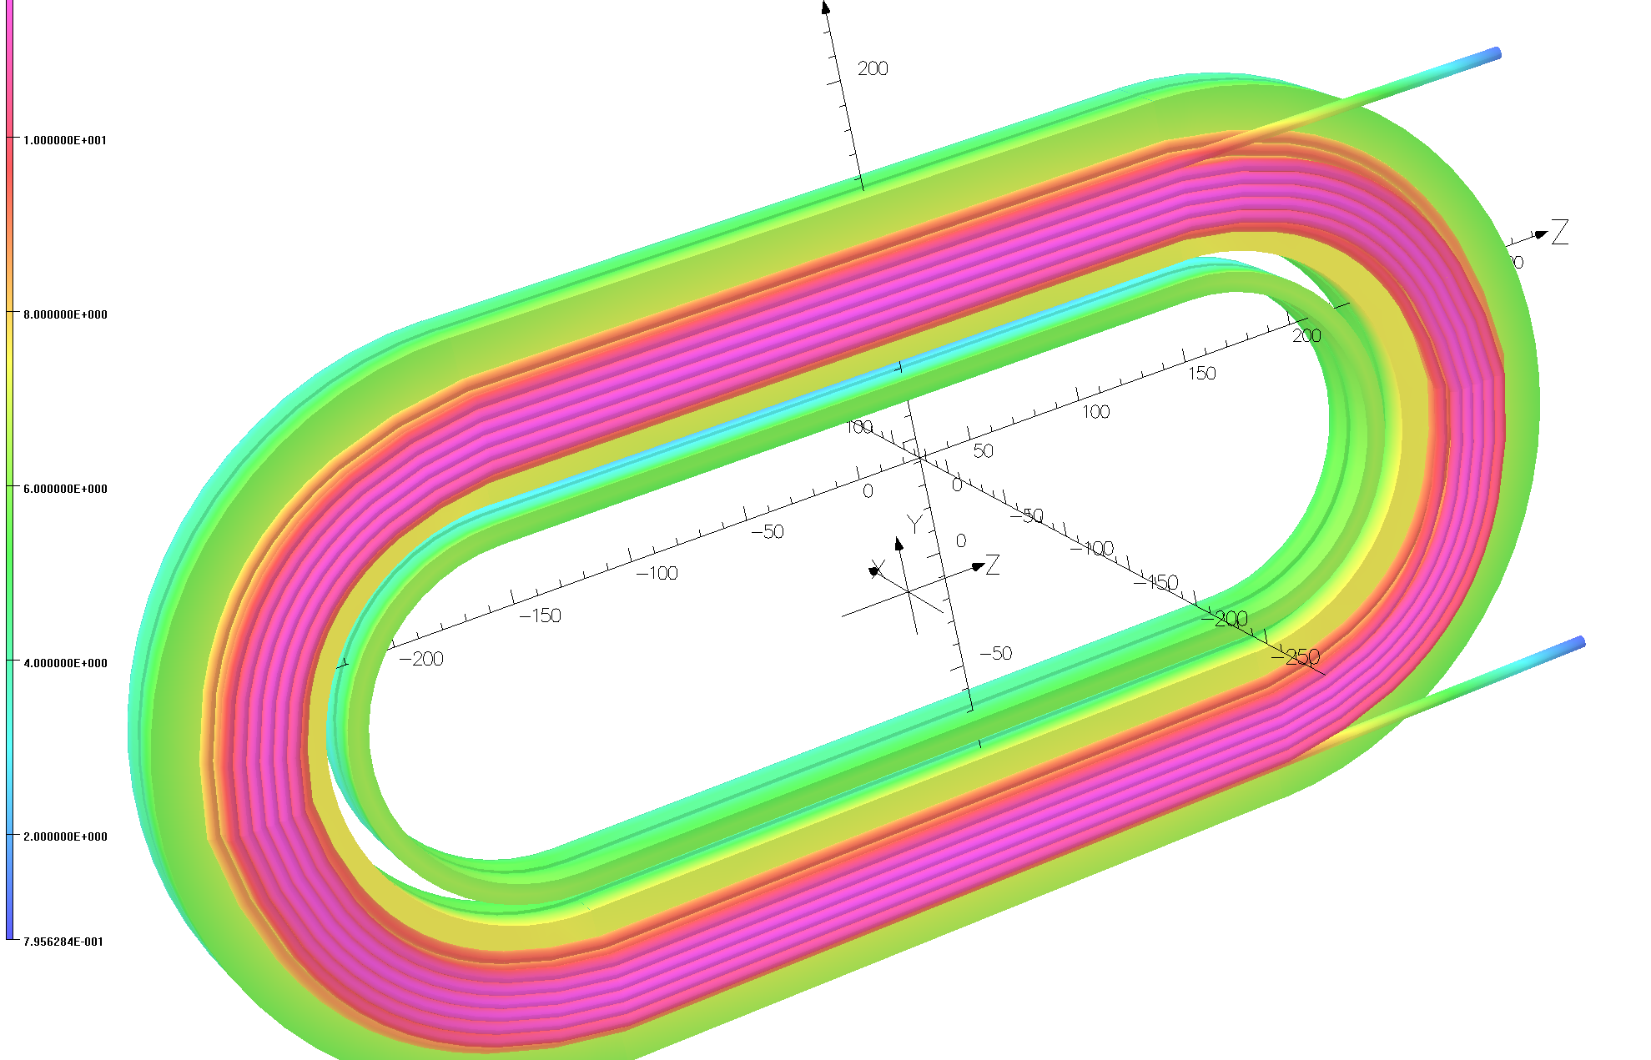
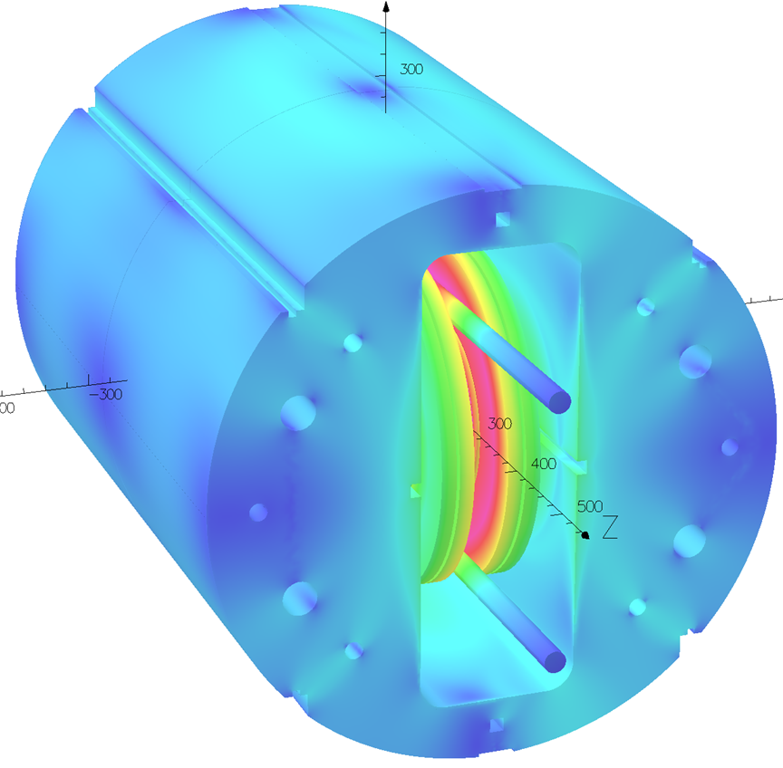
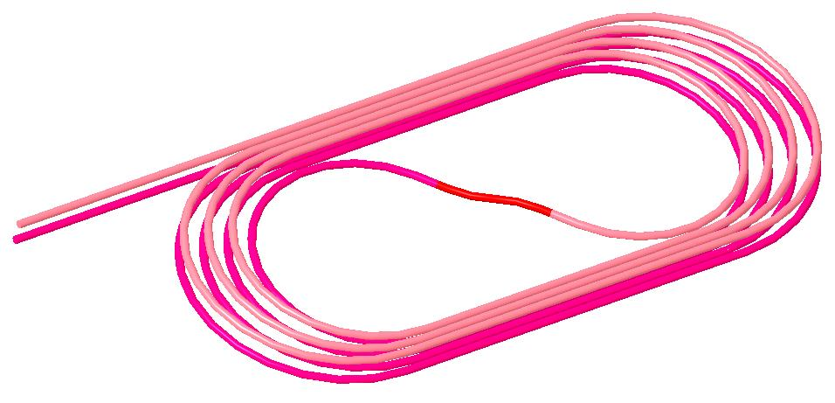
CORC Coil Programs with the Common Coil Dipole
STTR Coils two sets:
Each with 6 and 8 turns
STTR: High field Demo
MDP: Quench studies and technology demo
MDP Coil
4+4 turns
with an S-turn

Slide 14
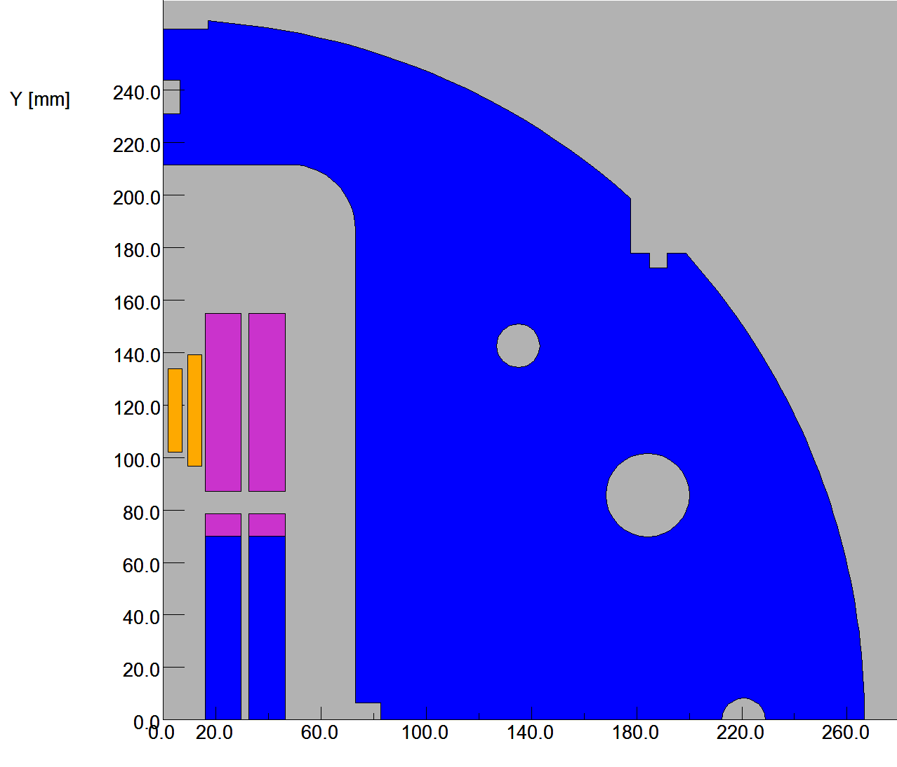
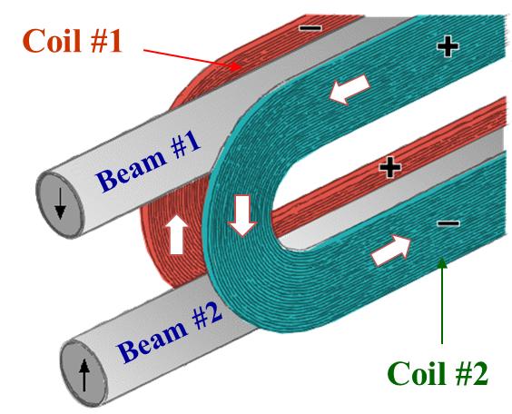
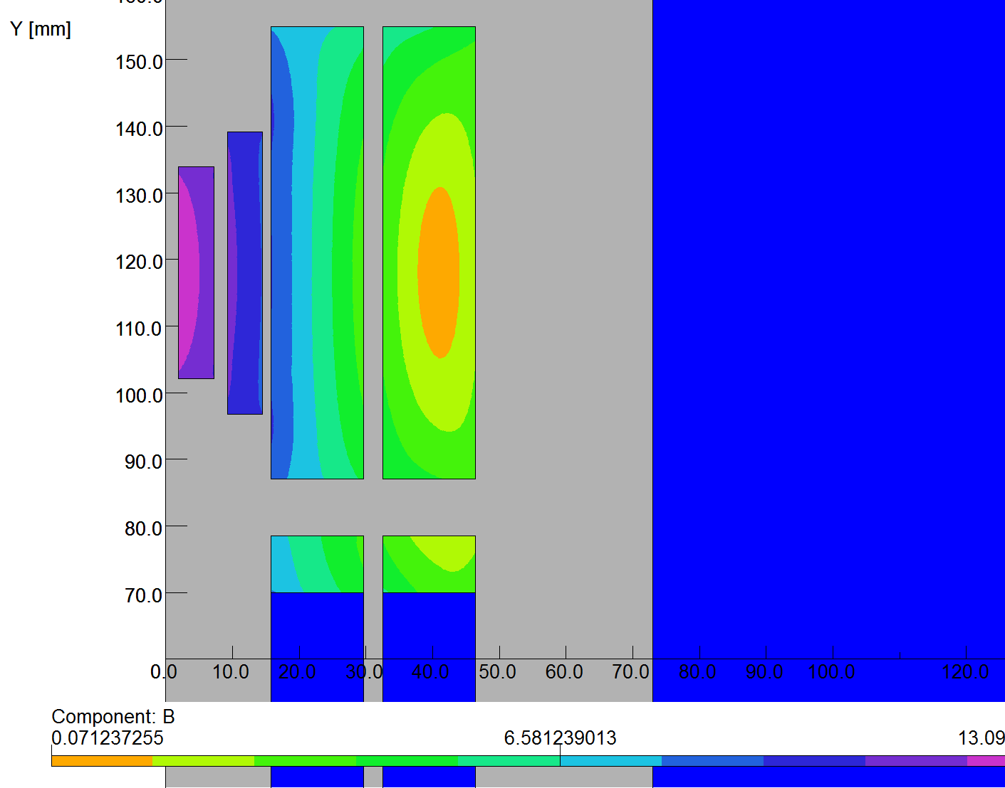
CORC Coil based HTS/LTS Hybrid Dipole STTR
High current CORC coils in series with the Nb₃Sn coils
Desired for quench protection
Large radii of common coil allows high J_{e} CORC cables
CORC coils:
  6 and 8 turns, running
  in series with Nb₃Sn coils
Hybrid field: 13.1 T @10 kA
: 14.4 T @11 kA
  (peak field in Nb₃Sn coils reduced by CORC coils)
2-d model
Nb₃Sn Coils
CORC Coils

