Slide 1
Update on Costheta cross section
V. Marinozzi
04/20/2021

Slide 2
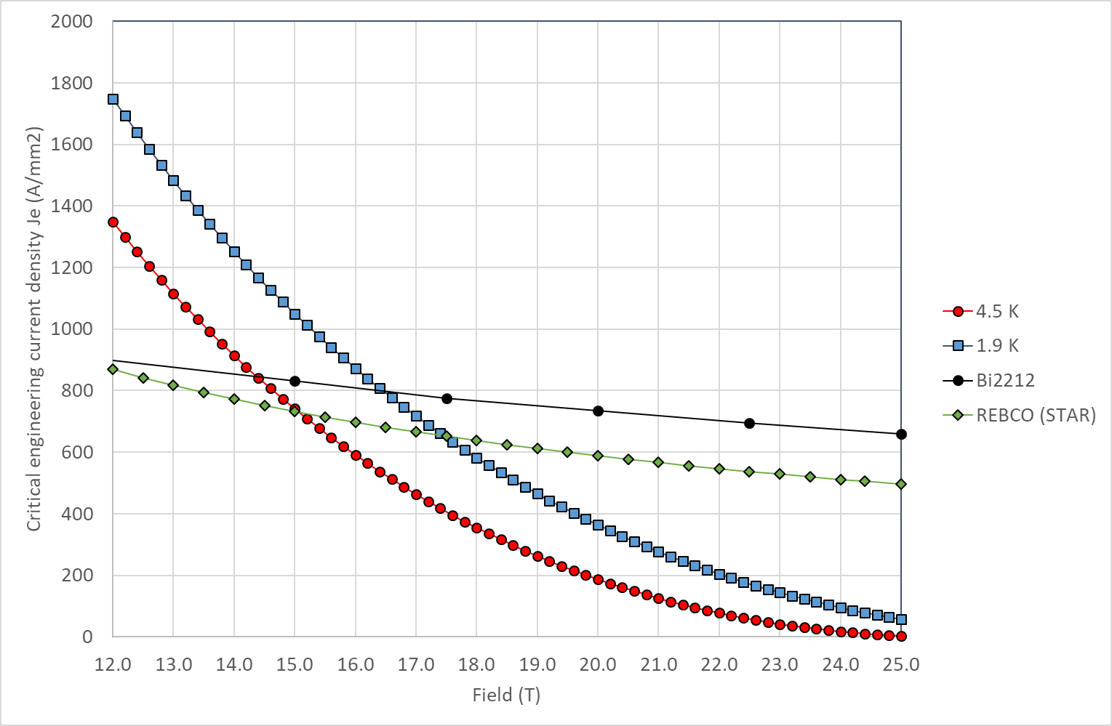
Critical current
Still using linear approximation in the peak field zone
Jc in SC obtained by scaling Jc engineering from Paolo slides
J_{c} for Nb₃Sn: 1928 A/mm² @16 T, 1.9 K
J_{c} for Bi2212: 2944 A/mm² @20 T, 1.9 K

Slide 3
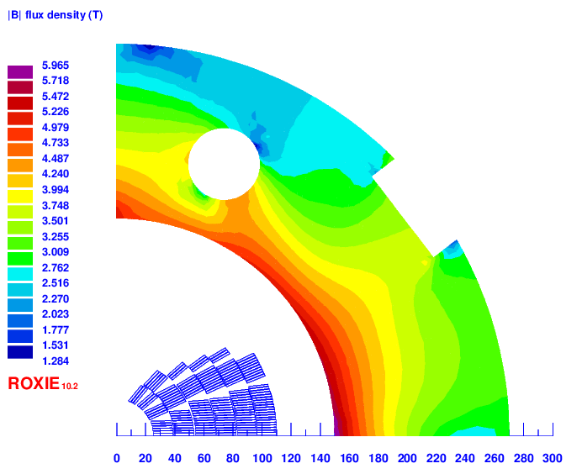
Iron yoke

Slide 4
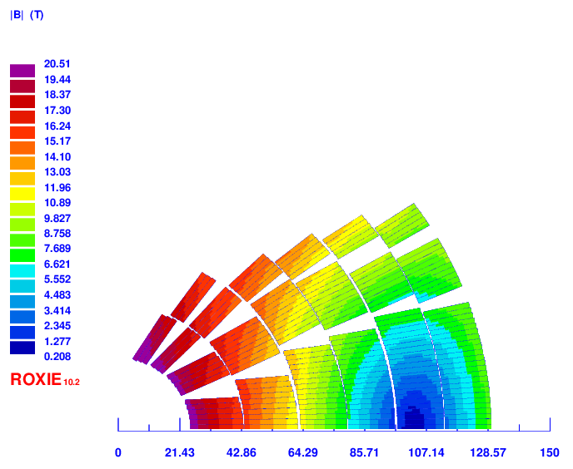
Baseline classic costheta (size optimized): v9f
4 layer HTS, 2 layer LTS
Strands: 0.8 mm, 40 – 35 – 30
Cable width: 18.35 – 16.06 – 13.3 mm
Stabilizer/Superconductor: 3 – 3 – 1
Coil width: 100 mm
Current: 11120
Peak field: 20.51 – 16.02 – 12.69 T
Margin: 83.4 – 84.1 – 75.5 %
J_{cu} on LTS: 1229 A/mm²
Peak azimuthal Lorentz force: 156/145 MPa (LTS/HTS)

Slide 5
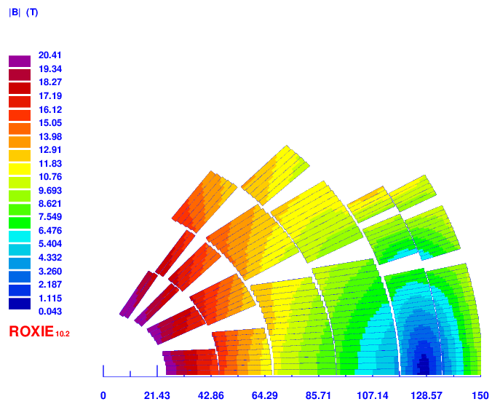
Baseline classic costheta (HTS optimized): v11c
2 layer HTS, 4 layer LTS
Strands: 0.9/1.1/0.8 mm, 40 – 40– 36
Cable width: 20.65 –24.38 – 15.96 mm
Stabilizer/Superconductor: 3 – 1 – 1
Coil width: 126 mm
Current: 13610
Peak field: 20.41 – 16.01 – 12.3 T
Margin: 81.6 – 84.6 – 77 %
J_{cu} on LTS: 1504 A/mm²
Peak azimuthal Lorentz force: 105/171 MPa (LTS/HTS)

Slide 6
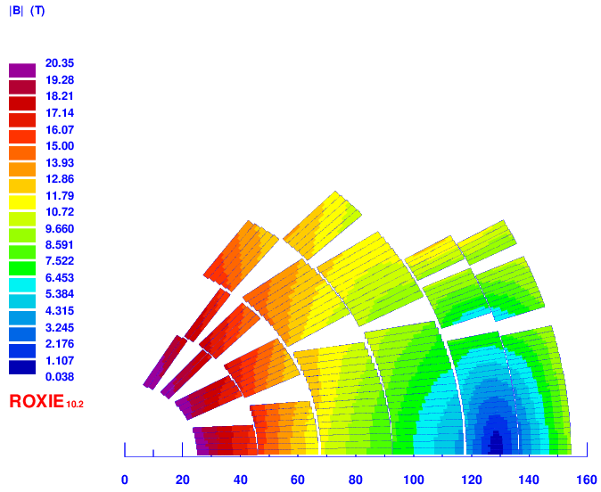
Baseline classic costheta (HTS optimized): v11d
2 layer HTS, 4 layer LTS
Strands: 0.9/1.1/0.8 mm, 40 – 40– 40
Cable width: 20.65 –24.38 – 17.73 mm
Stabilizer/Superconductor: 3 – 1 – 1.5
Coil width: 129 mm
Current: 13610
Peak field: 20.35 – 15.96 – 11.96 T
Margin: 81.5 – 84.4 – 78.0 %
J_{cu} on LTS: 1128 A/mm²
Peak azimuthal Lorentz force: 105/152 MPa (LTS/HTS)

Slide 7
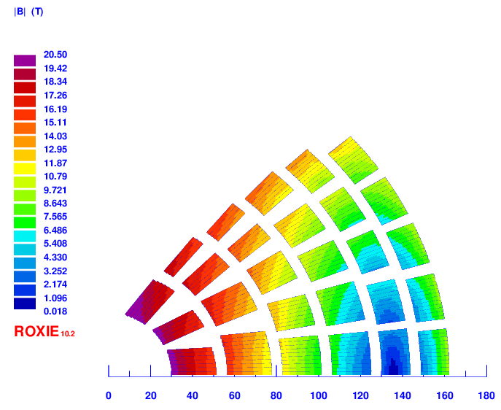
SMCT-like with 5 mm rings: v12d
4 layer HTS, 2 layer LTS
Strands: 0.8 mm, 46 – 40 – 35
Cable width: 21.1 – 18.35– 15.51 mm
Stabilizer/Superconductor: 3 – 3 – 1
Coil width: 136 mm
Current: 12000 A
Peak field: 20.74 – 16.33 – 13.77 T
Margin: 80.6 – 81.3 – 82.3 %
J_{cu} on LTS: 1364 A/mm²

Slide 8
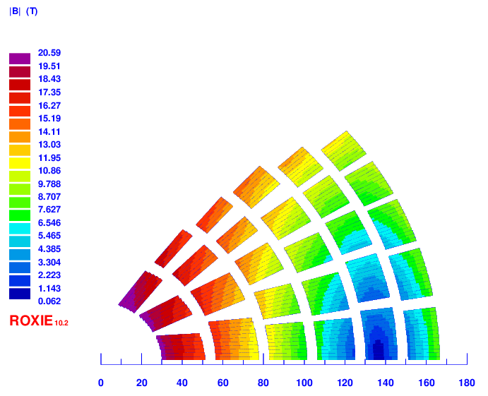
SMCT-like with 5 mm rings: v12e
4 layer HTS, 2 layer LTS
Strands: 0.8 mm, 46 – 40 – 35
Cable width: 21.1 – 18.35– 15.51 mm
Stabilizer/Superconductor: 3 – 3 – 1.2
Coil width: 136 mm
Current: 11900 A
Peak field: 20.59 – 16.24 – 13.6 T
Margin: 79.9 – 80.7 – 83.1 %
J_{cu} on LTS: 1240 A/mm²

Slide 9
Next steps
2 HTS + 4 HTS SMCT
Field quality
Quench protection studies

Slide 10
Cross sections

Slide 11
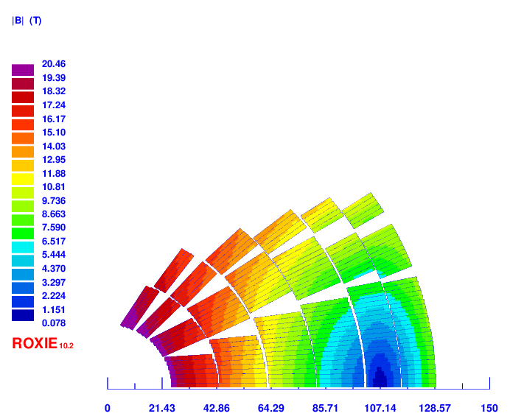
v2

Slide 12
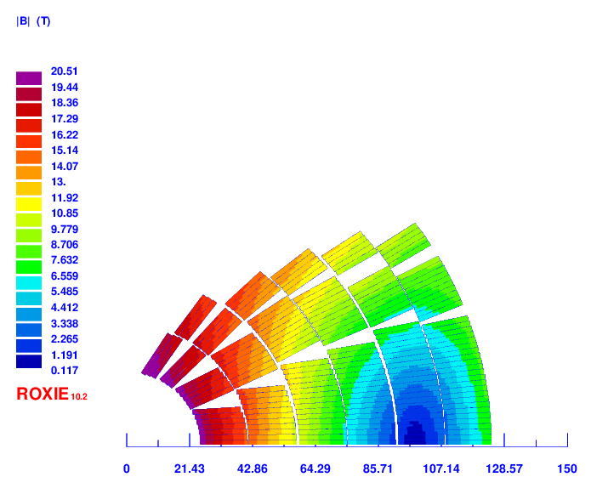
v3

Slide 13
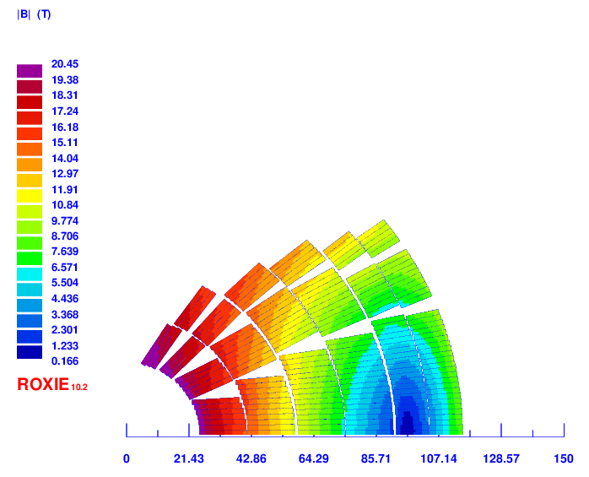
V4

Slide 14
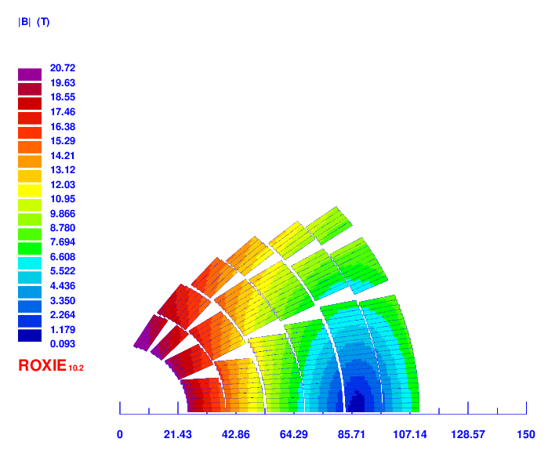
v5

Slide 15
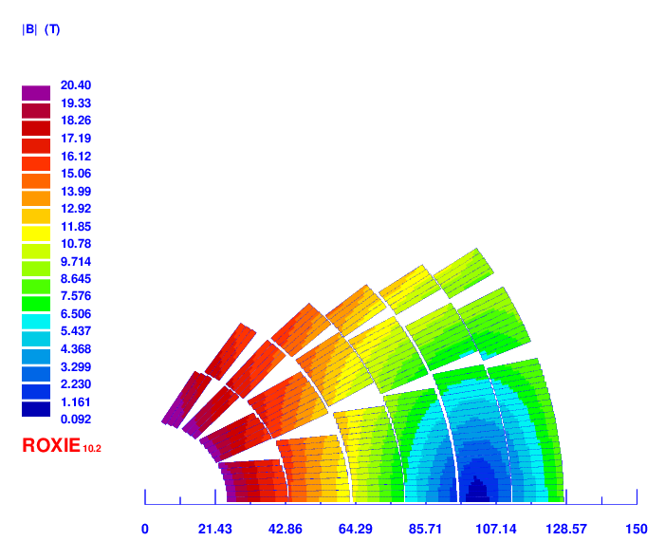
v6

Slide 16
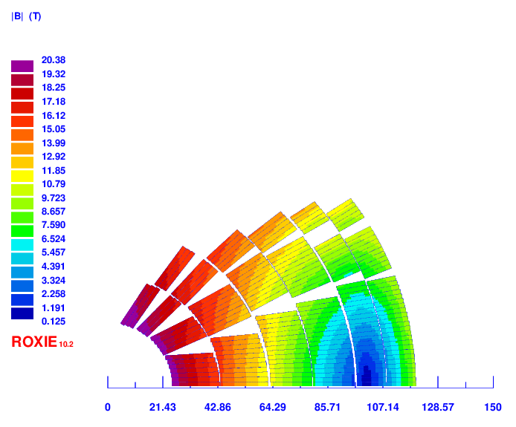
v8

Slide 17

v9

Slide 18
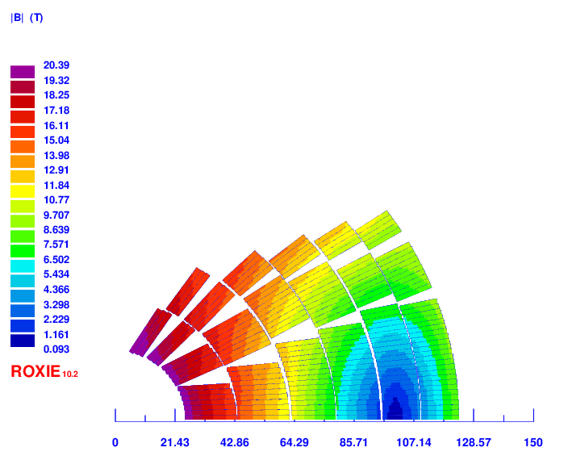
v10

Slide 19
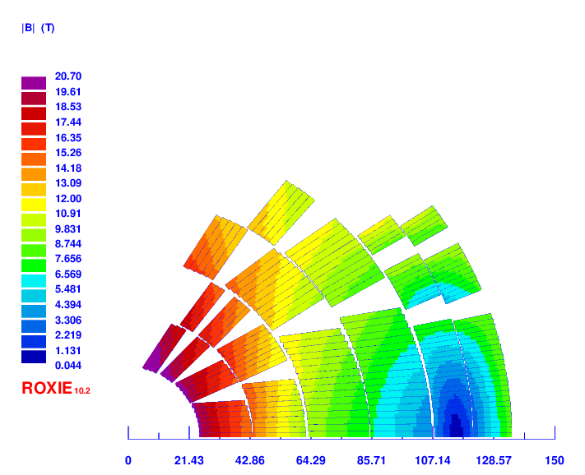
v11

