Slide 1
Status Report on the CORC Coil Program
Ramesh Gupta, BNL
May 26, 2021

Slide 2
High Level Goals/Plans/Tasks
Two Related R&D programs. Magnet Design Program (MDP) and Small Business Technology Transfer (STTR)
MDP: “In-field quench studies of a long CORC cable” in the background field of common coil dipole via one 8-turn HTS coil (S-turn in to flip the polarity)
A good collaborative efforts between MDP partners and ACT. Regular discussion on goals, instrumentation and test planning, etc.
STTR: “Demonstration of a high field HTS/LTS hybrid dipole” with two sets of double pancake coils made with 6+8 turns (total 28 turns) of CORC cable
This presentation will give the status of the MDP

Slide 3
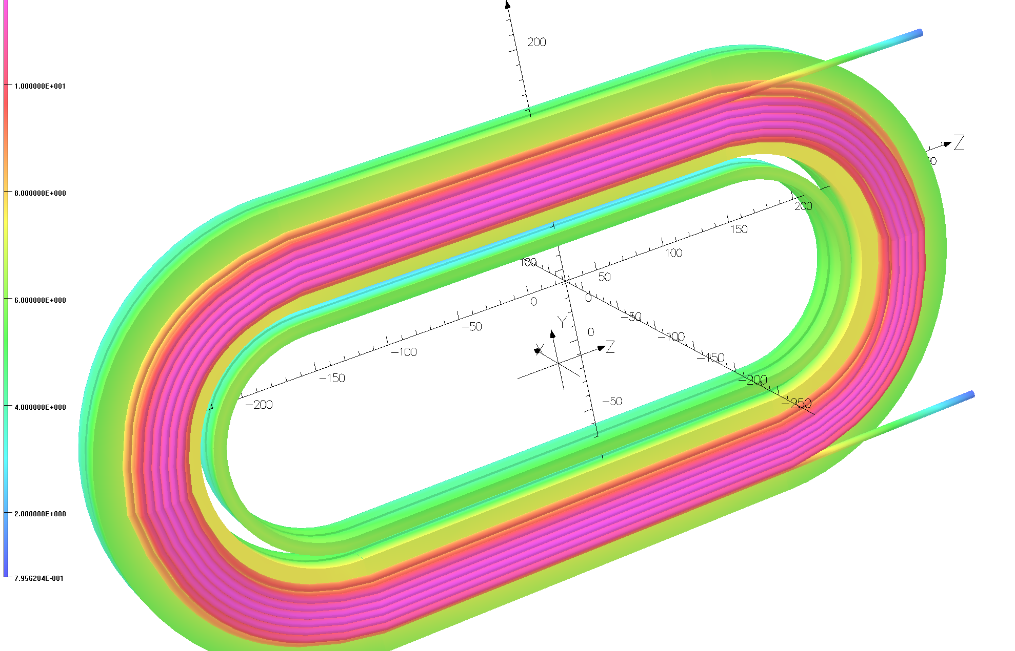
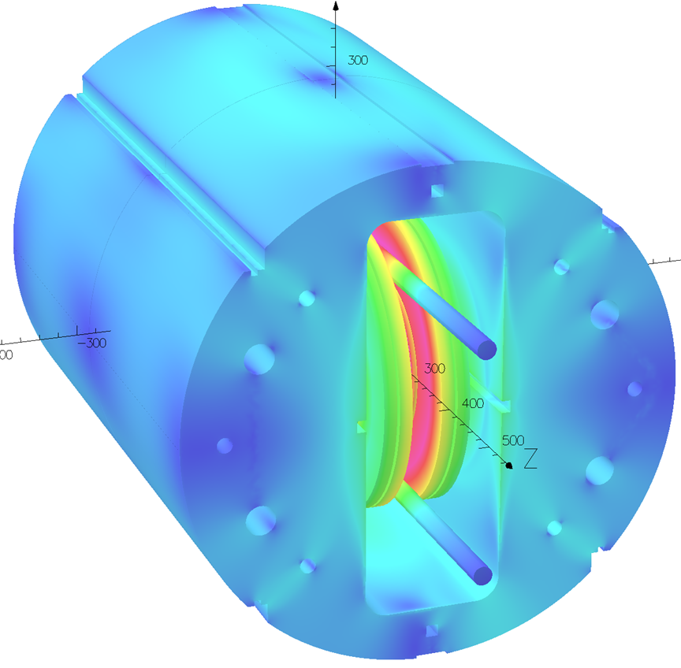
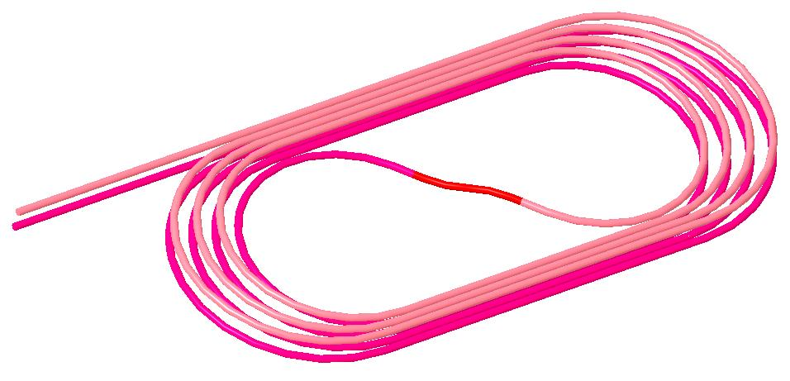
CORC Coil Programs with the Common Coil Dipole
STTR Coils two sets:
Each with 6 and 8 turns
STTR: High field Demo
(13-14 T with 10 T from LTS)
MDP: Quench studies and technology demo
(10.7 T with 10 T from LTS)
MDP Coil
4+4 turns
with an S-turn
CORC® coils will run in series with the Nb₃Sn coils

Slide 4
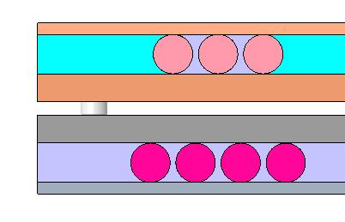
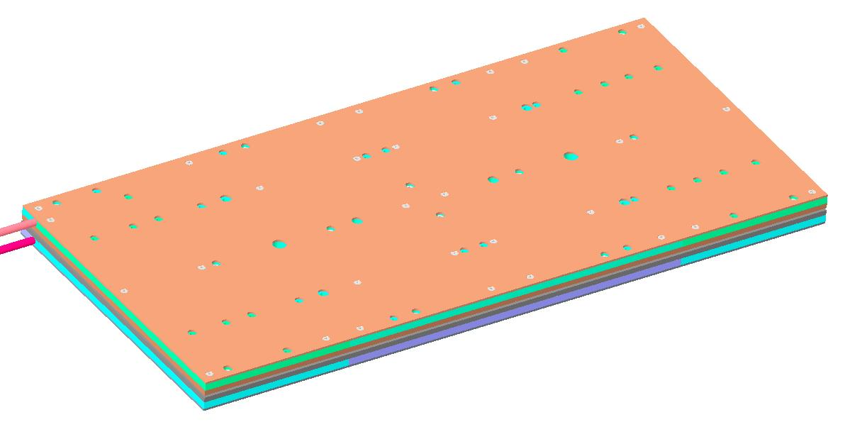
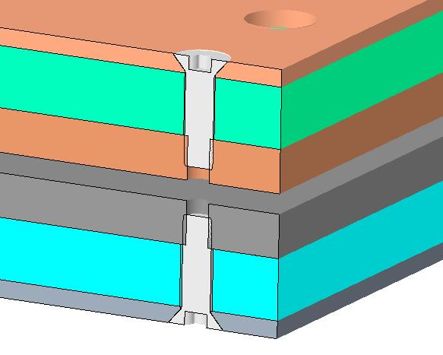
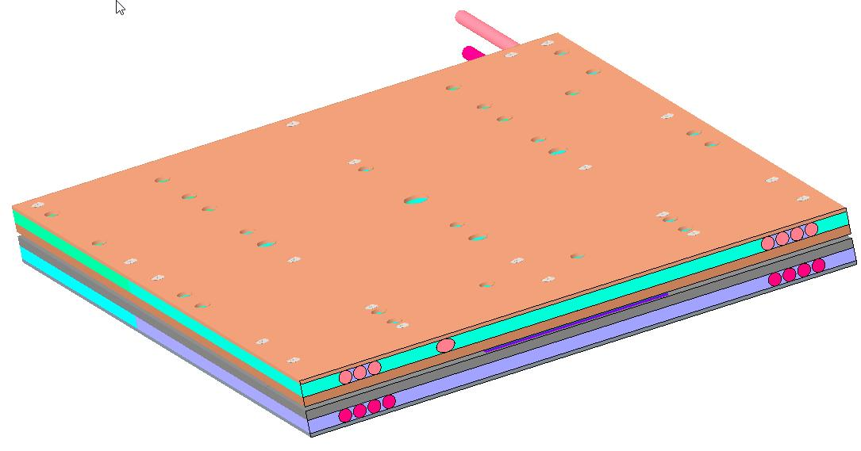
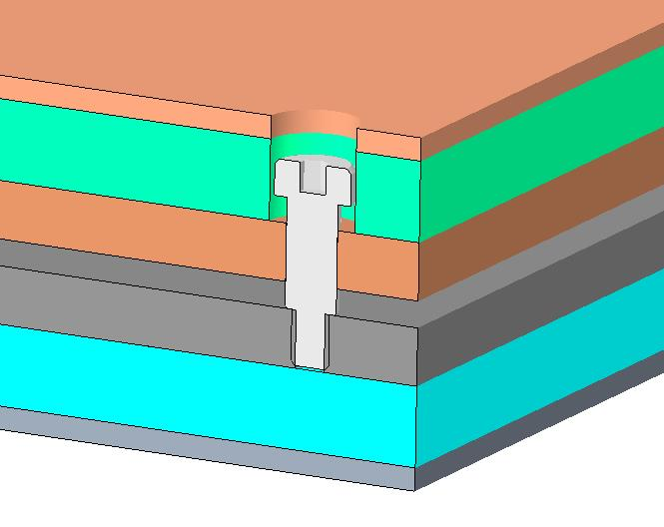
CORC Coil Package
Each layer held together with flat head screws
Assembly held with shoulder screws to allow separation of layers.
Overall thickness – 30.3 mm
Outer plates – 2 mm
Coil spacers – 7 mm
Inner plates – 5 mm
Gap between layers – 2.3 mm

Slide 5
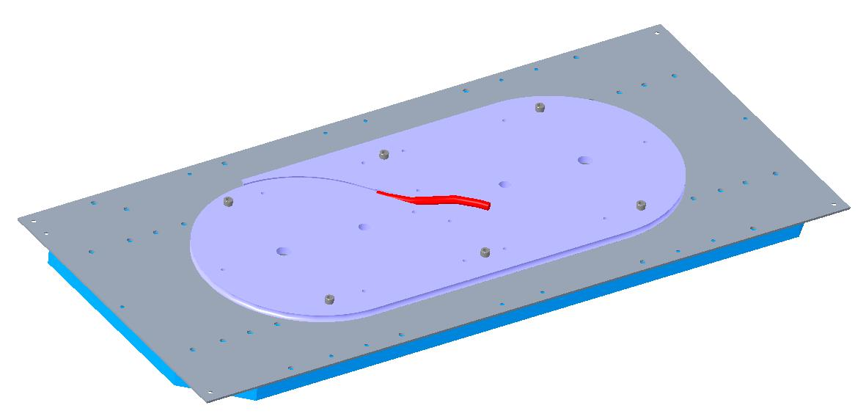
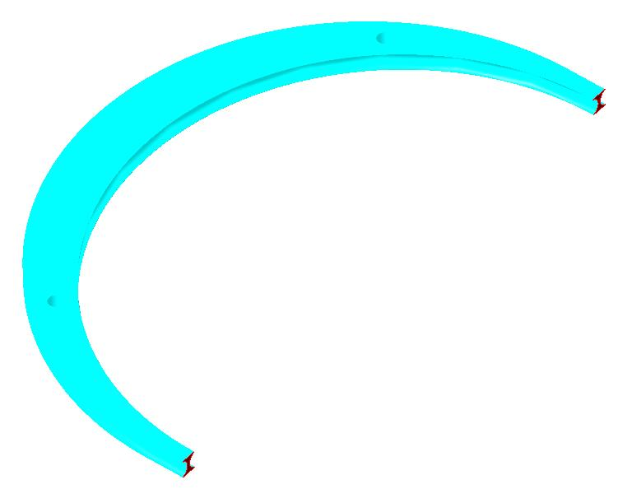
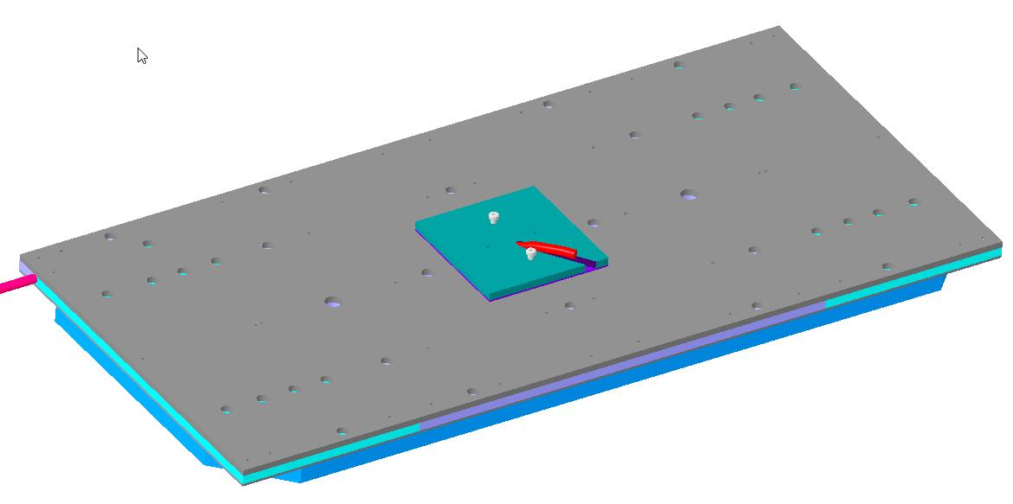
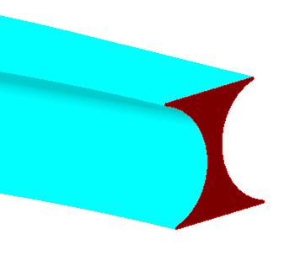
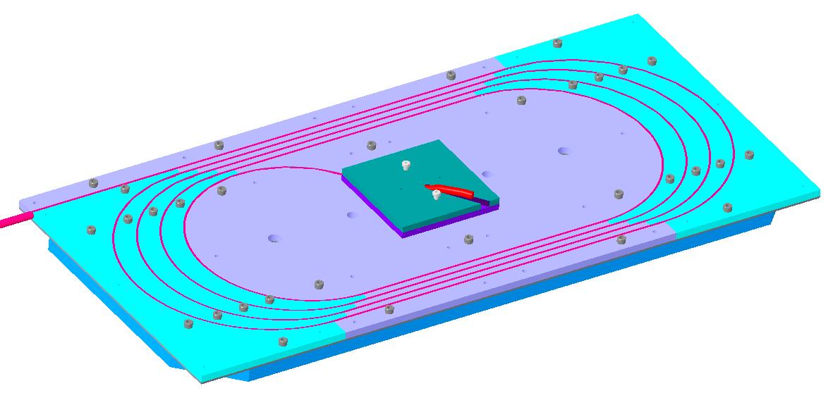
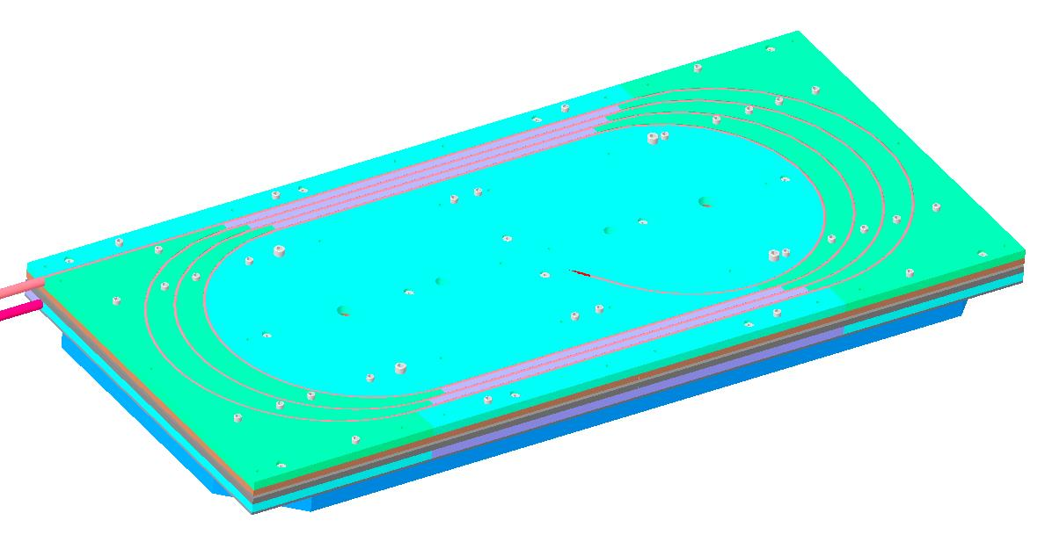
Coil & Structure Parts, as Designed

Slide 6
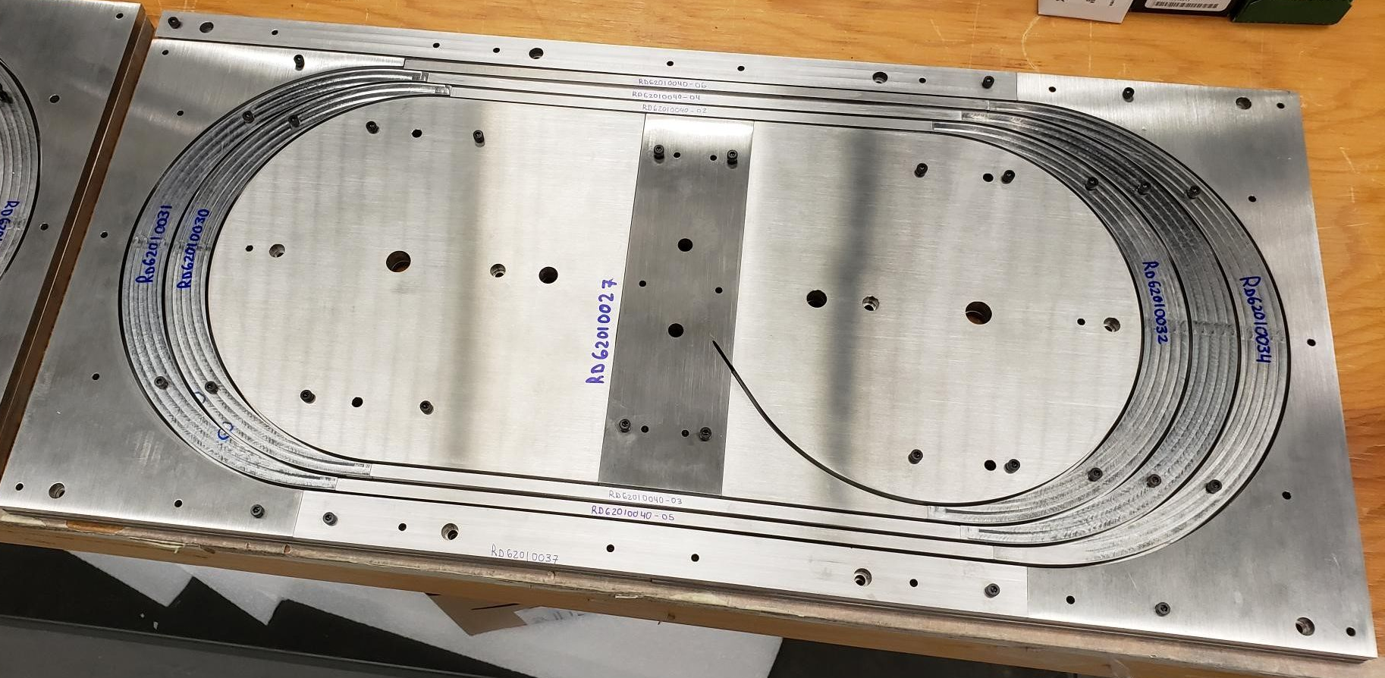
Parts, as Made or Delivered (1) (all parts in hand now)
Parts for one-side of the coil

Slide 7
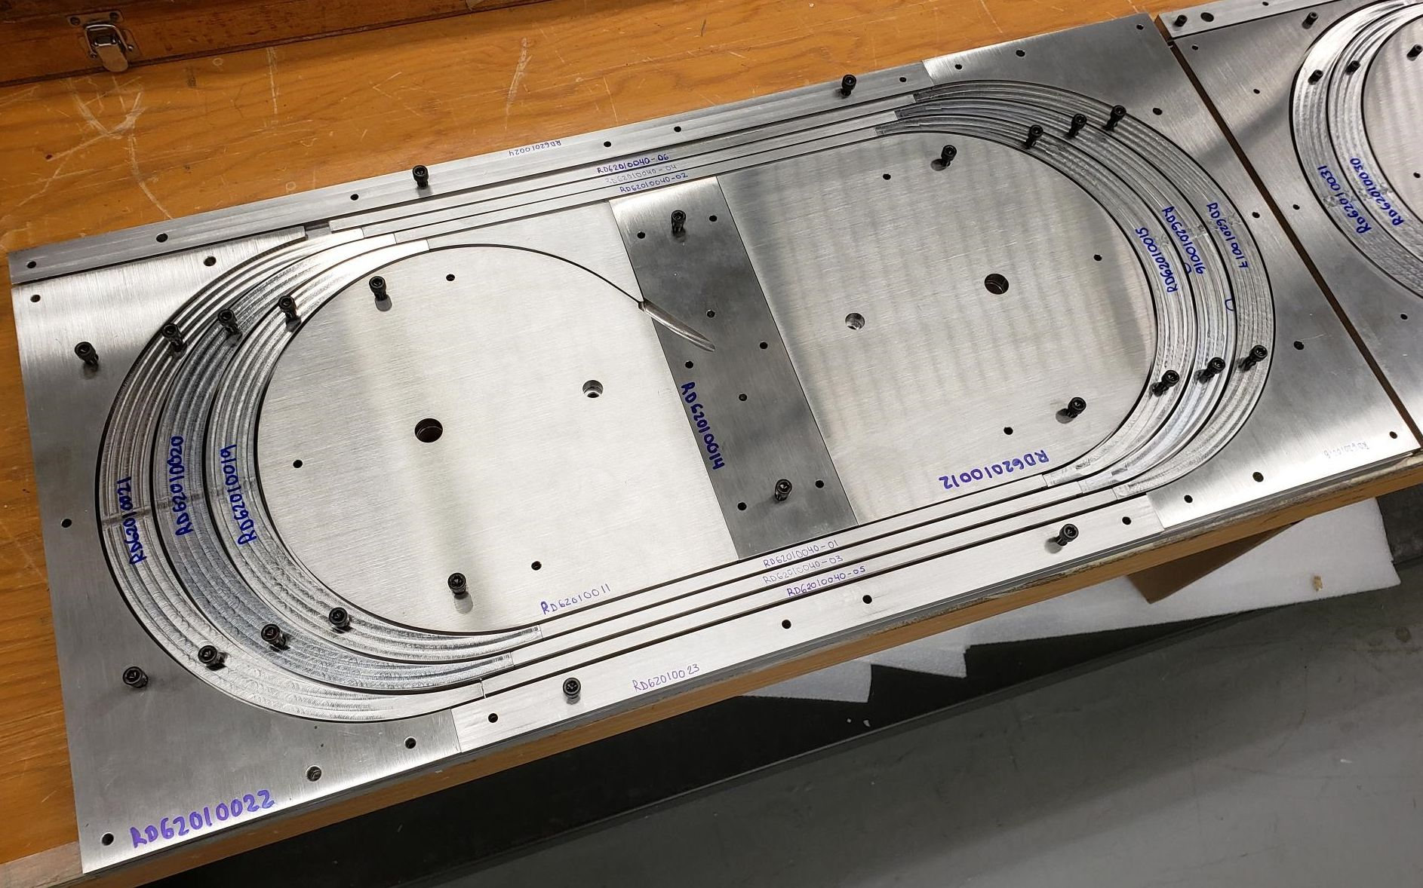
Parts, as Made or Delivered (2)
Parts for the
other-side of the coil

Slide 8
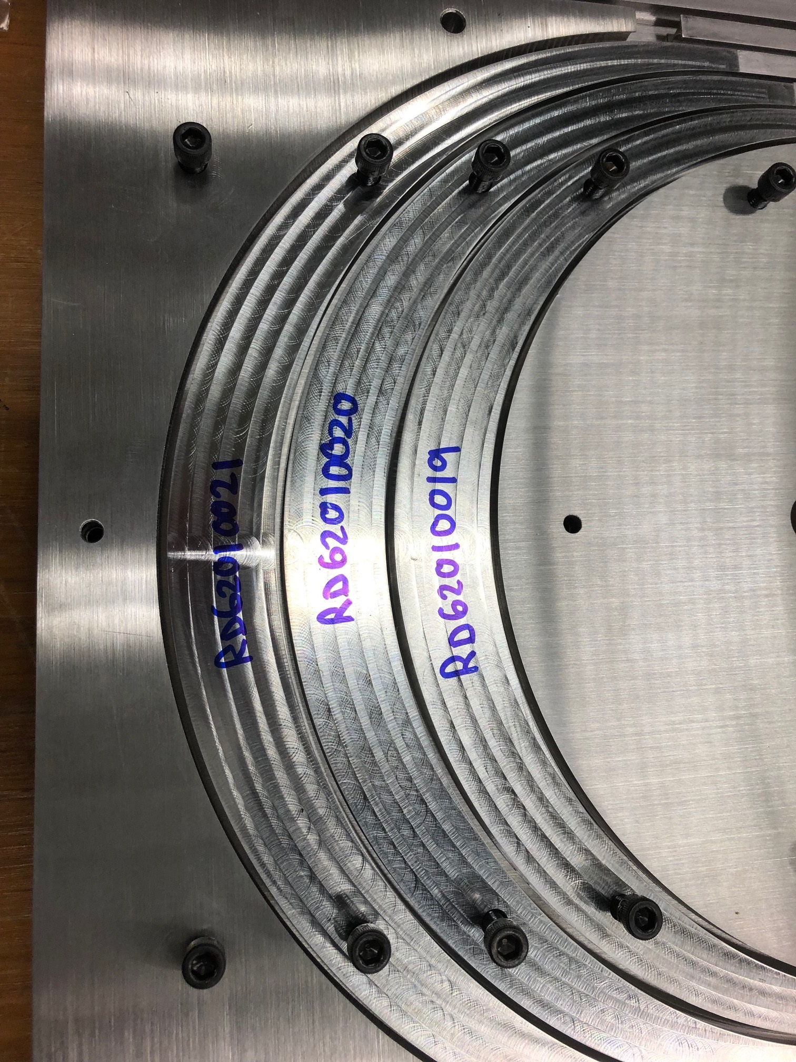
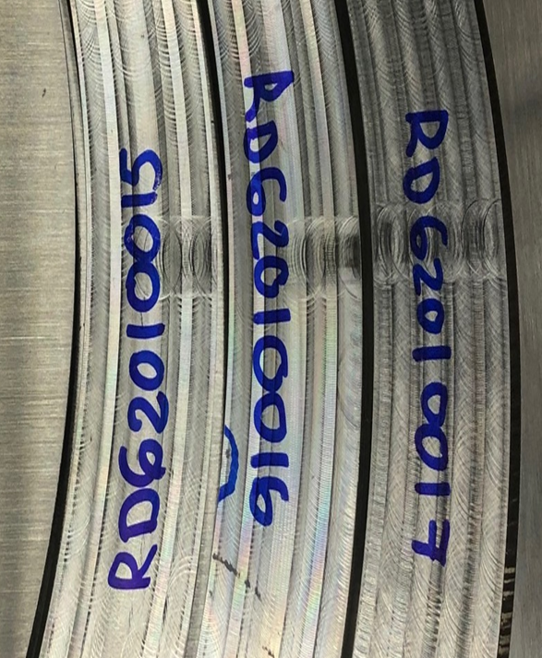
Coil Parts

Slide 9
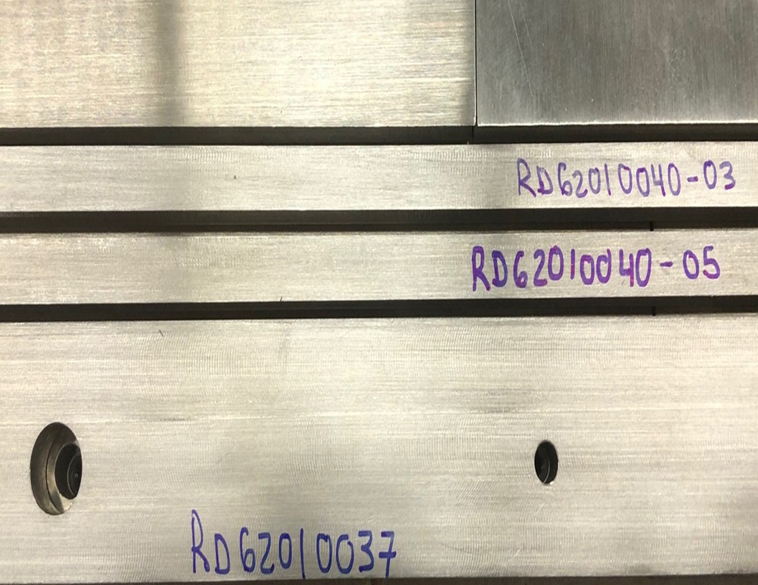
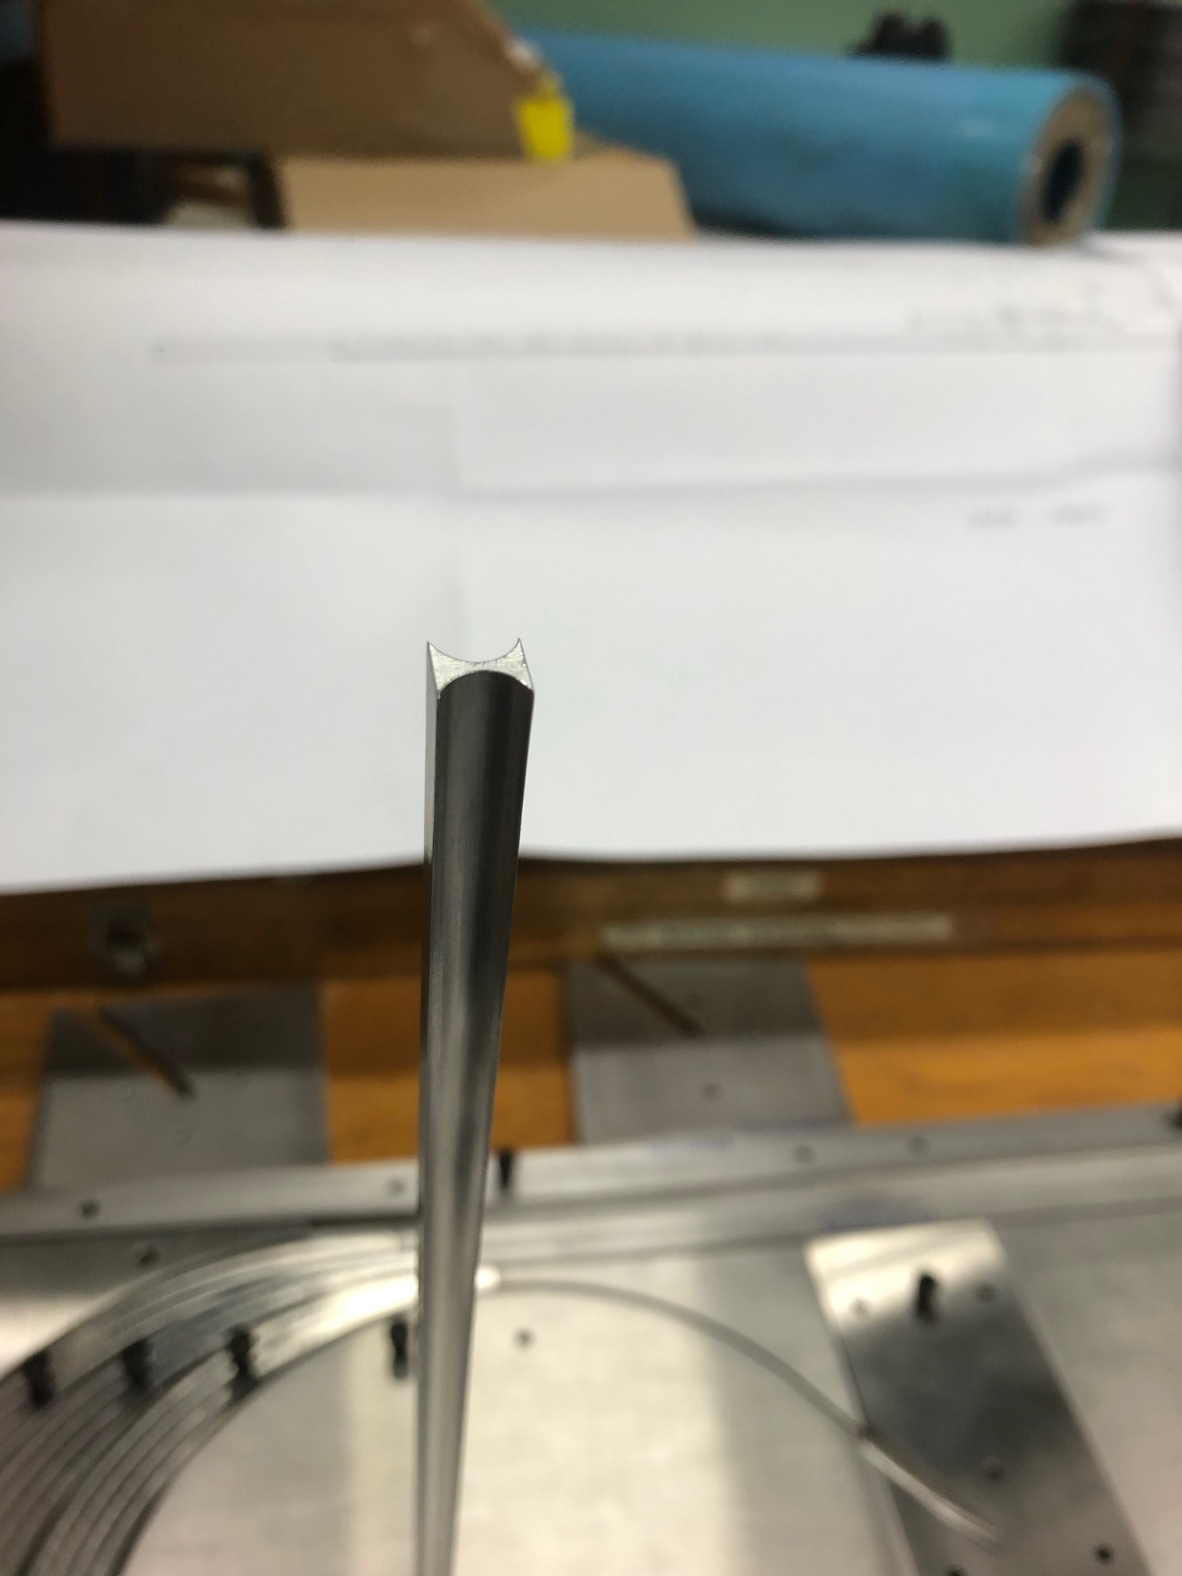
Coil Parts

Slide 10
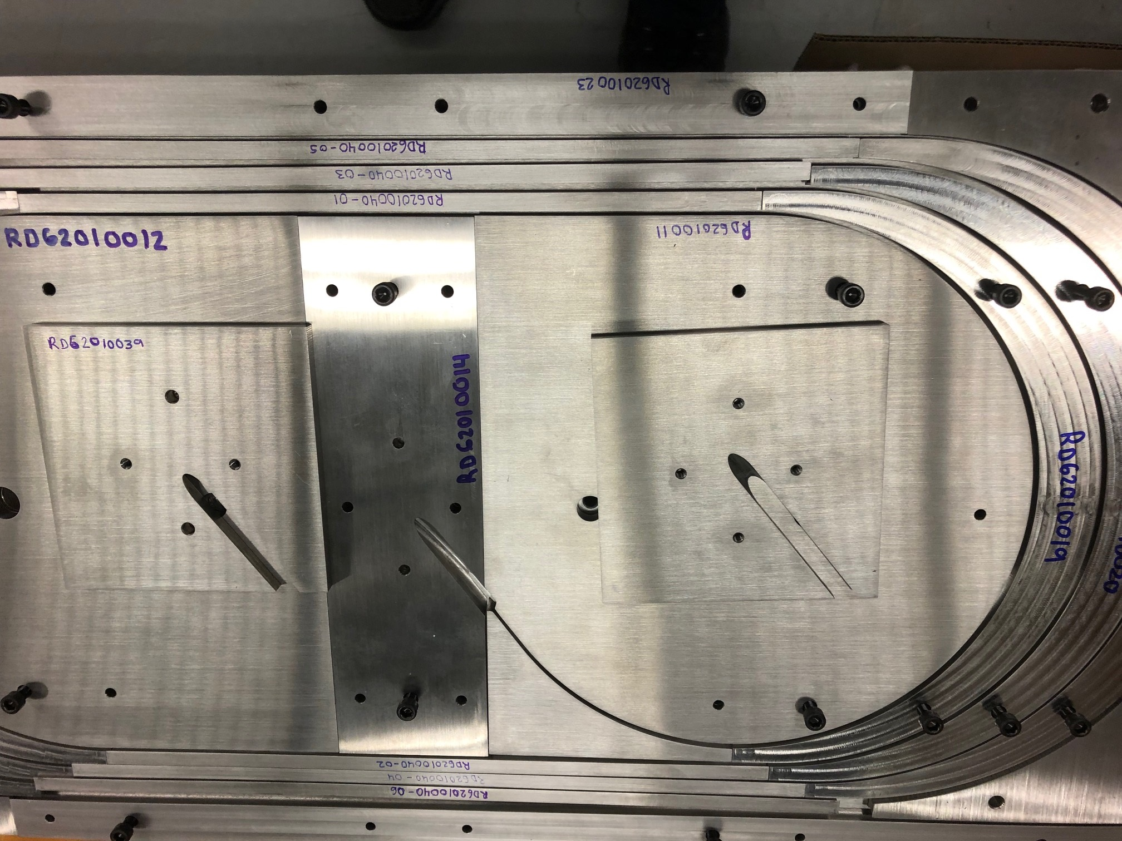
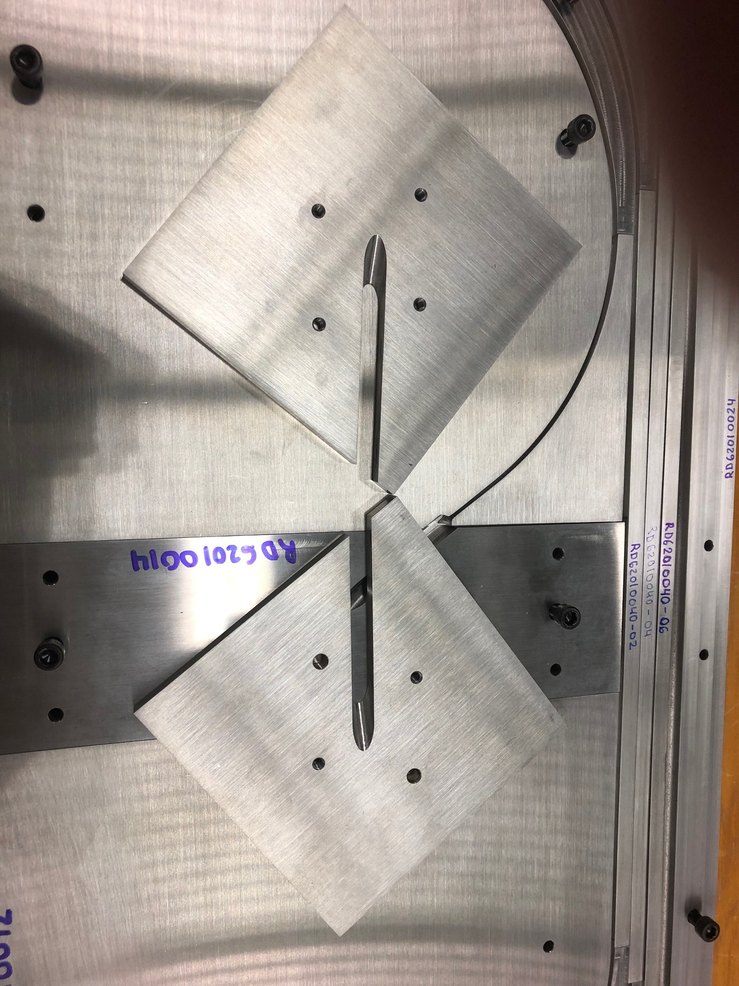
Coil Parts

Slide 11
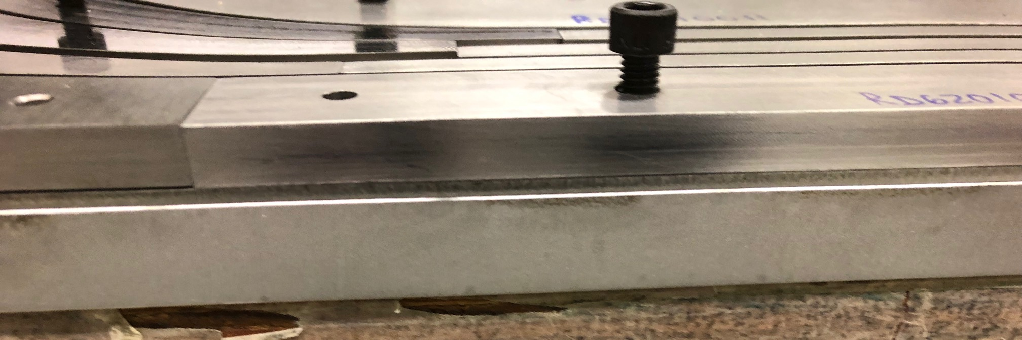
Coil Parts

Slide 12
Acknowledgement
This presentation benefited from the discussions with and direct contributions from the following colleagues:
ACT: Danko van der Laan, Jeremy Weiss
ASC: Ernesto Bosque, Lance Cooley
BNL: Anis Ben Yahia, Michael Anerella, Jesse Schmalzle, Piyush Joshi, …
FNAL: Vadim Kashikhin, Vito Lomardo
LBNL: Xiaorong Wang, Maxim Martchevsky, Reed Teyber, Steve Gourlay
… and more

Slide 13
Summary and Schedule
A good collaborative effort between different partners with regular meeting and discussions on all aspects of the program
Coil parts received. All meet requirement except one (not a showstopper)
These parts are being sent to ACT for further inspection and to adjust their cable design. ACT will also investigate routing of v-tap wire and insulation
BNL to receive back coil parts and practice cable from ACT in about a month
BNL will do practice winding (including investigation of winding machine)
ACT to provide CORC cable in about 3 months
Coil construction and test preparation will take another 3 months
Target test date is by the end of 2021

Slide 14
EXTRA SLIDES

Slide 15
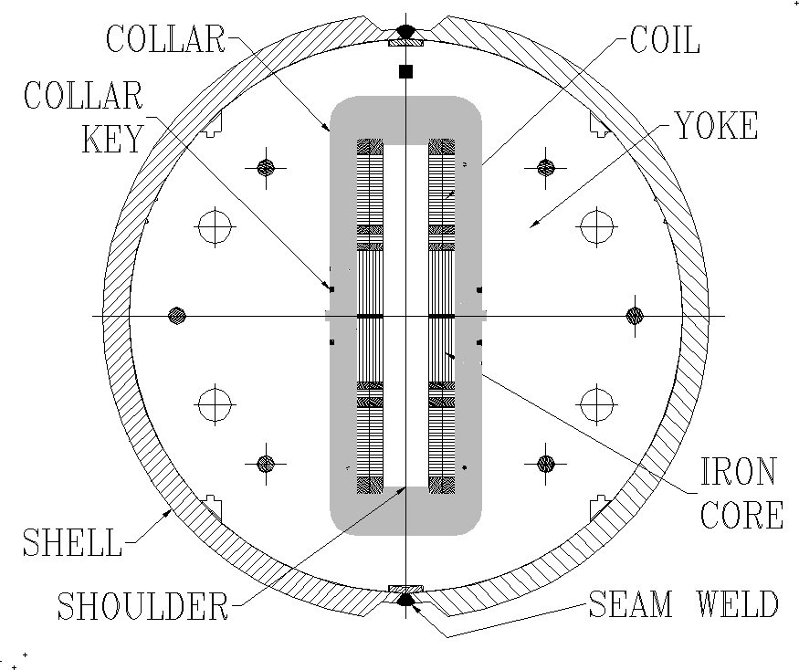
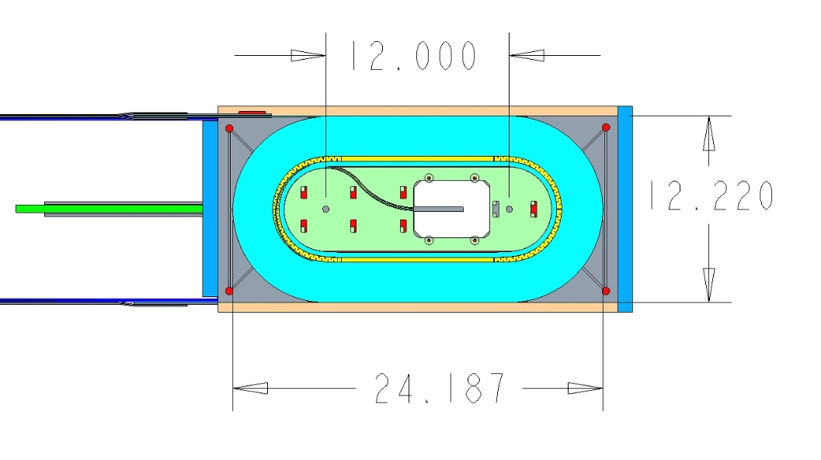
Parameters of BNL Dipole DCC017
31 mm
Two layer, 2-in-1 common coil design
10.2 T bore field, 10.7 T peak field at 10.8 kA short sample current
31 mm horizontal aperture
335 mm vertical aperture
A unique feature for insert coil or cable testing
0.8 mm, 30 strand Rutherford cable
70 mm minimum bend radius
85 mm coil height
614 mm coil length
One spacer in body and one in ends
Iron over ends
Iron bobbin
Stored Energy@Quench ~0.2 MJ
335 mm
304.8 mm
310.4 mm
614.3 mm

