Slide 1
Update on the REBCO magnet development
Vadim Kashikhin, Vito Lombardo
May 26, 2021

Slide 2
REBCO magnet development
The project’s objective is to address the U.S. MDP goal #2: “Develop and demonstrate an HTS accelerator magnet with a self-field of 5 T or greater, compatible with operation in a hybrid HTS/LTS magnet for fields beyond 16T.” This is achieved through a series of steps:
  Short sample studies to determine the bending degradation;
  Initial COMB magnet demonstration (proof of principle) with a CORC® cable made of average-performance REBCO tapes;
  Performance demonstration to reach 5 T self field goal in the HTS accelerator magnet using the CORC® cable made of pre-sorted (high Je) REBCO tapes;
  Demonstration of the hybrid HTS/LTS magnet operation using a Nb₃Sn coil outsert;
  Studies of the magnet parameter space to determine suitable designs and conductor requirements to reach 10 T standalone field and 5 T insert field.
Driving questions for area IIb REBCO magnets to be addressed:
  What performances and architectures should the conductor have? How can we make magnets using these conductors?
  What is the maximum dipole field a REBCO magnet can generate? What is the long-term conductor and magnet performance under cycling Lorentz loads?
  What is the magnet performance? How does it quench? How can one protect the magnet during a quench? What is the field quality of REBCO accelerator magnets?
  How can we characterize the transport performance for long conductors?

Slide 3
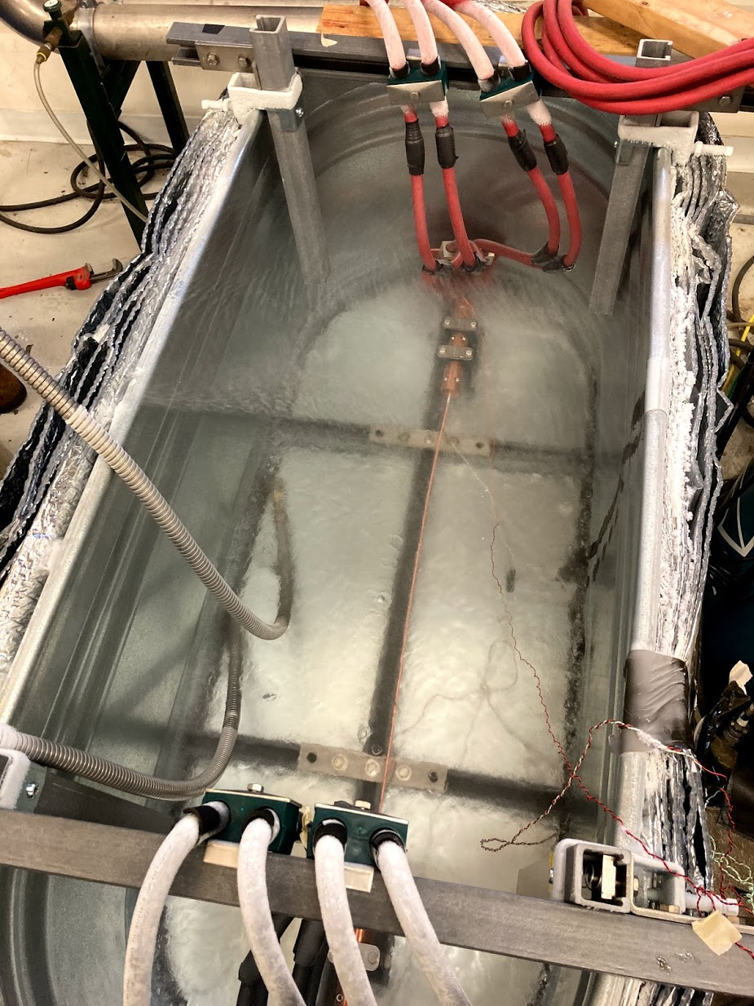
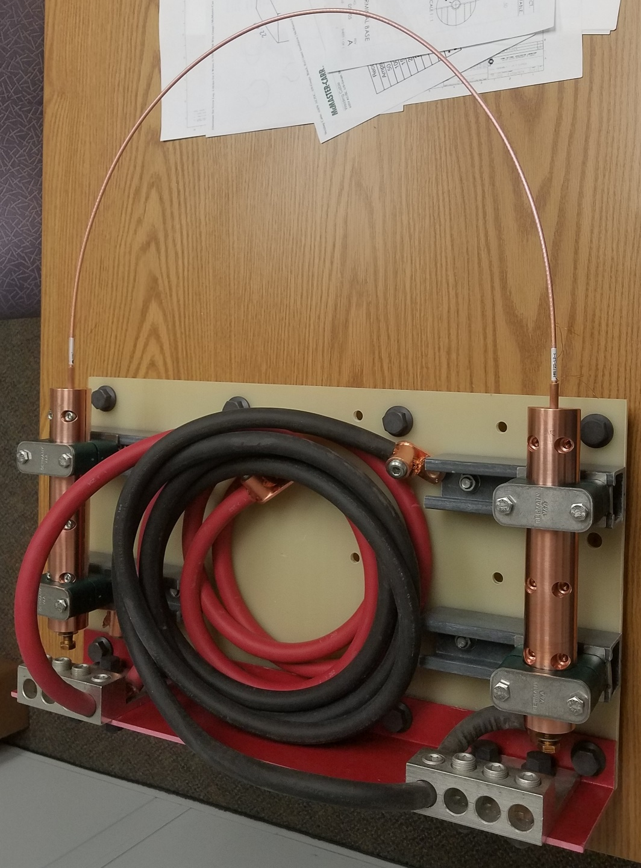
Improved test setup at 77 K
Testing the cables straight rather than bent to a large diameter to assess undisturbed cable performance and avoid a possible degradation.

Slide 4
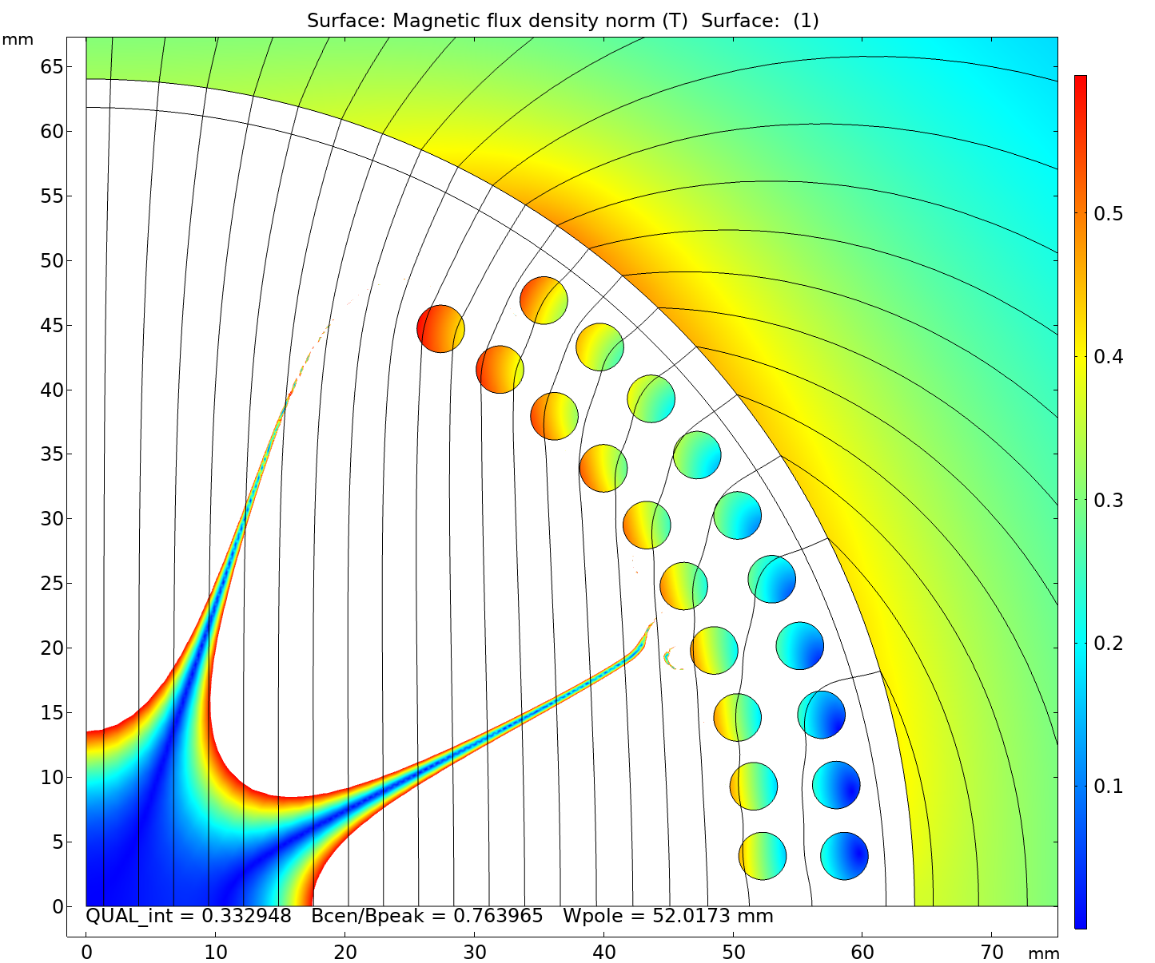
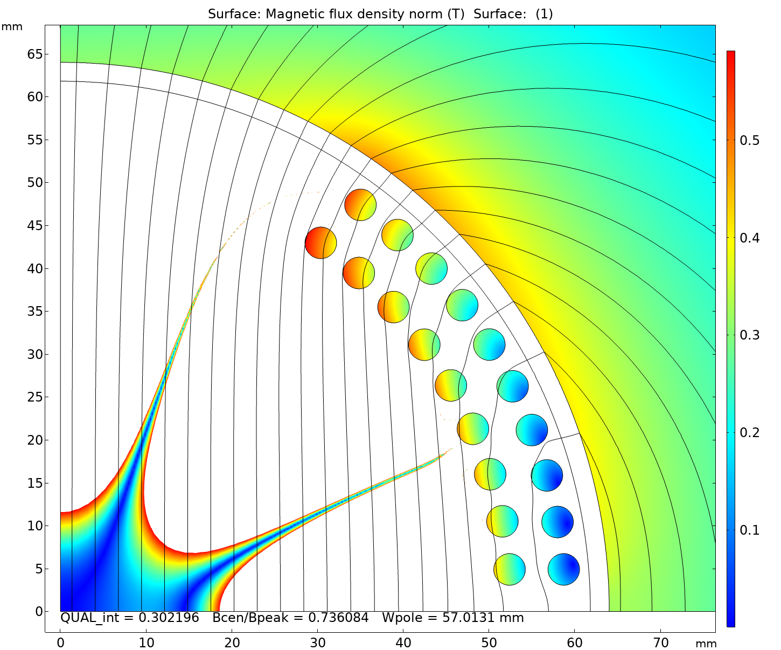
Redesigned coil cross-section
Changes vs. previous design:
Removed one cable per quadrant from the inner layer;
Increased the minimum pole width from 52 mm to 57 mm;
Adjusted the radial layer position to allow two individual mandrels and winding from outside;
Vertical transition between the layers (rather than radial) to maximize the pole width.

Slide 5
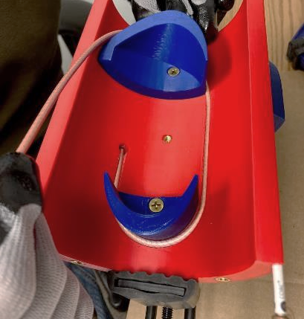
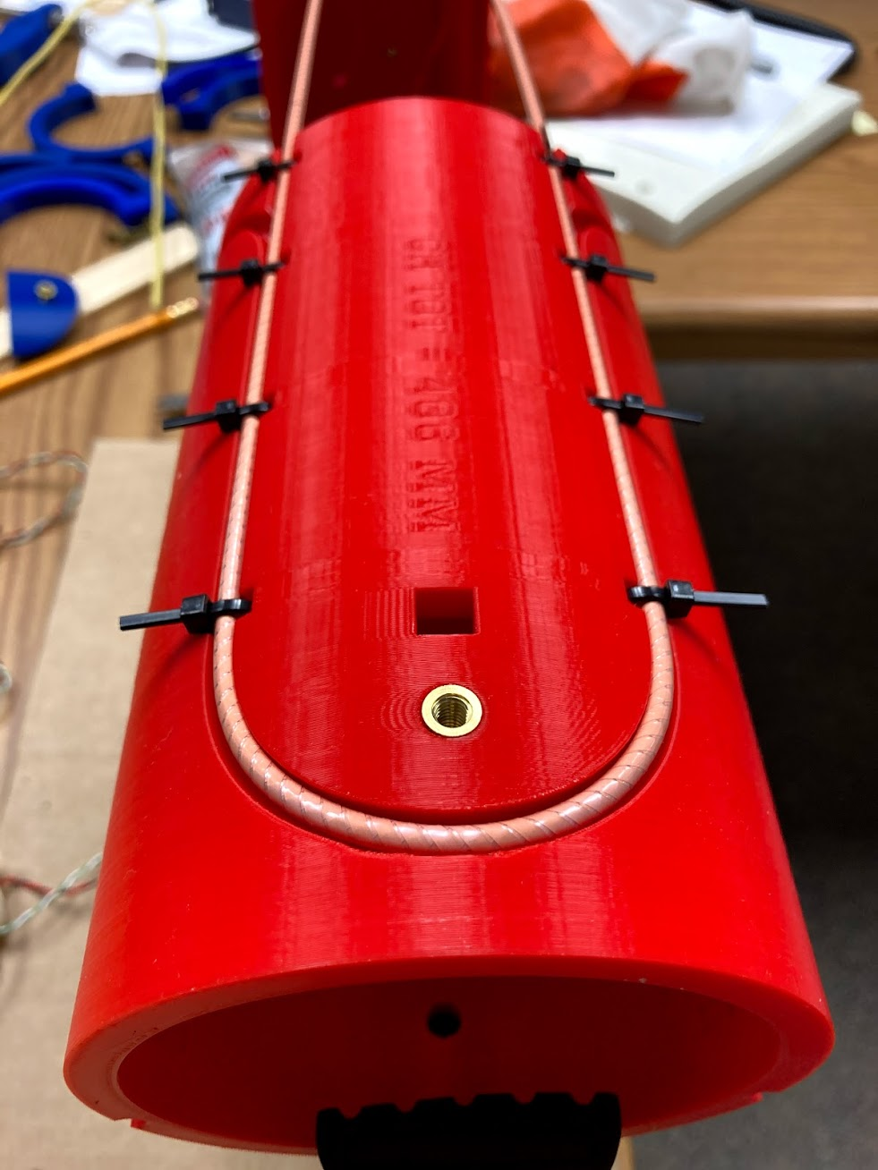
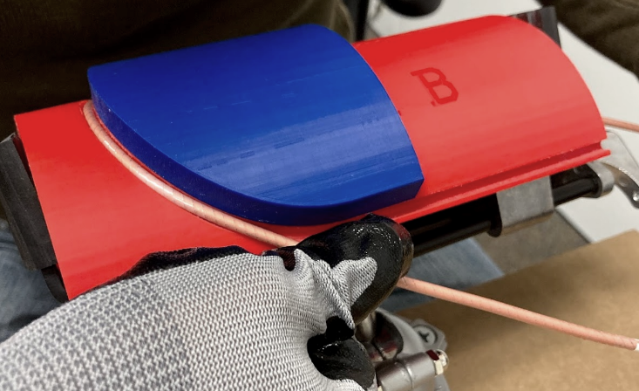
Revised support design
52 mm
57 mm
Single bend on the outer surface instead of 3 bends on the inner and outer surfaces.

Slide 6
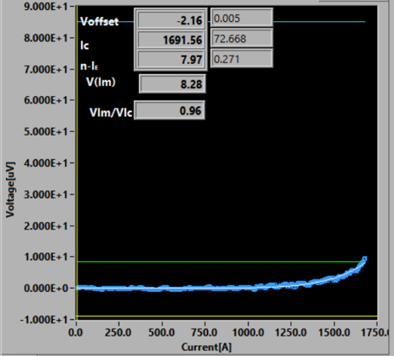
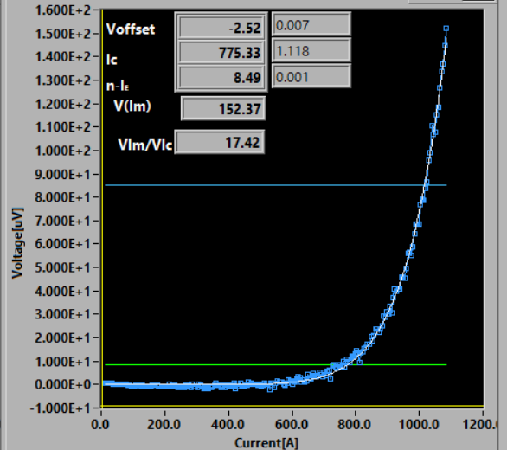
I_{c} retention before and after bending
1st set of tests
2nd set of tests
I_{c} retention increased from 49% to 54% (after the self-field correction).
Improvement, but not as much as expected based on ACT and LBNL data for relevant bending diameters.
Why?

Slide 7
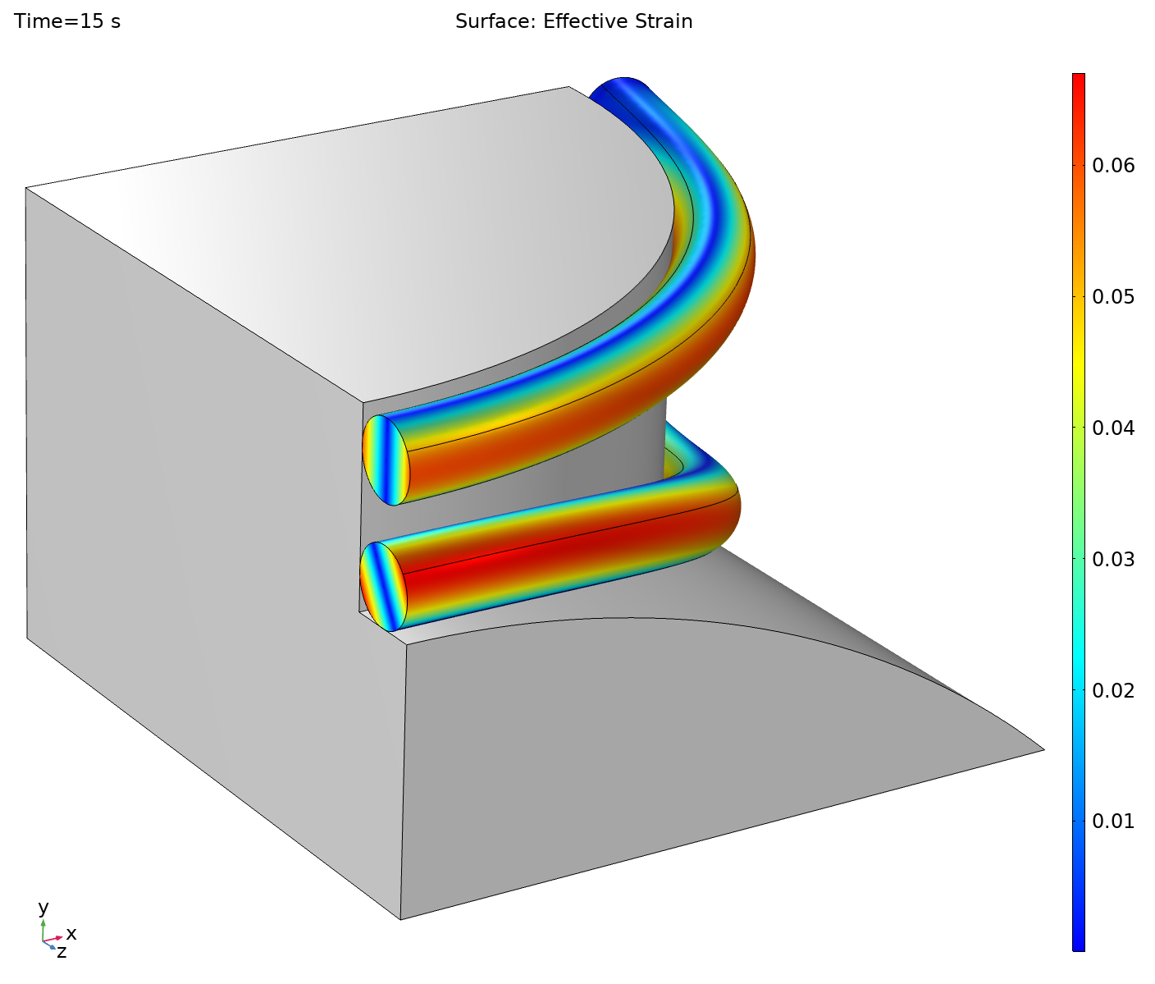
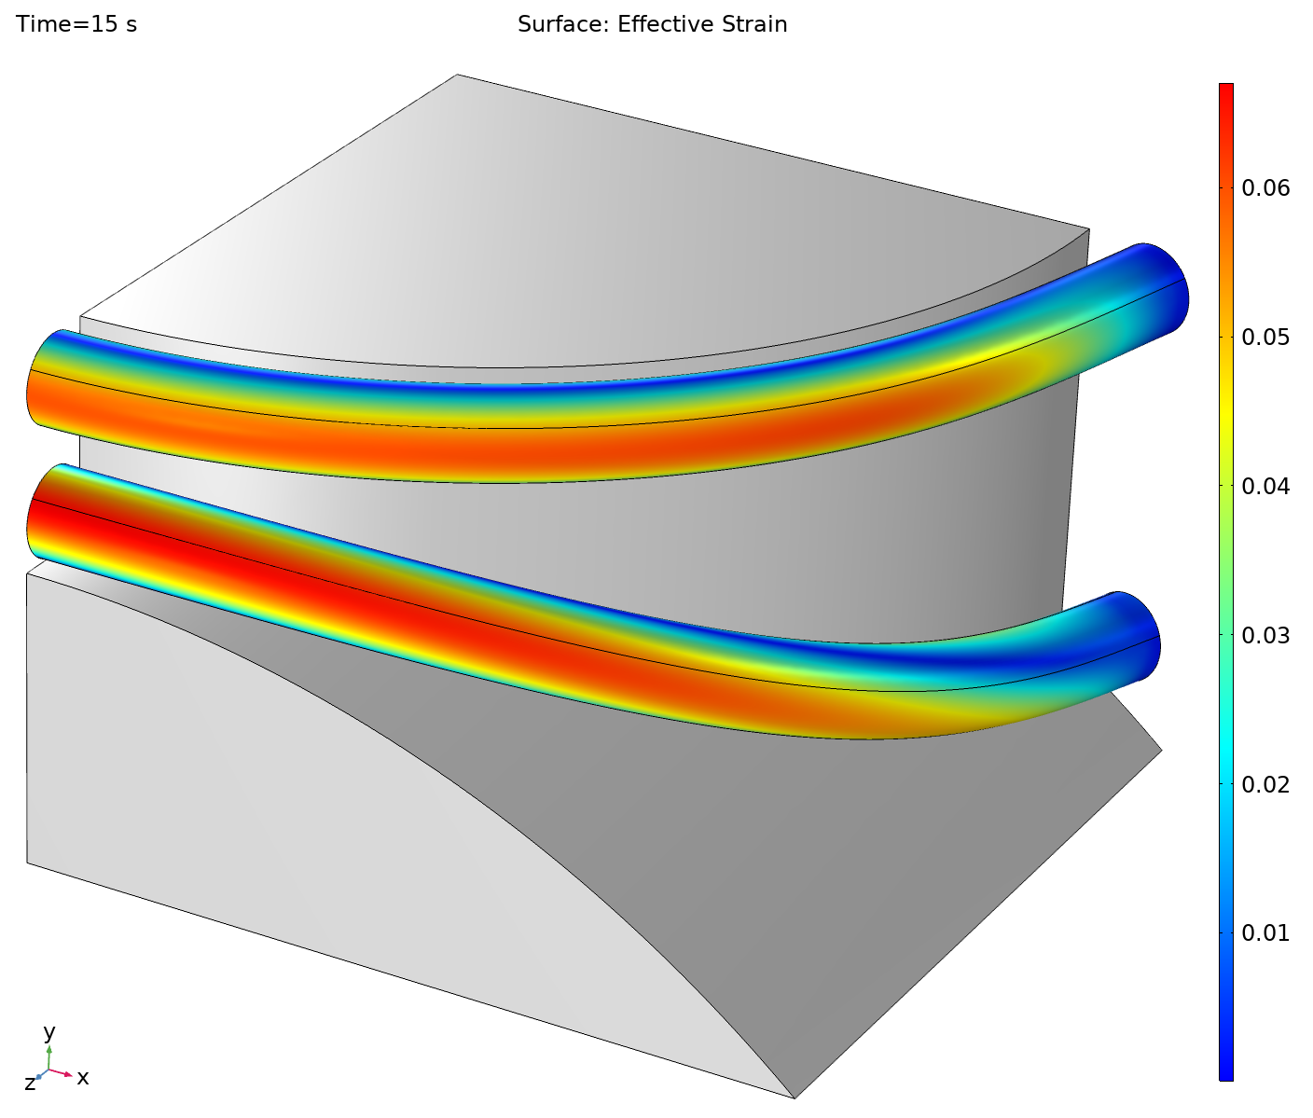
FEM model of cable bending in COMB structure
D_{pole} = 57.0 mm
ε_{max} = 0.0610
D_{cable} = 3.70 mm
ε_{max} = 0.0671
D_{mandrel} = 101.5 mm
Isotropic material properties. Symmetry condition at YZ plane.
Top cable was bent in one plane around the Y axis – uniaxial bending.
Bottom cable was bent in two planes around the Y and Z axes - biaxial bending.
10% higher strain in case of the biaxial bending vs. the uniaxial bending.

Slide 8
Effective strain vs. pole diameter
D_{mandrel} = const
Effective uniaxial bending diameter

Slide 9
Critical current retention in different tests

Slide 10
Possible options for the first model
Use the coil cross-section/ends as is.
  Around 50% degradation is to be expected with the available cable. Can be improved in future by optimizing the tape and cable parameters.
  Can test both standalone and as part of a hybrid magnet.
Scale the coil cross-section to larger pole and mandrel diameters to achieve a targeted strain reduction.
  Can only be tested stand-alone. Will no longer fit as insert into a Nb₃Sn coil.
  Since the total cable length is limited, the coil may become too short to be representable of an accelerator magnet.
Partially flatten the coil ends to change biaxial bending to uniaxial bending for the pole turn.
  Some loss of the useable aperture;
  More complicated coil and support structure geometry, but should not be a problem for 3D printing.

Slide 11
Flattened coil ends
The pole turns can be wound as flat racetracks with only uniaxial bending.
To make it possible, the curvature of the pole turns in XY plane should be subtracted from all the turns:
  makes the pole turns completely flat;
  the rest of the turns become flattened to some degree.
Would “gain” ~10 mm in the equivalent pole diameter for the same coil cross-section and OD with the expected I_{c} retention of ~65%.
The vertical aperture becomes limited to ~80 mm, while the horizontal is unchanged at ~100 mm.

Slide 12
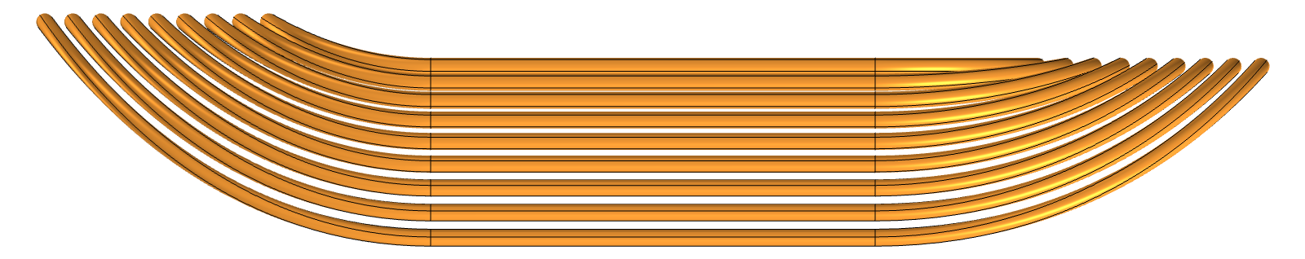
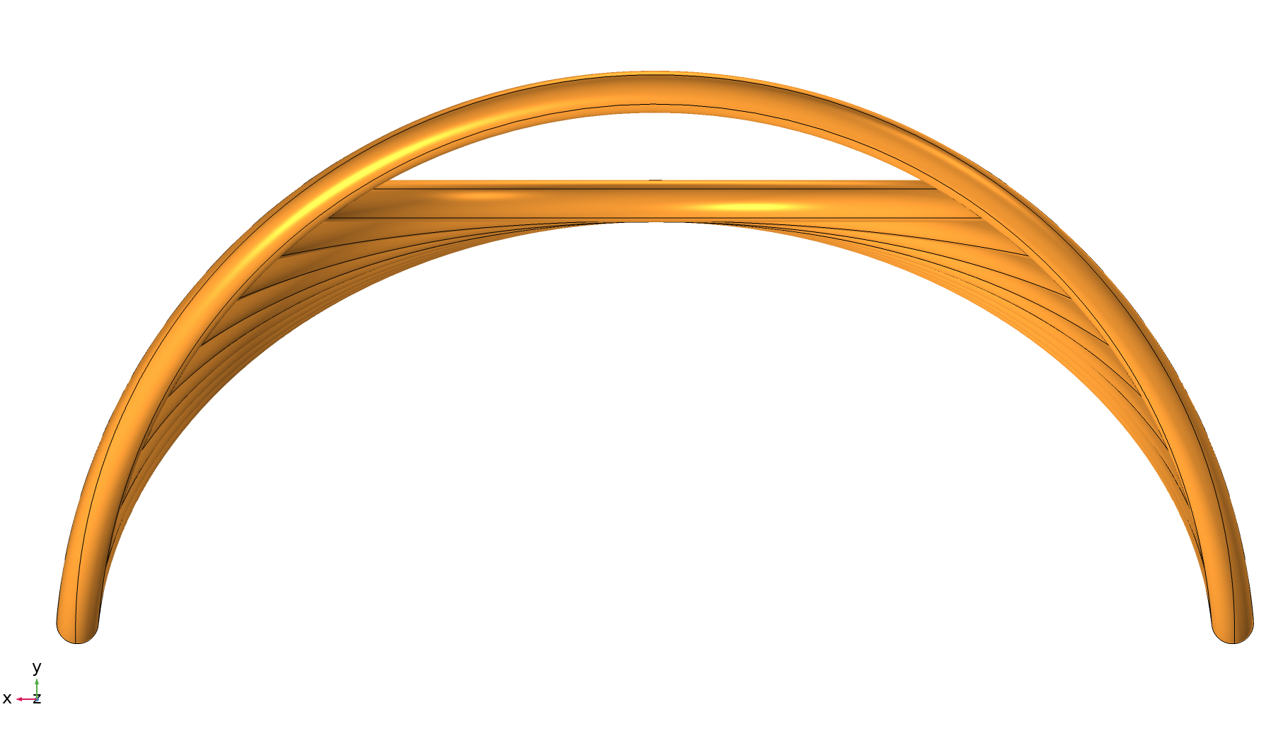
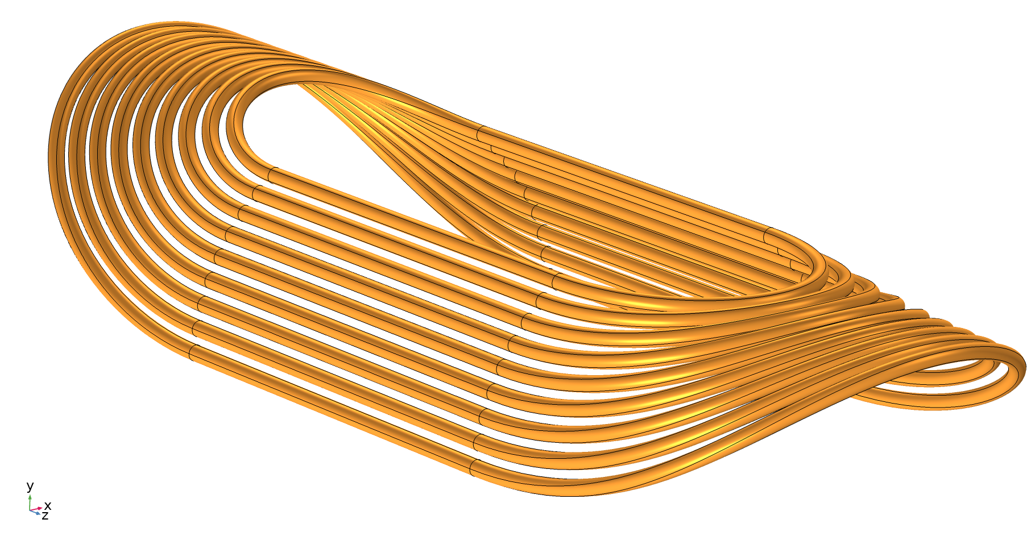
Model of the flattened coil ends (work in progress…)
Traditional end
Flattened end

