Slide 1
Fiber-optic diagnostics development at FNAL
M. Baldini, S. Krave
US Magnet Development Program
Fermi National Accelerator Laboratory

Slide 2
Outline
MDP milestones
Tensile stress test at 300 and at 77 K
Short term plans

Slide 3
MIlestones
Develop a novel diagnostic tool and analysis technique based on fiber optics sensors.
FBG: discrete sensors
AIIId-M9 | Calibration of FBG fibers in a small cryostat (...). Installation on an MDP magnet and strain measurement during a quench (...). Design a proof of principle experiment for quench 3D spatial detection and coil azimuthal strain mapping and install fiber on MDP magnet (...). Use fibers for energy spectrum analysis and HTS quench detection(...).

Slide 4
Diagnostic roadmap

Slide 5
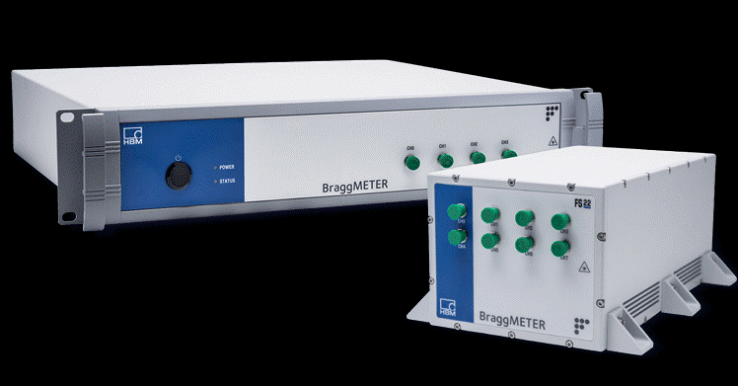
Tensile stress test: Ti and Steel
Nominal wavelengths FBG1=1502 nm
FBG2=1508 nm
FBG3=1514 nm
FBG4=1520 nm
500 mm
100 mm
100 mm
4 fibers with 4 FBG sensors
8-ch interrogator
FBG4
FBG3
FBG2
FBG1
Custom made fiber:
# of sensors, position and wavelenght
- 500mm Ormocer coated fiber
1,5 m aramid cable Ø3mm,
FBG sensor lengths is 5 mm
FC-APC connectors

Slide 6
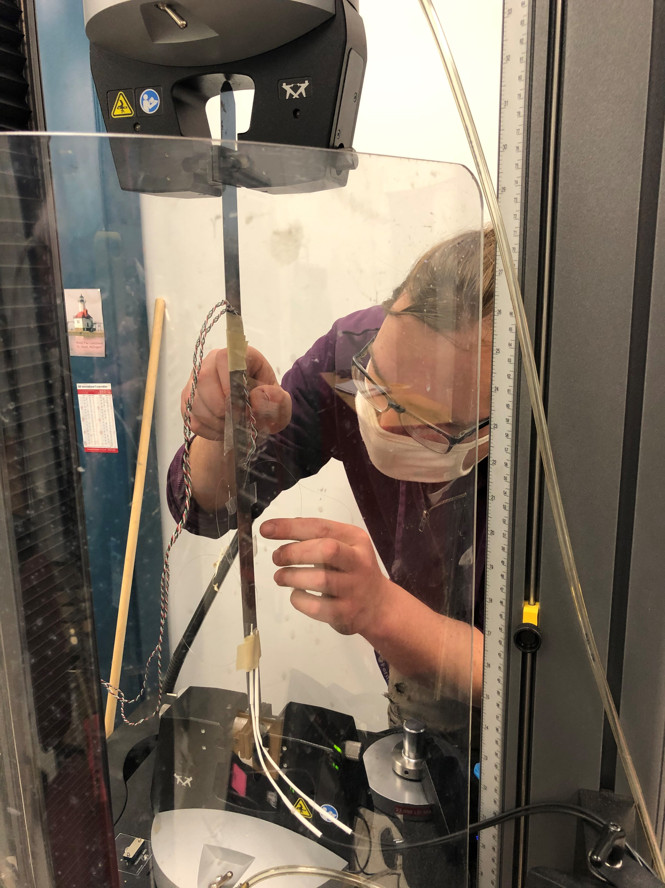
Tensile stress test at 300 K
AISI 1080 steel and Ti
Instron press in IB3 up to 200 MPs
Fibers vs strain gauges
Tensile vs Poisson strain
Conclusions
Young modulus measured with FBG sensors is in very good agreement with what is expected for steel and Ti.
Tensile stress tests performed at 300 K were successful
Gluing has been performed correctly

Slide 7
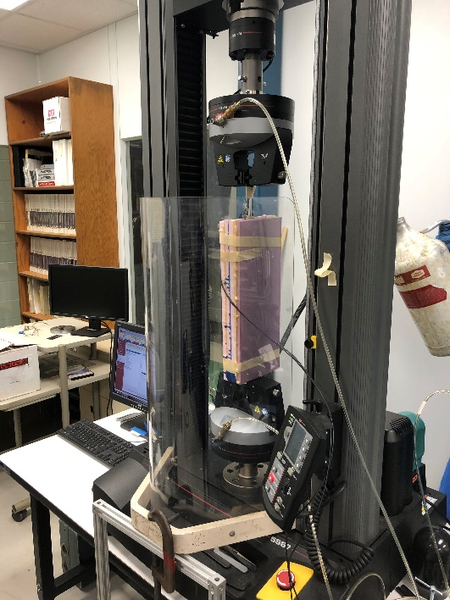
Tensile stress test in Liquid Nitrogen
AISI 1080 steel and Ti
Instron press in IB3 up to 200 MPs
Fibers vs strain gauges
Tensile vs Poisson strain
Strain gauges
Conclusions
Tensile stress was applied up to 200 Mpa in Liquid Nitrogen
Strain variation is around 800 με for both strain gauge and fibers
Poisson ratio is 0.3
Issues during cooldown
Signal was lost on some sensors
Absolute value after cooldown was not correct
FBG sensors

Slide 8
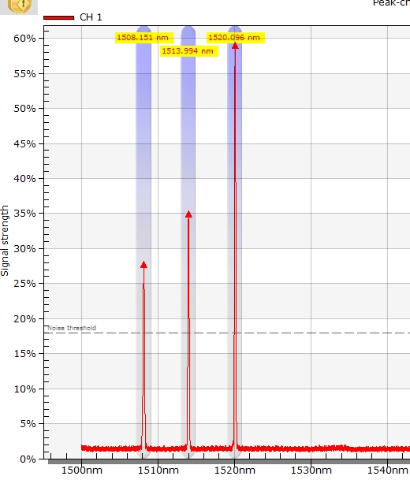
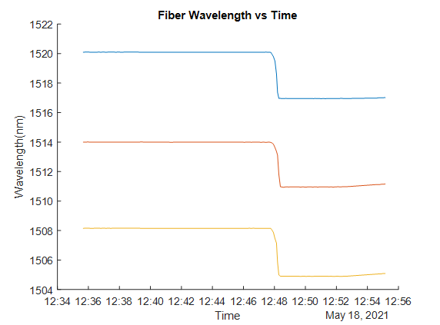
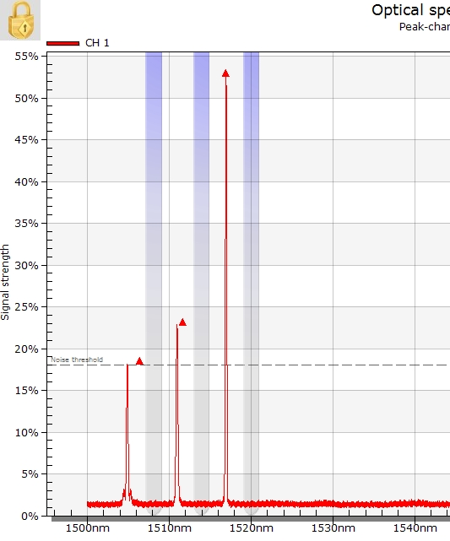
Issues during cooling
Peaks are all there
There is an issue with the allowed range
Lesson learned: choose carefully peaks wavelegths to avoid overlap

Slide 9
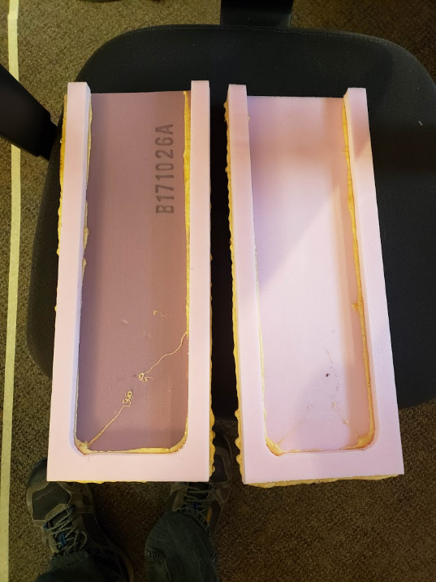
Short term plans
Estimate absolute strain value at 77 K
Cool down one fiber (4 sensors) with no gluing
GOAL: estimate the effect of temperature on the FBG sensors
We can use this value to rescale the low T data taken with the fiber glued on Ti and steel
Repeat the tensile stress test with stainless steel to compare results with CERN
Glue fiber on the shell of FNAL mirror magnet for QCD
By the end of June

Slide 10
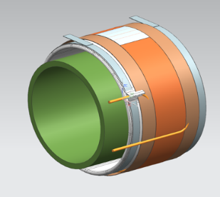
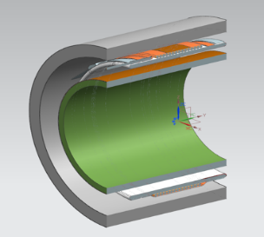
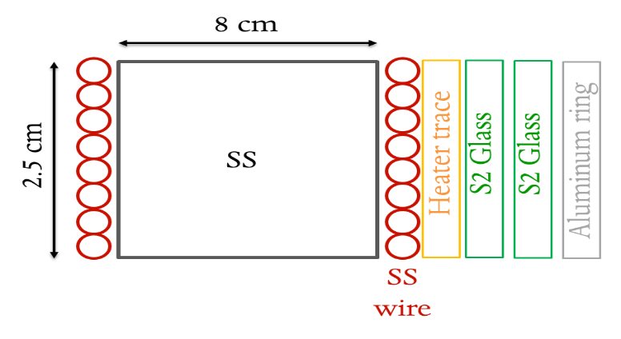
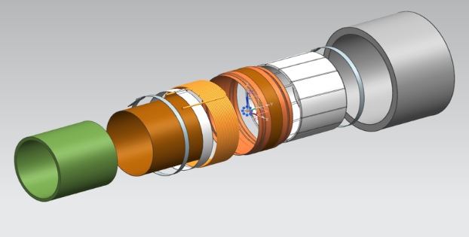
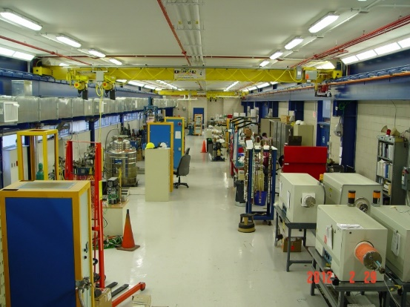
Short term plan
Simulate quench conditions
GOALS
learn the effect of epoxy impregnation on fiber sensors
Simulate quench conditions:
If 40 mF CLIQ unit charged at 300 V is discharged into the coil, it should reach 200 K in about 100 ms.
Use small solenoid made of cheap NiCr wires:
Wound one fiber with the wire and impregnate coils with epoxy
Use CLIQ to simulate quench condition at 4.5 K in IB3 lab of APS-TD
Small solenoid design and impregnation have been already tested for AUP coil insulation strength studies

Slide 11
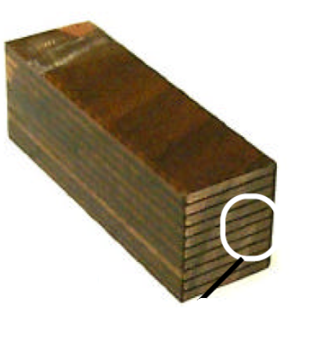
Short term plan
Apply load on a ten stack cable
Use an impregnated Nb3Sn ten stack cable
Apply fiber sensors on each side of the ten stack, across and along the cable and apply a load at 300k and in LNi
GOALS
apply a load at 300k and in Lni on a “simulated coil”
Distinguish between epoxy and Nb3Sb behavior (spectra)
Ten stacks and small coils: order new fibers (2-3 months lead).
Test will be in September/October 2021

